Slide 2
Second Sunday of Easter – April 07, 2024
CYCLE B – YEAR II

Slide 3
UNDERSTANDING THE GOSPEL (for facilitators only)
There are a lot of things that might worry or scare us, but God wants to take those fears away and give us peace instead. His disciples were hiding away in a room, because they were afraid. They knew that Jesus had been arrested and killed, and they didn’t want to be arrested, too. While they were huddled away in fear, Jesus showed up. He just appeared in their midst and said “peace be with you.” He knew that they were worried, and offered His peace instead. Jesus showed the disciples His scars and told them He wanted to send them out to proclaim His message into the world. He breathed on them with the Holy Spirit, reminding them that His presence would go with them always and that they should pass on His forgiveness to others.
Jesus wants us to know that His peace and presence is for us, too. Jesus said that those who believe without seeing are especially blessed. That’s us! We can trust that Jesus is near, even though we do not see or feel Him all the time. There are things that are scary and burdensome to us, but Jesus wants to take those burdens and replace them with His peace. He wants us to rely on Him. He can take away those fears that are so heavy, and swap them for His peace. We don’t have to bear grudges and worries alone. We can have the comfort of His love surround us always. We’d be foolish to refuse God’s comfort, too! He wants to give it to us. And we can share the love, forgiveness, and peace of Christ with others around us.

Slide 4
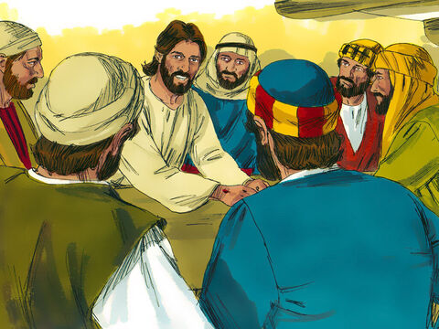
Jesus Appears to His Disciples
John 20:19-31

Slide 5
Leader: A reading from
the Holy Gospel
according to John.
All: Glory to You, Oh Lord.

Slide 6
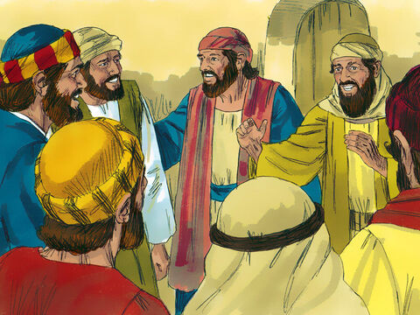
19
It was late that Sunday evening, and the disciples were gathered together behind locked doors, because they were afraid of the Jewish authorities. Then Jesus came and stood among them. “Peace be with you,” he said.

Slide 7
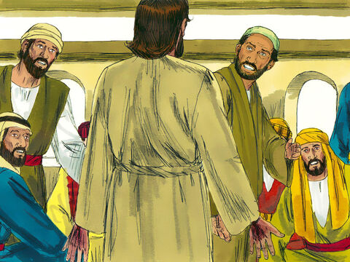
20
After saying this, he showed them his hands and his side. The disciples were filled with joy at seeing the Lord.

Slide 8
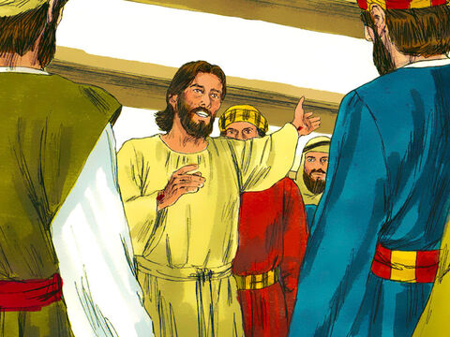
21
Jesus said to them again, “Peace be with you. As the Father sent me, so I send you.”

Slide 9
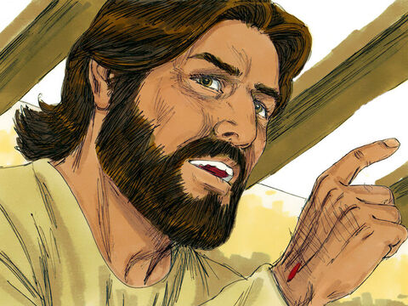
22
Then he breathed on them and said, “Receive the Holy Spirit.

Slide 10
23
If you forgive people's sins, they are forgiven; if you do not forgive them, they are not forgiven.”

Slide 11
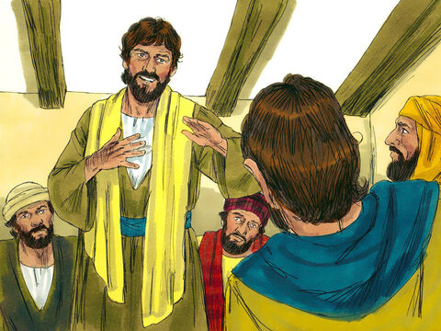
24
One of the twelve disciples, Thomas (called the Twin), was not with them when Jesus came.

Slide 12
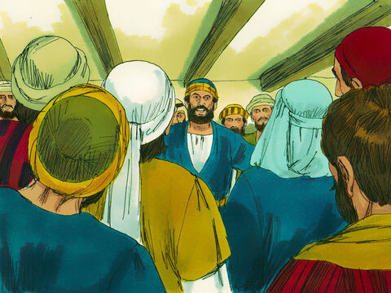
25
So the other disciples told him, “We have seen the Lord!”.
Thomas said to them, “Unless I see the scars of the nails in his hands and put my finger on those scars and my hand in his side, I will not believe.”

Slide 13
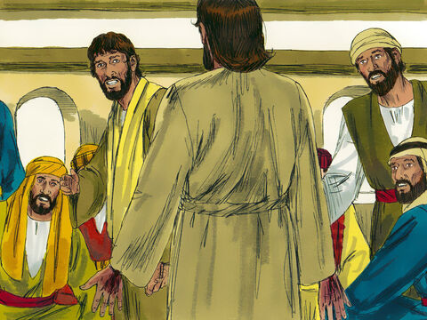
26
A week later the disciples were together again indoors, and Thomas was with them. The doors were locked, but Jesus came and stood among them and said, “Peace be with you.”

Slide 14
27
Then he said to Thomas, “Put your finger here, and look at my hands; then reach out your hand and put it in my side. Stop your doubting, and believe!”

Slide 15
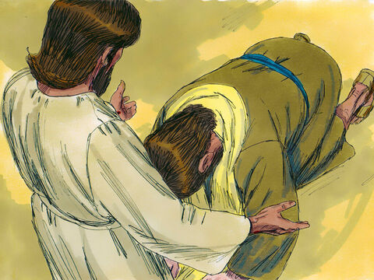
28
Thomas answered him, “My Lord and my God!”

Slide 16
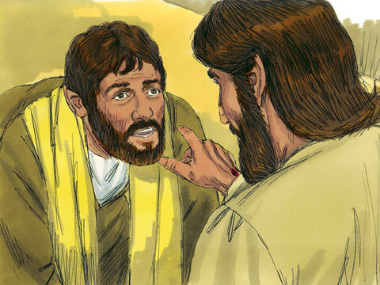
29
Jesus said to him, “Do you believe because you see me? How happy are those who believe without seeing me!”

Slide 17
30
In his disciples' presence Jesus performed many other miracles which are not written down in this book.

Slide 18
31
But these have been written in order that you may believe[a] that Jesus is the Messiah, the Son of God, and that through your faith in him you may have life.

Slide 19
Leader: The Gospel of the Lord.
All: Praise to You,
Lord Jesus Christ.

Slide 20
GOSPEL MESSAGE

Slide 21
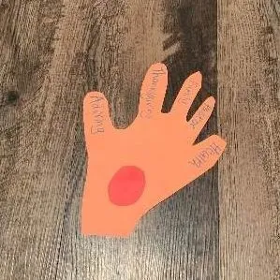
Activity: Handy Prayer
Construction Paper
Decorative materials
White paper
Glue
Scissors
Coloring Materials

Slide 22
Instructions:
Trace a hand onto paper or cardstock.
Add a round “nail scar” in the center, if desired.
Cut the hand out of the paper.
On each finger, write a person or topic to pray for.
5. If desired, place the praying hand on a stick or string for display.

Slide 23
Closing Prayer
Dear God,
Thank you for the peace of Jesus. Help us to rely on that instead of fear. Help us to trust in you and share your love with those around us
Thank you for loving us. We love you, God!
Thank you for Jesus
In His name, Amen!

Slide 25
Second Sunday of Easter – April 07, 2024
CYCLE B – YEAR II

