Slide 2
Twenty-Sixth Sunday in Ordinary Time – September 29, 2024
CYCLE B – YEAR II

Slide 3
UNDERSTANDING THE GOSPEL (for facilitators only)
Jesus wants us to do all things in and through Him. He tells the disciples that all things done in His name are for Him, and it is essential for us to remain faithful and focused. In the same way, we aren’t going to accidentally lose faith as if we dropped it on the sidewalk, but we can reject God’s teachings if we choose to. However, as long as we maintain trust in Jesus, we know He will live in us and help us. Christ will help us to make a difference for others who see us.
We will never manage to be “perfect Christians”, but our faith is not about us. Living solid lives for God means recognizing and embracing what He does for us. When we do things in the name of Jesus and for Him, He understands and appreciates our efforts. God wants us to be a positive influence on the world around us, and we can do that when we live in service and love for God and one another.

Slide 4
Leader: A reading from
the Holy Gospel
according to Mark.
All: Glory to You, Oh Lord.

Slide 5
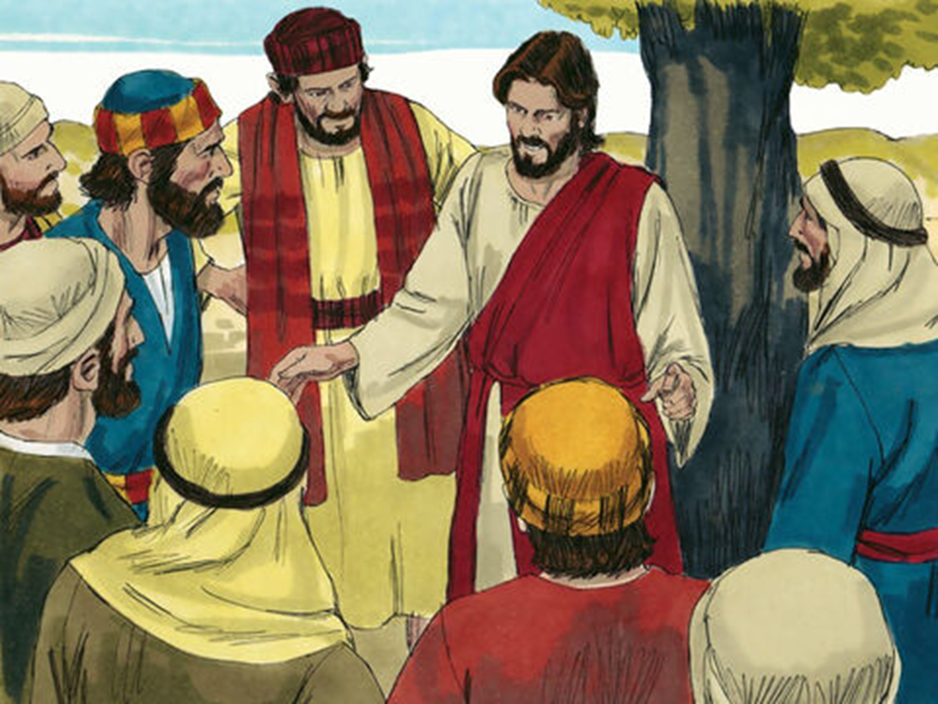
Temptations to Sin
Mark 9:38-43,45,47-48

Slide 6
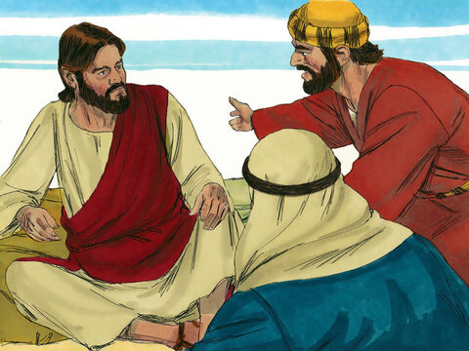
38
John said to him, “Teacher, we saw a man who was driving out demons in your name, and we told him to stop, because he doesn't belong to our group.”

Slide 7
39
“Do not try to stop him,” Jesus told them, “because no one who performs a miracle in my name will be able soon afterward to say evil things about me.

Slide 8
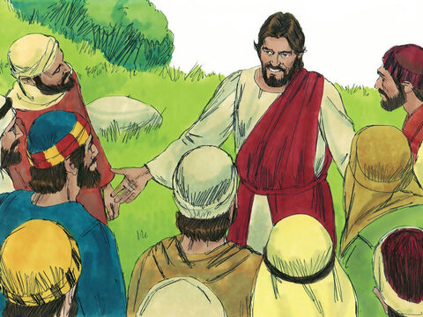
40
For whoever is not against us is for us.

Slide 9
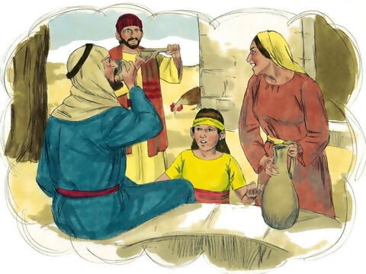
41
I assure you that anyone who gives you a drink of water because you belong to me will certainly receive a reward.

Slide 10
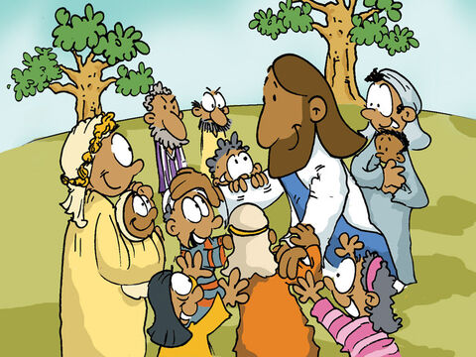
42
“If anyone should cause one of these little ones to lose faith in me, it would be better for that person to have a large millstone tied around the neck and be thrown into the sea.

Slide 11
43
So if your hand makes you lose your faith, cut it off! It is better for you to enter life without a hand than to keep both hands and go off to hell, to the fire that never goes out.

Slide 12
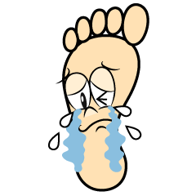
45
And if your foot makes you lose your faith, cut it off! It is better for you to enter life without a foot than to keep both feet and be thrown into hell.

Slide 13
47
And if your eye makes you lose your faith, take it out! It is better for you to enter the Kingdom of God with only one eye than to keep both eyes and be thrown into hell.

Slide 14
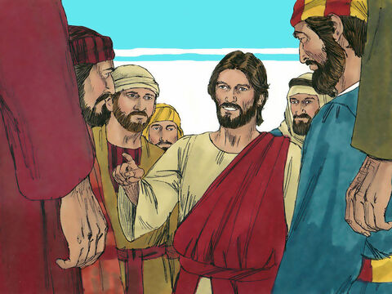
48
There ‘the worms that eat them never die, and the fire that burns them is never put out.’

Slide 15
Leader: The Gospel of the Lord.
All: Praise to You,
Lord Jesus Christ.

Slide 16
GOSPEL MESSAGE

Slide 17
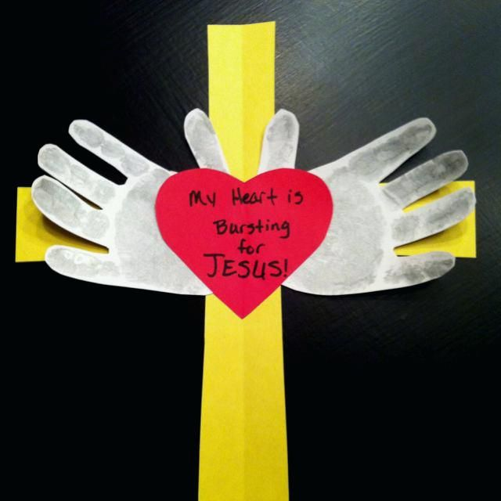
Activity:
“Perfect Faith”
Materials:
1. Construction Paper/ Colored paper
2. Scissors
3. Glue/Tape
4. Markers/Crayons

Slide 18
Instructions:
Cut the construction/colored paper into heart, cross and hands shapes.
Glue first the hands on the cross and after glue the heart shape on the hand.
Write your conviction of faith on the heart shape.

Slide 19
Closing Prayer
All: In the Name of the Father, the Son and the Holy Spirit. Amen.
Dear God, thank you for giving us faith. Help us trust in you for all things help us to be perfect Christians. So, we can love and influence others. Thank you for your love We love you, God!
In Jesus name, Amen!

Slide 20
Twenty-Sixth Sunday in Ordinary Time – September 29, 2024
CYCLE B – YEAR II

