Slide 2
Twenty-fourth Sunday in Ordinary Time – September 15, 2024
CYCLE B – YEAR II

Slide 3
UNDERSTANDING THE GOSPEL (for facilitators only)
Jesus’ disciples argued with him about his plan. They didn’t want him to suffer and die, but Jesus knew that this was part of God’s bigger plan to save us. Even though it was hard, Jesus followed God’s plan because he knew it was the best thing for everyone.
Just like Jesus, we may not always understand God’s plan for our lives. There will be times when things are hard, and we might feel like arguing with God. But it’s important to remember that he always has our best interests at heart. He loves us and wants what’s best for us, even when we can’t see it.
So next time you’re going through a tough time, remember that God is with you. Trust in him, even when you don’t understand his plan. And know that he will always love you and help you through anything.

Slide 4
Leader: A reading from
the Holy Gospel
according to Mark.
All: Glory to You, Oh Lord.

Slide 5
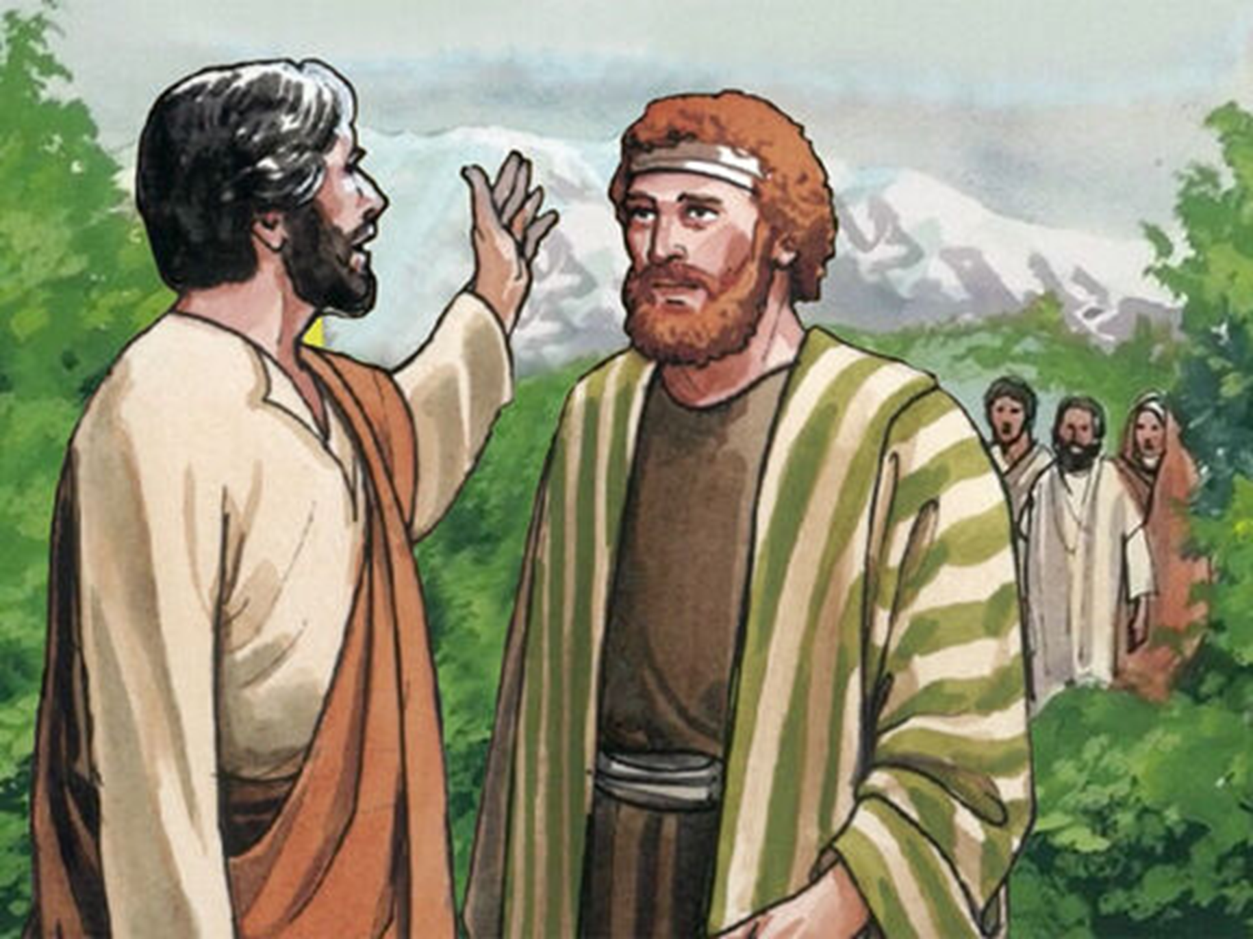
Peter's Declaration about Jesus
Mark 8:27-35

Slide 6
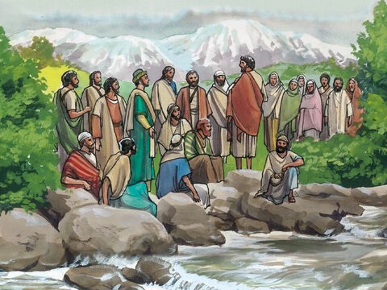
27
Then Jesus and his disciples went away to the villages near Caesarea Philippi. On the way he asked them, “Tell me, who do people say I am?”

Slide 7
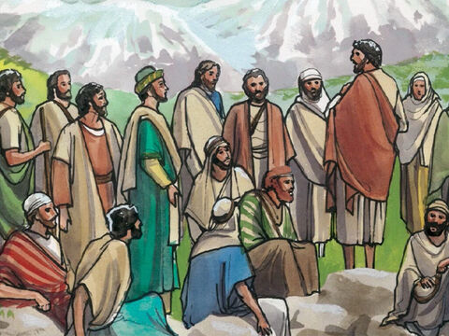
28
“Some say that you are John the Baptist,” they answered; “others say that you are Elijah, while others say that you are one of the prophets.”

Slide 8
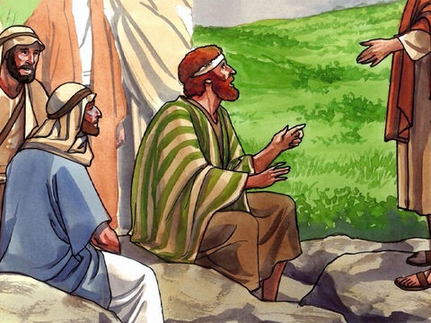
29
“What about you?” he asked them. “Who do you say I am?”
Peter answered, “You are the Messiah.”

Slide 9
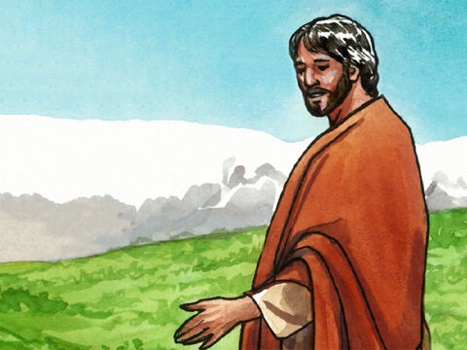
30
Then Jesus ordered them,
“Do not tell anyone about me.”

Slide 10
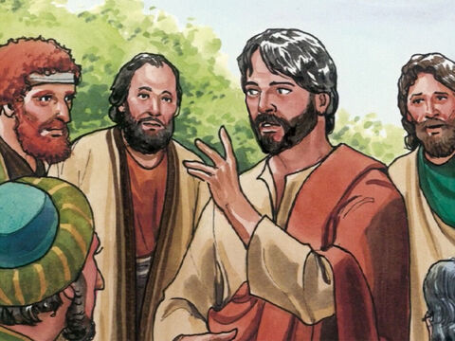
31
Then Jesus began to teach his disciples:
“The Son of Man must suffer much and be rejected by the elders, the chief priests, and the teachers of the Law. He will be put to death, but three days later he will rise to life.”

Slide 11
32
He made this very clear to them. So Peter took him aside and began to rebuke him.

Slide 12
33
But Jesus turned around, looked at his disciples, and rebuked Peter.
“Get away from me, Satan,” he said. “Your thoughts don't come from God but from human nature!”

Slide 13
34
Then Jesus called the crowd and his disciples to him. “If any of you want to come with me,” he told them, “you must forget yourself, carry your cross, and follow me.

Slide 14
35
For if you want to save your own life, you will lose it; but if you lose your life for me and for the gospel, you will save it.

Slide 15
Leader: The Gospel of the Lord.
All: Praise to You,
Lord Jesus Christ.

Slide 16
GOSPEL MESSAGE

Slide 17
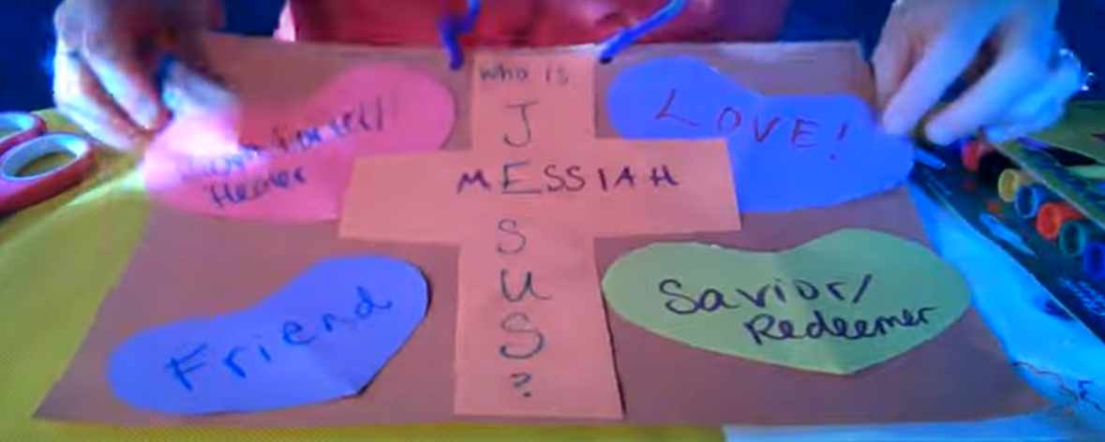
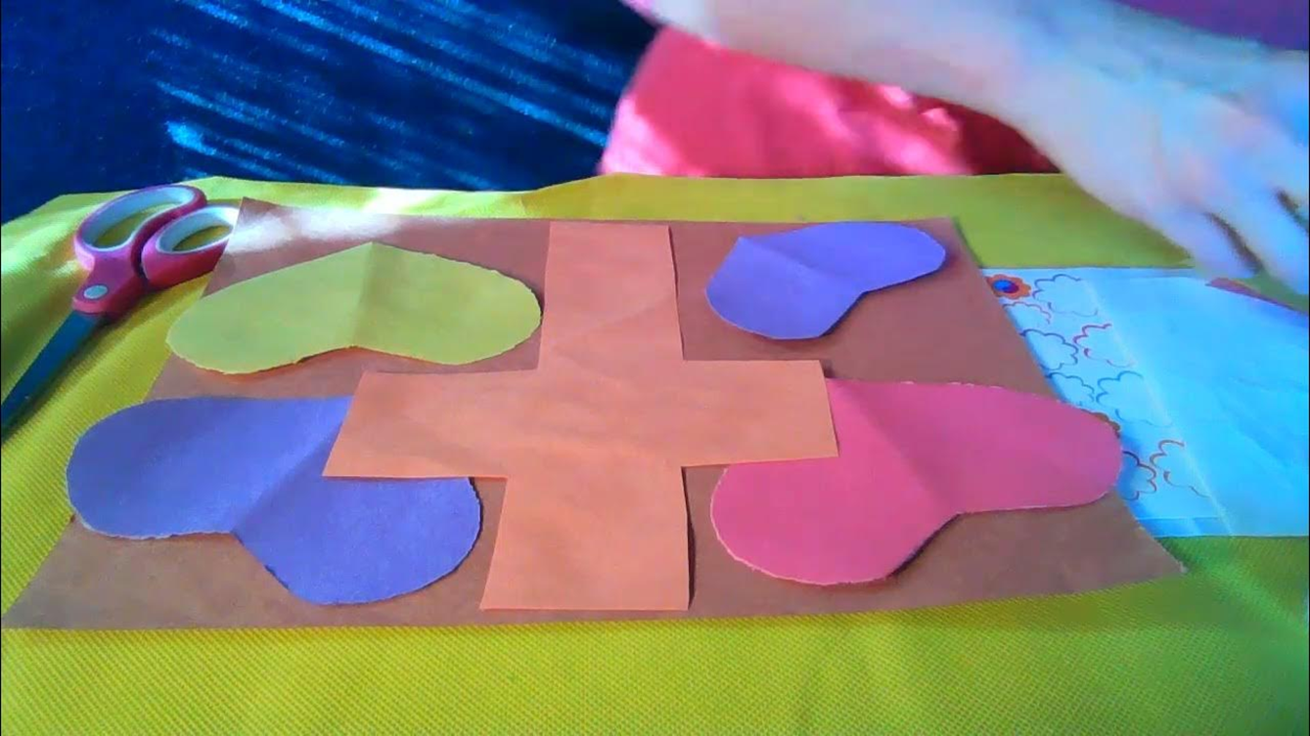
Activity:
“Who Is Jesus Poster”
Materials:
1. Construction Paper/ Colored paper
2. Scissors
3. Glue/Tape
4. Markers/Crayons
5. String

Slide 18
Instructions:
Cut several shapes out of construction paper (Heart, Cross, etc.). On each one, write a description of who Jesus is.
At the center of the paper, glue the cross shape.
Attach the other descriptions of Jesus to the paper surrounding the cross.
Add verses or captions.
Attach a hanger using the string.

Slide 19
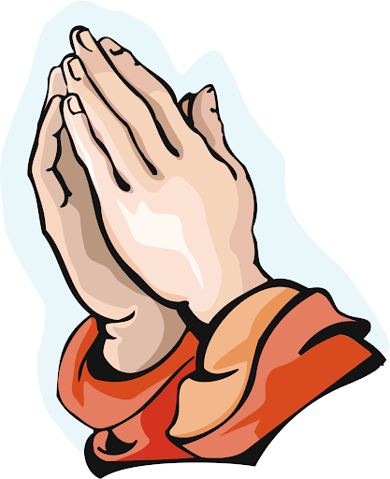
Closing Prayer
All: In the Name of the Father, the Son and the Holy Spirit. Amen.
Dear God, thank you for giving us, Jesus, the true hero. Help us to cling to Him when life is hard. And remember that He’s been through it all! We proclaim Him as Lord as we love one another. Thank you for your love. We love you, God!
In Jesus’s name, Amen!

Slide 20
Twenty-fourth Sunday in Ordinary Time – September 15, 2024
CYCLE B – YEAR II

