Slide 1
LIVE THE WORD KIDS
25th Sunday in Ordinary Time | Cycle A

Slide 2
GOSPEL REFLECTION
There are a lot of times in our lives when things might not seem fair. Sometimes we might feel like we don’t deserve things that happen to us. In the Gospel today, there were some people who felt upset over something that happened. Jesus told a parable about a farmer who hired workers for his vineyard. He agreed to pay the first person he hired a certain amount for the day of work.
A little while later, he found another person who wanted a job, and hired him on for the same amount of money. Then he found another and another worker, and let them start laboring as well. He even found someone who jumped into the job in the last hour of the day. Well, the owner gathered everyone around at the end of the day, and each worker received same amount. The first workers were upset, because they didn’t get any extra pay for working longer. But the owner said that he could do what he wanted with his money, and everyone was going to get the same pay check.
See, in today’s world, we sometimes worry a lot about things being fair. We think we earn and deserve things that we get, and we get upset if we think we’ve been cheated or mistreated. In this parable, Jesus reminds us that we don’t always need to be the first, or the hardest working, or the best in society’s eyes. Maybe we go to church our whole lives, and maybe we learn about Jesus in a nursing home. Maybe we make mistakes, or maybe we aim to do a lot of things right. God offers forgiveness to all of us. Remember how I mentioned that it’s a good thing life isn’t always fair? If we wanted life to be “fair” so that we would always get exactly what we deserved, we would actually get what we deserved for sin.

Slide 3
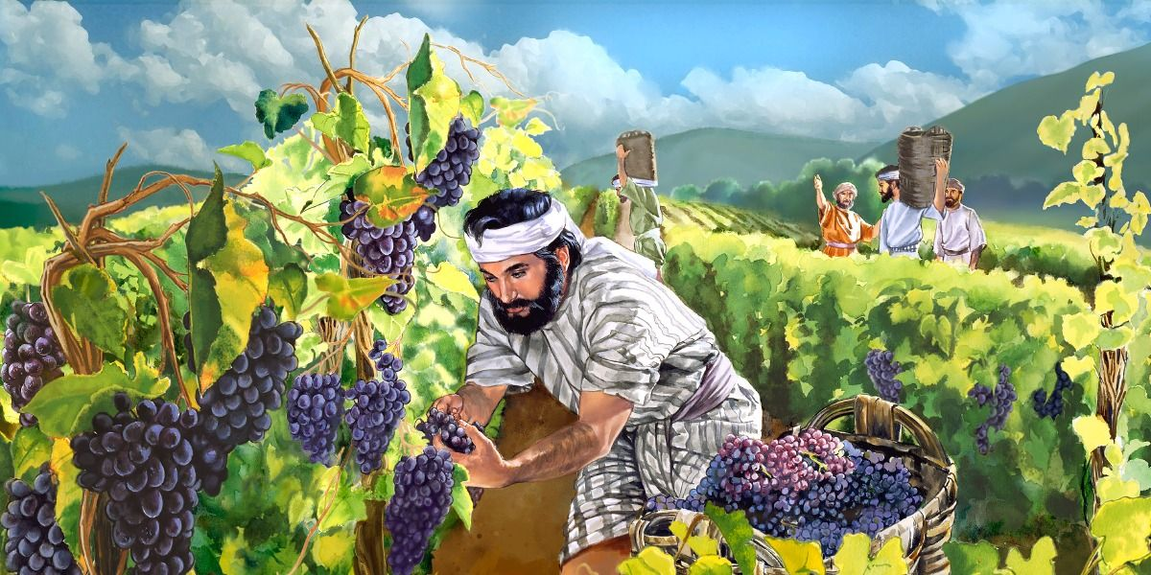
The Workers in the Vineyard
Matthew 20:1-16

Slide 4
Leader: A reading from
the Holy Gospel
according to Matthew.
All: Glory to You, Oh Lord.

Slide 5
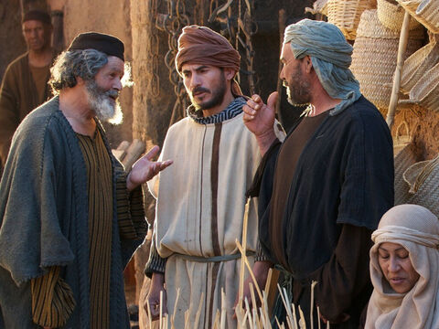
1
The Kingdom of heaven is like this.
Once there was a man who went out early in the morning to hire some men to work in his vineyard.

Slide 6
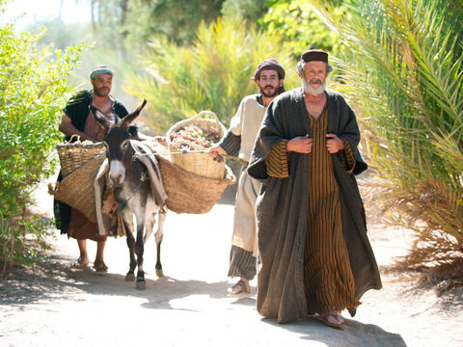
2
He agreed to pay them the regular wage, a silver coin a day, and sent them to work in his vineyard.

Slide 7
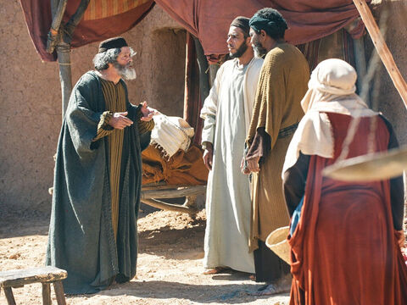
3
He went out again to the marketplace at nine o'clock and saw some men standing there doing nothing,

Slide 8
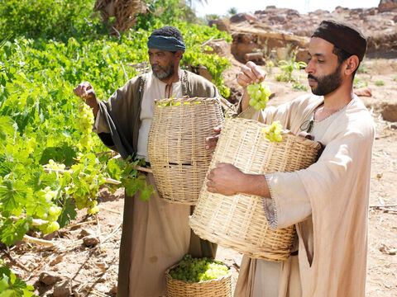
4
so he told them, ‘You also go and work in the vineyard, and I will pay you a fair wage.’

Slide 9
5
So they went.
Then at twelve o'clock and again at three o'clock he did the same thing.

Slide 10
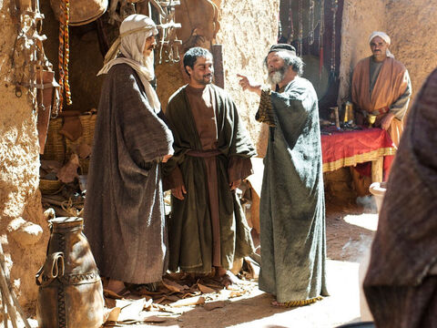
6
It was nearly five o'clock when he went to the marketplace and saw some other men still standing there. ‘Why are you wasting the whole day here doing nothing?’ he asked them.

Slide 11
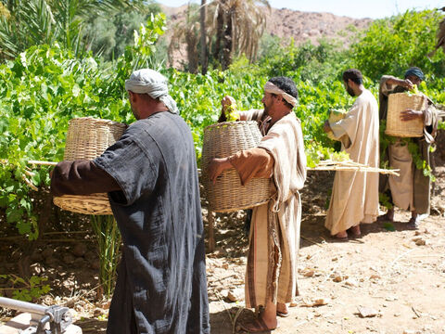
7
‘No one hired us,’ they answered. ‘Well, then, you go and work in the vineyard,’ he told them.

Slide 12
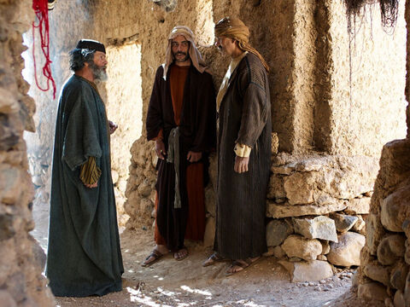
8
“When evening came, the owner told his foreman, ‘Call the workers and pay them their wages, starting with those who were hired last and ending with those who were hired first.’

Slide 13
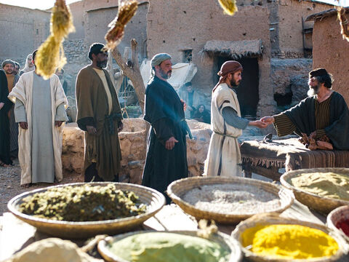
9
The men who had begun to work at five o'clock were paid a silver coin each.

Slide 14
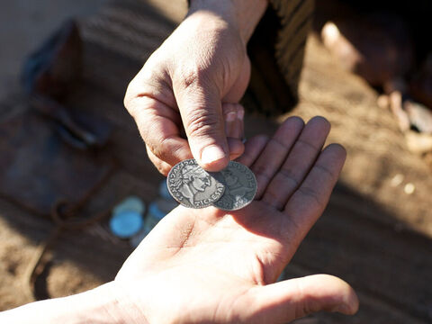
10
So when the men who were the first to be hired came to be paid, they thought they would get more; but they too were given a silver coin each.

Slide 15
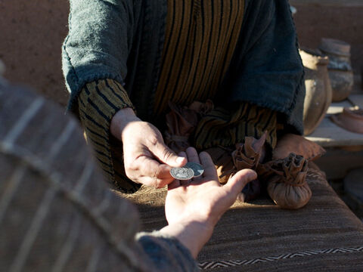
11
They took their money and started grumbling against the employer.

Slide 16
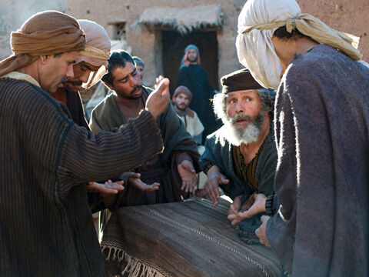
12
‘These men who were hired last worked only one hour,’ they said, ‘while we put up with a whole day's work in the hot sun—yet you paid them the same as you paid us!’

Slide 17
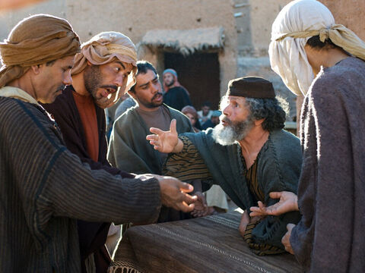
13
‘Listen, friend,’ the owner answered one of them, ‘I have not cheated you. After all, you agreed to do a day's work for one silver coin.

Slide 18
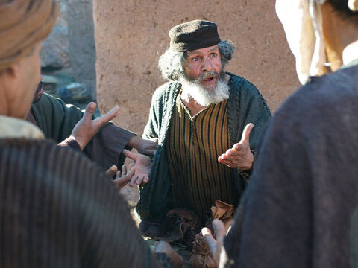
14
Now take your pay and go home. I want to give this man who was hired last as much as I gave you.

Slide 19
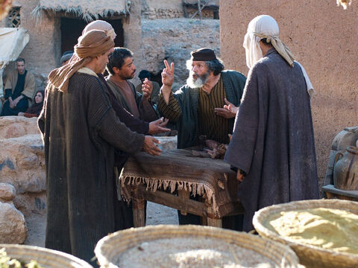
15
Don't I have the right to do as I wish with my own money? Or are you jealous because I am generous?’”

Slide 20
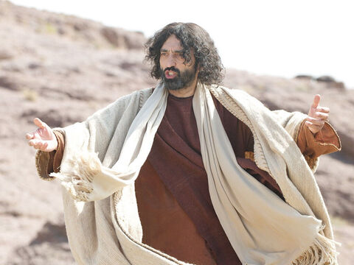
16
And Jesus concluded,
“So those who are last will be first, and those who are first will be last.”

Slide 21
Leader: The Gospel of the Lord.
All: Praise to You,
Lord Jesus Christ.

Slide 22
GOSPEL MESSAGE

Slide 23
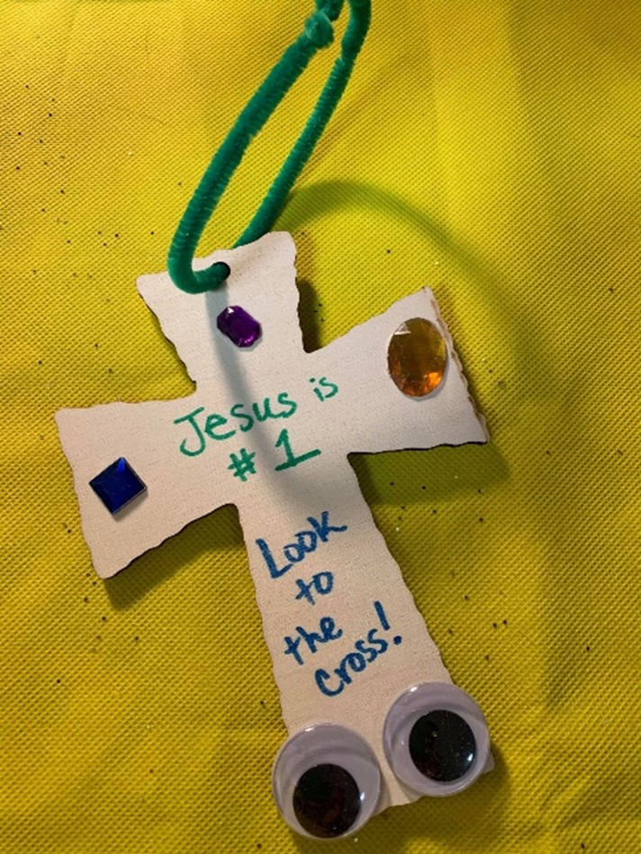
Activity: Look to the Cross
Stickers or other small decorative items
Glue or tape
Paper, cardstock, or wooden cross
Markers or crayons
Verse caption or extra decoration (optional)
Pipe cleaner or string

Slide 24
Activity: “Forgiveness Erases Wrong” Heart
Decorate the cross with markers, captions, or other decorations.
Add decorations such as stickers, jewels, glitter, and even google eyes!
Remind students that the cross is the most meaningful thing in our faith and in our lives.
Add a string or pipe cleaner if you’d like to make this into a decoration.
Notes:
“That’s not fair!!!” Children are often quite concerned with what seems fair to them. The parable of the workers in the vineyard emphasizes that often life does not seem fair or just. It also reminds us that “fair” in God’s eyes is not quite the same as our human understanding. Life isn’t fair, because we don’t deserve the mercy and grace that accompany the Lord’s love and forgiveness, but we receive them anyway!
This craft reminds us of the importance of the cross, and also remind us to be grateful for grace and for whatever we might have. Rather than comparing our situation with others, we can rejoice in the beauty of mercy that comes through Christ.

Slide 25
Closing Prayer
Dear God,
Thank you for granting us mercy and forgiveness. Thank you that life isn’t fair
And that means life for us! Remind us to be faithful and patient. Thank you for your love. We love you, God!
In Jesus name we pray, Amen.

Slide 26
LIVE THE WORD KIDS
25th Sunday in Ordinary Time | Cycle A

