Slide 1
LIVE THE WORD KIDS
24th Sunday in Ordinary Time | Cycle A

Slide 2
GOSPEL REFLECTION
God’s standard is far above the world’s standard. God’s standard is even far above the standard of the religious. Jesus said that one should forgive seventy-seven times (the Greek likely means seventy times seven.) If we compare ourselves to others, we may think that we are pretty good and quite spiritual. This is likely what Peter thought. However, we should not compare ourselves to people or to worldly standards. Instead we should strive to reach God’s standard.
The main point of the parable is very clear. God wants us to forgive others. And if we harbor unforgiveness and hatred in our hearts toward others, then it demonstrates we have not truly repented of our sins and therefore God will not forgive us either.
The king represents God. We see in this parable that He is both just and merciful. He is willing to forgive sins and show mercy. At the same time, He wants us to show true repentance. And He will punish unrepentant sin. God is the final judge. He is the decision maker. He sits on His throne. Our responsibility is first and foremost to please God above everything else. The servant in the story does not act like the king did. He did not learn the lesson of mercy that the king showed him. Our God is good and we are to try to emulate His character in our own lives.

Slide 3
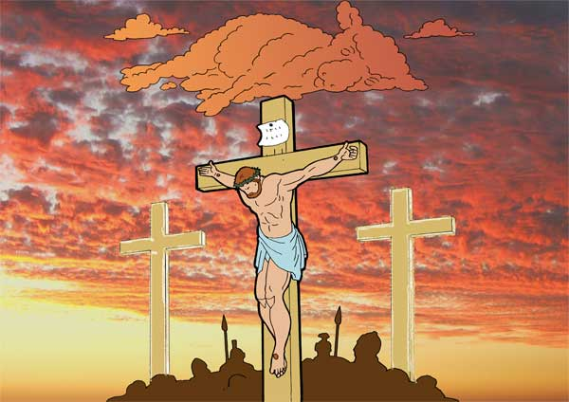
The Parable of the Unforgiving Servant
Matthew 18:21-35

Slide 4
Leader: A reading from
the Holy Gospel
according to Matthew.
All: Glory to You, Oh Lord.

Slide 5
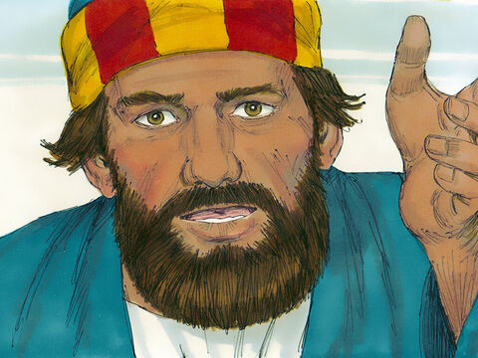
21
Then Peter came to Jesus and asked,
“Lord, if my brother keeps on sinning against me, how many times do I have to forgive him? Seven times?”

Slide 6
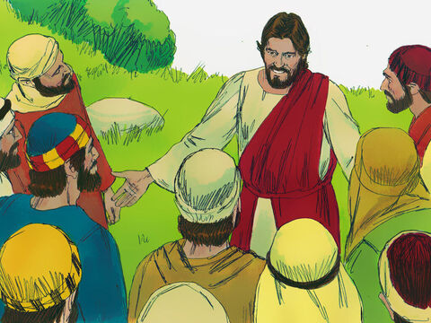
22
“No, not seven times,”
answered Jesus,
“but seventy times seven,

Slide 7
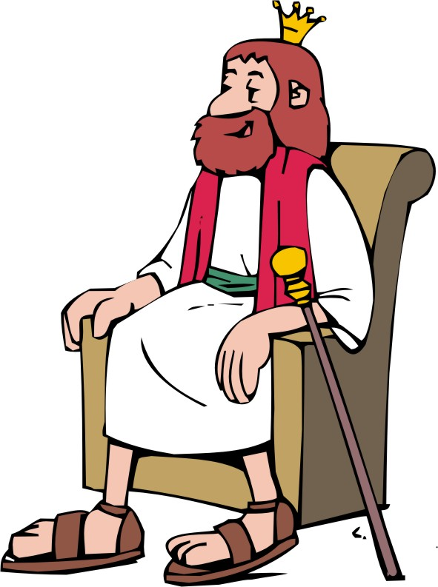
23
because the Kingdom of heaven is like this. Once there was a king who decided to check on his servants' accounts.

Slide 8
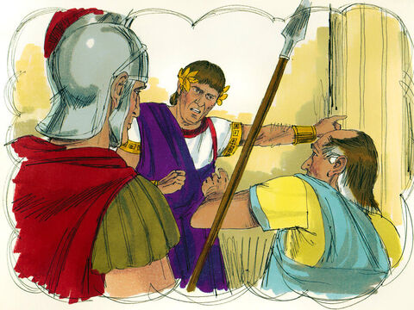
24
He had just begun to do so when one of them was brought in who owed him millions of dollars.

Slide 9
25
The servant did not have enough to pay his debt, so the king ordered him to be sold as a slave, with his wife and his children and all that he had, in order to pay the debt.

Slide 10
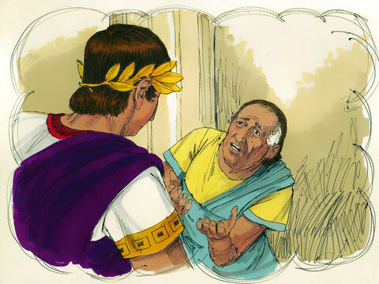
26
The servant fell on his knees before the king. ‘Be patient with me,’ he begged, ‘and I will pay you everything!’

Slide 11
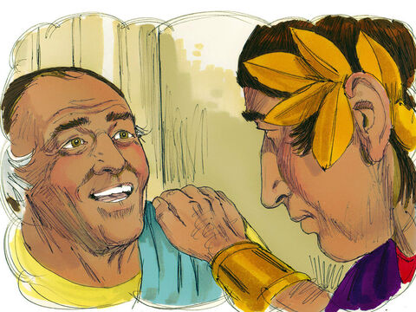
27
The king felt sorry for him, so he forgave him the debt and let him go.

Slide 12
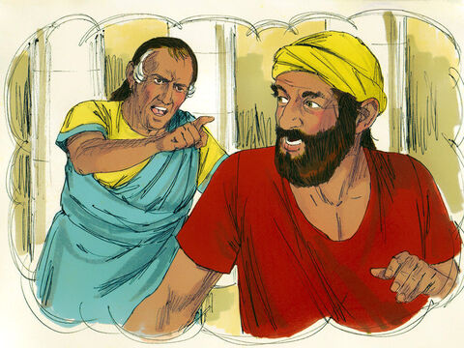
28
“Then the man went out and met one of his fellow servants who owed him a few dollars. He grabbed him and started choking him. ‘Pay back what you owe me!’ he said.

Slide 13
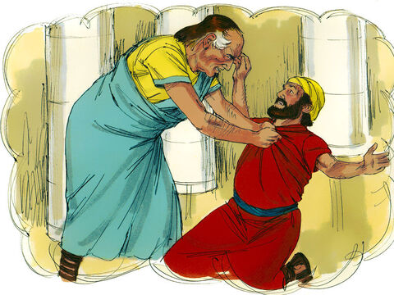
29
His fellow servant fell down and begged him,
‘Be patient with me, and I will pay you back!’

Slide 14
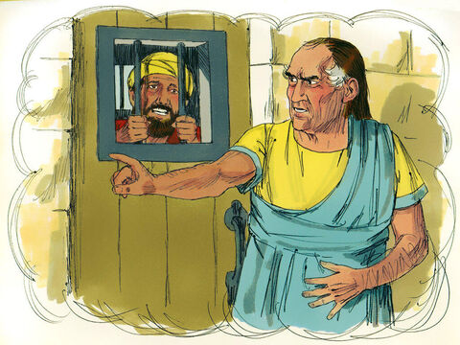
30
But he refused; instead, he had him thrown into jail until he should pay the debt.

Slide 15
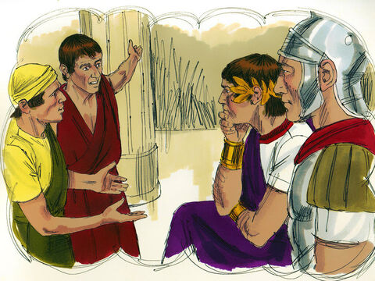
31
When the other servants saw what had happened, they were very upset and went to the king and told him everything.

Slide 16
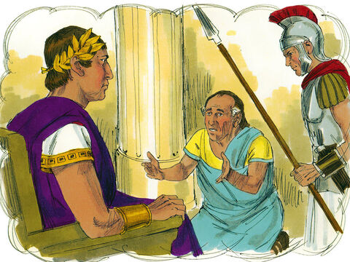
32
So he called the servant in. ‘You worthless slave!’ he said. ‘I forgave you the whole amount you owed me, just because you asked me to.

Slide 17
33
You should have had mercy on your fellow servant, just as I had mercy on you.’

Slide 18
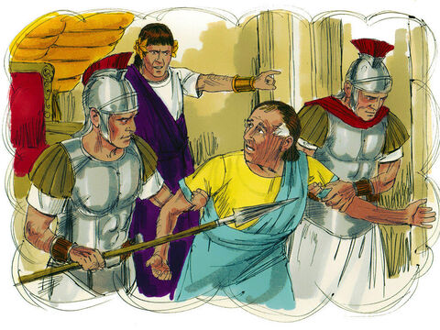
34
The king was very angry, and he sent the servant to jail to be punished until he should pay back the whole amount.”

Slide 19
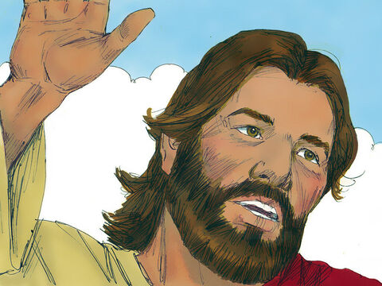
35
And Jesus concluded,
“That is how my Father in heaven will treat every one of you unless you forgive your brother from your heart.”

Slide 20
Leader: The Gospel of the Lord.
All: Praise to You,
Lord Jesus Christ.

Slide 21
GOSPEL MESSAGE

Slide 22
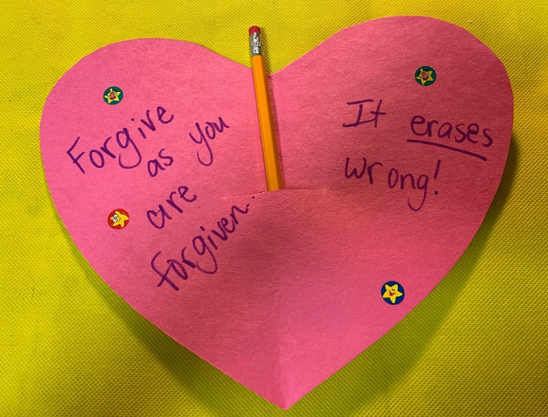
Activity: “Forgiveness Erases Wrong” Heart
Glue and/or tape
Construction paper or cardstock
Scissors
Caption or verse (Optional)
Markers or crayons
Pencils with erasers
Extra decorations (optional)

Slide 23
Activity: “Forgiveness Erases Wrong” Heart
Cut the paper into a heart shape.
Decorate the heart with verses, stickers, colors, or other items as desired.
Cut a slit in the back of the heart, and insert a pencil with eraser.
Give the heart away as a gift, or attach a hanger to use as a reminder that forgiveness “erases” sins!

Slide 24
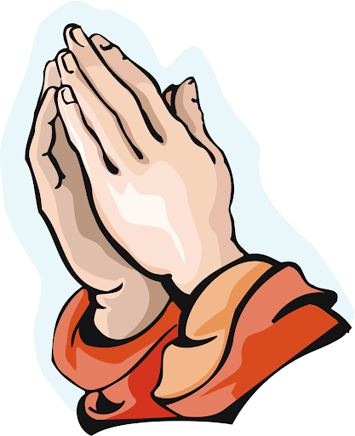
Closing Prayer
Dear God,
Thank you for granting us mercy and forgiveness. Help us to forgive one another. Give us peace and not bitterness. Thank you for erasing our sins. Thank you for your love
We love you, God!
In Jesus name we pray, Amen.

Slide 25
LIVE THE WORD KIDS
24th Sunday in Ordinary Time | Cycle A

