Slide 1
LIVE THE WORD KIDS
23rd Sunday in Ordinary Time | Cycle A

Slide 2
GOSPEL REFLECTION
The Bible tells us that it’s important to get along well with others, but it’s not always easy. In fact, the Gospel today mentions how we might have to go through a few steps to fix a conflict we have in relationship. If someone is having trouble or giving us a hard time, we should try to address the problem and restore friendship. If that doesn’t work, though, sometimes we need to get other people involved. We can ask friends for help, or we can even turn to parents or pastors to try to assist. Sometimes, people might still not want to fix issues. But usually, with prayer and care, we can resolve things and be able to work together.
The point is, God values relationships. He wants us to do everything we can to keep peace and to stick with one another in friendship. He knows that friendships are important in our lives, as well as the life of the church. He wants us to love and live well with one another, and gives us helpers to keep relationships going. Most importantly, we hear that when we are together with others, God is with us. No matter what, HE is present with us, and will help us when things get rough. So if you have been having a problem with someone, talk to them about it. If that doesn’t work it out, you might bring others in for support, but most importantly, pray.

Slide 3
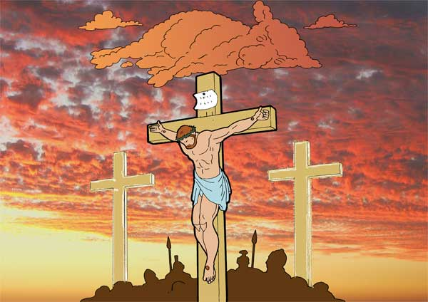
When Someone Sins
Matthew 18:15-20

Slide 4
Leader: A reading from
the Holy Gospel
according to Matthew.
All: Glory to You, Oh Lord.

Slide 5
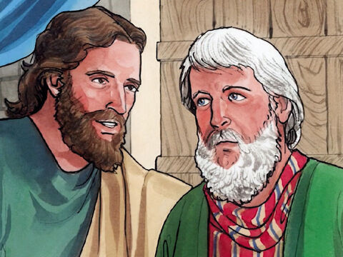
15
Jesus said to his disciples:
“If your brother sins against you, go to him and show him his fault. But do it privately, just between yourselves. If he listens to you, you have won your brother back.

Slide 6
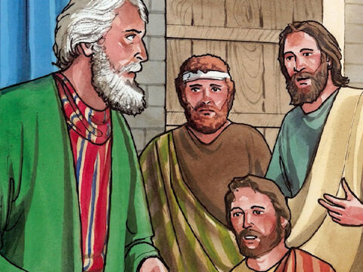
16
But if he will not listen to you, take one or two other persons with you, so that ‘every accusation may be upheld by the testimony of two or more witnesses,’ as the scripture says.

Slide 7
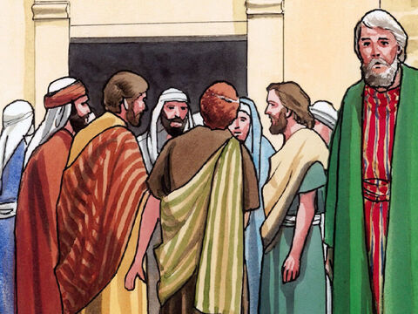
17
And if he will not listen to them, then tell the whole thing to the church. Finally, if he will not listen to the church, treat him as though he were a pagan or a tax collector.

Slide 8
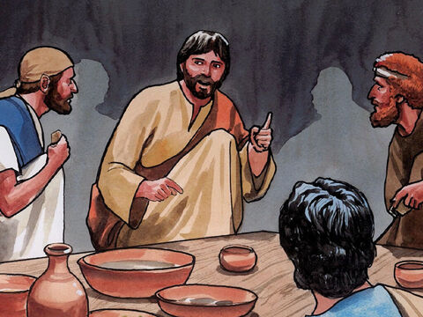
18
And so I tell all of you: what you prohibit on earth will be prohibited in heaven, and what you permit on earth will be permitted in heaven.

Slide 9
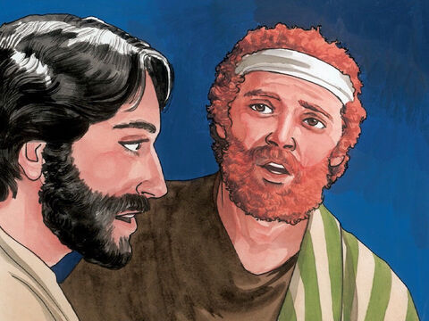
19
And I tell you more: whenever two of you on earth agree about anything you pray for, it will be done for you by my Father in heaven.

Slide 10
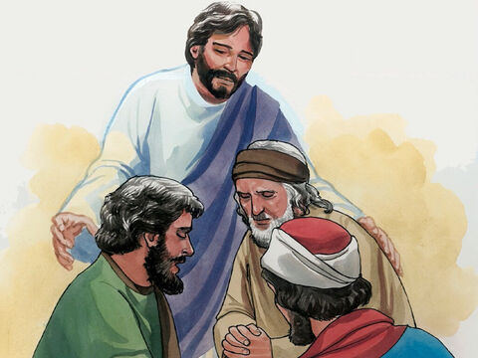
20
For where two or three come together in my name, I am there with them.”

Slide 11
Leader: The Gospel of the Lord.
All: Praise to You,
Lord Jesus Christ.

Slide 12
GOSPEL MESSAGE

Slide 13
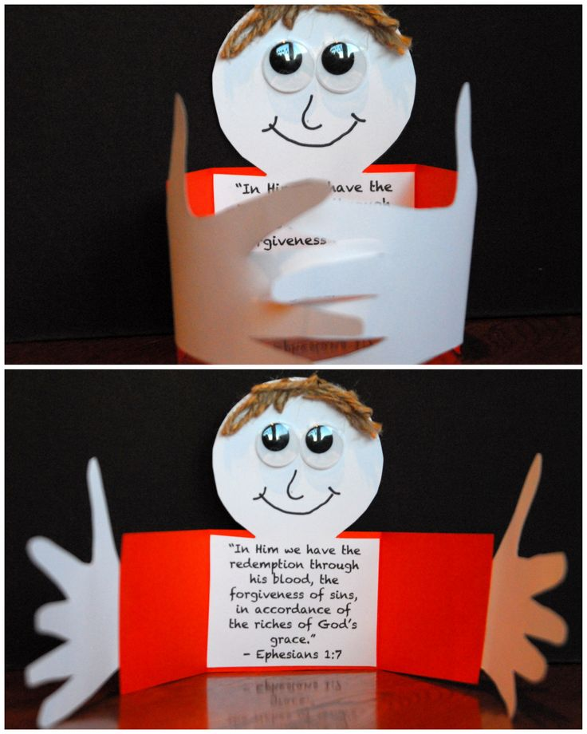
Activity: Forgiving Friend
Materials needed:
Colored Paper/ Cardstock
Crayons/Markers
Glue

Slide 14
Activity: Forgiving Friend
Cut pieces of cardstock measuring approximately 3 inches x 11 inches. Draw out and pre-cut the keyhole shape from the same piece of cardstock. Be sure the rectangular part of the keyhole shape measures about 3 inches in length and 4 inches in width.

Slide 15
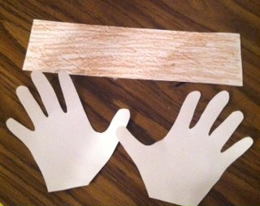
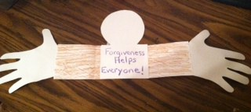
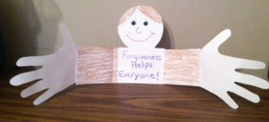
Activity: Forgiving Friend
Trace both hands on another piece of paper and then cut our your hand shapes.
On the rectangular part of the shape, write down the phrase “Forgiveness helps everyone”
Decorate the face of your forgiving friend craft.

Slide 16
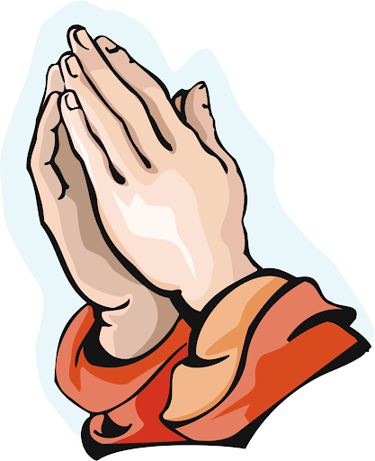
Closing Prayer
Dear God,
Help us to resolve our arguments,
to remember your grace, and to have good relationships. Thank you for your forgiveness. Help us pass it on to others. Thank you for your love. We love you, God!
In Jesus name we pray, Amen.

Slide 17
LIVE THE WORD KIDS
23rd Sunday in Ordinary Time | Cycle A

