Slide 1
LIVE THE WORD KIDS
22nd Sunday in Ordinary Time | Cycle A

Slide 2
GOSPEL REFLECTION
When we speak of the Christian life, there is an element of sacrifice. Jesus spoke to His disciples of this fact, warning them not to be concerned with things of this world, but to focus on lasting things that would matter. He told Peter that it isn’t worth it to “gain the whole world, but lose your soul.” Well, what might that mean? See, people are always seeking after something. It might not be athletic glory, but people today work hard for one thing or another. Some might want money, or a prestigious job, or fancy clothes, or a nice house, or power, or fame, or the perfect family. It is not wrong to want things like that. But we can’t let those pursuits outweigh worship of God. He needs to take the number one spot in our hearts. All of those other things will fade away. They don’t last, and they aren’t worth it.
Being a Christian isn’t always easy. In fact, we are promised that it can be tough. Sometimes we have to make sacrifices. We might not do the same things as some of our friends, and it may seem like we are missing out on certain activities or opportunities because we choose to follow God. But it’s worth it. You know why? Because ultimately, it was Jesus who made the biggest sacrifice possible. He gave up a Godly throne to come to Earth and live as a human. He gave up His life so that we could be saved and have eternal life. Compared with that, the minor discomforts of life or sacrifice of missing out on an event or music artist here and there seem pretty insignificant. Jesus paid it all. Loving and serving Him brings us the promise of Heaven, and we don’t really have to do anything but believe! That is something worth living for and celebrating, and it’s even better than a gold medal!

Slide 3
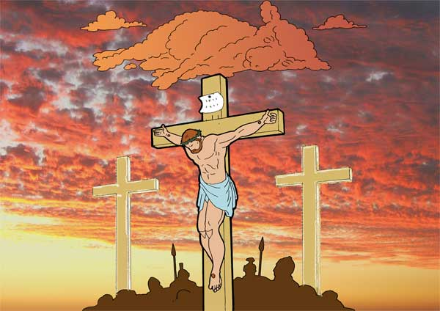
Jesus Speaks about His Suffering and Death
Matthew 16:21-27

Slide 4
Leader: A reading from
the Holy Gospel
according to Matthew.
All: Glory to You, Oh Lord.

Slide 5
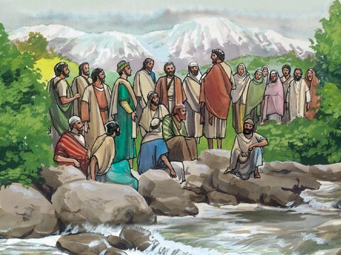
21
From that time on Jesus began to say plainly to his disciples,
“I must go to Jerusalem and suffer much from the elders, the chief priests, and the teachers of the Law.
I will be put to death, but three days later I will be raised to life.”

Slide 6
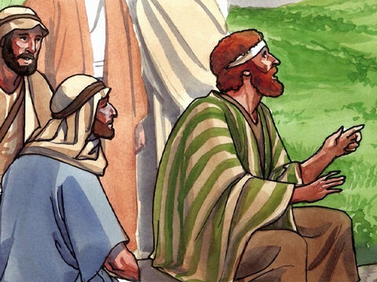
22
Peter took him aside and began to rebuke him.
“God forbid it, Lord!” he said. “That must never happen to you!”

Slide 7
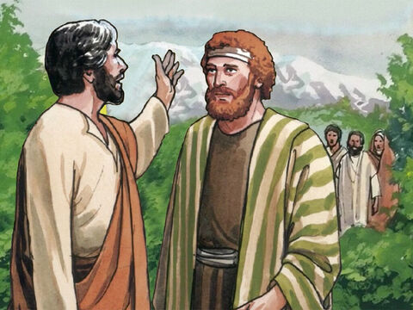
23
Jesus turned around and said to Peter, “Get away from me, Satan! You are an obstacle in my way, because these thoughts of yours don't come from God, but from human nature.”

Slide 8
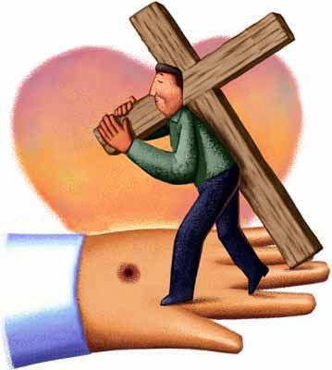
24
Then Jesus said to his disciples, “If any of you want to come with me, you must forget yourself, carry your cross, and follow me.

Slide 9
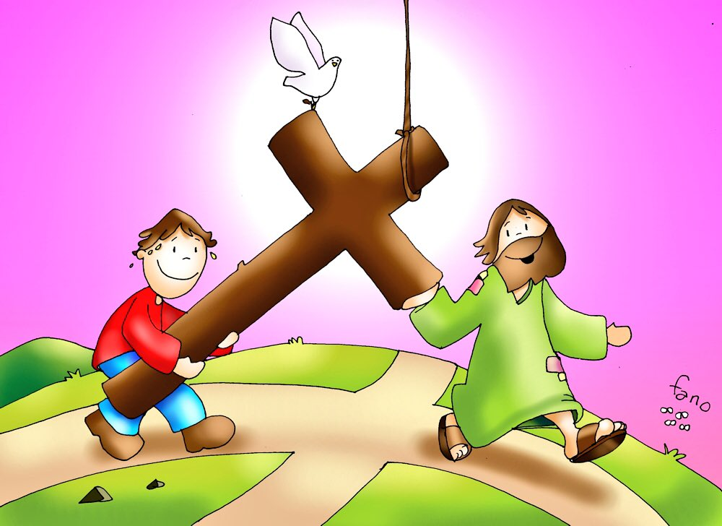
25
For if you want to save your own life, you will lose it;
but if you lose your life for my sake, you will find it.

Slide 10
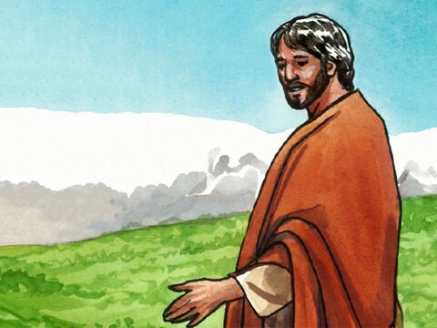
26
Will you gain anything if you win the whole world but lose your life? Of course not! There is nothing you can give to regain your life.

Slide 11
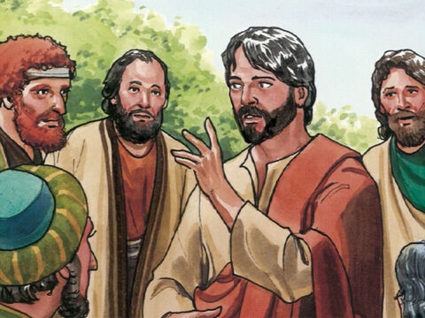
27
For the Son of Man is about to come in the glory of his Father with his angels, and then he will reward each one according to his deeds.

Slide 12
Leader: The Gospel of the Lord.
All: Praise to You,
Lord Jesus Christ.

Slide 13
GOSPEL MESSAGE

Slide 14
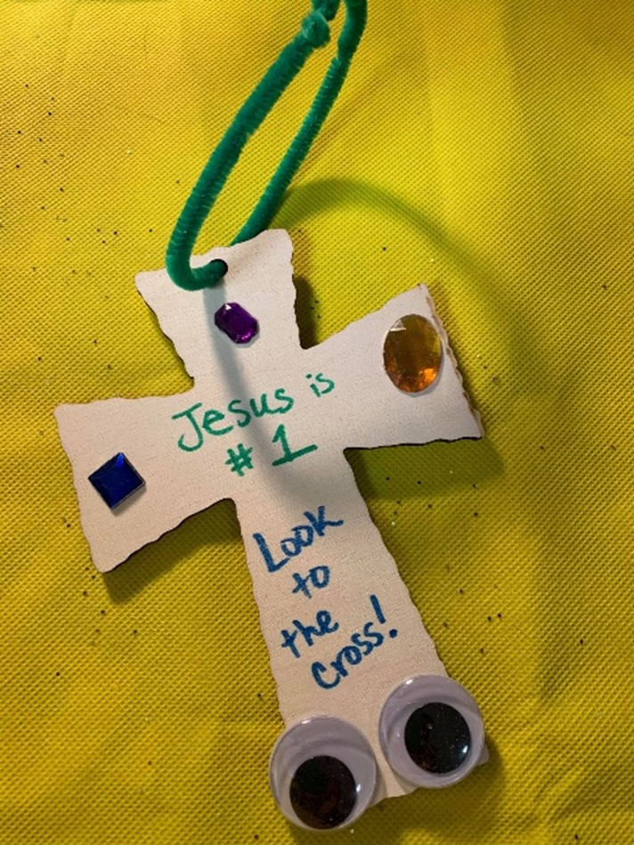
Activity: Worth the Cost
Materials needed:
Stickers or other small decorative items
Glue or tape
Paper, cardstock, or wooden cross
Markers or crayons
Verse caption or extra decoration (optional)
Pipe cleaner or string

Slide 15
Activity: Worth the Cost
Decorate the cross with markers, captions, or other decorations.
Add decorations such as stickers, jewels, glitter, and even google eyes!
Add a string or pipe cleaner if you’d like to make this into a decoration.
This will remind us that the cross is the most meaningful thing in our faith and in our lives.

Slide 16
Closing Prayer
Dear God,
You are worth more than the whole world
Help us to be willing to live for you
Knowing that you sacrificed all for us
Thank you for your love! We love you, God!
In Jesus name we pray, Amen.

Slide 17
LIVE THE WORD KIDS
22nd Sunday in Ordinary Time | Cycle A

