Slide 1
LIVE THE WORD KIDS
30th Sunday in Ordinary Time | Cycle A

Slide 2
GOSPEL REFLECTION
This Gospel lesson reminds us of what should be the most important element of our lives as Christians. At the end of the day, the essential “rule” to follow is that we love God and love one another. If we put that first, other things should fall into place. This message seeks to communicate that to children. There are always laws, instructions, or regulations to follow. First and foremost in these should be our commitment to love the Lord and His people.
It can be tricky to navigate through the law sometimes. We might become wrapped up in what we “should” or shouldn’t do, and wonder how to recognize if we are doing “enough.” The good news is that Jesus is enough. We will never perfectly keep the Law, but that’s okay! This message reminds us that we are saved by God’s grace. In turn, we should offer love to one another, recognizing that other things fall into place when we put love first.

Slide 3
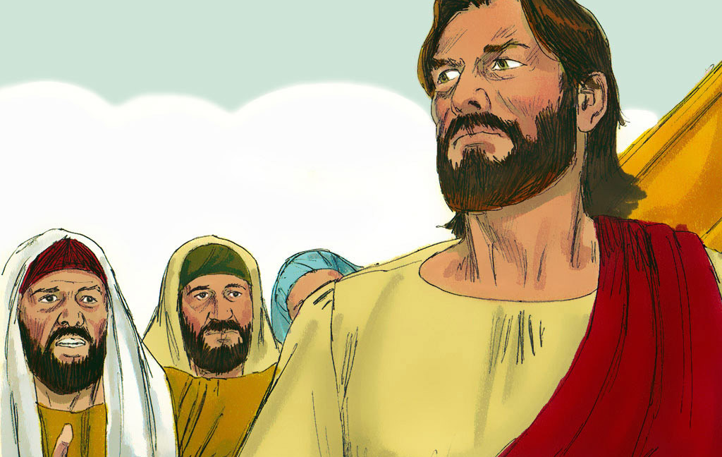
The Great Commandment
Matthew 22:34-40

Slide 4
Leader: A reading from
the Holy Gospel
according to Matthew.
All: Glory to You, Oh Lord.

Slide 5
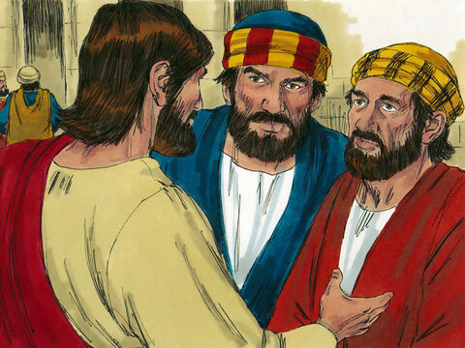
34
When the Pharisees heard that Jesus had silenced the Sadducees, they came together,

Slide 6
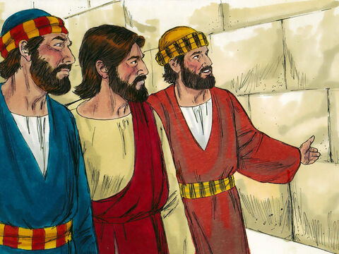
35
and one of them, a teacher of the Law, tried to trap him with a question.

Slide 7
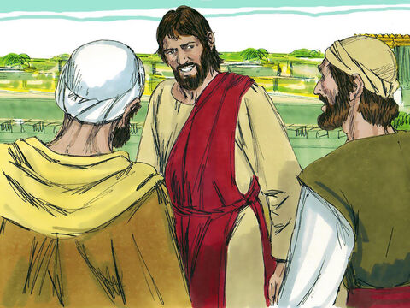
36
“Teacher,” he asked, “which is the greatest commandment in the Law?”

Slide 8
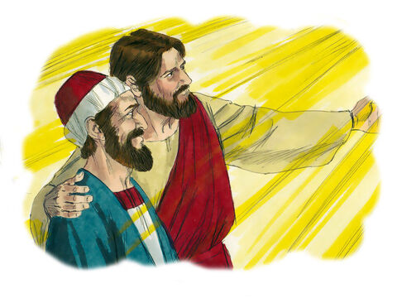
37
Jesus answered, “‘Love the Lord your
God with all your heart, with all your soul, and with all your mind.’

Slide 9
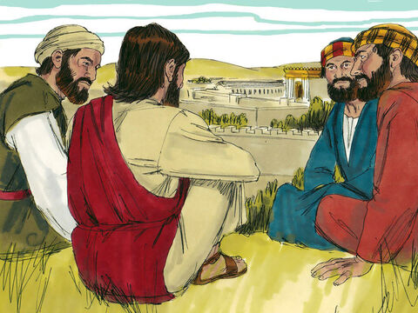
38
This is the greatest and the most important commandment.

Slide 10
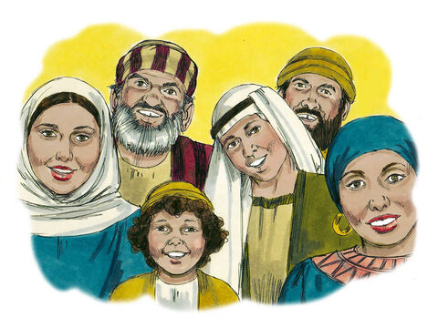
39
The second most important commandment is like it: ‘Love your neighbor as you love yourself.’

Slide 11
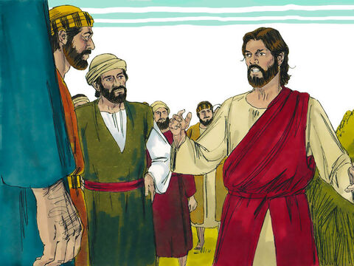
40
The whole Law of Moses and the teachings of the prophets depend on these two commandments.”

Slide 12
Leader: The Gospel of the Lord.
All: Praise to You,
Lord Jesus Christ.

Slide 13
GOSPEL MESSAGE

Slide 14
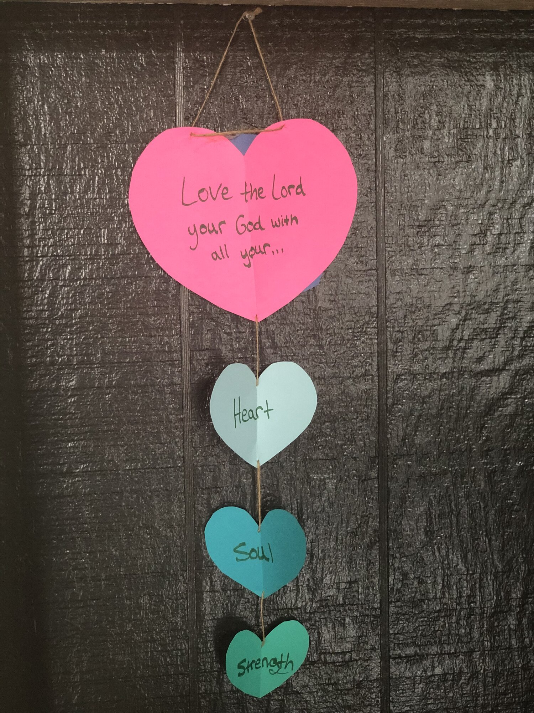
Activity:
The Greatest Commandment
4 different colors of paper
Scissors
String
Pen or Marker

Slide 15
Instructions:
Cut out one large heart and 3 smaller hearts
Attach the hearts with string
Write on each heart, the greatest commandment and at the back of the heart write the second greatest commandment
Hang up the heart in a place that you will see often

Slide 16
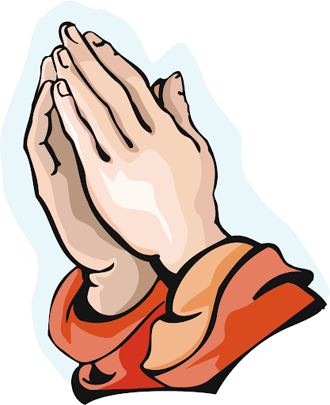
Closing Prayer
Dear God,
Thank you for loving us always through the people around us. Thank you for reminding us what is the greatest commandment among all. May you teach us to love you with all our hearts, mind, souls and strength. And may we never forget to love also our neighbor.
Amen.

Slide 17
LIVE THE WORD KIDS
30th Sunday in Ordinary Time | Cycle A

