Slide 1
LIVE THE WORD KIDS
29th Sunday in Ordinary Time | Cycle A

Slide 2
GOSPEL REFLECTION
In the Gospel lesson today, Jesus encountered some people who tried to trick Him with a question. They asked Him if people should pay taxes to the government. These church leaders did not like Jesus very much, and they wanted to trap Him, thinking that He might get in trouble if He said that taxes were not important…but if he said that people of God should pay taxes, the Jews might become angry because not everyone liked the Roman government. But Jesus, being the son of God and far more clever than Pharisee tricks, gave them another answer. He had them show Him a coin, and asked whose picture was on the coin. Well, the ruler (Caesar) was pictured on the coin. So Jesus pointed out that money could go back to the people in charge of the government, because they were in charge of the state. But Jesus also said “give to God what is God’s.”
What belongs to God? Well, everything! We recognize that we can (and must) use some of our money on things like taxes, groceries, clothes, or whatever else we need to survive. But God is not just another budget line item. We give to Him with our tithing offerings, but we also honor Him by giving our whole lives to Him. We pray; we read our Bibles; and we take care of others. We recognize that He made us, so we belong to Him. Coins and money and taxes are necessary, but those things don’t last. Eventually, they fade away. Our lives are meant to serve God, because He loves us. He has given us all that we have, and He wants us to have meaningful lives.

Slide 3
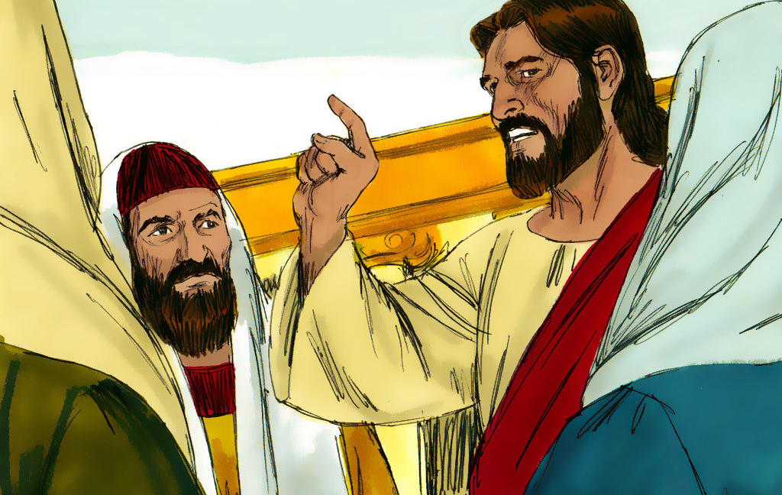
The Question about Paying Taxes
Matthew 22:15-21

Slide 4
Leader: A reading from
the Holy Gospel
according to Matthew.
All: Glory to You, Oh Lord.

Slide 5
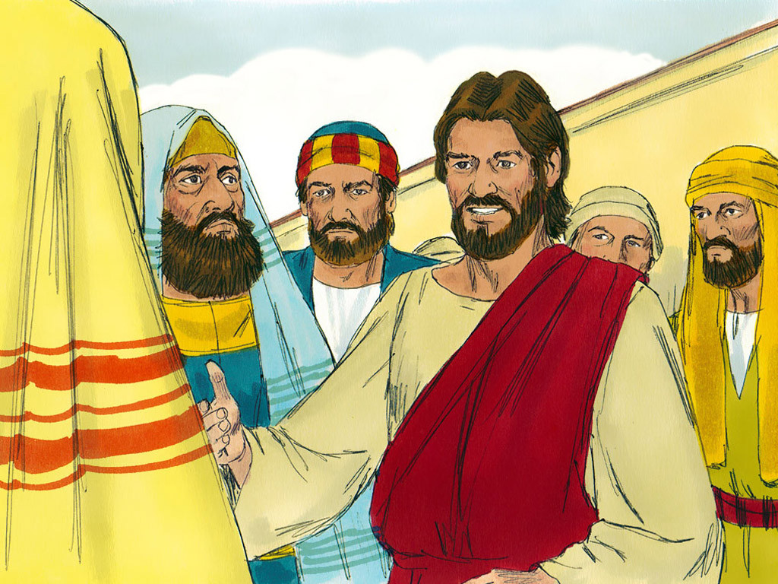
15
The Pharisees went off and made a plan to trap Jesus with questions.

Slide 6
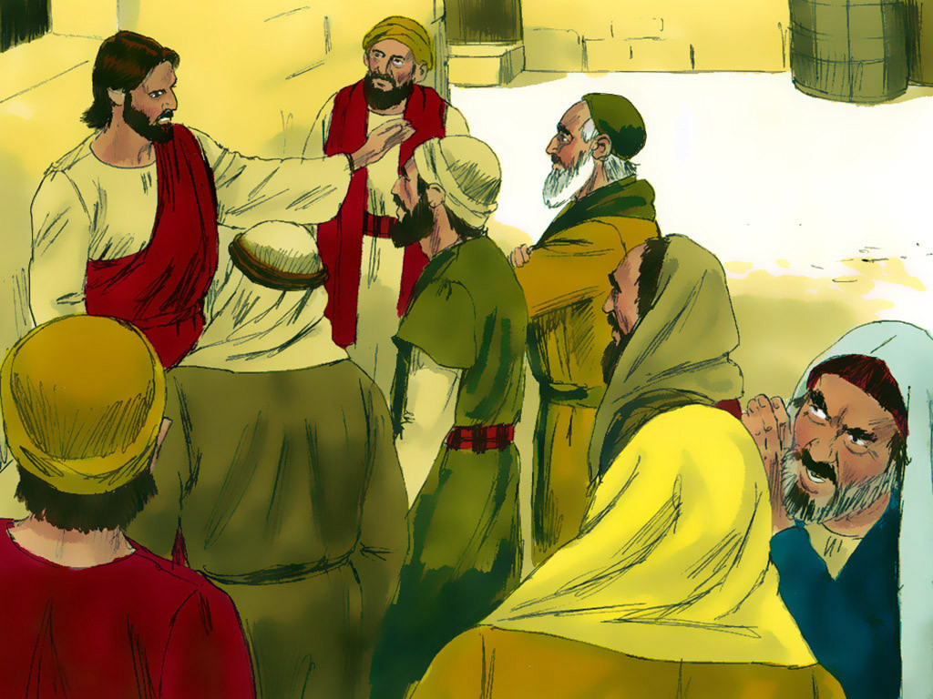
16
Then they sent to him some of their disciples and some members of Herod's party. “Teacher,” they said, “we know that you tell the truth. You teach the truth about God's will for people, without worrying about what others think, because you pay no attention to anyone's status.

Slide 7
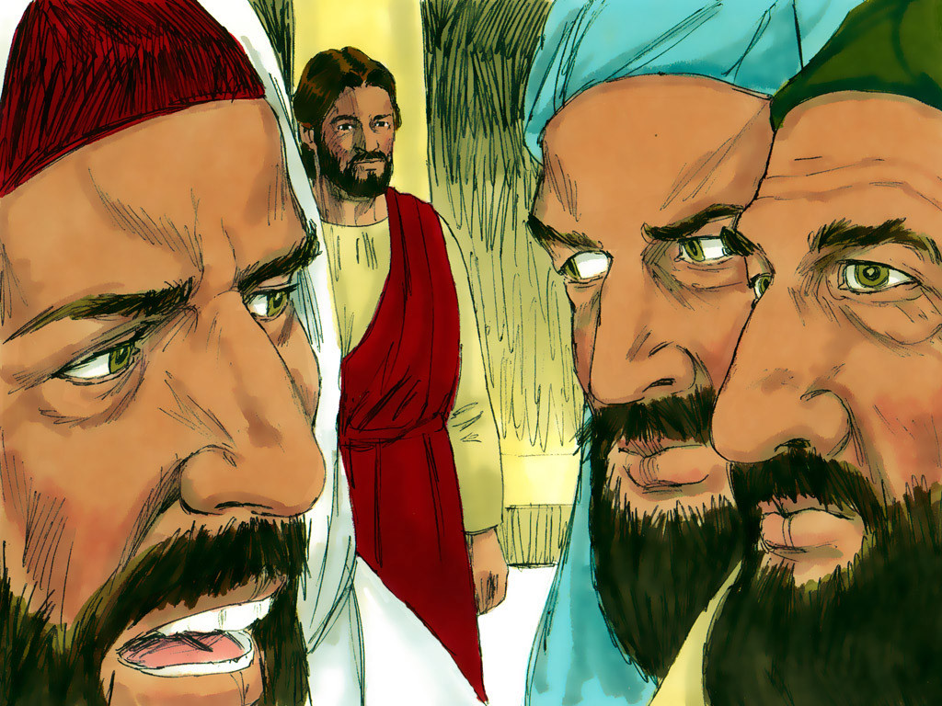
17
Tell us, then, what do you think? Is it against our Law to pay taxes to the Roman Emperor, or not?”

Slide 8
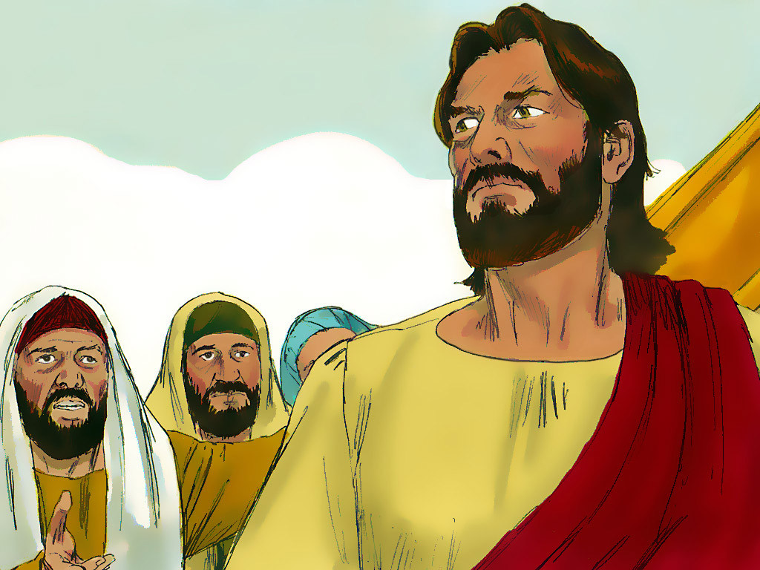
18
Jesus, however, was aware of their evil plan, and so he said, “You hypocrites! Why are you trying to trap me?

Slide 9
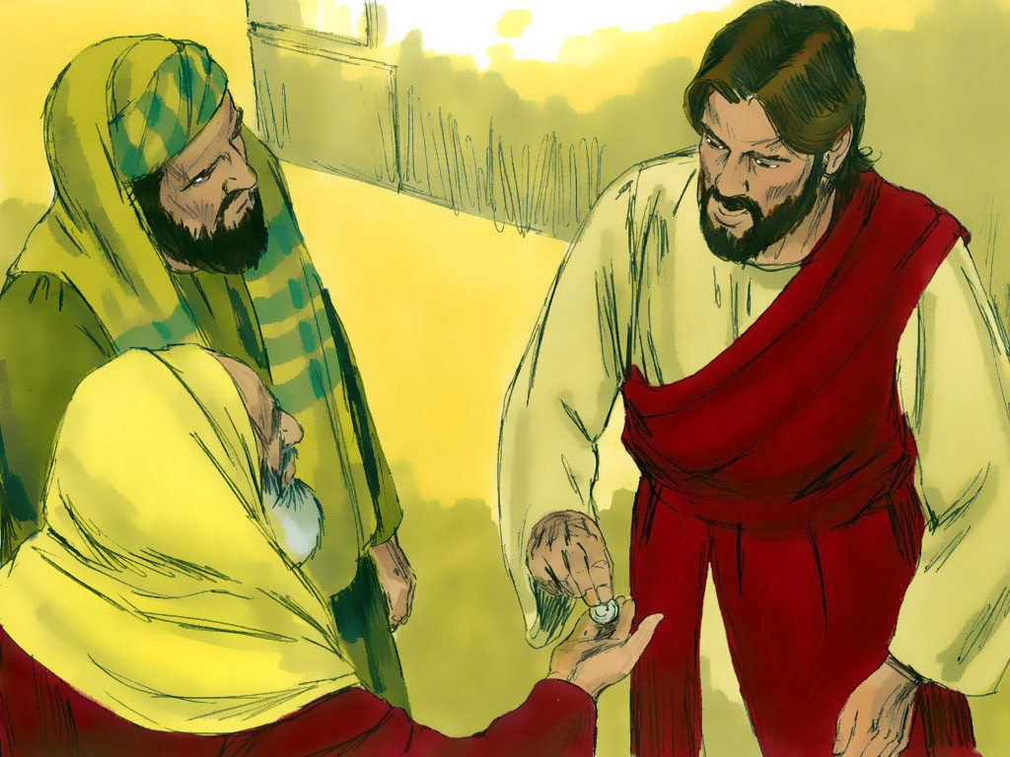
19
how me the coin for paying the tax!”
They brought him the coin,

Slide 10
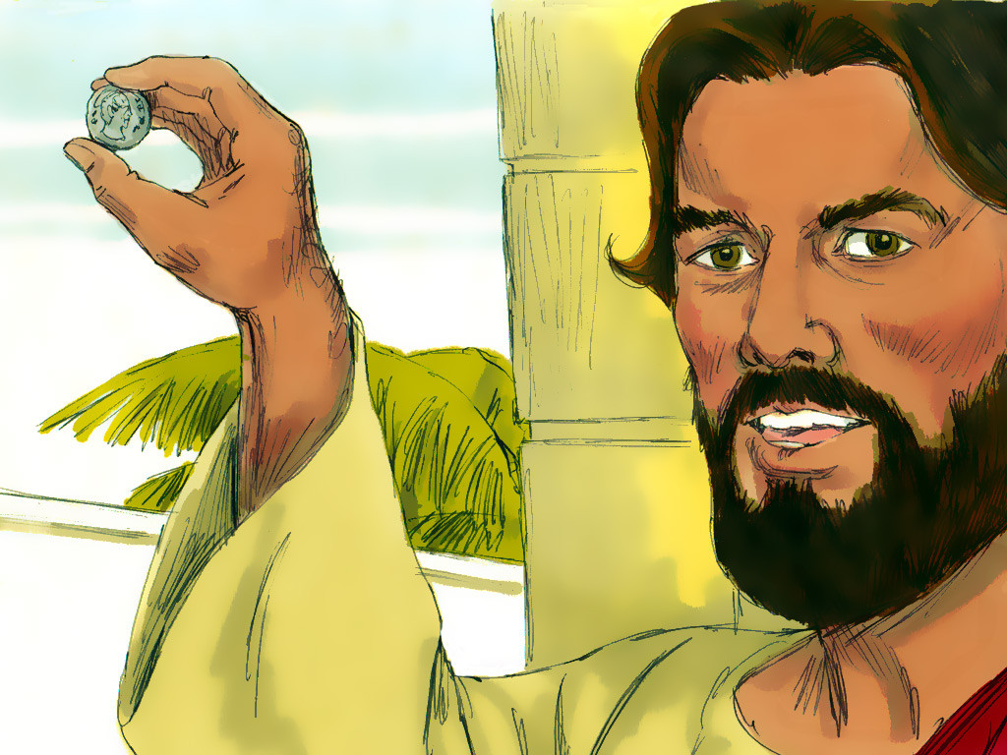
20
and he asked them, “Whose face and name are these?”

Slide 11
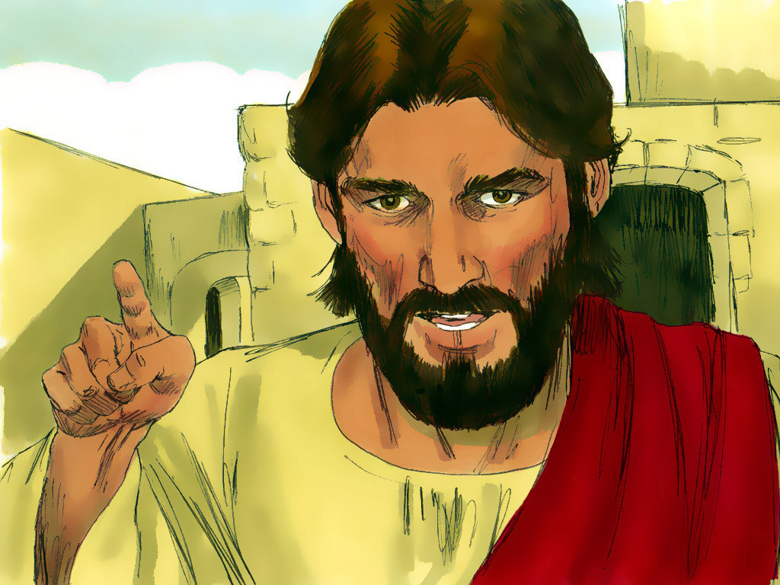
21
“The Emperor's,” they answered.
So Jesus said to them, “Well, then, pay to the Emperor what belongs to the Emperor, and pay to God what belongs to God.”

Slide 12
Leader: The Gospel of the Lord.
All: Praise to You,
Lord Jesus Christ.

Slide 13
GOSPEL MESSAGE

Slide 14
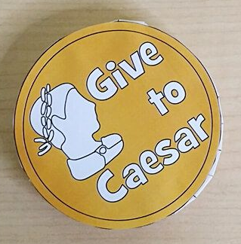
Activity:
Coins Statements
Bond Paper
Yellow Colored Paper
Scissors
Glue
Pen

Slide 15
Instructions:
Use your yellow colored paper to draw a coin pattern.
Carefully cut out the pattern from your yellow colored paper. Take your time to make sure the edges are neat.
Cut out a long rectangle from another piece of paper; this will serve as the foundation of your coin.
On the front and back of your coin, draw a man and write the words “Give to Caesar.” You can use markers or crayons to add colors and details.
Apply glue to the edges of the foundation and carefully attach it to both sides of your coin. Make sure it's securely glued in place.
Allow your coin to dry completely. This ensures that the foundation is firmly attached to the coin.
There you go! You have created your own coin.

Slide 16
Closing Prayer
Dear God,
Please help us be nice to everyone and do good things for our friends and neighbors. Remind us that every person is special, just like you made them. Show us how to help others and make the world a better place. May we also always remember that everything we have belongs to you and is not ours.
Amen.

Slide 17
LIVE THE WORD KIDS
29th Sunday in Ordinary Time | Cycle A

