Slide 1
LIVE THE WORD KIDS
28th Sunday in Ordinary Time | Cycle A

Slide 2
GOSPEL REFLECTION
In the gospel’s story, there was a big party thrown by a king for his son's wedding. The king invited many people, but some said no and made excuses. So the king invited everyone he could find, but they had to wear special clothes to join the party. Some people didn't want to wear the special clothes and couldn't stay at the party.
What this story tells us is that God invites us to be part of His family in heaven. We don't have to do anything special to be invited - we just need to accept God's love and forgiveness, which is a free gift. This special 'clothing' is like understanding and accepting the love Jesus has for us. It changes our lives and makes us new inside. We can also share this wonderful news with others so they can join God's family too. Let's take a moment to thank God for this amazing gift!

Slide 3
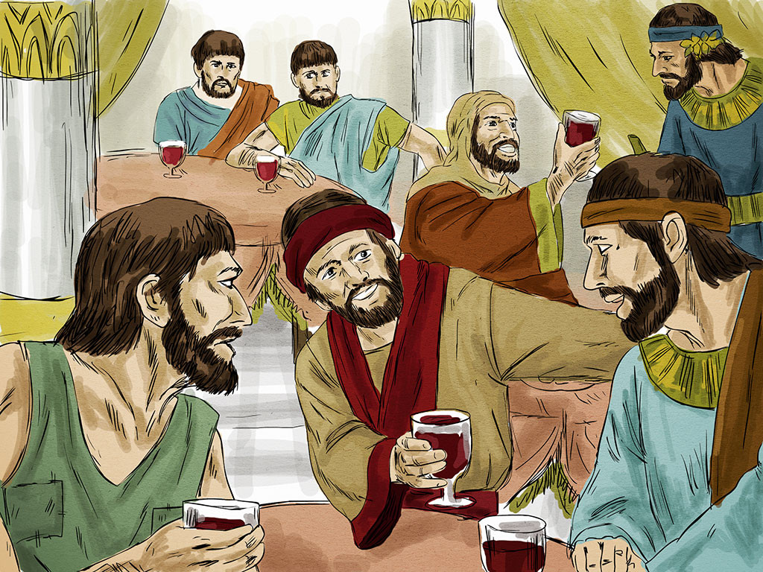
The Parable of the Wedding Feast
Matthew 22:1-14

Slide 4
Leader: A reading from
the Holy Gospel
according to Matthew.
All: Glory to You, Oh Lord.

Slide 5
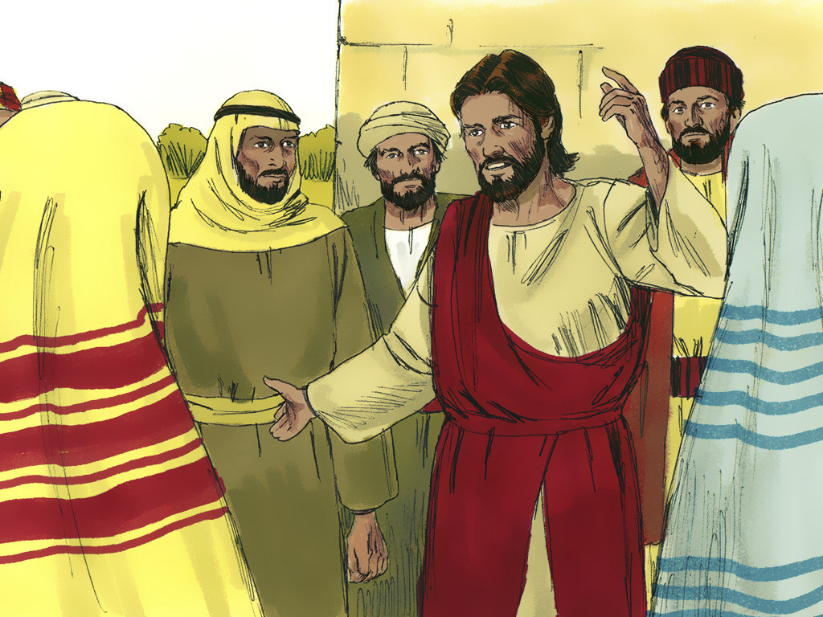
1
Jesus again used parables in talking to the people.

Slide 6
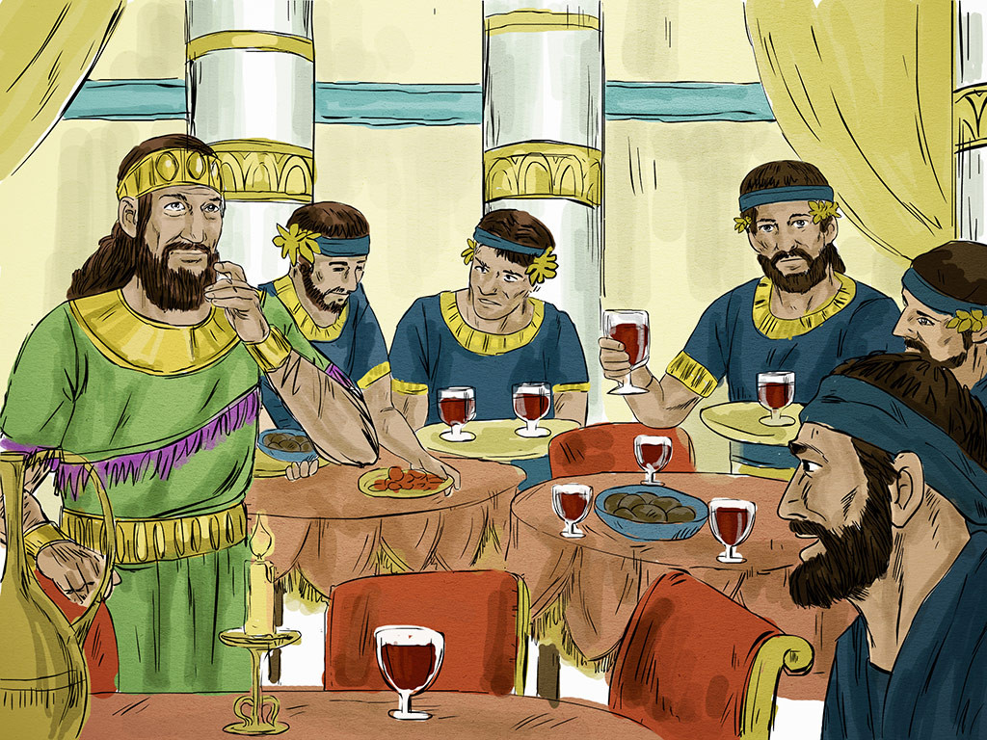
2
The Kingdom of heaven is like this. Once there was a
king who prepared
a wedding feast
for his son.

Slide 7
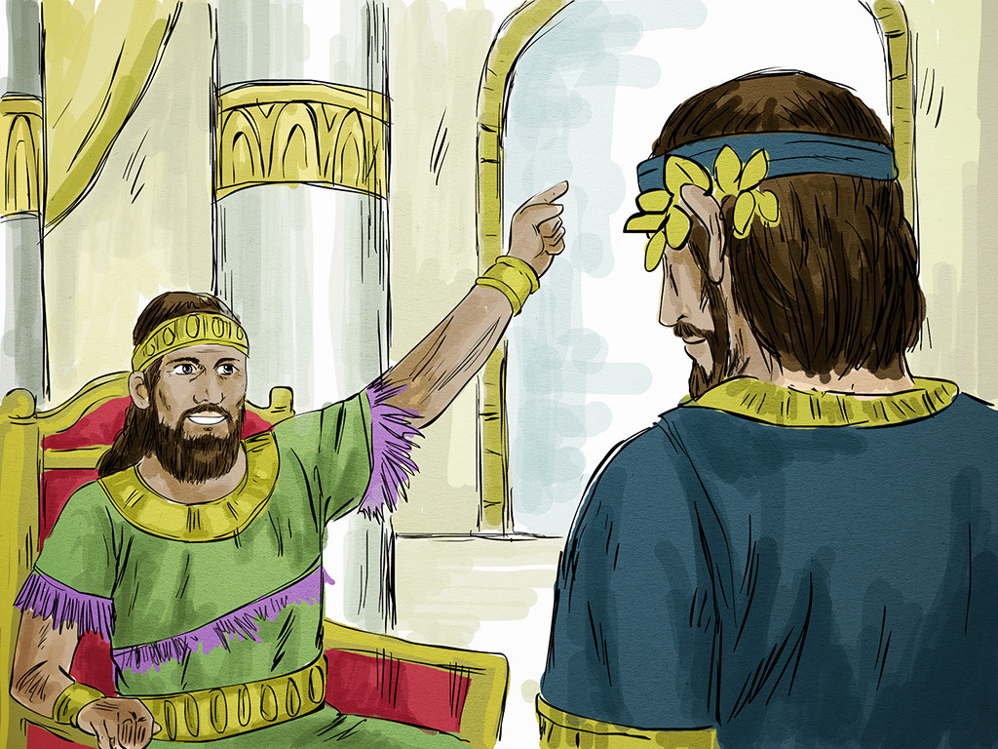
3
He sent his servants to tell the invited guests to come to the feast, but they did not want to come.

Slide 8
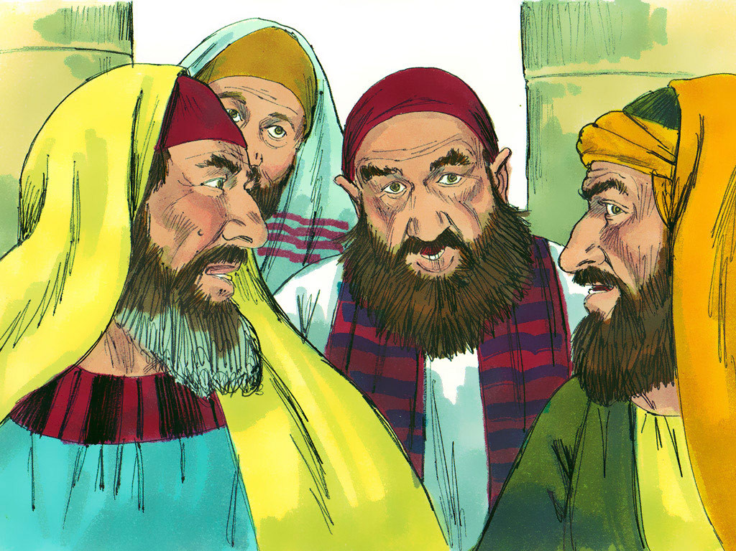
4
So he sent other servants with this message for the guests: ‘My feast is ready now; my steers and prize calves have been butchered, and everything is ready. Come to the wedding feast!’

Slide 9
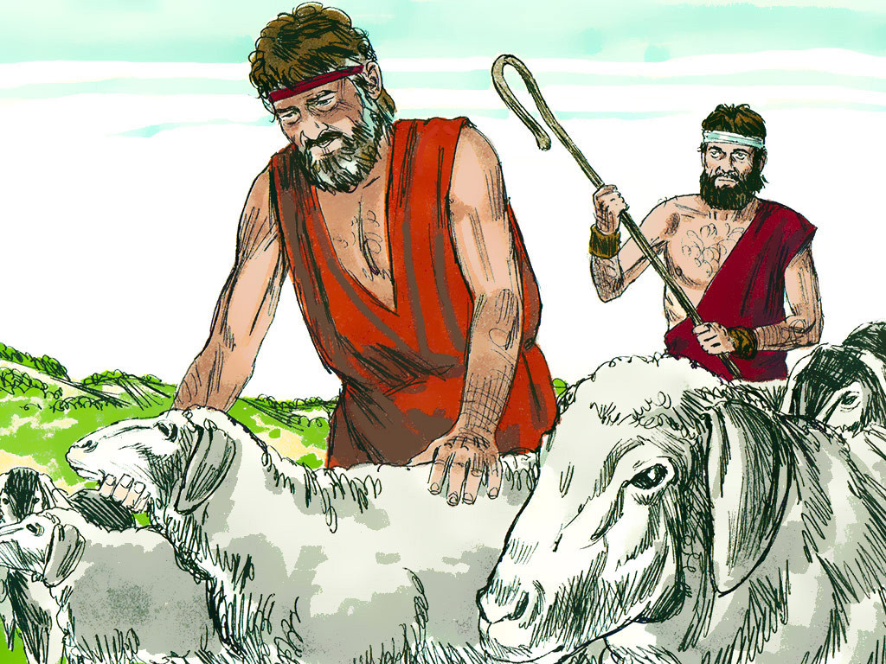
5
But the invited guests paid no attention and went about their business: one went to his farm, another to his store,

Slide 10
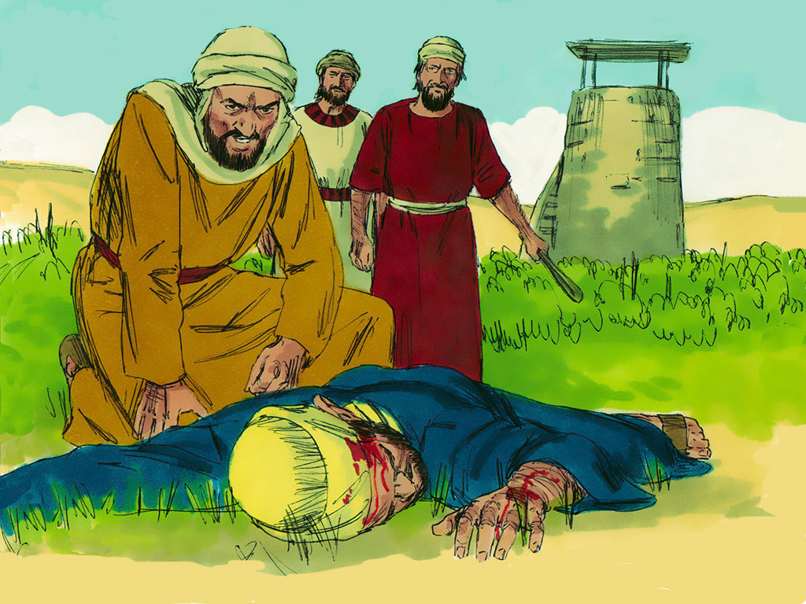
6
while others grabbed the servants, beat them, and killed them.

Slide 11
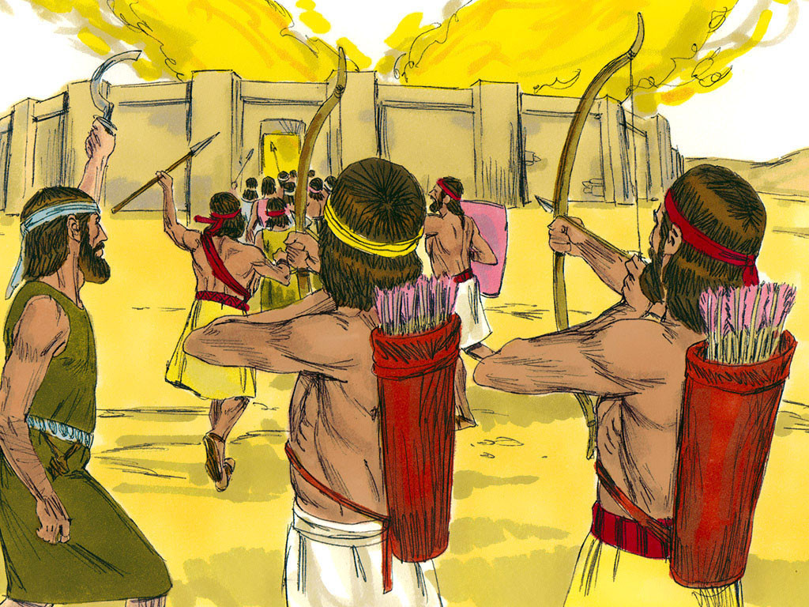
7
The king was very angry; so he sent his soldiers, who killed those murderers and burned down their city.

Slide 12
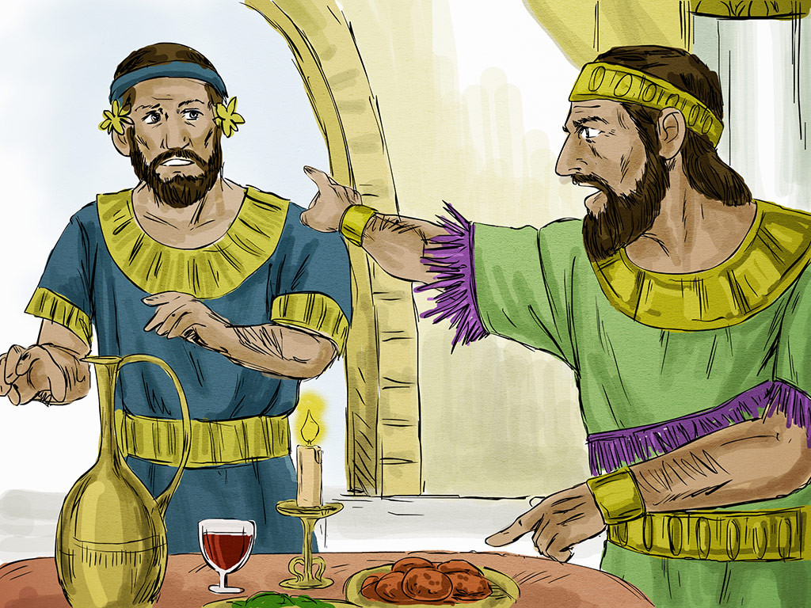
8
Then he called his servants and said to them, ‘My wedding
feast is ready, but
the people I invited
did not deserve it.

Slide 13
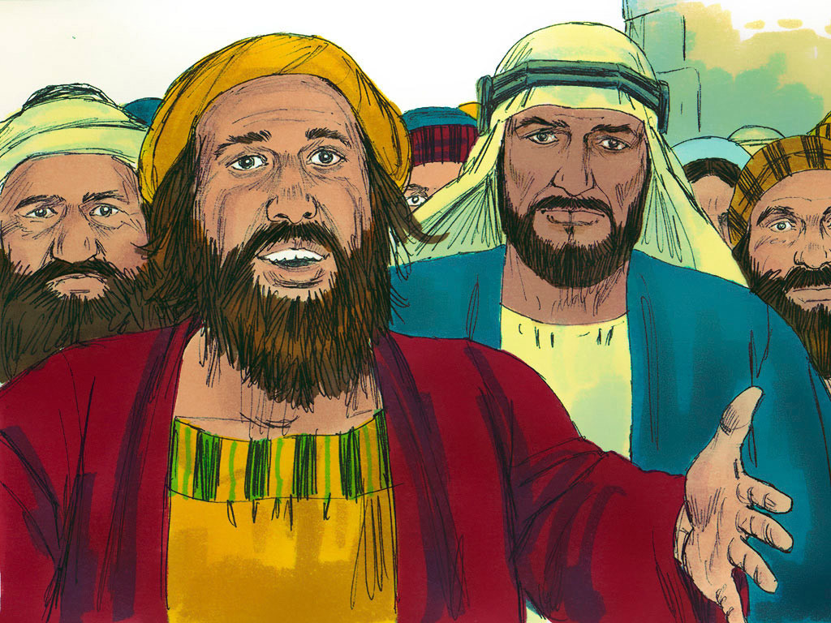
9
Now go to the main streets and invite to the feast as many people as you find.’

Slide 14
10
So the servants went out into the streets and gathered all the people they could find, good and bad alike; and the wedding hall was filled with people.

Slide 15
11
“The king went in to look at the guests and saw a man who was not wearing wedding clothes.

Slide 16
12
‘Friend, how did you get in here without wedding clothes?’ the king asked him. But the man said nothing.

Slide 17
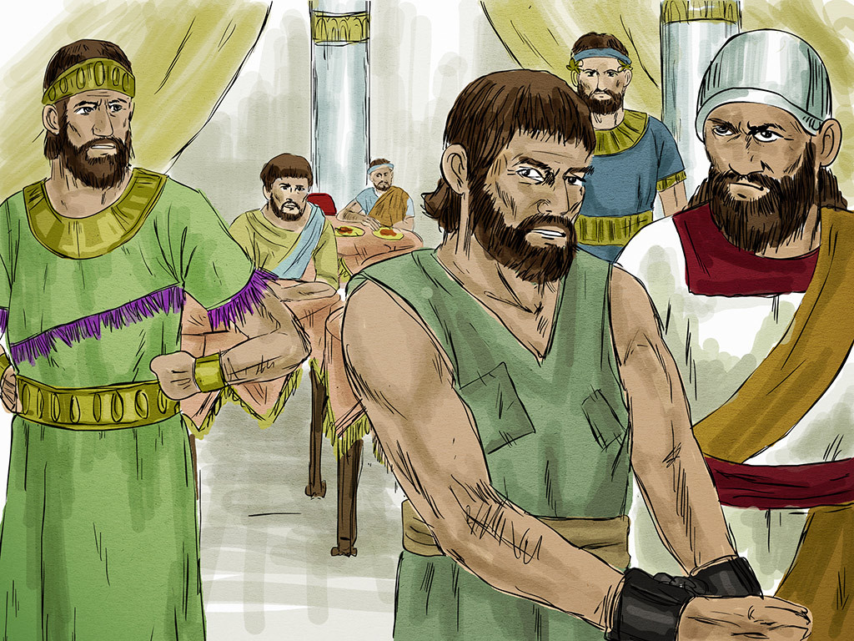
13
Then the king told the servants, ‘Tie him up hand and foot, and throw him outside in the dark. There he will cry and gnash his teeth.’’

Slide 18
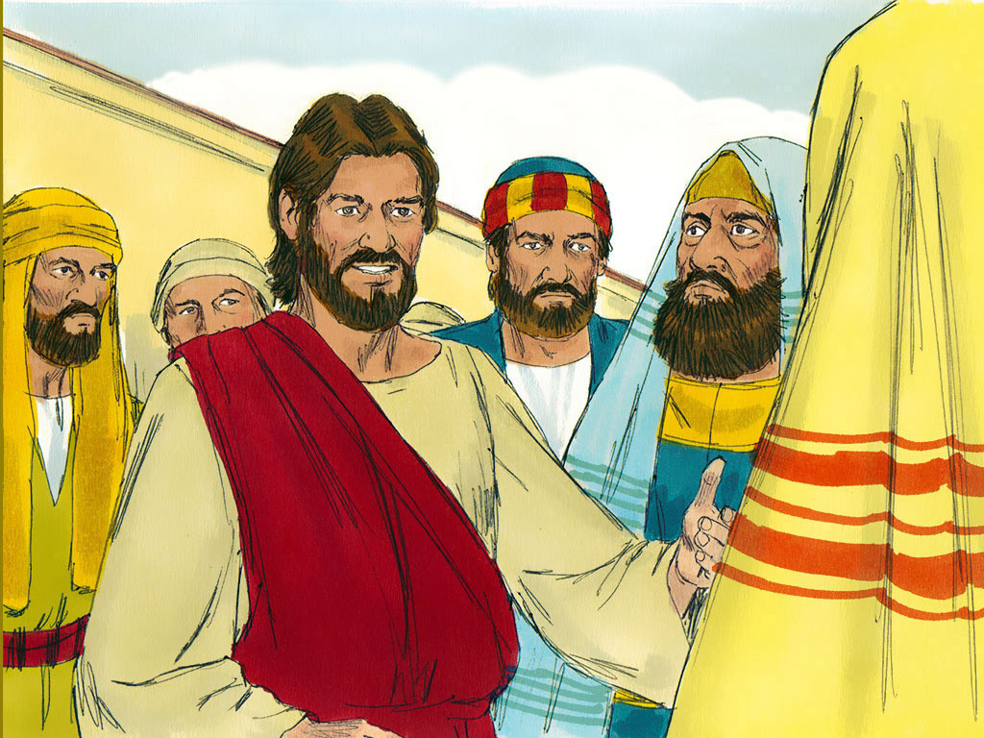
14
And Jesus concluded, “Many are invited,
but few are chosen.”

Slide 19
Leader: The Gospel of the Lord.
All: Praise to You,
Lord Jesus Christ.

Slide 20
GOSPEL MESSAGE

Slide 21
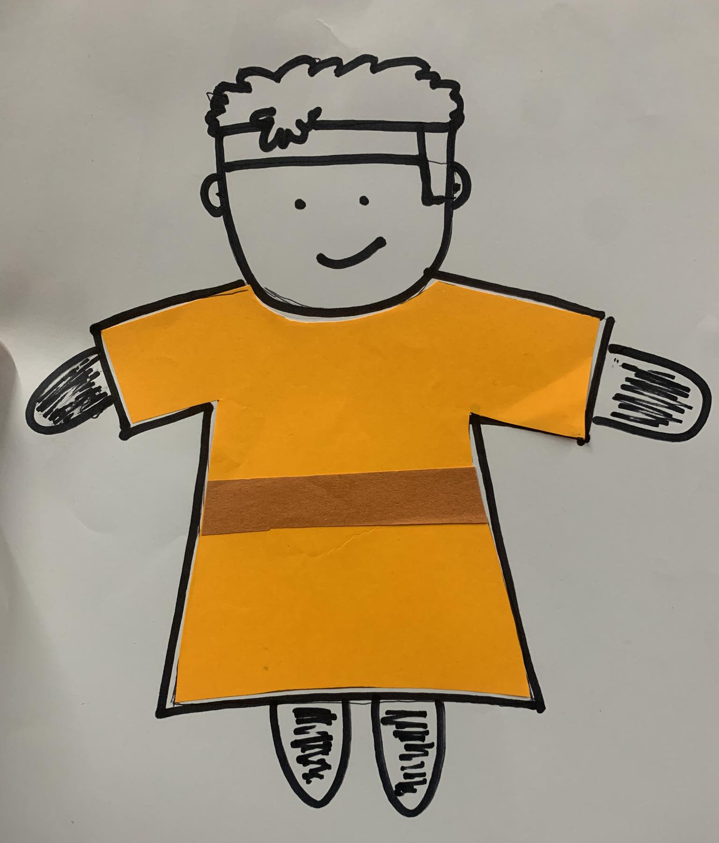
Activity:
You’re Invited “Wear your Best”
Bond Paper
Colored Paper
Crayons
Scissors
Glue
Pen

Slide 22
Instructions:
Gather all the materials you need.
Draw yourself on the bond paper as if you are one of the guests at the wedding feast.
After drawing yourself, use colored paper to create the outfit you want to wear. You can also add accessories if you like.
Use markers, crayons, or any coloring materials to add details and make it more beautiful.
Attach the clothes you have made to your drawing.
There you go! Now you have a well-dressed character that you can use for attending the wedding feast.

Slide 23
Closing Prayer
Dear God,
Thank you for welcoming us to your family and inviting us to to your kingdom.
May we have a heart that is accepting your invitation. And may you help us to reach out and invite others as well.
In Jesus name, Amen!

Slide 24
LIVE THE WORD KIDS
28th Sunday in Ordinary Time | Cycle A

