Slide 1
LIVE THE WORD KIDS
27th Sunday in Ordinary Time | Cycle A

Slide 2
GOSPEL REFLECTION
Jesus was explaining what happened between God and the people of Israel. God chose those people to be His, and they didn’t listen. The landowner in this case is God. God sent prophets (the first messengers or “rent collectors”), but the people didn’t listen to them. God kept trying to reach out, and finally sent Jesus, His son.
God offers us His amazing vineyard that comes with abundant blessings, but He does expect us to bear fruit and give Him His rightful share. He doesn’t force this relationship on us, but offers it freely. The choice is ours.
That moral lesson is if we live our lives in sinful ways we will forfeit all the gifts God offers. We are stewards of God’s Kingdom on earth. Everything we have is through God’s abundant love. He has sent us prophets, fellow Christians, communities and Christ Himself to get us to turn to Him as His children. If we choose to reject God, His Son, and everything He stands for, we will lose out on His promise of eternal glory because that gift is reserved for those who love and follow Him.

Slide 3
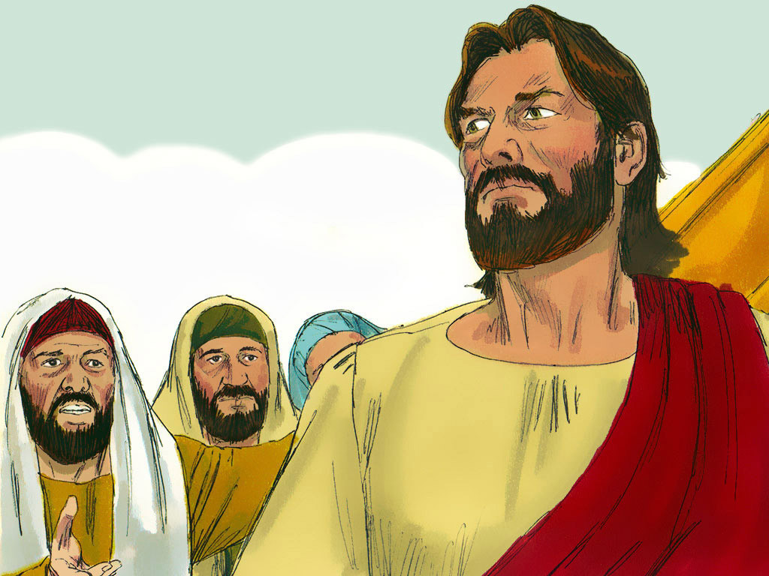
The Parable of the Tenants in the Vineyard
Matthew 21:33-43

Slide 4
Leader: A reading from
the Holy Gospel
according to Matthew.
All: Glory to You, Oh Lord.

Slide 5
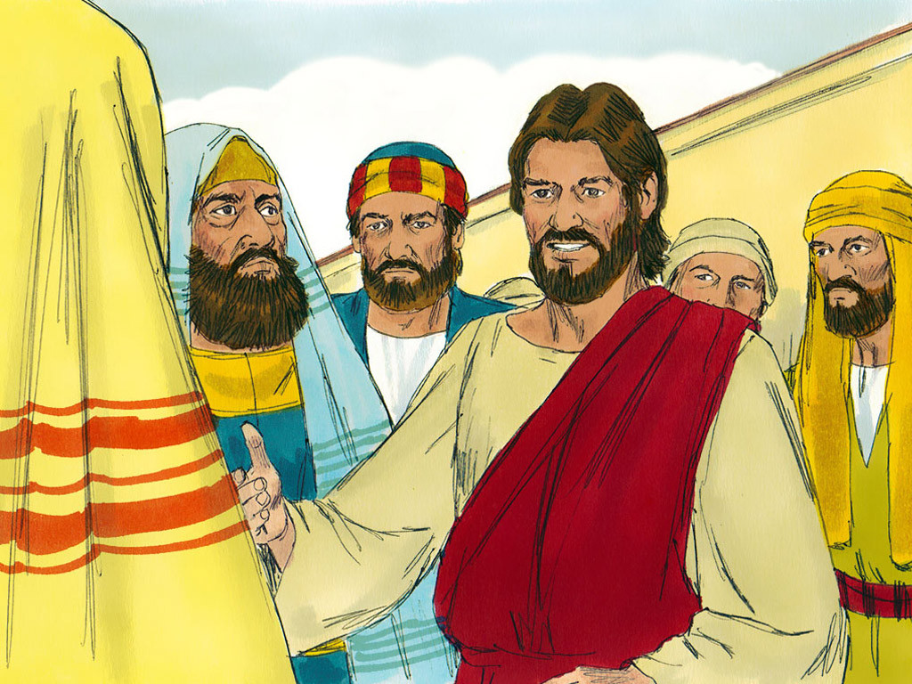
33
“Listen to another parable,” Jesus said. “There was once a landowner who planted a vineyard, put a fence around it, dug a hole for the wine press, and built a watchtower. Then he rented the vineyard to tenants and left home on a trip.

Slide 6
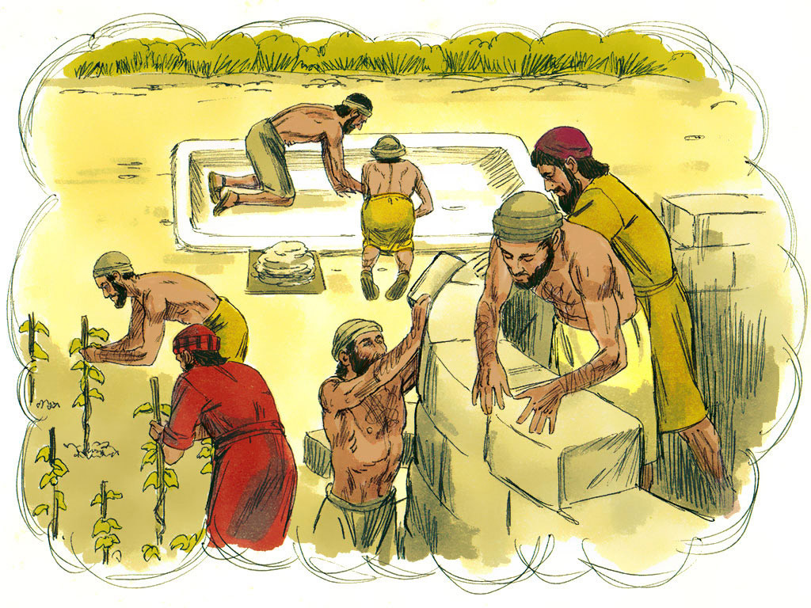
34
When the time came to gather the grapes, he sent his slaves to the tenants to receive his share of the harvest.

Slide 7
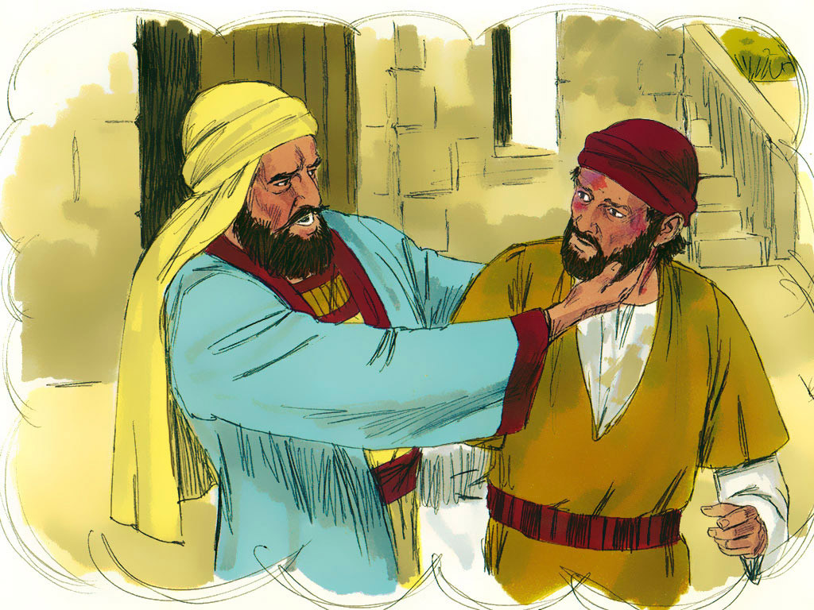
35
The tenants grabbed his slaves, beat one, killed another, and stoned another.

Slide 8
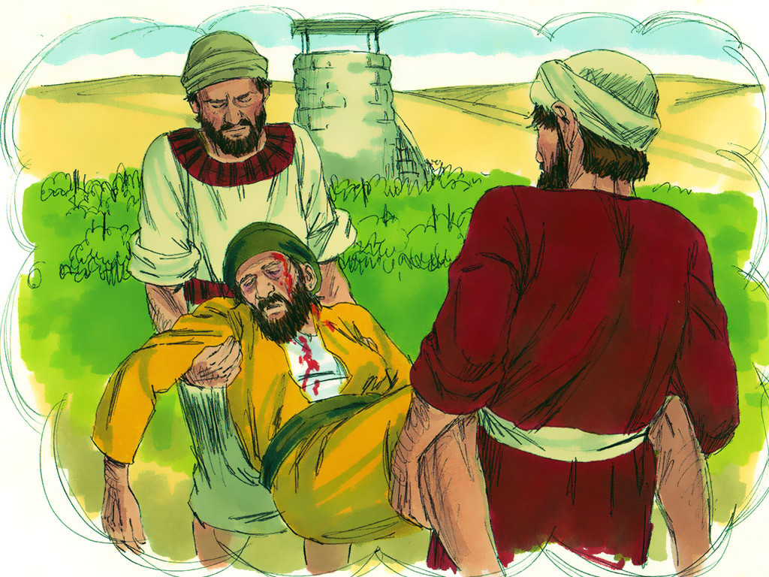
36
Again the man sent other slaves, more than the first time, and the tenants treated them the same way.

Slide 9
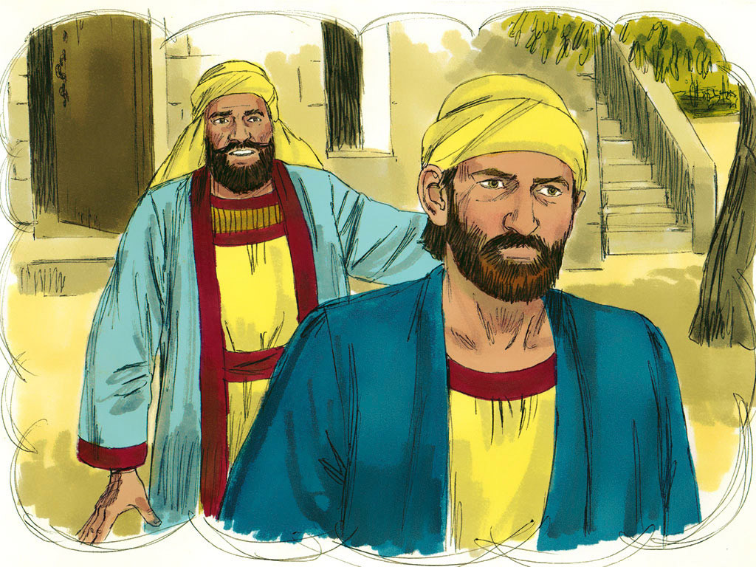
37
Last of all he sent his son to them. ‘Surely they will respect my son,’
he said.

Slide 10
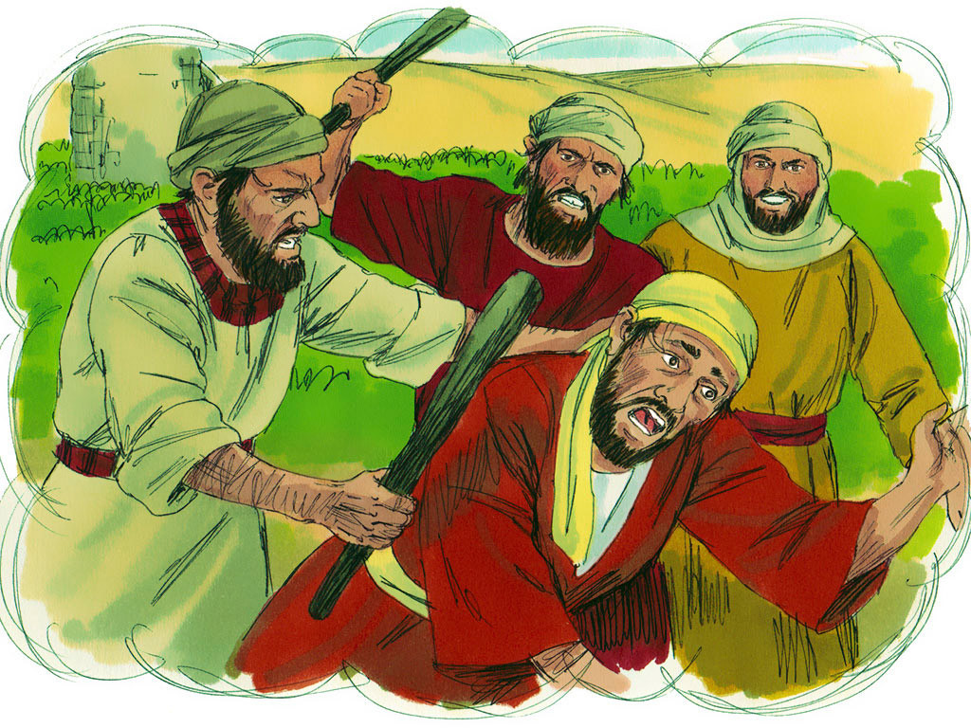
38
But when the tenants saw the son, they said to themselves, ‘This is the owner's son. Come on, let's kill him, and we will get his property!’

Slide 11
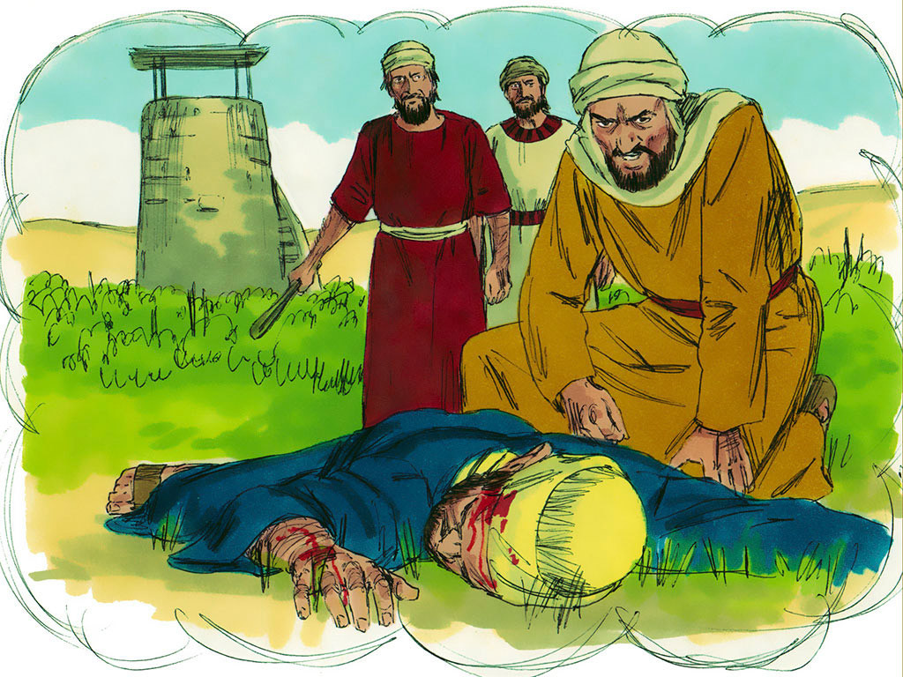
39
So they grabbed him, threw him out of the vineyard, and killed him.

Slide 12
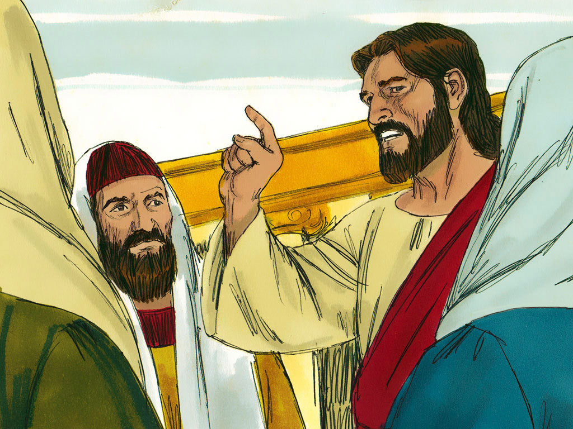
40
“Now, when the owner of the vineyard comes, what will he do to those tenants?” Jesus asked.

Slide 13
41
“He will certainly kill those evil men,” they answered, “and rent the vineyard out to other tenants, who will give him his share of the harvest at the right time.”

Slide 14
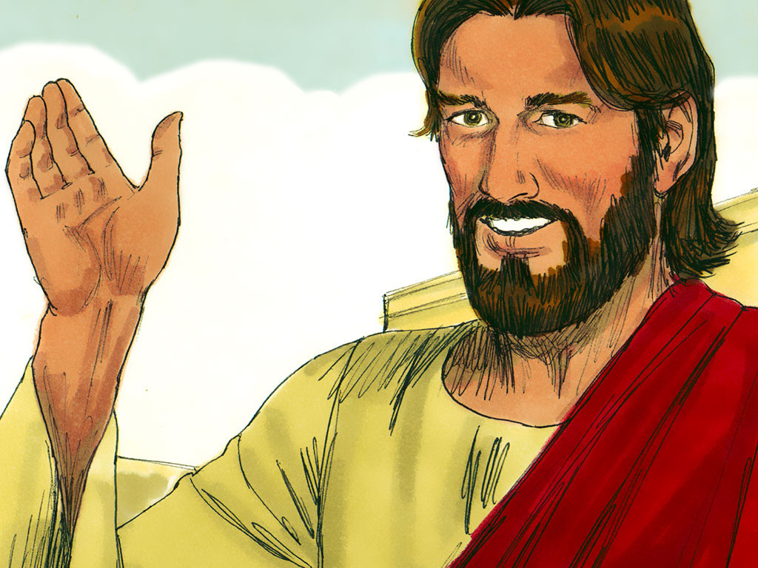
42
Jesus said to them,
“Haven't you ever read what the Scriptures say?
‘The stone which the builders rejected as worthless turned out to be the most important of all.This was done by the Lord; what a wonderful sight it is!’

Slide 15
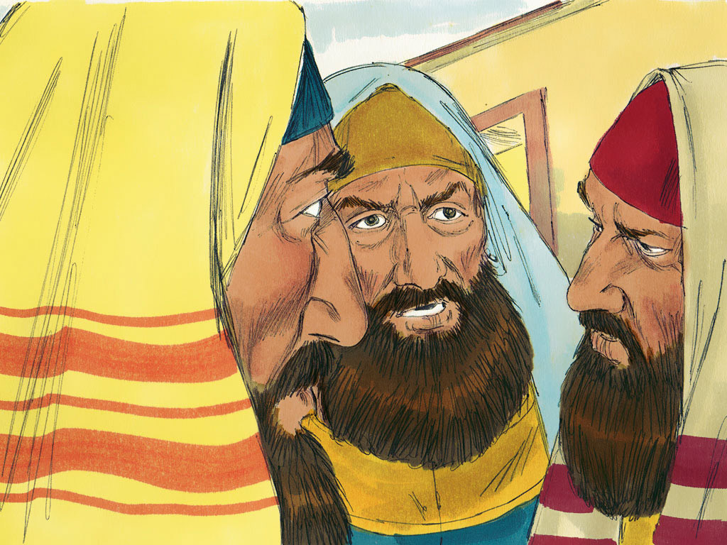
43
“And so I tell you,” added Jesus,
“the Kingdom of God will be taken away from you and given to a people who will produce the proper fruits.”

Slide 16
Leader: The Gospel of the Lord.
All: Praise to You,
Lord Jesus Christ.

Slide 17
GOSPEL MESSAGE

Slide 18
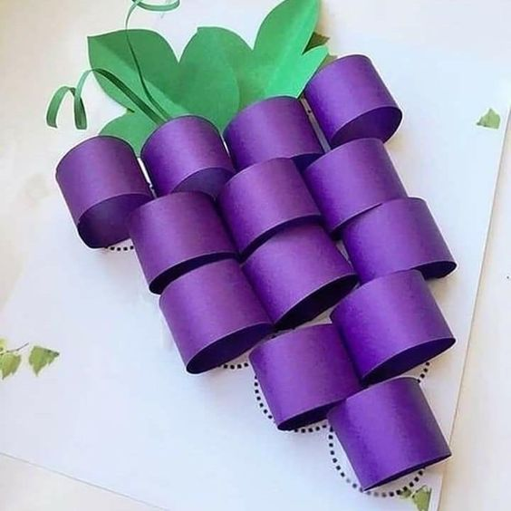
Activity:
Honesty “I Will” Statements
Bond Paper
Violet Colored Paper
Green Colored Paper
Scissors
Glue
Pen

Slide 19
Instructions:
Cut out small rectangles on your violet colored paper.
Draw a grape pattern on your bond paper.
Roll the small rectangles to connect each edges of the rectangles then make sure to glue it.
After doing it to all the the cut-out rectangles, make a small leaves by cutting out from the green colored paper.
Then glue your grapes and leaves patterned to your drawing on bond paper.

Slide 20
Closing Prayer
Dear God,
Thank you for the every moment of our life and the people we meet every day. Help us to notice the special moments and lessons you are trying to teach us. Sometimes, there will me moments we might miss them or not pay enough attention. Please forgive us and help us be better at understanding your messages.
Amen.

Slide 21
LIVE THE WORD KIDS
27th Sunday in Ordinary Time | Cycle A

