Slide 1
LIVE THE WORD KIDS
26th Sunday in Ordinary Time | Cycle A

Slide 2
GOSPEL REFLECTION
The parable of the two sons (Matt. 21:28-32) is about two brothers whose father tells them to go work in his vineyard. One tells his father that he will but doesn’t do it. The other tells his father that he won’t go but ends up working all day among the vines. Jesus then asks the question, “Which of the two did the will of his father?” The answer is clear: the one who actually worked, though initially refusing to do so.
This parable, reminds us that actions speak louder than words. Being a good person means keeping those promises and doing what you say you'll do. It's like a special superpower called 'integrity.' When you have integrity, it means you're always trying to do the right thing, even when no one is looking.
So, if you say you'll share your toys, you actually do it because it's the right thing to do, and it makes you a trustworthy friend. Being good and true to your words means people can trust you, and that's an amazing quality to have. It's like being a superhero of kindness and honesty!

Slide 3
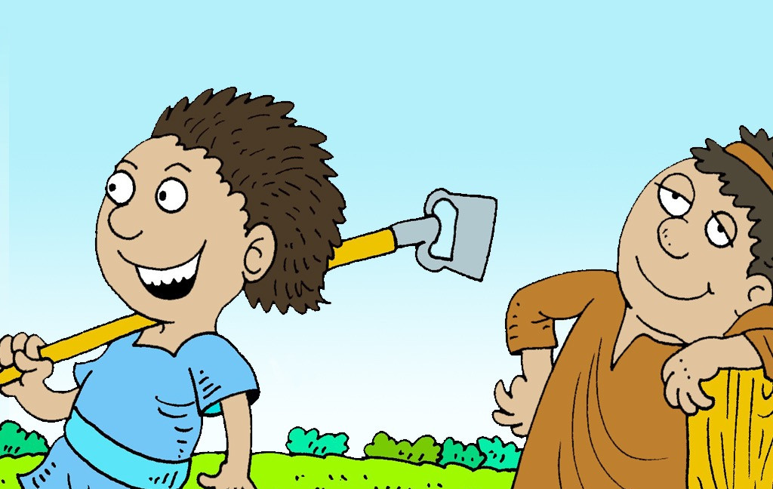
The Parable of the Two Sons
Matthew 21:28-32

Slide 4
Leader: A reading from
the Holy Gospel
according to Matthew.
All: Glory to You, Oh Lord.

Slide 5
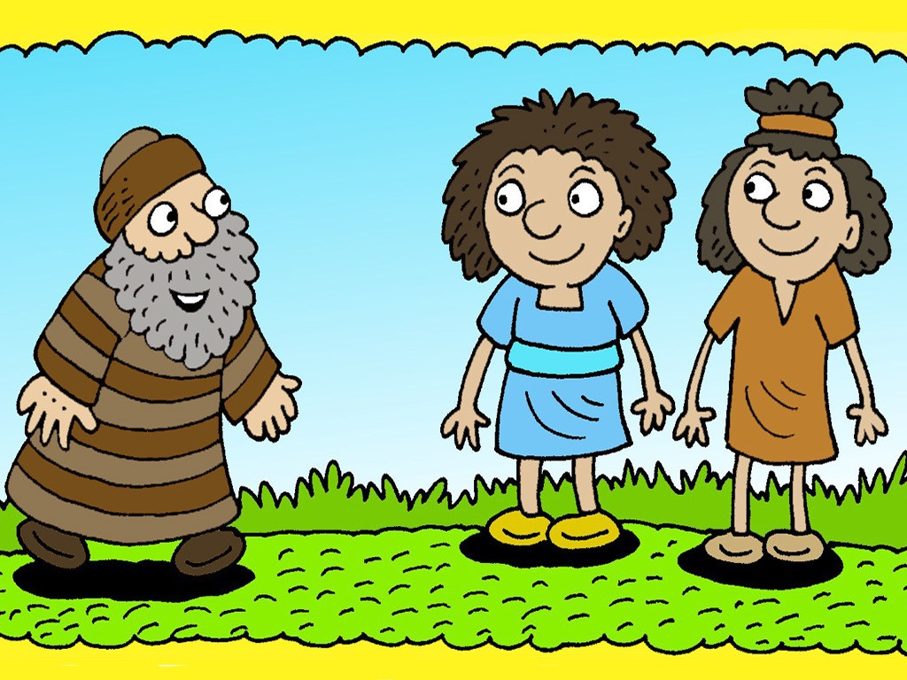
28
“Now, what do you think? There was once a man who had two sons. He went to the older one and said, ‘Son, go and work in the vineyard today.’

Slide 6
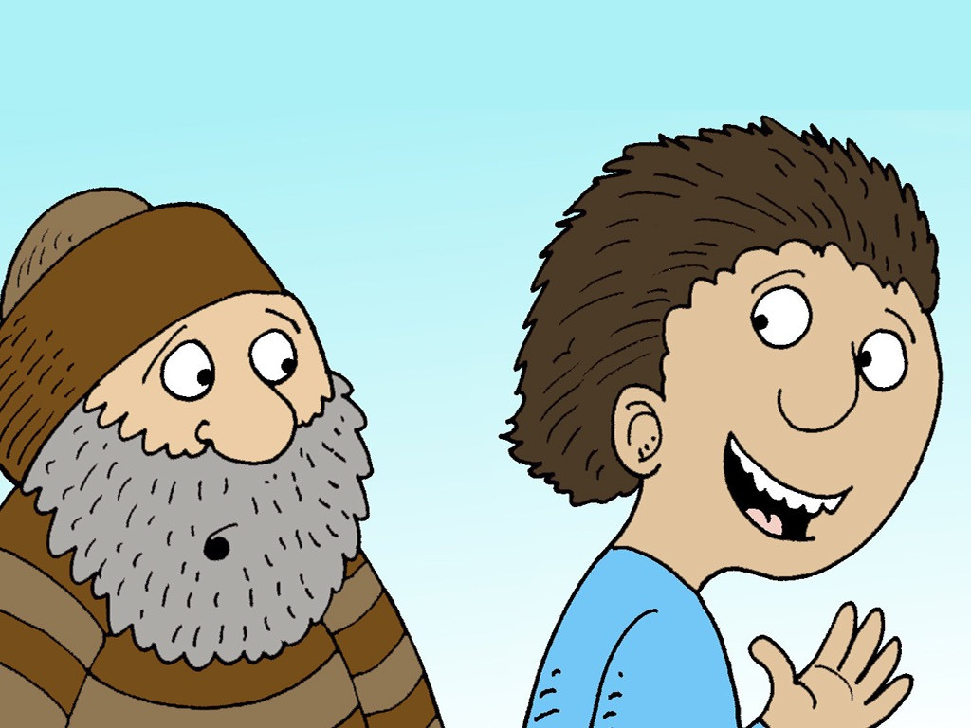
29
‘I don't want to,’ he answered, but later he changed his mind and went.

Slide 7
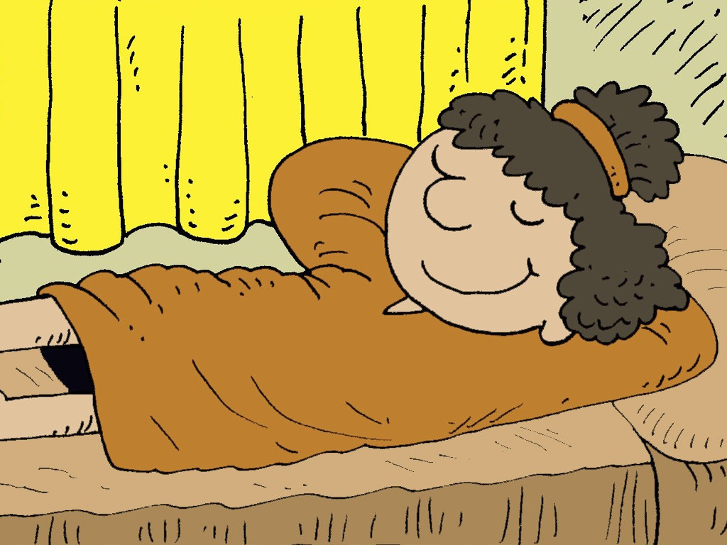
30
Then the father went to the other son and said the same thing. ‘Yes, sir,’ he answered, but he did not go.

Slide 8
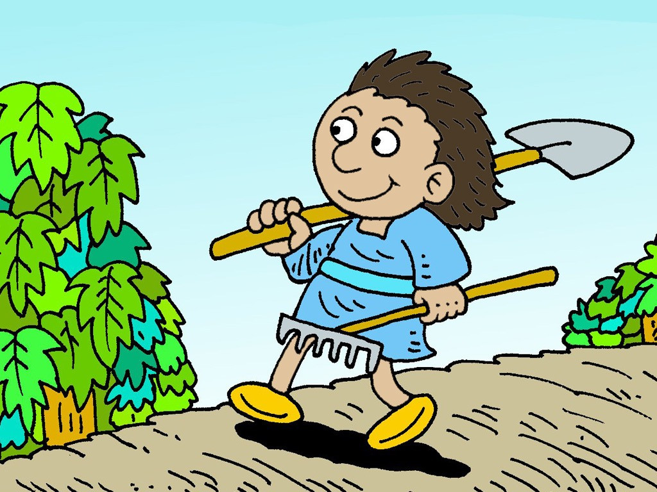
31
Which one of the two did what his father wanted?”
“The older one,” they answered.
So Jesus said to them, “I tell you: the tax collectors and the prostitutes are going into the Kingdom of God ahead of you.

Slide 9
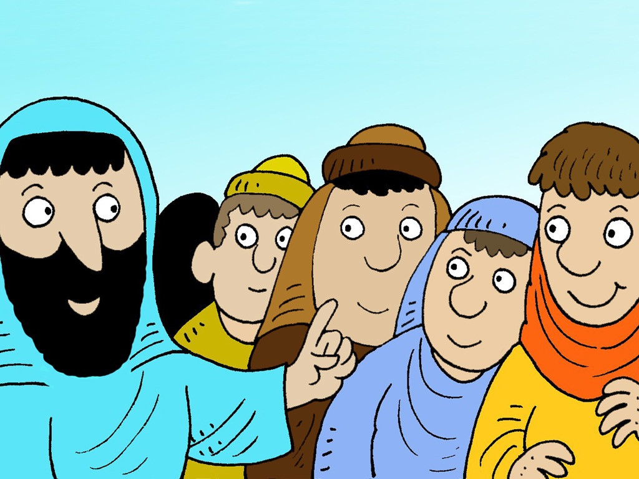
32
For John the Baptist came to you showing you the right path to take, and you would not believe him; but the tax collectors and the prostitutes believed him. Even when you saw this, you did not later change your minds and believe him.

Slide 10
Leader: The Gospel of the Lord.
All: Praise to You,
Lord Jesus Christ.

Slide 11
GOSPEL MESSAGE

Slide 12
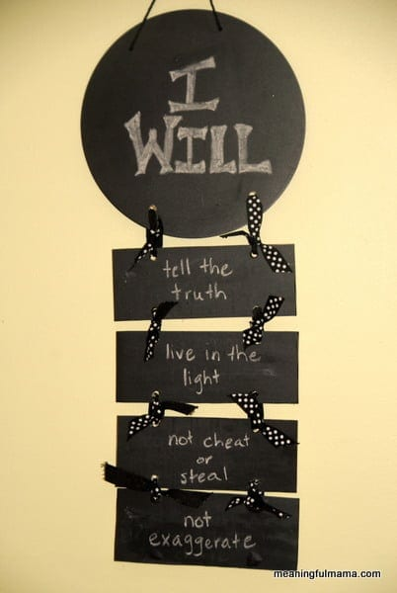
Activity:
Honesty “I Will” Statements
Colored Paper/Bond Paper
Scissors and Glue
Ribbon or Yarn
Pen and Crayons

Slide 13
Instructions:
"Cut out one circle shape and four rectangles."
"Write down the words 'I will' in the circle shape."
"In the four rectangles, write down the things that you promise to do honestly, which can help you become a better person."
"After writing them down, make holes at the top and bottom of each shape."
"Then, connect the shapes using ribbon or yarn through the holes."
Then there you go, you will have a honesty
“I will” statements.

Slide 14
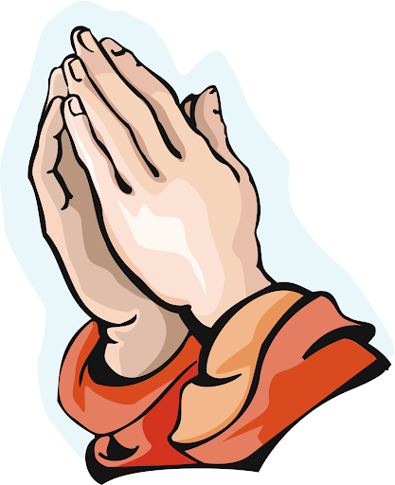
Closing Prayer
Dear God,
Lord thank you for not giving up on us. May we always follow and obey You everytime we do things. May we be honest and sincere in everything that we do. Jesus teach us to have an obedient heart and to be a good follower like you.
Amen.

Slide 15
LIVE THE WORD KIDS
26th Sunday in Ordinary Time | Cycle A

