Slide 1
LIVE THE WORD KIDS
Solemnity of our Lord Jesus, Christ the King

Slide 2
GOSPEL REFLECTION
God uses people to do His work. We are charged with passing Christ’s love and service on to others, just as the Great Commission invites us to be part of God’s plan. Jesus endured hunger and shame while He was on Earth, when we take care of others, we do it as though we do it for Christ, because it is for Him! The gospel invites us to love and serve the Lord by what they do for other people.

Slide 3
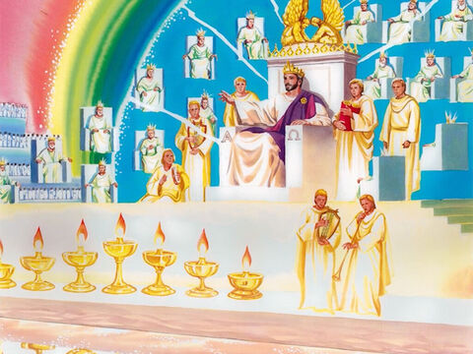
The Final Judgment
Matthew 25:31-46

Slide 4
Leader: A reading from
the Holy Gospel
according to Matthew.
All: Glory to You, Oh Lord.

Slide 5
31
“When the Son of Man comes as King and all the angels with him, he will sit on his royal throne,

Slide 6
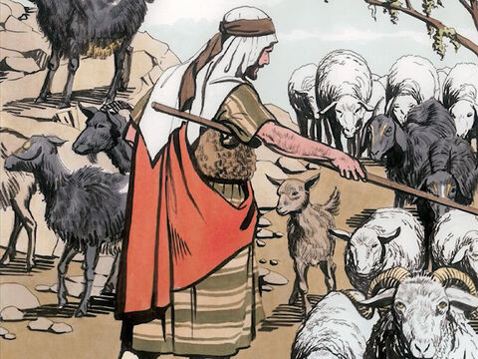
32
and the people of all the nations will be gathered before him. Then he will divide them into two groups, just as a shepherd separates the sheep from the goats.

Slide 7
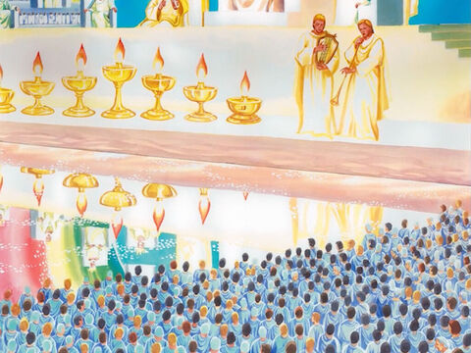
33
He will put the righteous people at his right and the others at his left.

Slide 8
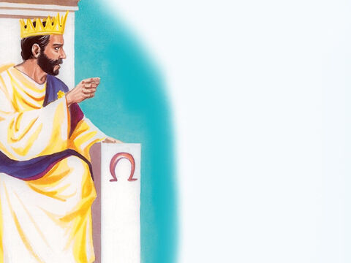
34
Then the King will say to the people on his right, ‘Come, you that are blessed by my Father! Come and possess the kingdom which has been prepared for you ever since the creation of the world.

Slide 9
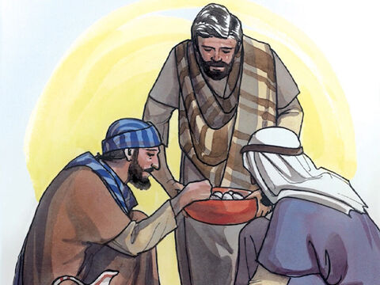
35
I was hungry and you fed me, thirsty and you gave me a drink; I was a stranger and you received me in your homes,

Slide 10
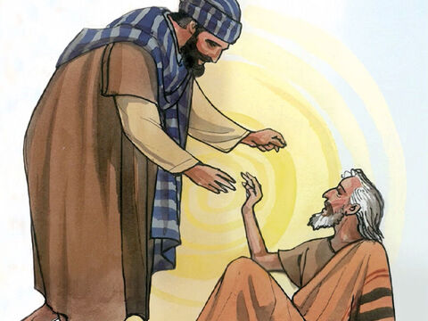
36
naked and you clothed me; I was sick and you took care of me, in prison and you visited me.

Slide 11
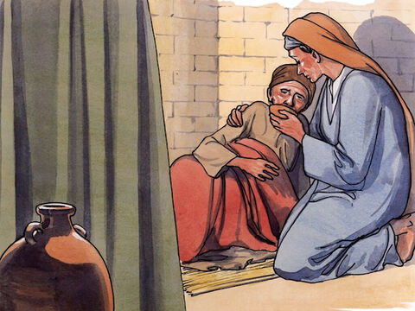
37
The righteous will then answer him, ‘When, Lord, did we ever see you hungry and feed you, or thirsty and give you a drink?

Slide 12
38
When did we ever see you a stranger and welcome you in our homes, or naked and clothe you?

Slide 13
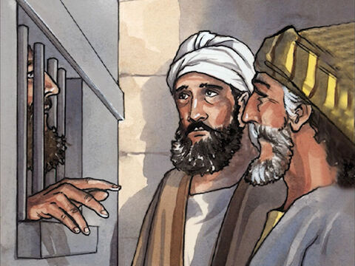
39
When did we ever see you sick or in prison, and visit you?’

Slide 14
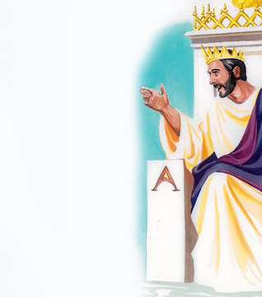
40
The King will reply, ‘I tell you, whenever you did this for one of the least important of these followers of mine, you did it for me!’

Slide 15
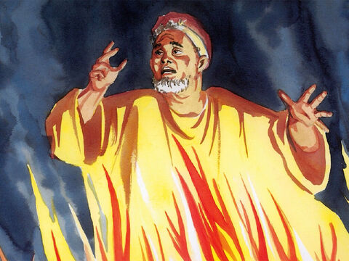
41
“Then he will say to those on his left, ‘Away from me, you that are under God's curse! Away to the eternal fire which has been prepared for the Devil and his angels!

Slide 16
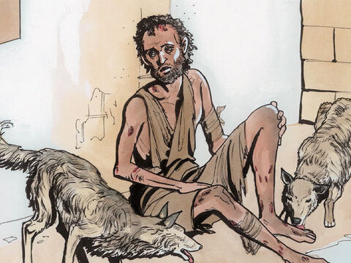
42
I was hungry but you would not feed me, thirsty but you would not give me a drink;

Slide 17
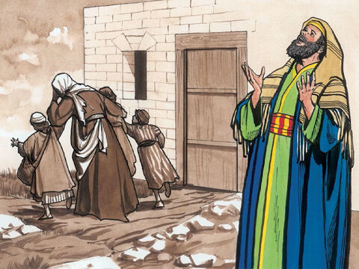
43
I was a stranger but you would not welcome me in your homes, naked but you would not clothe me; I was sick and in prison but you would not take care of me.’

Slide 18
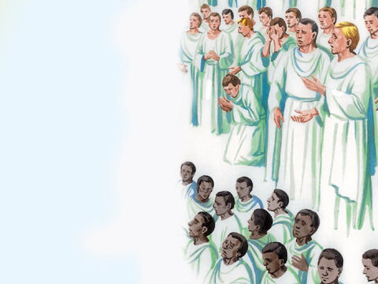
44
Then they will answer him, ‘When, Lord, did we ever see you hungry or thirsty or a stranger or naked or sick or in prison, and we would not help you?’

Slide 19
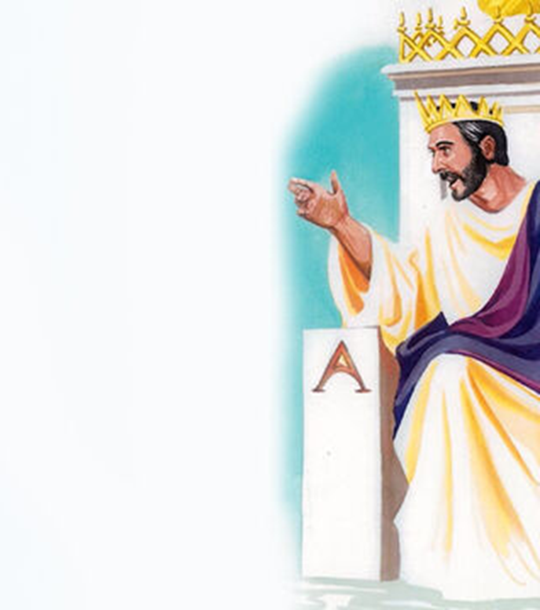
45
The King will reply, ‘I tell you, whenever you refused to help one of these least important ones, you refused to help me.’

Slide 20
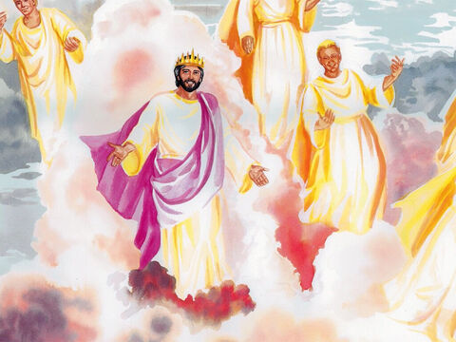
46
These, then, will be sent off to eternal punishment, but the righteous will go to eternal life.”

Slide 21
Leader: The Gospel of the Lord.
All: Praise to You,
Lord Jesus Christ.

Slide 22
GOSPEL MESSAGE

Slide 23
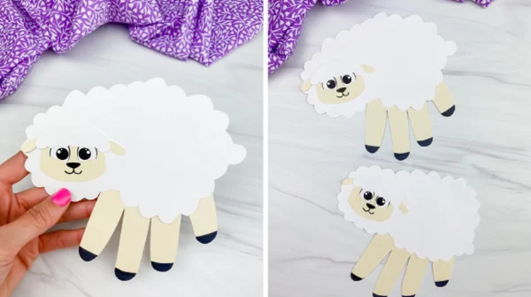
Activity:
Sheep at your Service
Construction paper or Colored Paper
Scissors
Pen or Marker
Glue
Coloring Materials

Slide 24
Instructions:
Draw a big cloud shape and cut it out, it will be the body of the sheep. And another small one for the head part.
Draw the face of the sheep and glue it to the smaller cloud shape.
Trace your hand and cut it out.
Glue the body of the sheep in the middle of the handprint.
Glue the head of the sheep onto the thumb portion of the hand print.
In the body of the sheep write down specific ways on how you can serve others.

Slide 25
Closing Prayer
Dear God,
Thank you for letting us be part of your work. When we serve other people, we serve you. Help us look for ways to do that and to care for those around us. Help us to share your love
We love you, God!
Amen.

Slide 26
LIVE THE WORD KIDS
30th Sunday in Ordinary Time | Cycle A

