Slide 1
LIVE THE WORD KIDS
33rd Sunday in Ordinary Time | Cycle A

Slide 2
GOSPEL REFLECTION
The parable of the talents is much more than a financial tale. In this story, we see the importance of using our blessings wisely and sharing with others. This doesn’t just refer to monetary possessions or physical belongings, but to the time and talents that God gives all of us.
God has given us each of us talents and abilities. He’s made us to be good at certain things. And God wants us to use our talents and the things we’re good at for Him.
If we use our talents and the things we’re good at for God, then Jesus will reward us when He comes back. But if we don’t use our talents and the things we’re good at for God, and we just waste our talents, then Jesus will punish us when He comes back.
So, we should always remember to thank God for the things that He’s made us to be good at, and we should always use our talents for God.

Slide 3
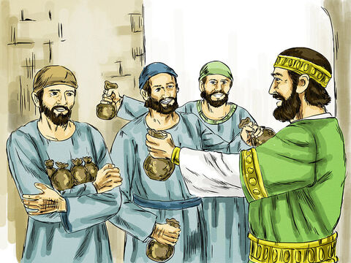
The Parable of the Three Servants
Matthew 25:14-30

Slide 4
Leader: A reading from
the Holy Gospel
according to Matthew.
All: Glory to You, Oh Lord.

Slide 5
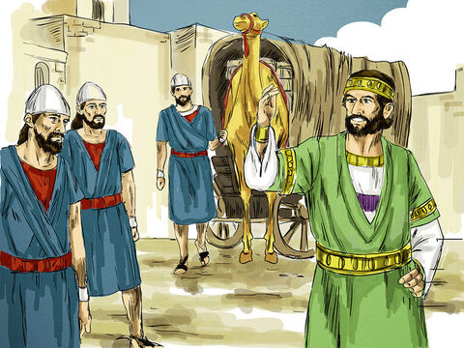
14
“At that time the Kingdom of heaven will be like this. Once there was a man who was about to leave home on a trip; he called his servants and put them in charge of his property.

Slide 6
15
He gave to each one according to his ability: to one he gave five thousand gold coins, to another he gave two thousand, and to another he gave one thousand. Then he left on his trip.

Slide 7
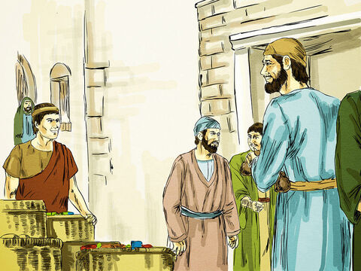
16
The servant who had received five thousand coins went at once and invested his money and earned another five thousand.

Slide 8
17
In the same way the servant who had received two thousand coins earned another two thousand.

Slide 9
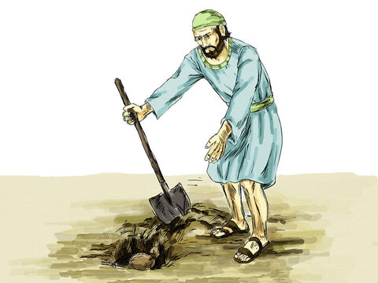
18
But the servant who had received one thousand coins went off, dug a hole in the ground, and hid his master's money.

Slide 10
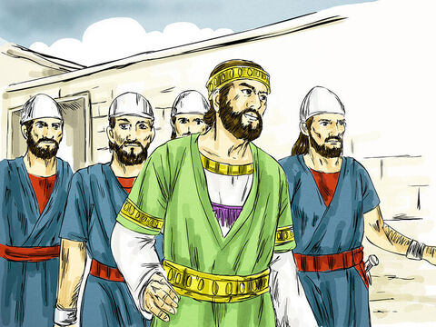
19
“After a long time the master of those servants came back and settled accounts with them.

Slide 11
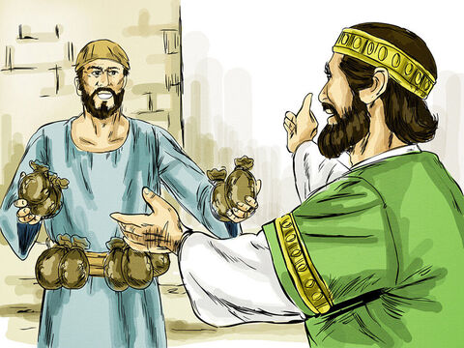
20
The servant who had received five thousand coins came in and handed over the other five thousand. ‘You gave me five thousand coins, sir,’ he said. ‘Look! Here are another five thousand that I have earned.’

Slide 12
21
‘Well done, you good and faithful servant!’ said his master. ‘You have been faithful in managing small amounts, so I will put you in charge of large amounts. Come on in and share my happiness!’

Slide 13
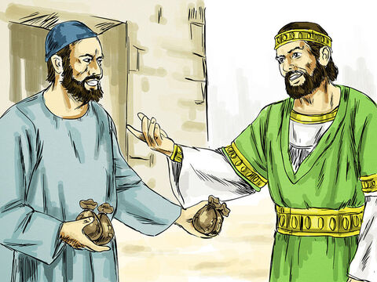
22
Then the servant who had been given two thousand coins came in and said, ‘You gave me two thousand coins, sir. Look! Here are another two thousand that I have earned.’

Slide 14
23
‘Well done, you good and faithful servant!’ said his master. ‘You have been faithful in managing small amounts, so I will put you in charge of large amounts. Come on in and share my happiness!’

Slide 15
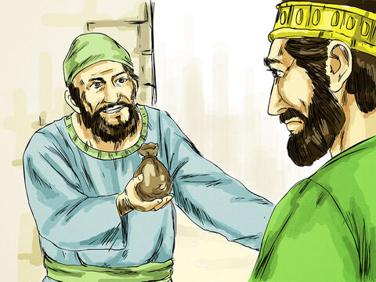
24
Then the servant who had received one thousand coins came in and said, ‘Sir, I know you are a hard man; you reap harvests where you did not plant, and you gather crops where you did not scatter seed.

Slide 16
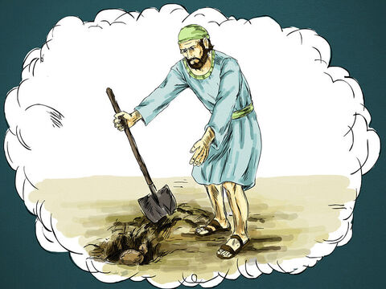
25
I was afraid, so I went off and hid your money in the ground. Look! Here is what belongs to you.’

Slide 17
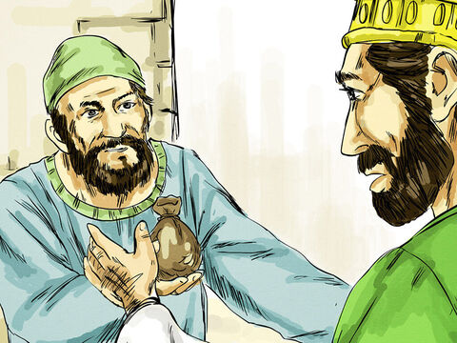
26
‘You bad and lazy servant!’ his master said. ‘You knew, did you, that I reap harvests where I did not plant, and gather crops where I did not scatter seed?

Slide 18
27
Well, then, you should have deposited my money in the bank, and I would have received it all back with interest when I returned.

Slide 19
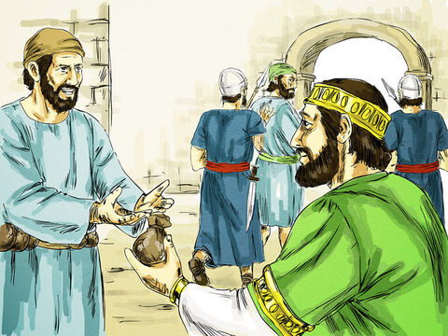
28
Now, take the money away from him and give it to the one who has ten thousand coins.

Slide 20
29
For to every person who has something, even more will be given, and he will have more than enough; but the person who has nothing, even the little that he has will be taken away from him.

Slide 21
30
As for this useless servant—throw him outside in the darkness; there he will cry and gnash his teeth.’

Slide 22
Leader: The Gospel of the Lord.
All: Praise to You,
Lord Jesus Christ.

Slide 23
GOSPEL MESSAGE

Slide 24
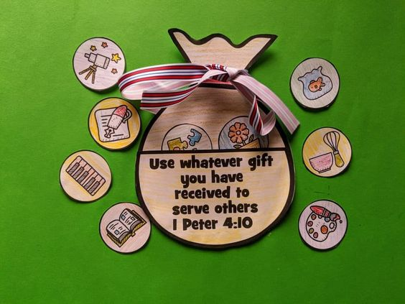
Activity:
Talent Bag
Construction paper or Colored Paper
Scissors
Pen or Marker
Glue
Coloring Materials
Ribbon

Slide 25
Instructions:
Draw a sack/bag and cut it out.
Make a small circles (it will be the coins) write or draw the talents you have that you want to share to others.
Cut out the coins and glue it on the sack/bag.
Design your talent bag

Slide 26
Closing Prayer
Dear God,
We thank You for giving all of us talents and skills. Please help us to see how we can use our talents for You. In Jesus’ name we pray,
Amen.

Slide 27
LIVE THE WORD KIDS
33rd Sunday in Ordinary Time | Cycle A

