Slide 1
LIVE THE WORD KIDS
32nd Sunday in Ordinary Time | Cycle A

Slide 2
GOSPEL REFLECTION
Wisdom allows us to recognize God’s plan and discern God’s presence. To be wise by the world’s standards is to have knowledge and show good judgement. To be wise by God’s standards is to know God’s will and act accordingly. That is how we prepare for the arrival of the Bridegroom, Jesus Christ.
The gift of wisdom helps us to conform our lives to God’s will so that we can be with the Lord forever. All our earthly life is preparation for the world to come. We do not know how long our earthly lives will be or the day on which they will end. Yet we do not grieve the end of this life because we know that Jesus has prepared a place for us that is beyond our ability to imagine, where we will see God face to face.

Slide 3
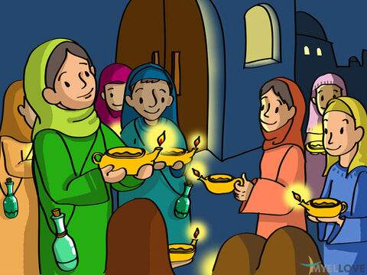
The Parable of the Ten Young Women
Matthew 25:1-13

Slide 4
Leader: A reading from
the Holy Gospel
according to Matthew.
All: Glory to You, Oh Lord.

Slide 5
1
“At that time the Kingdom of heaven will be like this. Once there were ten young women who took their oil lamps and went out to meet the bridegroom.

Slide 6
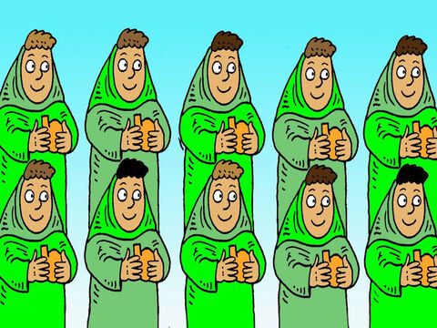
2
Five of them were foolish, and the other five were wise.

Slide 7
3
The foolish ones took their lamps but did not take any extra oil with them,

Slide 8
4
while the wise ones took containers full of oil for their lamps.

Slide 9
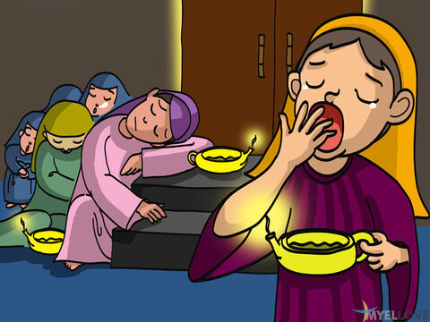
5
The bridegroom was late in coming, so they began to nod and fall asleep.

Slide 10
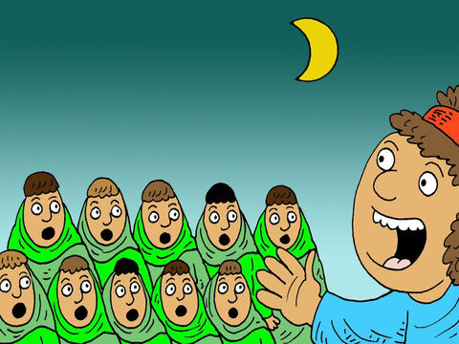
6
“It was already midnight when the cry rang out, ‘Here is the bridegroom! Come and meet him!’

Slide 11
7
The ten young women woke up and trimmed their lamps.

Slide 12
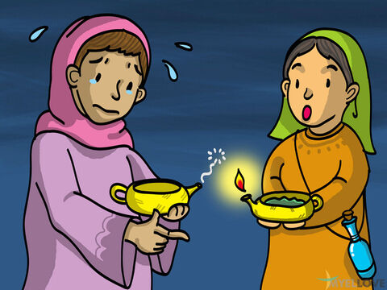
8
Then the foolish ones said to the wise ones, ‘Let us have some of your oil, because our lamps are going out.’

Slide 13
9
‘No, indeed,’ the wise ones answered, ‘there is not enough for you and for us. Go to the store and buy some for yourselves.’

Slide 14
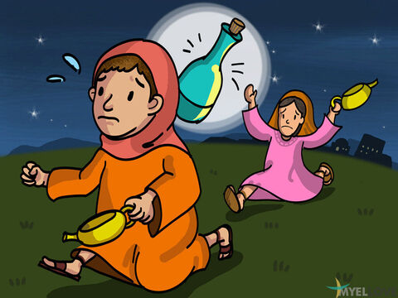
10
So the foolish ones went off to buy some oil; and while they were gone, the bridegroom arrived. The five who were ready went in with him to the wedding feast, and the door was closed.

Slide 15
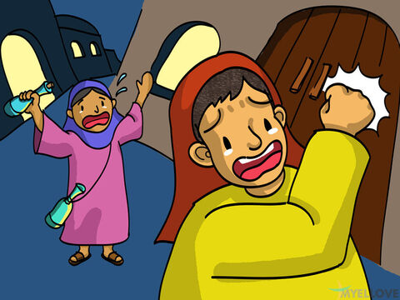
11
“Later the others arrived. ‘Sir, sir! Let us in!’ they cried out.

Slide 16
12
‘Certainly not! I don't know you,’ the bridegroom answered.”

Slide 17
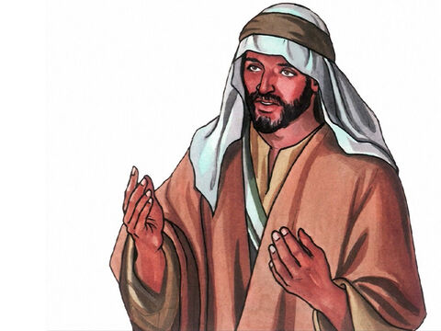
13
And Jesus concluded, “Watch out, then, because you do not know the day or the hour.

Slide 18
Leader: The Gospel of the Lord.
All: Praise to You,
Lord Jesus Christ.

Slide 19
GOSPEL MESSAGE

Slide 20
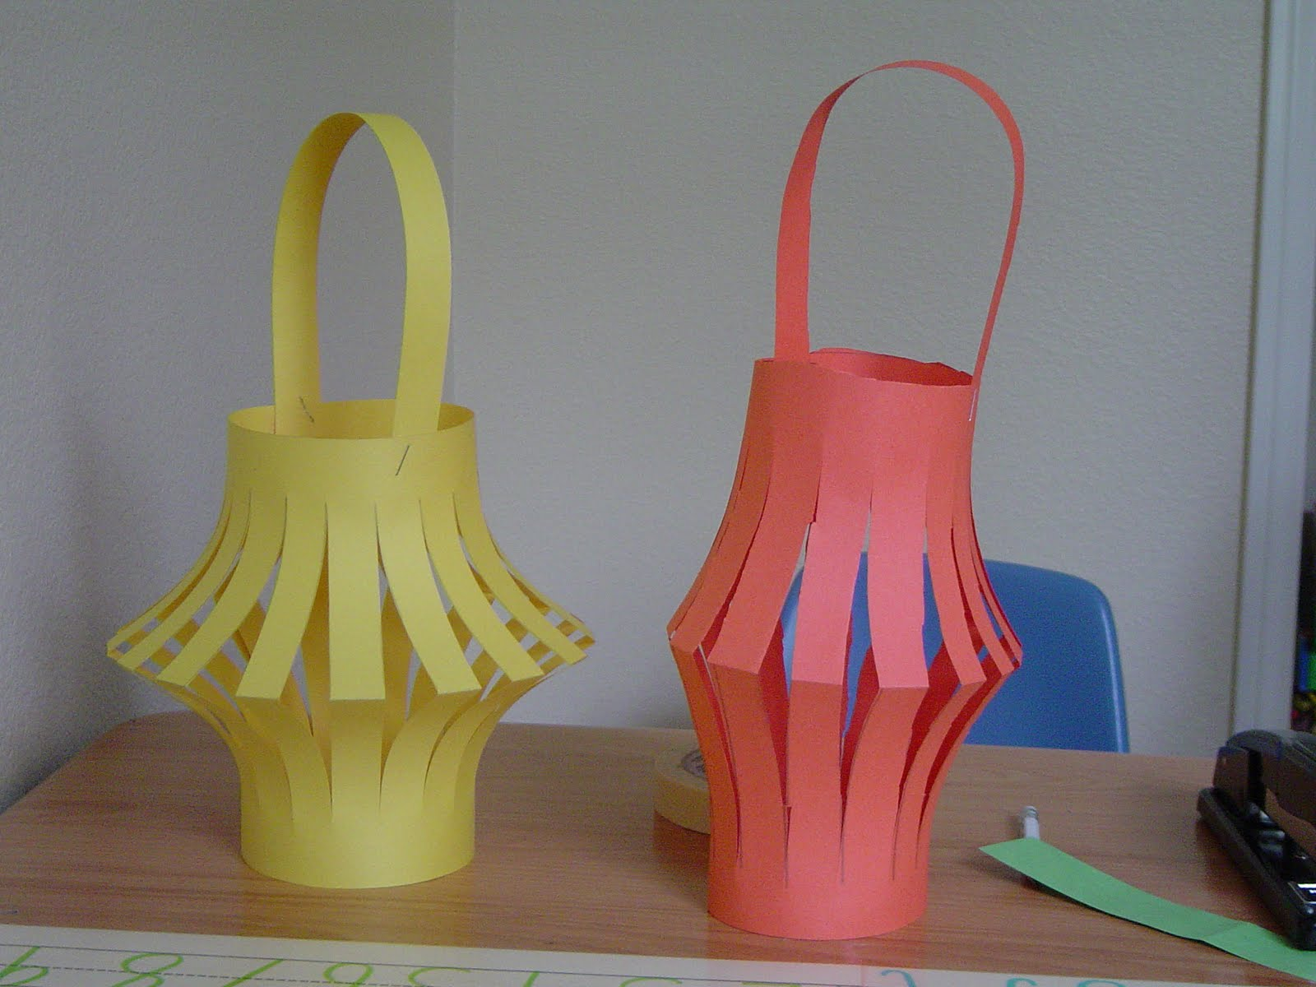
Activity:
Ready, Set, Wait! Lantern
Construction paper or Colored Paper
Scissors
Pen or Marker
Glue
Coloring Materials

Slide 21
Instructions:
Cut off a one inch (ish) strip from the top of the paper. Fold the paper in half and draw lines that go almost to the top.
cut the lines, cutting through two layers of paper at once.
Open the paper once it is cut and fold the ends together. You can also flip it "inside out" so that that pencil lines don't show on the outside. Staple the handle that you cut out earlier and staple the lantern closed
Decorate it.

Slide 22
Closing Prayer
Dear God,
We know one day we’ll get to meet you face to face. May we always be ready so we can welcome you when you come and arrive. May we always be alert and ready to see God and receive Him in our lives and in our hearts. Grant us the wisdom to know your will.
Amen.

Slide 23
LIVE THE WORD KIDS
32nd Sunday in Ordinary Time | Cycle A

