Slide 1
LIVE THE WORD KIDS
31st Sunday in Ordinary Time | Cycle A

Slide 2
GOSPEL REFLECTION
The gospel focuses on the difference between pride and humility. There’s nothing wrong with taking joy in hard work, but sinful pride occurs when we become self-absorbed, brag, and think that our actions can somehow save us. Being humble doesn’t mean that we beat ourselves up or constantly think negatively. It does mean recognizing that we live for Christ. This lesson reminds students to place others before themselves, and to place God at the head of all things.

Slide 3
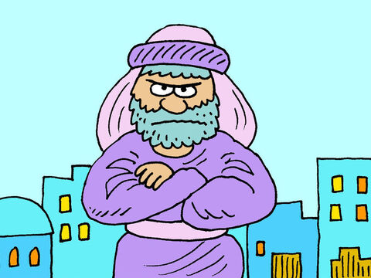
Jesus Warns Against the Teachers of the Law
and the Pharisees
Matthew 23:1-12

Slide 4
Leader: A reading from
the Holy Gospel
according to Matthew.
All: Glory to You, Oh Lord.

Slide 5
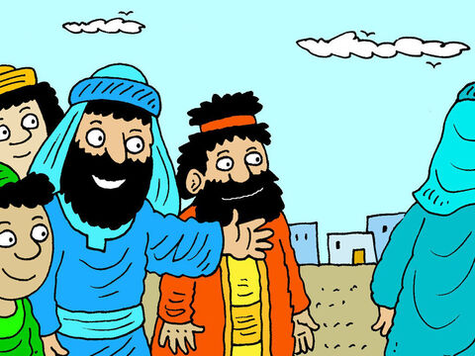
1
Then Jesus spoke to the crowds and to his disciples.

Slide 6
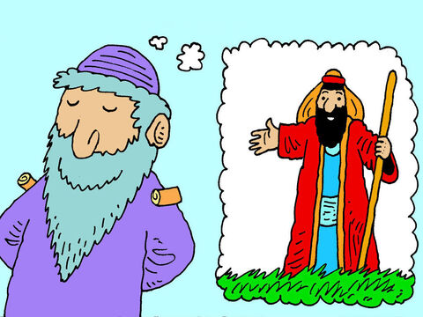
2
“The teachers of the Law and the Pharisees are the authorized interpreters of Moses' Law.

Slide 7
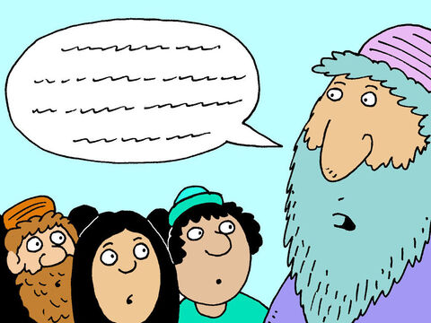
3
So you must obey and follow everything they tell you to do; do not, however, imitate their actions, because they don't practice what they preach.

Slide 8
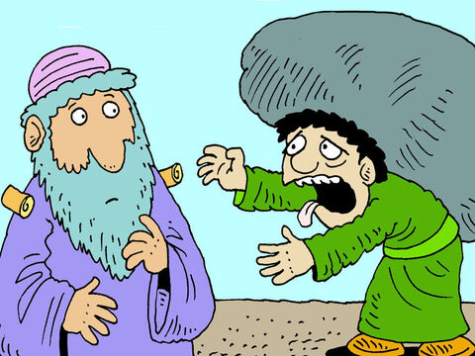
4
They tie onto people's backs loads that are heavy and hard to carry, yet they aren't willing even to lift a finger to help them carry those loads.

Slide 9
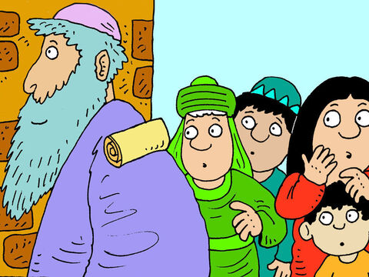
5
They do everything so that people will see them. Look at the straps with scripture verses on them which they wear on their foreheads and arms, and notice how large they are! Notice also how long are the tassels on their cloaks!

Slide 10
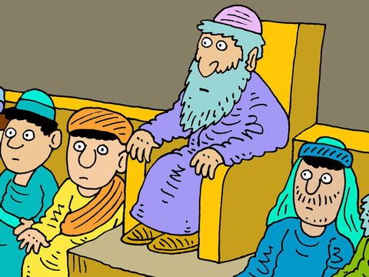
6
They love the best places at feasts and the reserved seats in the synagogues;

Slide 11
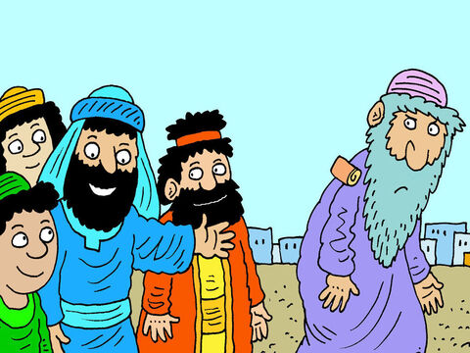
7
they love to be greeted with respect in the marketplaces and to have people call them ‘Teacher.’

Slide 12
8
You must not be called ‘Teacher,’ because you are all equal and have only one Teacher.

Slide 13
9
And you must not call anyone here on earth ‘Father,’ because you have only the one Father in heaven.

Slide 14
10
Nor should you be called ‘Leader,’ because your one and only leader is the Messiah.

Slide 15
11
The greatest one among you must be your servant.

Slide 16
12
Whoever makes himself great will be humbled, and whoever humbles himself will be made great.

Slide 17
Leader: The Gospel of the Lord.
All: Praise to You,
Lord Jesus Christ.

Slide 18
GOSPEL MESSAGE

Slide 19
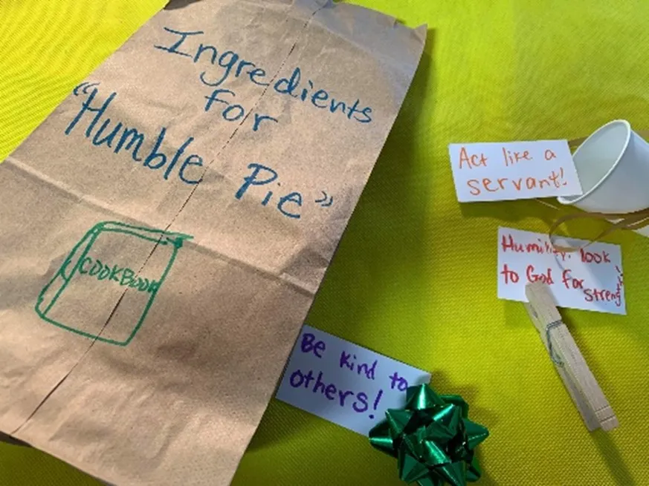
Activity:
Humble Pie Recipe
Construction paper or card stock
Scissors
Paper Bag
Pen or Marker
Glue
String or ribbon

Slide 20
Instructions:
Decorate the paper bag to be a “recipe bag” or “ingredient bag”, making it plain but fun!
Decorate notecards or papers to nestle within the bag, including notes about “ingredients” needed to be humble and not prideful.
Place the “humble pie ingredients” inside the paper bag.
Seal the bag with ribbon or string. Add captions or verses.
Use your bag to recall what humility means, or use it as a prayer request receptacle!

Slide 21
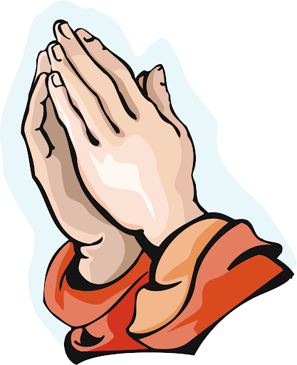
Closing Prayer
Dear God,
We thank You for the wisdom and guidance found in Your Word. May we not only be hearers of Your Word but also doers. Use us as instruments of Your love and grace, and may our actions bring glory to Your name.
Amen.

Slide 22
LIVE THE WORD KIDS
31st Sunday in Ordinary Time | Cycle A

