Slide 1
LIVE THE WORD KIDS
Solemnity of the Ascension of the Lord | Cycle A

Slide 2
GOSPEL REFLECTION
All of us are called to love and serve one another, and to share the Gospel with those around us. This might be people far away, or it might be those close to us! There are so many ways we can communicate God’s love. We can tell people about God, and we can also live as His people by demonstrating genuine care for one another. Everyone, everywhere is our mission field!
And remember, I am with you always, to the end of the age. These are the last words of the gospel according to Matthew. Jesus wants us to remember that whatever happens and however difficult the circumstances of our life are, he will never leave us.

Slide 3
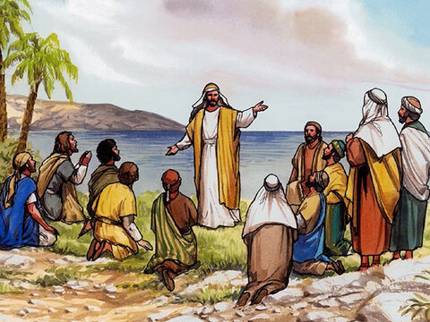
Jesus Appears to His Disciples
Matthew 28:16-20

Slide 4
Leader: A reading from
the Holy Gospel
according to Matthew.
All: Glory to You, Oh Lord.

Slide 5
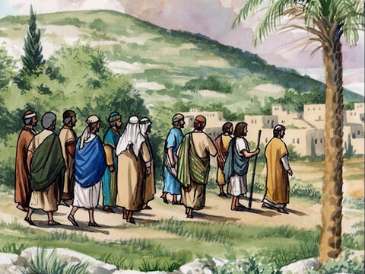
16
The eleven disciples went to the hill in Galilee where Jesus had told them to go.

Slide 6
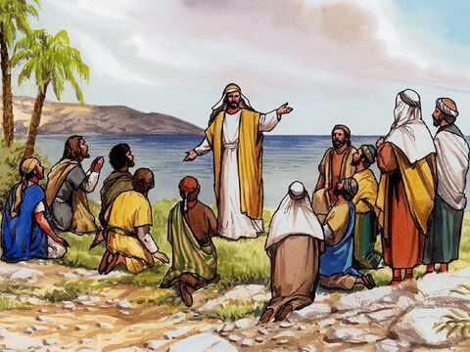
17
When they saw him, they worshiped him, even though some of them doubted.

Slide 7
18
Jesus drew near and said to them, “I have been given all authority in heaven and on earth.

Slide 8
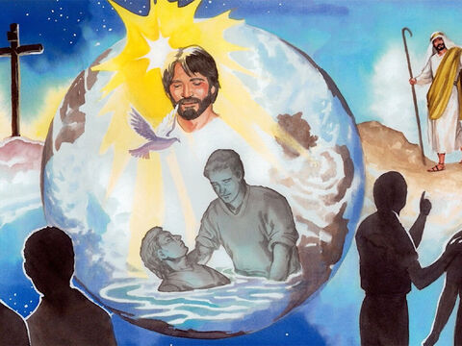
19
Go, then, to all peoples everywhere and make them my disciples: baptize them in the name of the Father, the Son, and the Holy Spirit,

Slide 9
20
and teach them to obey everything I have commanded you. And I will be with you always, to the end of the age.”

Slide 10
Leader: The Gospel of the Lord.
All: Praise to You,
Lord Jesus Christ.

Slide 11
GOSPEL MESSAGE

Slide 12
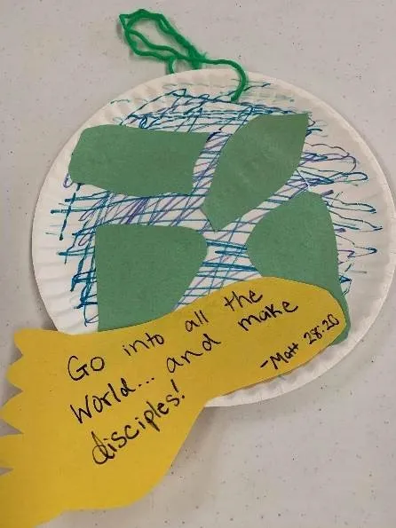
Activity:
Commission Globe
Colored Paper
Paper Plate
Coloring Materials
Scissors
Glue
Pen

Slide 13
Instructions:
Decorate the plate to look like a globe, beginning with blue marker or crayon.
Add green “land” with cut paper or additional color.
Trace a foot on a sheet of paper. Cut and write the verse “Go, then, to all peoples everywhere and make them my disciples”.
Attach the foot to the globe with tape or glue.

Slide 14
Closing Prayer
Dear God,
Please help us to love and serve others
Those near us, and around the world
Thank you for allowing us to be part of your great plan
Help us to share the good news
And spread your love to one another
Thank you for your love
We love you, God!
In Jesus name,
Amen!

Slide 15
LIVE THE WORD KIDS
Solemnity of the Ascension of the Lord | Cycle A

