Slide 1
LIVE THE WORD KIDS
Sixth Sunday of Easter | Cycle A

Slide 2
GOSPEL REFLECTION
We don’t see God with our eyes, but we know that His Spirit lives in us, and we can feel that. The Holy Spirit helps us to pray, guides us, and comforts us. We know that God is present always. He is always at work in our lives, and He will come back one day!
For now, we will take the comforting reminder that He never leaves us. We can also show evidence of having that Holy Spirit within us. As we demonstrate love to one another, and as we follow God’s rules and commandments, we prove that the Spirit is alive and working everywhere, and we prove our love for Jesus.

Slide 3
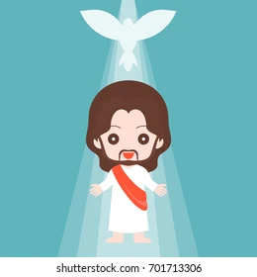
The Promise of the Holy Spirit
John 14:15-21

Slide 4
Leader: A reading from
the Holy Gospel
according to John.
All: Glory to You, Oh Lord.

Slide 5
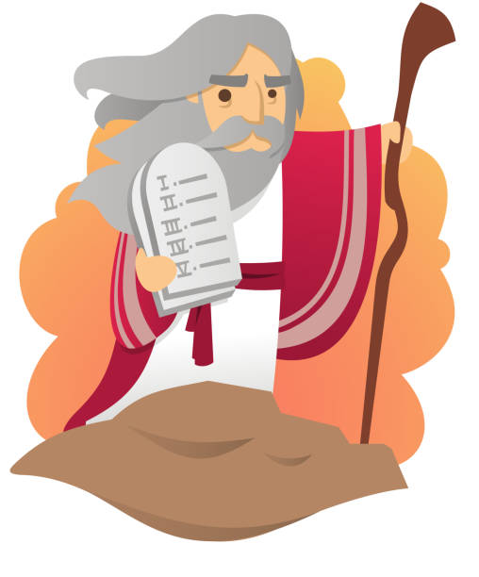
15
“If you love me, you will obey my commandments.

Slide 6
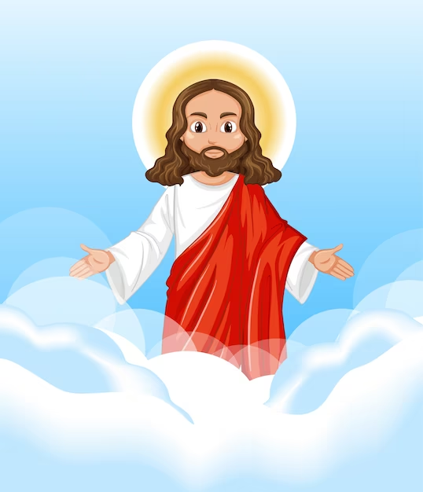
16
I will ask the Father, and he will give you another Helper, who will stay with you forever.

Slide 7
17
He is the Spirit, who reveals the truth about God. The world cannot receive him, because it cannot see him or know him. But you know him, because he remains with you and is in you.

Slide 8
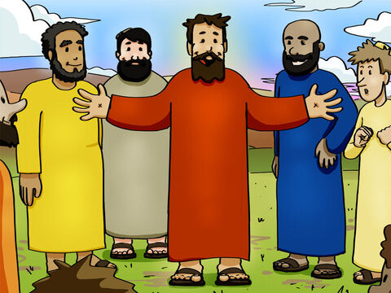
18
“When I go, you will not be left all alone; I will come back to you.

Slide 9
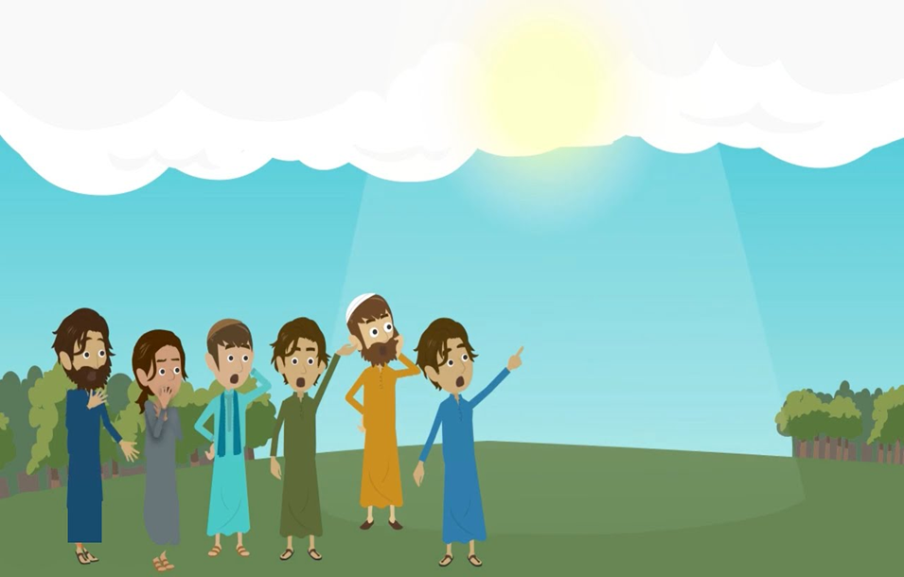
19
In a little while the world will see me no more, but you will see me; and because I live, you also will live.

Slide 10
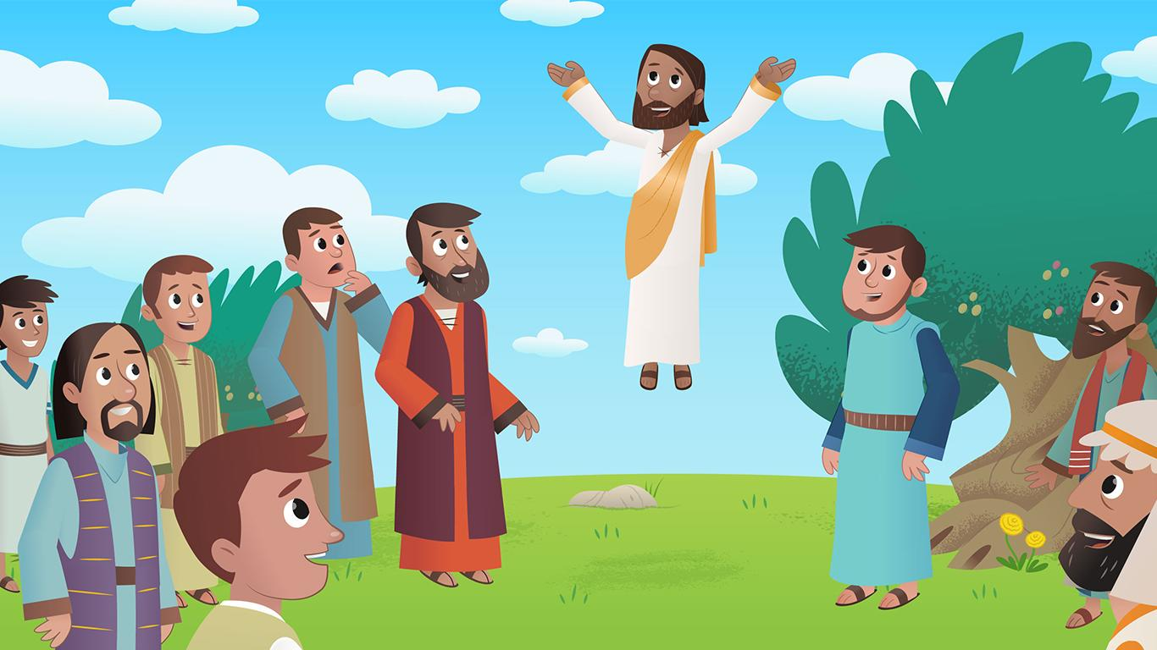
20
When that day comes, you will know that I am in my Father and that you are in me, just as I am in you.

Slide 11
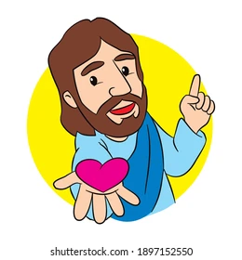
21
“Those who accept my commandments and obey them are the ones who love me. My Father will love those who love me; I too will love them and reveal myself to them.”

Slide 12
Leader: The Gospel of the Lord.
All: Praise to You,
Lord Jesus Christ.

Slide 13
GOSPEL MESSAGE

Slide 14
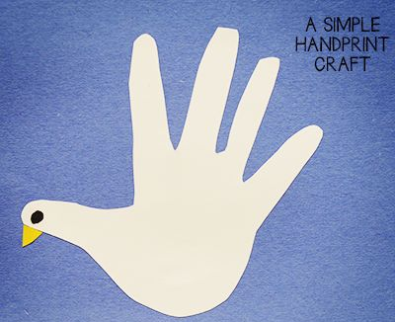
Activity:
Promise To Holy Spirit
Colored Paper
Bond Paper
Scissors
Glue
Marker

Slide 15
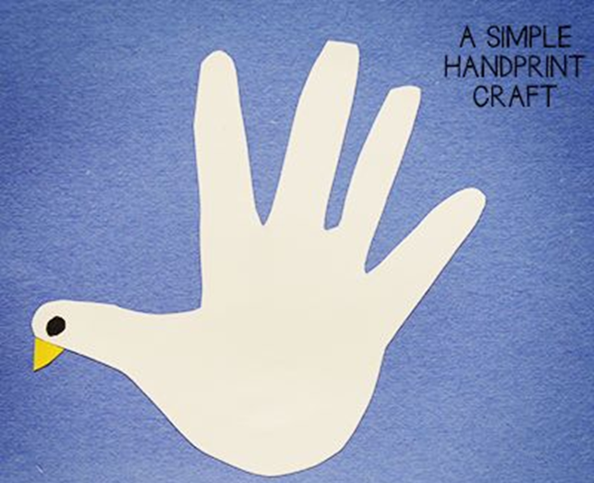
Instructions:
Trace your hand in a white bond paper and cut it out.
Put a dot on the thumb part of your hand.
Cut a small triangle in a yellow colored paper and glue it on the thumb part of your hand.

Slide 16
Closing Prayer
Dear God,
Thank you for all of the words of Jesus
Thank you for the comfort of your Spirit
Help us to remember what that means
And to live always in your presence
Thank you for your love
We love you, God!
In Jesus name,
Amen!

Slide 17
LIVE THE WORD KIDS
Sixth Sunday of Easter | Cycle A

