Slide 1
LIVE THE WORD KIDS
Fifth Sunday of Easter | Cycle A

Slide 2
GOSPEL REFLECTION
Jesus wanted us to know that He had to leave, but that He is
coming back.
Jesus also wanted us to know that there is room for any of us
who want to come, in Heaven with God the Father.
Jesus wanted us to know that He is the Way to the Father

Slide 3
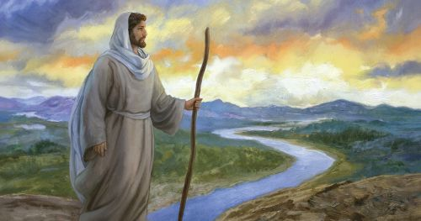
Jesus the Way to the Father
John 14:1-12

Slide 4
Leader: A reading from
the Holy Gospel
according to John.
All: Glory to You, Oh Lord.

Slide 5
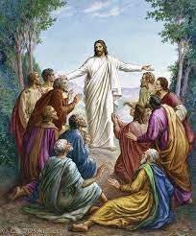
1
“Do not be worried and upset,” Jesus told them.
“Believe in God and believe also in me.

Slide 6
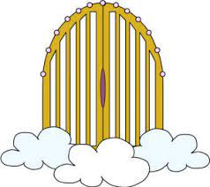
2
There are many rooms in my Father's house, and I am going to prepare a place for you. I would not tell you this if it were not so.

Slide 7
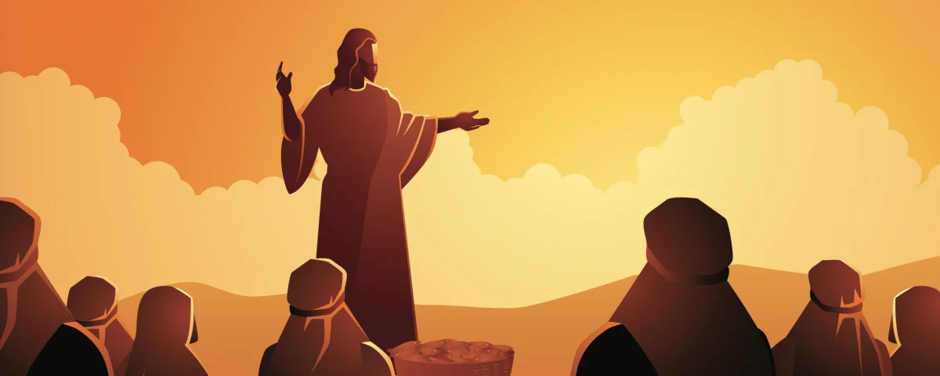
3
And after I go and prepare a place for you, I will come back and take you to myself, so that you will be where I am.

Slide 8
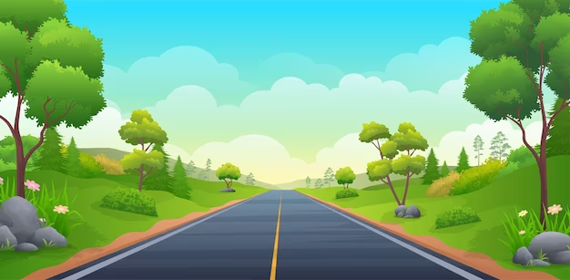
4
You know the way that leads to the place where I am going.”

Slide 9
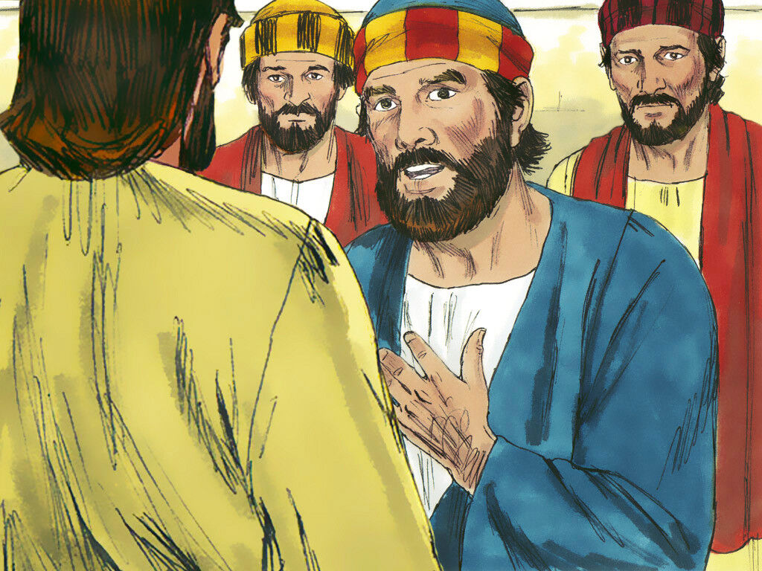
5
Thomas said to him,
“Lord, we do not know where you are going; so how can we know the way to get there?”

Slide 10
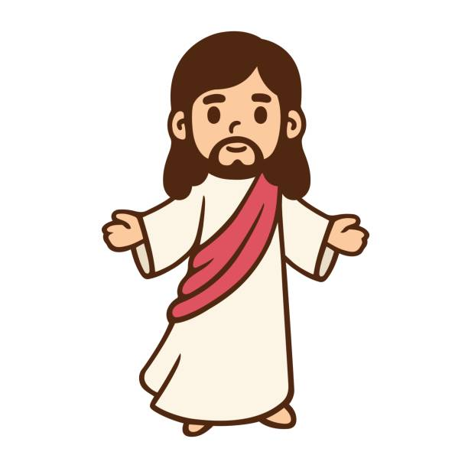
6
Jesus answered him, “I am the way, the truth, and the life; no one goes to the Father except by me.

Slide 11
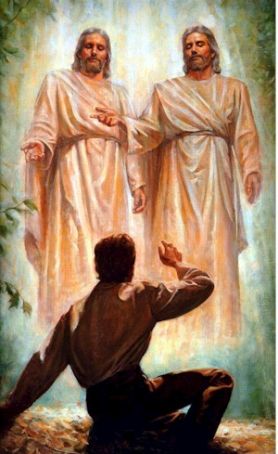
7
Now that you have known me,” he said to them, “you will know my Father also, and from now on you do know him and you have seen him.”

Slide 12
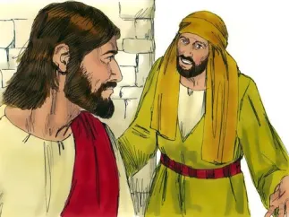
8
Philip said to him,
“Lord, show us the Father; that is all we need.”

Slide 13
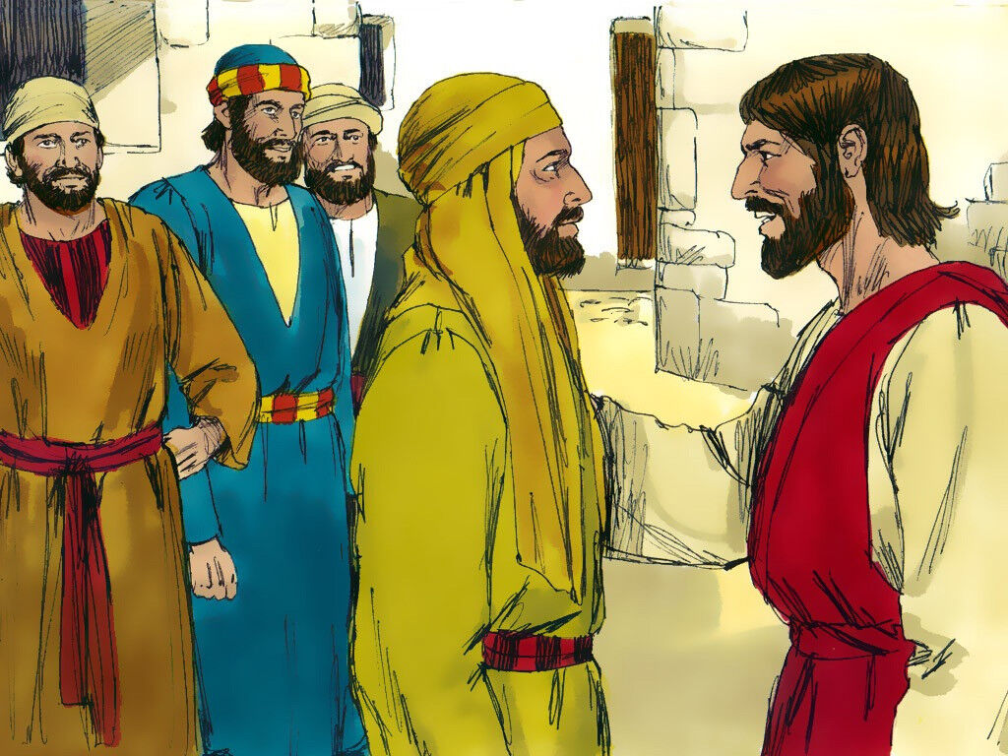
9
Jesus answered, “For a long time I have been with you all; yet you do not know me, Philip? Whoever has seen me has seen the Father. Why, then, do you say, ‘Show us the Father’?

Slide 14
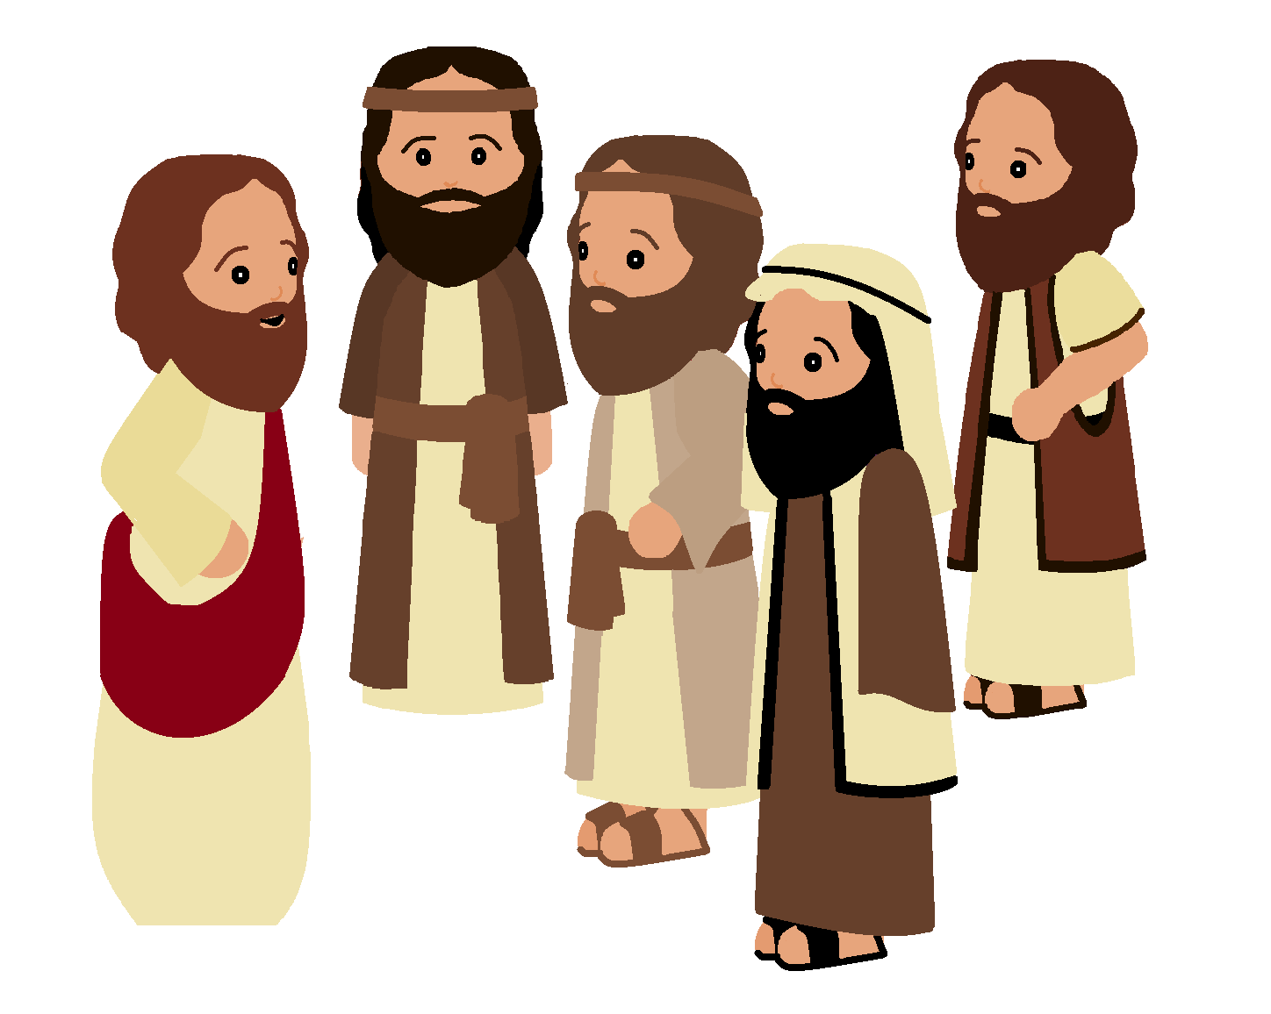
10
Do you not believe, Philip, that I am in the Father and the Father is in me? The words that I have spoken to you,” Jesus said to his disciples, “do not come from me. The Father, who remains in me, does his own work.

Slide 15
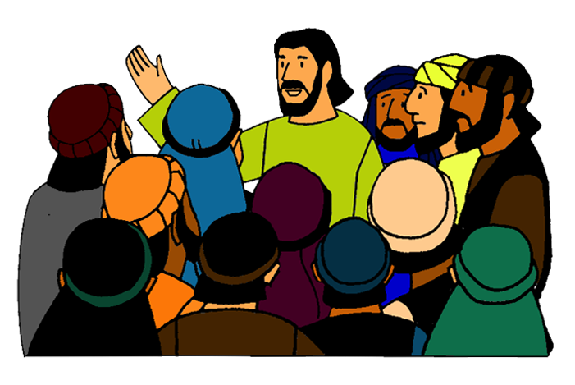
11
Believe me when I say that I am in the Father and the Father is in me. If not, believe because of the things I do.

Slide 16
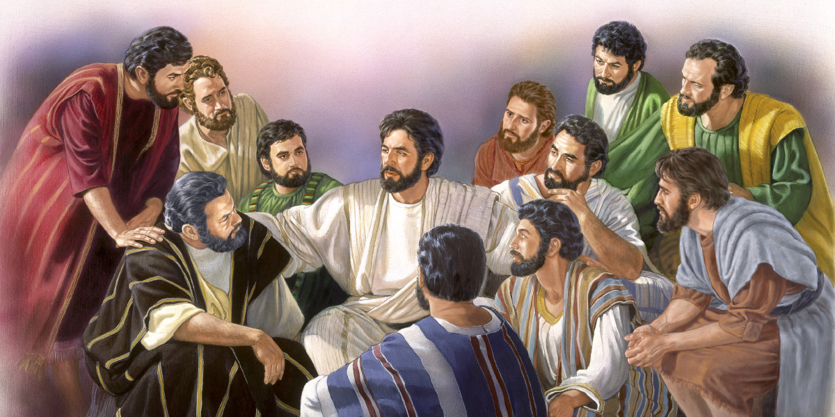
12
I am telling you the truth: those who believe in me will do what I do—yes, they will do even greater things, because I am going to the Father.

Slide 17
Leader: The Gospel of the Lord.
All: Praise to You,
Lord Jesus Christ.

Slide 18
GOSPEL MESSAGE

Slide 19
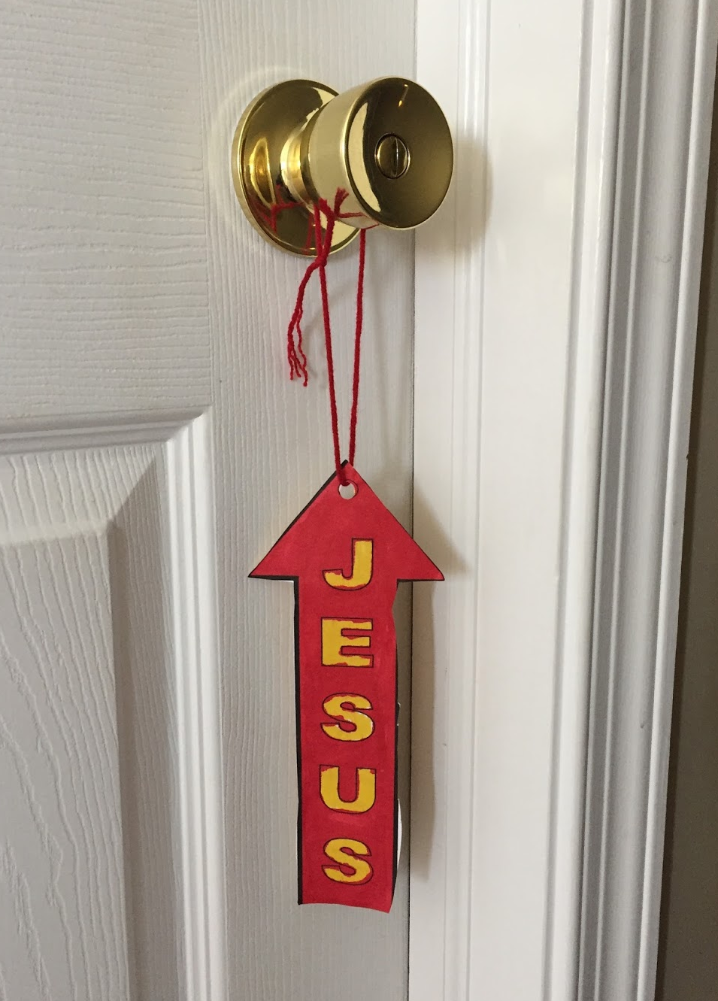
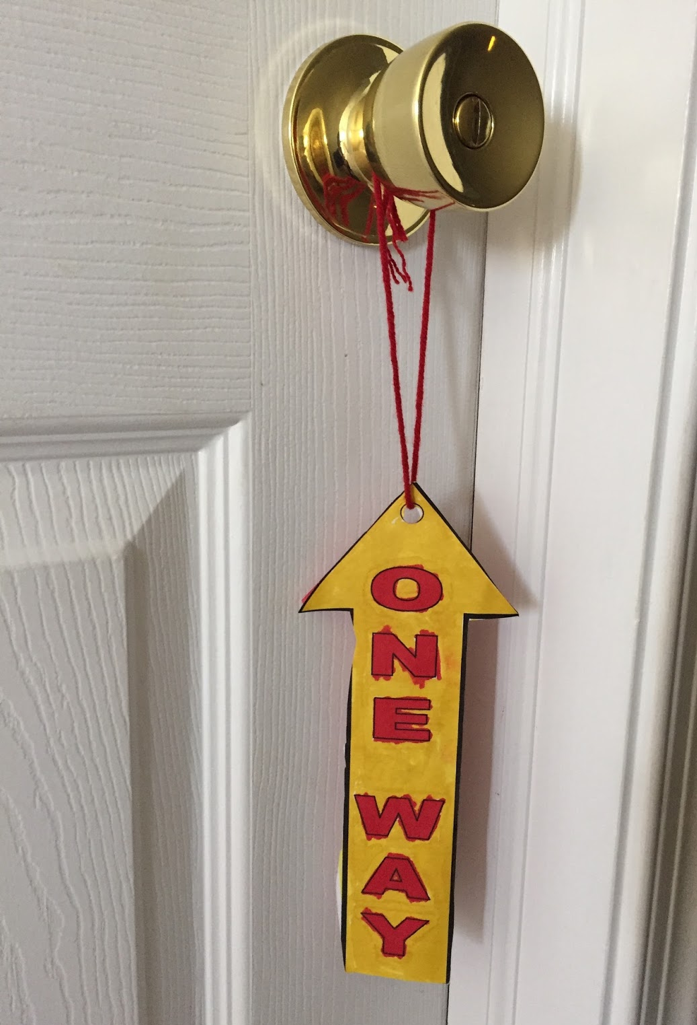
Activity:
One Way Door Knob Hanger
Colored Paper
Bond Paper
Scissors
Glue
Pen and Crayons
Yarn

Slide 20
Instructions:
Cut out two same size arrows sign.
Glue your arrow sign to stick the two sides of the sign together, back-to-back
Write on one side “Jesus” and on the other side “One Way.”
Color it and add design to your arrow sign.
Punch a hole in the top of the arrows at the circle.
Place a loop of yarn through the hole and tie its ends together in a knot.

Slide 21
Closing Prayer
Dear God,
Thank you that you love us. Thank you for sending Jesus, your Son. Thank you that He is the Way to you to heaven. Thank you that because of Jesus we can be with you forever. Teach us to follow your way always.
Amen.

Slide 22
LIVE THE WORD KIDS
Fifth Sunday of Easter | Cycle A

