Slide 1
LIVE THE WORD KIDS
5th Sunday of Lent | Cycle A

Slide 2
GOSPEL REFLECTION
Lazarus has died, the brother of Mary and Martha, and the friend of Jesus. But the sisters and the Son of God saw the situation differently. They lamented that, if Jesus had been present, before he died, he could have cured him. But he was not alarmed, saying “Your brother will rise again”. Death for them had to run its course. Jesus reminds us many times that, if we have faith, nothing is impossible. Martha’s faith is indomitable. Knowing that the tomb contains the decomposing body of her beloved brother, she can still summon up the words, “even now I know that God will give you whatever you ask of him”. Do I truly believe that anything is possible for one who believes?
There are several significant things that happen in our Gospel. We see that Jesus is “deeply moved.” He loved Lazarus, and loved Martha and Mary. He wept, genuinely crying and grieving for His friend. We can know that Jesus loves us, too, and feels sad with us when we are sad. But Jesus does something else…He goes to the tomb, calls to Lazarus, and brings him back to life! He had clearly died and been buried, but through Christ he returned to life.In the case of Lazarus or Jesus, pain and hardship, and even death, took place, but ultimately restoration came, too. What does this say about our lives? Things might be challenging, but one day God is going to bring all things together and make a whole new world for us. That is a promise we can believe and take to heart. When we believe and trust God, we can be assured of eventual blessing. Life on Earth is still hard. It’s a broken, sinful, messed-up world. But God is in control!

Slide 3
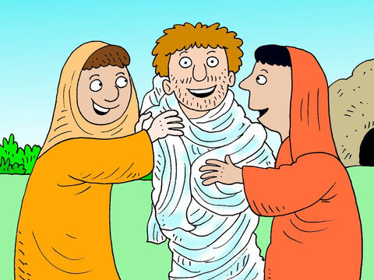
The Raising of Lazarus
John 11:3-7,17,20-27,33-45

Slide 4
Leader: A reading from
the Holy Gospel
according to John.
All: Glory to You, Oh Lord.

Slide 5
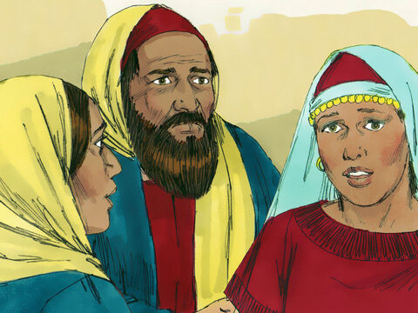
3
The sisters of Lazarus sent Jesus a message: “Lord, your dear friend is sick.”

Slide 6
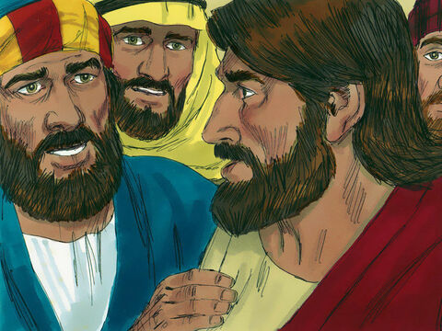
4
When Jesus heard it, he said, “The final result of this sickness will not be the death of Lazarus; this has happened in order to bring glory to God, and it will be the means by which the Son of God will receive glory.”

Slide 7
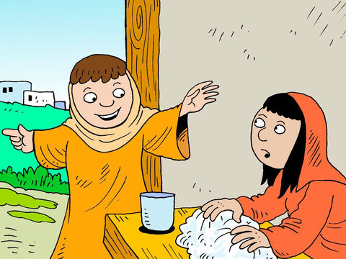
5
Jesus loved Martha and her sister and Lazarus.

Slide 8
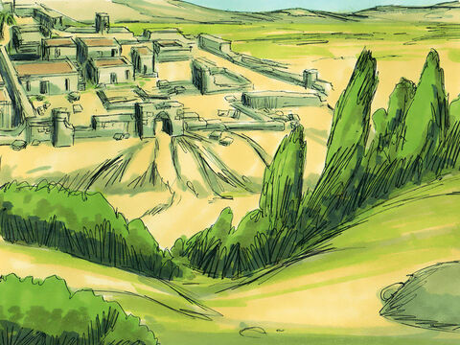
6
Yet when he received the news that Lazarus was sick, he stayed where he was for two more days.

Slide 9
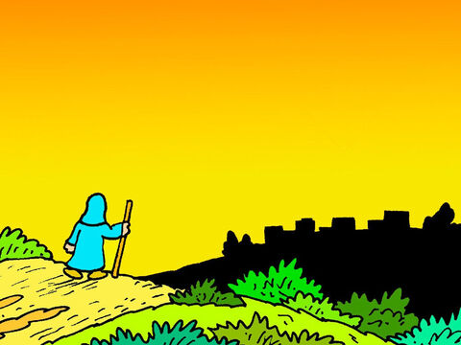
7
Then he said to the disciples, “Let us go back to Judea.”

Slide 10
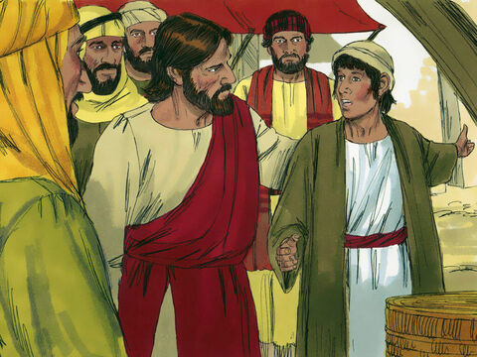
17
When Jesus arrived, he found that Lazarus had been buried four days before.

Slide 11
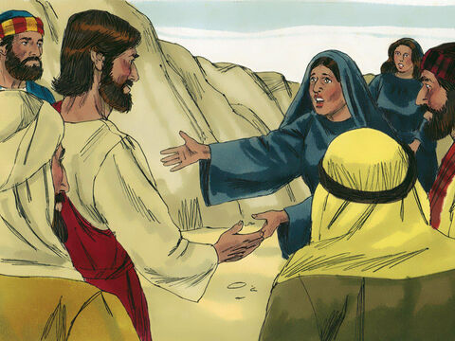
20
When Martha heard that Jesus was coming, she went out to meet him, but Mary stayed in the house.

Slide 12
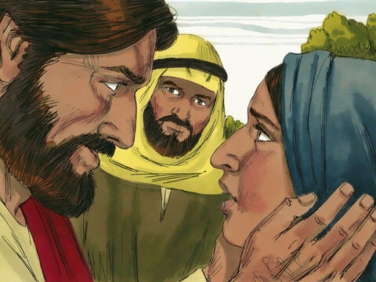
21
Martha said to Jesus,
“If you had been here, Lord, my brother would not have died!

Slide 13
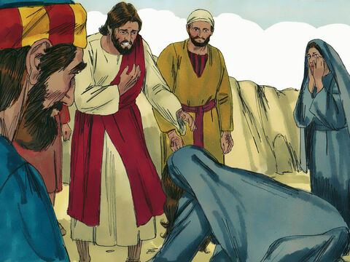
22
But I know that even now God will give you whatever you ask him for.”

Slide 14
23
“Your brother will rise to life,” Jesus told her.

Slide 15
33
Jesus saw her weeping, and he saw how the people with her were weeping also; his heart was touched, and he was deeply moved.

Slide 16
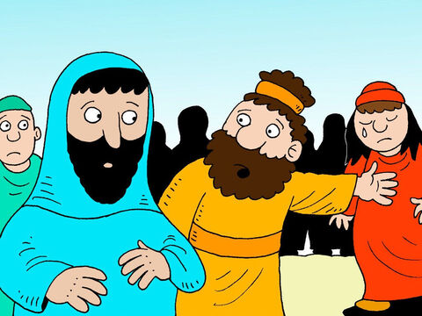
34
“Where have you buried him?”
he asked them.
“Come and see, Lord,” they answered.

Slide 17
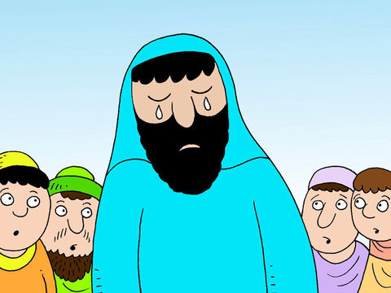
35
Jesus wept.

Slide 18
36
See how much he loved him!” the people said.

Slide 19
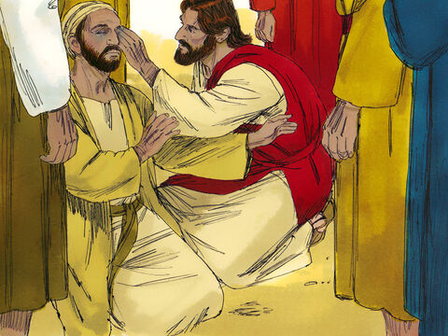
37
But some of them said,
“He gave sight to the blind man, didn't he? Could he not have kept Lazarus from dying?”

Slide 20
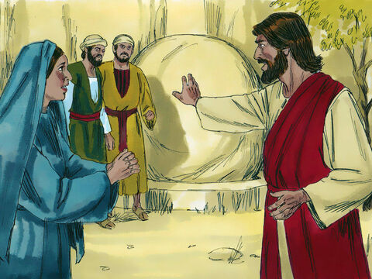
38
Deeply moved once more, Jesus went to the tomb, which was a cave with a stone placed at the entrance.

Slide 21
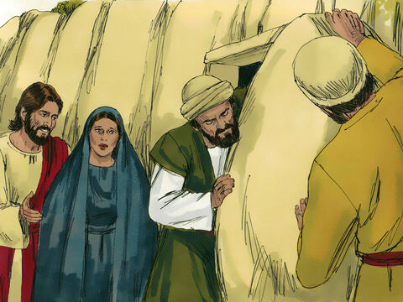
39
“Take the stone away!” Jesus ordered.
Martha, the dead man's sister, answered, “There will be a bad smell, Lord. He has been buried four days!”

Slide 22
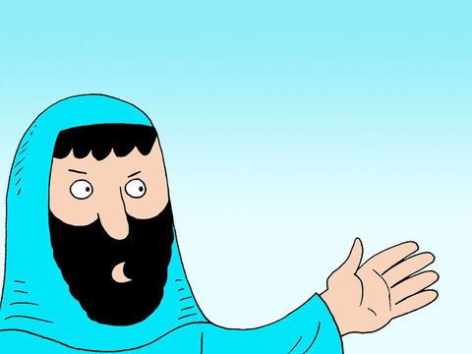
40
Jesus said to her, “Didn't I tell you that you would see God's glory if you believed?”

Slide 23
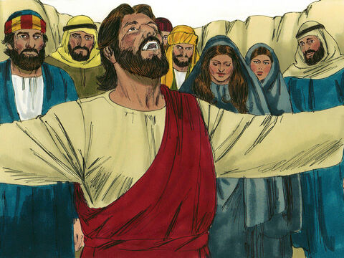
41
They took the stone away. Jesus looked up and said, “I thank you, Father, that you listen to me.

Slide 24
42
I know that you always listen to me, but I say this for the sake of the people here, so that they will believe that you sent me.”

Slide 25
43
After he had said this, he called out in a loud voice, “Lazarus, come out!”

Slide 26
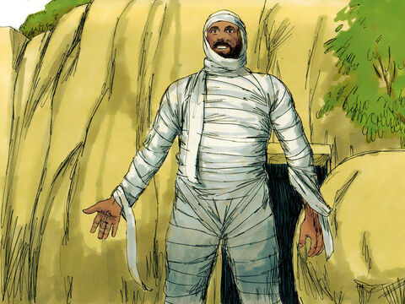
44
He came out, his hands and feet wrapped in grave cloths, and with a cloth around his face. “Untie him,” Jesus told them, “and let him go.”

Slide 27
45
Many of the people who had come to visit Mary saw what Jesus did, and they believed in him.

Slide 28
Leader: The Gospel of the Lord.
All: Praise to You,
Lord Jesus Christ.

Slide 29
GOSPEL MESSAGE

Slide 30
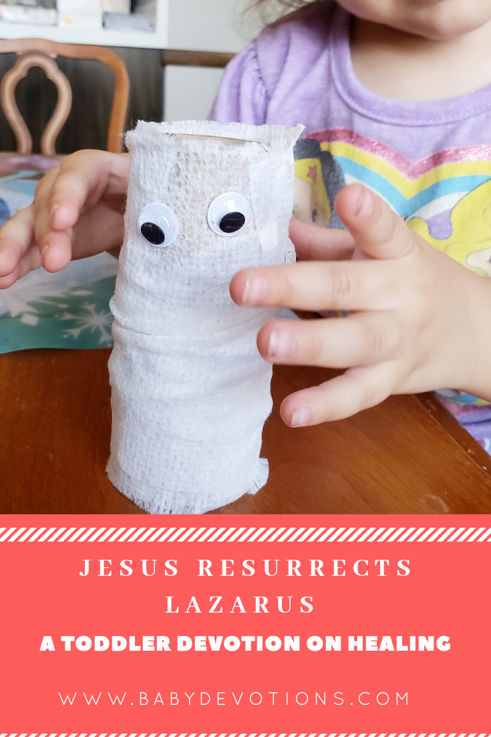
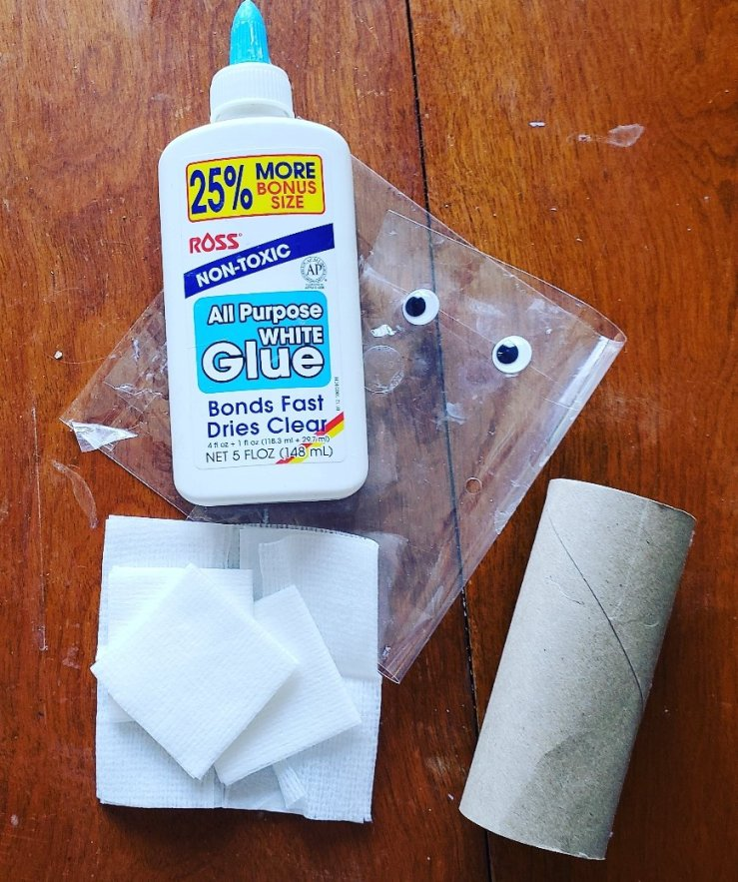
Activity:
Lazarus Craft
Paper tube
Gauze
Googly eyes
White Glue

Slide 31
Instructions:
Put glue all over paper tube. Your child can help. Squeezing the glue bottle builds fine-motor skills.
Wrap gauze around the paper tube.
Finally, glue on some googly eyes!

Slide 32
Closing Prayer
Dear God,
Thank you for your unending love for us! it is comforting to know that when we cry, You cry with us. But it is even more comforting to know that You have power over death and the grave and that one day we will be in heaven with You--and then there will be no more tears.
In Jesus’ name, Amen!

Slide 33
LIVE THE WORD KIDS
5th Sunday of Lent | Cycle A

