Slide 1
LIVE THE WORD KIDS
4th Sunday of Lent | Cycle A

Slide 2
GOSPEL REFLECTION
For this week’s Gospel lesson story, we will focus on the importance of keeping our eyes open. The miraculous healing of a man born blind is great, but that is not the only thing happening in this passage. Jesus is defying social norms, as He so often does. He opens the eyes of the blind man, but the eyes of others remain closed and refuse to acknowledge what is in their midst. Nothing is wrong with their vision, but they cannot see. For kids, we want to help them understand how to be aware of the needs of others around us. We should all seek to recognize God’s hand in our lives and in the world around us. God’s love gives us sight.

Slide 3
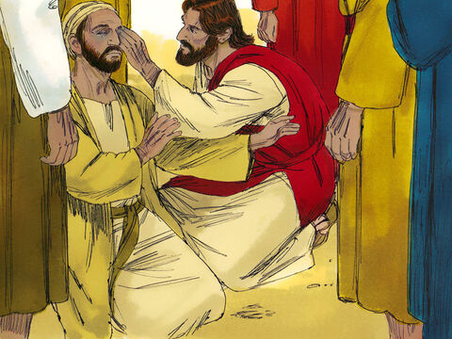
Jesus Heals a Man Born Blind
John 9: 1, 6-9, 13-17, 34-38

Slide 4
Leader: A reading from
the Holy Gospel
according to John.
All: Glory to You, Oh Lord.

Slide 5
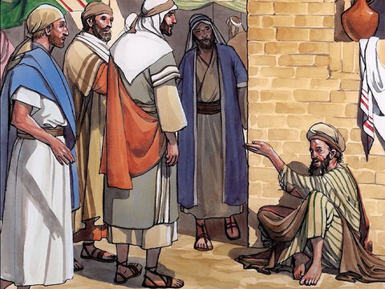
1
As Jesus passed by he saw a man blind from birth.

Slide 6
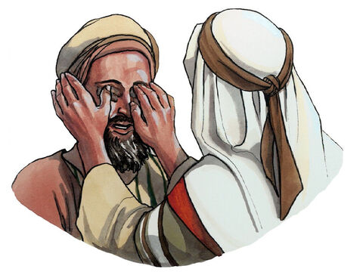
6
Jesus spat on the ground and made clay with the saliva, and smeared the clay on his eyes.

Slide 7
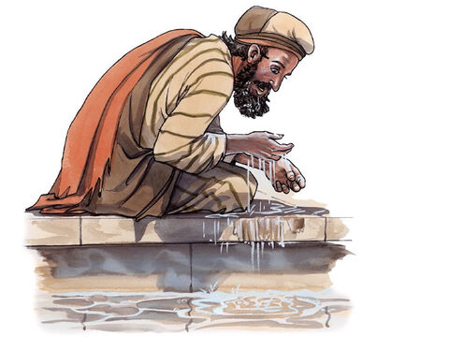
7
And said to him, “Go wash in the Pool of Siloam” (which means Sent). So he went and washed, and came back able to see.

Slide 8
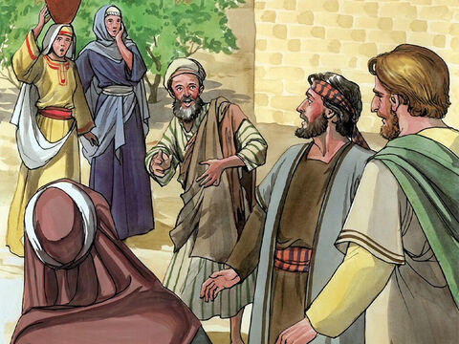
8
His neighbors and those who had seen him earlier as a beggar said, “Isn’t this the one who used to sit and beg?”

Slide 9
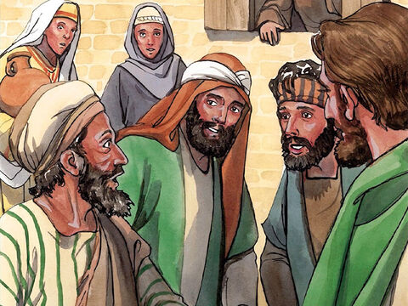
9
Some said, “It is,” but others said, “No, he just looks like him.”
He said, “I am.”

Slide 10
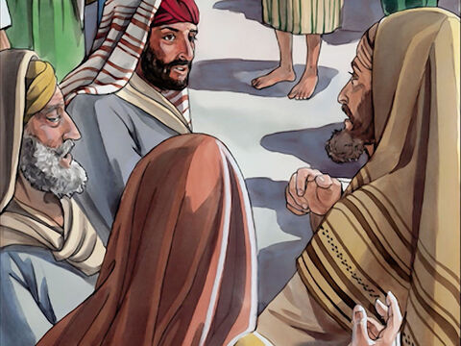
13
They brought the one who was once blind to the Pharisees.

Slide 11
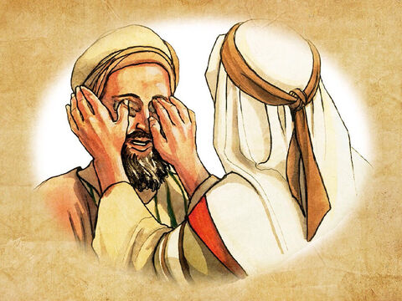
14
Now Jesus had made clay and opened his eyes on a sabbath.

Slide 12
15
So then the Pharisees also asked him how he was able to see. He said to them, “He put clay on my eyes, and I washed, and now I can see.”

Slide 13
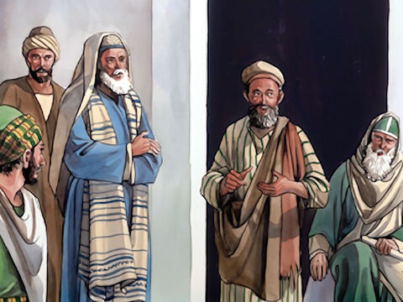
16
So some of the Pharisees said,
“This man is not from God, because he does not keep the sabbath.” But others said,
“How can a sinful man do such signs?”
And there was a division among them.

Slide 14
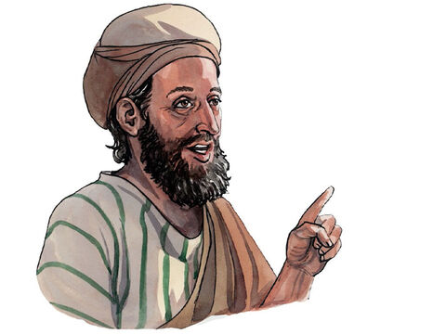
17
So they said to the blind man again, “What do you have to say about him, since he opened your eyes?”
He said,
“He is a prophet.”

Slide 15
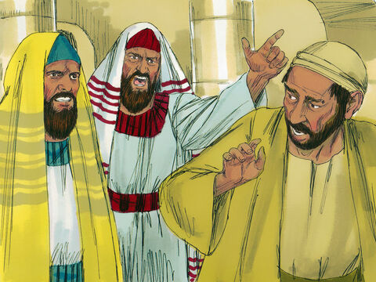
34
They answered and said to him, “You were born totally in sin, and are you trying to teach us?” Then they threw him out.

Slide 16
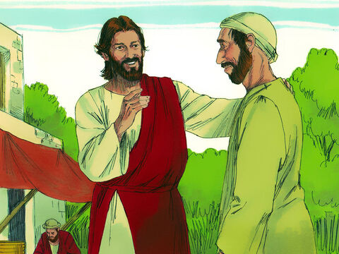
35
When Jesus heard that they had thrown him out, he found him and said, “Do you believe in the Son of Man?”

Slide 17
36
He answered and said, “Who is he, sir, that I may believe in him?”

Slide 18
37
Jesus said to him, “You have seen him and the one speaking with you is he.”

Slide 19
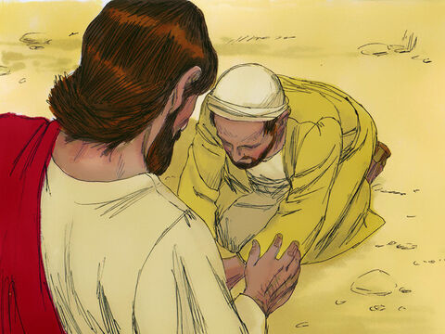
38
He said,
“I do believe, Lord,” and he worshiped him.

Slide 20
Leader: The Gospel of the Lord.
All: Praise to You,
Lord Jesus Christ.

Slide 21
GOSPEL MESSAGE

Slide 22
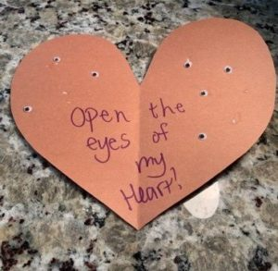
Activity:
The Eyes of the Heart
Paper, paper plates, or cardstock
Scissors
Glue
Google eyes
Decorative materials (markers, fabric paint)

Slide 23
Instructions:
Cut the paper or paper plate into a heart shape.
Decorate the heart, adding a verse or caption as well as pictures.
Glue eyes onto the heart, using just a pair or several eyes.
Hang to display, if desired, as a reminder of the Gospel Story.
Notes:
Jesus healed the man’s vision, but there were others watching who refused to “see” what happened. God wants us to look not only with our eyes, but with our hearts. This means we are to pay attention to those around us, as well as to God’s work in our lives.

Slide 24
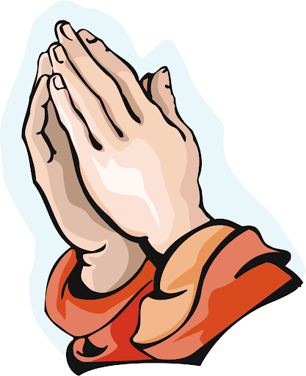
Closing Prayer
Dear God,
Help us to see those around us who need Your love. Open the eyes of our hearts so we will be able to recognize your goodness and to appreciate what You have done in our lives. Keep us and our family safe always.
We love you, God!
In Jesus’s name, Amen!

Slide 25
LIVE THE WORD KIDS
4th Sunday of Lent | Cycle A

