Slide 1
LIVE THE WORD KIDS
3rd Sunday of Lent | Cycle A

Slide 2
GOSPEL REFLECTION
The story of Jesus and the woman at the well reminds us of a couple of essential insights. For one thing, we see Christ’s love for all, and desire that all would know Him and be saved. This reminds us that we want to share the message of Jesus with everyone. Another key element is the blessed hope that Jesus is the “living water” that will truly satisfy. This might be an abstract idea, but kids can understand the idea of being thirsty. In our lives, we can be spiritually “thirsty”, as well, and need to know that we need Jesus every day to survive.
Jesus told the woman that He had water that would keep her from ever being thirsty again. She was a little confused, and asked where she could get such amazing water. Jesus told her that He was the answer to what she needed. He shared with her some information about her life that only she knew, revealing that He knew who she was… she realized that this man was someone amazing. She was so excited that she ran and told her friends who she had found, and when they heard about it, they believed as well!
When Jesus fills our insides, it allows us to serve and share with other people. We also know that Jesus will satisfy our needs. We know we need to drink water every day in order to survive. Well, we also need the love of Jesus in our lives every day. We connect with that by reading God’s word, living in His presence, and of course by praying

Slide 3
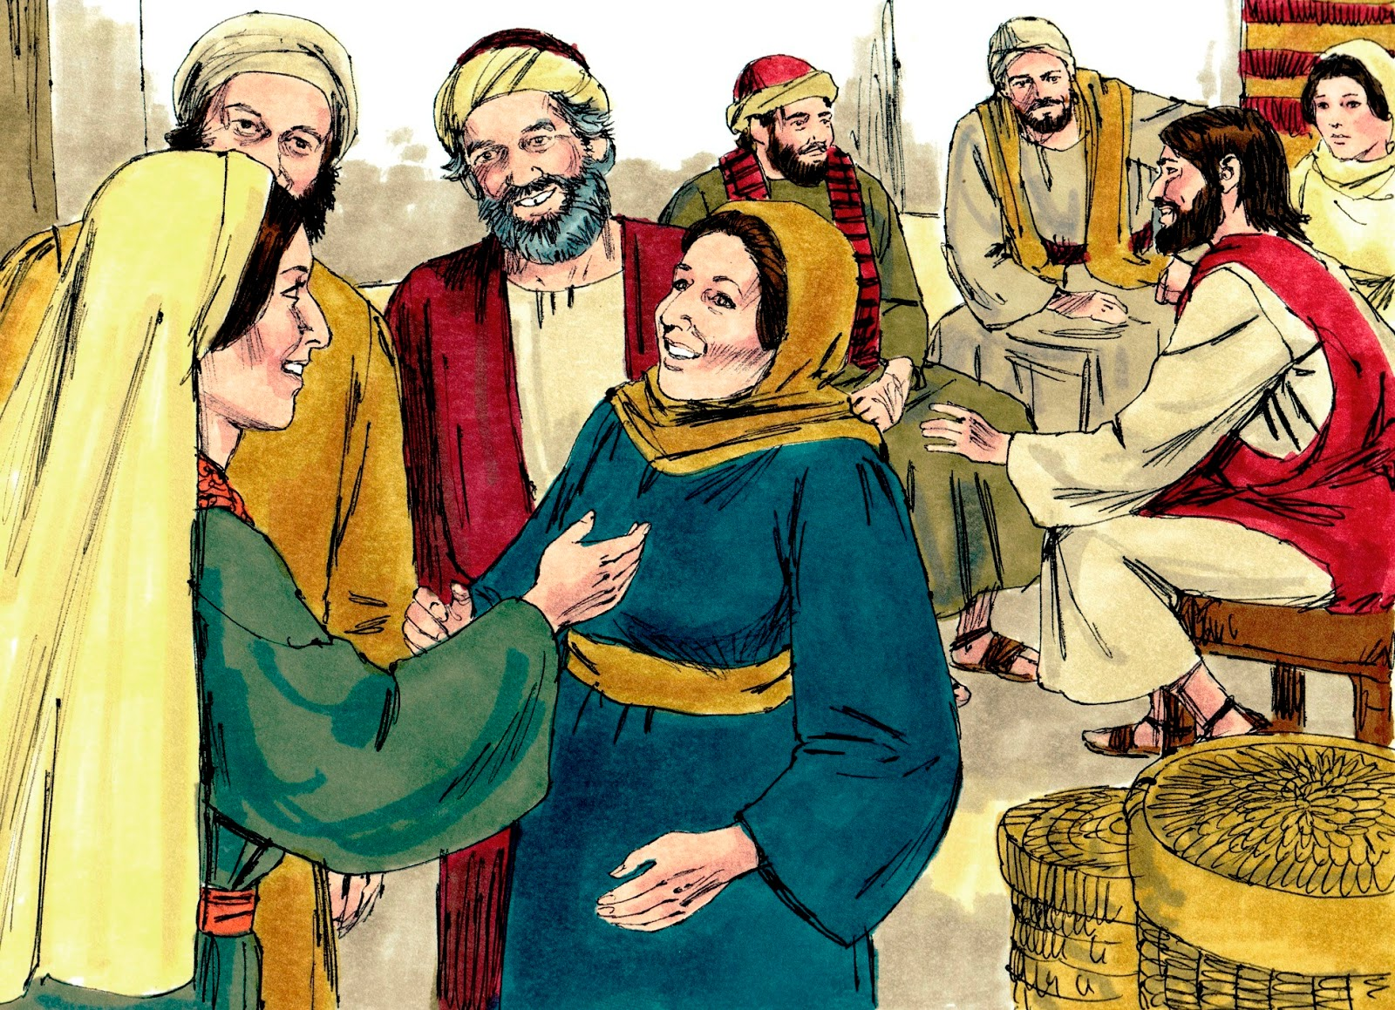
Jesus and the Samaritan Woman
John 4:5-15, 19-26, 39

Slide 4
Leader: A reading from
the Holy Gospel
according to John.
All: Glory to You, Oh Lord.

Slide 5
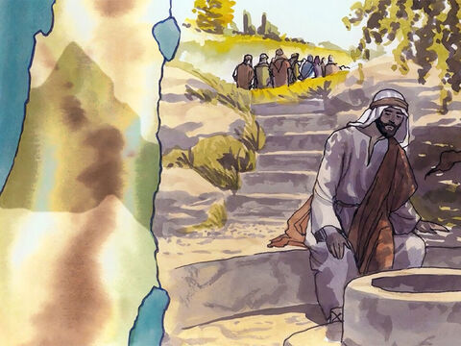
5
Jesus came to a town of Samaria called Sychar, which was not far from the field that Jacob had given to his son Joseph.

Slide 6
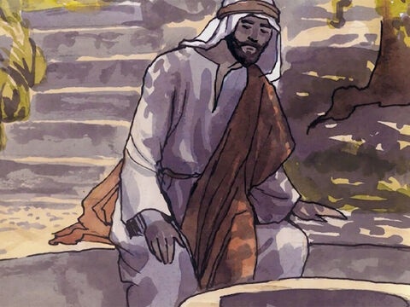
6
Jacob's well was there, and Jesus, tired out by the trip, sat down by the well. It was about noon.

Slide 7
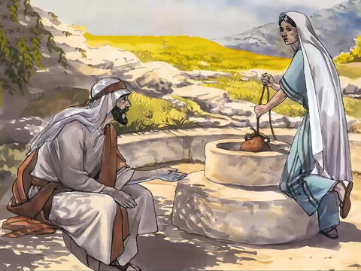
7
A Samaritan woman came to draw some water, and Jesus said to her, “Give me a drink of water.”

Slide 8
8
His disciples had gone into town to buy food

Slide 9
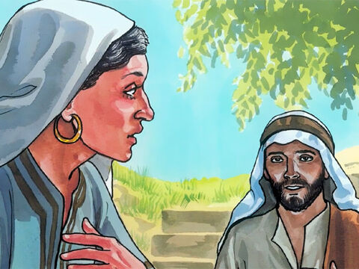
9
The woman answered,
“You are a Jew,
and I am a Samaritan
—so how can you ask
me for a drink?”
(Jews will not use the same cups and bowls
that Samaritans use.)

Slide 10
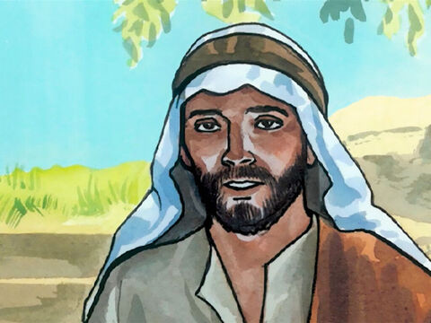
10
Jesus answered and said to her,
“If you knew the gift of God and who is saying to you, ‘Give me a drink,’ you would have asked him and he would have given you living water.”

Slide 11
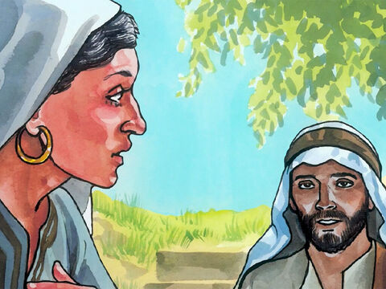
11
The woman said to him,
“Sir, you do not even have a bucket and the well is deep; where then can you get this living water?

Slide 12
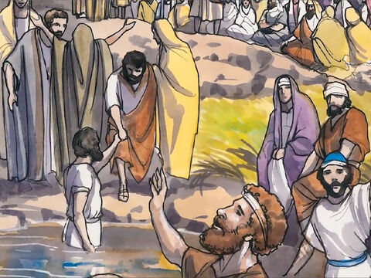
12
Are you greater than our father Jacob, who gave us this well and drank from it himself with his children and his flocks?”

Slide 13
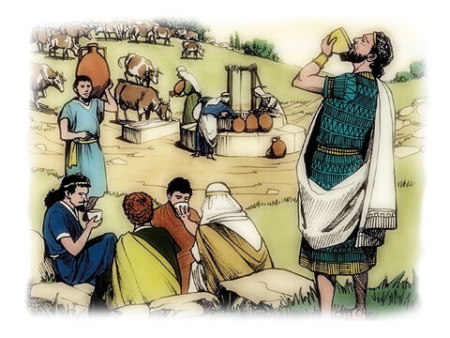
13
Jesus answered and said to her,
“Everyone who drinks this water will be thirsty again;

Slide 14
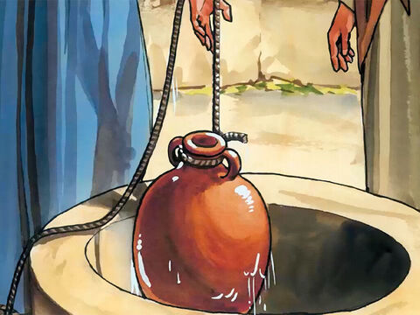
14
but whoever drinks the water I shall give will never thirst; the water I shall give will become in him a spring of water welling up to eternal life.”

Slide 15
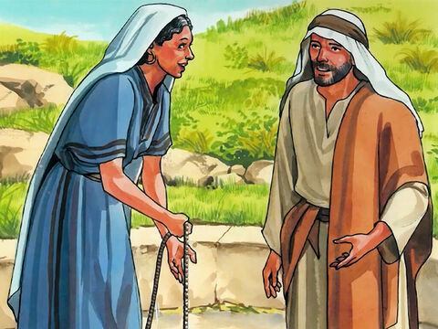
15
The woman said to him, “Sir, give me this water, so that I may not be thirsty or have to keep coming here to draw water.”

Slide 16
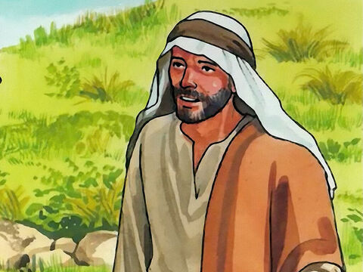
19
The woman said to him,
“Sir, I can see that you are a prophet.

Slide 17
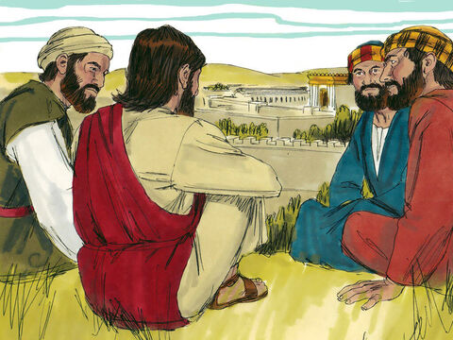
20
Our ancestors worshiped on this mountain;
but you people say that the place to worship is in Jerusalem.”

Slide 18
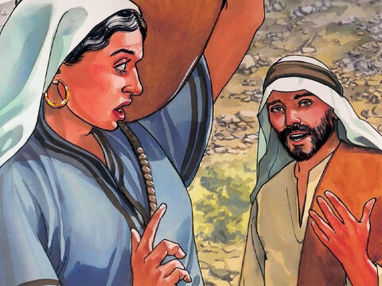
21
Jesus said to her, “Believe me, woman, the hour is coming when you will worship the Father neither on this mountain nor in Jerusalem.

Slide 19
22
You people worship what you do not understand; we worship what we understand, because salvation is from the Jews.

Slide 20
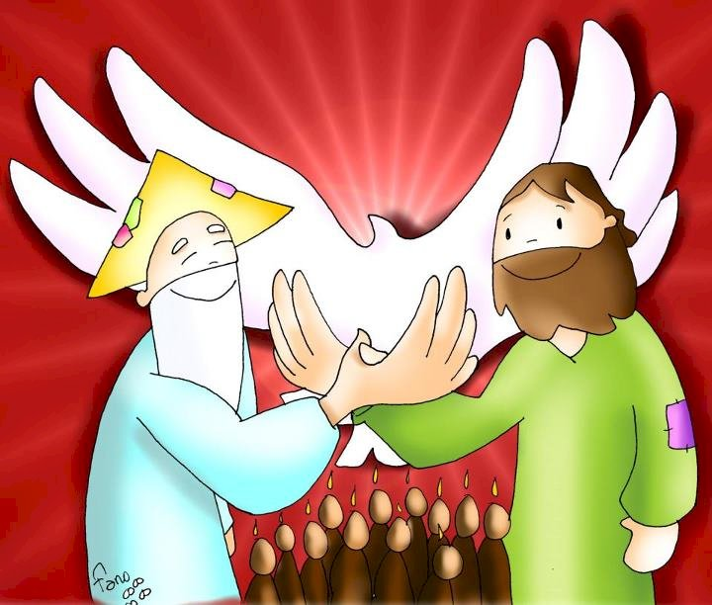
23
But the hour is coming, and is now here, when true worshipers will worship the Father in Spirit and truth; and indeed the Father seeks such people to worship him.

Slide 21
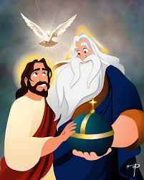
24
God is Spirit, and those who worship him must worship in Spirit and truth.”

Slide 22
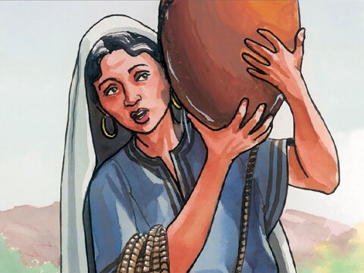
25
The woman said to him,
“I know that the Messiah is coming, the one called the Anointed; when he comes, he will tell us everything.”

Slide 23
26
Jesus said to her,
“I am he, the one who is speaking with you.”

Slide 24
39
Many of the Samaritans of that town began to believe in him because of the word of the woman who testified,
“He told me everything I have done.”

Slide 25
Leader: The Gospel of the Lord.
All: Praise to You,
Lord Jesus Christ.

Slide 26
GOSPEL MESSAGE

Slide 27
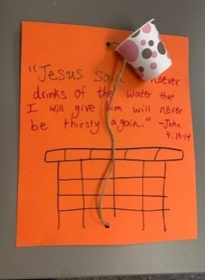
Activity: Well of Life
Scissors
Construction paper
Paper cups
Markers or decorating materials
String or yarn
Hole punch

Slide 28
Instructions:
Decorate the paper to look like a “well”.
Punch a hole in the top and bottom of the paper, about two inches from each border (or as much as your hole punch allows).
Punch a hole in the side of a small paper cup, which will serve as a “bucket.”
Cut a piece of string long enough to go up and down the length of paper. Insert the string into one side of the paper, then through the cup, and then through the other side of the paper. Tie the string at the back and trim any extra ends.
Add a verse caption, and any extra “water drops” or stickers that you like. Have fun tugging the string to raise and lower the “bucket”!

Slide 29
Closing Prayer
Dear God,
Thank you for our savior Jesus. Thank you that His “water” will help us. Please help us to share His message. And to love all those around us. Thank you for your love and your providence. Keep us and our family safe always.
We love you, God!
In Jesus’s name, Amen!

Slide 30
LIVE THE WORD KIDS
3rd Sunday of Lent | Cycle A

