Slide 1
LIVE THE WORD KIDS
2nd Sunday of Lent | Cycle A

Slide 2
GOSPEL REFLECTION
We now come to the amazing account of the transfiguration of Christ on the mountain. This dramatic event marks a major turning point in the gospel narratives, for Jesus was beginning to turn more and more to Jerusalem and the suffering and death that awaited Him there. But before all of that would take place, there was this glimpse of glory. And we read in the New Testament that it was because of the glory that was set before Him He was able to endure the cross. The revelation of Christ’s glory in this chapter was a clear confirmation to the disciples of the truth of Peter’s confession of faith (16:16); but it was also a great encouragement for Christ Himself as He faced the agony that would occur on another hill called Golgotha.
The point is that God’s revelation to His people is a demonstration of His love and His grace for them. Of course we are overwhelmed by it, by the thought of it. But at every turn the revelation of God confirms to us that Jesus is our Lord, that our faith is not in vain, that we need not live in fear, but that we should live by faith in Him. And a revelation of this kind provides us with another word from God about the hope of glory that lies ahead of us, no matter what we have to endure here on earth. Only in Christ is there any hope of passing beyond the grave to glory.
Revelation demands a response. The natural instinct is fear and worship, falling on our faces before Him. But the practical continuation of our response comes at the divine instruction to listen to, i.e., obey, Jesus. If Jesus truly is the Lord of Glory and not just a man from Galilee, then we must worship Him and obey Him.

Slide 3
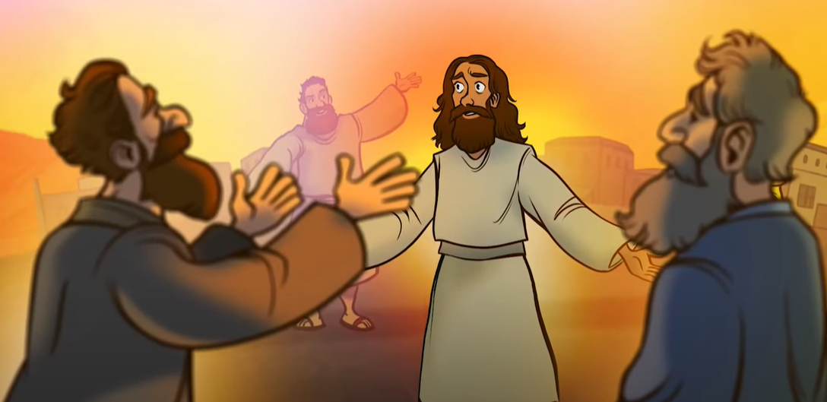
The Transfiguration of Jesus
Matthew 17:1-9

Slide 4
Leader: A reading from
the Holy Gospel
according to Matthew.
All: Glory to You, Oh Lord.

Slide 5
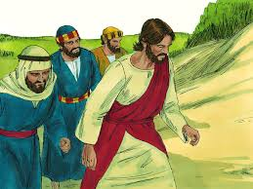
1
Jesus took with him Peter and the brothers James and John and led them up a high mountain where they were alone

Slide 6
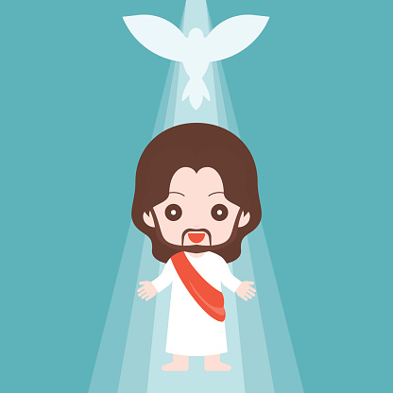
2
As they looked on,
a change came over Jesus:
his face was shining like the sun, and his clothes were dazzling white.

Slide 7
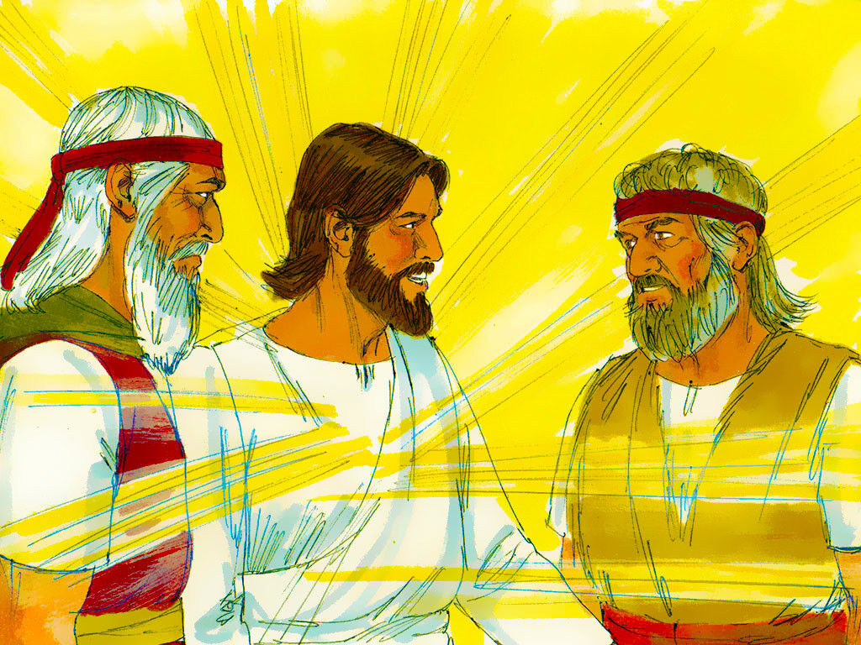
3
Then the three disciples saw Moses and Elijah talking with Jesus.

Slide 8
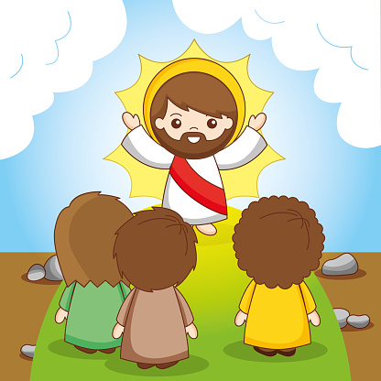
4
So Peter spoke up and said to Jesus,
“Lord, how good it is that we are here! If you wish, I will make three tents here, one for you, one for Moses, and one for Elijah.”

Slide 9
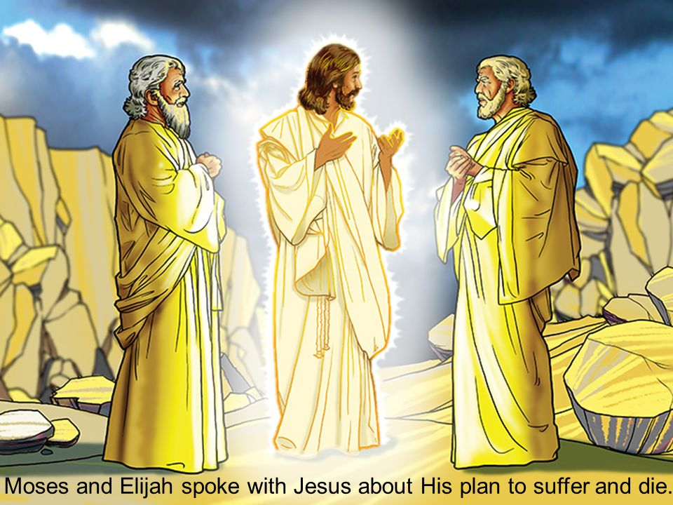
5
While he was talking, a shining cloud came over them, and a voice from the cloud said,
“This is my own dear Son, with whom I am pleased—listen to him!”

Slide 10
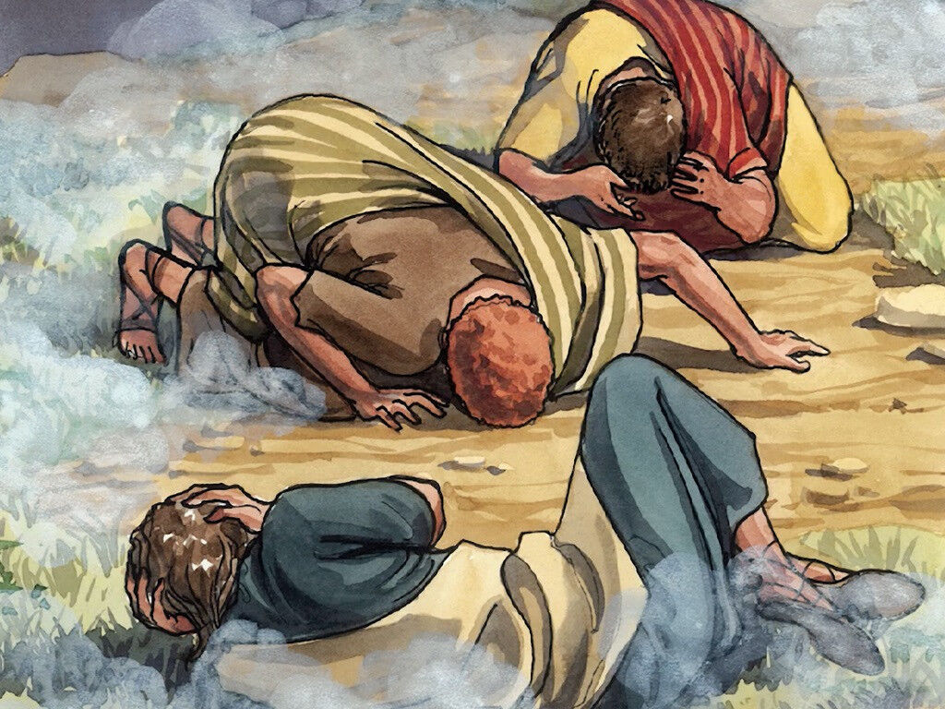
6
When the disciples heard the voice, they were so terrified that they threw themselves face downward on the ground.

Slide 11
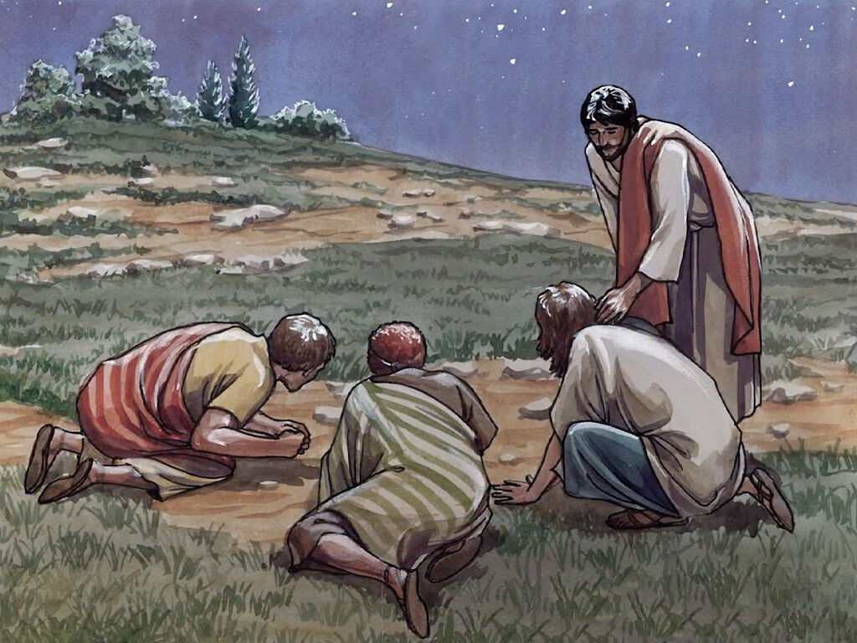
7
Jesus came to them and touched them. “Get up,” he said. “Don't be afraid!”

Slide 12
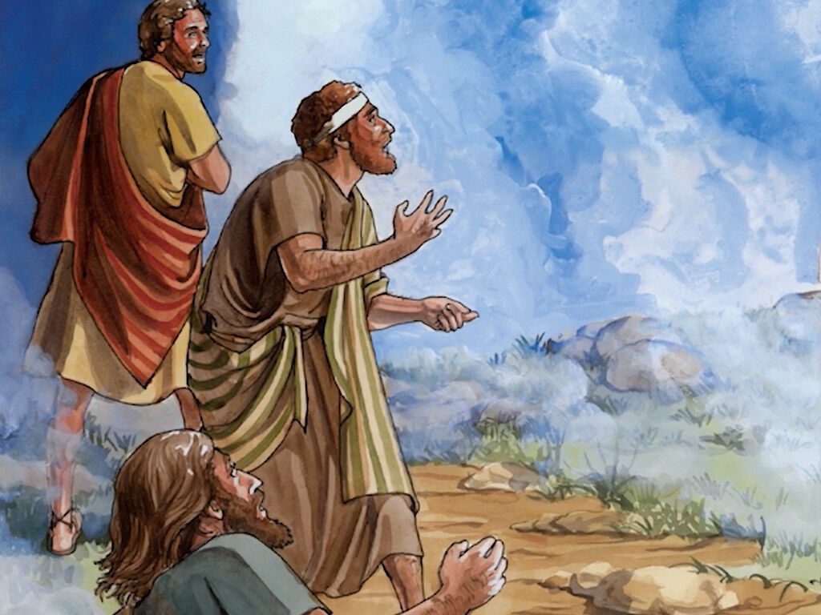
8
So they looked up and saw no one there but Jesus.

Slide 13
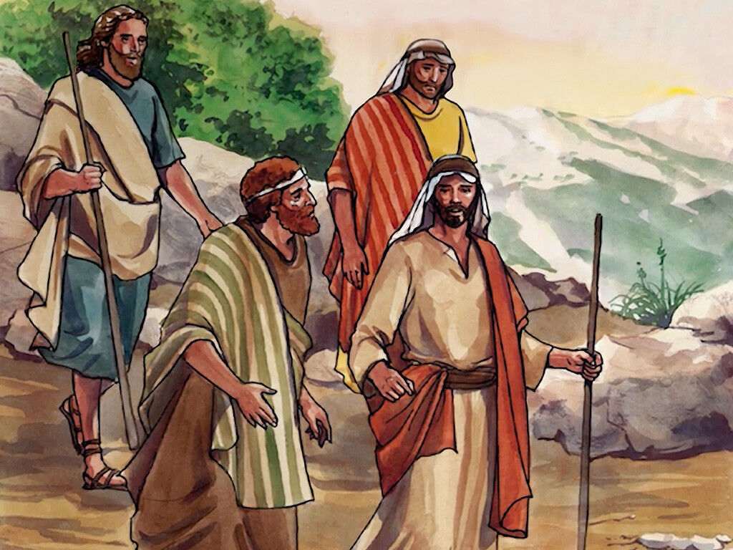
9
As they came down the mountain, Jesus ordered them, “Don't tell anyone about this vision you have seen until the Son of Man has been raised from death.”

Slide 14
Leader: The Gospel of the Lord.
All: Praise to You,
Lord Jesus Christ.

Slide 15
GOSPEL MESSAGE

Slide 16
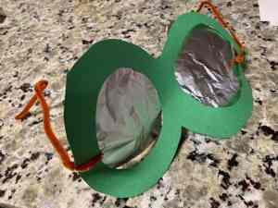
Activity:
Transfiguration Goggles
Materials: 1. Paper, paper plates, or cardstock
2. Scissors
3. Aluminum foil
4. Pipe cleaners
5. Glue and/or tape
Decorative materials (markers, crayons, stickers

Slide 17
Instructions:
Cut the paper or cardstock into a circular shape, similar to a figure eight or a “headless snowman” sideways (these will be “glasses” or “goggles”).
Cut out two large holes from the inside of each rounded portion.
If desired, decorate the outside of goggles with marker, crayon, stickers, and verses.
Cut two pieces of foil for the “shiny element”, and tape these behind the holes.
If you prefer to use the goggles functionally and be able to see out of them, cut two more small holes within the foil, for eye holes.
Attach pipe cleaners to the outside for the ear piece attachments. Remember the remarkable vision of transfiguration glory

Slide 18
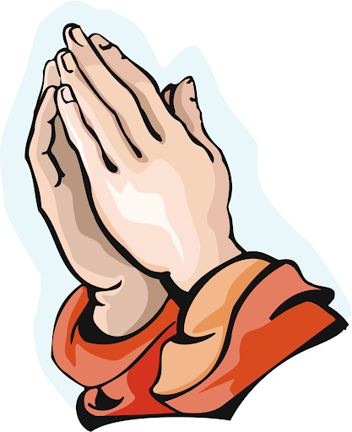
Closing Prayer
Dear God,
Thank you for showing us who you are. Help us to be amazed by your glory. And to shine like the sun with your love. Thank you for the Bible that teaches us to love and live truly. Thank you for the love of Jesus. May we also be obedient like your Him. We love you, Lord!
In Jesus’s name, Amen!

Slide 19
LIVE THE WORD KIDS
2nd Sunday of Lent | Cycle A

