Slide 1
LIVE THE WORD KIDS
12thSunday in Ordinary Time | Cycle A

Slide 2
GOSPEL REFLECTION
It’s not by accident that Jesus links together a series of conflicts that his disciples will have to face. Some think of concealing themselves; they think that it is possible to keep what they truly think hidden in their hearts. These are those who hide in the darkness, deceiving themselves by thinking that their actions go unseen. To these people, Jesus foretells of the light: there is nothing hidden that will not be revealed. The disciples of Jesus ought to live in such a way that they never fear the light. In the rules for discernment, Ignatius of Loyola translates these words of Jesus into some practical advice which was very useful in his time:
The disciple that confronts the conflicts of daily life can’t help getting injured or wrapped up in them, just like the traveler that must cross through a forest of brambles can’t help but get scratched. And yet there is something more profound that remains untouched. Though the body may show visible signs of battle, there is an inner core that belongs to God alone and remains pure. For this reason, Jesus contrasts the exteriority body and the interiority of the soul.

Slide 3
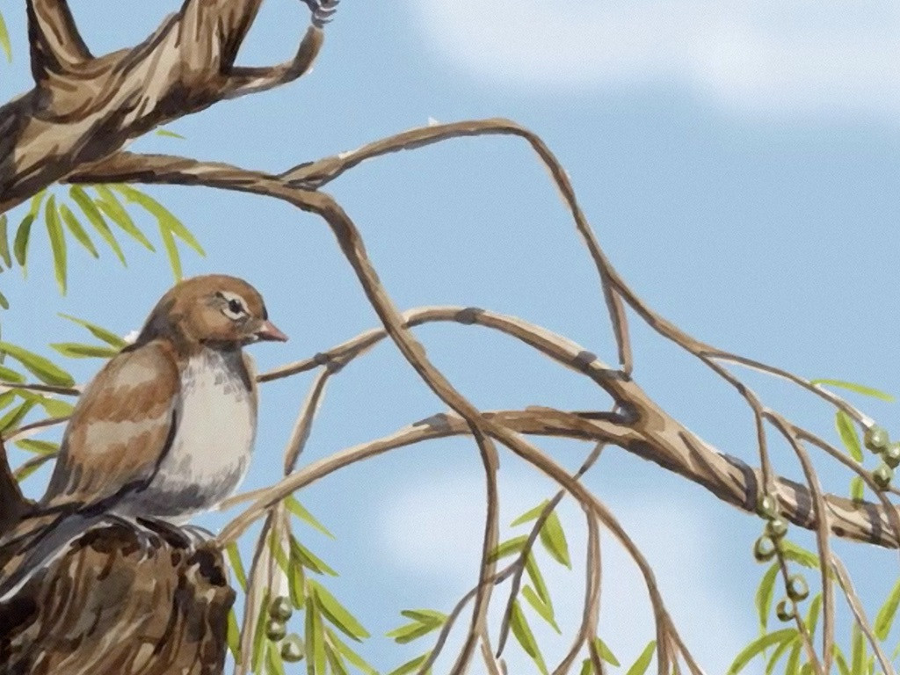
Fear No One
Matthew 10:26-33

Slide 4
Leader: A reading from
the Holy Gospel
according to Matthew.
All: Glory to You, Oh Lord.

Slide 5
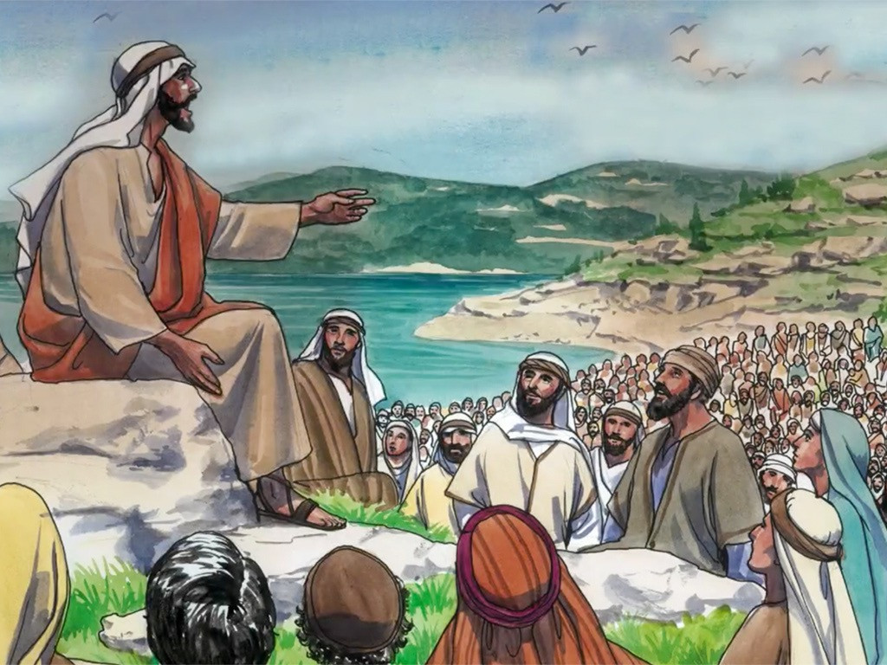
26
“So do not be afraid of people. Whatever is now covered up will be uncovered, and every secret will be made known.

Slide 6
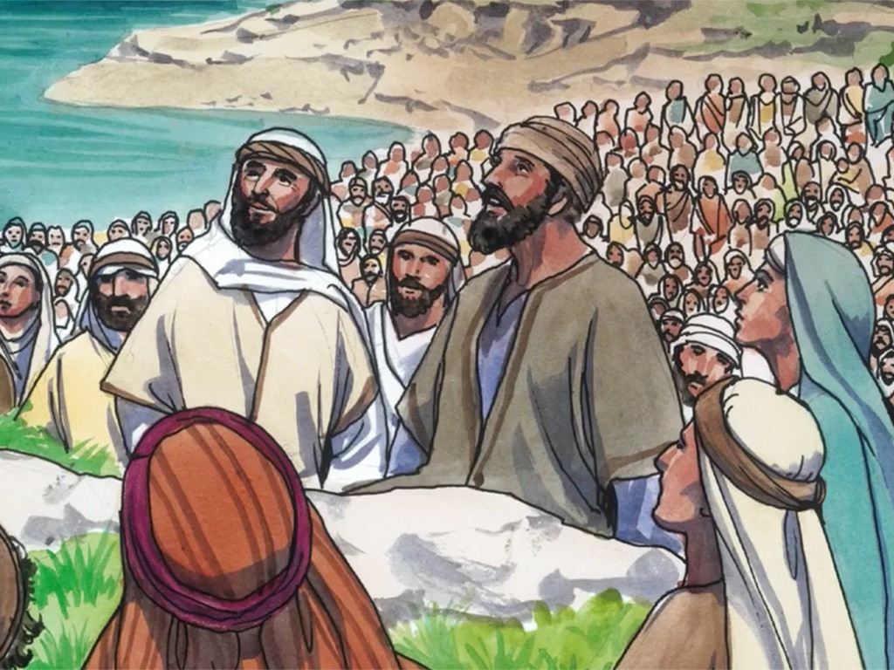
27
What I am telling you in the dark you must repeat in broad daylight, and what you have heard in private you must announce from the housetops.

Slide 7
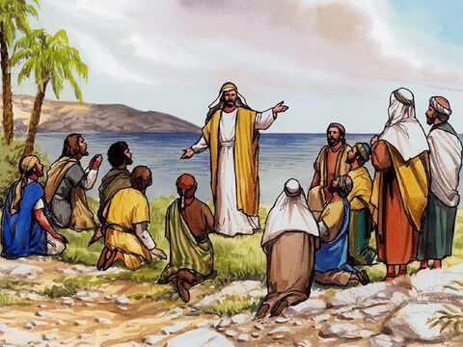
28
Do not be afraid of those who kill the body but cannot kill the soul; rather be afraid of God, who can destroy both body and soul in hell.

Slide 8
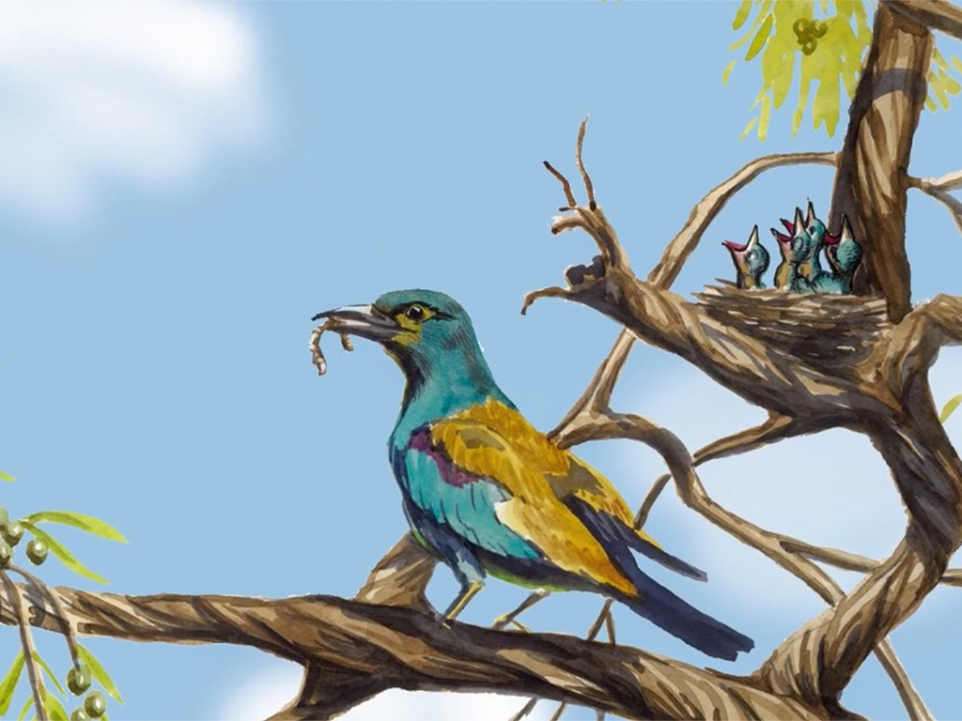
29
For only a penny you can buy two sparrows, yet not one sparrow falls to the ground without your Father's consent.

Slide 9
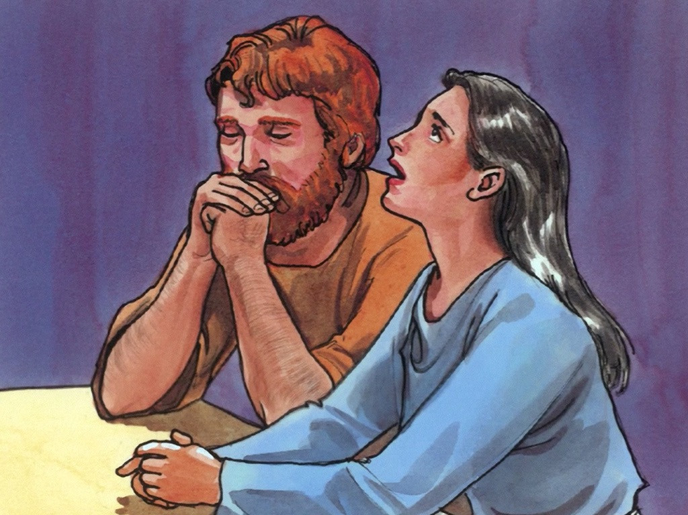
30
As for you, even the hairs of your head have all been counted.

Slide 10
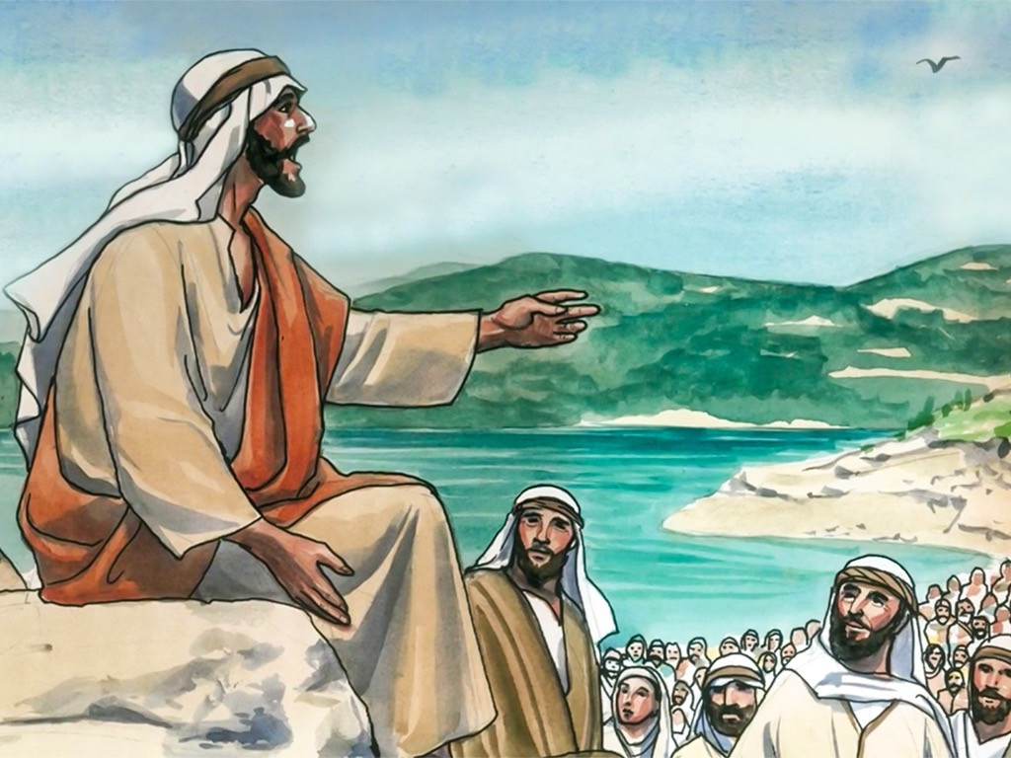
31
So do not be afraid; you are worth much more than many sparrows!

Slide 11
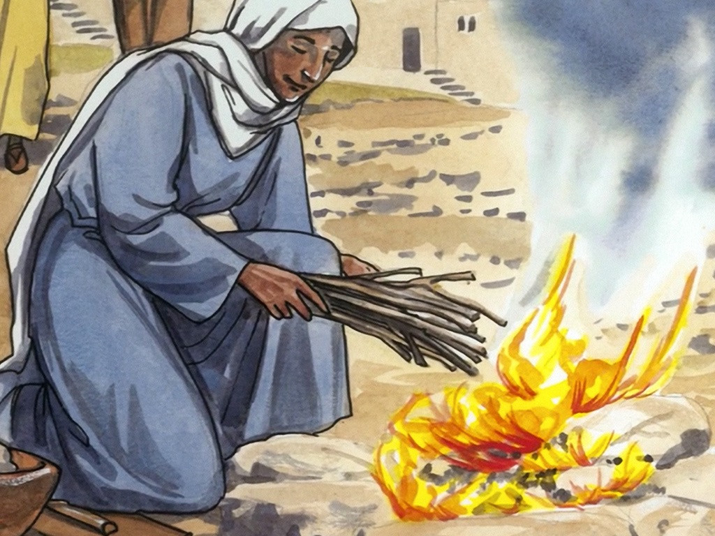
32
“Those who declare publicly that they belong to me, I will do the same for them before my Father in heaven.

Slide 12
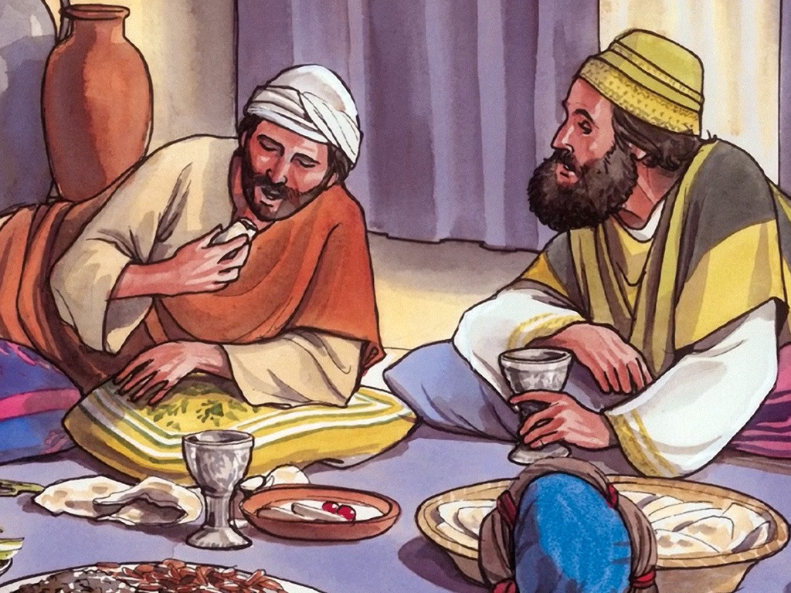
33
But those who reject me publicly, I will reject before my Father in heaven.

Slide 13
Leader: The Gospel of the Lord.
All: Praise to You,
Lord Jesus Christ.

Slide 14
GOSPEL MESSAGE

Slide 15
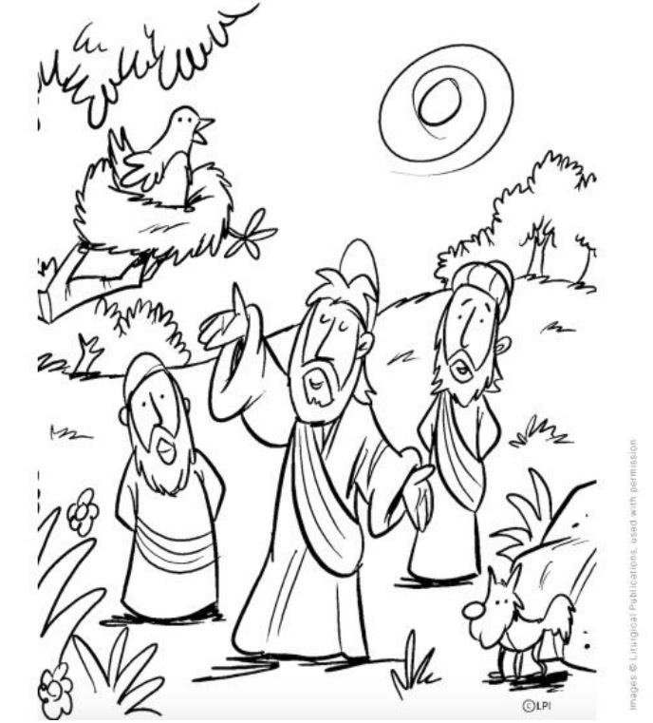
Activity: Coloring
Printed Material
Coloring Materials

Slide 17
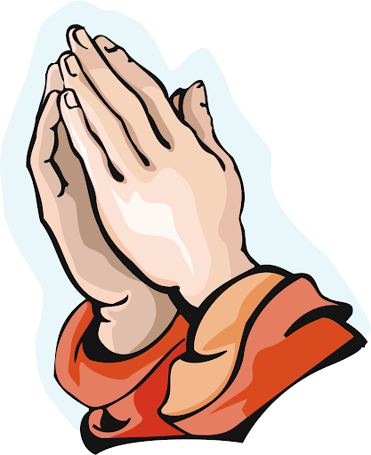
Closing Prayer
Dear Jesus,
Thank you for being our light. Take us out of the darkness and please always make us brave to face every challenges.
We pray, Amen!

Slide 18
LIVE THE WORD KIDS
12th Sunday in Ordinary Time | Cycle A

