Slide 1
LIVE THE WORD KIDS
11th Sunday in Ordinary Time | Cycle A

Slide 2
GOSPEL REFLECTION
This lesson challenges children to think about the world around them. There are many people in the world who have never heard about Jesus. As Christians, it is our responsibility to tell these people about Jesus and pray that God would send people into the world to tell others about Jesus.

Slide 3
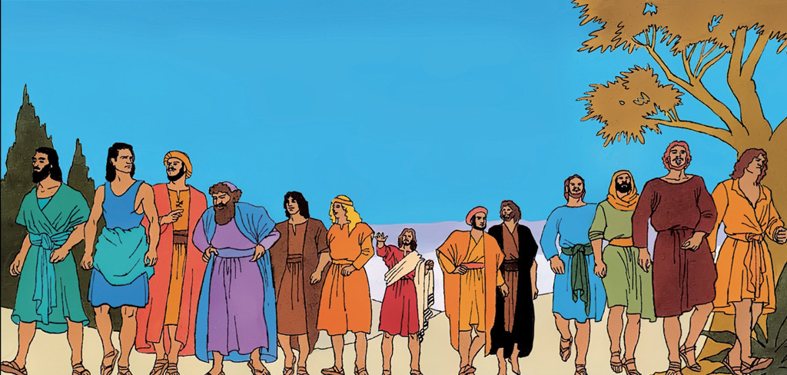
The Harvest is Great
Matthew 9:36 - 10:8

Slide 4
Leader: A reading from
the Holy Gospel
according to Matthew.
All: Glory to You, Oh Lord.

Slide 5
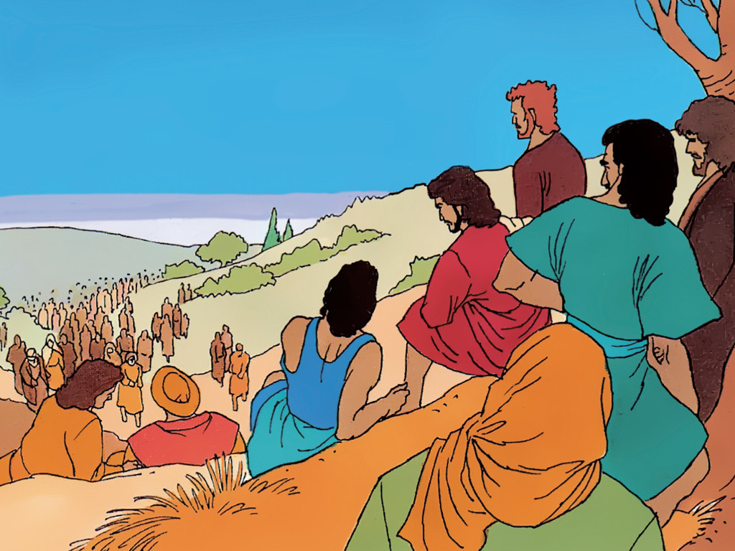
36
As he saw the crowds, his heart was filled with pity for them, because they were worried and helpless, like sheep without a shepherd.

Slide 6
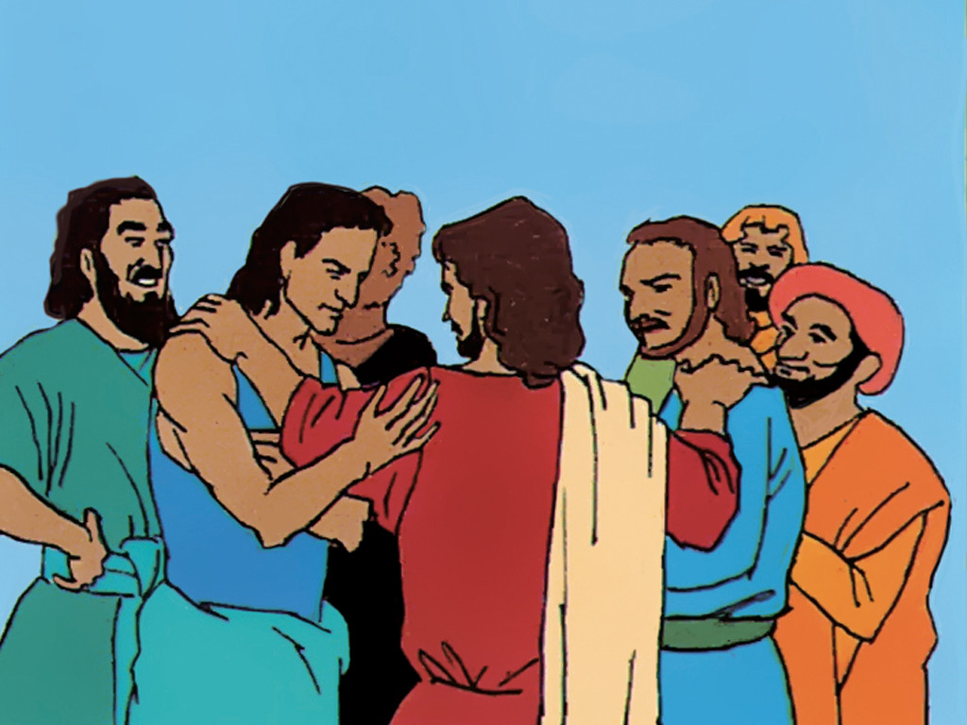
37
So he said to his disciples, “The harvest is large, but there are few workers to gather it in.

Slide 7
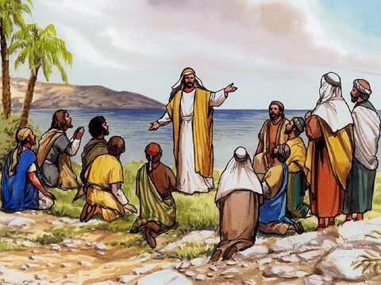
38
Pray to the owner of the harvest that he will send out workers to gather in his harvest.”

Slide 8
1
Jesus called his twelve disciples together and gave them authority to drive out evil spirits and to heal every disease and every sickness.

Slide 9
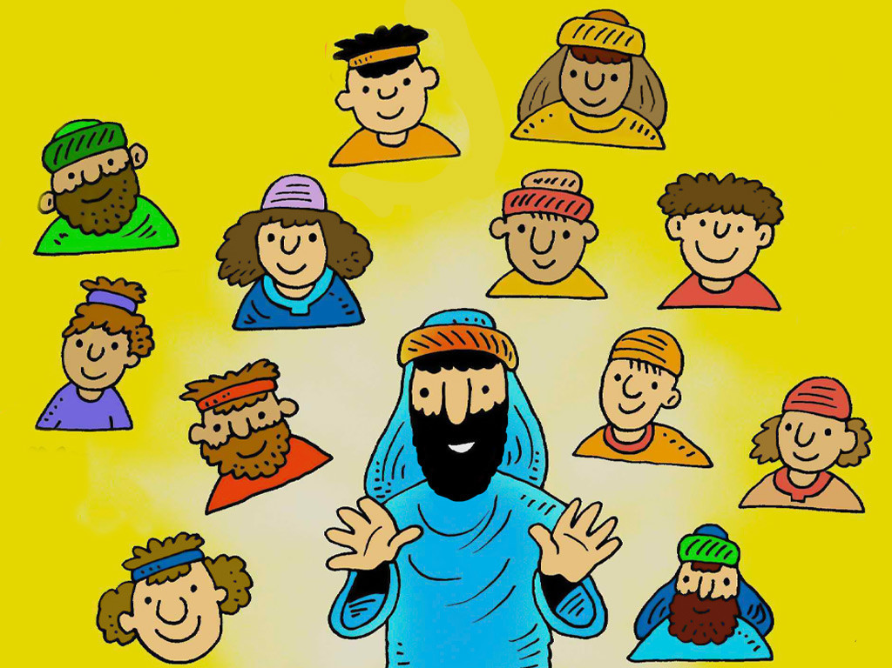
2-4
These are the names of the twelve apostles: first, Simon (called Peter) and his brother Andrew; James and his brother John, the sons of Zebedee; ³ Philip and Bartholomew; Thomas and Matthew, the tax collector; James son of Alphaeus, and Thaddaeus; ⁴ Simon the Patriot, and Judas Iscariot, who betrayed Jesus.

Slide 10
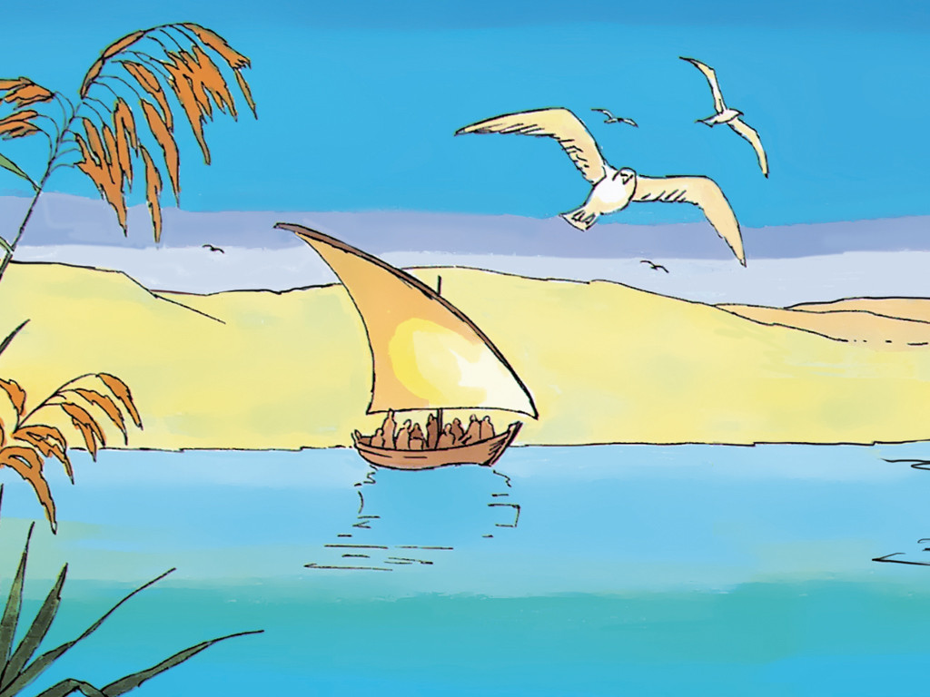
5
These twelve men were sent out by Jesus with the following instructions: “Do not go to any Gentile territory or any Samaritan towns.

Slide 11
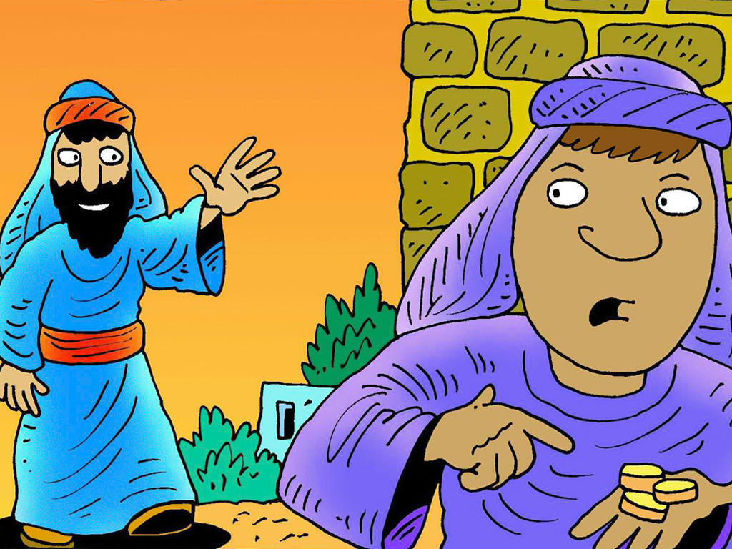
6
Instead, you are to go to the lost sheep of the people of Israel.

Slide 12
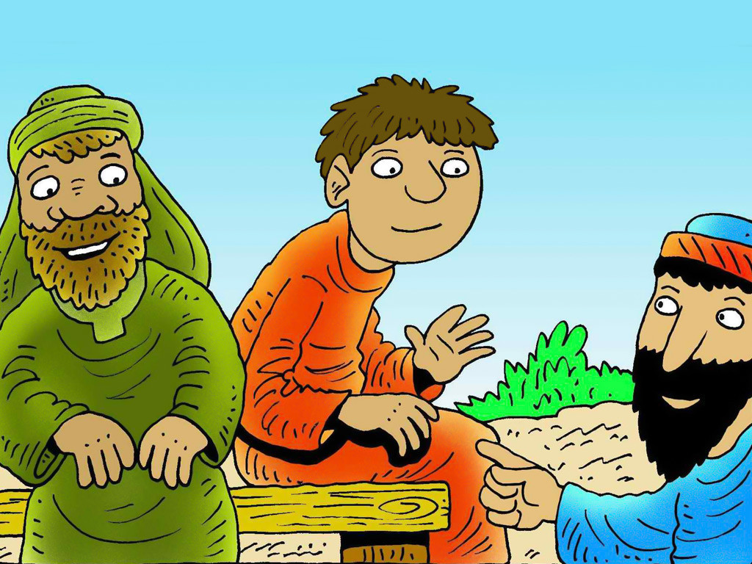
7
Go and preach, ‘The Kingdom of heaven is near!’

Slide 13
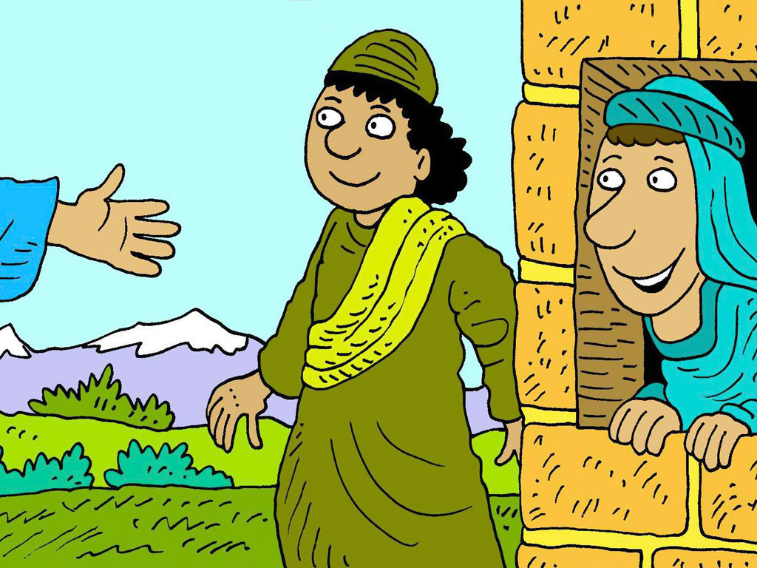
8
Heal the sick, bring the dead back to life, heal those who suffer from dreaded skin diseases, and drive out demons. You have received without paying, so give without being paid.

Slide 14
Leader: The Gospel of the Lord.
All: Praise to You,
Lord Jesus Christ.

Slide 15
GOSPEL MESSAGE

Slide 16
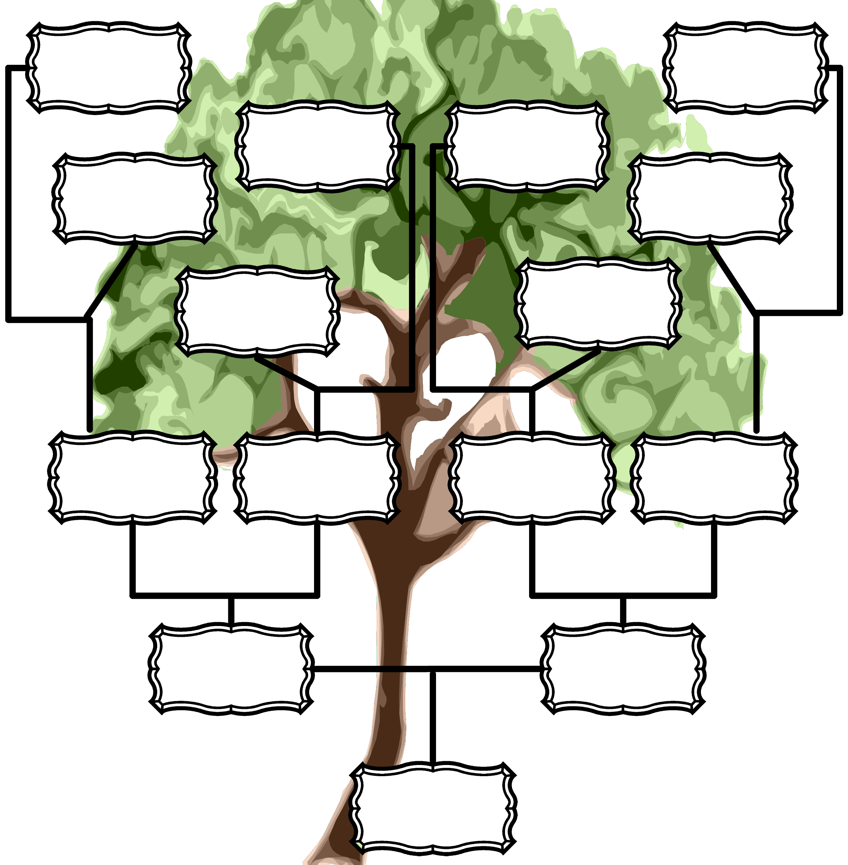
Activity: Tree of Harvest
Bond Paper
Writing & Coloring Materials, Markers or crayons

Slide 17
Instructions:
On the bond paper, draw a tree with big leaves
Write on each leaf a name of a family or friend who you want to invite to Mass / Prayer or Kids Assembly / LTWKids
Challenge: Invite them to go with you on a Mass, Kids Assembly, or LTW Kids

Slide 18
Closing Prayer
Dear Jesus,
The harvest in many, but the laborers are few. Please send more people who will tend to your sheep, the people you love. Make us instruments to proclaim Your kingdom!
We pray, Amen!

Slide 19
LIVE THE WORD KIDS
11th Sunday in Ordinary Time | Cycle A

