Slide 1
LIVE THE WORD KIDS
17th Sunday in Ordinary Time| Cycle A

Slide 2
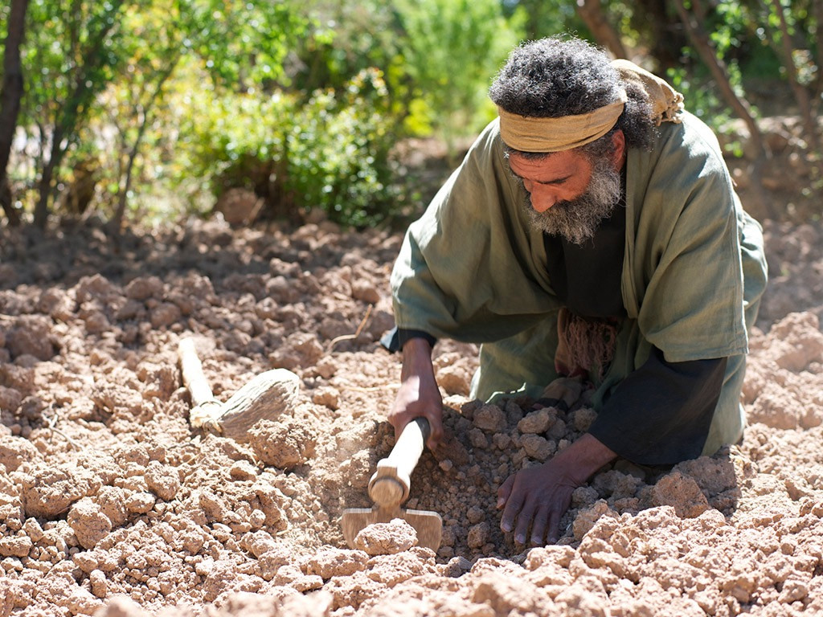
The Parable of the Hidden Treasure, Pearl and the Net
Matthew 13:44-52

Slide 3
Leader: A reading from
the Holy Gospel
according to Matthew.
All: Glory to You, Oh Lord.

Slide 4
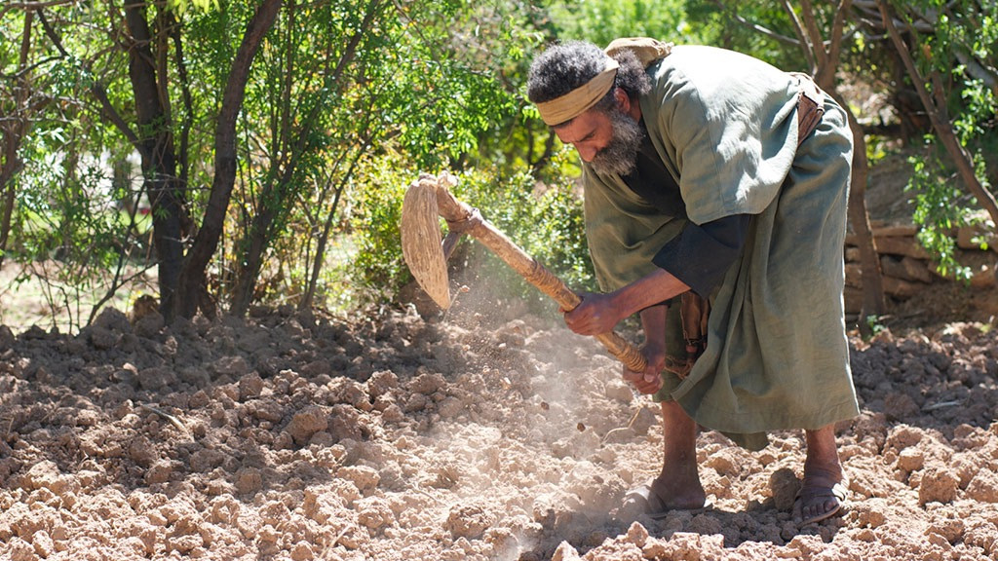
44
“The Kingdom of heaven is like this.
A man happens to find a treasure hidden in a field. He covers it up again, and is so happy that he goes and sells everything he has, and then goes back and buys that field.

Slide 5
45
“Also, the Kingdom of heaven is like this. A man is looking for fine pearls,

Slide 6
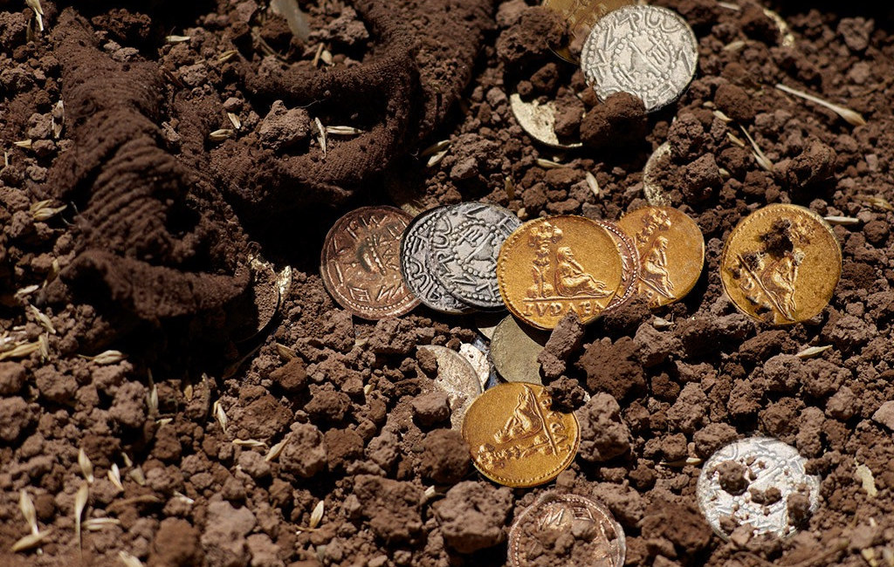
46
and when he finds one that is unusually fine, he goes and sells everything he has, and buys that pearl.

Slide 7
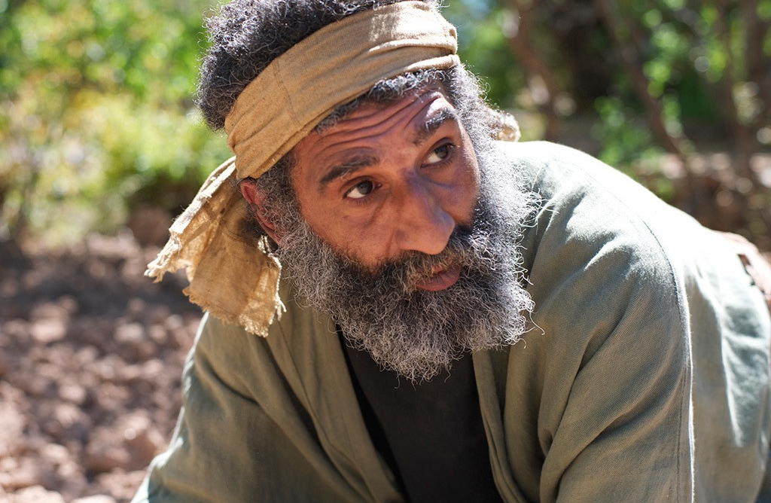
47
“Also, the Kingdom of heaven is like this. Some fishermen throw their net out in the lake and catch all kinds of fish.

Slide 8
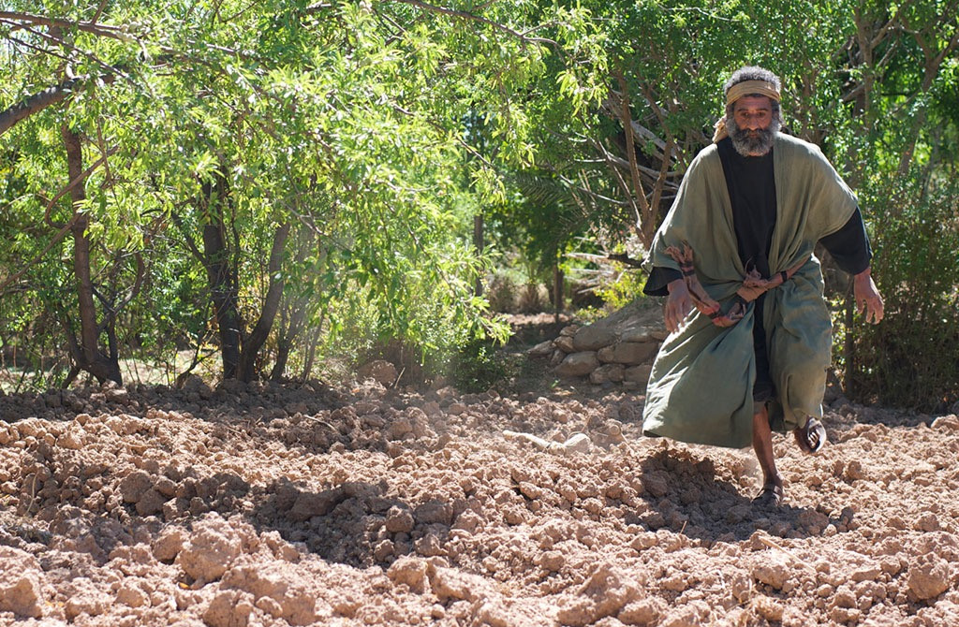
48
When the net is full, they pull it to shore and sit down to divide the fish: the good ones go into the buckets, the worthless ones are thrown away.

Slide 9
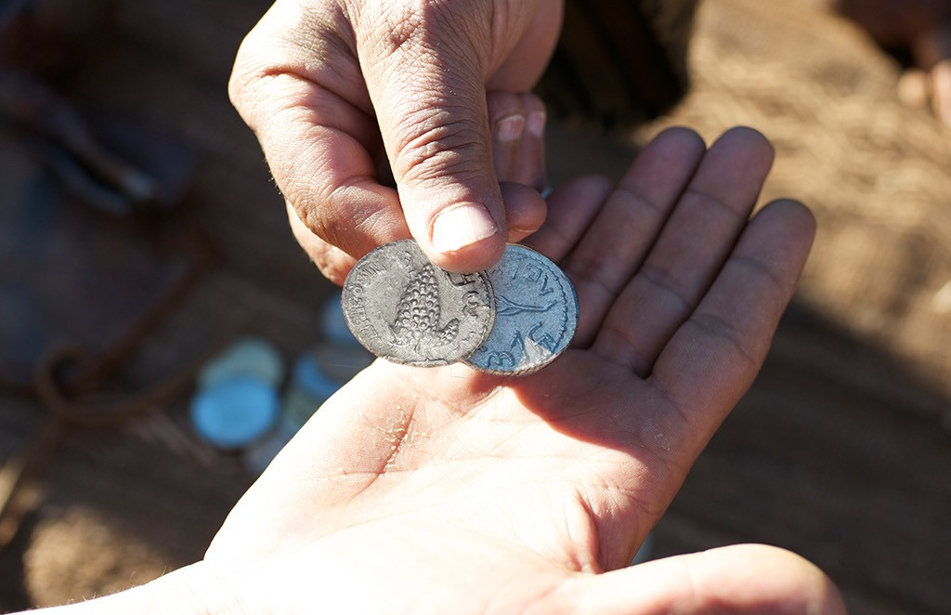
49
It will be like this at the end of the age: the angels will go out and gather up the evil people from among the good

Slide 10
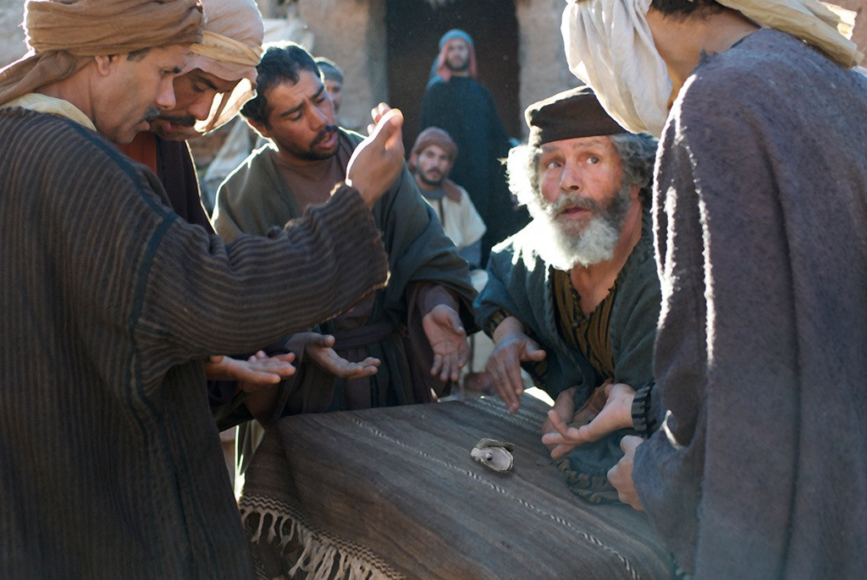
50
and will throw them into the fiery furnace, where they will cry and gnash their teeth.

Slide 11
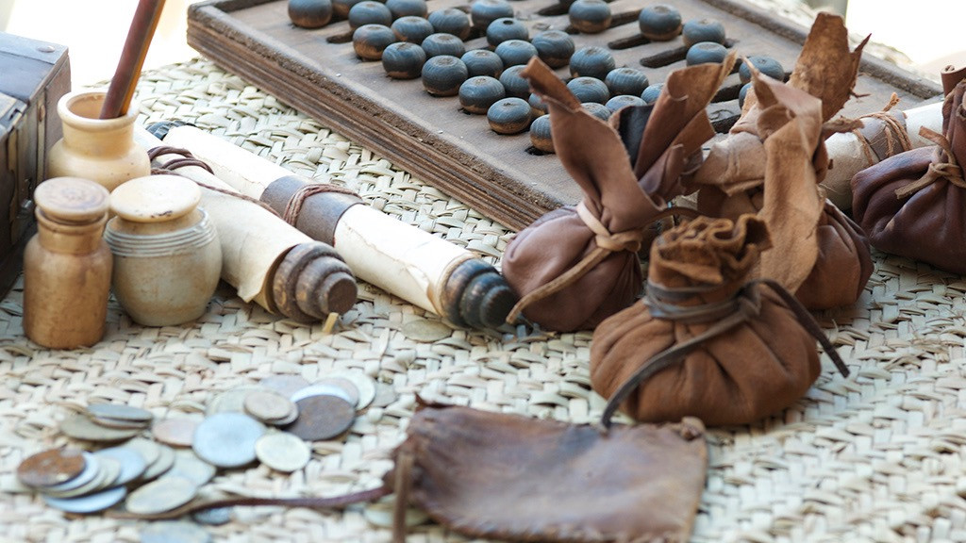
51
“Do you understand these things?” Jesus asked them.
“Yes,” they answered.

Slide 12
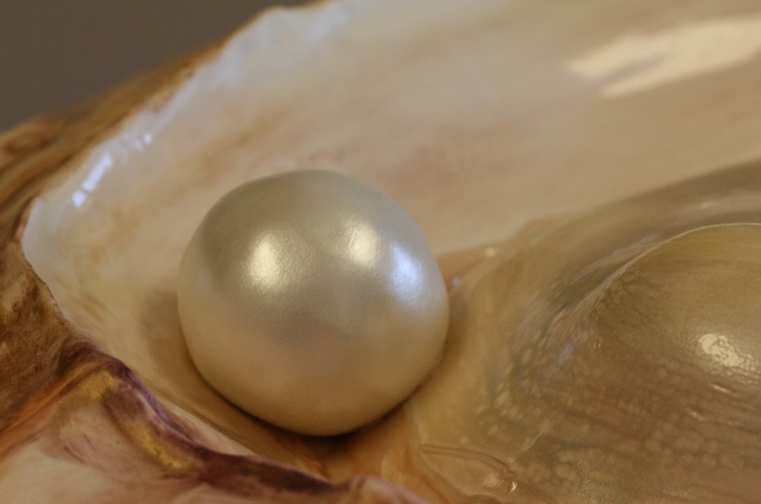
52
So he replied, “This means, then, that every teacher of the Law who becomes a disciple in the Kingdom of heaven is like a homeowner who takes new and old things out of his storage room.”

Slide 13
Leader: The Gospel of the Lord.
All: Praise to You,
Lord Jesus Christ.

Slide 14
GOSPEL MESSAGE
Notes:
Jesus told a story about a farmer because many of his listeners were farmers. He knew they would relate to the struggles of this farmer to plant his seed in good soil so it would produce a good crop. But Jesus was not interested in helping farmers to grow more lettuce and broccoli. He wanted us to grow in our faith.
Some seed fell on the path and was eaten or swept away. This seed represents people who hear the stories of the Bible but aren’t really listening. Some seed fell in the rocky places and among the thorns. These people hear the message of the Bible, but they are so distracted by other things, they quickly forget the message and never grow.
Some of the seed fell in good soil and produced a huge crop. This is where God wants us to be, planted in good soil. He wants us to read the Word of God daily. He wants us to spend time in prayer. If we take the time to nurture our faith, it will grow, and God will use us to spread His Word to the world.
Jesus told a story about a farmer because many of his listeners were farmers. He knew they would relate to the struggles of this farmer to plant his seed in good soil so it would produce a good crop. But Jesus was not interested in helping farmers to grow more lettuce and broccoli. He wanted us to grow in our faith.
Some seed fell on the path and was eaten or swept away. This seed represents people who hear the stories of the Bible but aren’t really listening. Some seed fell in the rocky places and among the thorns. These people hear the message of the Bible, but they are so distracted by other things, they quickly forget the message and never grow.
Some of the seed fell in good soil and produced a huge crop. This is where God wants us to be, planted in good soil. He wants us to read the Word of God daily. He wants us to spend time in prayer. If we take the time to nurture our faith, it will grow, and God will use us to spread His Word to the world.
Jesus told a story about a farmer because many of his listeners were farmers. He knew they would relate to the struggles of this farmer to plant his seed in good soil so it would produce a good crop. But Jesus was not interested in helping farmers to grow more lettuce and broccoli. He wanted us to grow in our faith.
Some seed fell on the path and was eaten or swept away. This seed represents people who hear the stories of the Bible but aren’t really listening. Some seed fell in the rocky places and among the thorns. These people hear the message of the Bible, but they are so distracted by other things, they quickly forget the message and never grow.
Some of the seed fell in good soil and produced a huge crop. This is where God wants us to be, planted in good soil. He wants us to read the Word of God daily. He wants us to spend time in prayer. If we take the time to nurture our faith, it will grow, and God will use us to spread His Word to the world.
Jesus told a story about a farmer because many of his listeners were farmers. He knew they would relate to the struggles of this farmer to plant his seed in good soil so it would produce a good crop. But Jesus was not interested in helping farmers to grow more lettuce and broccoli. He wanted us to grow in our faith.
Some seed fell on the path and was eaten or swept away. This seed represents people who hear the stories of the Bible but aren’t really listening. Some seed fell in the rocky places and among the thorns. These people hear the message of the Bible, but they are so distracted by other things, they quickly forget the message and never grow.
Some of the seed fell in good soil and produced a huge crop. This is where God wants us to be, planted in good soil. He wants us to read the Word of God daily. He wants us to spend time in prayer. If we take the time to nurture our faith, it will grow, and God will use us to spread His Word to the world.
Jesus told a story about a farmer because many of his listeners were farmers. He knew they would relate to the struggles of this farmer to plant his seed in good soil so it would produce a good crop. But Jesus was not interested in helping farmers to grow more lettuce and broccoli. He wanted us to grow in our faith.
Some seed fell on the path and was eaten or swept away. This seed represents people who hear the stories of the Bible but aren’t really listening. Some seed fell in the rocky places and among the thorns. These people hear the message of the Bible, but they are so distracted by other things, they quickly forget the message and never grow.
Some of the seed fell in good soil and produced a huge crop. This is where God wants us to be, planted in good soil. He wants us to read the Word of God daily. He wants us to spend time in prayer. If we take the time to nurture our faith, it will grow, and God will use us to spread His Word to the world.
Jesus told a story about a farmer because many of his listeners were farmers. He knew they would relate to the struggles of this farmer to plant his seed in good soil so it would produce a good crop. But Jesus was not interested in helping farmers to grow more lettuce and broccoli. He wanted us to grow in our faith.
Some seed fell on the path and was eaten or swept away. This seed represents people who hear the stories of the Bible but aren’t really listening. Some seed fell in the rocky places and among the thorns. These people hear the message of the Bible, but they are so distracted by other things, they quickly forget the message and never grow.
Some of the seed fell in good soil and produced a huge crop. This is where God wants us to be, planted in good soil. He wants us to read the Word of God daily. He wants us to spend time in prayer. If we take the time to nurture our faith, it will grow, and God will use us to spread His Word to the world.
Jesus told a story about a farmer because many of his listeners were farmers. He knew they would relate to the struggles of this farmer to plant his seed in good soil so it would produce a good crop. But Jesus was not interested in helping farmers to grow more lettuce and broccoli. He wanted us to grow in our faith.
Some seed fell on the path and was eaten or swept away. This seed represents people who hear the stories of the Bible but aren’t really listening. Some seed fell in the rocky places and among the thorns. These people hear the message of the Bible, but they are so distracted by other things, they quickly forget the message and never grow.
Some of the seed fell in good soil and produced a huge crop. This is where God wants us to be, planted in good soil. He wants us to read the Word of God daily. He wants us to spend time in prayer. If we take the time to nurture our faith, it will grow, and God will use us to spread His Word to the world.
Jesus told a story about a farmer because many of his listeners were farmers. He knew they would relate to the struggles of this farmer to plant his seed in good soil so it would produce a good crop. But Jesus was not interested in helping farmers to grow more lettuce and broccoli. He wanted us to grow in our faith.
Some seed fell on the path and was eaten or swept away. This seed represents people who hear the stories of the Bible but aren’t really listening. Some seed fell in the rocky places and among the thorns. These people hear the message of the Bible, but they are so distracted by other things, they quickly forget the message and never grow.
Some of the seed fell in good soil and produced a huge crop. This is where God wants us to be, planted in good soil. He wants us to read the Word of God daily. He wants us to spend time in prayer. If we take the time to nurture our faith, it will grow, and God will use us to spread His Word to the world.
Jesus told a story about a farmer because many of his listeners were farmers. He knew they would relate to the struggles of this farmer to plant his seed in good soil so it would produce a good crop. But Jesus was not interested in helping farmers to grow more lettuce and broccoli. He wanted us to grow in our faith.
Some seed fell on the path and was eaten or swept away. This seed represents people who hear the stories of the Bible but aren’t really listening. Some seed fell in the rocky places and among the thorns. These people hear the message of the Bible, but they are so distracted by other things, they quickly forget the message and never grow.
Some of the seed fell in good soil and produced a huge crop. This is where God wants us to be, planted in good soil. He wants us to read the Word of God daily. He wants us to spend time in prayer. If we take the time to nurture our faith, it will grow, and God will use us to spread His Word to the world.
JJesus told a story about a farmer because many of his listeners were farmers. He knew they would relate to the struggles of this farmer to plant his seed in good soil so it would produce a good crop. But Jesus was not interested in helping farmers to grow more lettuce and broccoli. He wanted us to grow in our faith.
Some seed fell on the path and was eaten or swept away. This seed represents people who hear the stories of the Bible but aren’t really listening. Some seed fell in the rocky places and among the thorns. These people hear the message of the Bible, but they are so distracted by other things, they quickly forget the message and never grow.
Some of the seed fell in good soil and produced a huge crop. This is where God wants us to be, planted in good soil. He wants us to read the Word of God daily. He wants us to spend time in prayer. If we take the time to nurture our faith, it will grow, and God will use us to spread His Word to the world.

Slide 15
GOSPEL REFLECTION
God has given us all that we need. Sometimes we become distracted by things of this world, and we think that we can equip ourselves with earthly “treasures.” But nothing is greater or should be worth more to us than Jesus. His blood is precious and priceless and provides us with salvation and new life. We have the hope of a future in Heaven, aware that it is beyond any richness we might seek in this life.
Just like air is something that is important, good, and shouldn't be kept from others, so too is the kingdom of heaven something that is important, good, and shared with others.
With air, we already know how to use it. We know how to breathe it in.
But when it comes to the kingdom of heaven, we have to learn what it is, how to choose it, and how to share it. We can do this learning by praying, by worshiping together, and by reading and talking about the Bible stories – including parables.
The more we do these things, the more we will learn and know about God’s kingdom, how to live in it (in the here and now), and how to share it with others.
Notes:
Jesus told a story about a farmer because many of his listeners were farmers. He knew they would relate to the struggles of this farmer to plant his seed in good soil so it would produce a good crop. But Jesus was not interested in helping farmers to grow more lettuce and broccoli. He wanted us to grow in our faith.
Some seed fell on the path and was eaten or swept away. This seed represents people who hear the stories of the Bible but aren’t really listening. Some seed fell in the rocky places and among the thorns. These people hear the message of the Bible, but they are so distracted by other things, they quickly forget the message and never grow.
Some of the seed fell in good soil and produced a huge crop. This is where God wants us to be, planted in good soil. He wants us to read the Word of God daily. He wants us to spend time in prayer. If we take the time to nurture our faith, it will grow, and God will use us to spread His Word to the world.

Slide 16
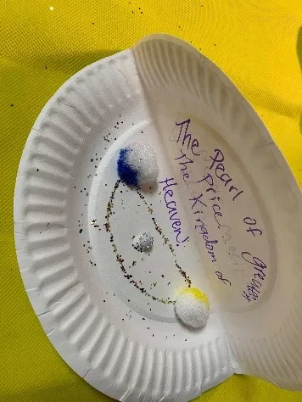
Activity:
Handprint Plant
Paper plates
Markers, stickers, or other decorating materials
Scissors
Glue, tape or staples
Glitter, or sparkles
Pom-poms or cotton balls

Slide 17
Instructions:
Use markers to decorate the paper plate, adding a written or glued on verse/caption.
Fold the plate in half like an “oyster”.
Glue a pom-pom “pearl” into the plate.
Embellish with glitter, sequins, or stickers.
Unfold the plate to reveal a “pearl” of great worth!

Slide 18
Closing Prayer
Dear God,
Thank you for teaching us how to be grateful with the things that we have, Thank you for teaching us the kingdom of heaven so that we can also then share your kingdom with those around us.
Amen.

Slide 19
LIVE THE WORD KIDS
15th Sunday in Ordinary Time | Cycle A

