Slide 1
LIVE THE WORD KIDS
16th Sunday in Ordinary Time| Cycle A

Slide 2
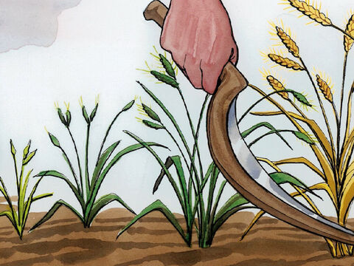
The Parable of the Weeds
Matthew 13:24-43

Slide 3
Leader: A reading from
the Holy Gospel
according to Matthew.
All: Glory to You, Oh Lord.

Slide 4
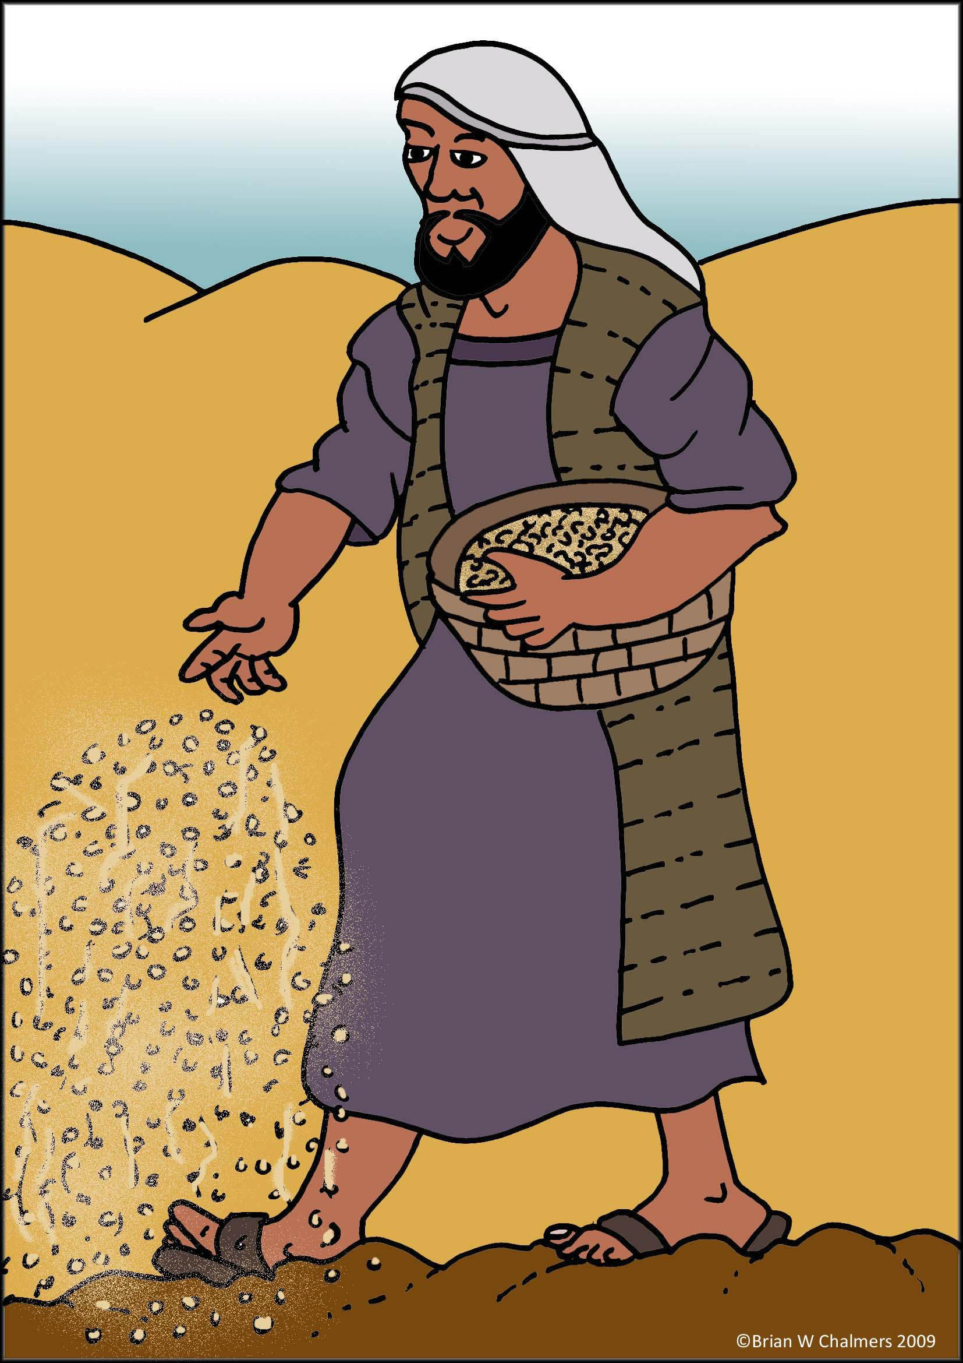
24
Jesus told them another parable: “The Kingdom of heaven is like this. A man sowed good seed in his field.

Slide 5
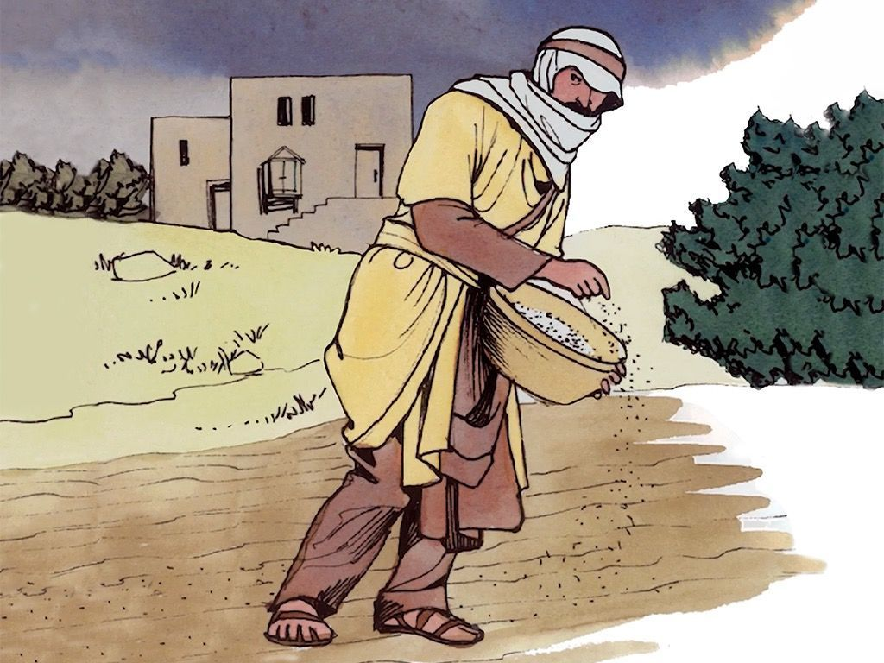
25
One night, when everyone was asleep, an enemy came and sowed weeds among the wheat and went away.

Slide 6
26
When the plants grew and the heads of grain began to form, then the weeds showed up.

Slide 7
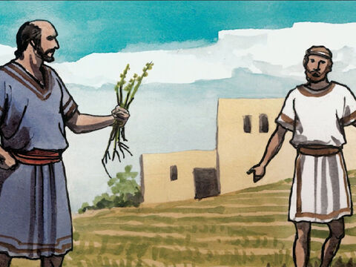
27
The man's servants came to him and said, ‘Sir, it was good seed you sowed in your field; where did the weeds come from?’

Slide 8
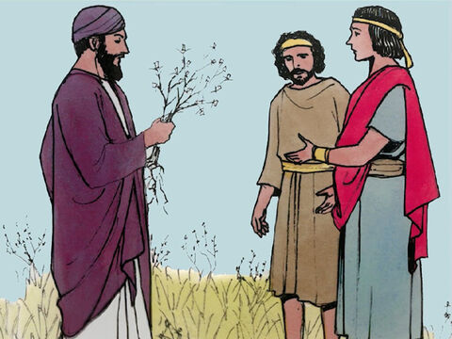
28
‘It was some enemy who did this,’ he answered. ‘Do you want us to go and pull up the weeds?’ they asked him.

Slide 9
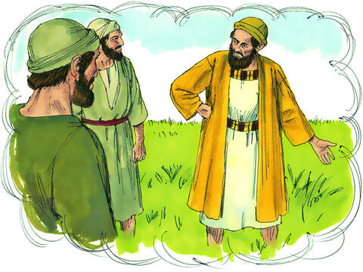
29
‘No,’ he answered, ‘because as you gather the weeds you might pull up some of the wheat along with them.

Slide 10
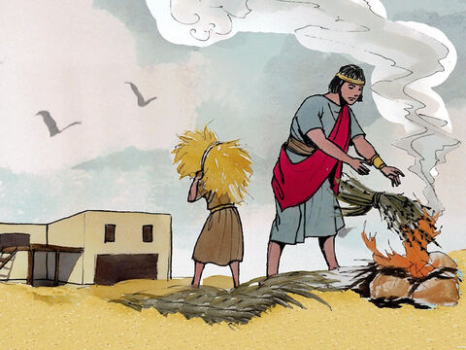
30
Let the wheat and the weeds both grow together until harvest. Then I will tell the harvest workers to pull up the weeds first, tie them in bundles and burn them, and then to gather in the wheat and put it in my barn.’”

Slide 11
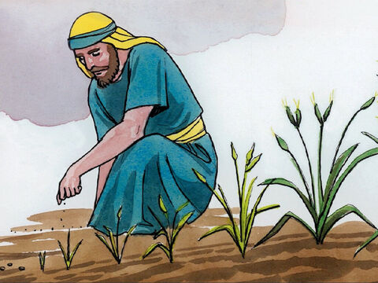
31
Jesus told them another parable: “The Kingdom of heaven is like this. A man takes a mustard seed and sows it in his field.

Slide 12
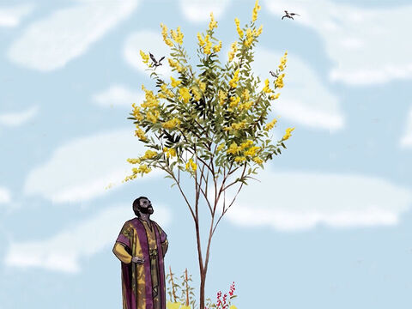
32
It is the smallest of all seeds, but when it grows up, it is the biggest of all plants. It becomes a tree, so that birds come and make their nests in its branches.”

Slide 13
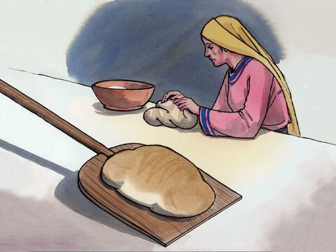
33
Jesus told them still another parable: “The Kingdom of heaven is like this. A woman takes some yeast and mixes it with a bushel of flour until the whole batch of dough rises.”

Slide 14
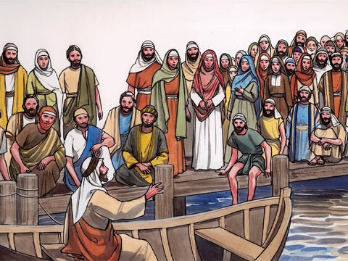
34
Jesus used parables to tell all these things to the crowds; he would not say a thing to them without using a parable.

Slide 15
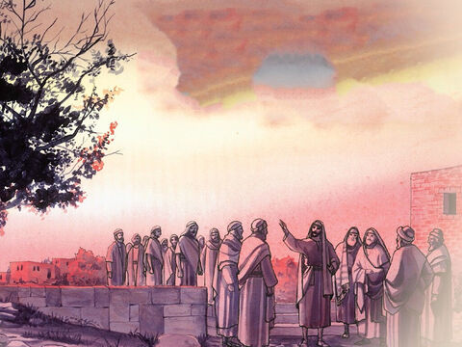
35
He did this to make come true what the prophet had said,
“I will use parables when I speak to them;
I will tell them things unknown since the creation of the world.”

Slide 16
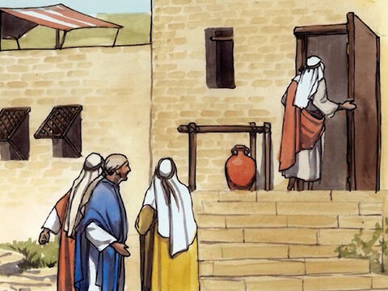
36
When Jesus had left the crowd and gone indoors, his disciples came to him and said, “Tell us what the parable about the weeds in the field means.”

Slide 17
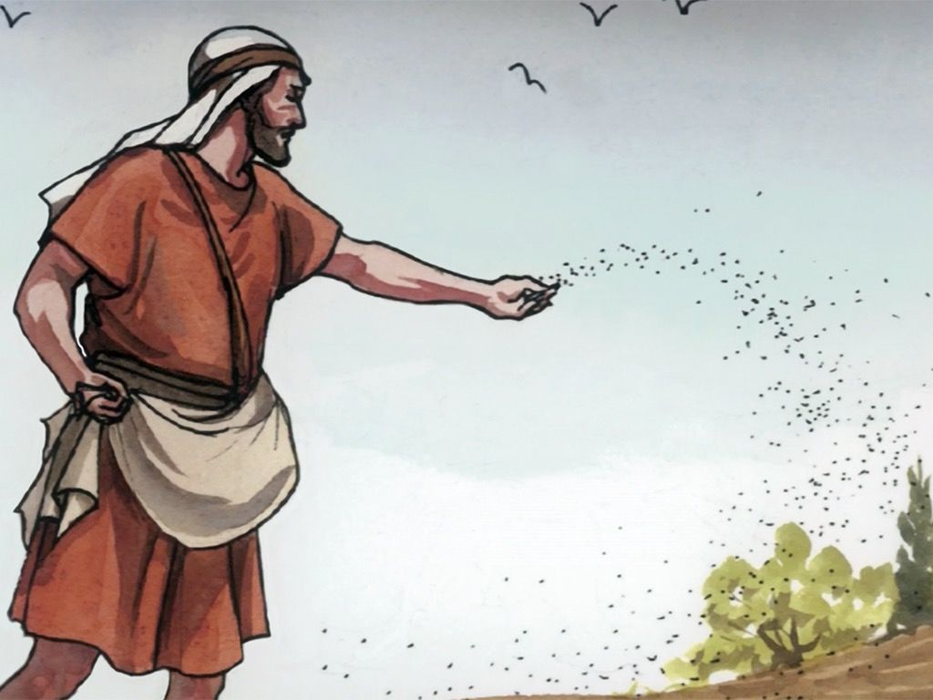
37
Jesus answered, “The man who sowed the good seed is the Son of Man;

Slide 18
38
the field is the world; the good seed is the people who belong to the Kingdom; the weeds are the people who belong to the Evil One;

Slide 19
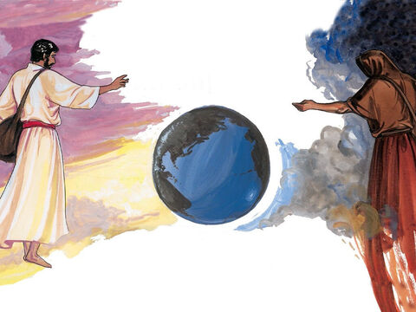
39
and the enemy who sowed the weeds is the Devil. The harvest is the end of the age, and the harvest workers are angels.

Slide 20
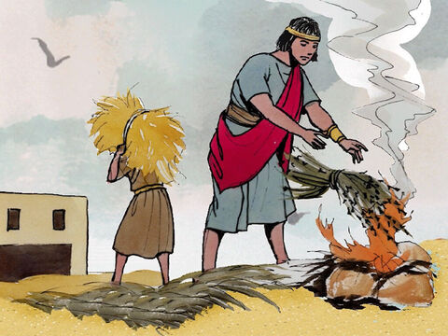
40
Just as the weeds are gathered up and burned in the fire, so the same thing will happen at the end of the age:

Slide 21
41
the Son of Man will send out his angels to gather up out of his Kingdom all those who cause people to sin and all others who do evil things,

Slide 22
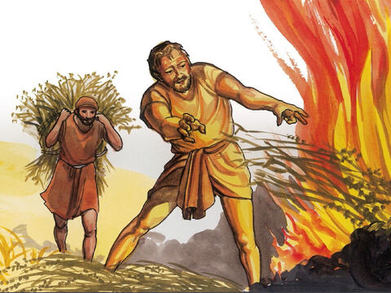
42
and they will throw them into the fiery furnace, where they will cry and gnash their teeth.

Slide 23
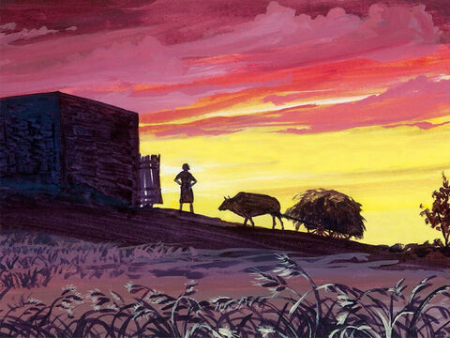
43
Then God's people will shine like the sun in their Father's Kingdom. Listen, then, if you have ears!

Slide 24
Leader: The Gospel of the Lord.
All: Praise to You,
Lord Jesus Christ.

Slide 25
GOSPEL MESSAGE
Notes:
Jesus told a story about a farmer because many of his listeners were farmers. He knew they would relate to the struggles of this farmer to plant his seed in good soil so it would produce a good crop. But Jesus was not interested in helping farmers to grow more lettuce and broccoli. He wanted us to grow in our faith.
Some seed fell on the path and was eaten or swept away. This seed represents people who hear the stories of the Bible but aren’t really listening. Some seed fell in the rocky places and among the thorns. These people hear the message of the Bible, but they are so distracted by other things, they quickly forget the message and never grow.
Some of the seed fell in good soil and produced a huge crop. This is where God wants us to be, planted in good soil. He wants us to read the Word of God daily. He wants us to spend time in prayer. If we take the time to nurture our faith, it will grow, and God will use us to spread His Word to the world.
Jesus told a story about a farmer because many of his listeners were farmers. He knew they would relate to the struggles of this farmer to plant his seed in good soil so it would produce a good crop. But Jesus was not interested in helping farmers to grow more lettuce and broccoli. He wanted us to grow in our faith.
Some seed fell on the path and was eaten or swept away. This seed represents people who hear the stories of the Bible but aren’t really listening. Some seed fell in the rocky places and among the thorns. These people hear the message of the Bible, but they are so distracted by other things, they quickly forget the message and never grow.
Some of the seed fell in good soil and produced a huge crop. This is where God wants us to be, planted in good soil. He wants us to read the Word of God daily. He wants us to spend time in prayer. If we take the time to nurture our faith, it will grow, and God will use us to spread His Word to the world.
Jesus told a story about a farmer because many of his listeners were farmers. He knew they would relate to the struggles of this farmer to plant his seed in good soil so it would produce a good crop. But Jesus was not interested in helping farmers to grow more lettuce and broccoli. He wanted us to grow in our faith.
Some seed fell on the path and was eaten or swept away. This seed represents people who hear the stories of the Bible but aren’t really listening. Some seed fell in the rocky places and among the thorns. These people hear the message of the Bible, but they are so distracted by other things, they quickly forget the message and never grow.
Some of the seed fell in good soil and produced a huge crop. This is where God wants us to be, planted in good soil. He wants us to read the Word of God daily. He wants us to spend time in prayer. If we take the time to nurture our faith, it will grow, and God will use us to spread His Word to the world.
Jesus told a story about a farmer because many of his listeners were farmers. He knew they would relate to the struggles of this farmer to plant his seed in good soil so it would produce a good crop. But Jesus was not interested in helping farmers to grow more lettuce and broccoli. He wanted us to grow in our faith.
Some seed fell on the path and was eaten or swept away. This seed represents people who hear the stories of the Bible but aren’t really listening. Some seed fell in the rocky places and among the thorns. These people hear the message of the Bible, but they are so distracted by other things, they quickly forget the message and never grow.
Some of the seed fell in good soil and produced a huge crop. This is where God wants us to be, planted in good soil. He wants us to read the Word of God daily. He wants us to spend time in prayer. If we take the time to nurture our faith, it will grow, and God will use us to spread His Word to the world.
Jesus told a story about a farmer because many of his listeners were farmers. He knew they would relate to the struggles of this farmer to plant his seed in good soil so it would produce a good crop. But Jesus was not interested in helping farmers to grow more lettuce and broccoli. He wanted us to grow in our faith.
Some seed fell on the path and was eaten or swept away. This seed represents people who hear the stories of the Bible but aren’t really listening. Some seed fell in the rocky places and among the thorns. These people hear the message of the Bible, but they are so distracted by other things, they quickly forget the message and never grow.
Some of the seed fell in good soil and produced a huge crop. This is where God wants us to be, planted in good soil. He wants us to read the Word of God daily. He wants us to spend time in prayer. If we take the time to nurture our faith, it will grow, and God will use us to spread His Word to the world.
Jesus told a story about a farmer because many of his listeners were farmers. He knew they would relate to the struggles of this farmer to plant his seed in good soil so it would produce a good crop. But Jesus was not interested in helping farmers to grow more lettuce and broccoli. He wanted us to grow in our faith.
Some seed fell on the path and was eaten or swept away. This seed represents people who hear the stories of the Bible but aren’t really listening. Some seed fell in the rocky places and among the thorns. These people hear the message of the Bible, but they are so distracted by other things, they quickly forget the message and never grow.
Some of the seed fell in good soil and produced a huge crop. This is where God wants us to be, planted in good soil. He wants us to read the Word of God daily. He wants us to spend time in prayer. If we take the time to nurture our faith, it will grow, and God will use us to spread His Word to the world.
Jesus told a story about a farmer because many of his listeners were farmers. He knew they would relate to the struggles of this farmer to plant his seed in good soil so it would produce a good crop. But Jesus was not interested in helping farmers to grow more lettuce and broccoli. He wanted us to grow in our faith.
Some seed fell on the path and was eaten or swept away. This seed represents people who hear the stories of the Bible but aren’t really listening. Some seed fell in the rocky places and among the thorns. These people hear the message of the Bible, but they are so distracted by other things, they quickly forget the message and never grow.
Some of the seed fell in good soil and produced a huge crop. This is where God wants us to be, planted in good soil. He wants us to read the Word of God daily. He wants us to spend time in prayer. If we take the time to nurture our faith, it will grow, and God will use us to spread His Word to the world.
Jesus told a story about a farmer because many of his listeners were farmers. He knew they would relate to the struggles of this farmer to plant his seed in good soil so it would produce a good crop. But Jesus was not interested in helping farmers to grow more lettuce and broccoli. He wanted us to grow in our faith.
Some seed fell on the path and was eaten or swept away. This seed represents people who hear the stories of the Bible but aren’t really listening. Some seed fell in the rocky places and among the thorns. These people hear the message of the Bible, but they are so distracted by other things, they quickly forget the message and never grow.
Some of the seed fell in good soil and produced a huge crop. This is where God wants us to be, planted in good soil. He wants us to read the Word of God daily. He wants us to spend time in prayer. If we take the time to nurture our faith, it will grow, and God will use us to spread His Word to the world.
Jesus told a story about a farmer because many of his listeners were farmers. He knew they would relate to the struggles of this farmer to plant his seed in good soil so it would produce a good crop. But Jesus was not interested in helping farmers to grow more lettuce and broccoli. He wanted us to grow in our faith.
Some seed fell on the path and was eaten or swept away. This seed represents people who hear the stories of the Bible but aren’t really listening. Some seed fell in the rocky places and among the thorns. These people hear the message of the Bible, but they are so distracted by other things, they quickly forget the message and never grow.
Some of the seed fell in good soil and produced a huge crop. This is where God wants us to be, planted in good soil. He wants us to read the Word of God daily. He wants us to spend time in prayer. If we take the time to nurture our faith, it will grow, and God will use us to spread His Word to the world.
JJesus told a story about a farmer because many of his listeners were farmers. He knew they would relate to the struggles of this farmer to plant his seed in good soil so it would produce a good crop. But Jesus was not interested in helping farmers to grow more lettuce and broccoli. He wanted us to grow in our faith.
Some seed fell on the path and was eaten or swept away. This seed represents people who hear the stories of the Bible but aren’t really listening. Some seed fell in the rocky places and among the thorns. These people hear the message of the Bible, but they are so distracted by other things, they quickly forget the message and never grow.
Some of the seed fell in good soil and produced a huge crop. This is where God wants us to be, planted in good soil. He wants us to read the Word of God daily. He wants us to spend time in prayer. If we take the time to nurture our faith, it will grow, and God will use us to spread His Word to the world.

Slide 26
GOSPEL REFLECTION
On the outset, the parable of the weeds sewn among the seed might seem a bit odd, or even negative and judgmental. Separate the “bad seeds”, and throw them away to be burned? Does this mean we ought to shun those who are not deemed good enough? On the contrary, the parable teaches quite the opposite. The farmer will dictate which plants to keep and which to throw away. God will judge the hearts of man. It is for Him to determine, not us. The object of this lesson is to communicate to children that we have difficulty discerning things by sight, and it is not our job to do so. We pray that all would come to know Christ, and while we recognize that some will not, we acknowledge God as the ultimate judge.
When we seek to live “by the rules” alone, it is tempting to strictly follow the letter of the Law, and to think we know better than others who seem to live differently. The truth is that we are all sinners, fallen short of God’s glory and in need of grace. The good news of the Gospel reminds us that His love is for everyone. True, there will be some who reject the Gospel and are punished. But God’s desire is for us to know Him and be part of His family, and we have the opportunity if we only accept it.
Notes:
Jesus told a story about a farmer because many of his listeners were farmers. He knew they would relate to the struggles of this farmer to plant his seed in good soil so it would produce a good crop. But Jesus was not interested in helping farmers to grow more lettuce and broccoli. He wanted us to grow in our faith.
Some seed fell on the path and was eaten or swept away. This seed represents people who hear the stories of the Bible but aren’t really listening. Some seed fell in the rocky places and among the thorns. These people hear the message of the Bible, but they are so distracted by other things, they quickly forget the message and never grow.
Some of the seed fell in good soil and produced a huge crop. This is where God wants us to be, planted in good soil. He wants us to read the Word of God daily. He wants us to spend time in prayer. If we take the time to nurture our faith, it will grow, and God will use us to spread His Word to the world.

Slide 27
Activity:
Bond Paper
Colored paper
Scissors
Popsicle Stick
Glue

Slide 28
Instructions:

Slide 29
Closing Prayer
Dear God,
We pray, that every day as we hear your word by your spirit, you would soften our hearts and that our hearts, minds and lives would indeed be fertile soil for hearing your word, holding it fast, with honest and good hearts and bearing fruit with patience.
Amen.

Slide 30
LIVE THE WORD KIDS
15th Sunday in Ordinary Time | Cycle A

