Slide 1
LIVE THE WORD KIDS
15th Sunday in Ordinary Time| Cycle A

Slide 2
The Parable of the Sower
Matthew 13:1-9

Slide 3
Leader: A reading from
the Holy Gospel
according to Matthew.
All: Glory to You, Oh Lord.

Slide 4
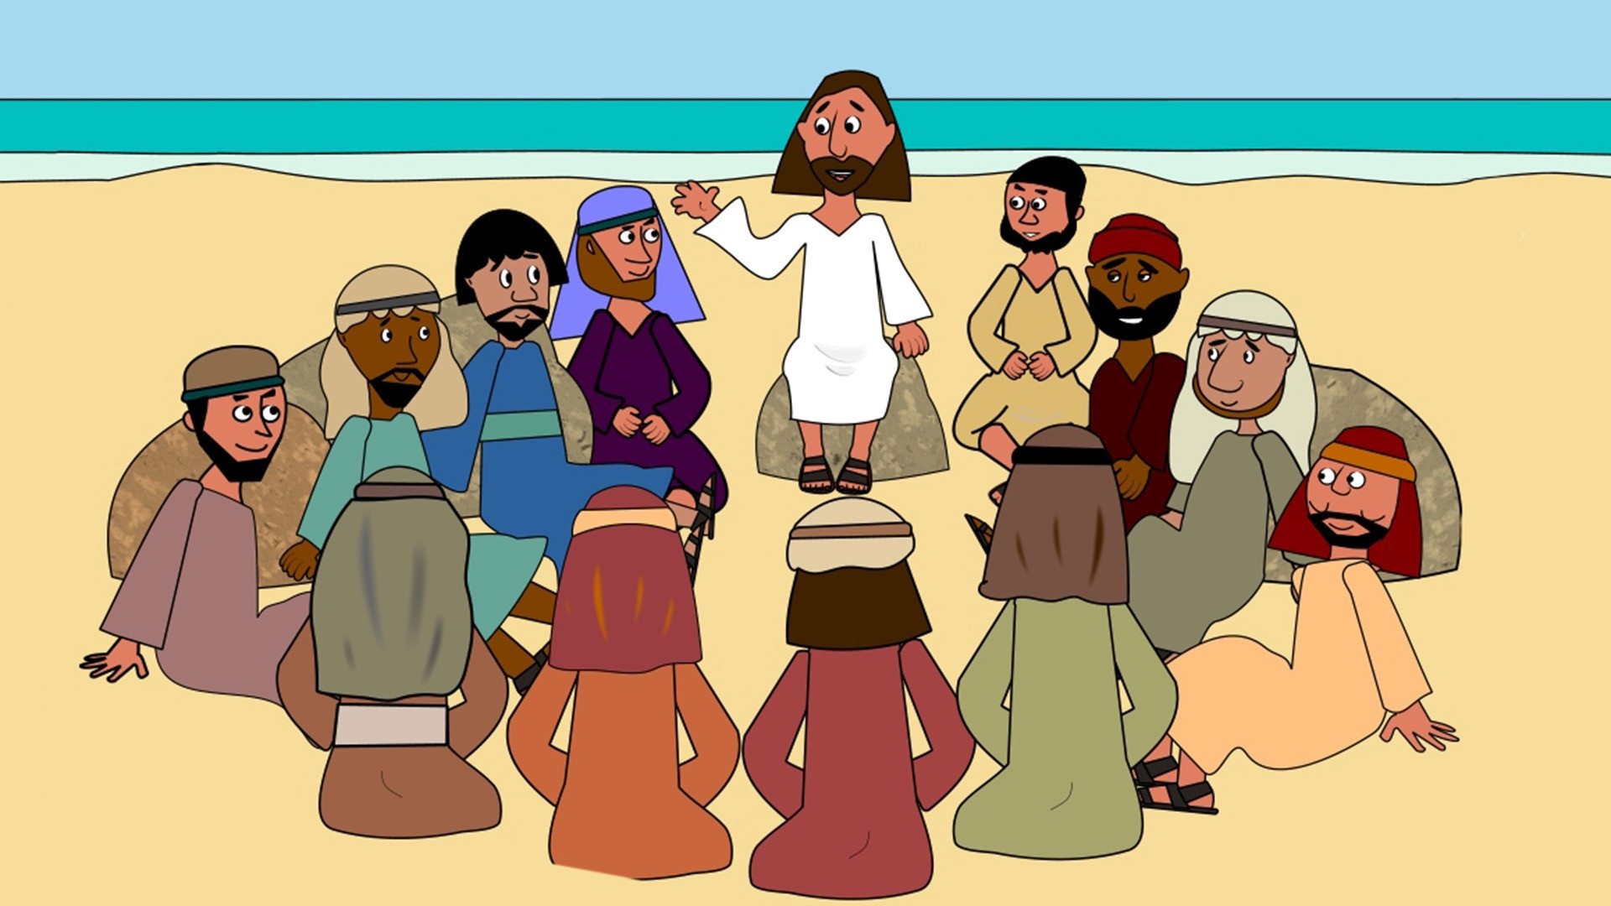
1
That same day Jesus left the house and went to the lakeside, where he sat down to teach

Slide 5
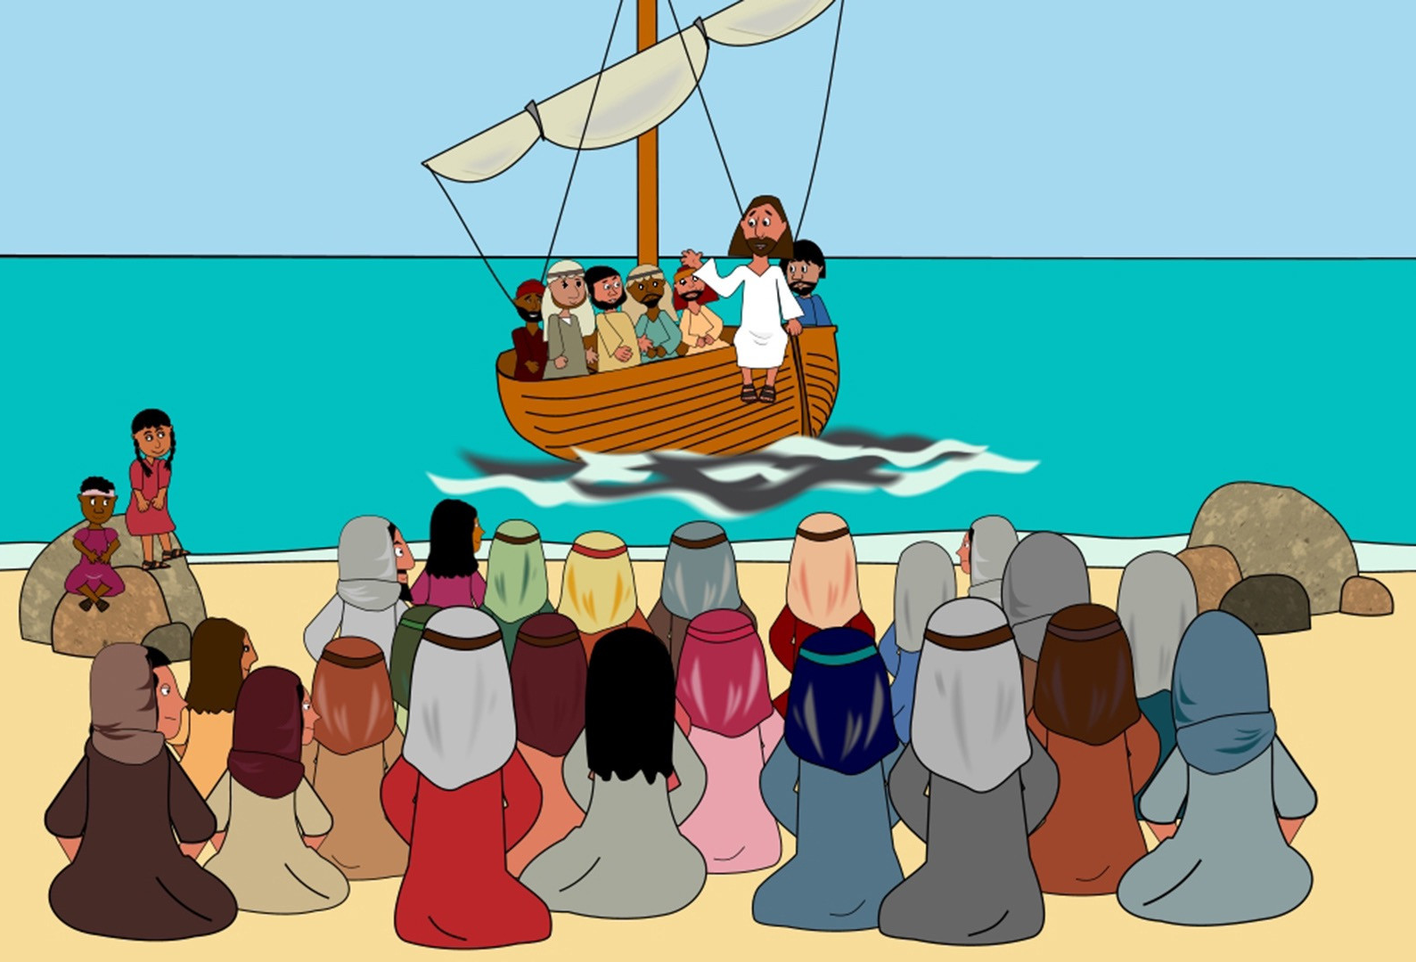
2
The crowd that gathered around him was so large that he got into a boat and sat in it, while the crowd stood on the shore.

Slide 6
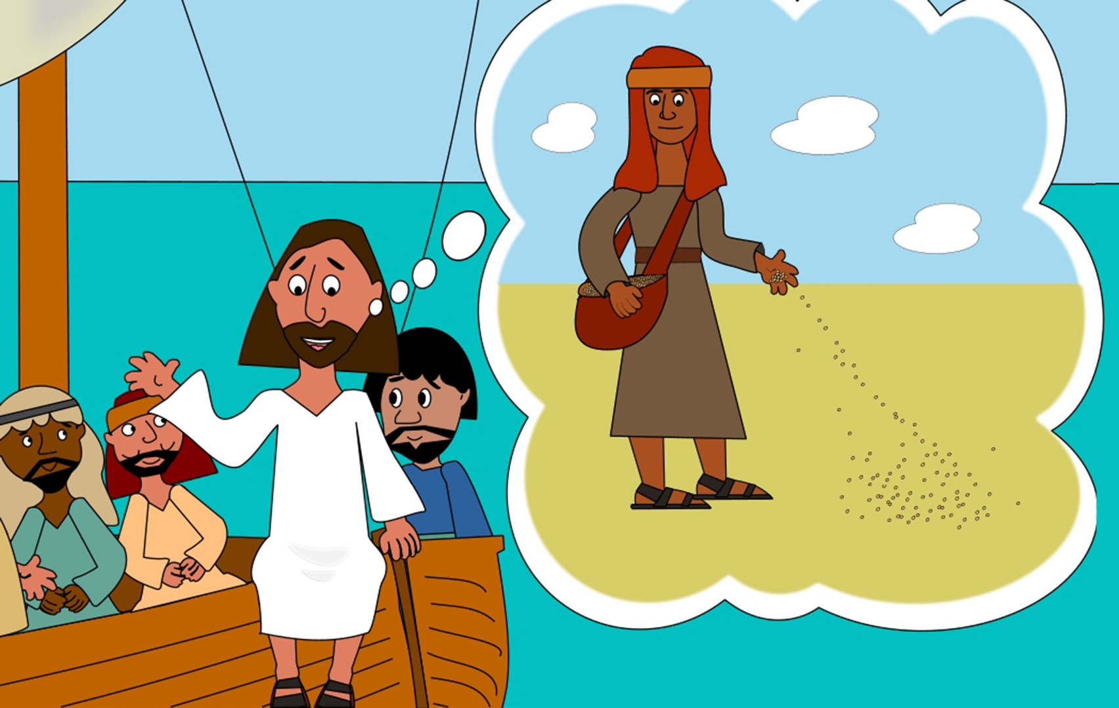
3
He used parables to tell them many things.
“Once there was a man who went out to sow grain.

Slide 7
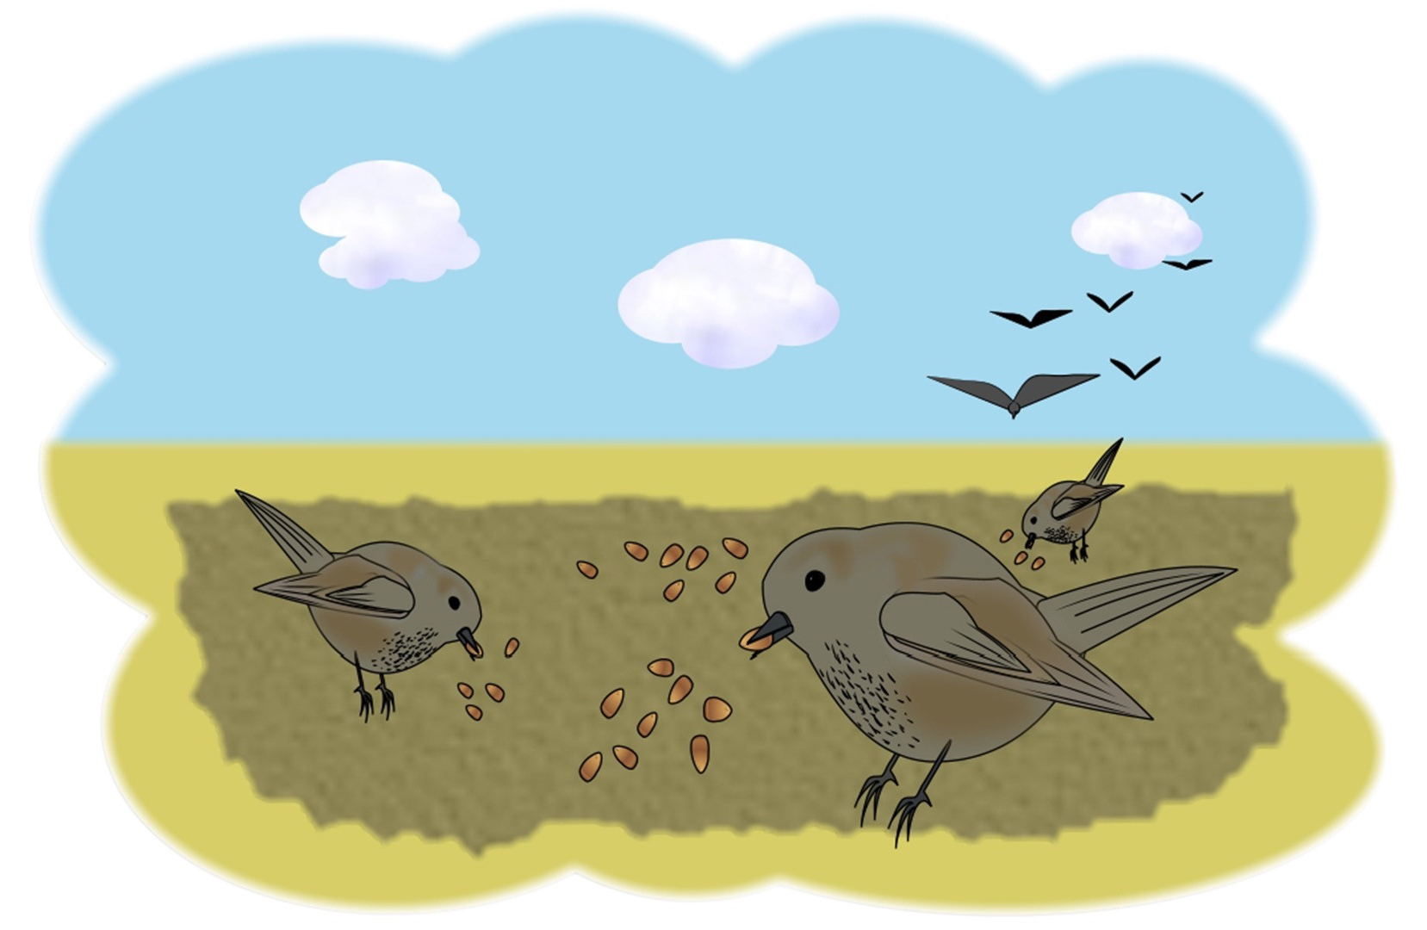
4
As he scattered the seed in the field, some of it fell along the path, and the birds came and ate it up.

Slide 8
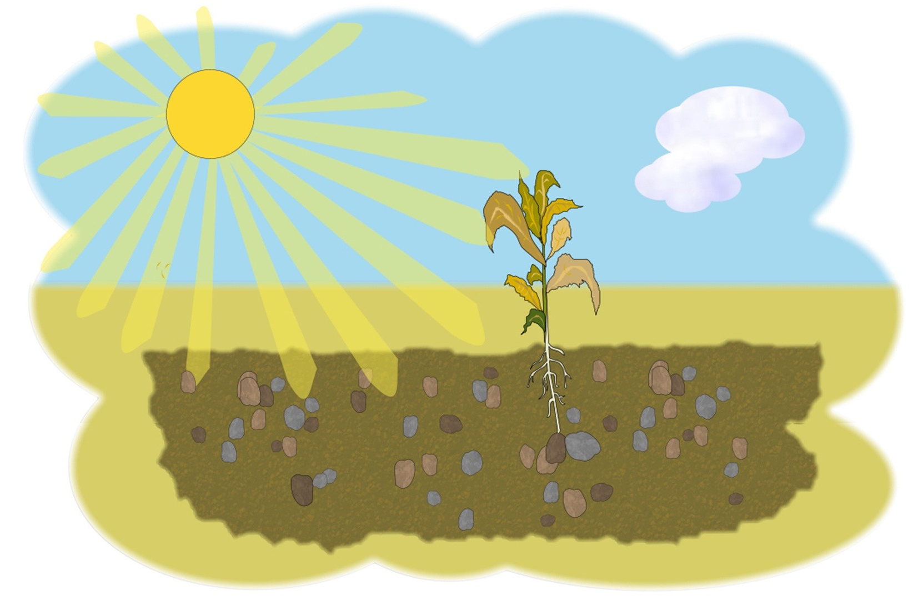
5
Some of it fell on rocky ground, where there was little soil. The seeds soon sprouted, because the soil wasn't deep.

Slide 9
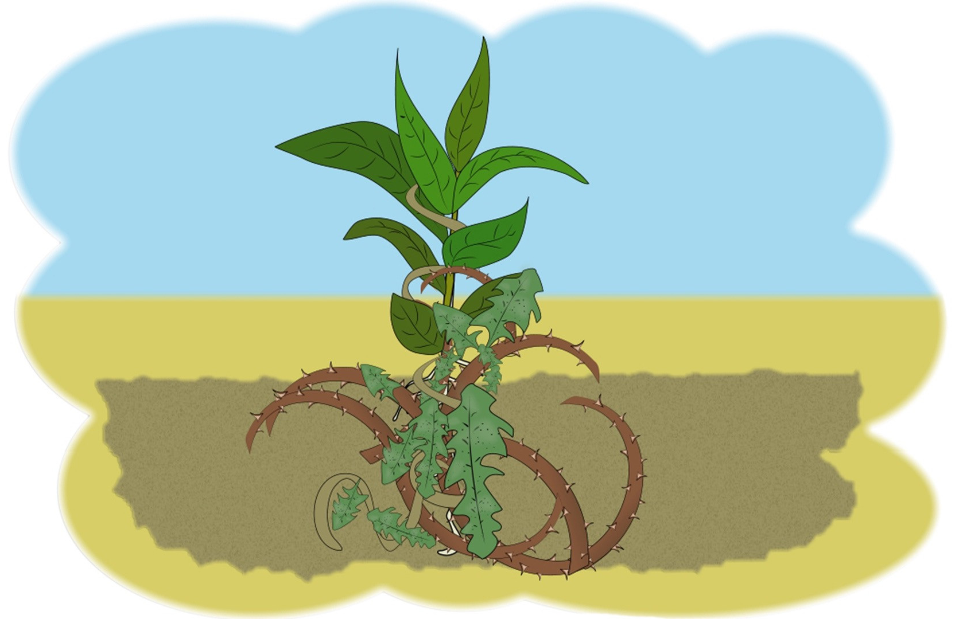
6
But when the sun came up, it burned the young plants; and because the roots had not grown deep enough, the plants soon dried up.

Slide 10
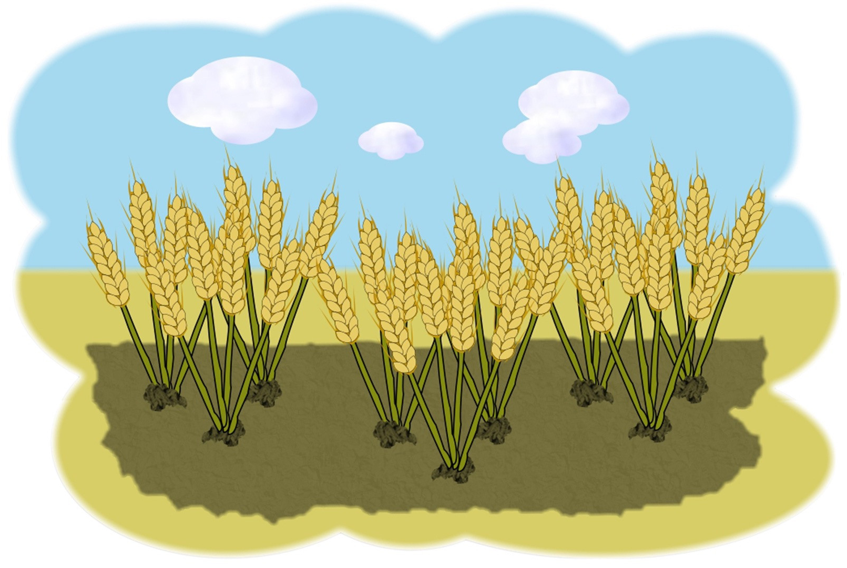
7
Some of the seed fell among thorn bushes, which grew up and choked the plants.

Slide 11
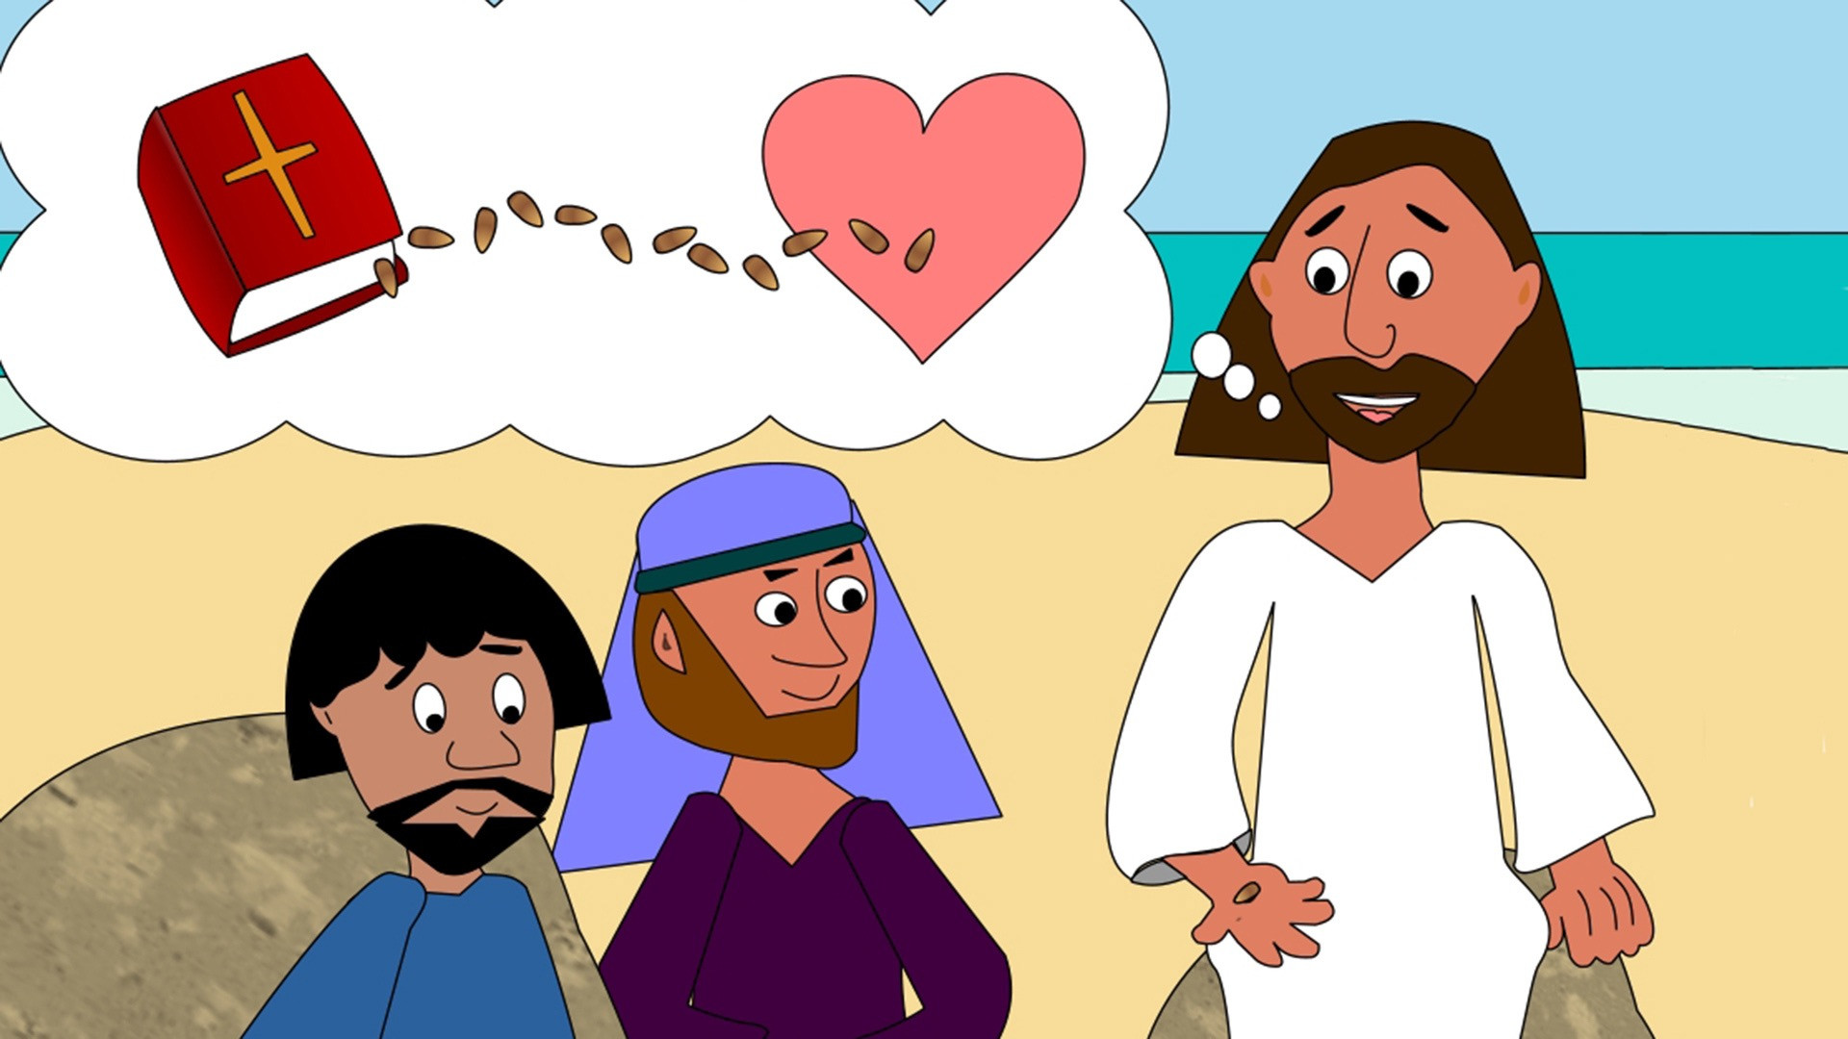
8
But some seeds fell in good soil, and the plants bore grain: some had one hundred grains, others sixty, and others thirty.”

Slide 12
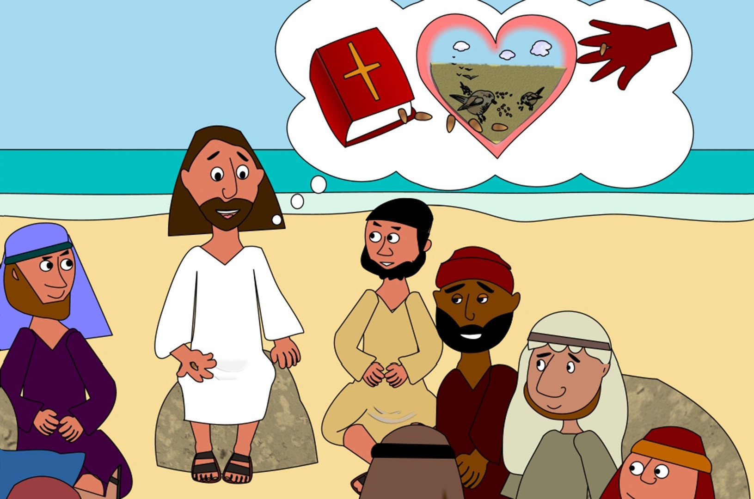
9
And Jesus concluded, “Listen, then, if you have ears!”

Slide 13
Leader: The Gospel of the Lord.
All: Praise to You,
Lord Jesus Christ.

Slide 14
GOSPEL MESSAGE
Notes:
Jesus told a story about a farmer because many of his listeners were farmers. He knew they would relate to the struggles of this farmer to plant his seed in good soil so it would produce a good crop. But Jesus was not interested in helping farmers to grow more lettuce and broccoli. He wanted us to grow in our faith.
Some seed fell on the path and was eaten or swept away. This seed represents people who hear the stories of the Bible but aren’t really listening. Some seed fell in the rocky places and among the thorns. These people hear the message of the Bible, but they are so distracted by other things, they quickly forget the message and never grow.
Some of the seed fell in good soil and produced a huge crop. This is where God wants us to be, planted in good soil. He wants us to read the Word of God daily. He wants us to spend time in prayer. If we take the time to nurture our faith, it will grow, and God will use us to spread His Word to the world.
Jesus told a story about a farmer because many of his listeners were farmers. He knew they would relate to the struggles of this farmer to plant his seed in good soil so it would produce a good crop. But Jesus was not interested in helping farmers to grow more lettuce and broccoli. He wanted us to grow in our faith.
Some seed fell on the path and was eaten or swept away. This seed represents people who hear the stories of the Bible but aren’t really listening. Some seed fell in the rocky places and among the thorns. These people hear the message of the Bible, but they are so distracted by other things, they quickly forget the message and never grow.
Some of the seed fell in good soil and produced a huge crop. This is where God wants us to be, planted in good soil. He wants us to read the Word of God daily. He wants us to spend time in prayer. If we take the time to nurture our faith, it will grow, and God will use us to spread His Word to the world.
Jesus told a story about a farmer because many of his listeners were farmers. He knew they would relate to the struggles of this farmer to plant his seed in good soil so it would produce a good crop. But Jesus was not interested in helping farmers to grow more lettuce and broccoli. He wanted us to grow in our faith.
Some seed fell on the path and was eaten or swept away. This seed represents people who hear the stories of the Bible but aren’t really listening. Some seed fell in the rocky places and among the thorns. These people hear the message of the Bible, but they are so distracted by other things, they quickly forget the message and never grow.
Some of the seed fell in good soil and produced a huge crop. This is where God wants us to be, planted in good soil. He wants us to read the Word of God daily. He wants us to spend time in prayer. If we take the time to nurture our faith, it will grow, and God will use us to spread His Word to the world.
Jesus told a story about a farmer because many of his listeners were farmers. He knew they would relate to the struggles of this farmer to plant his seed in good soil so it would produce a good crop. But Jesus was not interested in helping farmers to grow more lettuce and broccoli. He wanted us to grow in our faith.
Some seed fell on the path and was eaten or swept away. This seed represents people who hear the stories of the Bible but aren’t really listening. Some seed fell in the rocky places and among the thorns. These people hear the message of the Bible, but they are so distracted by other things, they quickly forget the message and never grow.
Some of the seed fell in good soil and produced a huge crop. This is where God wants us to be, planted in good soil. He wants us to read the Word of God daily. He wants us to spend time in prayer. If we take the time to nurture our faith, it will grow, and God will use us to spread His Word to the world.
Jesus told a story about a farmer because many of his listeners were farmers. He knew they would relate to the struggles of this farmer to plant his seed in good soil so it would produce a good crop. But Jesus was not interested in helping farmers to grow more lettuce and broccoli. He wanted us to grow in our faith.
Some seed fell on the path and was eaten or swept away. This seed represents people who hear the stories of the Bible but aren’t really listening. Some seed fell in the rocky places and among the thorns. These people hear the message of the Bible, but they are so distracted by other things, they quickly forget the message and never grow.
Some of the seed fell in good soil and produced a huge crop. This is where God wants us to be, planted in good soil. He wants us to read the Word of God daily. He wants us to spend time in prayer. If we take the time to nurture our faith, it will grow, and God will use us to spread His Word to the world.
Jesus told a story about a farmer because many of his listeners were farmers. He knew they would relate to the struggles of this farmer to plant his seed in good soil so it would produce a good crop. But Jesus was not interested in helping farmers to grow more lettuce and broccoli. He wanted us to grow in our faith.
Some seed fell on the path and was eaten or swept away. This seed represents people who hear the stories of the Bible but aren’t really listening. Some seed fell in the rocky places and among the thorns. These people hear the message of the Bible, but they are so distracted by other things, they quickly forget the message and never grow.
Some of the seed fell in good soil and produced a huge crop. This is where God wants us to be, planted in good soil. He wants us to read the Word of God daily. He wants us to spend time in prayer. If we take the time to nurture our faith, it will grow, and God will use us to spread His Word to the world.
Jesus told a story about a farmer because many of his listeners were farmers. He knew they would relate to the struggles of this farmer to plant his seed in good soil so it would produce a good crop. But Jesus was not interested in helping farmers to grow more lettuce and broccoli. He wanted us to grow in our faith.
Some seed fell on the path and was eaten or swept away. This seed represents people who hear the stories of the Bible but aren’t really listening. Some seed fell in the rocky places and among the thorns. These people hear the message of the Bible, but they are so distracted by other things, they quickly forget the message and never grow.
Some of the seed fell in good soil and produced a huge crop. This is where God wants us to be, planted in good soil. He wants us to read the Word of God daily. He wants us to spend time in prayer. If we take the time to nurture our faith, it will grow, and God will use us to spread His Word to the world.
Jesus told a story about a farmer because many of his listeners were farmers. He knew they would relate to the struggles of this farmer to plant his seed in good soil so it would produce a good crop. But Jesus was not interested in helping farmers to grow more lettuce and broccoli. He wanted us to grow in our faith.
Some seed fell on the path and was eaten or swept away. This seed represents people who hear the stories of the Bible but aren’t really listening. Some seed fell in the rocky places and among the thorns. These people hear the message of the Bible, but they are so distracted by other things, they quickly forget the message and never grow.
Some of the seed fell in good soil and produced a huge crop. This is where God wants us to be, planted in good soil. He wants us to read the Word of God daily. He wants us to spend time in prayer. If we take the time to nurture our faith, it will grow, and God will use us to spread His Word to the world.
Jesus told a story about a farmer because many of his listeners were farmers. He knew they would relate to the struggles of this farmer to plant his seed in good soil so it would produce a good crop. But Jesus was not interested in helping farmers to grow more lettuce and broccoli. He wanted us to grow in our faith.
Some seed fell on the path and was eaten or swept away. This seed represents people who hear the stories of the Bible but aren’t really listening. Some seed fell in the rocky places and among the thorns. These people hear the message of the Bible, but they are so distracted by other things, they quickly forget the message and never grow.
Some of the seed fell in good soil and produced a huge crop. This is where God wants us to be, planted in good soil. He wants us to read the Word of God daily. He wants us to spend time in prayer. If we take the time to nurture our faith, it will grow, and God will use us to spread His Word to the world.
JJesus told a story about a farmer because many of his listeners were farmers. He knew they would relate to the struggles of this farmer to plant his seed in good soil so it would produce a good crop. But Jesus was not interested in helping farmers to grow more lettuce and broccoli. He wanted us to grow in our faith.
Some seed fell on the path and was eaten or swept away. This seed represents people who hear the stories of the Bible but aren’t really listening. Some seed fell in the rocky places and among the thorns. These people hear the message of the Bible, but they are so distracted by other things, they quickly forget the message and never grow.
Some of the seed fell in good soil and produced a huge crop. This is where God wants us to be, planted in good soil. He wants us to read the Word of God daily. He wants us to spend time in prayer. If we take the time to nurture our faith, it will grow, and God will use us to spread His Word to the world.

Slide 15
GOSPEL REFLECTION
Jesus told a story about a farmer because many of his listeners were farmers. He knew they would relate to the struggles of this farmer to plant his seed in good soil so it would produce a good crop. But Jesus was not interested in helping farmers to grow more lettuce and broccoli. He wanted us to grow in our faith.
Some seed fell on the path and was eaten or swept away. This seed represents people who hear the stories of the Bible but aren’t really listening. Some seed fell in the rocky places and among the thorns. These people hear the message of the Bible, but they are so distracted by other things, they quickly forget the message and never grow.
Some of the seed fell in good soil and produced a huge crop. This is where God wants us to be, planted in good soil. He wants us to read the Word of God daily. He wants us to spend time in prayer. If we take the time to nurture our faith, it will grow, and God will use us to spread His Word to the world.
Notes:
Jesus told a story about a farmer because many of his listeners were farmers. He knew they would relate to the struggles of this farmer to plant his seed in good soil so it would produce a good crop. But Jesus was not interested in helping farmers to grow more lettuce and broccoli. He wanted us to grow in our faith.
Some seed fell on the path and was eaten or swept away. This seed represents people who hear the stories of the Bible but aren’t really listening. Some seed fell in the rocky places and among the thorns. These people hear the message of the Bible, but they are so distracted by other things, they quickly forget the message and never grow.
Some of the seed fell in good soil and produced a huge crop. This is where God wants us to be, planted in good soil. He wants us to read the Word of God daily. He wants us to spend time in prayer. If we take the time to nurture our faith, it will grow, and God will use us to spread His Word to the world.

Slide 16
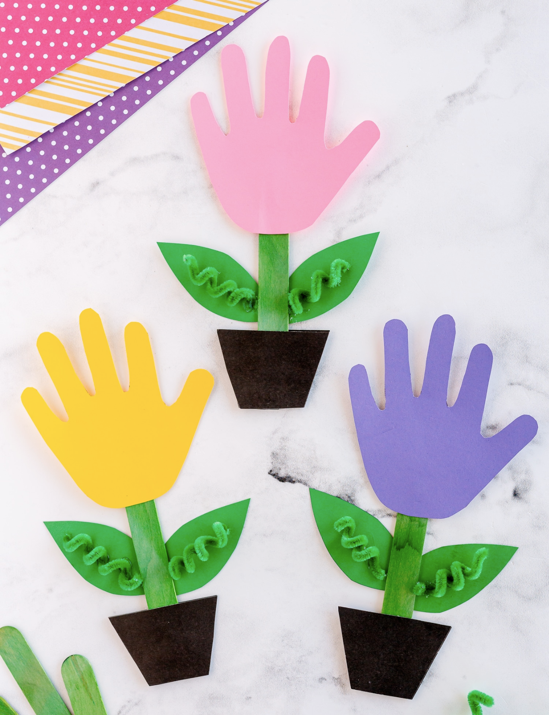
Activity:
Handprint Plant
Bond Paper
Colored paper
Scissors
Popsicle Stick
Glue

Slide 17
Instructions:
Cut out three handprints out of cardstock – yellow, pink, and purple.
Cut out two black pot shapes per flower pot. You will need six black pots in total.
Glue the black pot to the bottom of your popsicle stick. Flip it over and add a second pot.
Wrap a pipe cleaner around a pencil to make it curly. Glue the twisted pipe cleaner to the cardstock leaves Glue the twisted pipe cleaner and leaves to the back of your popsicle stick stem.
Glue the handprint flower on top.

Slide 18
Closing Prayer
Dear God,
We pray, that every day as we hear your word by your spirit, you would soften our hearts and that our hearts, minds and lives would indeed be fertile soil for hearing your word, holding it fast, with honest and good hearts and bearing fruit with patience.
Amen.

Slide 19
LIVE THE WORD KIDS
15th Sunday in Ordinary Time | Cycle A

