Slide 1
LIVE THE WORD KIDS
14th Sunday in Ordinary Time | Cycle A

Slide 2
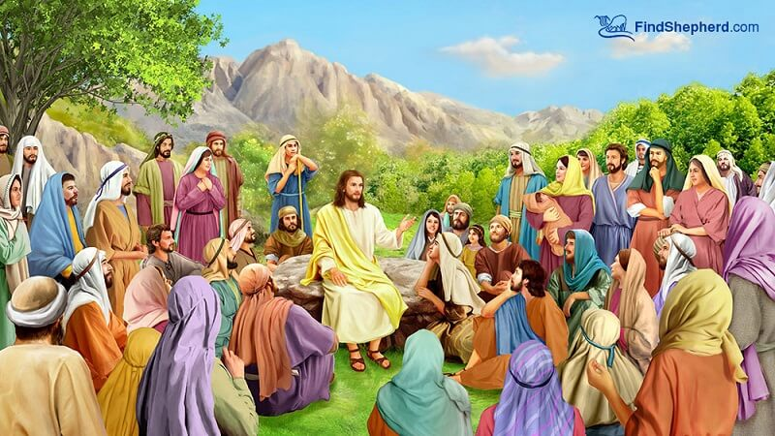
Come to Me and Rest
Matthew 11:25-30

Slide 3
Leader: A reading from
the Holy Gospel
according to Matthew.
All: Glory to You, Oh Lord.

Slide 4
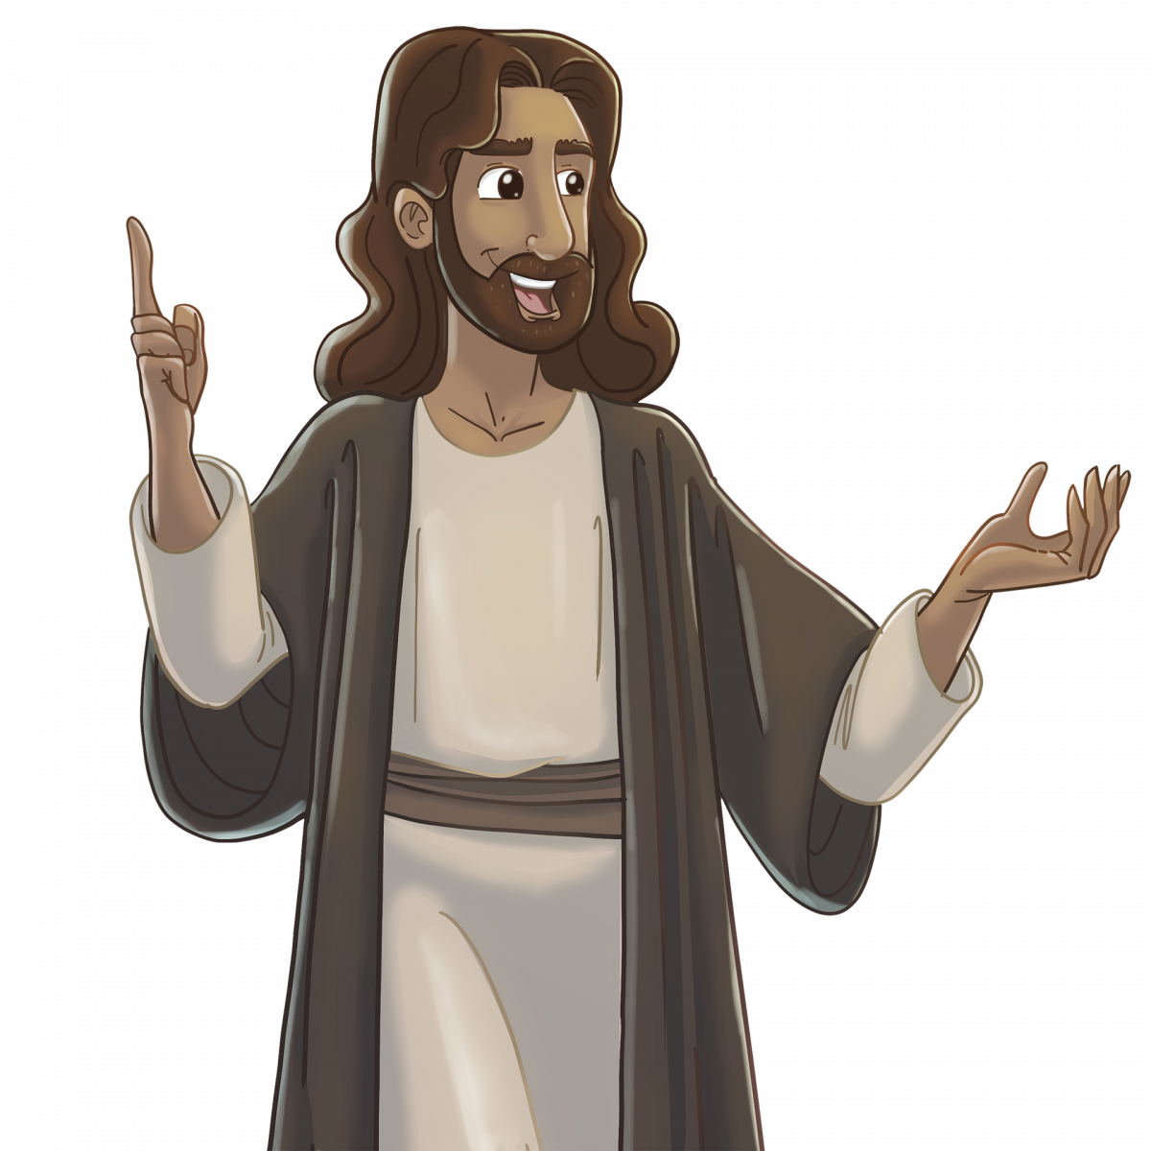
25
At that time Jesus said, “Father, Lord of heaven and earth! I thank you because you have shown to the unlearned what you have hidden from the wise and learned.

Slide 5
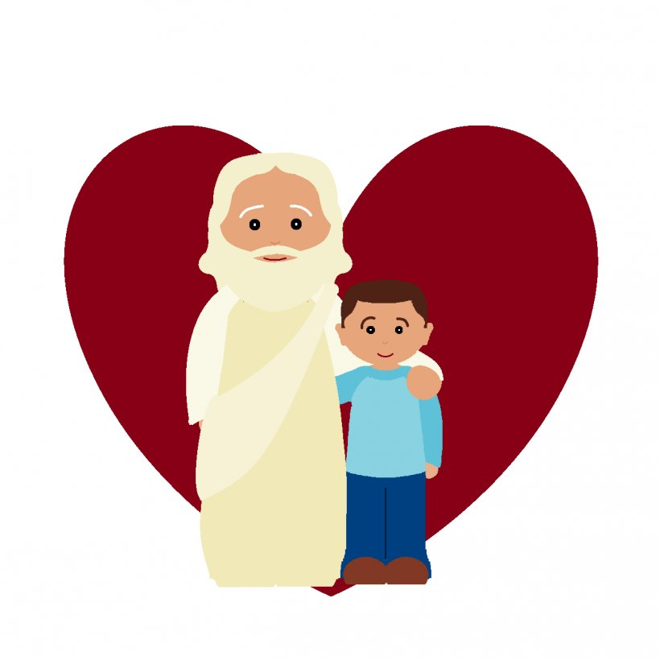
26
Yes, Father, this was how you were pleased to have it happen.

Slide 6
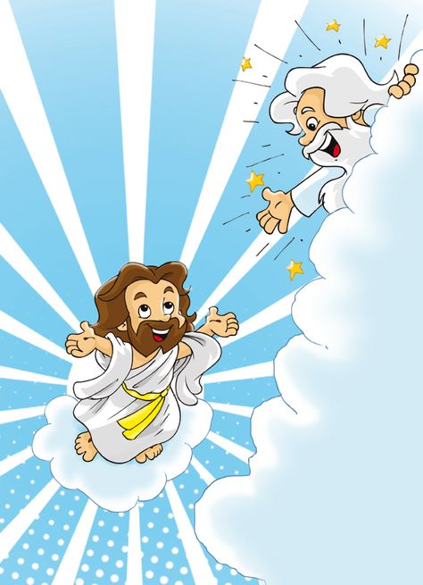
27
“My Father has given me all things. No one knows the Son except the Father, and no one knows the Father except the Son and those to whom the Son chooses to reveal him.

Slide 7
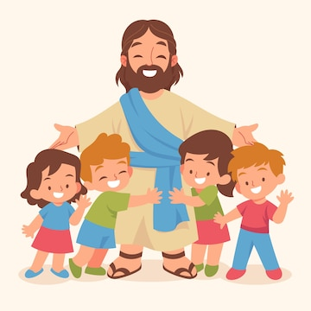
28
“Come to me, all of you who are tired from carrying heavy loads, and I will give you rest.

Slide 8
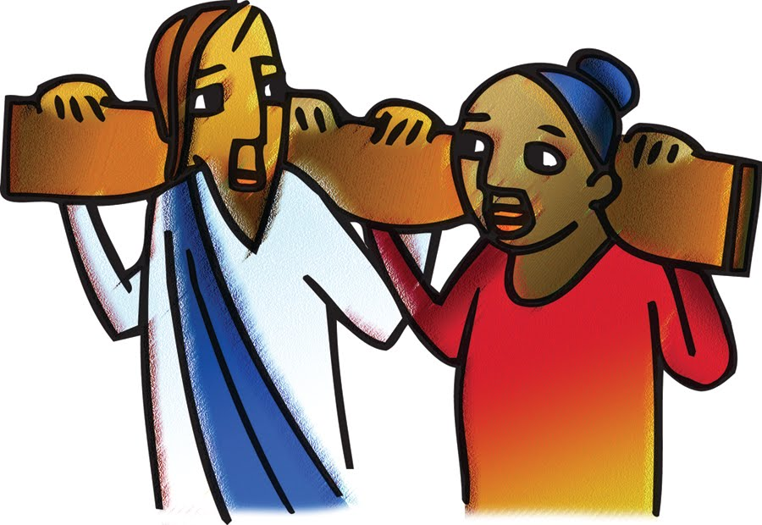
29
Take my yoke and put it on you, and learn from me, because I am gentle and humble in spirit; and you will find rest.

Slide 9
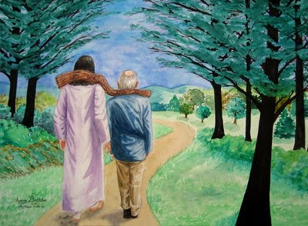
30
For the yoke I will give you is easy, and the load I will put on you is light.”

Slide 10
Leader: The Gospel of the Lord.
All: Praise to You,
Lord Jesus Christ.

Slide 11
GOSPEL MESSAGE

Slide 12
Activity: Jesus is my Shepherd Craft
Colored Paper, Glue, Bond Paper, Colored Pens and Scissor, Brown or Black Yarn, Googly eyes.

Slide 13
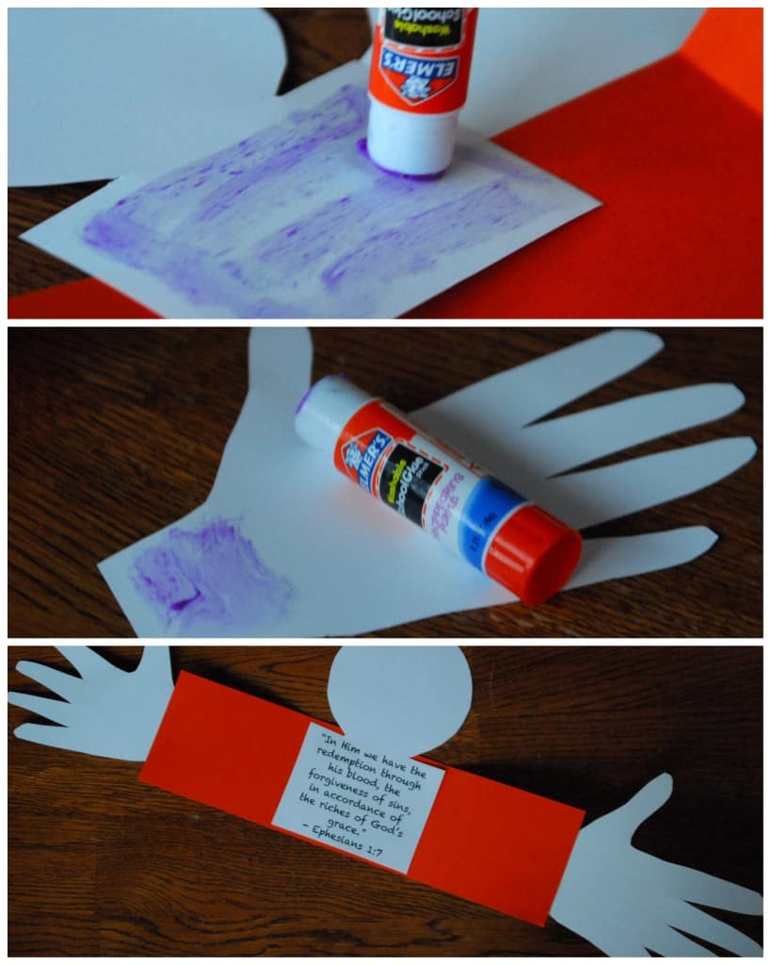
Instructions:
1. On your bond paper, make a head outline then cut it out.
Draw around a hand and cut it out.
Glue down the head and hands on another piece of rectangle paper.
Use a pen to create the mouth and nose.
Use the glue to attach the googly eyes.
For the hair, use yarn and glue it on the top of the head.
The final step is to write down this phrase “Come to me, all of you who are tired from carrying heavy loads, and I will give you rest.”

Slide 14
Closing Prayer
Thank you, Lord, for today. Thank you for guiding and loving us always. Thank you for reminding us today that we can always come to you to rest. Help us to be an instrument of your love so other people may recognize you in their lives.
In Jesus’ name, we pray. Amen.

Slide 15
LIVE THE WORD KIDS
14th Sunday in Ordinary Time | Cycle A

