Slide 1
LIVE THE WORD KIDS
13th Sunday in Ordinary Time| Cycle A

Slide 2
GOSPEL REFLECTION
Jesus is saying, if you’re not ready to give up your life in a humiliating and excruciatingly painful fashion for the sake of the kingdom of God, you’re not worthy of me.
Jesus isn’t messing around about the need for commitment.
Indeed, Jesus further clarifies by saying that we may very well lose our lives.
In reminding us of this, He says that in finding our lives we will lose it, and in losing our lives because of Him we will truly find it. He’s reminding us that this physical life doesn’t matter compared to the glories of our fellowship with our God, Creator, and King in the life to come.
He’s reminding us that those who endure to the end will be saved.
He’s reminding us that finding life in Him is truly finding life.
Jesus must be such a priority in our lives that everything else in this world doesn’t compare to Him.
Indeed, even our own physical safety must be denied for us to be worthy of Jesus.
We must deny everything else.
Jesus is so important, He is such a priority, that when you support those who serve Him, you are remembered and rewarded by God. It’s all about Jesus and His work.

Slide 3
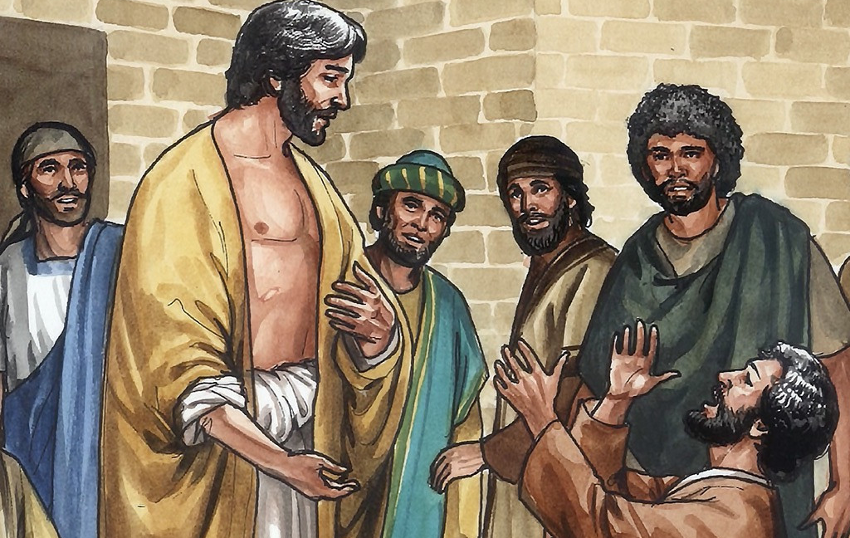
Rewards
Matthew 10:37-42

Slide 4
Leader: A reading from
the Holy Gospel
according to Matthew.
All: Glory to You, Oh Lord.

Slide 5
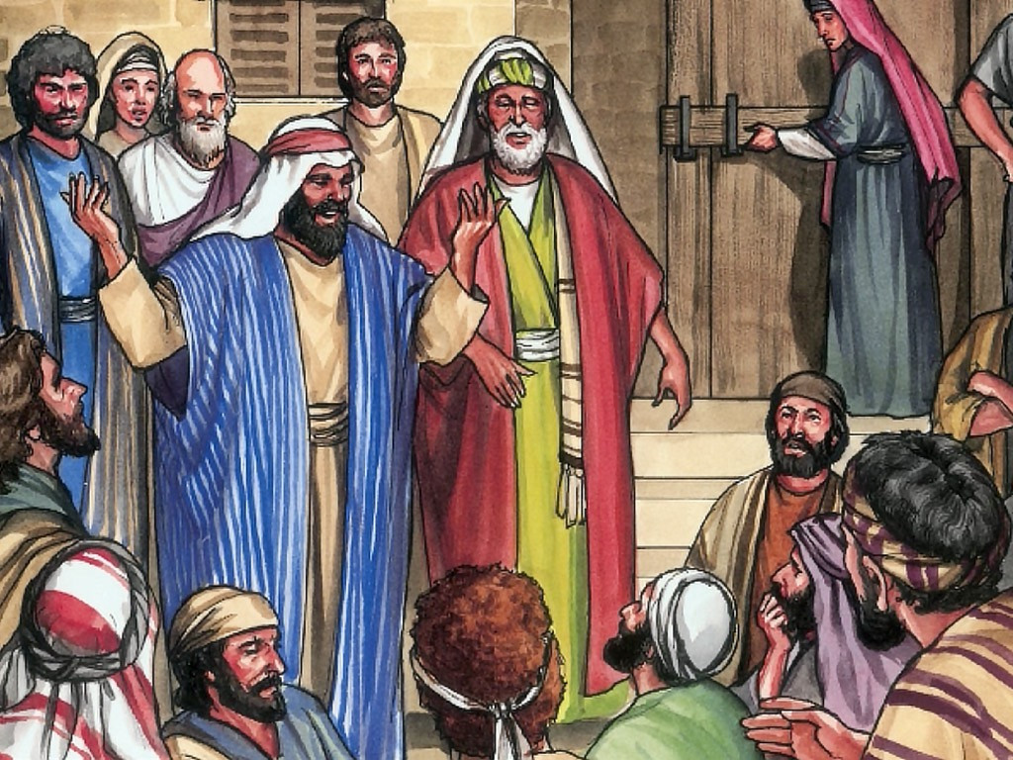
37
“Those who love their father or mother more than me are not fit to be my disciples; those who love their son or daughter more than me are not fit to be my disciples.

Slide 6
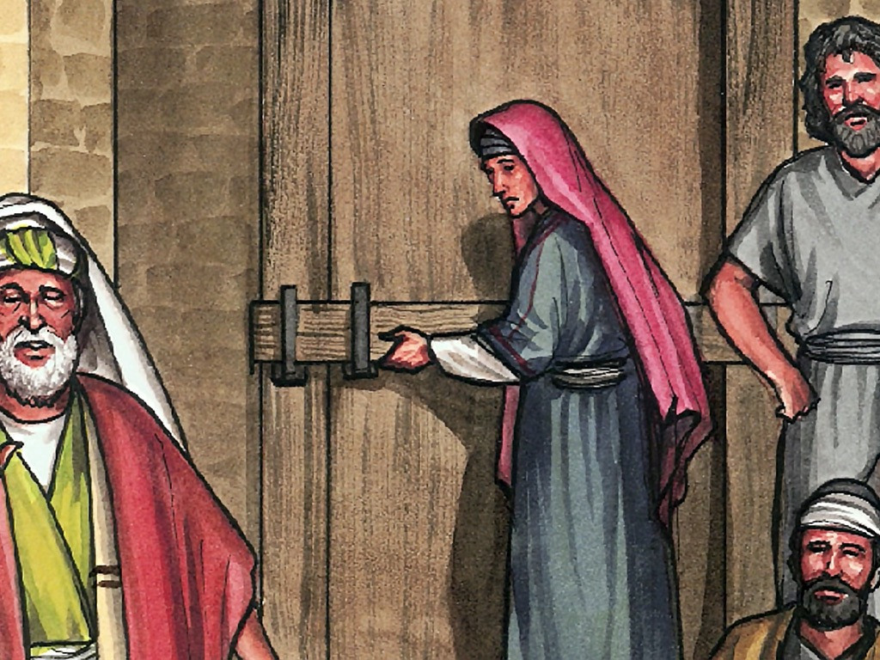
38
Those who do not take up their cross and follow in my steps are not fit to be my disciples.

Slide 7
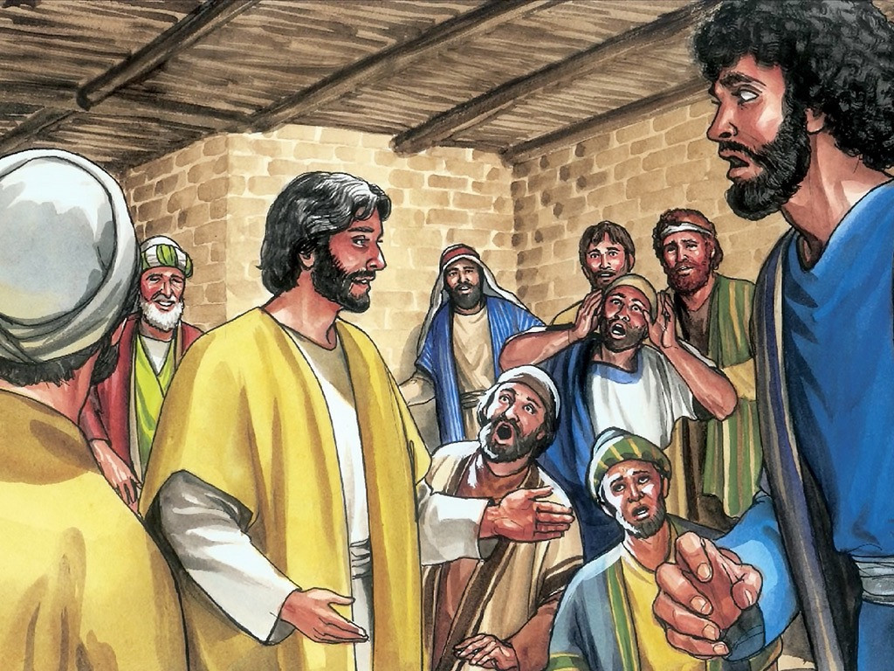
39
Those who try to gain their own life will lose it; but those who lose their life for my sake will gain it.

Slide 8
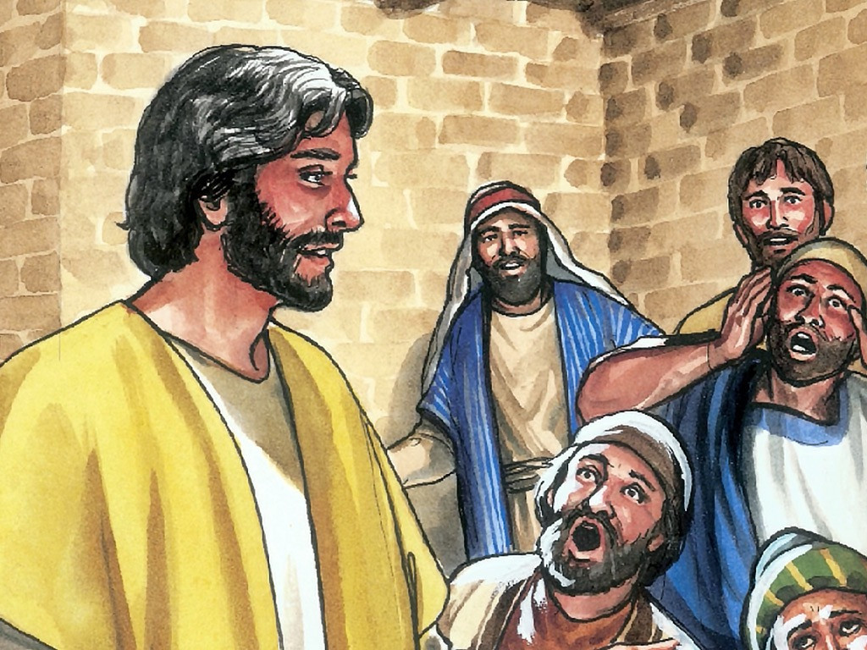
40
“Whoever welcomes you welcomes me; and whoever welcomes me welcomes the one who sent me.

Slide 9
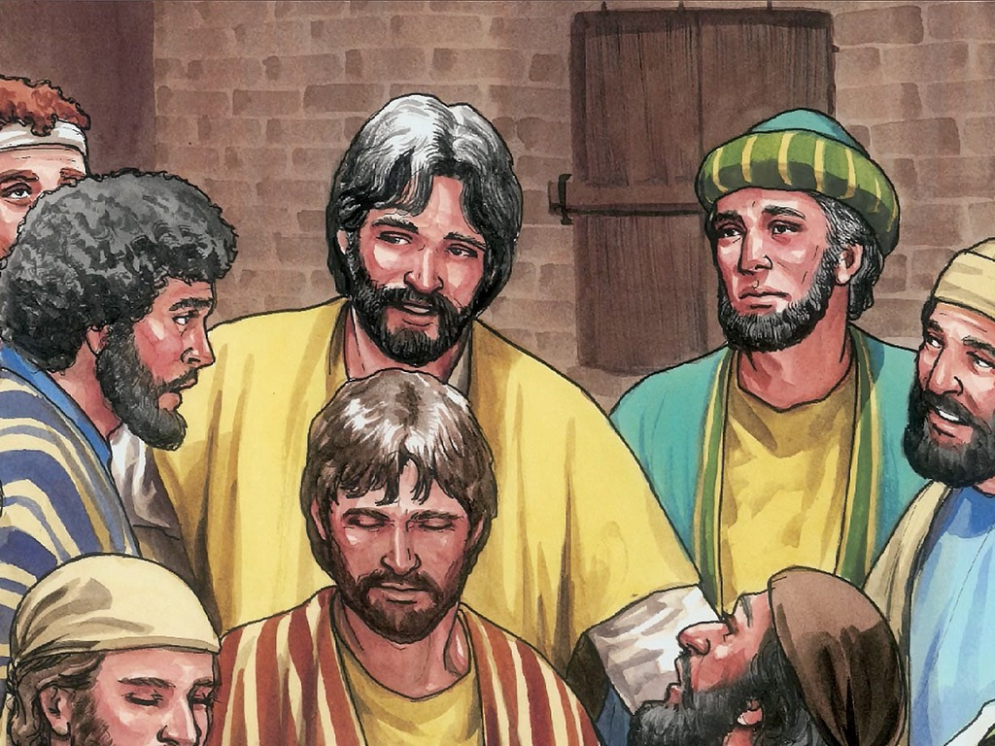
41
Whoever welcomes God's messenger because he is God's messenger, will share in his reward. And whoever welcomes a good man because he is good, will share in his reward.

Slide 10
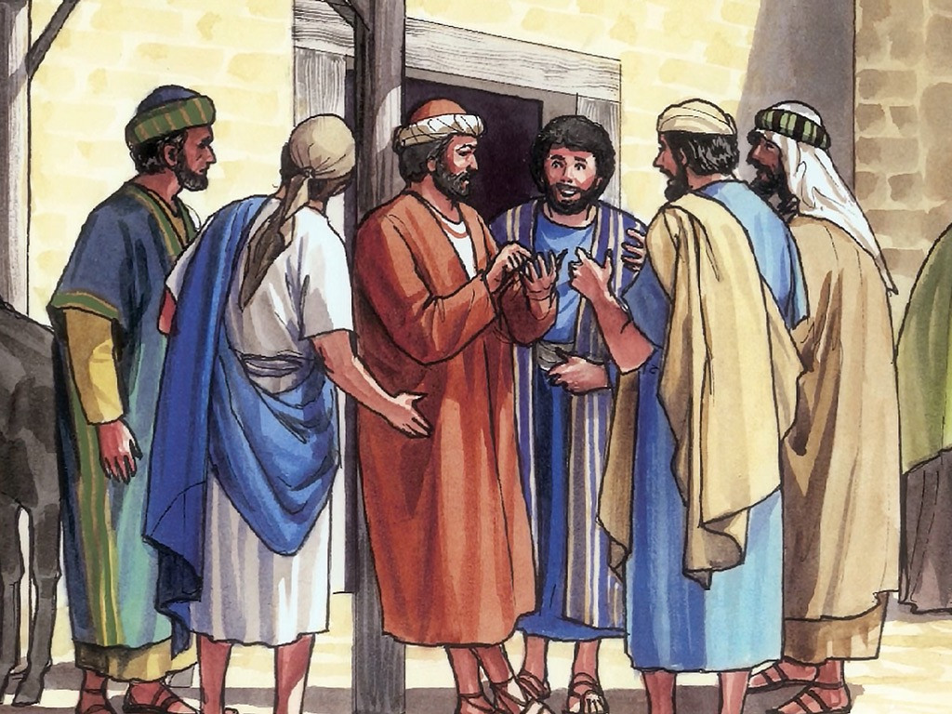
42
You can be sure that whoever gives even a drink of cold water to one of the least of these my followers because he is my follower, will certainly receive a reward.”

Slide 11
Leader: The Gospel of the Lord.
All: Praise to You,
Lord Jesus Christ.

Slide 12
Leader: The Gospel of the Lord.
All: Praise to You,
Lord Jesus Christ.

Slide 13
GOSPEL MESSAGE

Slide 14
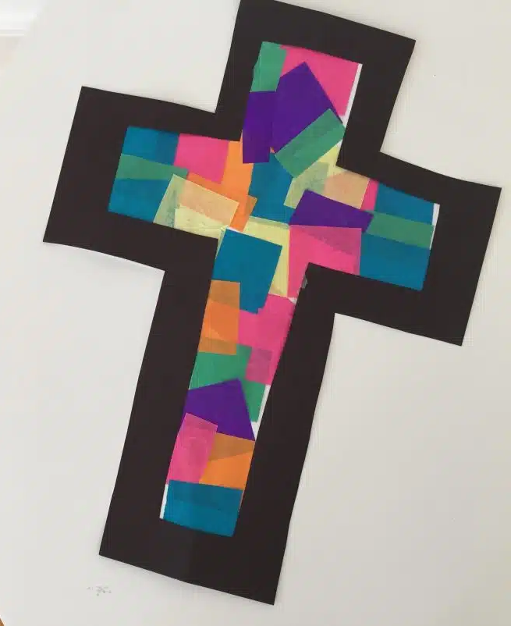
Activity:
Stained Cross
Black Colored Paper
Bond Paper
Different colors of colored paper
Scissors
Glue

Slide 15
Instructions:
Cut a large cross out of the black construction paper.
Then cut out the inside of the cross, to make it like a black “border” for the cross. Place it on the white paper and trace the inside.
Put the black cross to the side.
Fill the whole cross shape on the white paper with glue and stick on the mini tissue squares. Make any pattern you like!
Then glue the black cross/ the outline in place (see the picture).
Last, cut around the cross, cutting off all of the excess white paper. Hang your cross on a window and the light will shine through!

Slide 16
Closing Prayer
Dear God,
We give thanks for your understanding love. Love us with patience, Lord.
Help us to love others as you love us. To accept others without judgment. To see difference as your gift of creation. To remember that love is the greatest thing we can do.
May we give because you have so generously given to us. Take these gifts and multiply them. Send these gifts to places and people where they are needed so that others may see Jesus.
Amen.

Slide 17
LIVE THE WORD KIDS
13th Sunday in Ordinary Time | Cycle A

