Slide 1
LIVE THE WORD KIDS
January 22 | 3rd Sunday in Ordinary Time, Cycle A

Slide 2
For Facilitators Only: Gospel Lessons
- As Christians, we are called to do whatever it takes to follow Jesus. The gospel focuses on becoming a disciple, as well as bringing others into God’s family. Learners will explore how the first followers came to Christ, and how we can be “fishers of men”, too.
- Jesus called His first disciples, who were willing to leave everything and follow Him. We should also be willing to do whatever it takes to follow Christ, and we should be eager to share the good news with others and “fish for people”!
- Jesus chose his disciples not because they were more intelligent, gifted or prosperous than others but because they had willing hearts to follow him and serve. Service is not about what we can do from our own strength but what God can do when we are humble and submit to his will.

Slide 3
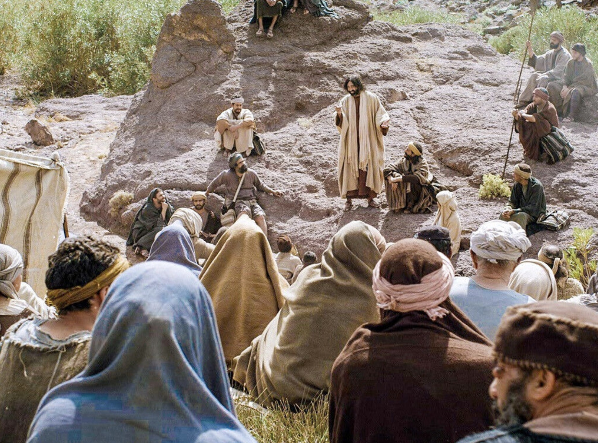
Jesus Begins His Work in Galilee
Matthew 4:12-23

Slide 4
Leader: A reading from
the Holy Gospel
according to Matthew.
All: Glory to You, Oh Lord.

Slide 5
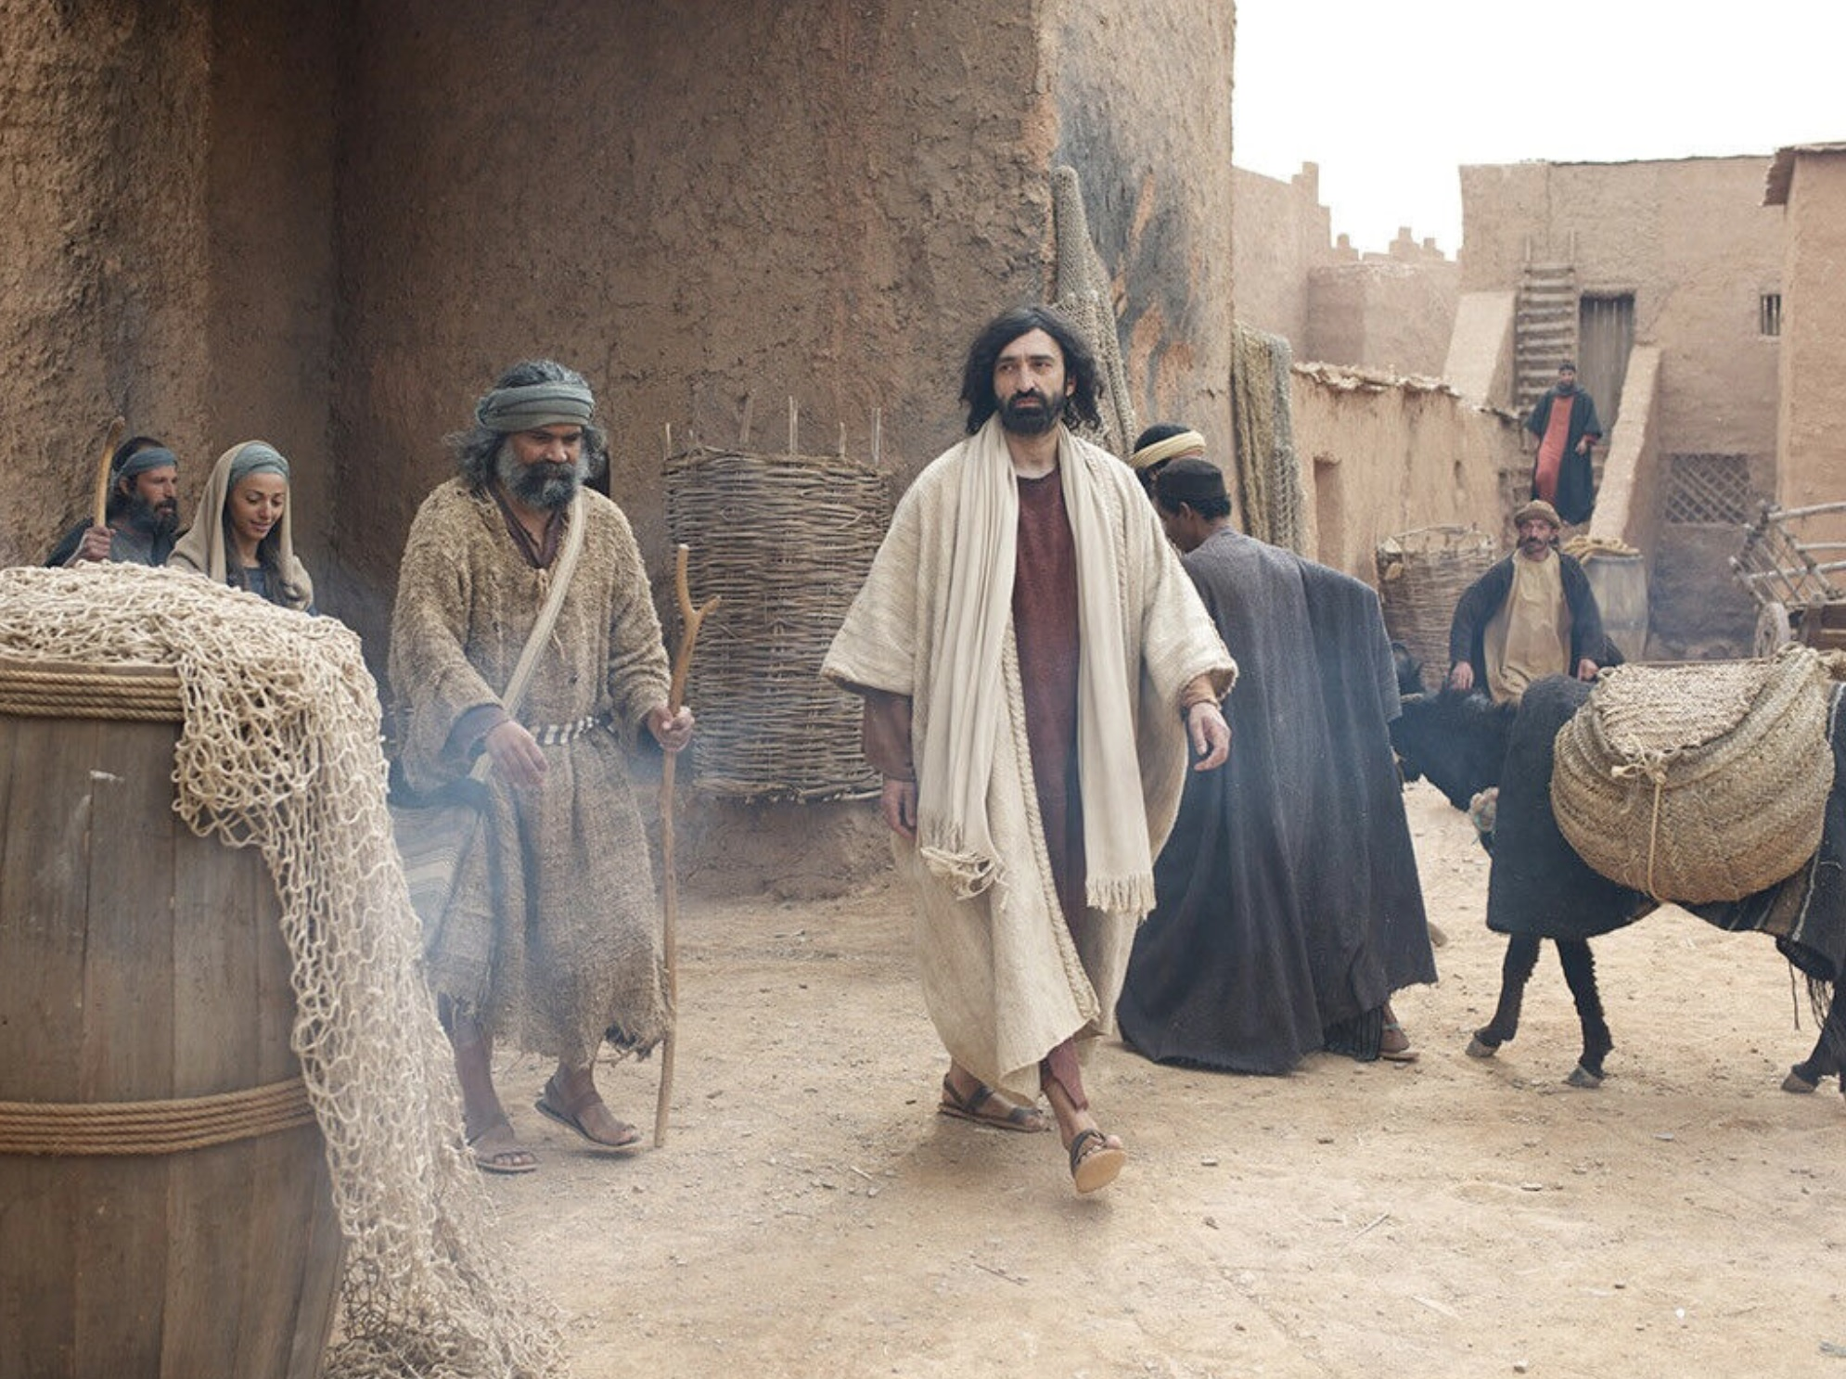
12
When Jesus heard that John had been put in prison, he went away to Galilee.

Slide 6
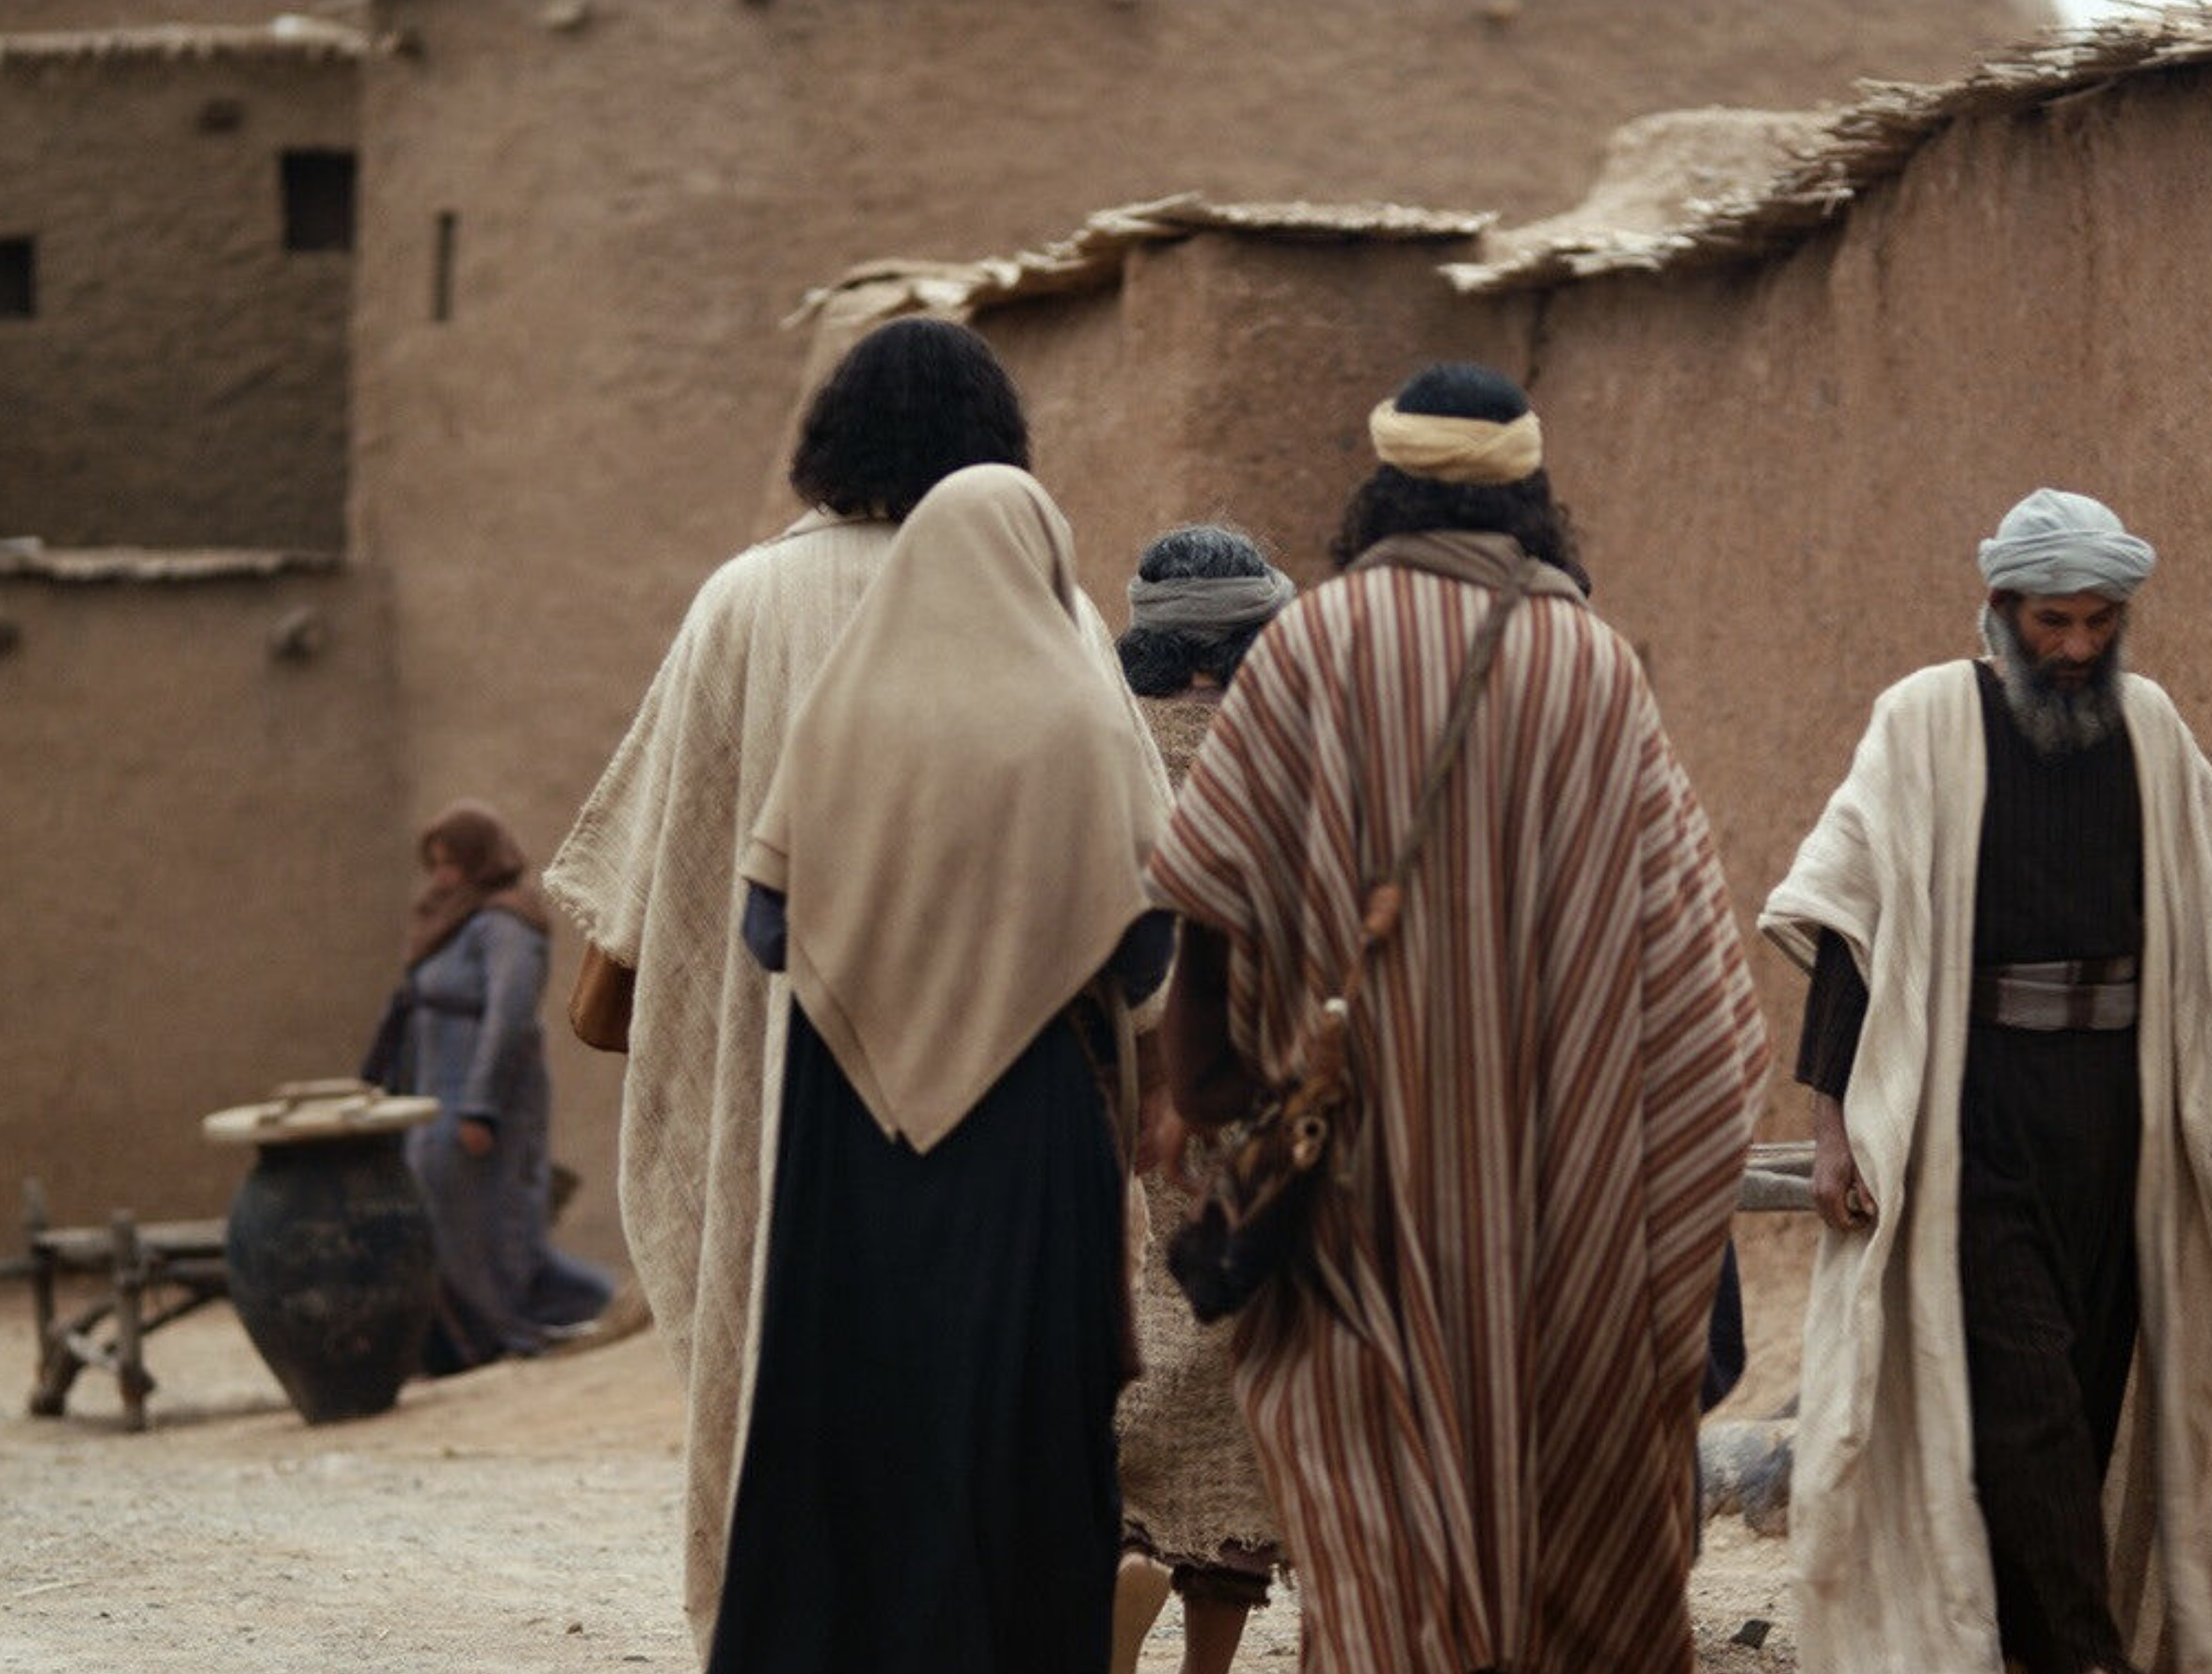
13
He did not stay in Nazareth, but went to live in Capernaum, a town by Lake Galilee, in the territory of Zebulun and Naphtali.

Slide 7
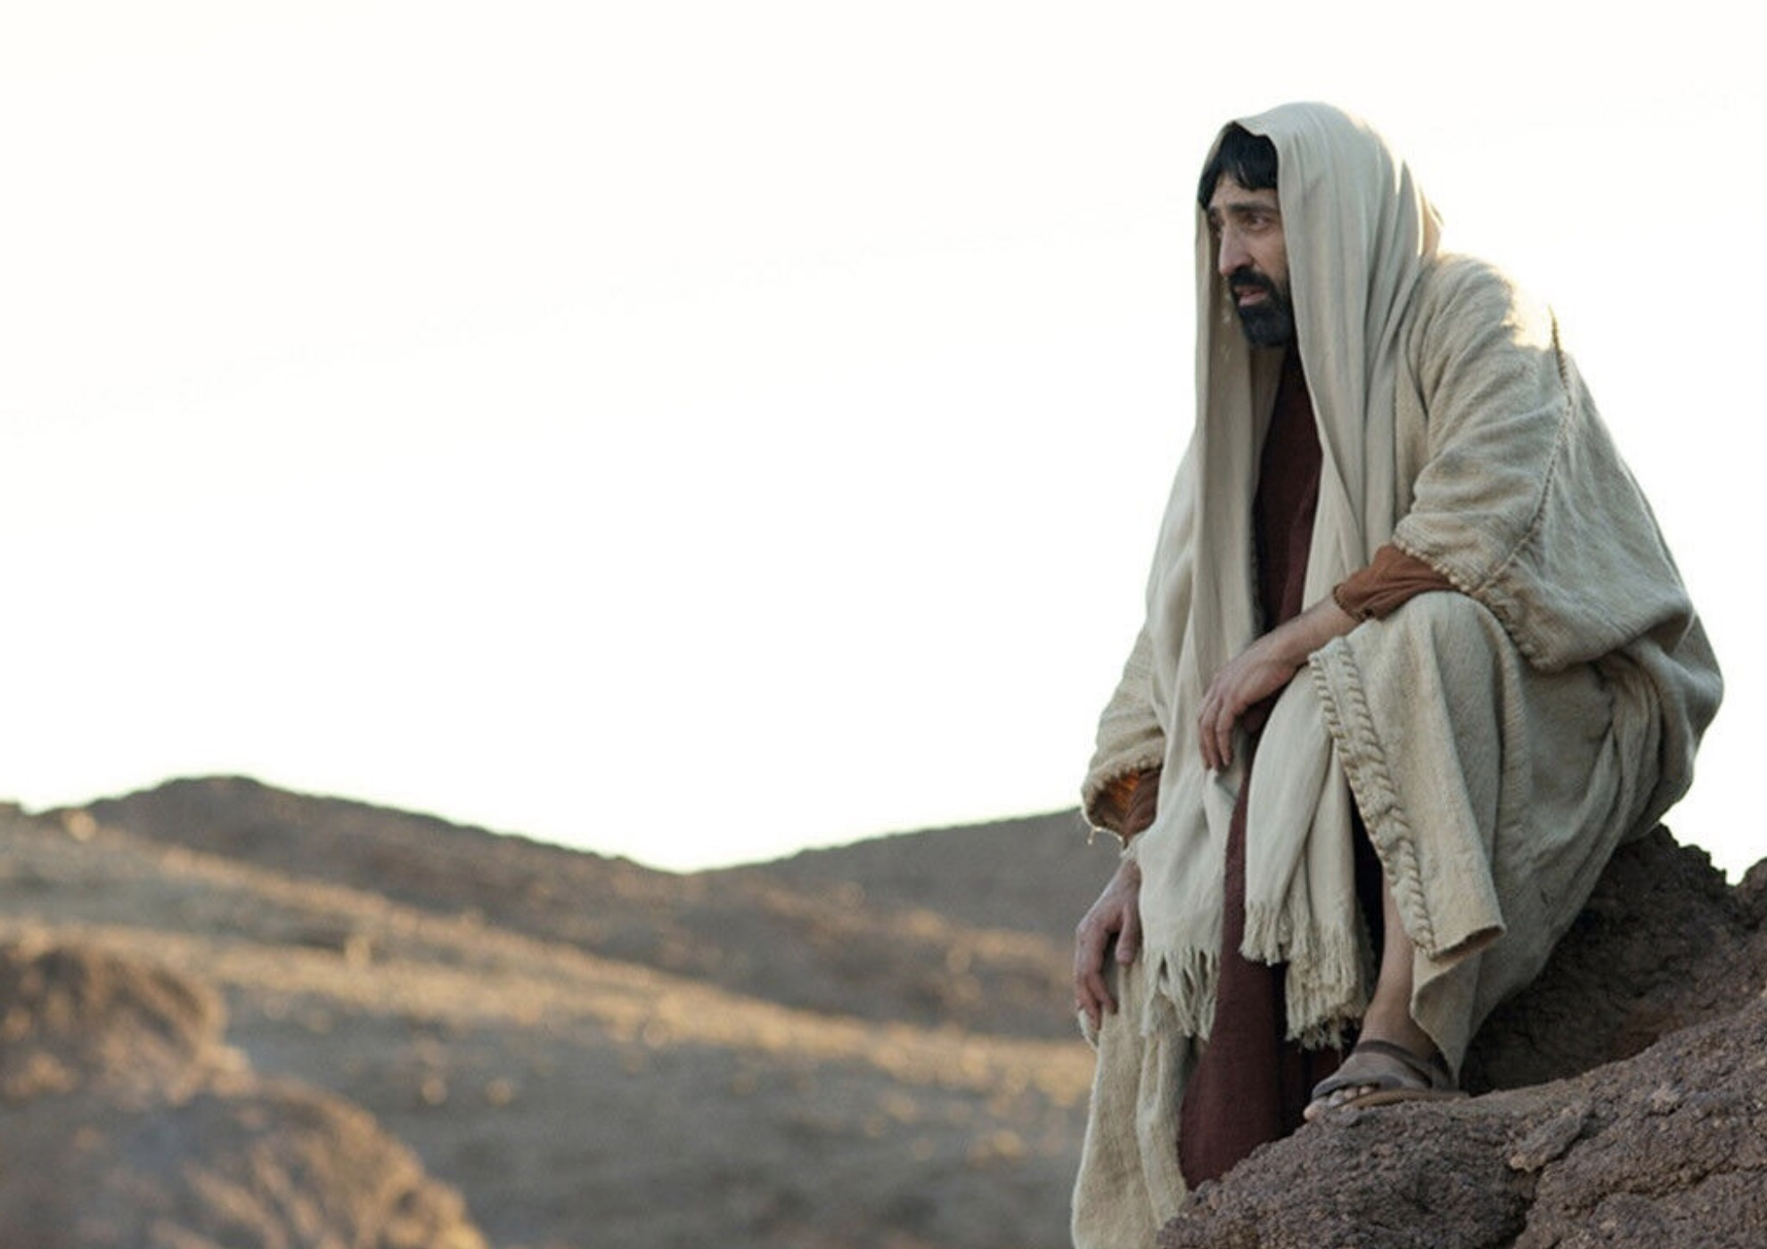
14
This was done to make come true what the prophet Isaiah had said,

Slide 8
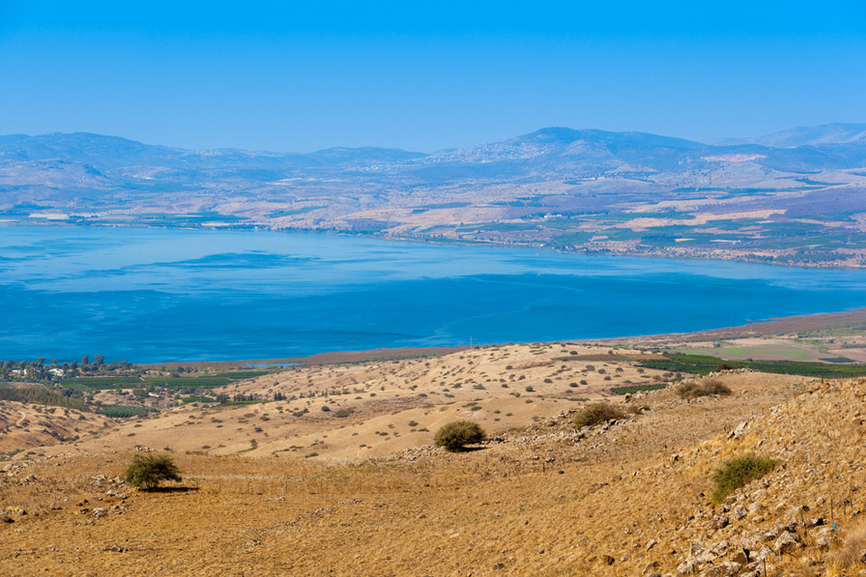
15
“Land of Zebulun and land of Naphtali, on the road to the sea, on the other side of the Jordan, Galilee, land of the Gentiles!

Slide 9
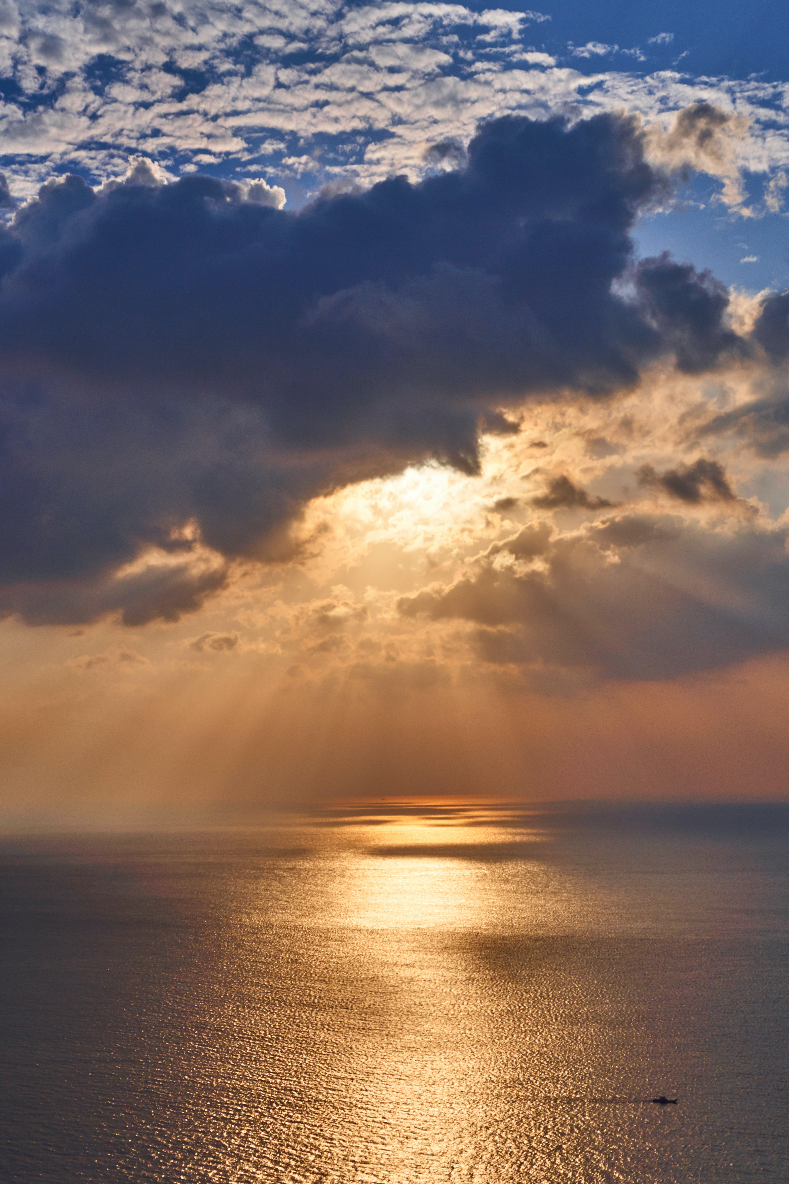
16
The people who live in darkness will see a great light. On those who live in the dark land of death the light will shine.”

Slide 10
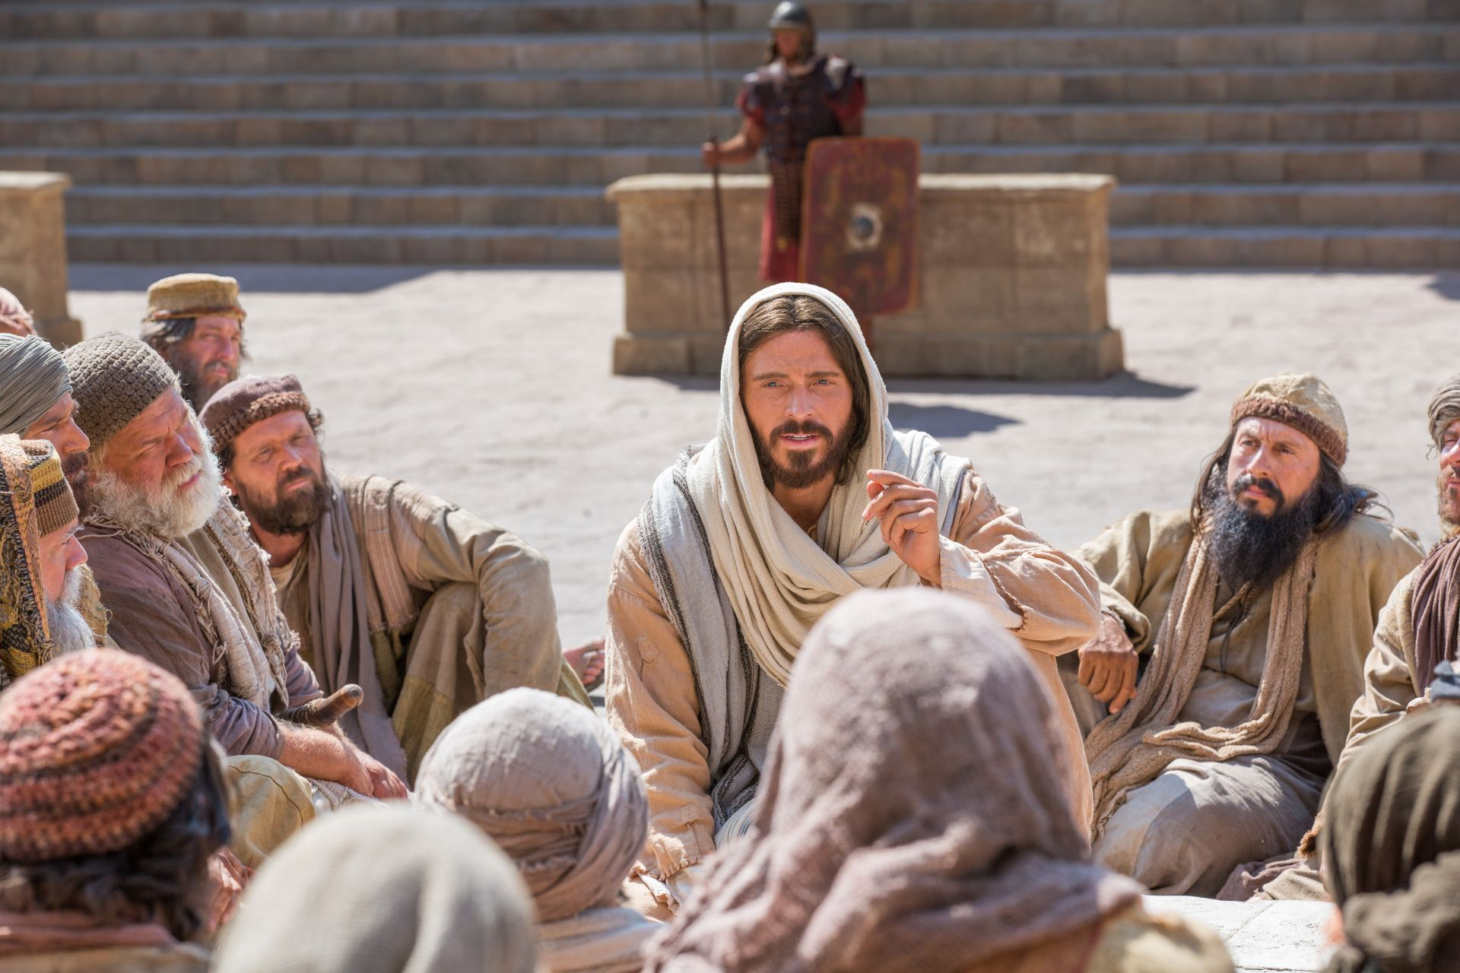
17
From that time Jesus began to preach his message: “Turn away from your sins, because the Kingdom of heaven is near!”

Slide 11
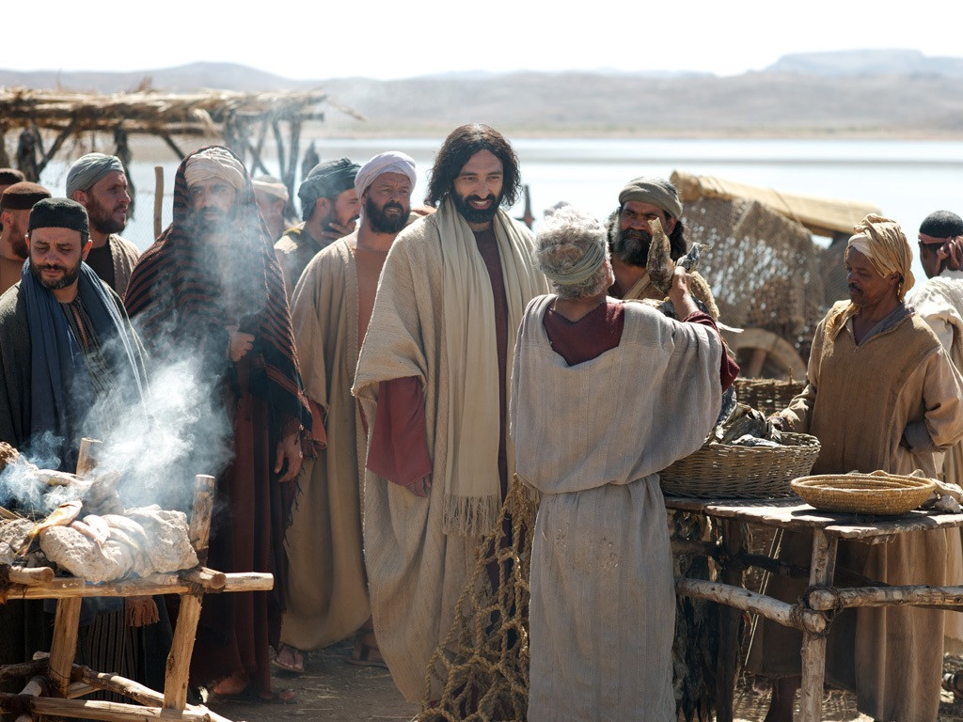
18
As Jesus walked along the shore of Lake Galilee, he saw two brothers who were fishermen, Simon (called Peter) and his brother Andrew, catching fish in the lake with a net.

Slide 12
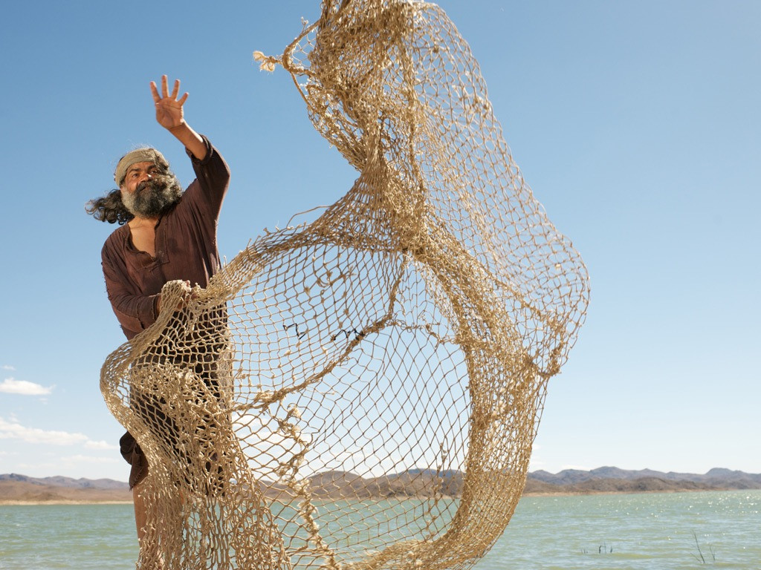
19
Jesus said to them, “Come with me, and I will teach you to catch people.”

Slide 13
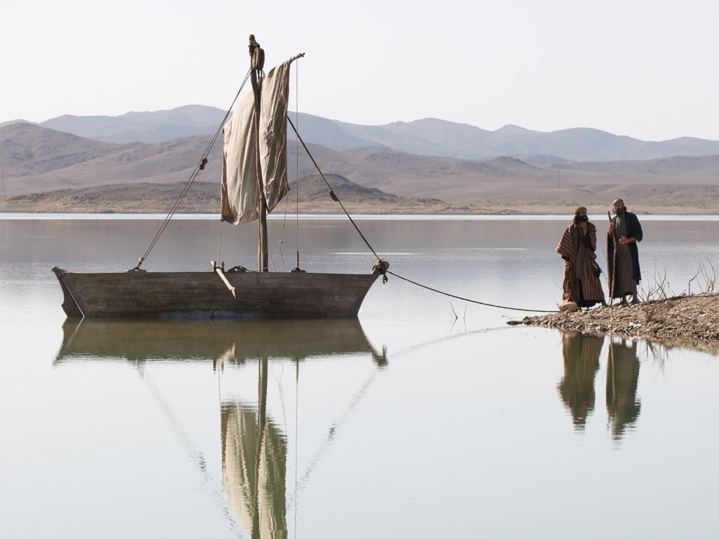
20
At once they left their nets and went with him.

Slide 14
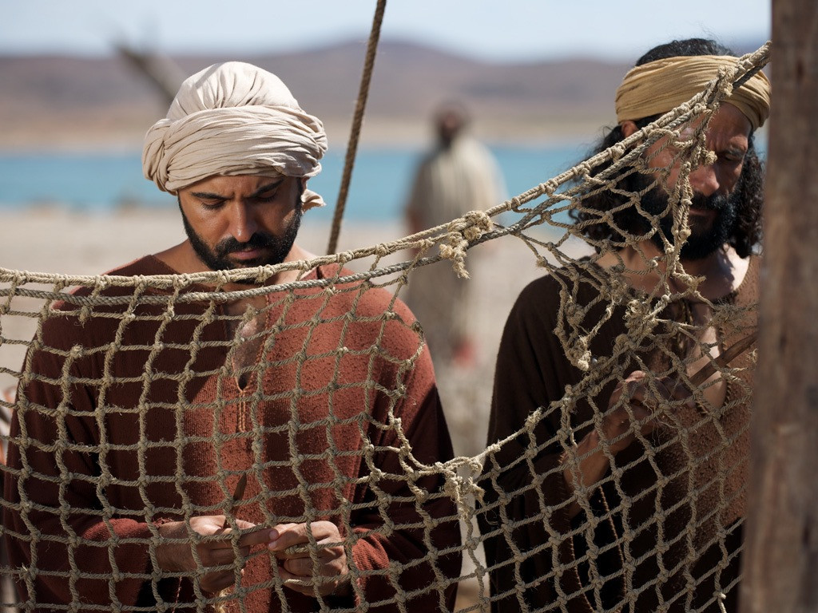
21
He went on and saw two other brothers, James and John, the sons of Zebedee. They were in their boat with their father Zebedee, getting their nets ready. Jesus called them,

Slide 15
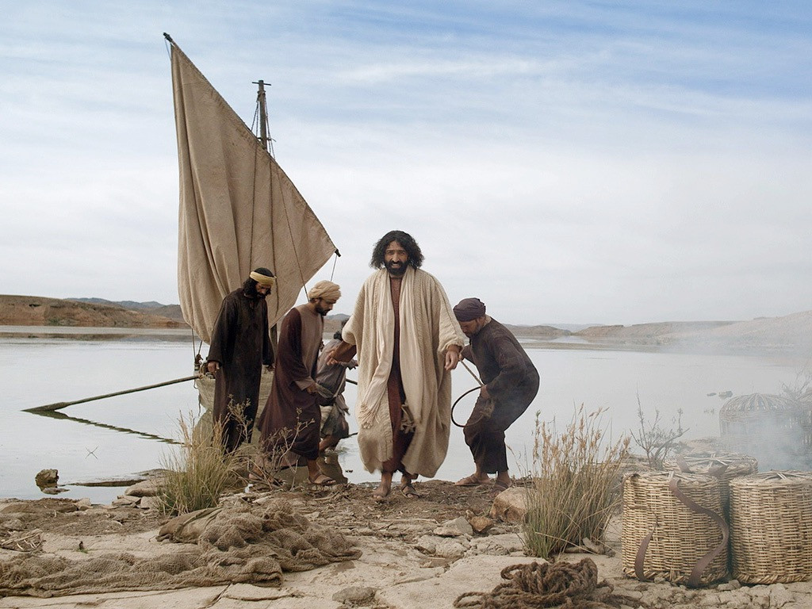
22
and at once they left the boat and their father, and went with him.

Slide 16
23
Jesus went all over Galilee, teaching in the synagogues, preaching the Good News about the Kingdom, and healing people who had all kinds of disease and sickness.

Slide 17
Leader: The Gospel of the Lord.
All: Praise to You,
Lord Jesus Christ.

Slide 18
GOSPEL MESSAGE

Slide 19
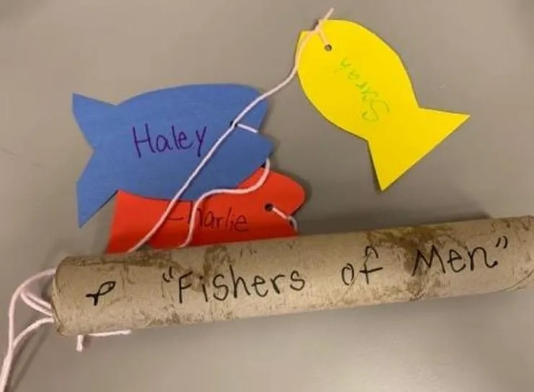
Activity: “Fishing for Friends” Rod
Materials:
Toilet paper or paper towel tubes
Colored Paper
Ribbon or String
Decorative materials
(mini tickers, etc.)
Scissors
Tape
Hole Punch (optional)
Pen / Markers
Crayons

Slide 20
Instructions:
1. Cut fish shapes out of the paper.
2. Decorate the fish, writing down names of people that you think you need to pray for.
3. Decorate the tube using crayons and stickers.
4. String the fish and attach them to the tube. You may tie them through the holes you made from your hole punch, or you may tape them.
5. Lastly, pray for the “fish” (the names you’ve written.

Slide 21
Closing Prayer
Dear God, Thank you for the love of Jesus. Help us to follow Him and know what that means. Help us share His love with one another. Thank you that we can be disciples, too.
Thank you for your love. We love you!
In Jesus' name we pray.
Amen.

Slide 22
LIVE THE WORD KIDS
January 22 | 3rd Sunday in Ordinary Time, Cycle A

