Slide 1
LIVE THE WORD KIDS
January 15 | Feast of Sto. Niño

Slide 2
Notable Background and Lessons
- Back when Jesus was alive, people did not always think kids were very important! A lot of times children were ignored or used for work until they were old enough to understand and really participate in things.
- God thinks that little children are important, and He wants even big people to think with a humble and childlike attitude.
- The greatest has a humble and sincere heart.
- What makes a person great? A person may have superior skills and abilities, they may win the contests and achieve much success by the world’s standards, but in God’s eyes, those things are unimportant for the truly great in His sight are those who are humble servants. They may serve in the spot light, or they may serve out of sight, but if they serve with the humility of a child they are great in His sight.

Slide 3
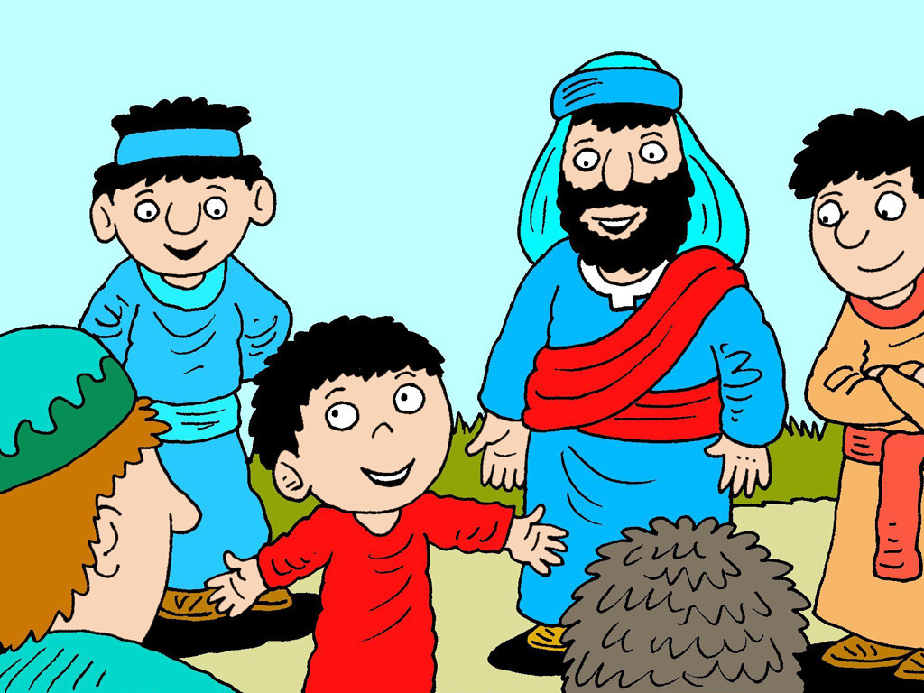
Who is the Greatest?
Matthew 18:1-5,10

Slide 4
Leader: A reading from
the Holy Gospel
according to Matthew.
All: Glory to You, Oh Lord.

Slide 5
1
At that time the disciples came to Jesus, asking, “Who is the greatest in the Kingdom of heaven?”

Slide 6
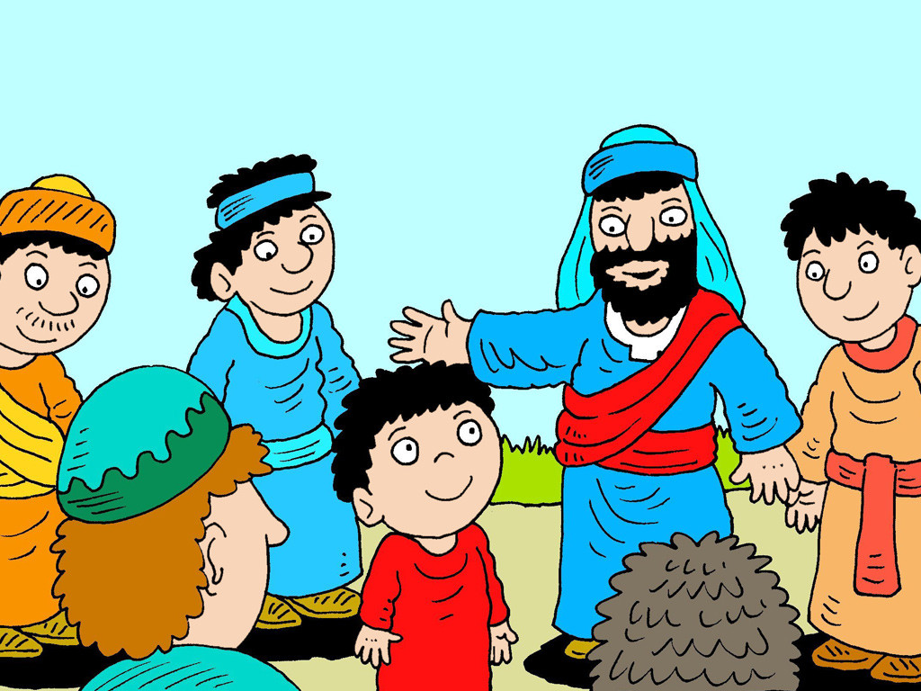
2
So Jesus called a child to come and stand in front of them,

Slide 7
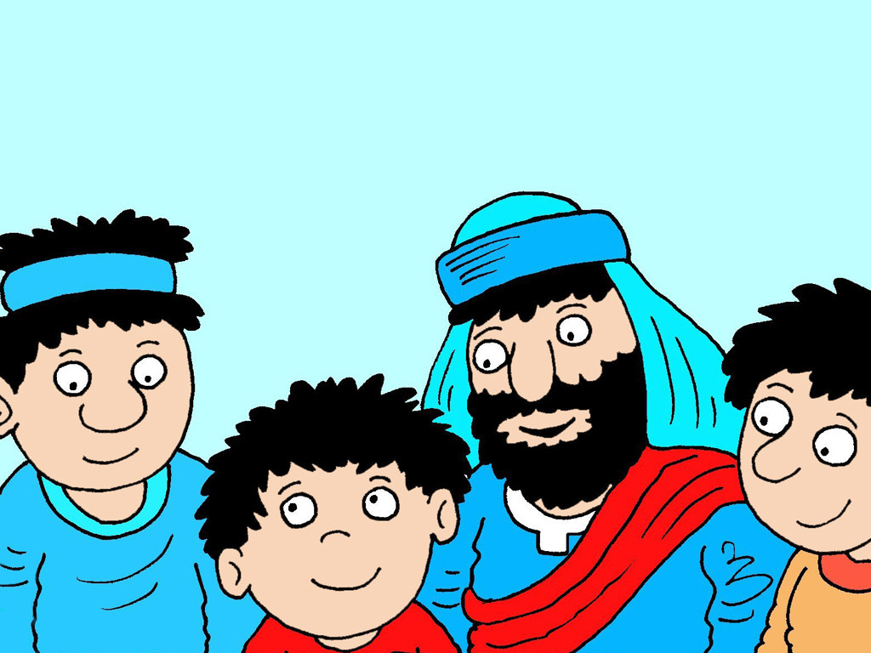
3
and said, “I assure you that unless you change and become like children, you will never enter the Kingdom of heaven.

Slide 8
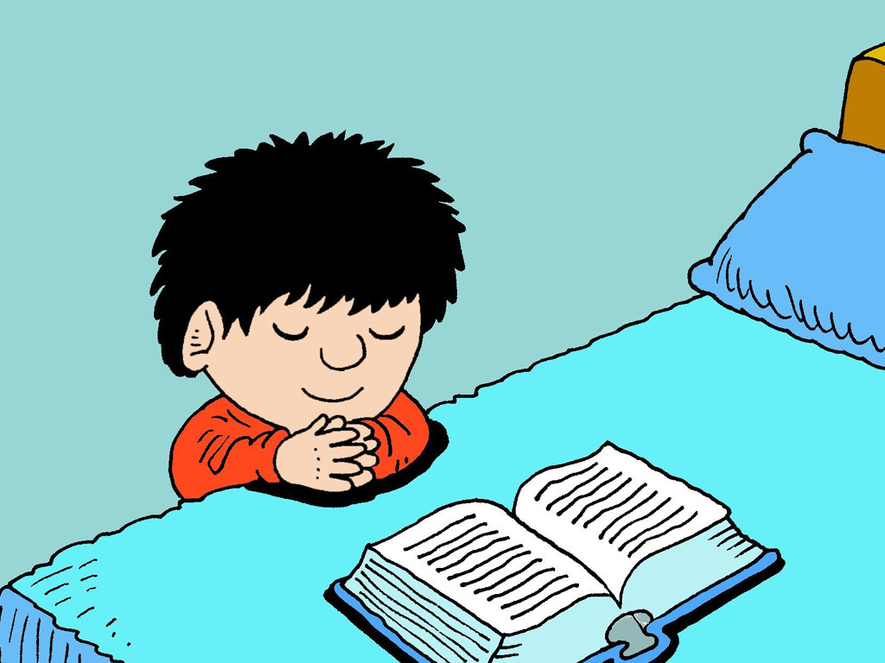
4
The greatest in the Kingdom of heaven is the one who humbles himself and becomes like this child.

Slide 9
5
And whoever welcomes in my name one such child as this, welcomes me.

Slide 10
10
See that you don't despise any of these little ones. Their angels in heaven, I tell you, are always in the presence of my Father in heaven.

Slide 11
Leader: The Gospel of the Lord.
All: Praise to You,
Lord Jesus Christ.

Slide 12
GOSPEL MESSAGE

Slide 13
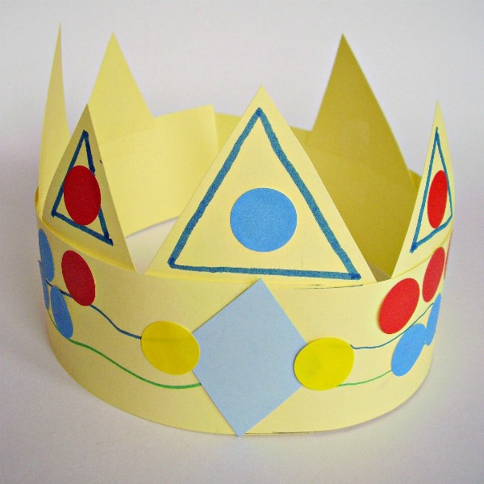
Activity: Paper Crown
Have the kids make crowns from paper.
Describe how God has made us all children of the King.
Materials:
1. Variety of construction papers
2. Scissors
3. Glue
4. Tape
5. Crayons
6. Glitters (optional)

Slide 14
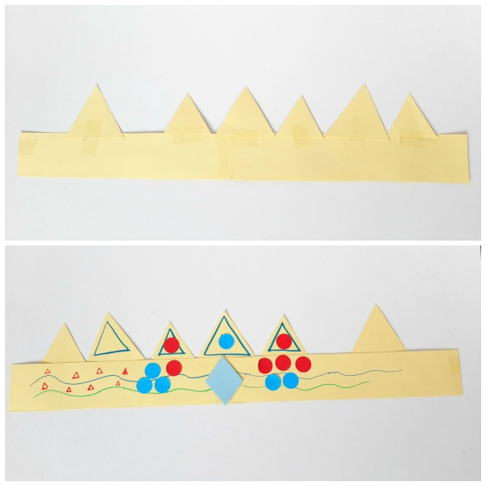
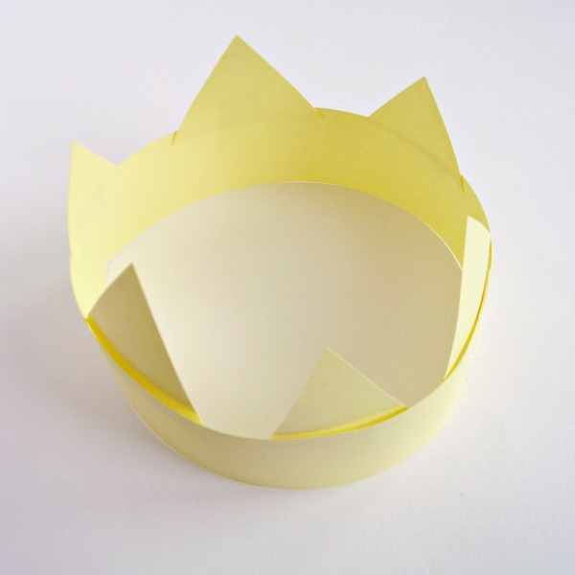
Instructions:
1. Cut a head band-wide (2-inch width) paper from the construction paper for the base.
2. Lay the headband flat on the table. Glue or tape triangles and other shapes to the back of the headband.
3. Decorate the crown with paper shapes, crayons or markers, and self-adhesive dots or other decorations.
4. Glue a large diamond shape to the front of the crown. You may add glitters if you have!

Slide 15
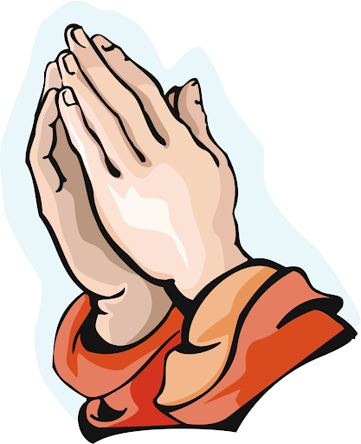
Closing Prayer
Dear God,
Teach me to be humble. Lead me in humility at all times. Teach me not to judge and let me find forgiveness through humility. Through humility, may love be seen in me. Amen.“
In Jesus' name we pray.
Amen.

Slide 16
LIVE THE WORD KIDS
January 15 | Feast of Sto. Niño

