Slide 1
LIVE THE WORD KIDS
Solemnity of the Epiphany of the Lord

Slide 2
GOSPEL REFLECTION
The wise men did not know where the star would lead them. They just followed it until it brought them to Bethlehem, and to Jesus. Let us try to have courage and trust the example of the wise men to follow our guiding lights.
We are invited to become part of this story. Perhaps we can accompany the wise men and ask to share in the manifestation (epiphany) that they experienced in Bethlehem. Their journey, like our own lives, involved highs and lows, times of insight and doubt, a dream calling them forward (star) and the deception of worldly values (Herod). But at the end they were enlightened in the presence of the child Jesus and “they knelt down and paid him homage”. Will we do likewise?

Slide 3
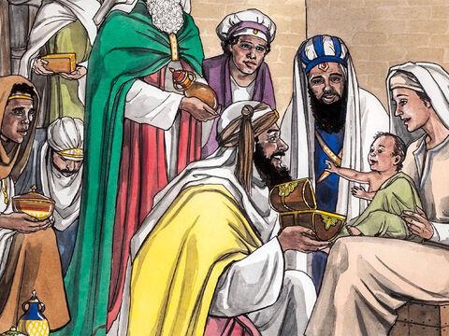
Visitors from the East
Matthew 2:1-12

Slide 4
Leader: A reading from
the Holy Gospel
according to Matthew.
All: Glory to You, Oh Lord.

Slide 5
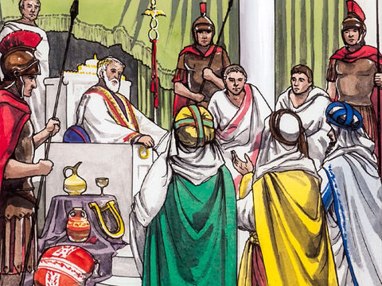
1
Jesus was born in the town of Bethlehem in Judea, during the time when Herod was king. Soon afterward, some men who studied the stars came from the East to Jerusalem

Slide 6
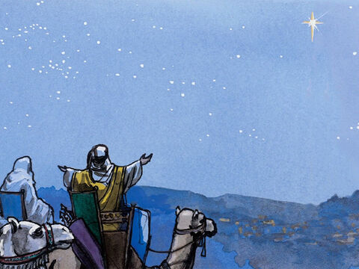
2
and asked, “Where is the baby born to be the king of the Jews? We saw his star when it came up in the east, and we have come to worship him.”

Slide 7
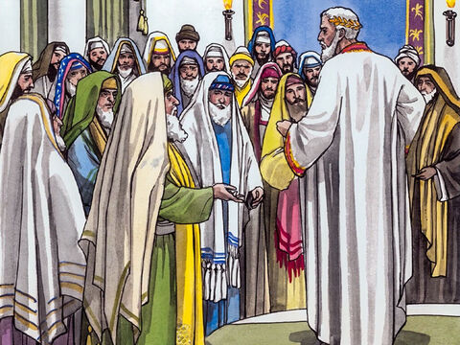
3
When King Herod heard about this, he was very upset, and so was everyone else in Jerusalem.

Slide 8
4
He called together all the chief priests and the teachers of the Law and asked them, “Where will the Messiah be born?”

Slide 9
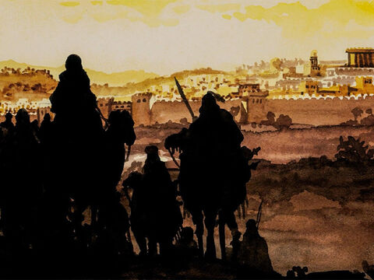
5
“In the town of Bethlehem in Judea,” they answered. “For this is what the prophet wrote:

Slide 10
6
‘Bethlehem in the land of Judah,
you are by no means the least of the leading cities of Judah;
for from you will come a leader
who will guide my people Israel.’”

Slide 11
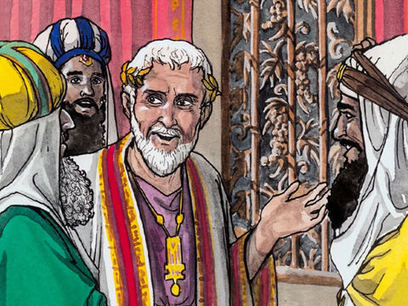
7
So Herod called the visitors from the East to a secret meeting and found out from them the exact time the star had appeared.

Slide 12
8
Then he sent them to Bethlehem with these instructions: “Go and make a careful search for the child; and when you find him, let me know, so that I too may go and worship him.”

Slide 13
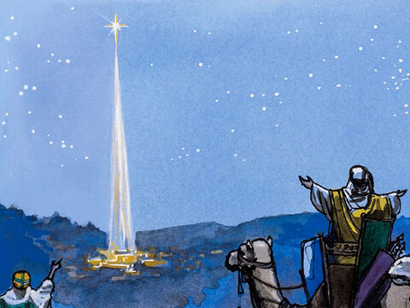
9-10
And so they left, and on their way they saw the same star they had seen in the East. When they saw it, how happy they were, what joy was theirs! It went ahead of them until it stopped over the place where the child was.

Slide 14
11
They went into the house, and when they saw the child with his mother Mary, they knelt down and worshiped him. They brought out their gifts of gold, frankincense, and myrrh, and presented them to him.

Slide 15
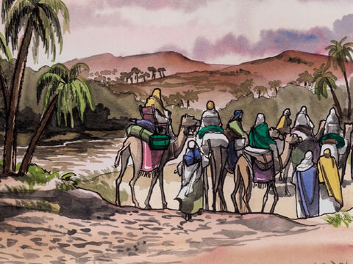
12
Then they returned to their country by another road, since God had warned them in a dream not to go back to Herod.

Slide 16
Leader: The Gospel of the Lord.
All: Praise to You,
Lord Jesus Christ.

Slide 17
GOSPEL MESSAGE

Slide 18
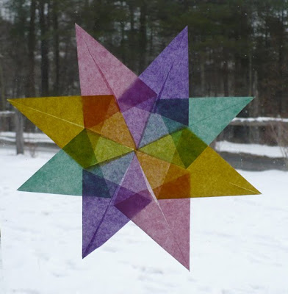
Activity: Guiding Star
Colored Paper
Coloring Materials
Pen/Marker
Scissors
Glue

Slide 19
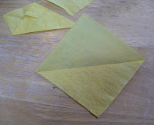
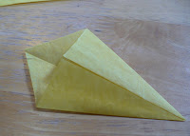
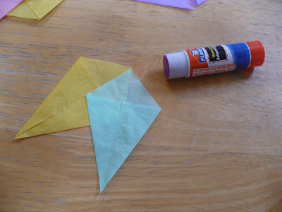
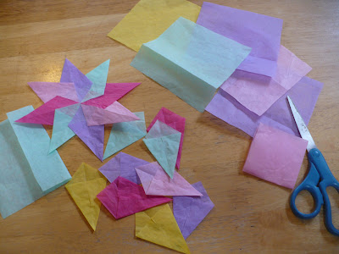
Instruction:
Cut paper into square. Make 8 pieces of square paper.
Fold each square diagonally.
Fold both side over and glue it.
Put it together to make it a star.
Write names who always guides you (ie. Your parents, Siblings, Teacher, Friends, etc.)

Slide 20
Closing Prayer
Dear God,
Thank you for all the gifts you have given to us. Thank you for always guiding us and lightning our path to the greatest gift who is Jesus. And may we share this light and gift to others. Be the treasure in our hearts.
Be the gift that we give.
In Jesus' name we pray.
Amen.

Slide 21
LIVE THE WORD KIDS
Solemnity of the Epiphany of the Lord

