Slide 1
LIVE THE WORD KIDS
1st Sunday of Lent | Year A

Slide 2
For Facilitators Only: Gospel Background & Explanation
-At the moment of his baptism, Jesus experienced an incredible moment of calling; the Holy Spirit had descended upon him and God the Father had proclaimed his love for his Son. After that, Jesus went into the desert to prepare for his life of ministry. In the desert, Satan tempted Jesus to doubt himself and who he was. He tempted Jesus to abandon the love and calling from God. The devil tempted him with food, popularity, and power. He made it seem that everything would have been easier for Jesus if he’d just give in and take what Satan offered him. We know that he did not give in. Jesus relied on God’s word to stand up to these temptations.
We are tempted all the time as well. These temptations often urge us to try to take the easy way out of a hard situation. Why spend money on something we want when we can just take it? Why be nice to someone we don’t like when it’s easier to just be mean to them instead? Why do our chores if we can get away with not doing them? Why? Because we know that it is the right thing to do and it is what God wants for us. God will help us resist temptation if we ask him for it. And just like Jesus, we can rely on his word, the Bible, to give us the power to make wise choices and do the right thing.

Slide 3
The Temptation of Jesus
Matthew 4:1-11

Slide 4
Leader: A reading from
the Holy Gospel
according to Matthew.
All: Glory to You, Oh Lord.

Slide 5
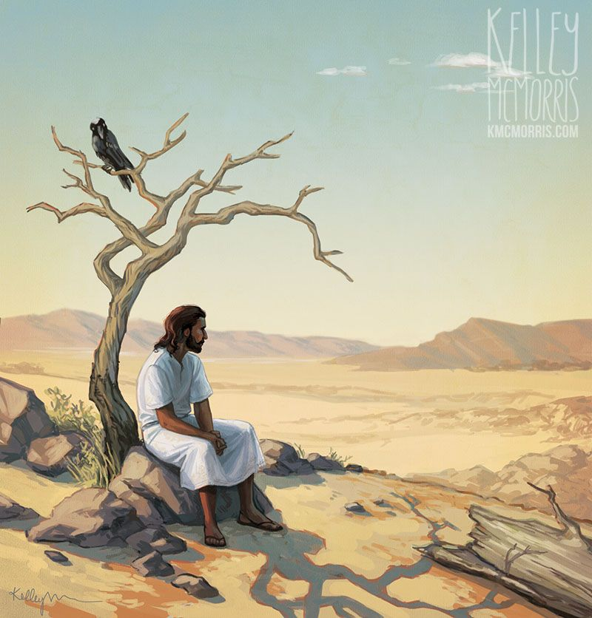
1
Then the Spirit led Jesus into the desert to be tempted by the Devil.

Slide 6
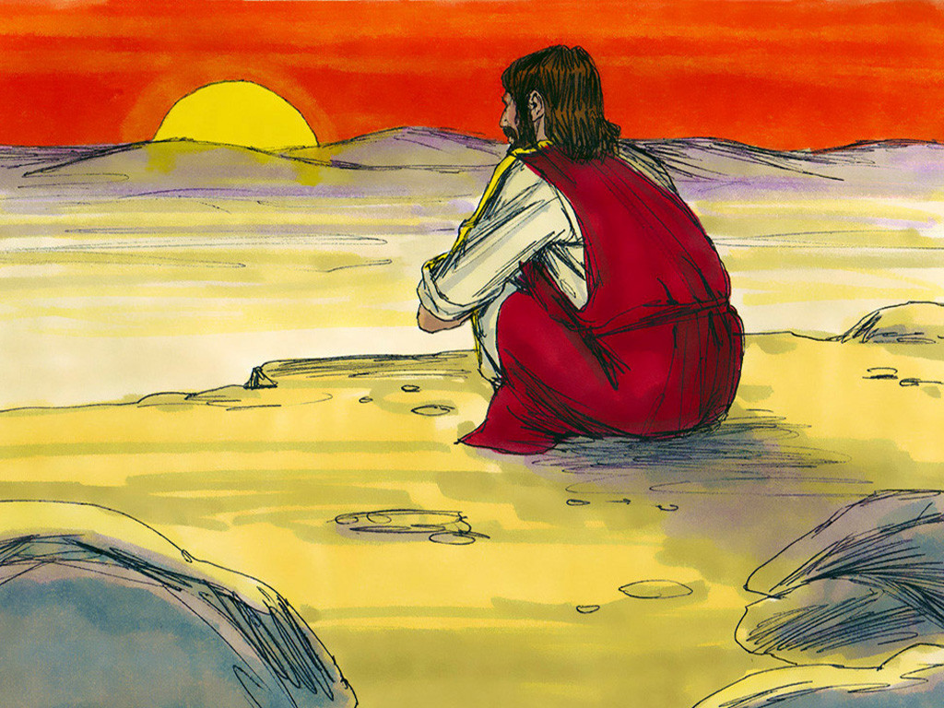
2
After spending forty days and nights without food, Jesus was hungry.

Slide 7
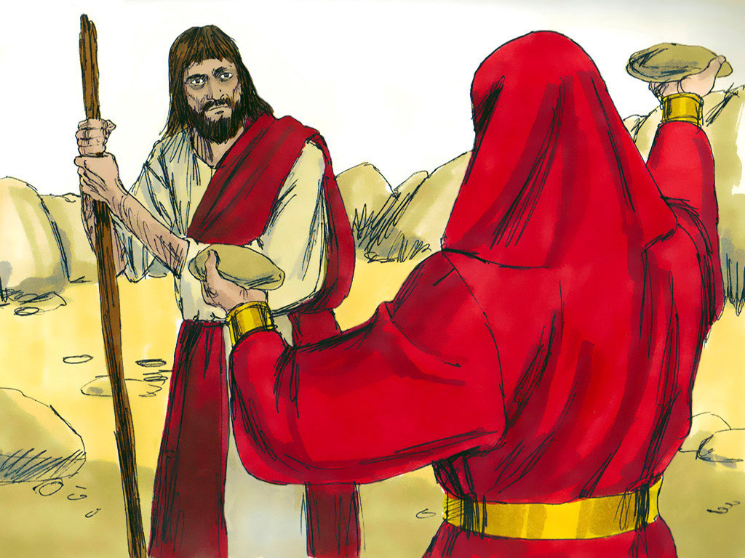
3
Then the Devil came to him and said,
“If you are God's Son, order these stones to turn into bread.”

Slide 8
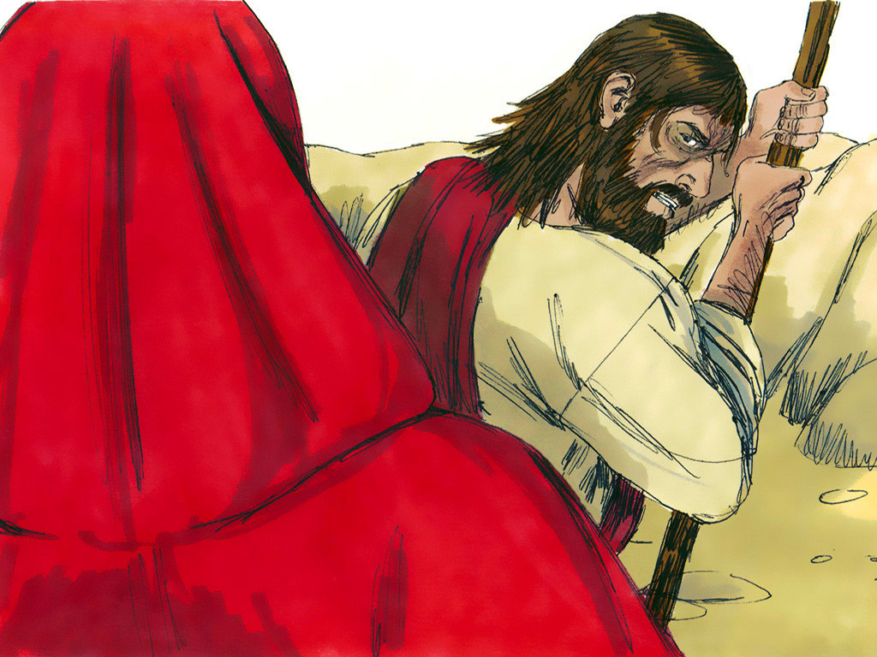
4
But Jesus answered,
“The scripture says, ‘Human beings cannot live on bread alone, but need every word that God speaks.’”

Slide 9
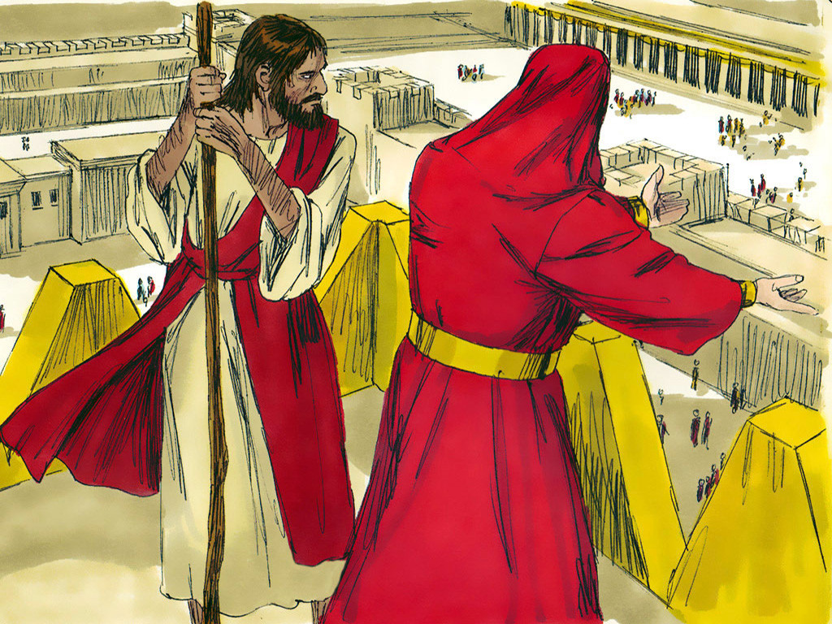
5
Then the Devil took Jesus to Jerusalem, the Holy City, set him on the highest point of the Temple,

Slide 10
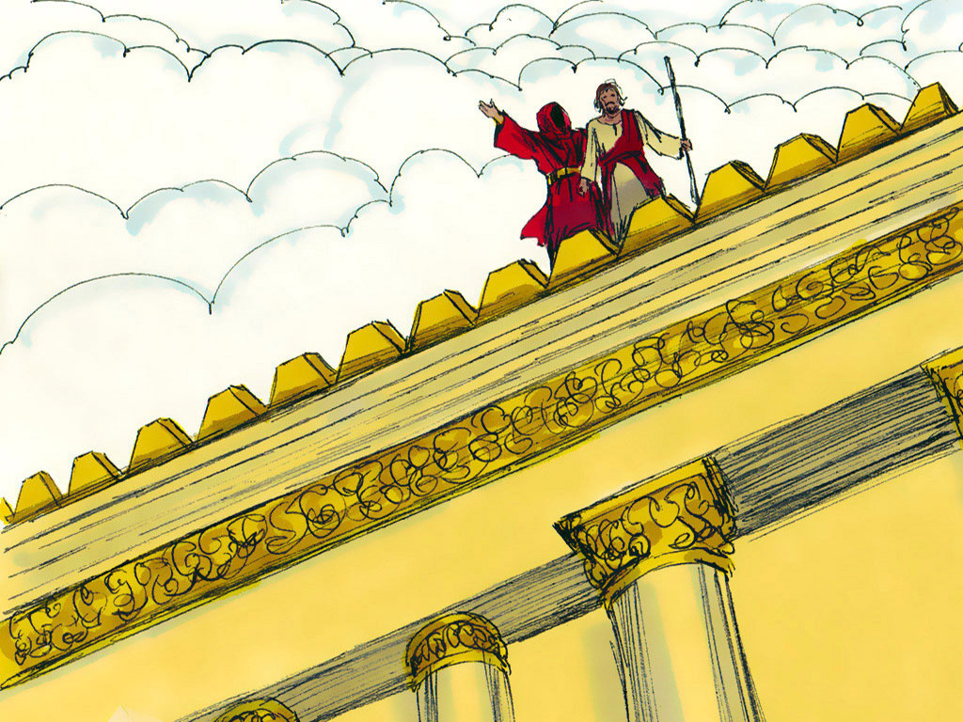
6
and said to him, “If you are God's Son, throw yourself down, for the scripture says,‘God will give orders to his angels about you;
they will hold you up with their hands, so that not even your feet will be hurt on the stones.’”

Slide 11
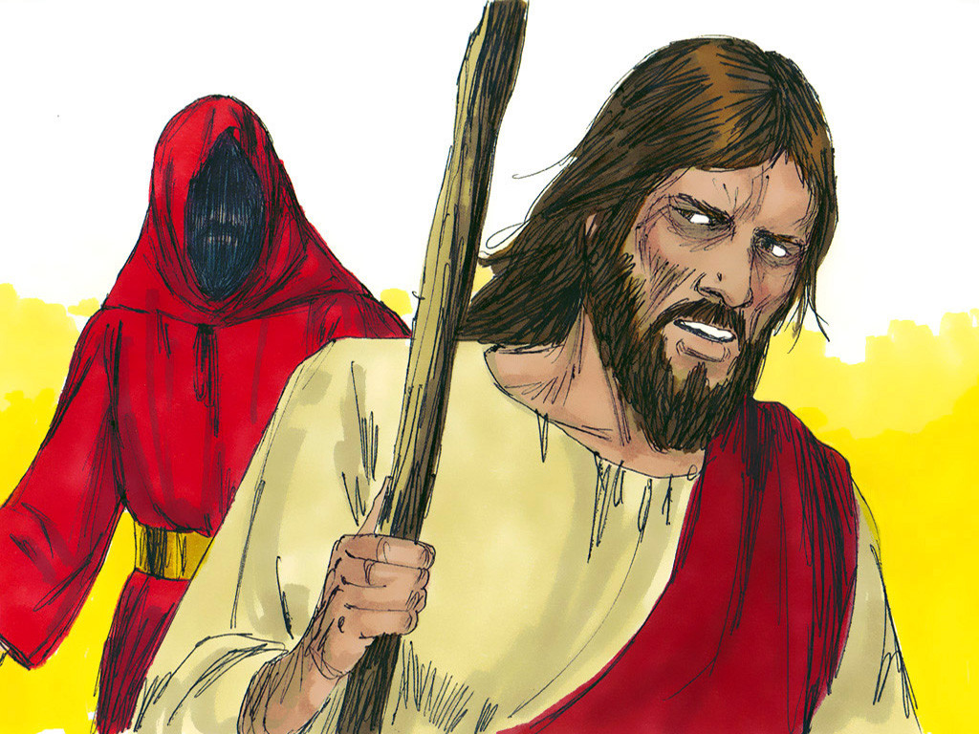
7
Jesus answered,
“But the scripture also says, ‘Do not put the Lord your God to the test.’”

Slide 12
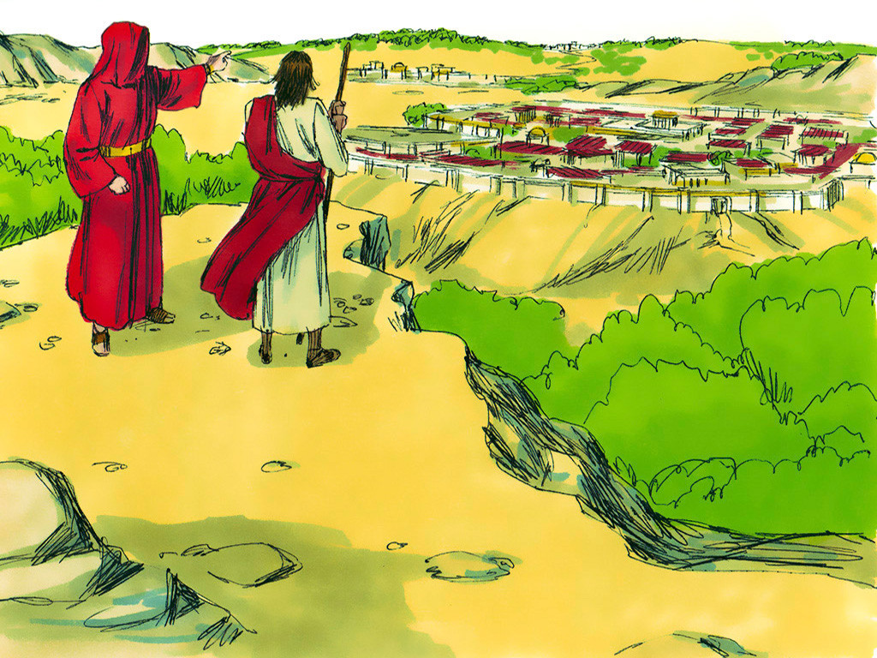
8
Then the Devil took Jesus to a very high mountain and showed him all the kingdoms of the world in all their greatness.

Slide 13
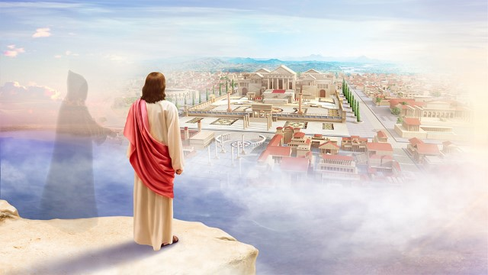
9
“All this I will give you,” the Devil said,
“if you kneel down and worship me.”

Slide 14
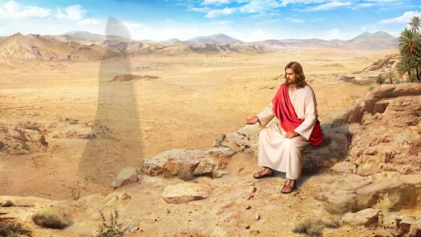
10
Then Jesus answered,
“Go away, Satan! The scripture says, ‘Worship the Lord your God and serve only him!’”

Slide 15
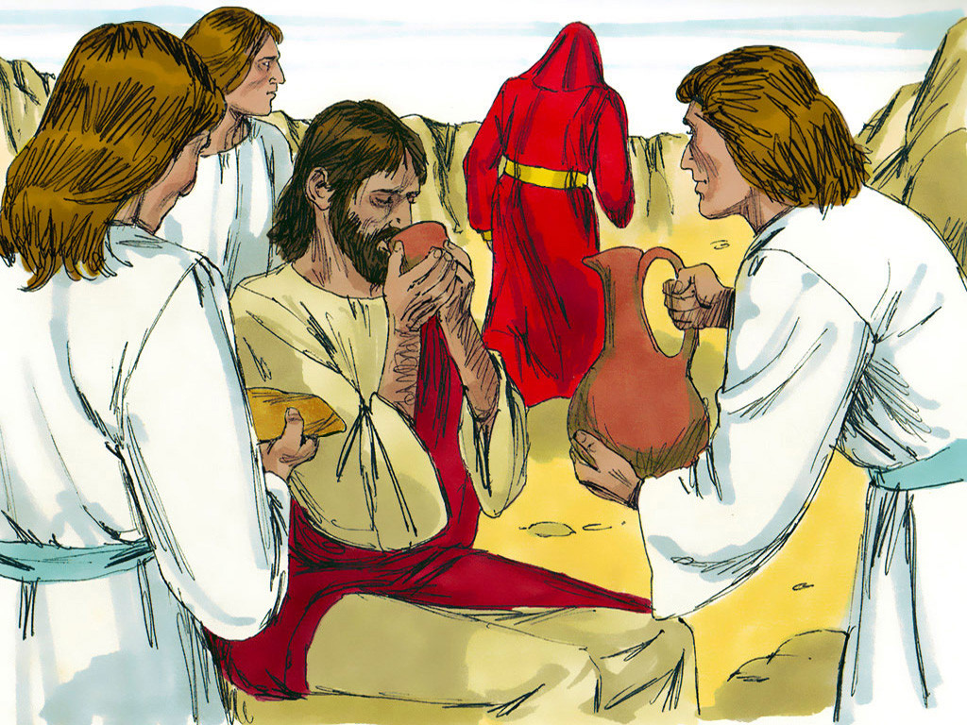
11
Then the Devil left Jesus; and angels came and helped him.

Slide 16
Leader: The Gospel of the Lord.
All: Praise to You,
Lord Jesus Christ.

Slide 17
GOSPEL MESSAGE

Slide 18
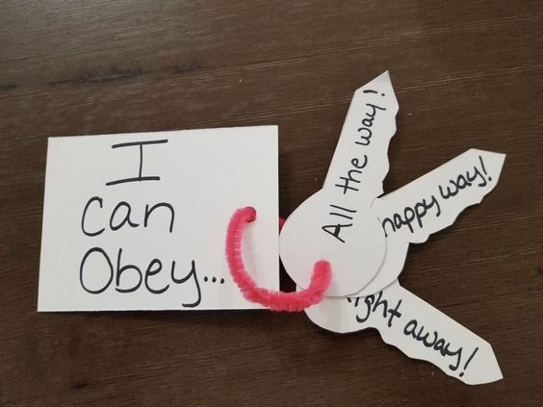
Craft:
“Key to Obedience”
Materials:
Scissors
Construction papers
Pens and markers
Some decorating materials
Glue or tape
Yarn

Slide 19
Instructions:
1. Cut the paper into key shapes or you can draw a key as your pattern then cut it.
2. You can color the key or use different color of papers as a key.
3. Then cut also a square shape and put a label “I will obey God” or “I will follow God” as the main key label.
4. Write down the things you can do to be a obedient follower of Christ.
5. Lastly, connect all the keys and the main key label which is the square using the yarn. Then here you go, you have the keys to be an obedient kid.

Slide 20
Closing Prayer
Dear God,
Help me to turn away from sins and protect me from all of temptations. May I always seek for what is good and do what is the right thing. I invite You to come into my heart and life. Take control of my life and make me the kind of person You want me to be. May I learn to trust you more and obey You as my Lord and Savior.
In Jesus' name we pray.
Amen.

Slide 21
LIVE THE WORD KIDS
1st Sunday of Lent | Year A

