Slide 1
LIVE THE WORD KIDS
February 19 | Seventh Sunday in Ordinary Time, Cycle A

Slide 2
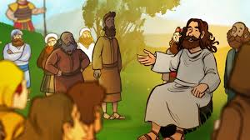
Teaching about Revenge & Love for Enemies
Matthew 5:38-48

Slide 3
For Facilitators Only: Gospel Background & Explanation
In the Gospel Jesus discusses how to respond to our enemies, that we should not take revenge to them and we should love them.
Forgiveness becomes optional due to the damage it has caused. However, with the second greatest commandment, God reminds us to instill love for thy neighbors. Even with the harshest actions thrown against you, even when they would never shed a single effort to have concern for you, even if they would never have the courage to appreciate things you are doing for them, God wants you to never plant hatred and revenge towards those who done against you.
Sometimes the best thing we can do is just re-pay evil with good…it’s not as seemingly gratifying initially, but the Bible promises it is worth it… As a phrase says “ Kill them with Kindness”
Jesus gives us difficult but important directions sometimes…for one thing, He asks us to show love for all people, even those who are not always kind to us.
Love everyone — even when they do wrong to you!
Loving, praying for, and forgiving one’s enemy is an extension of Jesus’ broader teaching about the perfection of God

Slide 4
Leader: A reading from
the Holy Gospel
according to Matthew.
All: Glory to You, Oh Lord.

Slide 5
38
“You have heard that it was said, ‘An eye for an eye, and a tooth for a tooth.’

Slide 6
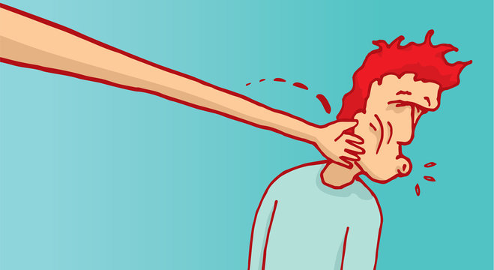
39
But now I tell you: do not take revenge on someone who wrongs you. If anyone slaps you on the right cheek, let him slap your left cheek too.

Slide 7
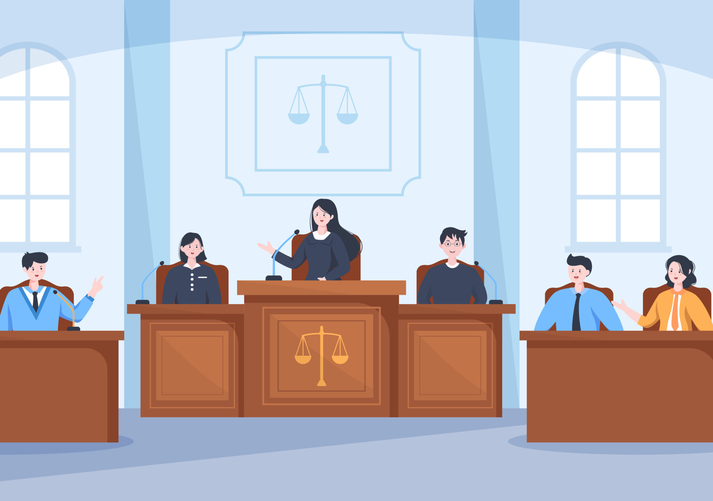
40
And if someone takes you to court to sue you for your shirt, let him have your coat as well.

Slide 8
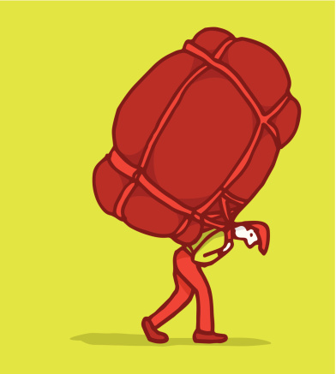
41
And if one of the occupation troops forces you to carry his pack one mile, carry it two miles.

Slide 9
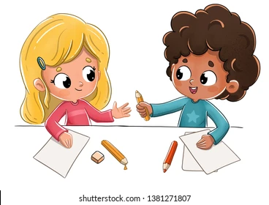
42
When someone asks you for something, give it to him; when someone wants to borrow something, lend it to him.

Slide 10
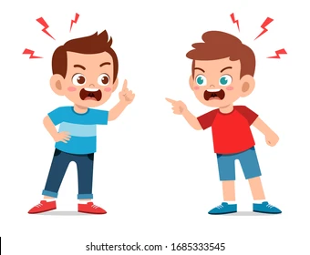
43
“You have heard that it was said, ‘Love your friends, hate your enemies.’

Slide 11
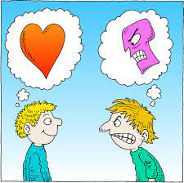
44
But now I tell you: love your enemies and pray for those who persecute you,

Slide 12
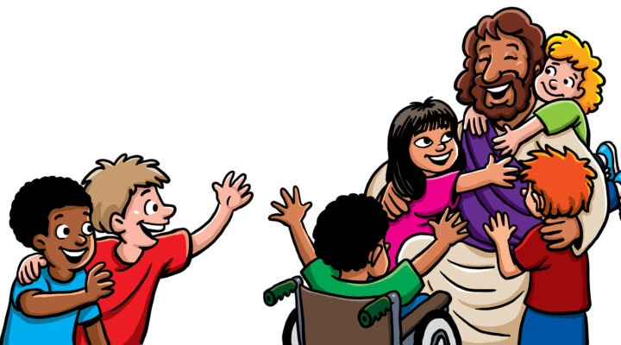
45
so that you may become the children of your Father in heaven. For he makes his sun to shine on bad and good people alike, and gives rain to those who do good and to those who do evil.

Slide 13
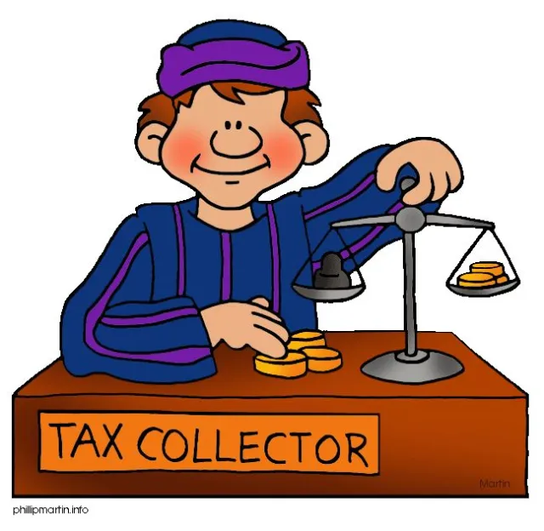
46
Why should God reward you if you love only the people who love you? Even the tax collectors do that!

Slide 14
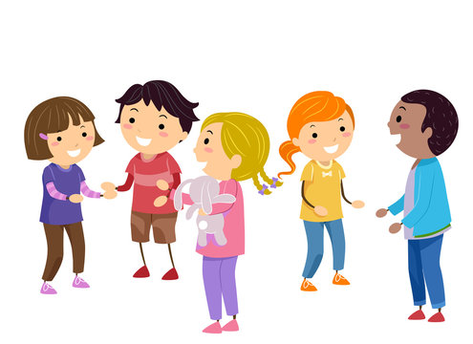
47
And if you speak only to your friends, have you done anything out of the ordinary? Even the pagans do that!

Slide 15
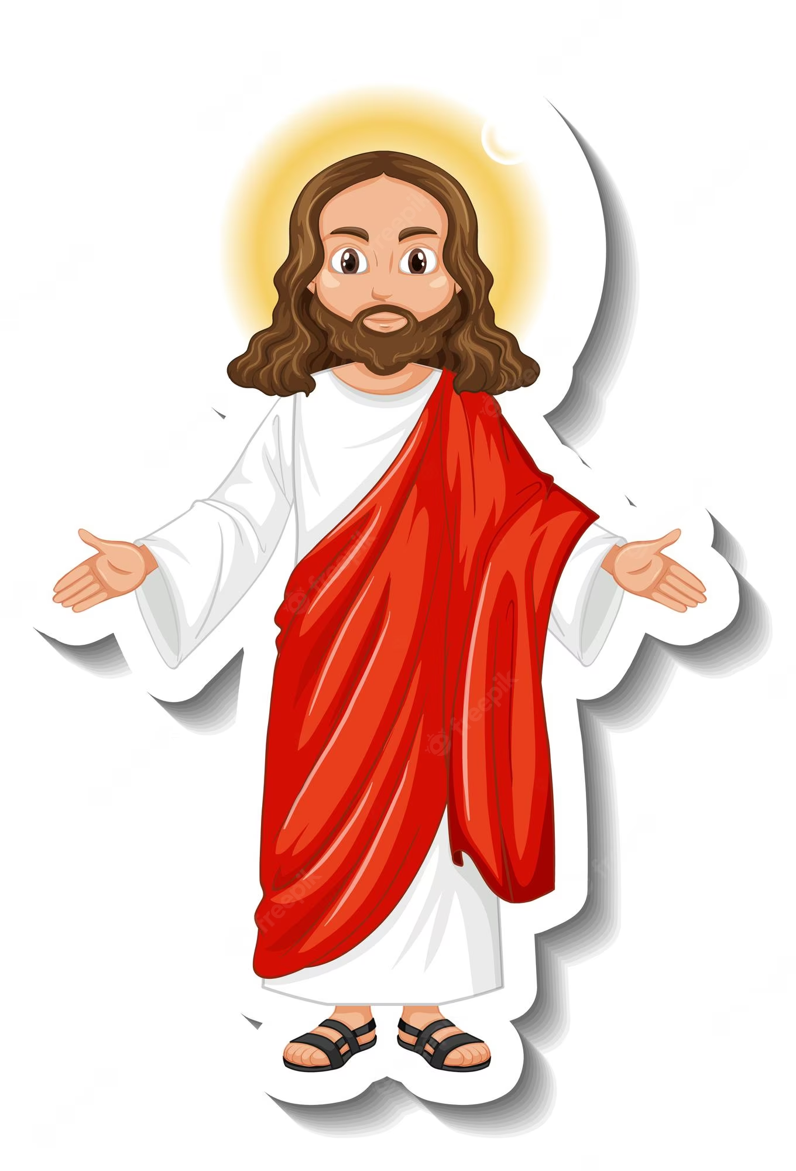
48
You must be perfect—just as your Father in heaven is perfect.

Slide 16
Leader: The Gospel of the Lord.
All: Praise to You,
Lord Jesus Christ.

Slide 17
GOSPEL MESSAGE

Slide 18
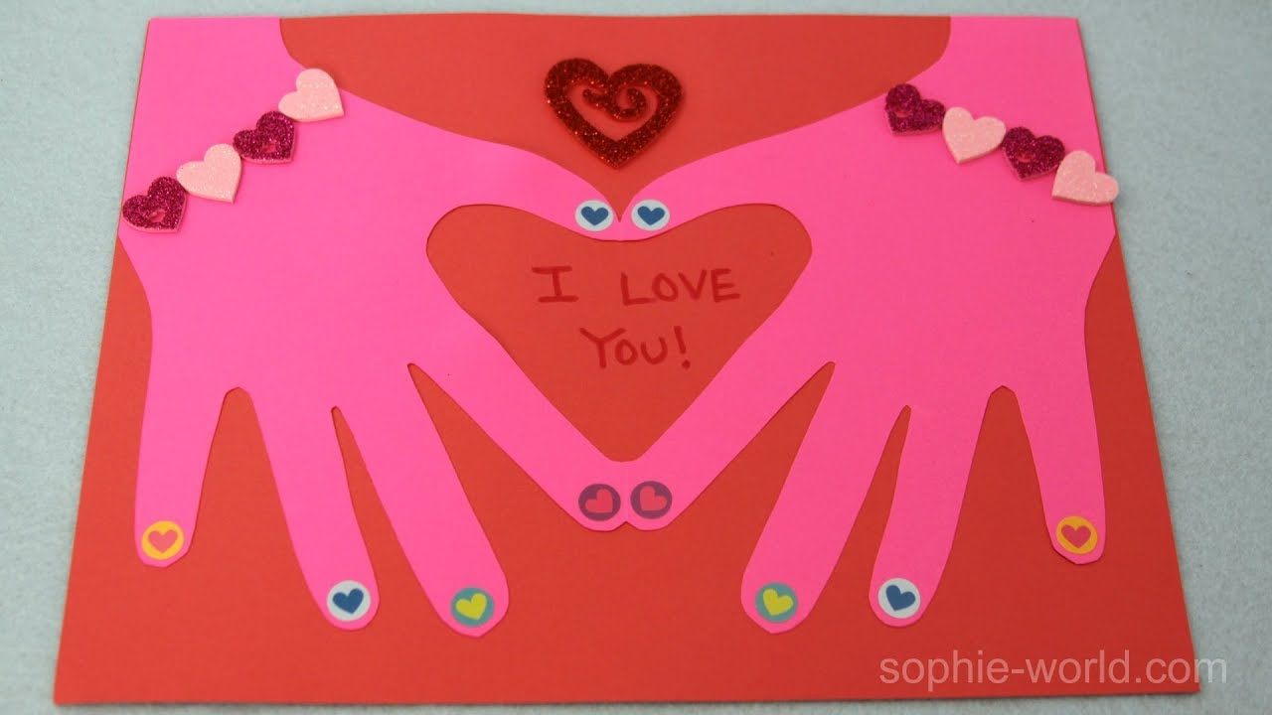
Craft:
“Loving Hand”
Materials:
Scissors
Construction papers
Pens and markers
Glue or tape

Slide 19
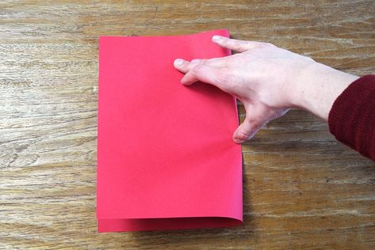
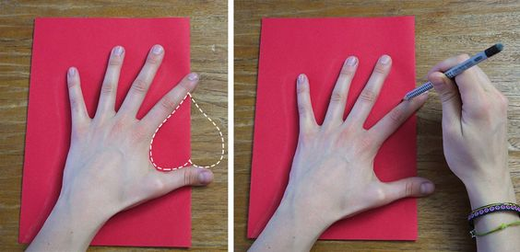
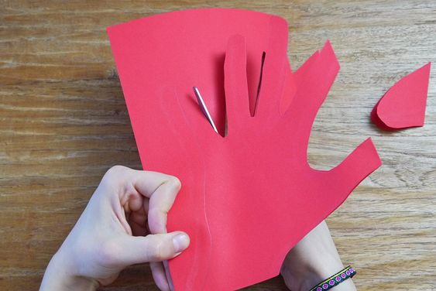
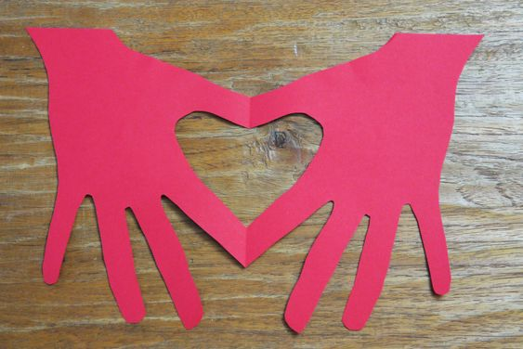
Instructions:
Fold the paper in half, pressing the crease well.
2. Trace your hand onto the folded paper so that the thumb and the pointer finger hang slightly over the folded edge.
3. Cut out the hand, leaving the places where the fingers go over the fold uncut. Open to reveal the heart inside
4. In each finger write the names of the persons you promise to love.
5. Decorate your hand.

Slide 20
Closing Prayer
Dear God,
Thank you for teaching us how to love. Thank you for your mercy. As you forgive us help us also to forgive others. Help us not to repay the bad doings with bad doings. May we show love and mercy to everyone.
In Jesus' name we pray.
Amen.

Slide 21
LIVE THE WORD KIDS
January 29 | Fourth Sunday in Ordinary Time, Cycle A

