Slide 1
LIVE THE WORD KIDS
6th Sunday in Ordinary Time | Year A

Slide 2
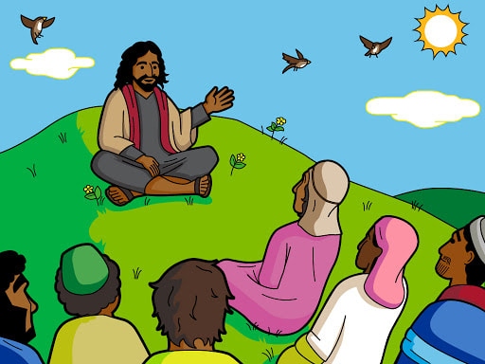
Jesus’ Teaching about the Law
Matthew 5:20-22, 27-28,33-34, 37

Slide 3
Leader: A reading from
the Holy Gospel
according to Matthew.
All: Glory to You, Oh Lord.

Slide 4
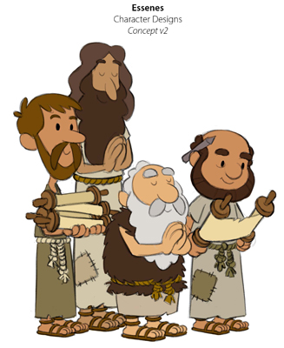
20
I tell you, then, that you will be able to enter the Kingdom of heaven only if you are more faithful than the teachers of the Law and the Pharisees in doing what God requires.

Slide 5
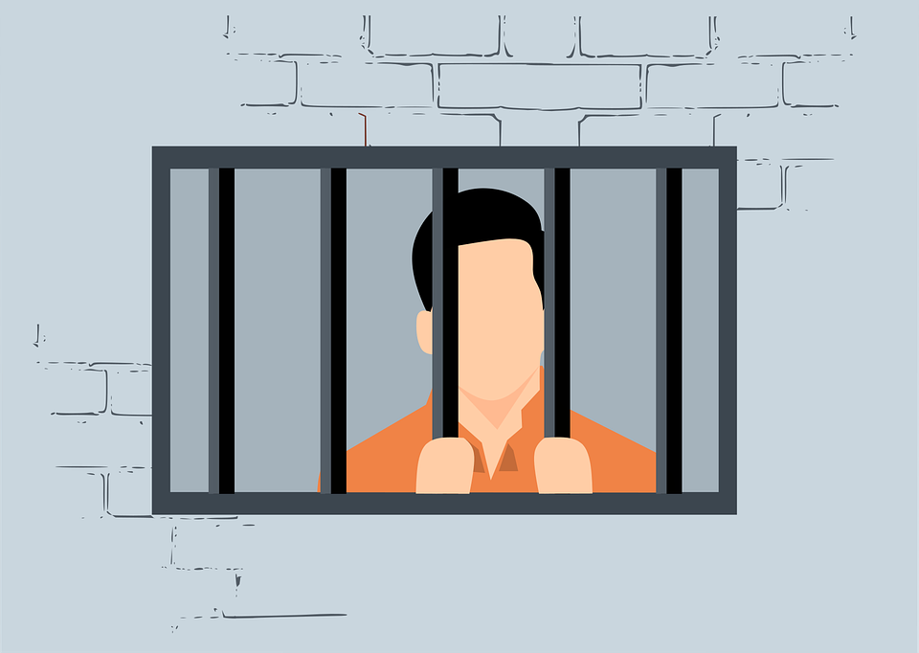
21
“You have heard that people were told in the past, ‘Do not commit murder; anyone who does will be brought to trial.’

Slide 6
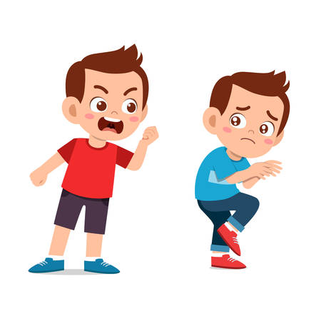
22
But now I tell you:
if you are angry with your brother you will be brought to trial, if you call your brother ‘You good-for-nothing!’ you will be brought before the Council, and if you call your brother a worthless fool you will be in danger of going to the fire of hell.

Slide 7
27
“You have heard that it was said, ‘Do not commit adultery.’

Slide 8
28
But now I tell you: anyone who looks at a woman and wants to possess her is guilty of committing adultery with her in his heart.

Slide 9
33
“You have also heard that people were told in the past, ‘Do not break your promise, but do what you have vowed to the Lord to do.’

Slide 10
34
But now I tell you: do not use any vow when you make a promise. Do not swear by heaven, for it is God's throne;

Slide 11
37
Just say ‘Yes’ or ‘No’—anything else you say comes from the Evil One.

Slide 12
Leader: The Gospel of the Lord.
All: Praise to You,
Lord Jesus Christ.

Slide 13
GOSPEL MESSAGE

Slide 14
Activity:
My Promises to God
Cotton balls
Colored Paper
Glue
Scissors
Markers
String
Stapler
Hole puncher

Slide 15
Instruction:
Draw a cloud on the piece of white cardstock and cut it out.
On one of the yellow pieces of construction paper, trace something circular in the size you desire for your sun.
Cut out 1.5 inch strips of paper.
On each of the strips of paper, write a promise that you will make to God or to your parents.
Punch a hole in the top of the cloud, lace a piece of yarn through it, and tie it together so you can hang the craft when you are finished. Then staple the sun so that it’s peaking out from the cloud and staple the strips of paper with the promises written on them to the bottom of the cloud.
Then write “I promise to God to….” on the sun.

Slide 16
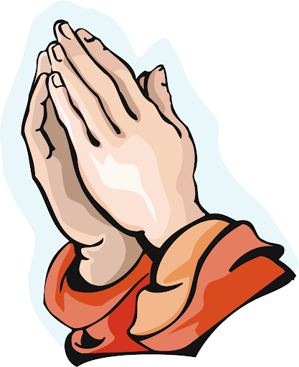
Closing Prayer
Dear God,
Help us to understand what love means. Help us practice it with those around us. Even when it is difficult, and even when we don’t feel like it! You are so amazing.
Thank you for the love of Jesus
We love you, God!
In Jesus' name we pray. Amen.

Slide 17
LIVE THE WORD KIDS
6th Sunday in Ordinary Time | Year A

