Slide 1
LIVE THE WORD KIDS
February 05| 5th Sunday in
Ordinary Time | Year A

Slide 2
GOSPEL REFLECTION
Faith changes the way we live. It requires that we step beyond our selfish concerns and care for those in need. People of faith seek righteousness, not power. Any power we do have is merely a reflection of God’s power.
Righteous living helps people directly by meeting their needs, but also by manifesting God’s goodness to them. The light they share brings clarity and warmth to those trapped in the cold and darkness. The shining example of the righteous draws people to God.

Slide 3
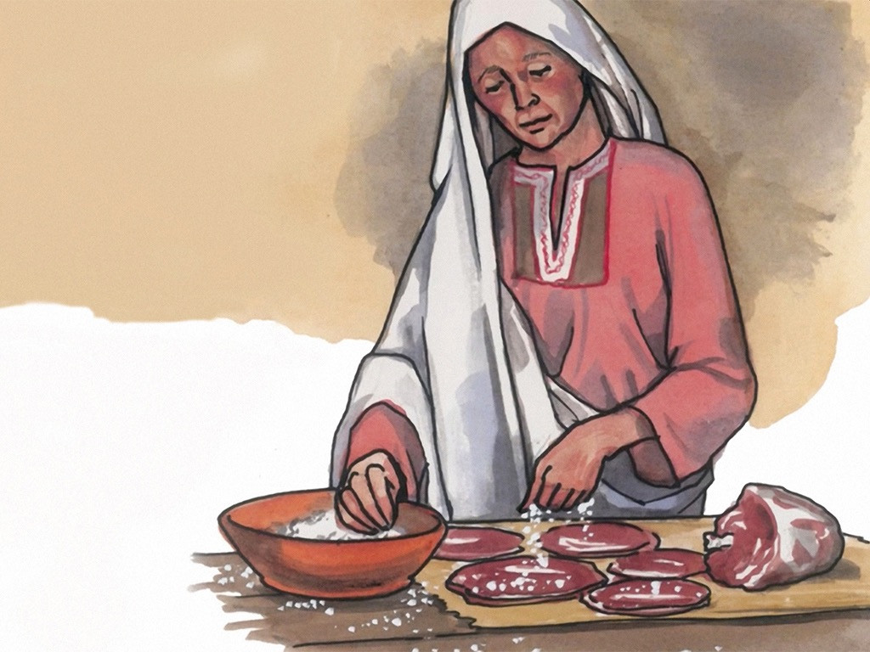
The Parable of Salt and Light
Matthew 5:13-16

Slide 4
Leader: A reading from
the Holy Gospel
according to Matthew.
All: Glory to You, Oh Lord.

Slide 5
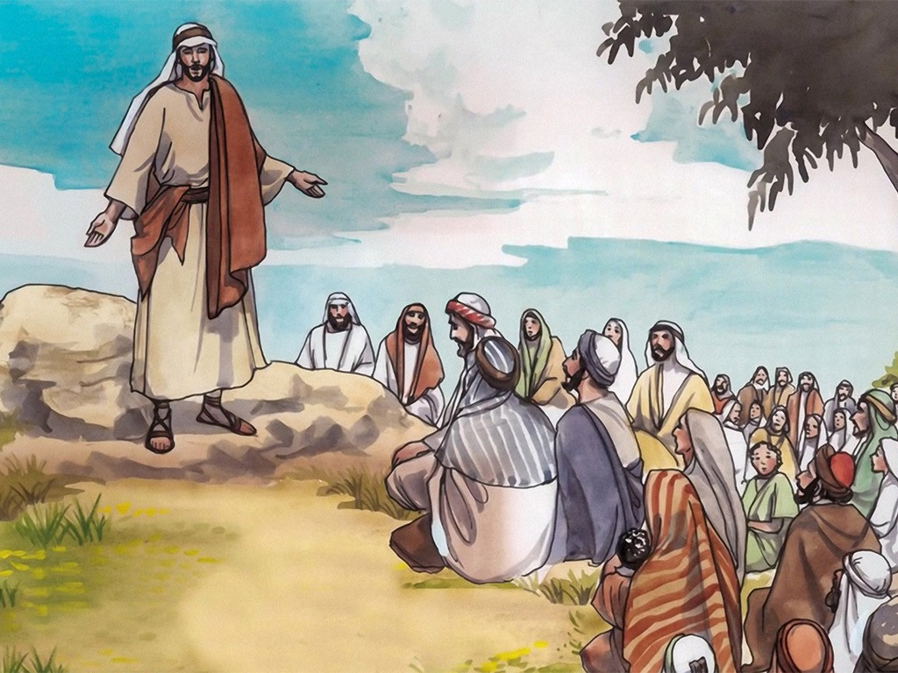
13
“You are like salt for the whole human race. But if salt loses its saltiness, there is no way to make it salty again. It has become worthless, so it is thrown out and people trample on it.

Slide 6
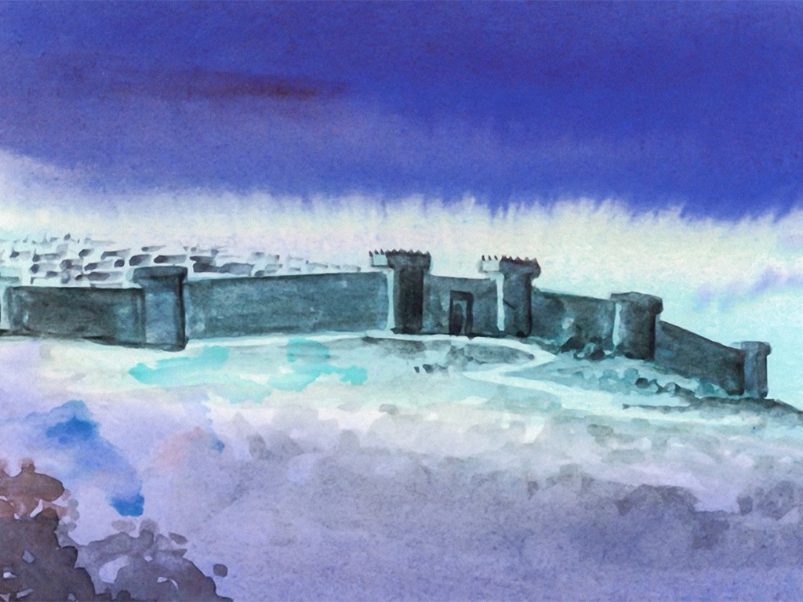
14
“You are like light for the whole world. A city built on a hill cannot be hid.

Slide 7
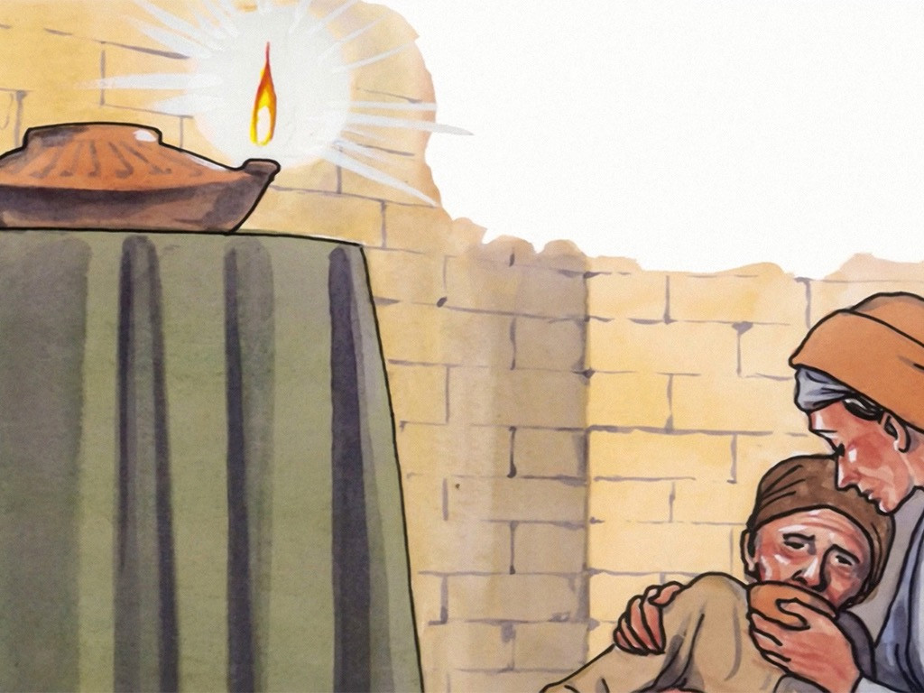
15
No one lights a lamp and puts it under a bowl; instead it is put on the lampstand, where it gives light for everyone in the house.

Slide 8
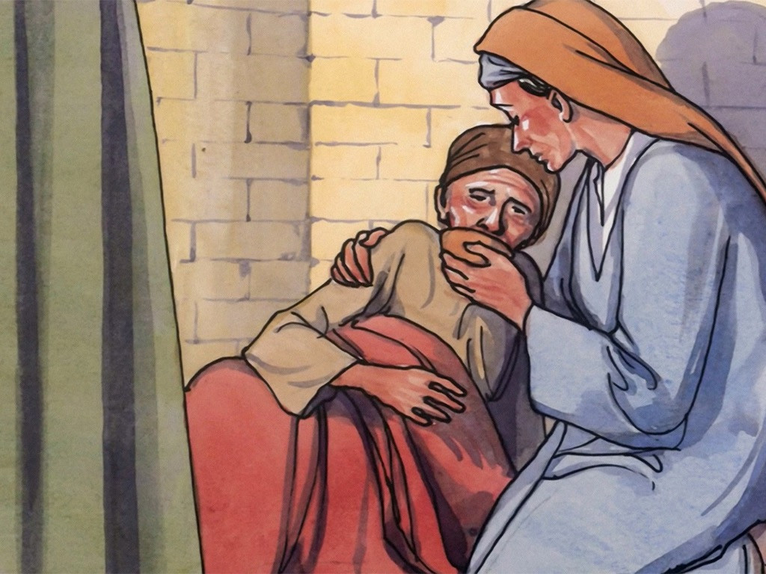
16
In the same way your light must shine before people, so that they will see the good things you do and praise your Father in heaven.

Slide 9
Leader: The Gospel of the Lord.
All: Praise to You,
Lord Jesus Christ.

Slide 10
GOSPEL MESSAGE

Slide 11
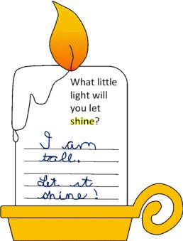
Activity:
I am a Light
Plain White Paper
Writing Materials
Coloring Materials

Slide 12
Instruction:
Draw (and color) a candle on a plain white sheet of paper
On the body part of the candle, write and answer the question “What little light will you let shine?”

Slide 13
Closing Prayer
Dear God,
Thank You for bringing light to my life. Please help me to become a good person so that Your light will shine on me. Allow me to share Your light with the people I meet.
In Jesus' name we pray. Amen.

Slide 14
LIVE THE WORD KIDS
February 05| 5th Sunday in
Ordinary Time | Year A

