Slide 1
LIVE THE WORD KIDS
Second Sunday of Advent | Cycle B

Slide 2
GOSPEL REFLECTION
In today’s gospel, we have seen how dedicated John the Baptist is to the voice that he heard out from the wilderness. Most of the time, if someone hears voices out of nowhere our immediate response is to run or be afraid. But instead of having that feeling towards the voice he heard, John the Baptist listens and prepares.
The gospel calls us to repent and prepare for the way of the Lord, just as John the Baptist did. We must decrease and Jesus must increase in our lives. John's baptism of repentance and forgiveness is a call to the people of Judea and the city of Jerusalem to turn from their evil ways and accept God's forgiveness. And many of them trusted the call of John the Baptist. John the Baptist taught us the first preparation for the Second Coming of Jesus and it is to know and speak the truth. Especially to prepare the cradle of God in our hearts.

Slide 3
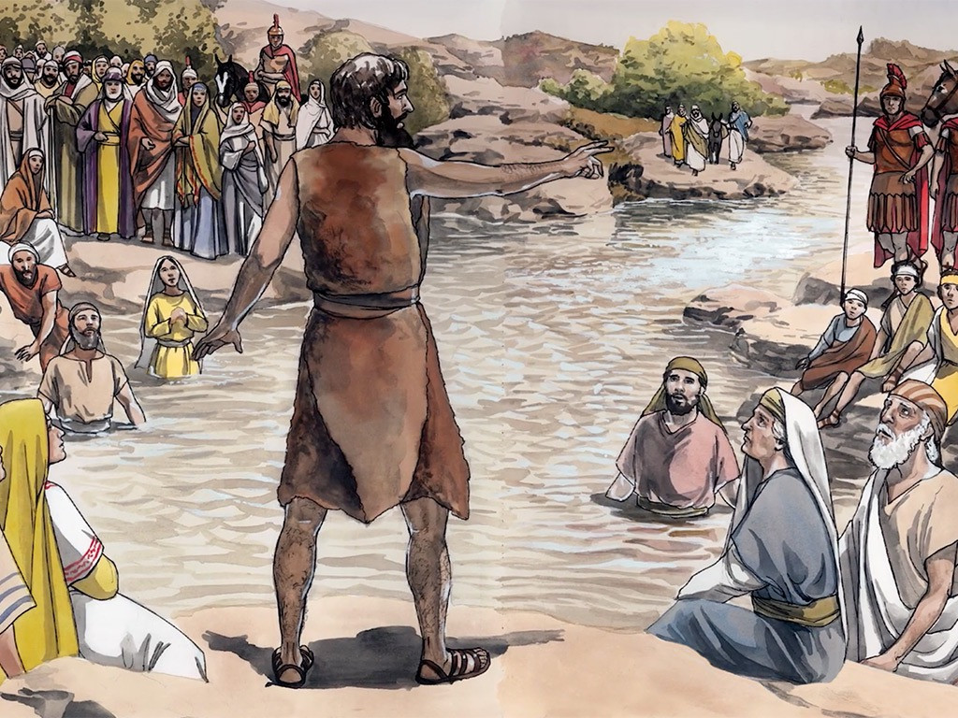
Preparing the way for Jesus
Mark 1:1-8

Slide 4
Leader: A reading from
the Holy Gospel
according to St. Mark.
All: Glory to You, Oh Lord.

Slide 5
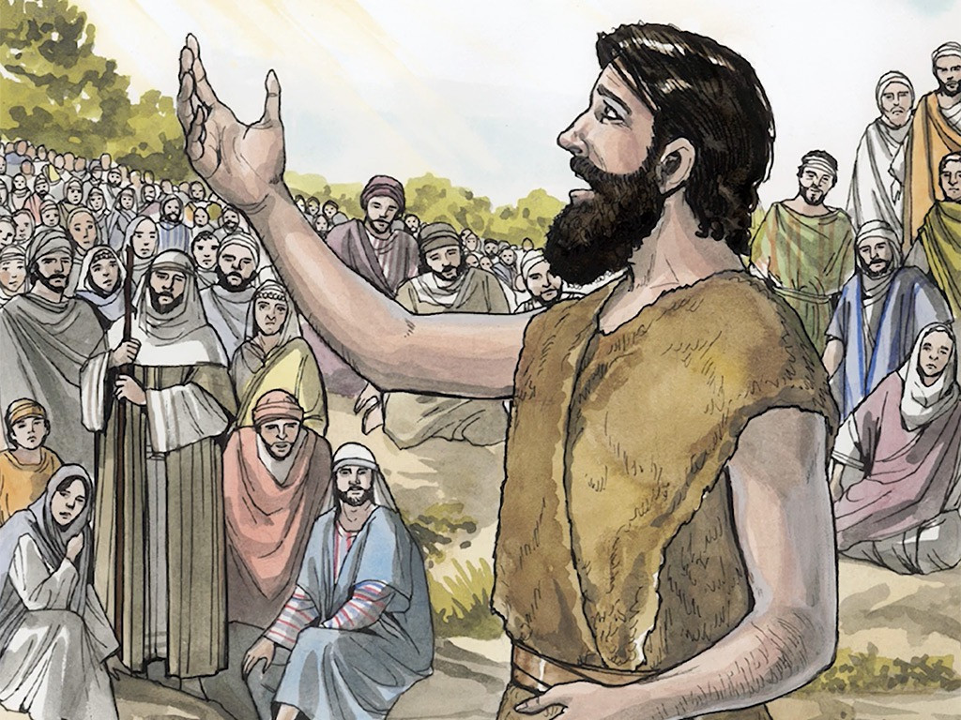
1
The beginning of the good news about Jesus the Messiah, the Son of God,

Slide 6
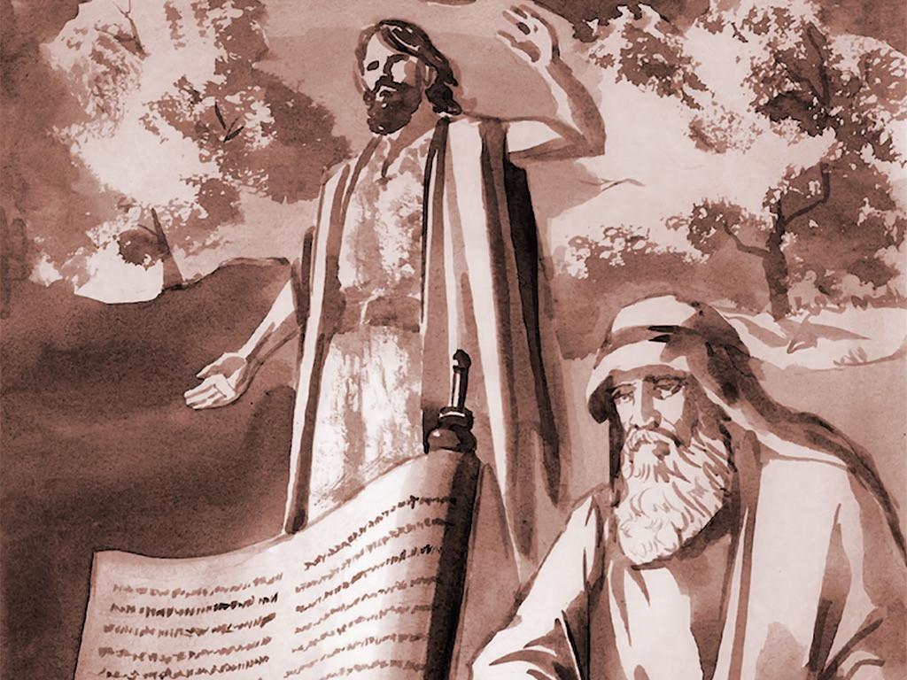
2
as it is written in Isaiah the prophet:
“I will send my messenger ahead of you, who will prepare your way”

Slide 7
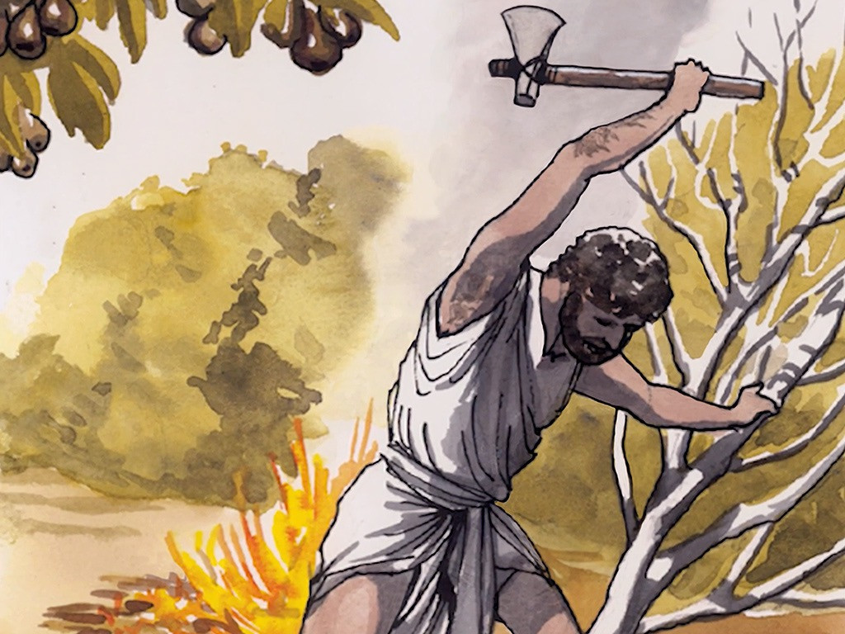
3
“a voice of one calling in the wilderness,
‘Prepare the way for the Lord,
make straight paths for him.”

Slide 8
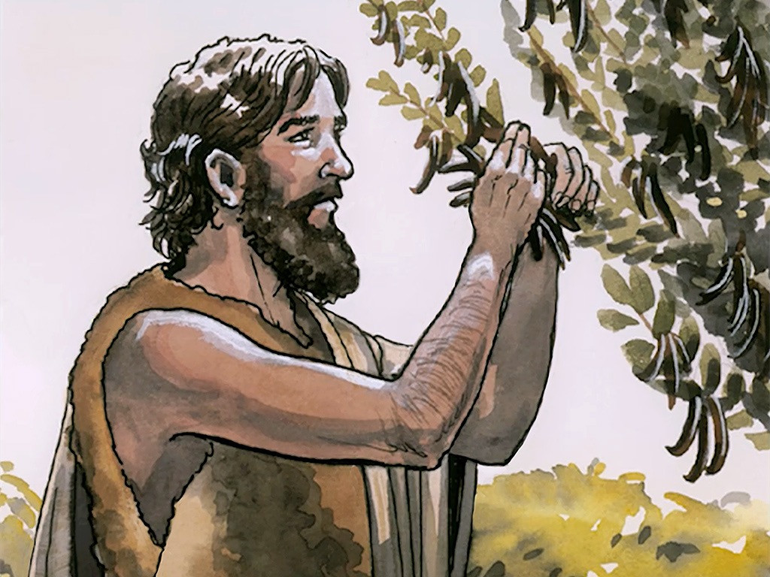
4
And so John the Baptist appeared in the wilderness, preaching a baptism of repentance for the forgiveness of sins.

Slide 9
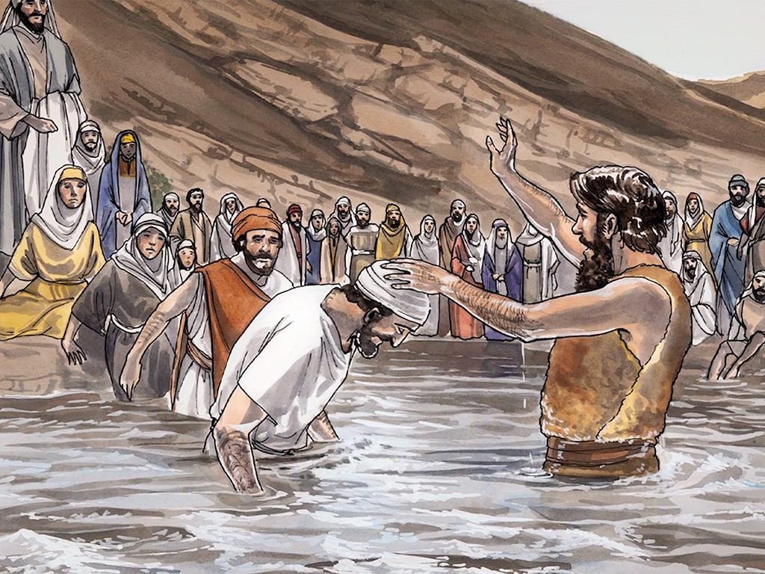
5
The whole Judean countryside and all the people of Jerusalem went out to him. Confessing their sins, they were baptized by him in the Jordan River.

Slide 10
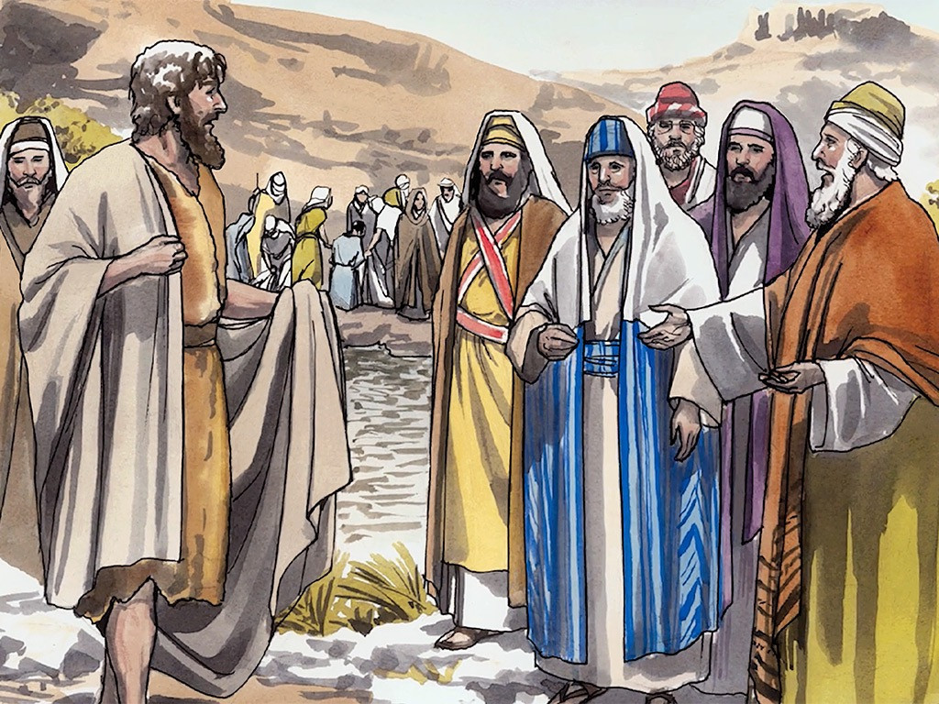
6
John wore clothing made of camel’s hair, with a leather belt around his waist, and he ate locusts and wild honey.

Slide 11
7
And this was his message: “After me comes the one more powerful than I, the straps of whose sandals I am not worthy to stoop down and untie.

Slide 12
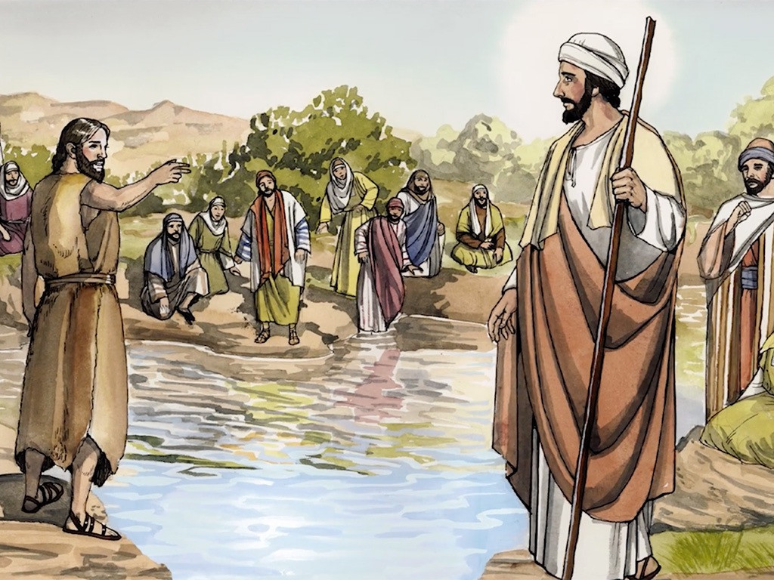
8
I baptize you with water, but he will baptize you with the Holy Spirit.”

Slide 13
Leader: The Gospel of the Lord.
All: Praise to You,
Lord Jesus Christ.

Slide 14
GOSPEL MESSAGE

Slide 15
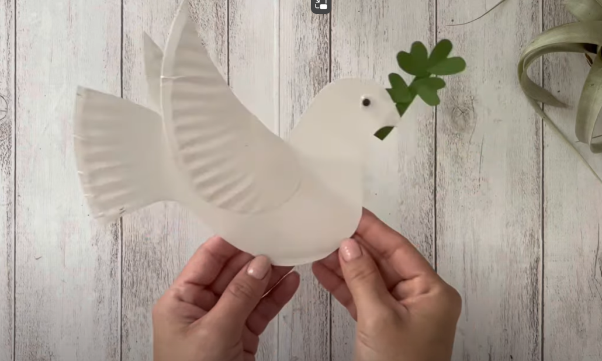
Activity:
Dove Christmas Ornament Making
Materials:
White Paper Plate
Pencil
Black Marker
Glue
Scissors
Yarn
References:
The Peace Dove Craft: A Cute and Easy DIY | Made From Paper Plate
https://www.youtube.com/watch?v=FTlJm_0Zhk8&ab_channel=HappyCrafty

Slide 16
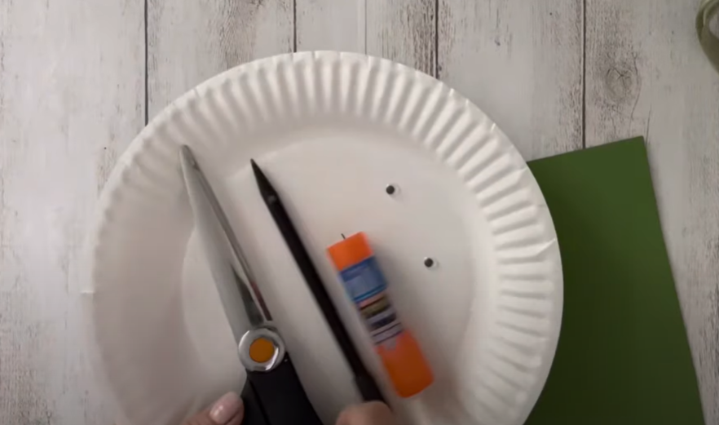
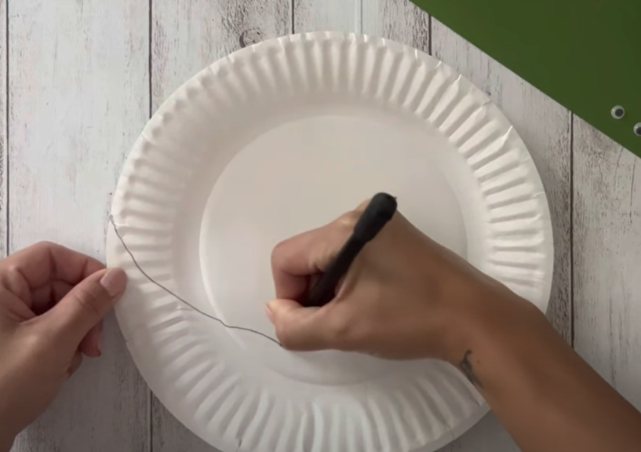
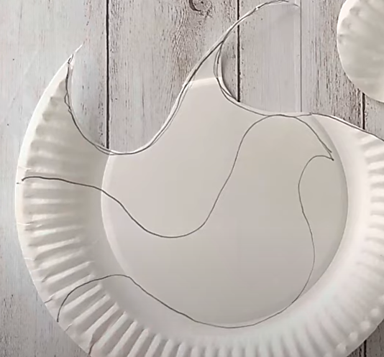
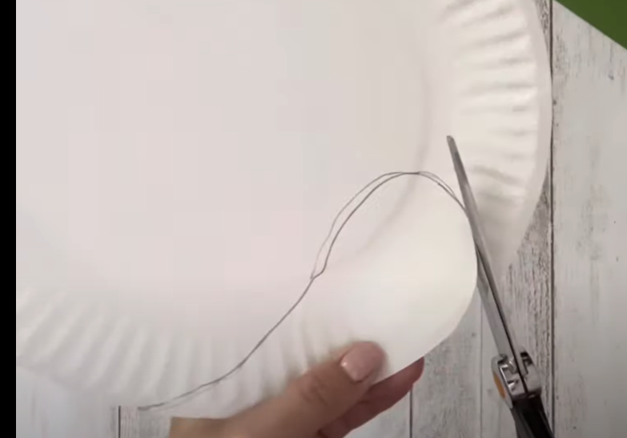
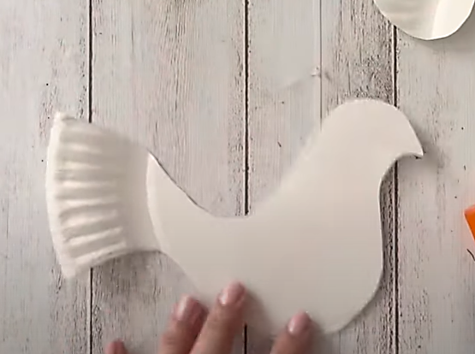
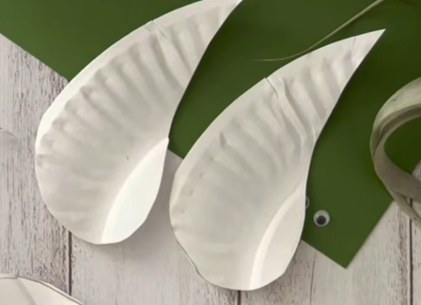
Procedure
1
Prepare your materials.
2
Create a curve pattern on the ending side of the paper plate, and cut it. Repeat the process to create two that will serve as your wings.
3
Using the same plate, draw and cut the base of your wings. This will serve as your dove’s body

Slide 17
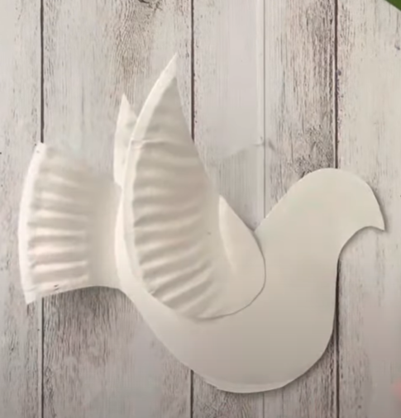
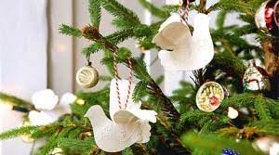
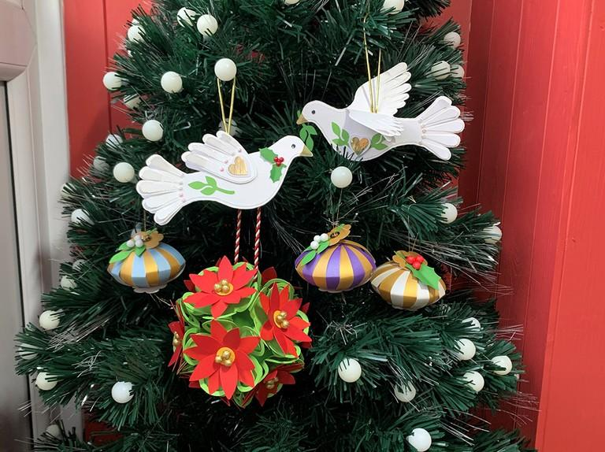
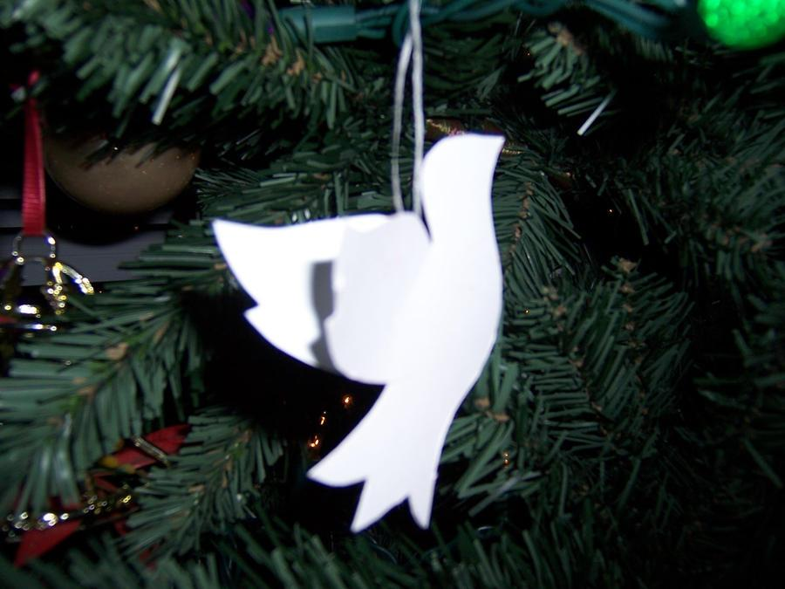
Procedure
6
Create a hole in the upper body of the bird and attach enough length of yarn to create its lace. Add this to your Christmas tree.
5
Using your marker, add a black dot at the face of the dove, side by side. This will serve as the eyes.
4
Paste the lower part of your wings to the middle portion of the dove’s body.

Slide 18
Closing Prayer
Dear God,
As we prepare ourselves for your coming O Jesus, ready our hearts and make us dare to prepare your way.
Jesus, Son of the living God, you are the light of the world and peace of peace. Please help us to follow you and enable us to share your light and your peace, especially to the poor, deprived, oppressed, and exploited. Amen.
Amen.

Slide 19
LIVE THE WORD KIDS
Second Sunday of Advent | Cycle B

