Slide 1
LIVE THE WORD KIDS
First Sunday of Advent | Cycle B

Slide 2
GOSPEL REFLECTION
Advent begins today. We spend this time preparing for the coming of Christ to our world. Of course he already exist in our lives and in our history, but we wanted Him to come again and prepare our lives for that. Let us be one of his entrances by staying awake and answering when he knocks at our door. Jesus was like a householder who went abroad. He gave His servants, you and me, His work, and each one did his own work. We all have our roles in this world. Then, what is our role? We need to fulfill the duties given to us by the Lord. Let us all be ready and stay awake because you never know when Jesus will return. Let us all stay awake.
As St. Paul tells us in the reading, “God is the source of all our hope.” He keeps His promises to us. He sent Jesus, His only Son to us. We must be a people of hope as the Israelites were, who waited thousands of years for Jesus. We must also share that hope in God with others during the Advent season and always. Let us be hopeful as we are experiencing different struggles in this year, we will overcome these things and start a new beginning.

Slide 3
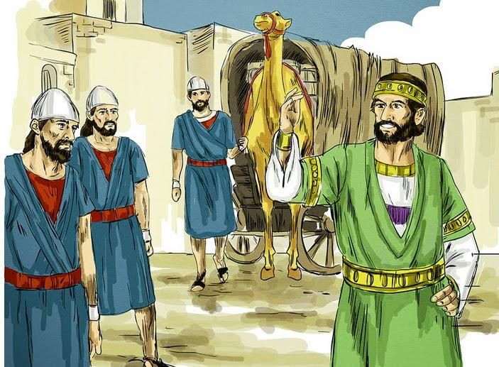
Be watchful, be alert!
Mark 13:33-37

Slide 4
Leader: A reading from
the Holy Gospel
according to St. Mark.
All: Glory to You, Oh Lord.

Slide 5
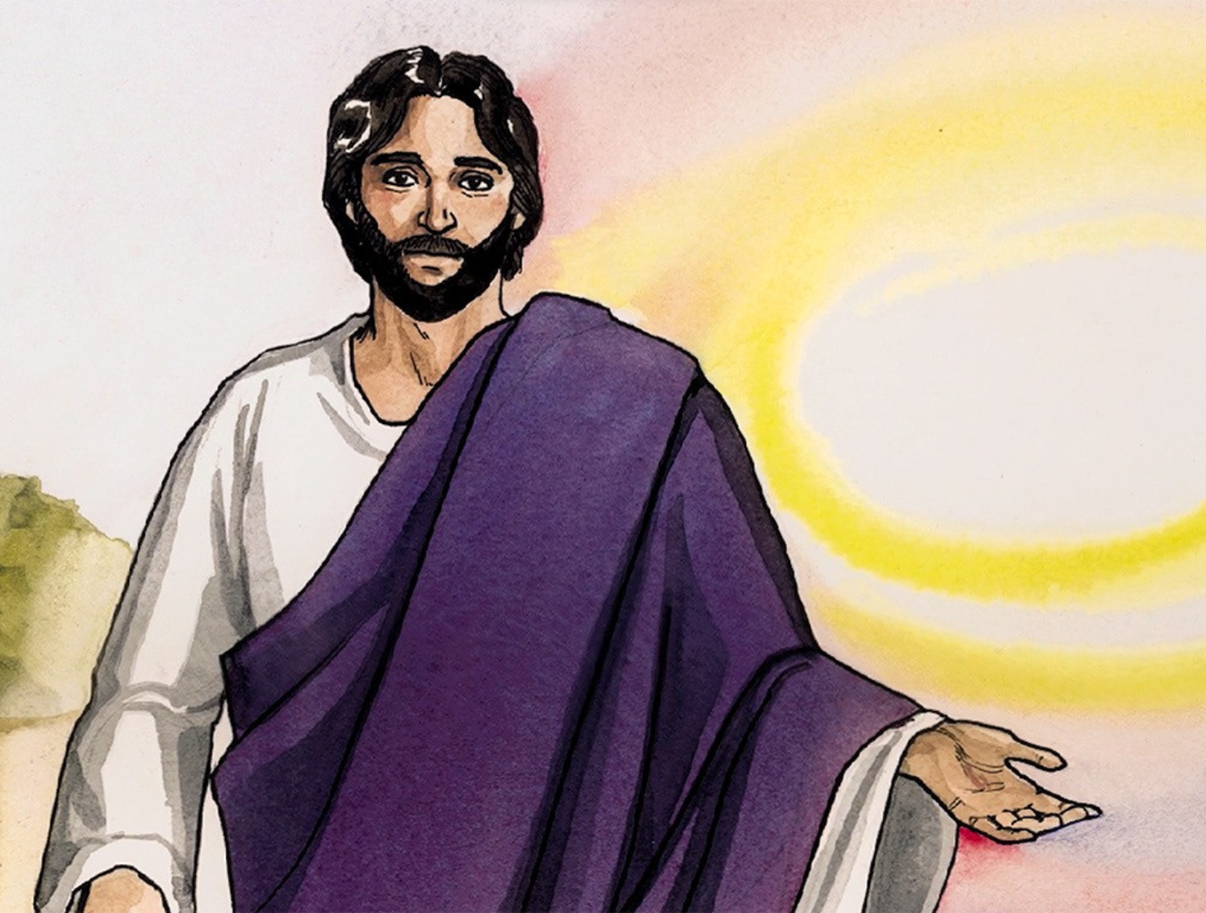
33
Be on guard! Be alert! You do not know when that time will come.

Slide 6
34
It’s like a man going away: He leaves his house and puts his servants in charge, each with their assigned task, and tells the one at the door to keep watch.

Slide 7
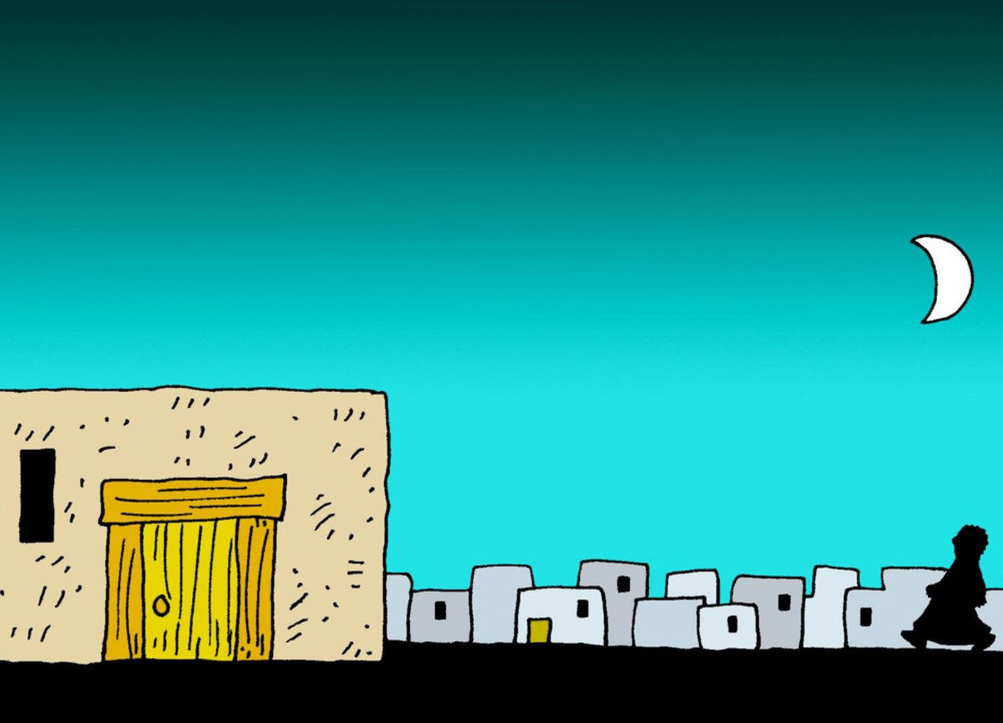
35
“Therefore keep watch because you do not know when the owner of the house will come back—whether in the evening, or at midnight, or when the rooster crows, or at dawn.

Slide 8
36
If he comes suddenly, do not let him find you sleeping.

Slide 9
37
What I say to you, I say to everyone: ‘Watch!’”

Slide 10
Leader: The Gospel of the Lord.
All: Praise to You,
Lord Jesus Christ.

Slide 11
GOSPEL MESSAGE

Slide 12
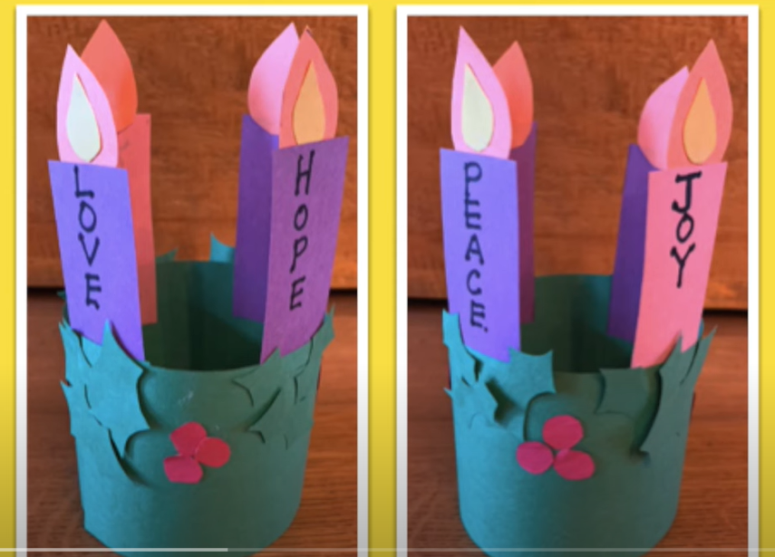
Activity:
Advent Wreath Craft
Materials:
Colored Papers:
- 1 piece each: Yellow, Violet, and Pink
- 2 pieces: Green
Glue
Scissors
Pencil
Marker
References:
Craft Club for Kids
https://www.youtube.com/watch?v=DKvtEL1QpTg&ab_channel=CraftClubforKids

Slide 13
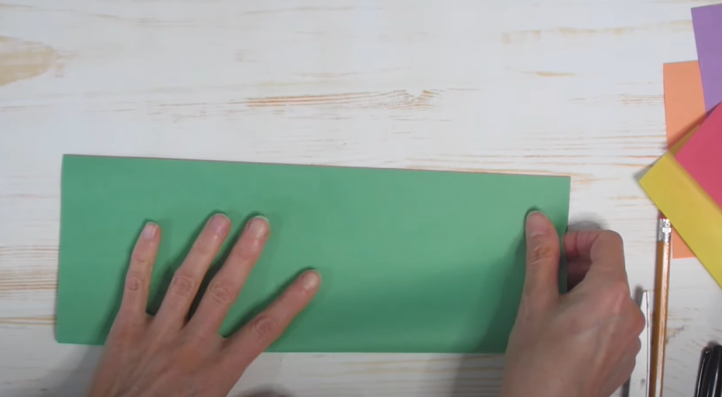
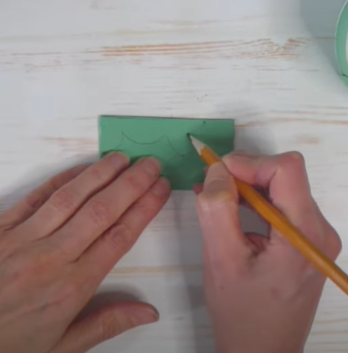
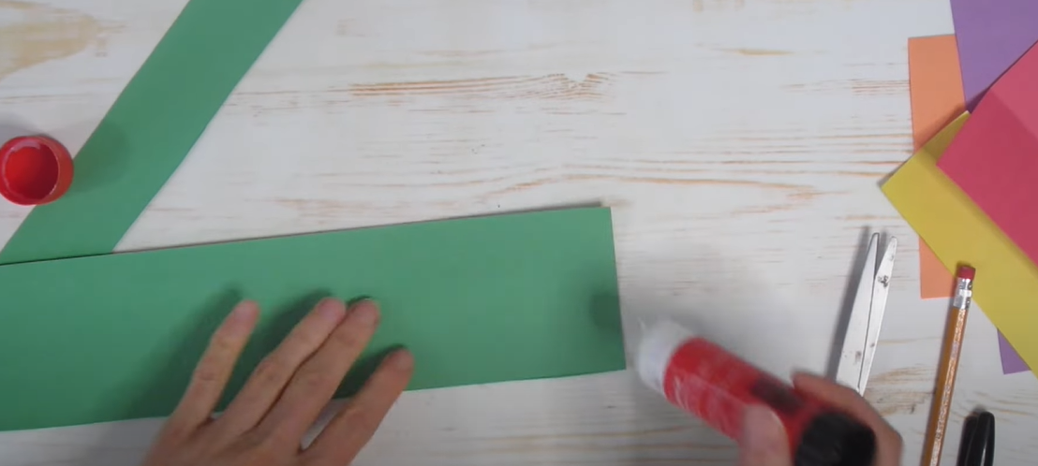
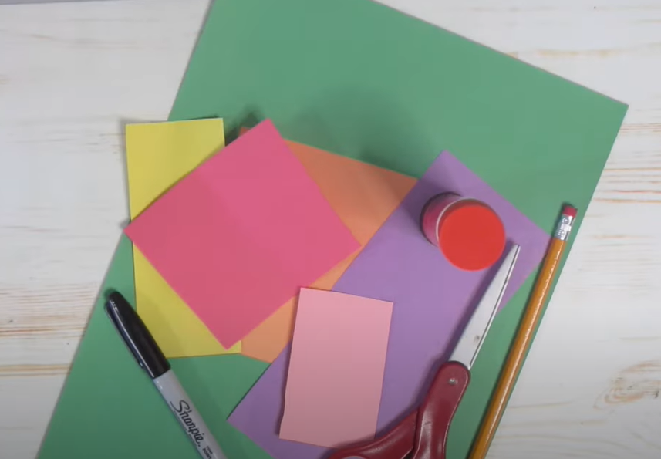
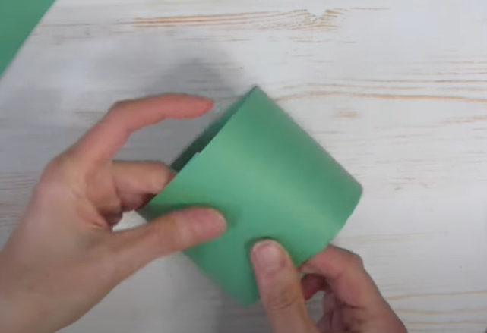
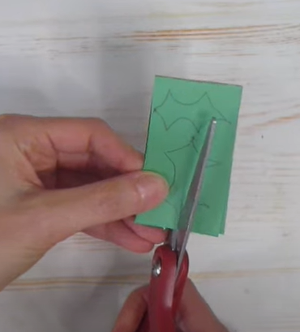
Procedure A: Creating of Advent Wreath Base
3
1
2
Prepare your Glue, Green colored papers, Scissors, and Pencil.
Fold your Green colored paper into half and paste both edges.
Using your other green-colored papers, draw and cut some advent leaves. Paste it to the upper part of your green Base wreath you created.

Slide 14
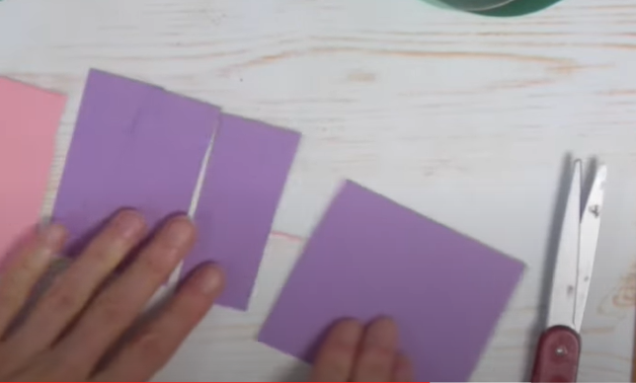
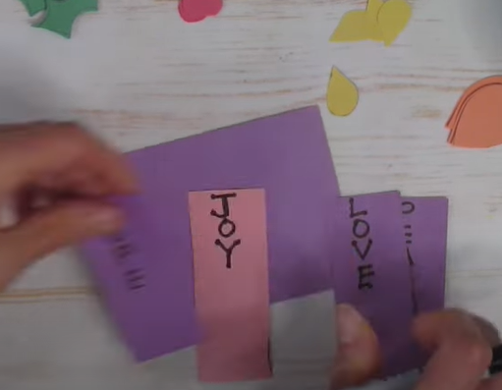
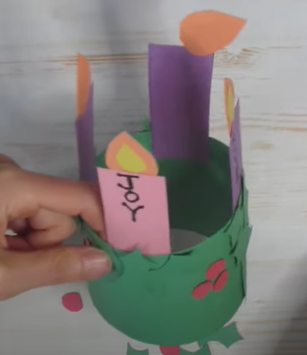
Procedure B: Creating of Advent Wreath Candles
1
2
3
Prepare your Glue, other colored papers, Scissors, and Pencil.
Cut out three pieces of same-sized rectangles using violet-colored paper and one piece of a rectangle using pink-colored paper. Set it aside.
Draw and cut medium-sized tear drop-like. It will serve as the flame in your candle. Set it aside.
4
5
In your Violet rectangle papers, write:
Rectangle #1: Hope
Rectangle #2: Peace
Rectangle #3: Love
Paste your flame in the top of your candle. Then, attach the lower part of the candle inside the Green wreath and add your Christmas designs.
In your Pink rectangle paper, write Joy
This will serve as your candle in your Advent wreath.

Slide 15
Activity:
Advent Wreath Craft
Just make sure the following candles are attached in an orderly manner.
Violet Candle #1 Hope
Violet Candle #2 Peace
Pink Candle #3 Joy
Violet Candle #4 Love
References:
Craft Club for Kids
https://www.youtube.com/watch?v=DKvtEL1QpTg&ab_channel=CraftClubforKids

Slide 16
Closing Prayer
Dear God,
As we prepare ourselves to your coming O Jesus, ready our hearts and make us dare to watch your coming.
Gracious God, all around us people are getting ready for Christmas. We eagerly wait for the coming of Your Son, Jesus. Help us to get ready in our hearts to celebrate His coming into the world. May Advent be a time of hope for all of us. Amen.
Amen.

Slide 17
LIVE THE WORD KIDS
First Sunday of Advent | Cycle B

