Slide 1
LIVE THE WORD KIDS
21st Sunday in Ordinary Time | Cycle A

Slide 2
GOSPEL REFLECTION
There are non-believers who question Jesus' existence in our religion, the same way as the other people in the gospel. They have a hard time identifying who is Jesus Christ. Mostly said that Jesus is a prophet but as God, the Father delivered His message to Peter, Peter then realized and mentioned that Jesus is our Messiah, the one sent forth by God the Father.
This information helped Peter to grow more in his Faith in Jesus because the message was directly sent to him by God the Father. With that, Jesus fully trusted Peter to be the strong foundation of the church. He is the rock of the Church and he also holds the Key to its by-laws since Jesus mentioned that “What you prohibit on earth will be prohibited in heaven, and what you permit on earth will be permitted in heaven.”
There are times that we misunderstand the message of God, but have faith in Him because through His revelations we will be saved.

Slide 3
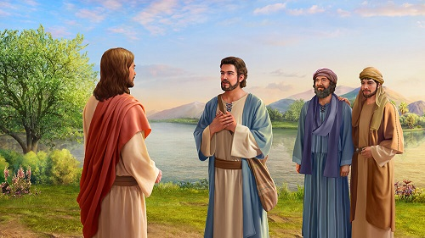
Peter's Declaration about Jesus
Matthew 16:13-20

Slide 4
Leader: A reading from
the Holy Gospel
according to Matthew.
All: Glory to You, Oh Lord.

Slide 5
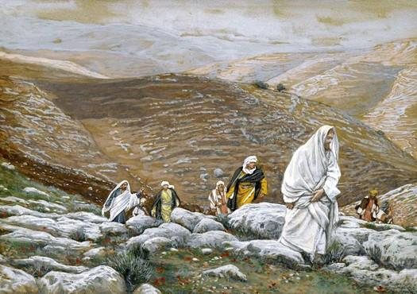
13
Jesus went to the territory near the town of Caesarea Philippi, where he asked his disciples, “Who do people say the Son of Man is?”

Slide 6
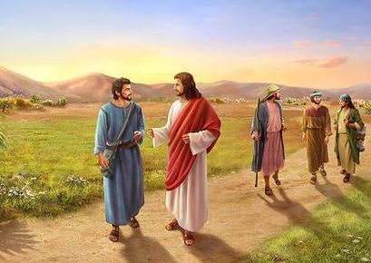
14
“Some say John the Baptist,” they answered. “Others say Elijah, while others say Jeremiah or some other prophet.”

Slide 7
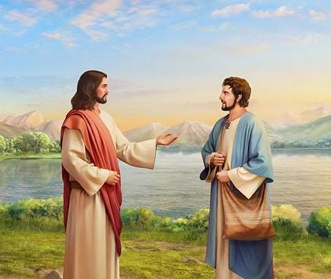
15
“What about you?” he asked them. “Who do you say I am?”

Slide 8
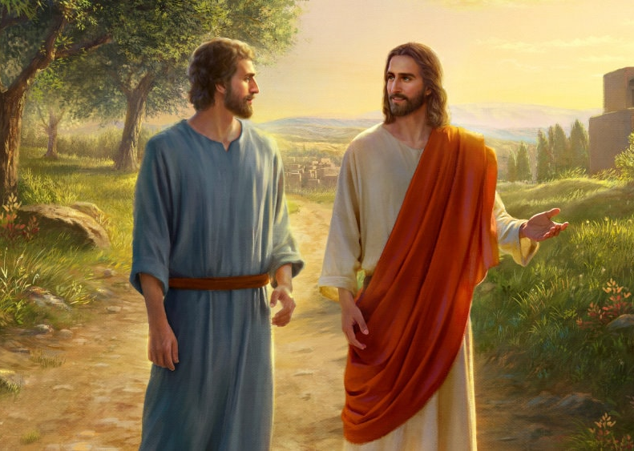
16
Simon Peter answered, “You are the Messiah, the Son of the living God.”

Slide 9
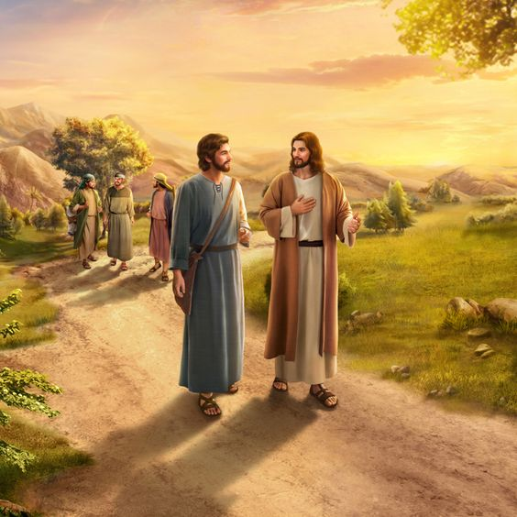
17
“Good for you, Simon son of John!” answered Jesus.
“For this truth did not come to you from any human being,
but it was given to you directly by my Father in heaven.

Slide 10
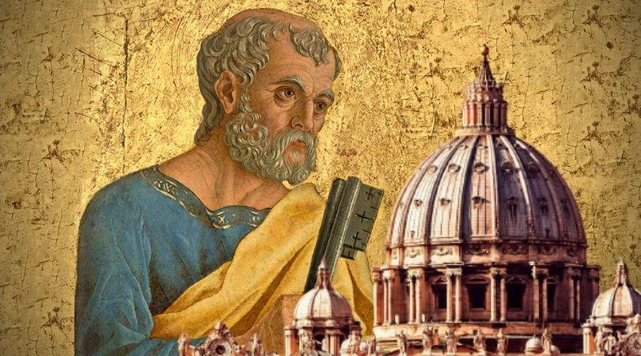
18
And so I tell you, Peter:
You are a rock, and on this rock foundation,
I will build my church, and not even death will ever be able to overcome it.

Slide 11
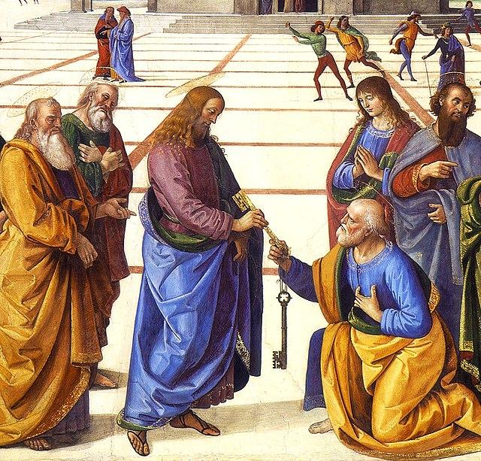
19
I will give you the keys of the Kingdom of heaven; what you prohibit on earth will be prohibited in heaven, and what you permit on earth will be permitted in heaven.”

Slide 12
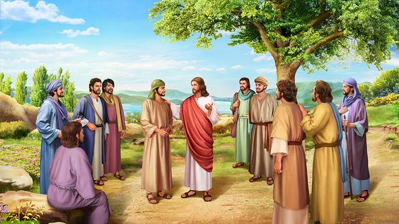
20
Then Jesus ordered his disciples not to tell anyone that he was the Messiah.

Slide 13
Leader: The Gospel of the Lord.
All: Praise to You,
Lord Jesus Christ.

Slide 14
GOSPEL MESSAGE

Slide 15
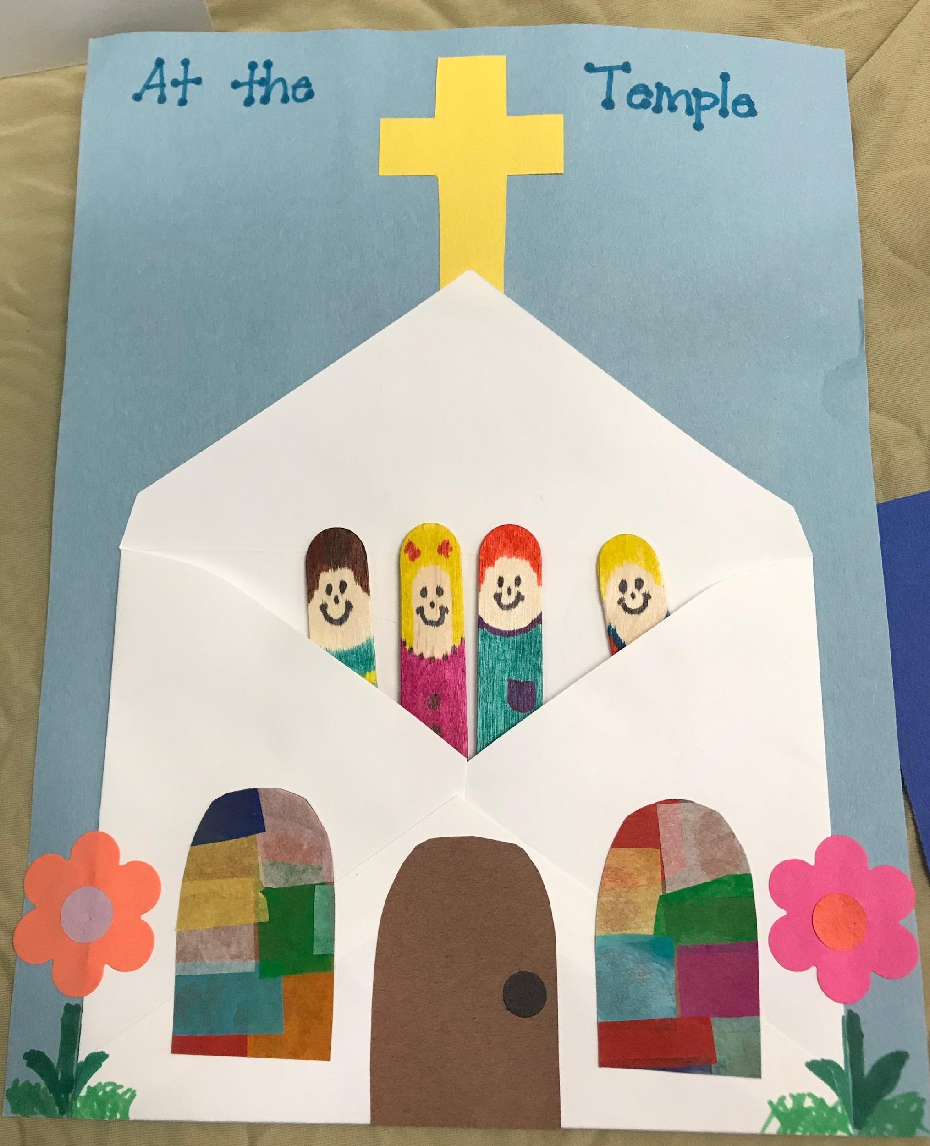
Activity:
My Family in Church
Materials needed:
White Small Envelope
Glue
Scissors
Extra decorations (stickers, etc.)
Colored Papers (2 different colors)
Colored Markers
Crayons
Big Popsicle Sticks (the number depends on the number of your family members)
Reference:
https://i.pinimg.com/originals/34/2a/40/342a40616cfec1937156ec51b99782d3.jpg

Slide 16
Procedure:
1
2
3
4
5
6

Slide 17
Closing Prayer
Dear God,
Thank you for revealing yourself through Jesus. We know that He is our savior and Messiah. Help us to remember that and proclaim it to others Thank you for your love.
We love you, God! In Jesus name, Amen.

Slide 18
LIVE THE WORD KIDS
21st Sunday in Ordinary Time | Cycle A

