Slide 1
LIVE THE WORD KIDS
20th Sunday in Ordinary Time | Cycle A

Slide 2
GOSPEL REFLECTION
Did you know that Canaanite people are those who stand against the Israelites, the people whom Jesus belongs with? This event shows us the mercy that Jesus has given to people who has faith in Him even if they oppose each other’s belief. Our Church celebrates the year of synodality, living in the value of synod. Synodality means journeying together as the People of God. We are all people of God, and even with different values and understanding, we must walk together as one. Together we walk to worship God, in a similar way to the Canaanite woman, we must put our full trust in Jesus.
When there is a family member of ours that are sick, we are begging and praying for the safety and recovery of our loved ones. We are humbly asking for the gift of healing that He can share with them, the same as the Canaanite women.
May we live our lives with faith in Jesus, and sooner or later our worries will be no longer a problem at all. All miraculous ways will happen.

Slide 3
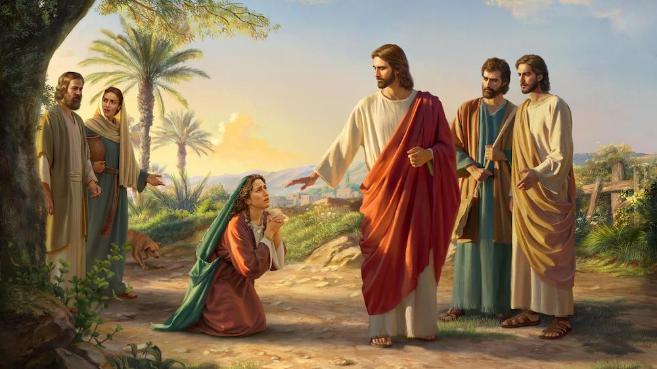
A Woman’s Faith
Matthew 15:21-28

Slide 4
Leader: A reading from
the Holy Gospel
according to Matthew.
All: Glory to You, Oh Lord.

Slide 5
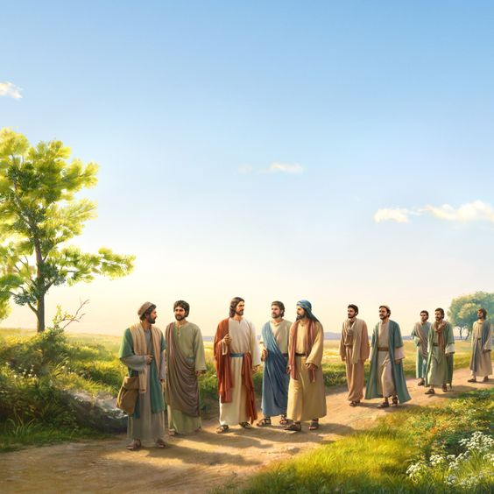
21
Jesus left that place and went off to the territory near the cities of Tyre and Sidon.

Slide 6
22
A Canaanite woman who lived in that region came to him. “Son of David!” she cried out. “Have mercy on me, sir! My daughter has a demon and is in a terrible condition.”

Slide 7
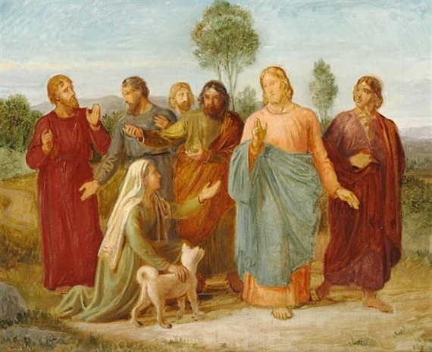
23
But Jesus did not say a word to her. His disciples came to him and begged him, “Send her away! She is following us and making all this noise!”

Slide 8
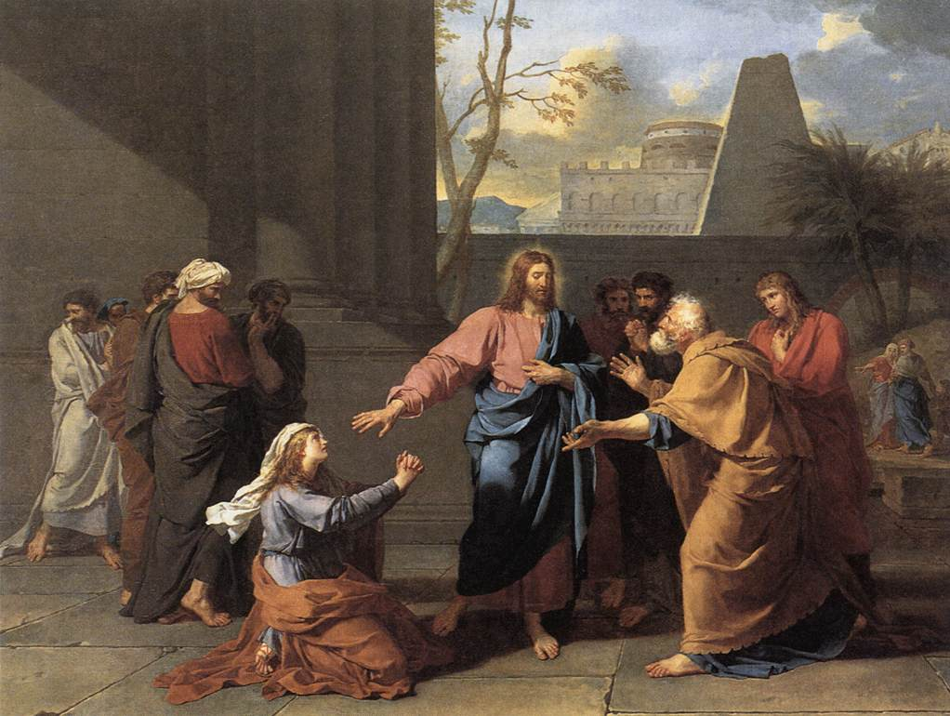
24
Then Jesus replied,
“I have been sent only to the lost sheep of the people of Israel.”

Slide 9
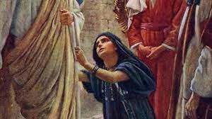
25
At this the woman came and fell at his feet. “Help me, sir!” she said.

Slide 10
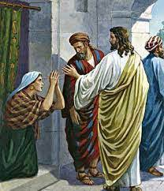
26
Jesus answered,
“It isn't right to take the children's food and throw it to the dogs.”

Slide 11
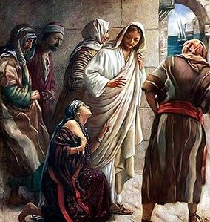
27
“That's true, sir,” she answered, “but even the dogs eat the leftovers that fall from their masters' table.”

Slide 12
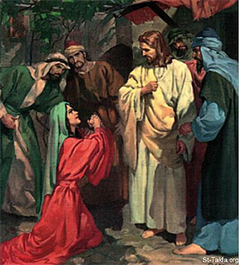
28
So Jesus answered her, “You are a woman of great faith! What you want will be done for you.”
And at that very moment, her daughter was healed.

Slide 13
Leader: The Gospel of the Lord.
All: Praise to You,
Lord Jesus Christ.

Slide 14
GOSPEL MESSAGE

Slide 15
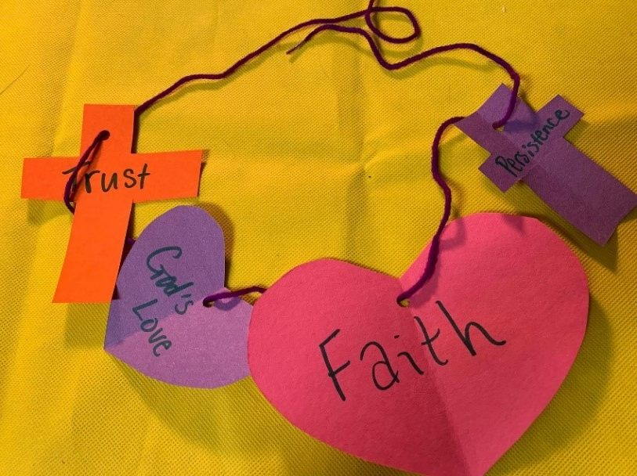
Activity:
String of Faith
Materials needed:
Yarn or string
Construction paper
Scissors
Extra decorations (stickers, etc.)
Caption or verse
Markers or crayons
Puncher
Reference:
https://ministry-to-children.com/jesus-and-the-canaanite-woman-craft-ideas/#gsc.tab=0

Slide 16
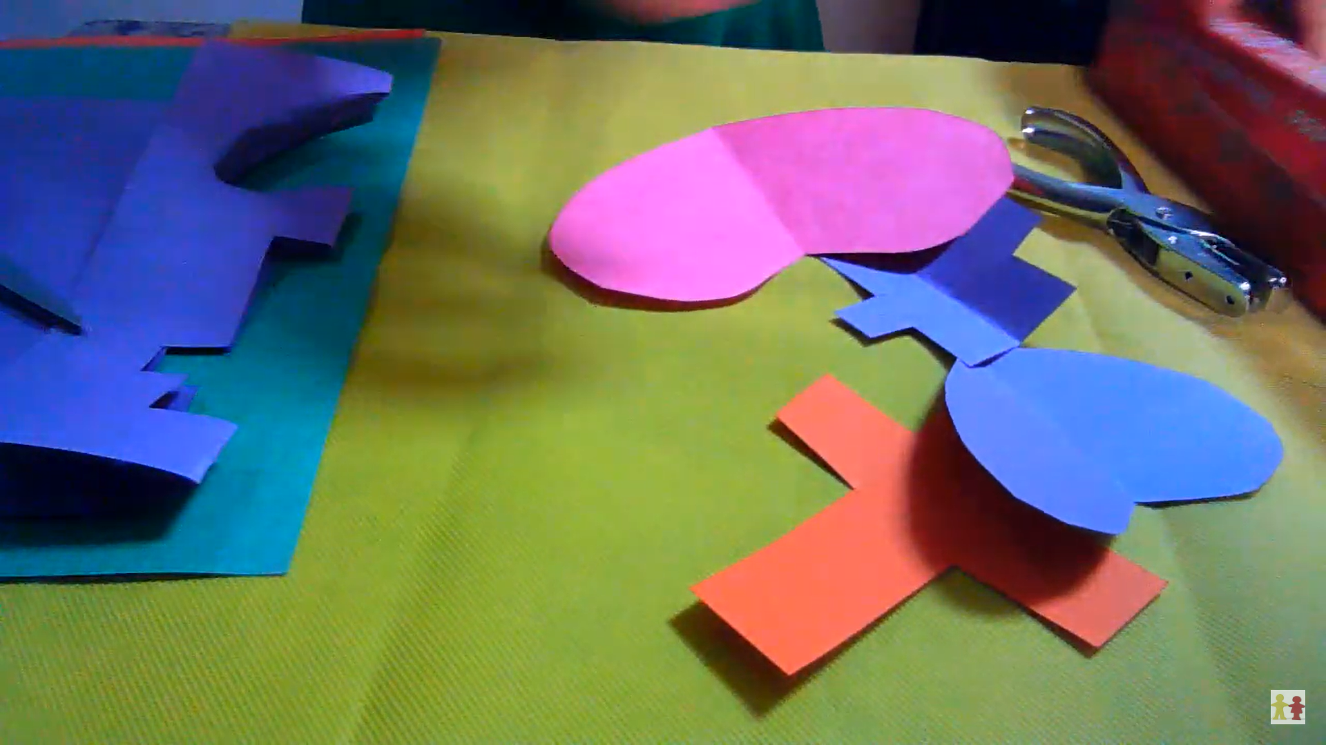
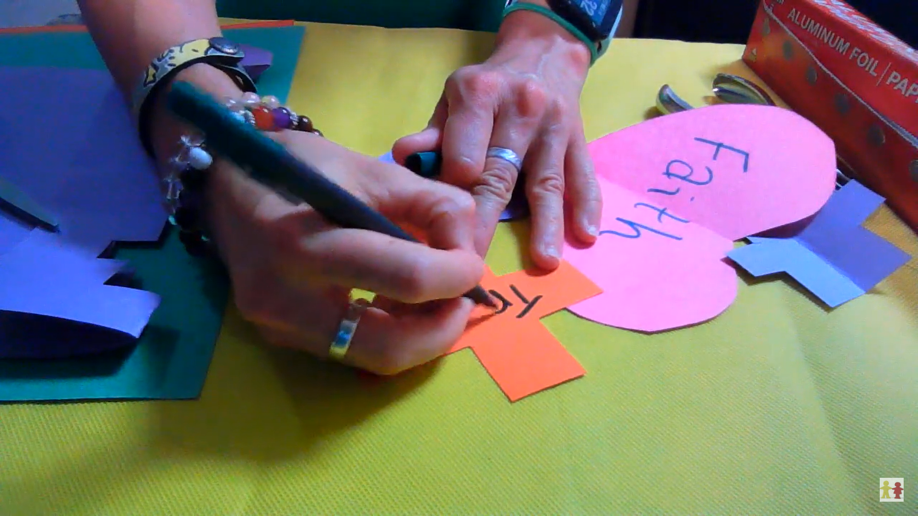
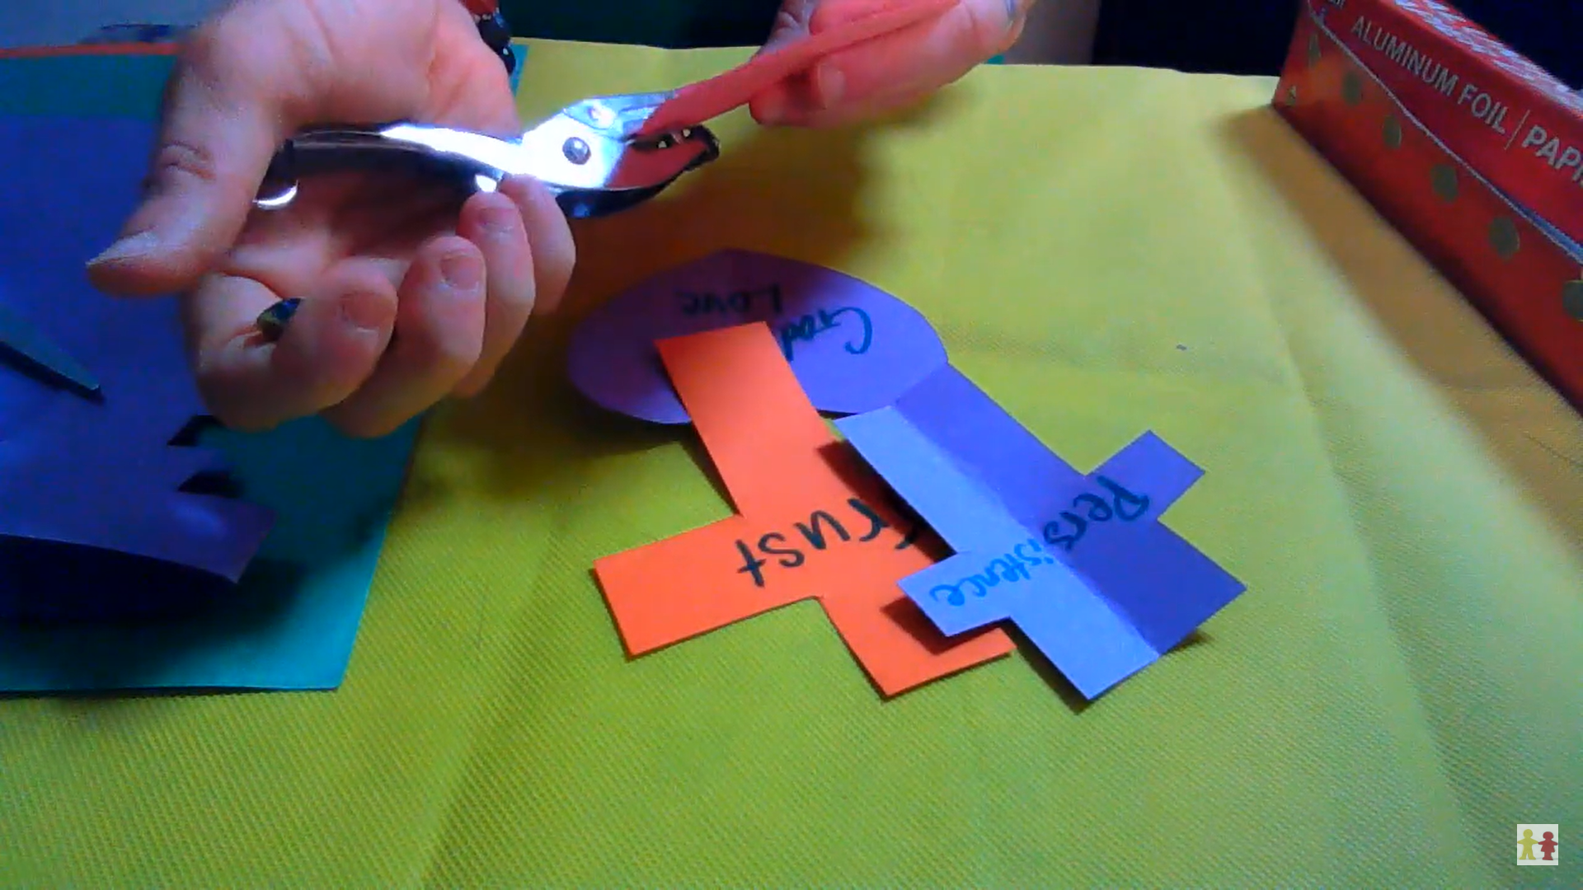
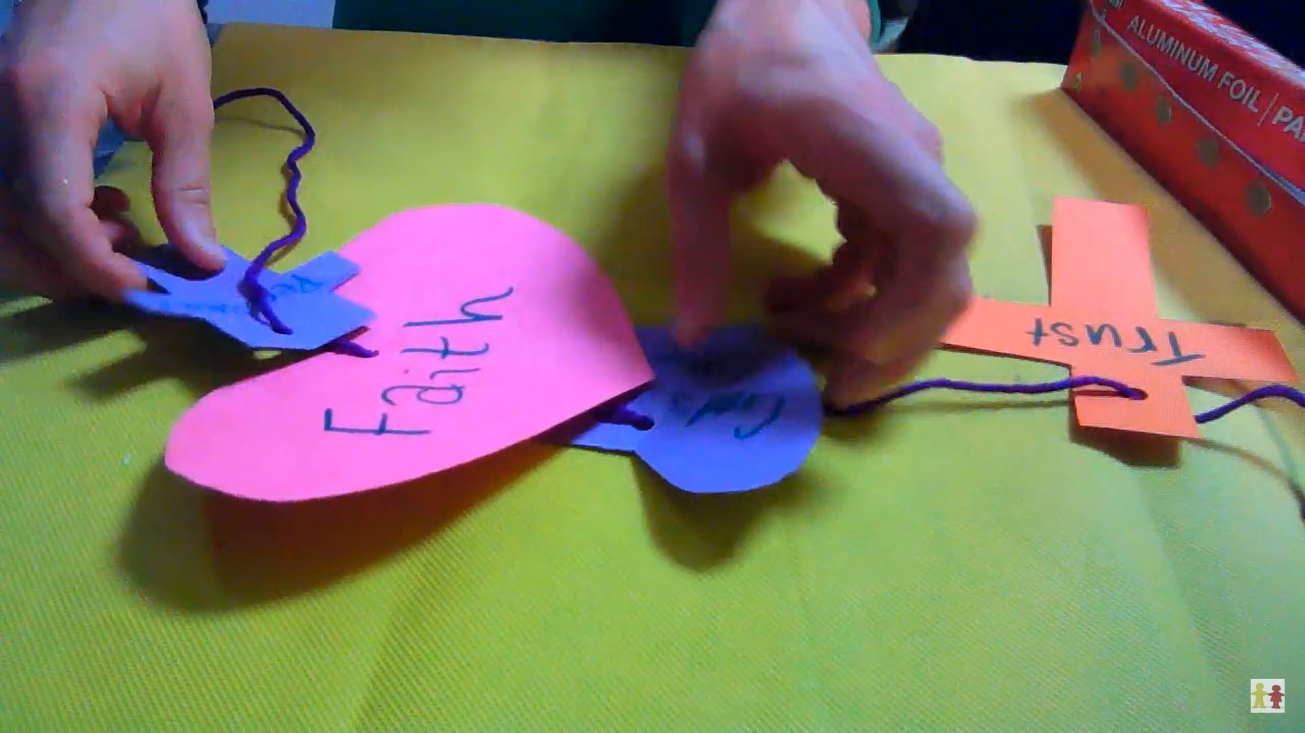
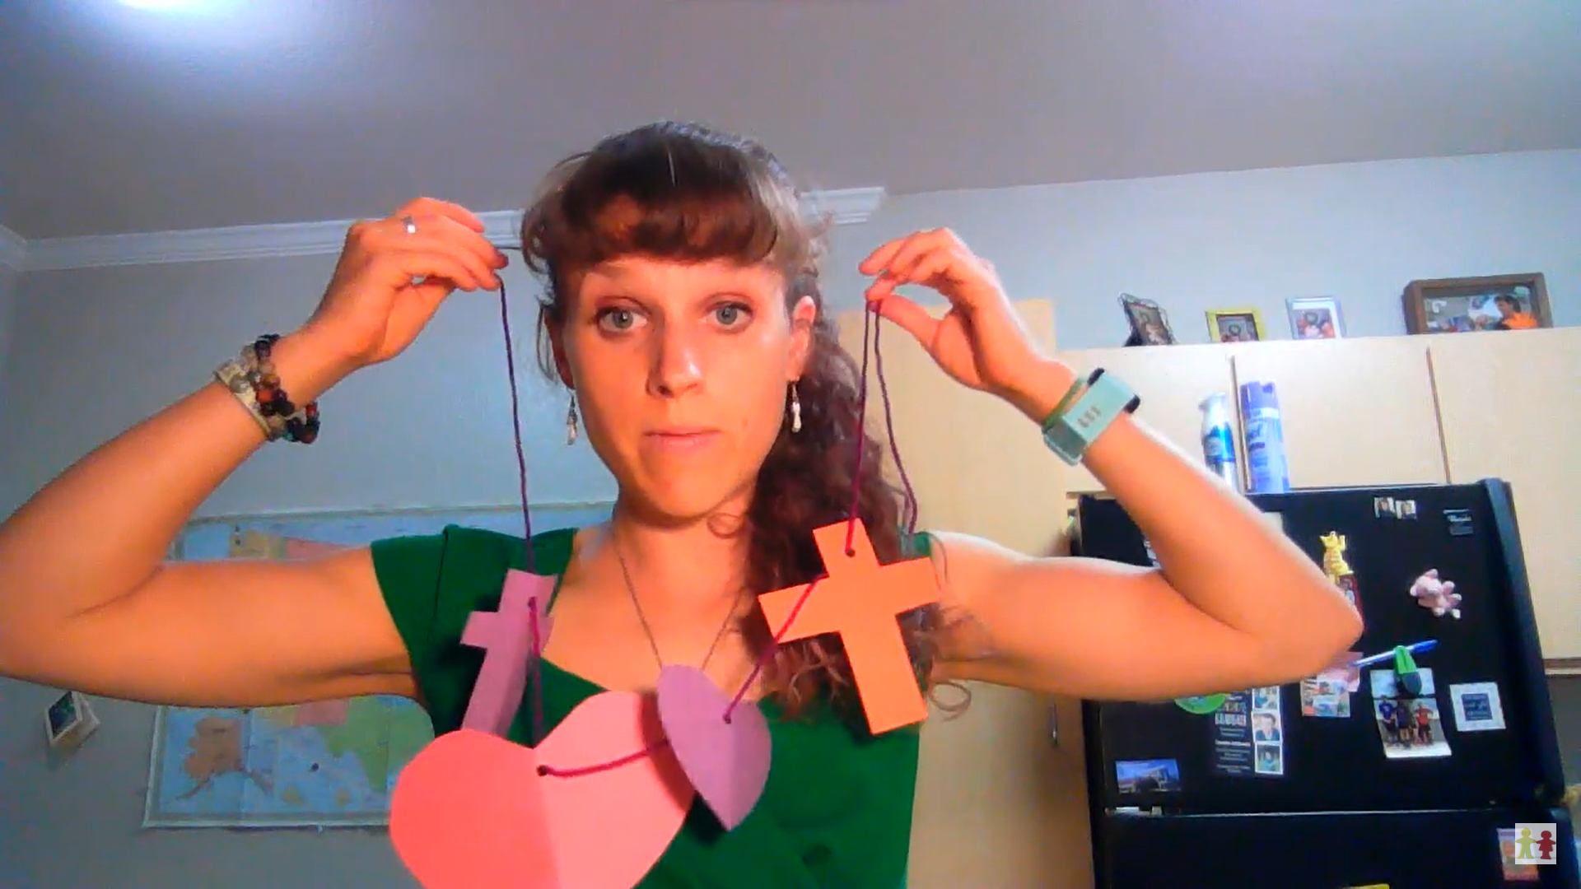
Instructions:
1
2
3
Cut construction paper into shapes such as hearts, crosses, or other shapes.
Choose positive words or verses you’d like on your decoration and write it down.
Hole-punch the papers, adding additional decoration if desired.
4
5
String the yarn, string, or pipe cleaner through the papers.
This can be used as a long wall decoration or a simple necklace or “belt” to enjoy.

Slide 17
Closing Prayer
Dear God,
We pray, that every day as we hear your word by your spirit, you would soften our hearts and that our hearts, minds and lives would indeed be fertile soil for hearing your word, holding it fast, with honest and good hearts and bearing fruit with patience.
Amen.

Slide 18
LIVE THE WORD KIDS
20th Sunday in Ordinary Time | Cycle A

