Slide 1
LIVE THE WORD KIDS
19th Sunday in Ordinary Time | Cycle A

Slide 2
GOSPEL REFLECTION
There are lots of unfolding stories mentioned in our gospel today. First, it reminds us about being healthy in our relationship with God. Even in our busy schedules, we must find time to stop, breathe and understand the message that God reveals to us. Jesus sent his disciples to the boat and ask to leave him and go to the other side of the lake. In the same way, in our aloneness, we can think with clarity. Likewise, we can do great things even in our aloneness.
The second thing is that we must wholeheartedly accept that Jesus is God. We must trust Him with reverence and grace. We must stand firm in our faith once we are dealing, defending, and taking a stand with Him. Same as the disciples, there will be times when we will be challenged in so many ways and doubt our capabilities.
In the calmness of the sea, there is a sudden wind blowing and waves tossing their boat. They are all afraid but they must really stand still and believe because once we pray that our God is with us, there will be no battles that we cannot win. Lastly, with all our faith and with Jesus, nothing can stand against us. Our Faith must be big enough to welcome all the grace sent by God to us.

Slide 3
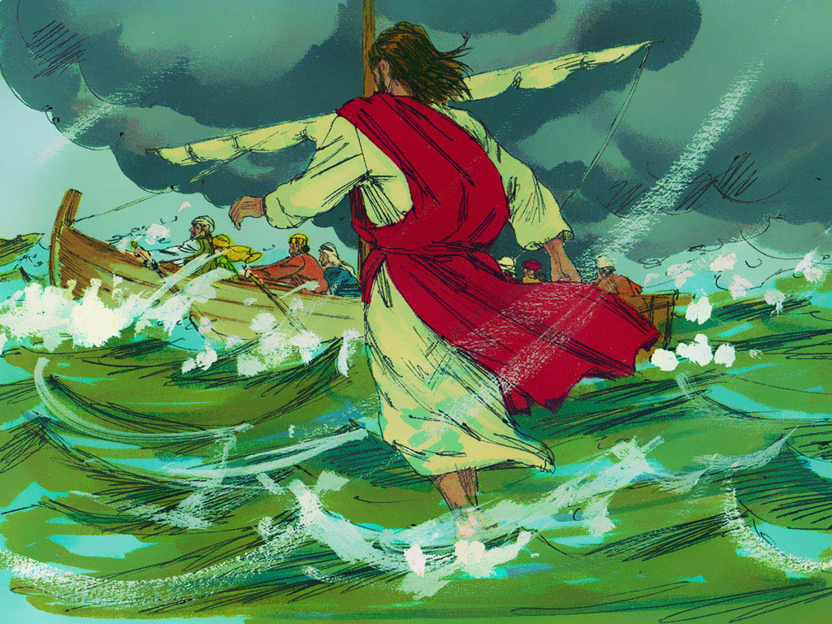
Jesus Walks on the Water
Matthew 14:22-33

Slide 4
Leader: A reading from
the Holy Gospel
according to Matthew.
All: Glory to You, Oh Lord.

Slide 5
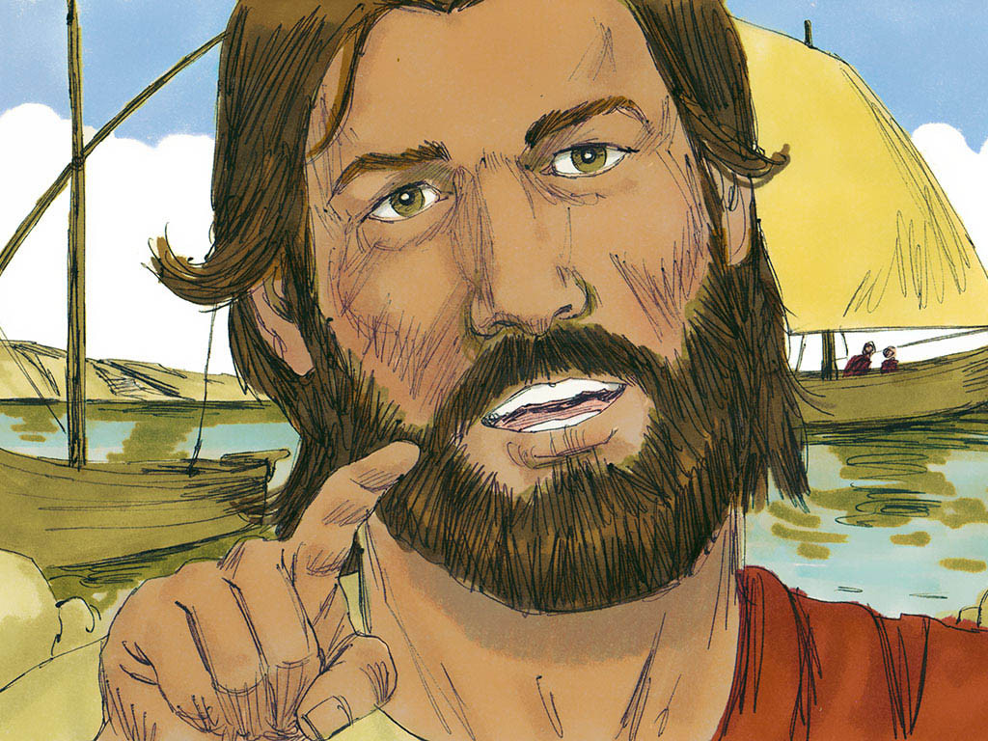
22
Then Jesus made the disciples get into the boat and go on ahead to the other side of the lake, while he sent the people away.

Slide 6
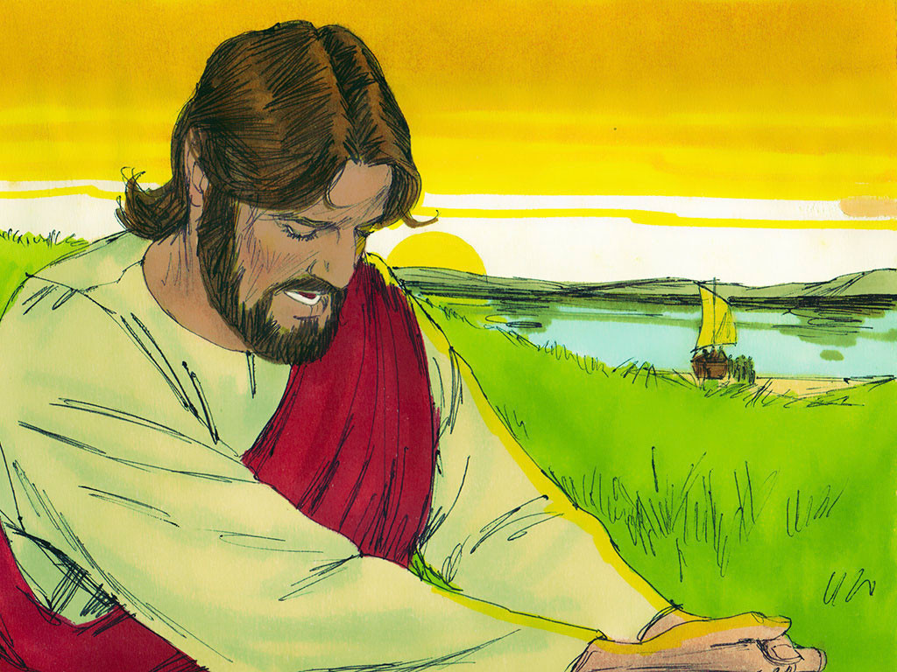
23
After sending the people away,
he went up a hill by himself to pray.
When evening came, Jesus was there alone;

Slide 7
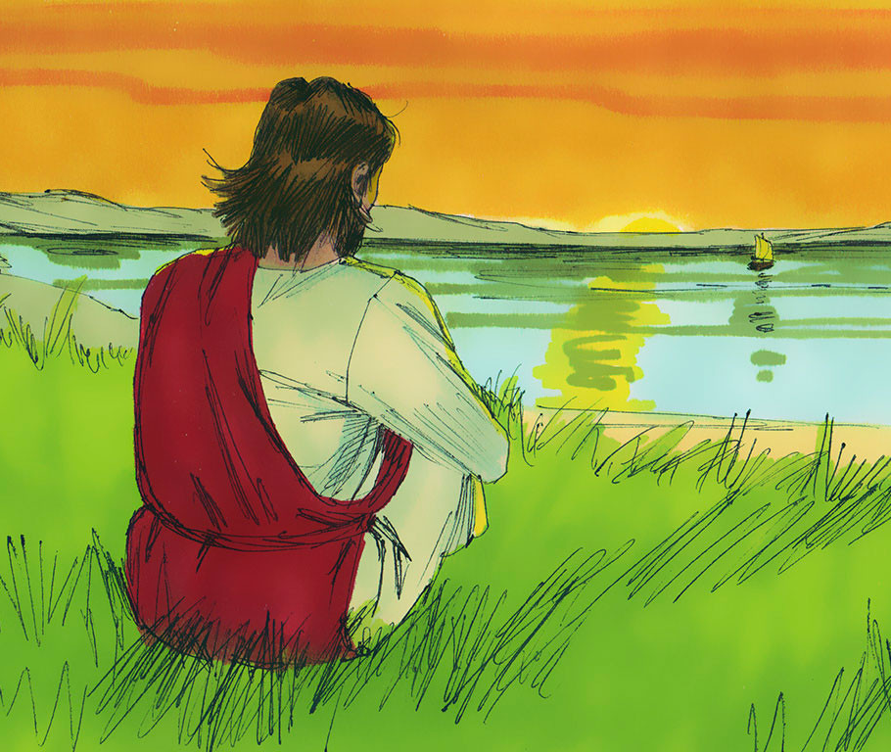
24
and by this time the boat was far out in the lake, tossed about by the waves because the wind was blowing against it.

Slide 8
25
Between three and six o'clock in the morning Jesus came to the disciples, walking on the water.

Slide 9
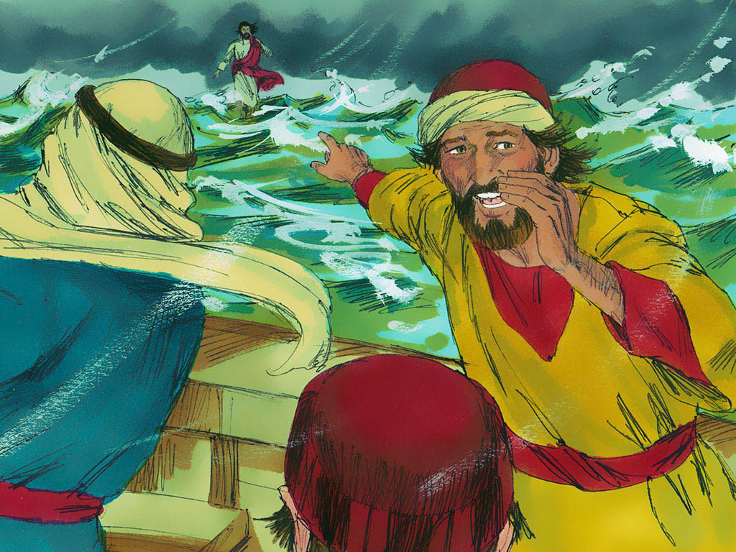
26
When they saw him walking on the water, they were terrified. “It's a ghost!” they said, and screamed with fear.

Slide 10
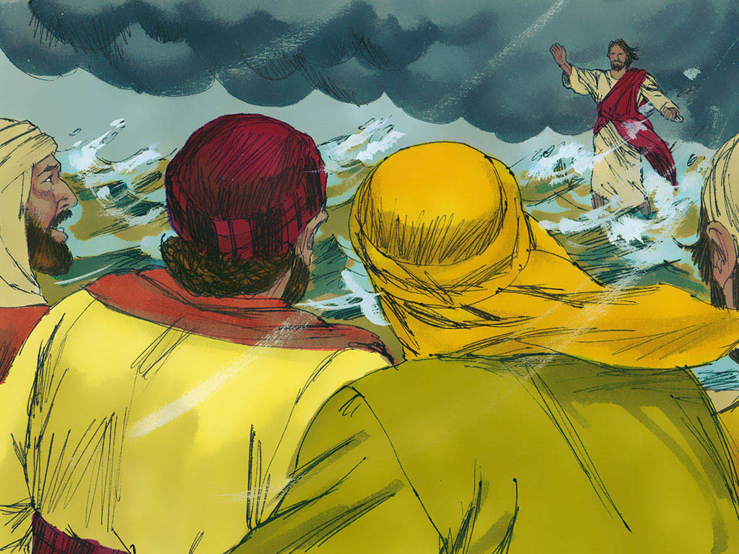
27
Jesus spoke to them at once. “Courage!” he said. “It is I. Don't be afraid!”

Slide 11
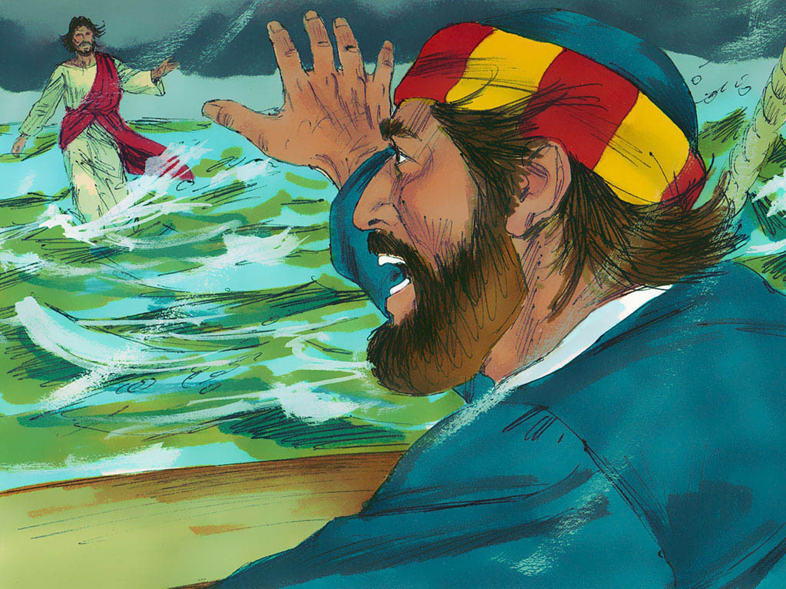
28
Then Peter spoke up. “Lord, if it is really you, order me to come out on the water to you.”

Slide 12
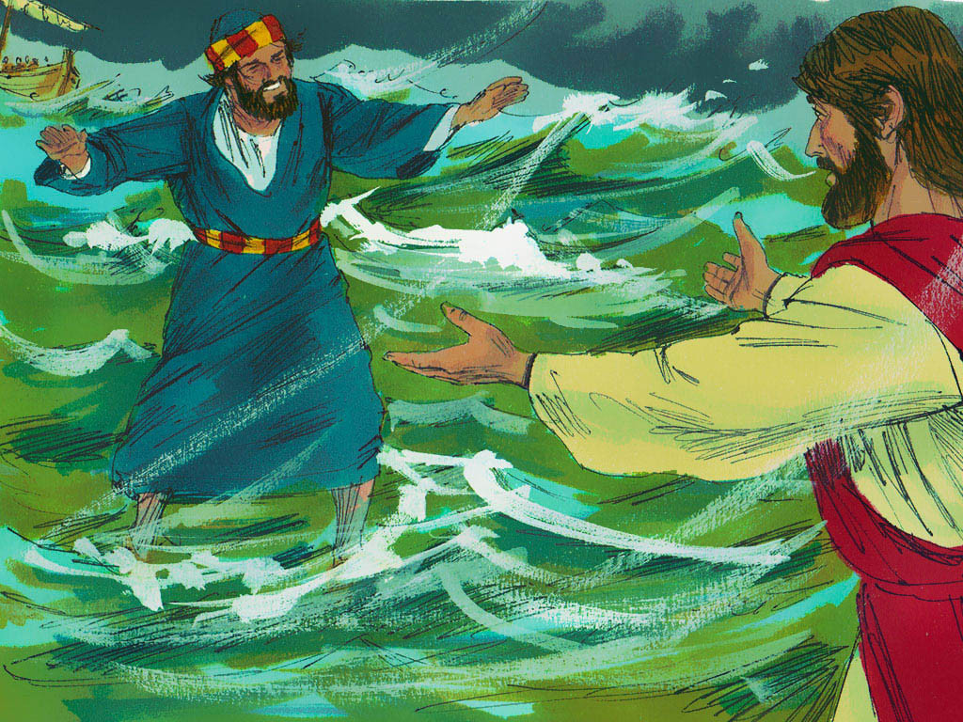
29
“Come!” answered Jesus.
So Peter got out of the boat and started walking on the water to Jesus.

Slide 13
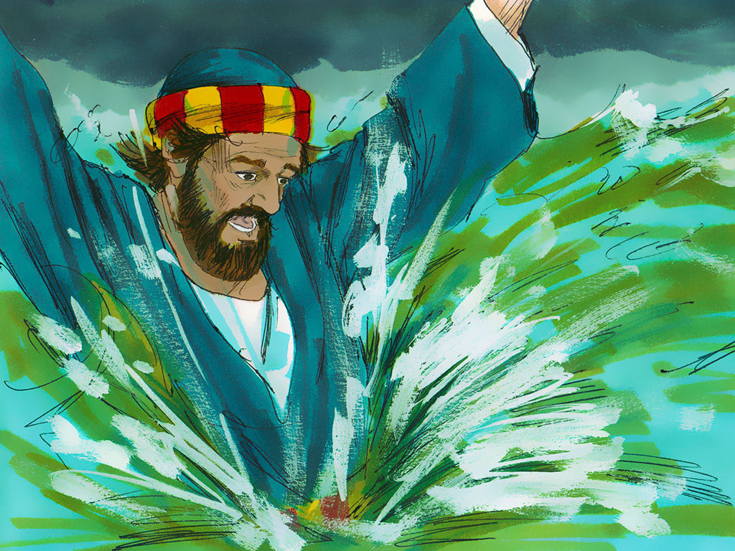
30
But when he noticed the strong wind, he was afraid and started to sink down in the water. “Save me, Lord!” he cried.

Slide 14
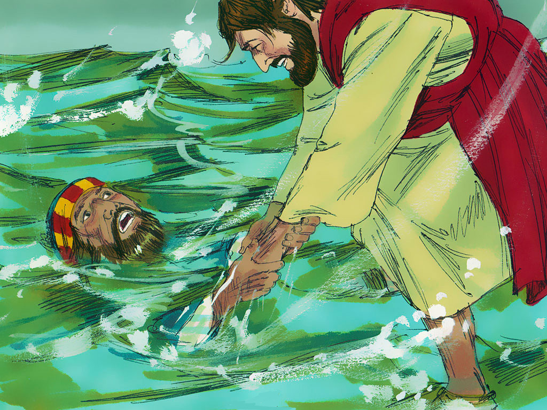
31
At once Jesus reached out and grabbed hold of him and said, “What little faith you have! Why did you doubt?”

Slide 15
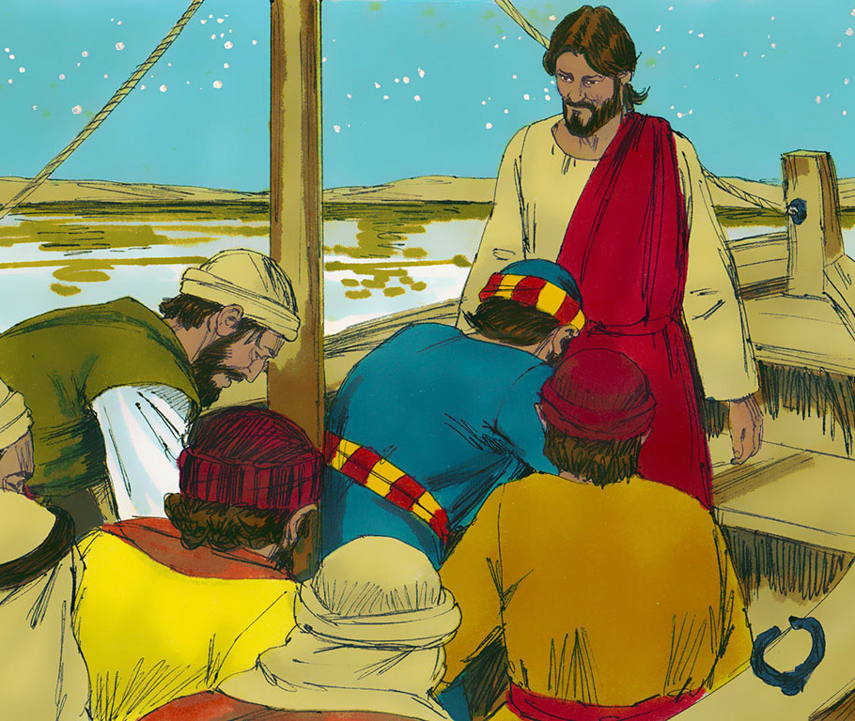
32
They both got into the boat, and the wind died down.

Slide 16
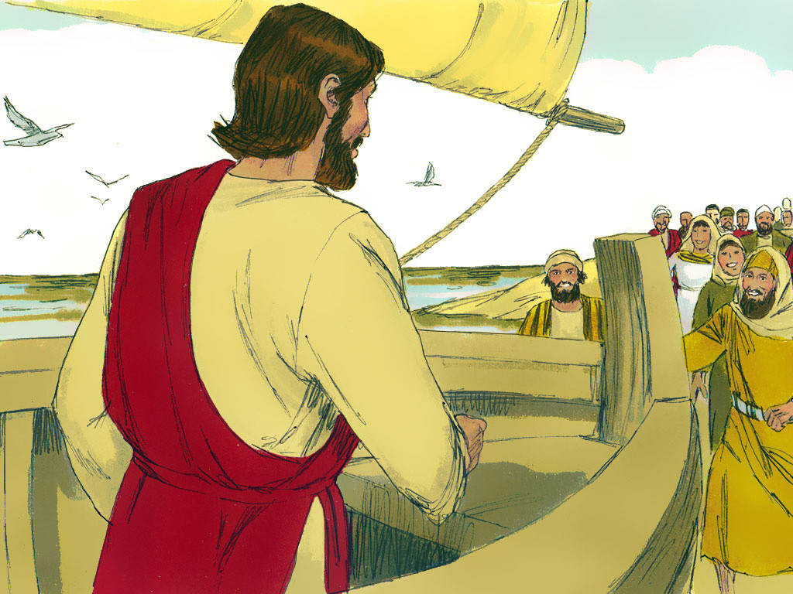
33
Then the disciples in the boat worshiped Jesus. “Truly you are the Son of God!” they exclaimed.

Slide 17
Leader: The Gospel of the Lord.
All: Praise to You,
Lord Jesus Christ.

Slide 18
GOSPEL MESSAGE

Slide 19
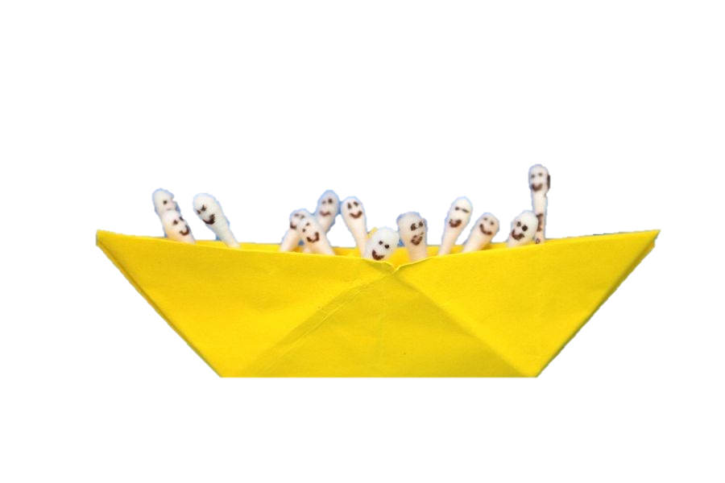
Activity:
Jesus and the Disciples
Materials:
Construction Paper
(1 Piece; any color)
Cotton Buds (7 pieces)
Black Marker
References:
https://mommysnippets.com/jesus-calms-the-storm-craft/
https://www.pinterest.ph/pin/145733737918535461/

Slide 20
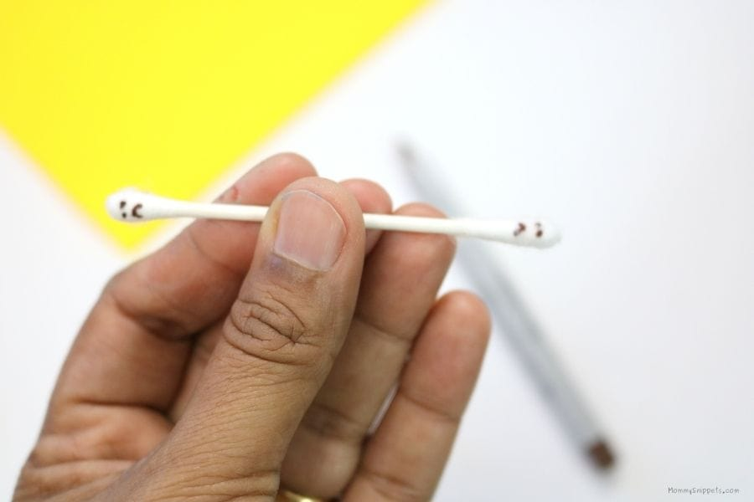
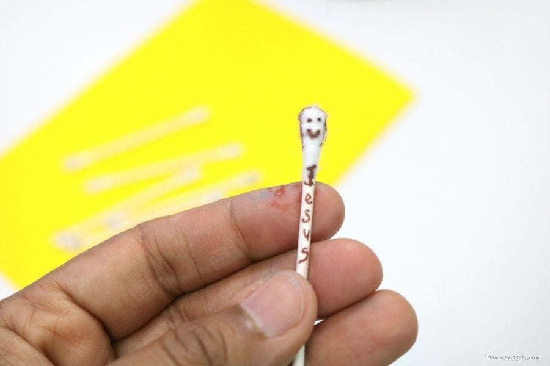
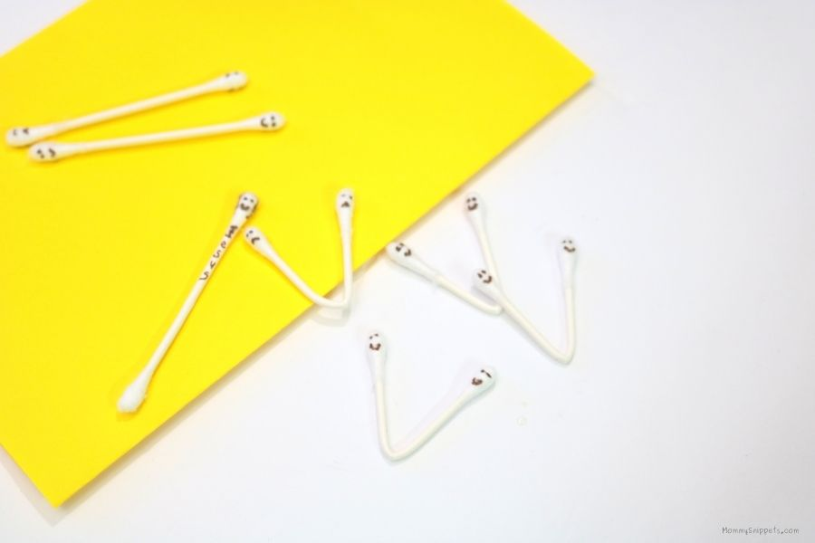
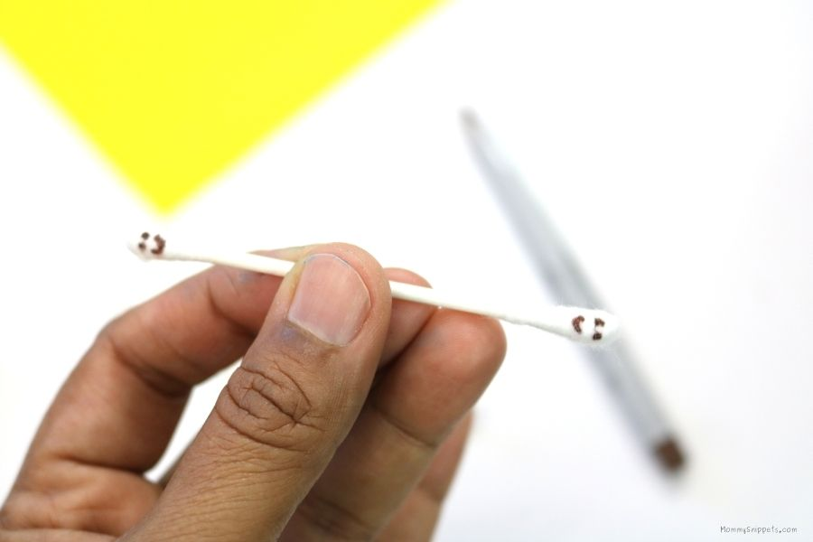
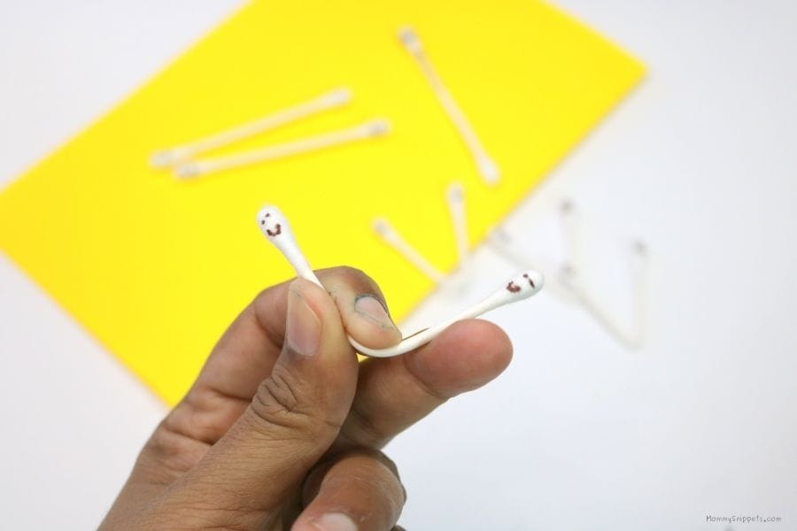
Procedure A: Cotton Buds Designing
1
2
Prepare your cotton buds and a black marker. For six (6) cotton buds, draw a smiley face on one side and a sad face on the opposite side.
(Note: you will be drawing faces on both sides of each cotton bud because you will create 2 disciples out of 1 cotton bud, by folding the same.)
For your 7th cotton bud, you’ll just have to draw a smiley face to it. This will represent Jesus. Write “Jesus” on the stem of the cotton buds.
3
Fold your six cotton buds. Set your cotton buds aside till we start assembling the craft.

Slide 21
Procedure B: Origami Boat
Grab your construction paper and make an origami boat. Follow the given instructions on how to make an origami boat.

Slide 22
Procedure C: Jesus and the Disciples
Carefully place the Q-tips into the boat.
Note:
You can write the verse in the boat saying,
“Be still and know that I am God” Psalm 46:10
“Be still and know that I am God”
Psalm 46:1O

Slide 23
Closing Prayer
Dear God,
We pray, that every day as we hear your word by your spirit, you would soften our hearts and that our hearts, minds and lives would indeed be fertile soil for hearing your word, holding it fast, with honest and good hearts and bearing fruit with patience.
Amen.

Slide 24
LIVE THE WORD KIDS
19th Sunday in Ordinary Time | Cycle A

