Slide 1
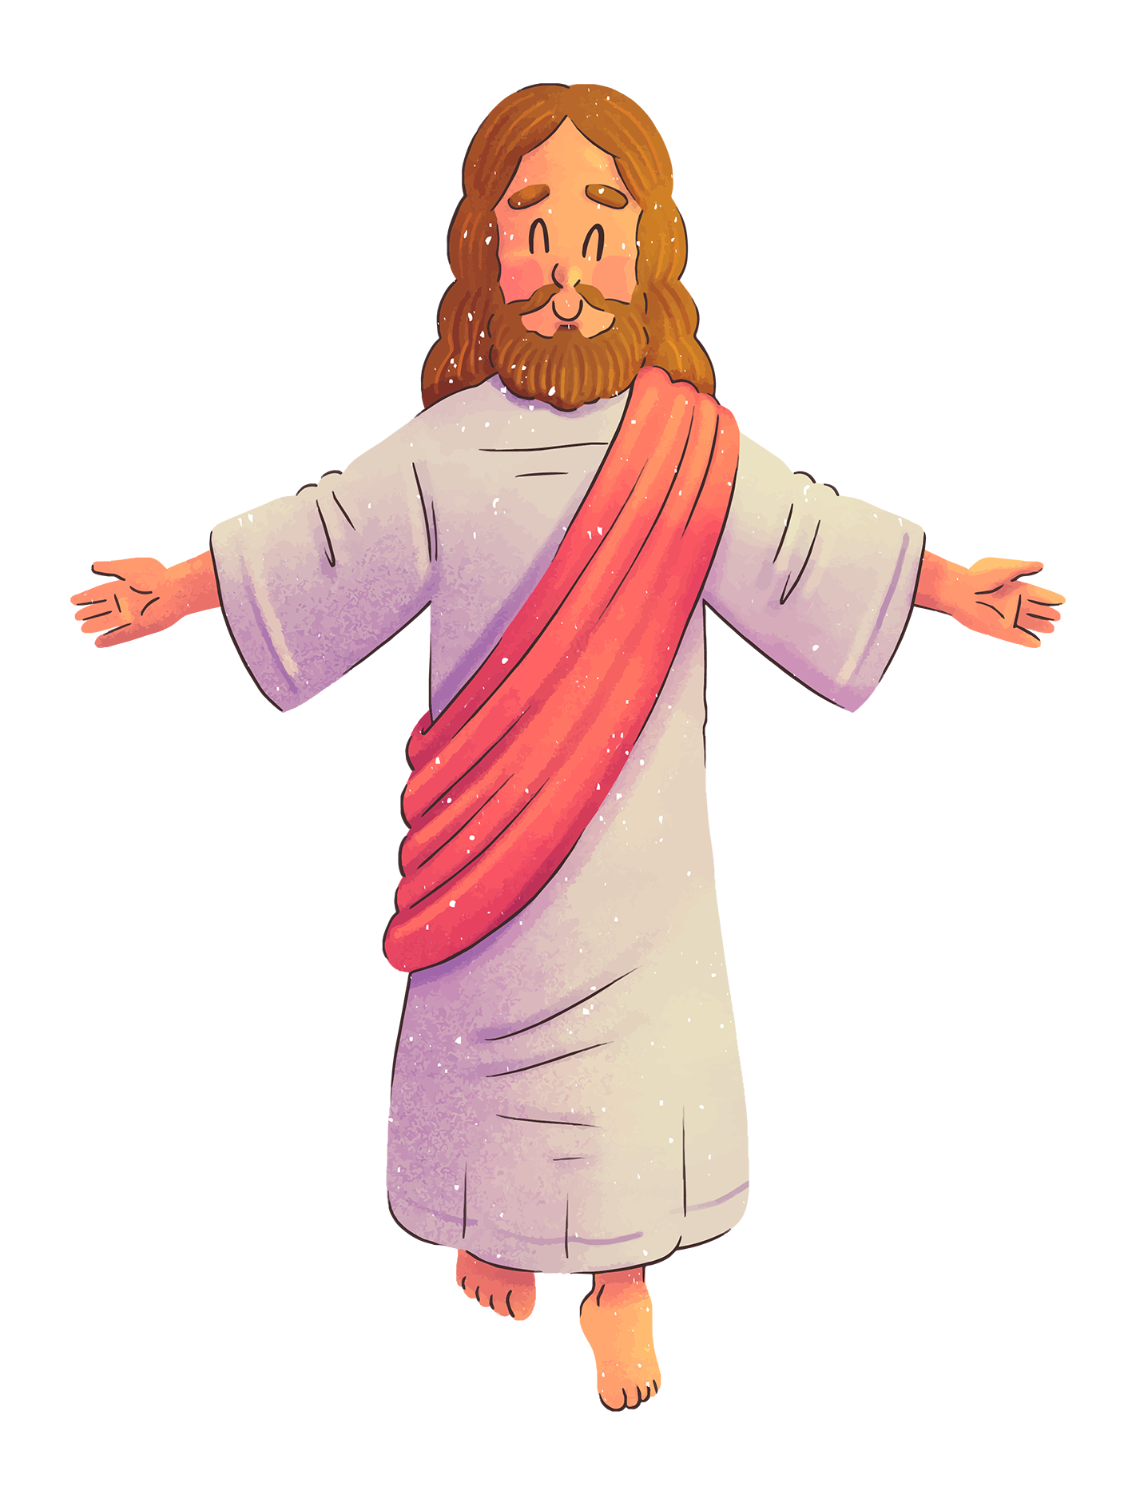
LIVE THE WORD KIDS
Feast of the Transfiguration of the Lord

Slide 2
GOSPEL REFLECTION
The Transfiguration event shows an important value in our Religion as Christians, the value of our faith. Jesus let Peter, James, and John experience an incredible scenario that not all disciples are entitled to experience. This event partakes these disciples to strengthen their faith. Truly, God will let you experience things in your life that will make you stronger, happier, and better. And all these experiences will surely awaken you, it prepares you to endure more challenges in life. These positive experiences will affirm you to do more greater things. But on the other hand, these are temporary events. It was not meant to be permanent.
This also says the wrong understanding done by Peter as he suggests putting up shelters for Moses and Elijah when they are about to depart. This action suggests prolonging the glorifying experience which is a wrong thing. One of the real meanings of this event is about the sufferings that Jesus is about to experience. It is an event to strengthen their faith not to experience divine glory. So, the special experiences of his grace strengthen our faith, and with that, we should welcome these experiences with grace. But we can’t be too complacent that challenges will not appear, instead, seize each experience as an opportunity to grow and to be faithful.

Slide 3
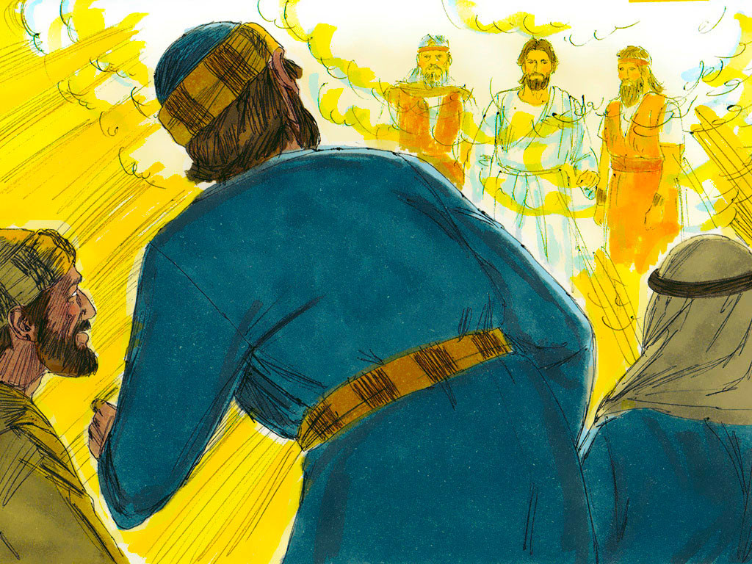
The
Transfiguration
Matthew 17: 1-9

Slide 4
Leader : A reading from
the Holy Gospel
according to Matthew.
All : Glory to You, Oh Lord.

Slide 5
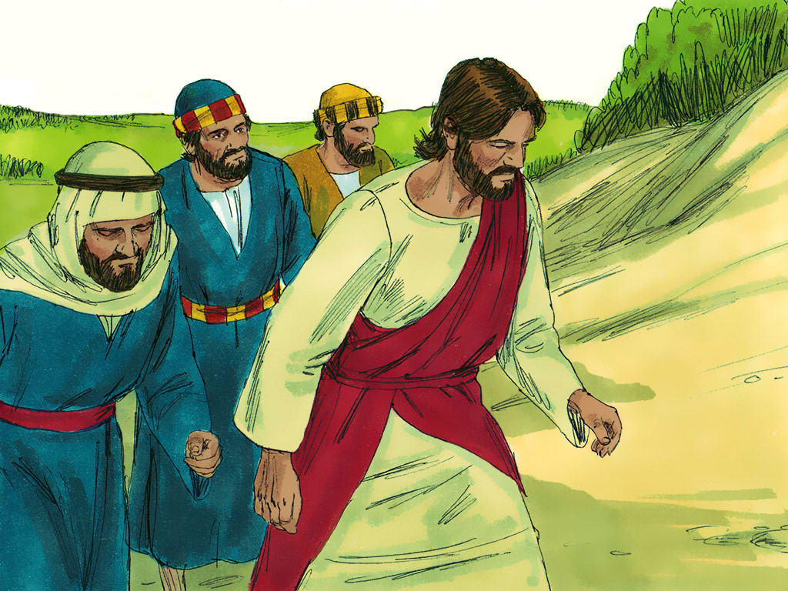
1
After six days Jesus took with him Peter, James and John the brother of James, and led them up a high mountain by themselves.

Slide 6
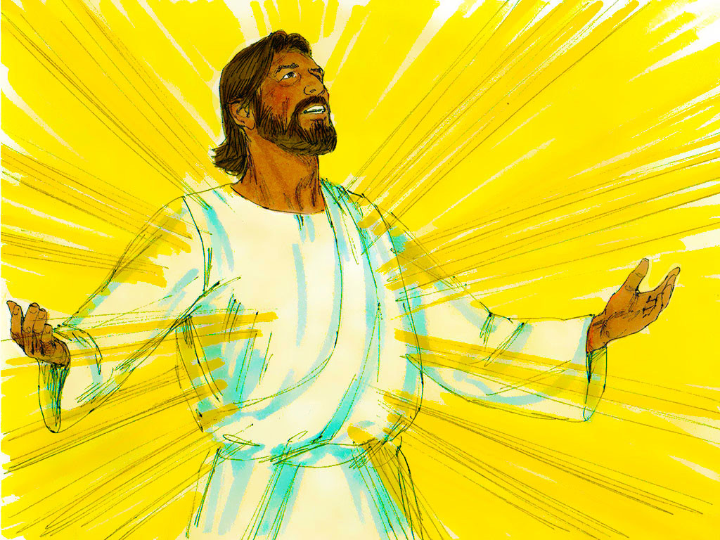
2
There he was transfigured before them. His face shone like the sun, and his clothes became as white as the light.

Slide 7
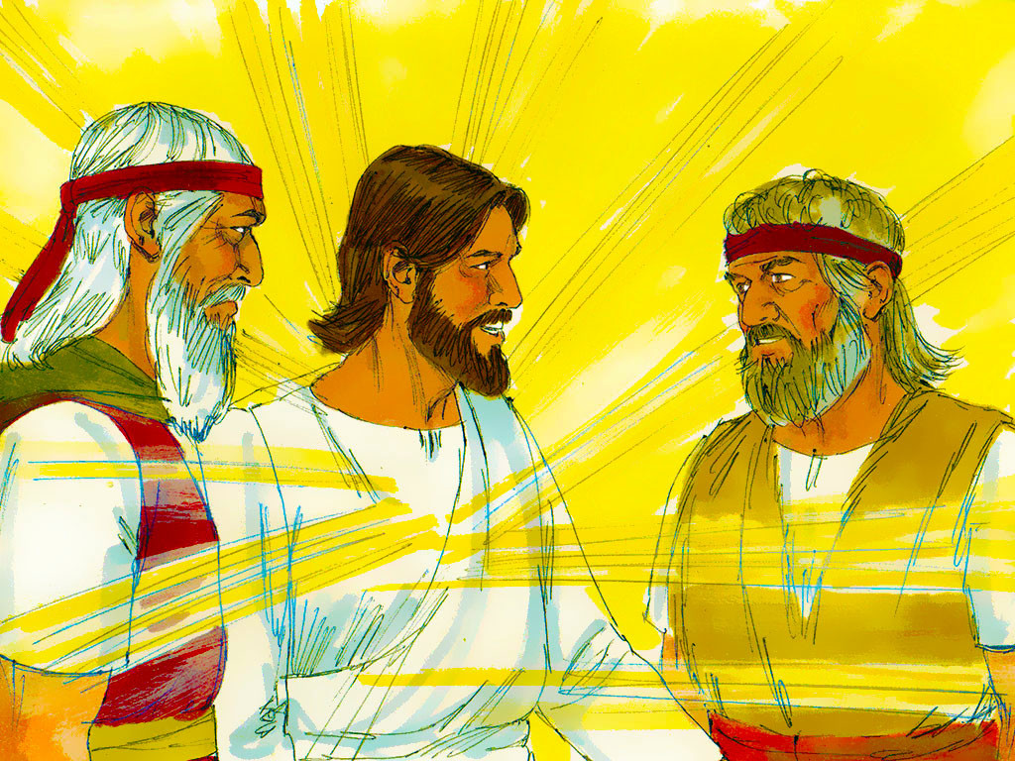
3
Just then there appeared before them Moses and Elijah, talking with Jesus.

Slide 8
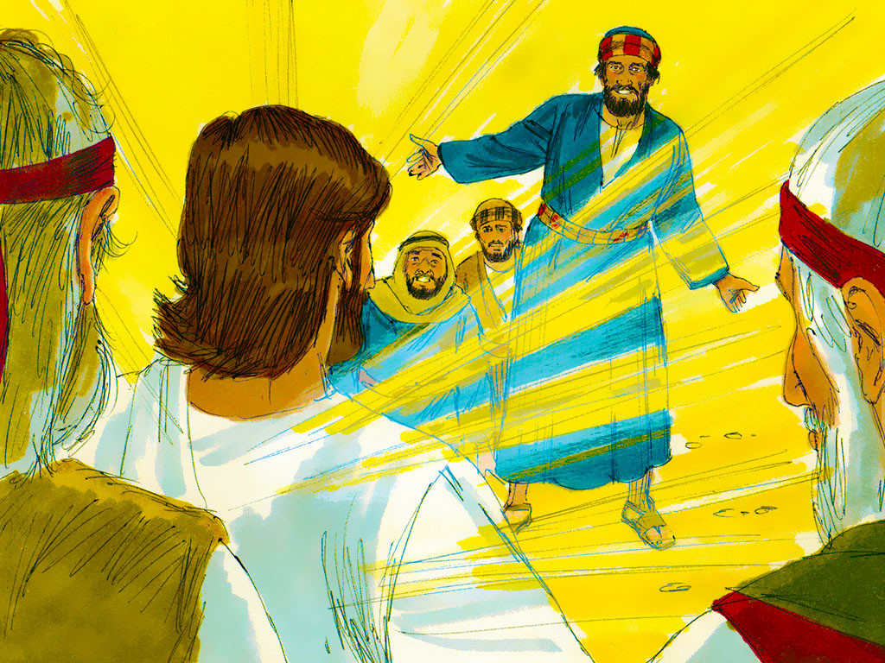
4
Peter said to Jesus, “Lord, it is good for us to be here. If you wish, I will put up three shelters—one for you, one for Moses and one for Elijah.”

Slide 9
5
While he was still speaking, a bright cloud covered them, and a voice from the cloud said,
“This is my Son, whom I love; with him I am well pleased. Listen to him!”

Slide 10
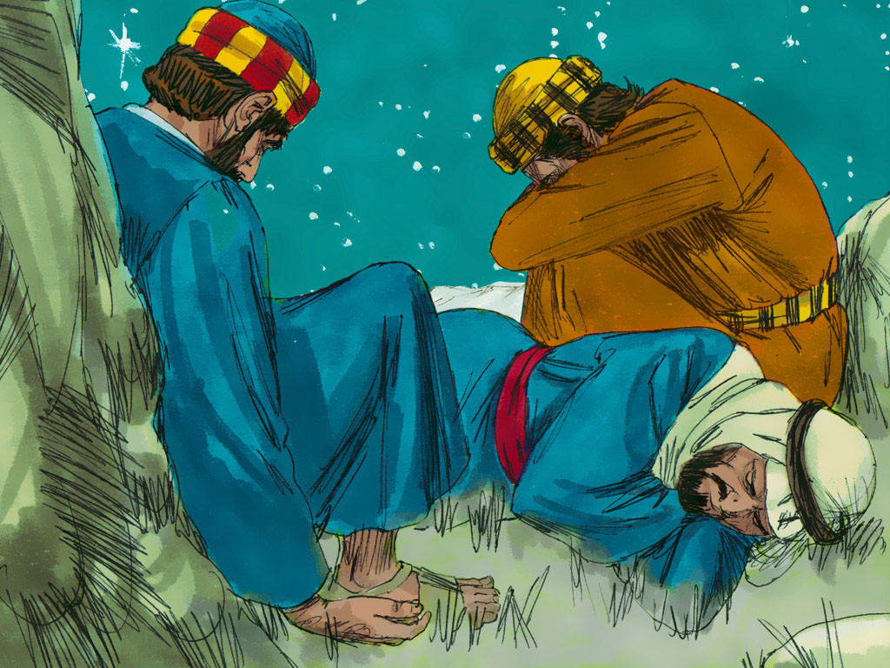
6
When the disciples heard this, they fell facedown to the ground, terrified.

Slide 11
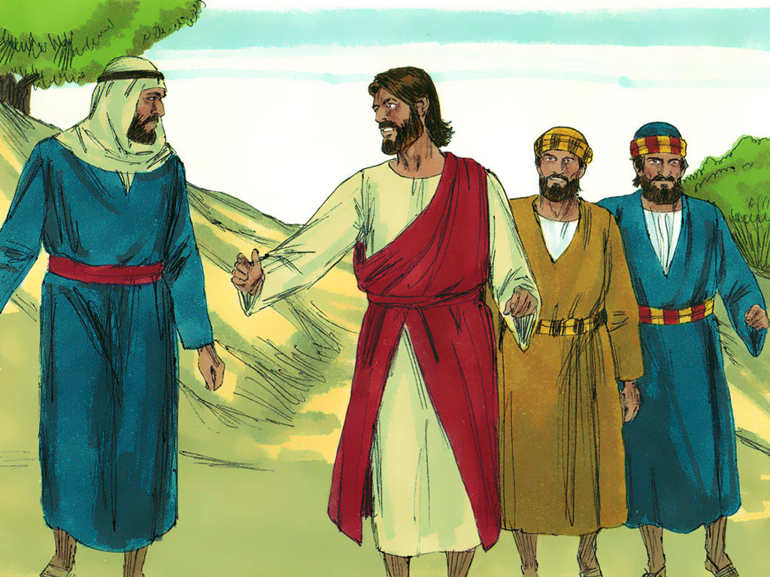
7
But Jesus came and touched them.
“Get up,” he said. “Don’t be afraid.”

Slide 12
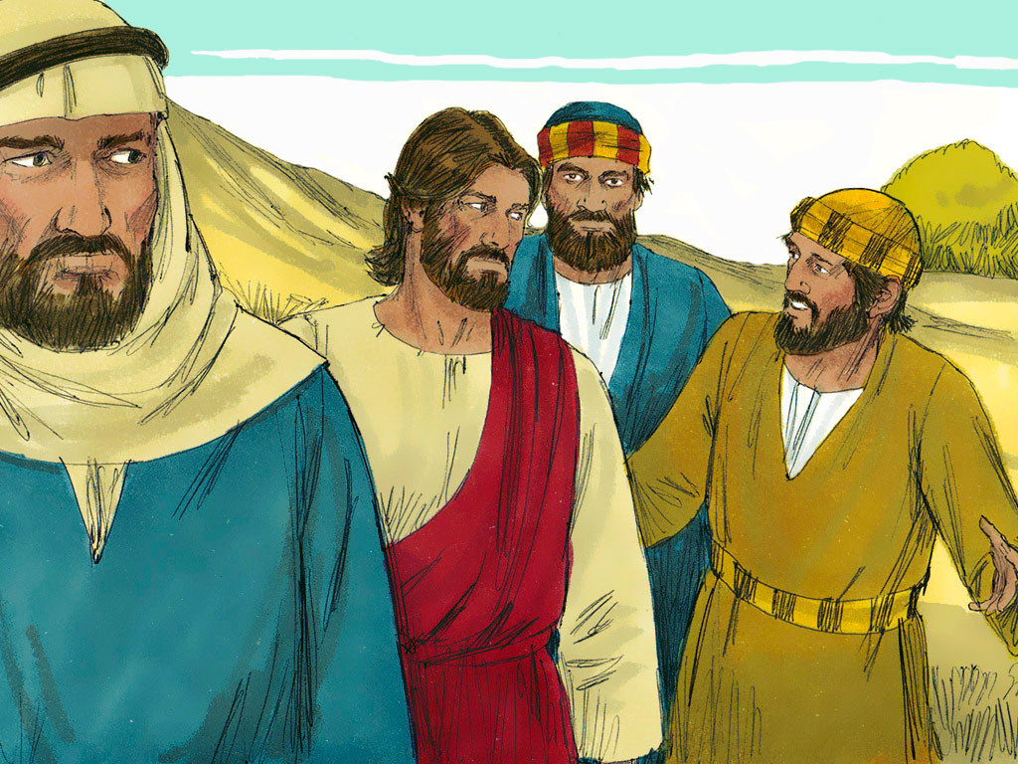
8
When they looked up, they saw no one except Jesus.

Slide 13
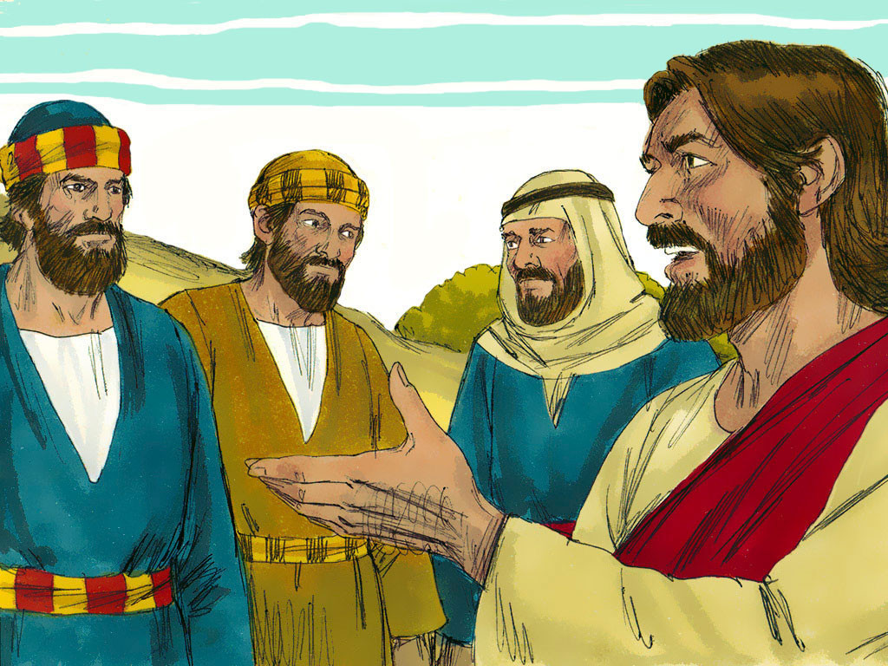
9
As they were coming down the mountain,
Jesus instructed them, “Don’t tell anyone what you have seen, until the Son of Man has been raised from the dead.”

Slide 14
Leader : The Gospel of the Lord.
All : Praise to You,
Lord Jesus Christ.

Slide 15
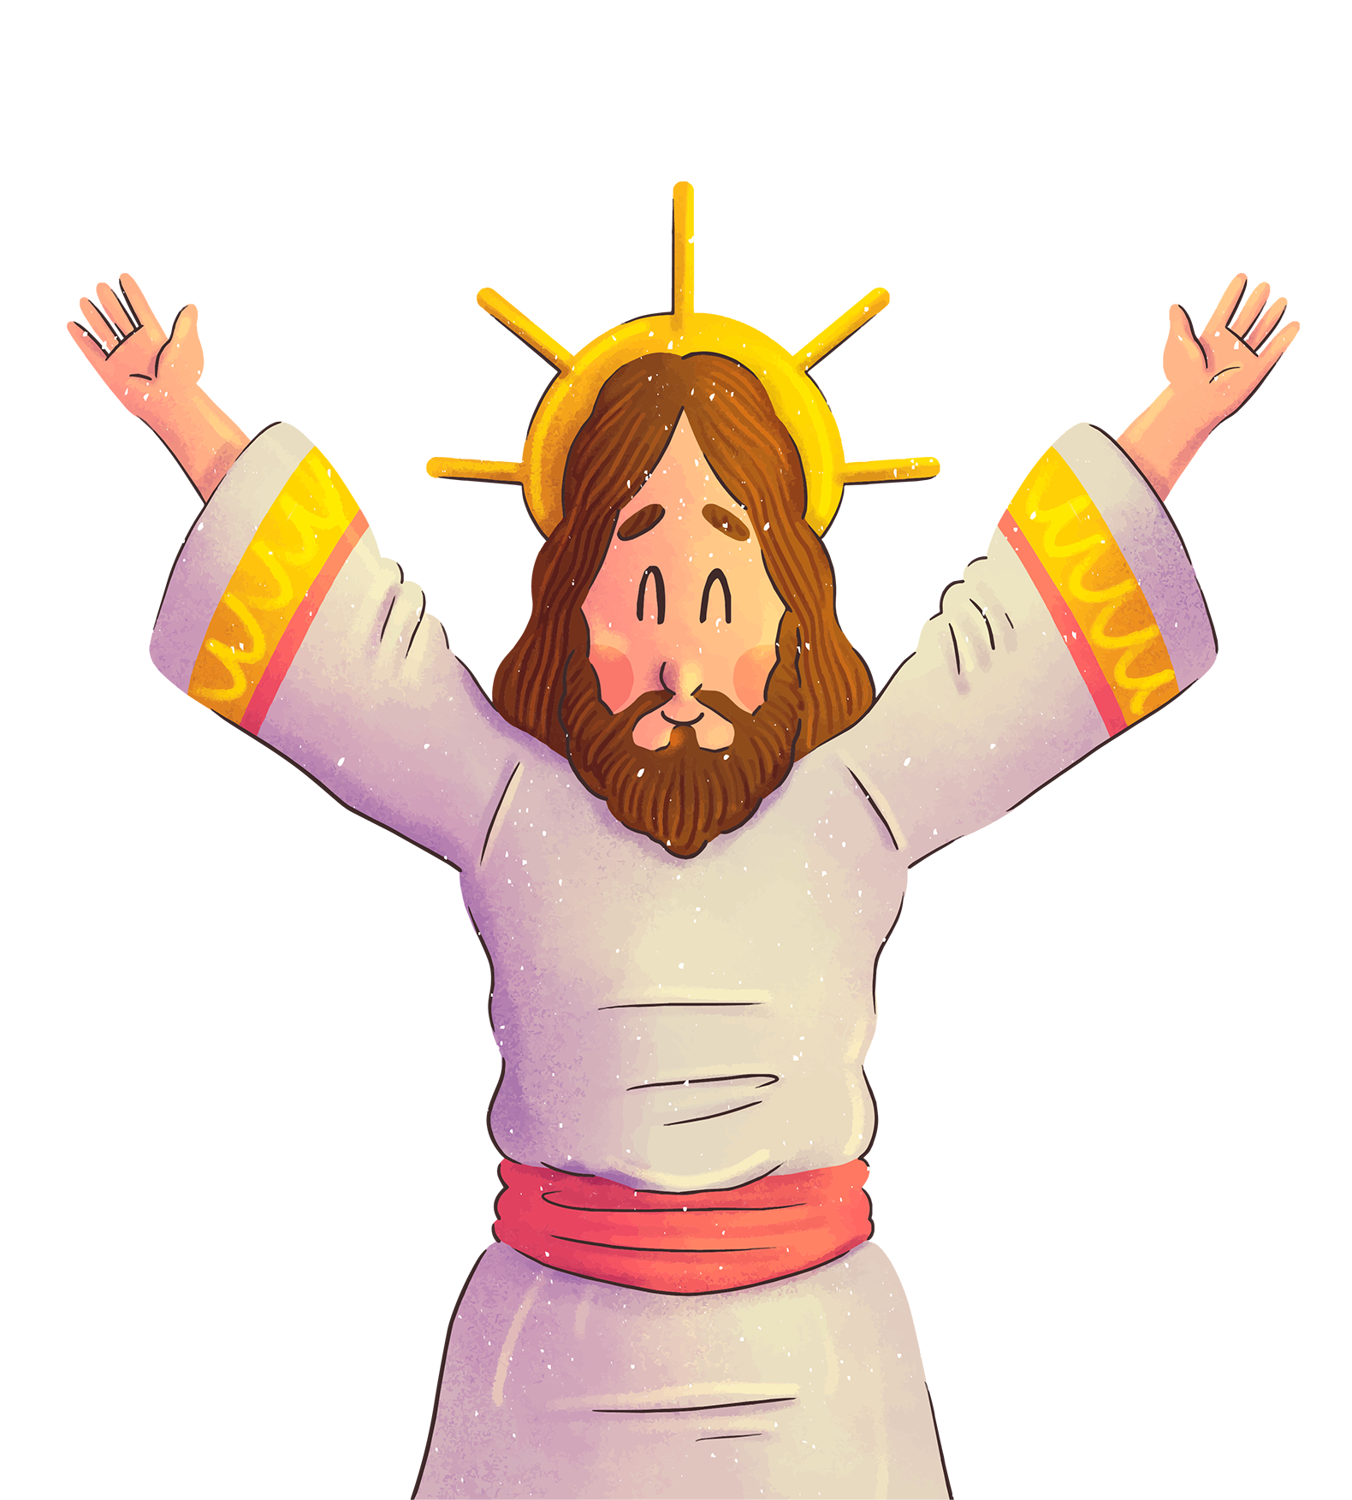
GOSPEL
MESSAGE

Slide 16
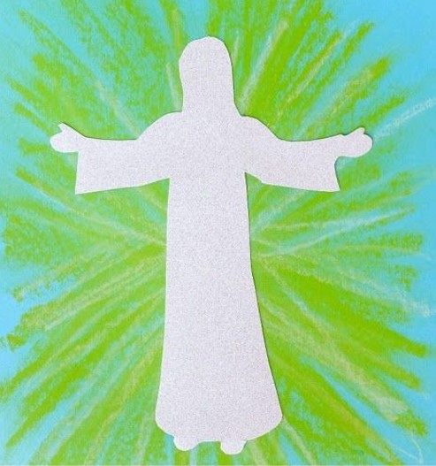
ACTIVITY: The Transfiguration of Jesus
Materials:
Yellow Oil Pastel/ Crayon
Bond Papers
Scissors
Pencil
Glue
Reference:
http://easybreezysundayschool.blogspot.com/2016/02/the-transfiguration.html

Slide 17
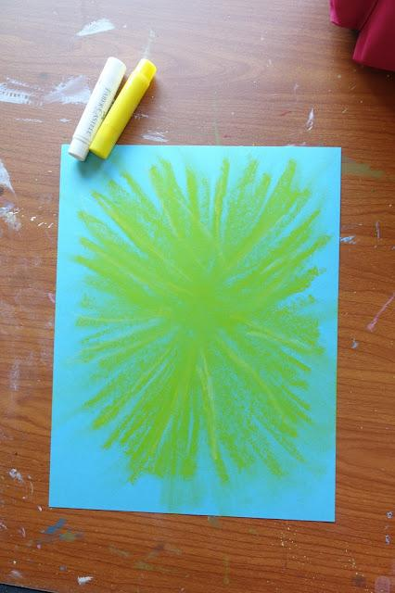
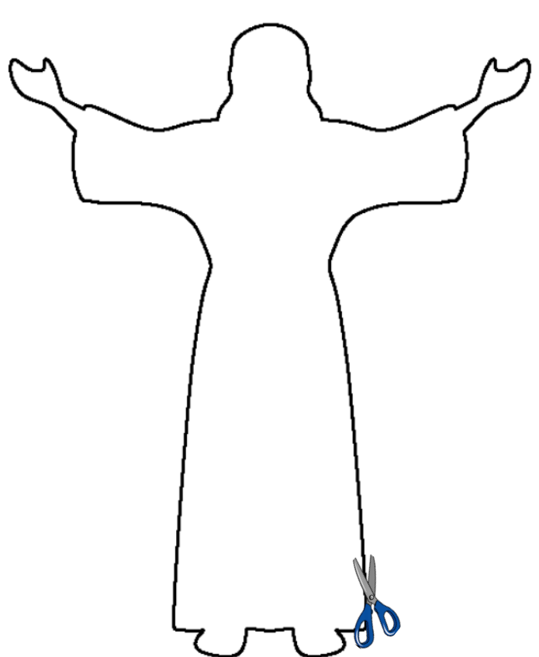
ACTIVITY PROCEDURE
1
2
3
Begin with a sheet of bond paper and the yellow oil pastel. Starting at the center of the page, draw several lines going from the center to the edges of the paper.
Print/trace the image of Jesus to a piece of Bond Paper and cut it.
Using your glue, attached the cut image of Jesus to the center of your lines. The bible verse may also be written on the page if desired.

Slide 18
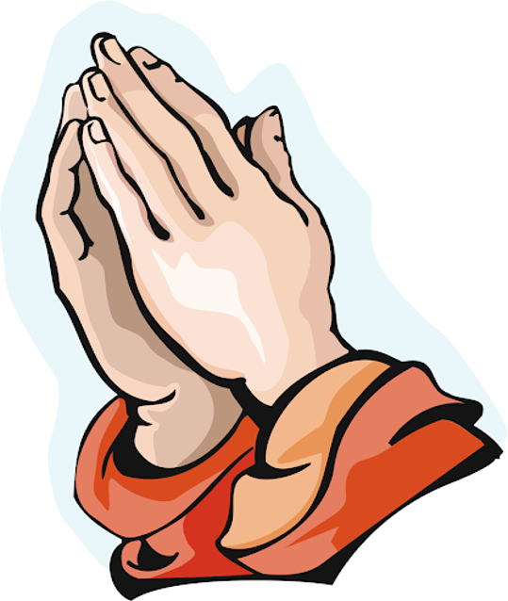
CLOSING PRAYER
Dear God,
We pray, that every day as we hear your word by your spirit, you would soften our hearts and that our hearts, minds, and lives would indeed be fertile soil for hearing your word, holding it fast, with honest and good hearts and bearing fruit with patience.
Amen.

Slide 19
LIVE THE WORD KIDS
Feast of the Transfiguration of the Lord

