Slide 1
LIVE THE WORD KIDS
Fourth Sunday of Easter | Cycle A

Slide 2
GOSPEL REFLECTION
In this parable, Jesus wanted to teach the people that we are like sheep. He doesn’t mean that we look like sheep but that we act like sheep. Sheep are followers and they depend on a shepherd to lead them to safety. This is true for us, too. We will have people in our lives that want to lead us down the wrong path. This path leads to danger. But, Jesus came to lead us toward safety.
He came to die for our sins to save us and he wants to lead us toward the life he has planned for us. So, we need to listen to Jesus, not those friends who are looking for trouble. So, kids, remember that Jesus is our good shepherd who takes care of us. Don’t be like a sheep who listens to the wrong voices. Follow and obey Jesus and you’ll have a safe and happy life.

Slide 3
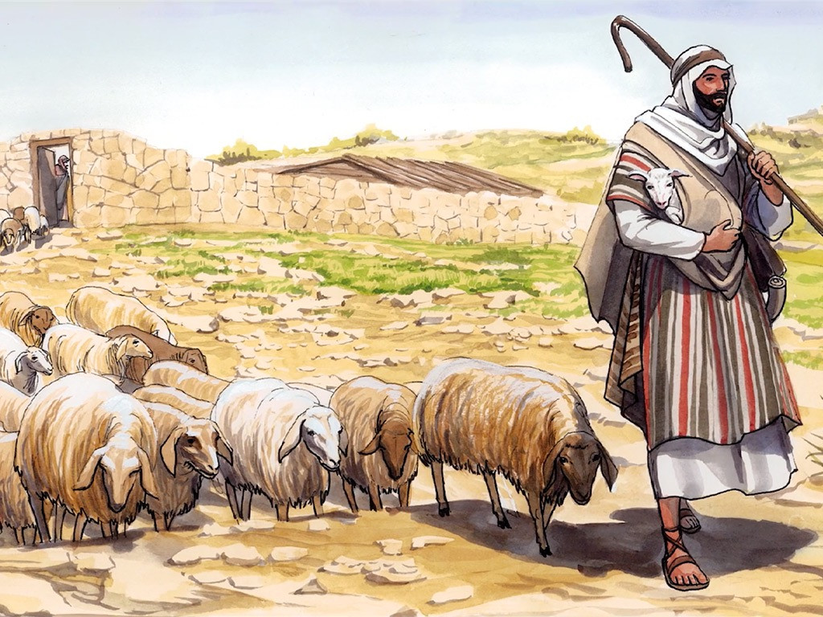
The Parable of the Good Shepherd
John 10:1-10

Slide 4
Leader: A reading from
the Holy Gospel
according to John.
All: Glory to You, Oh Lord.

Slide 5
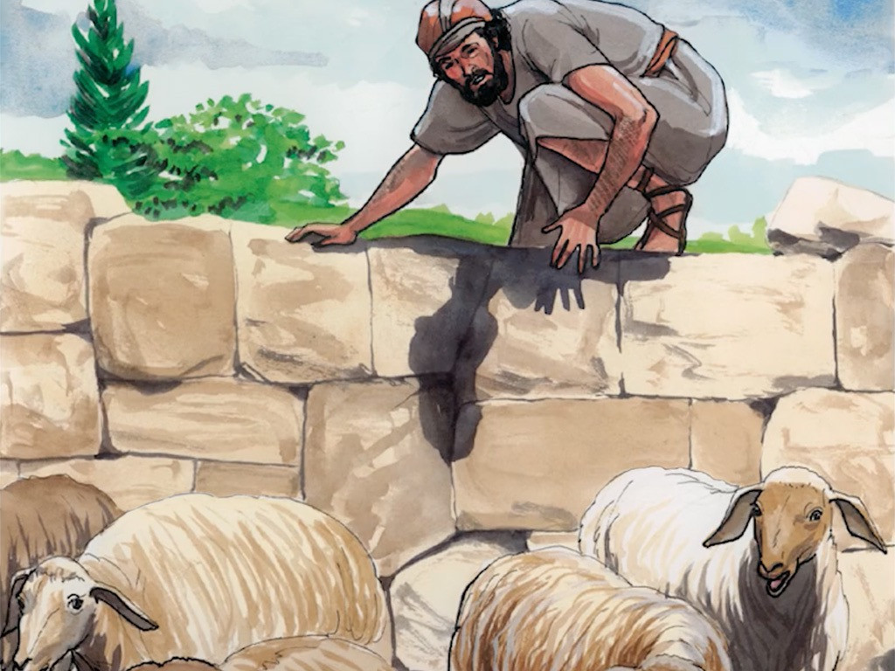
1
Jesus said, “I am telling you the truth: the man who does not enter the sheep pen by the gate, but climbs in some other way, is a thief and a robber.

Slide 6
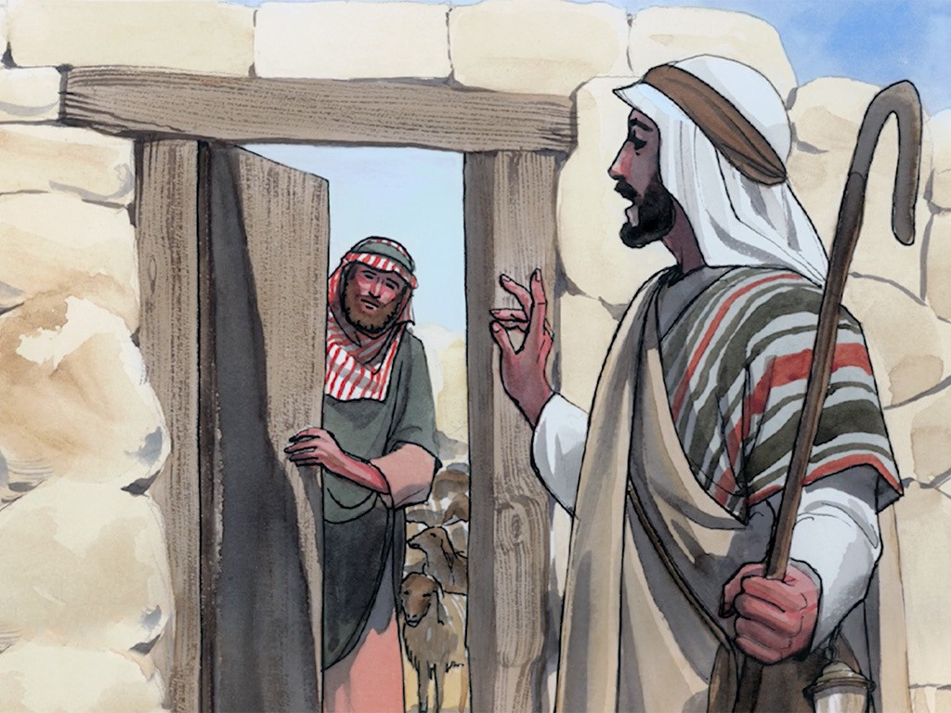
2
The man who goes in through the gate is the shepherd of the sheep.

Slide 7
3
The gatekeeper opens the gate for him; the sheep hear his voice as he calls his own sheep by name, and he leads them out.

Slide 8
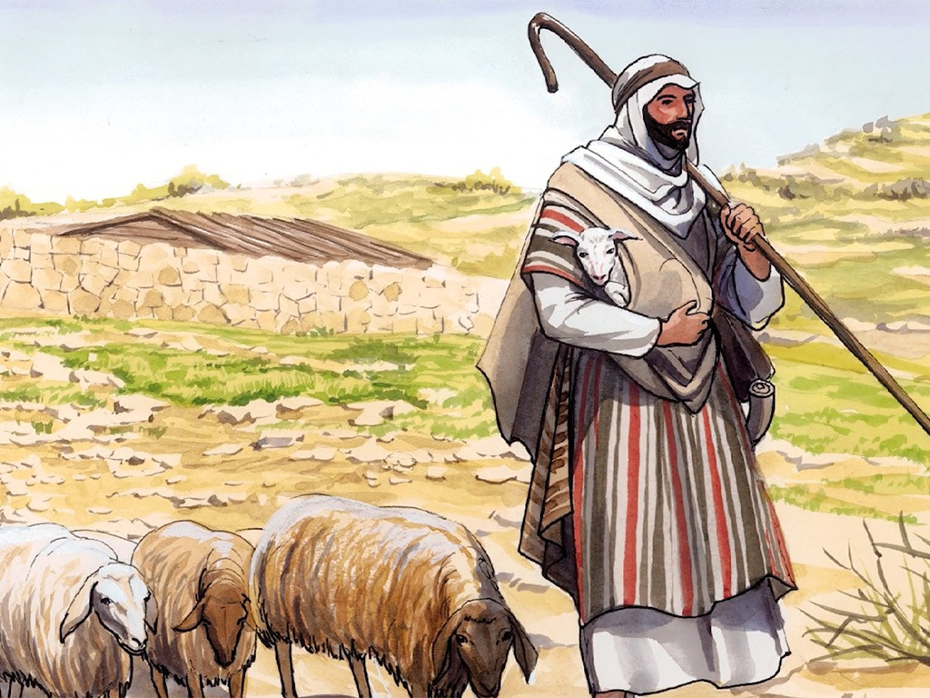
4
When he has brought them out, he goes ahead of them, and the sheep follow him, because they know his voice.

Slide 9
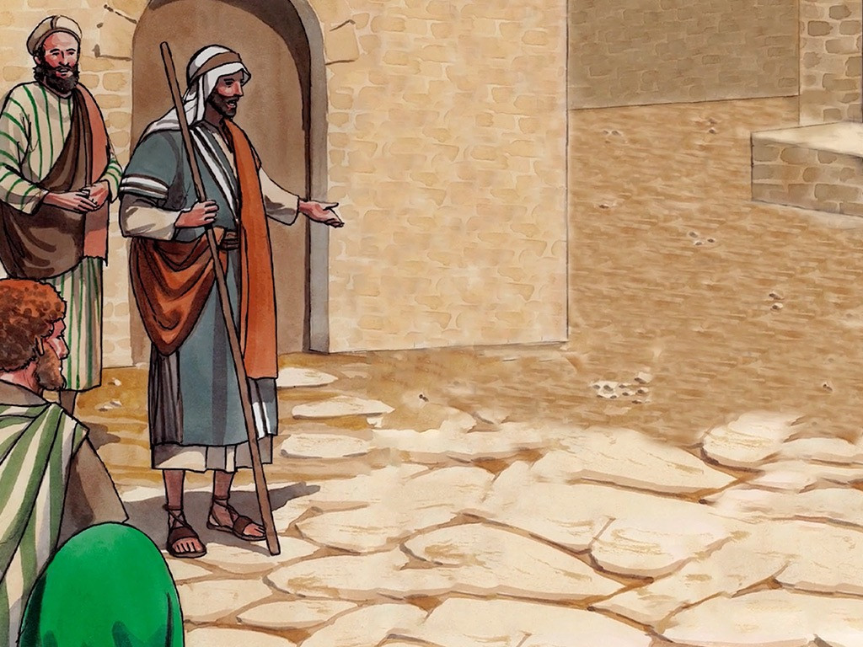
5
They will not follow someone else; instead, they will run away from such a person, because they do not know his voice.”

Slide 10
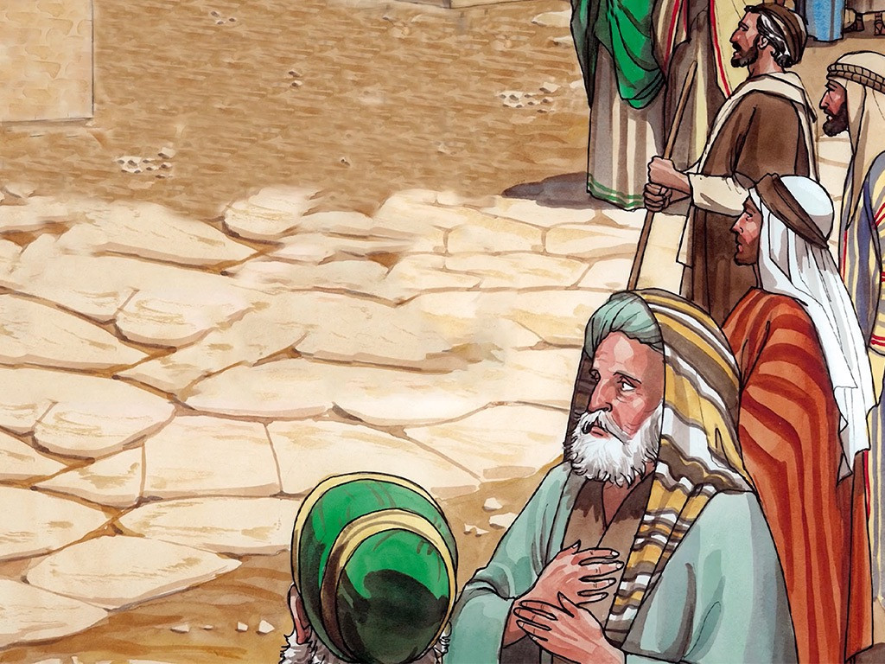
6
Jesus told them this parable, but they did not understand what he meant.

Slide 11
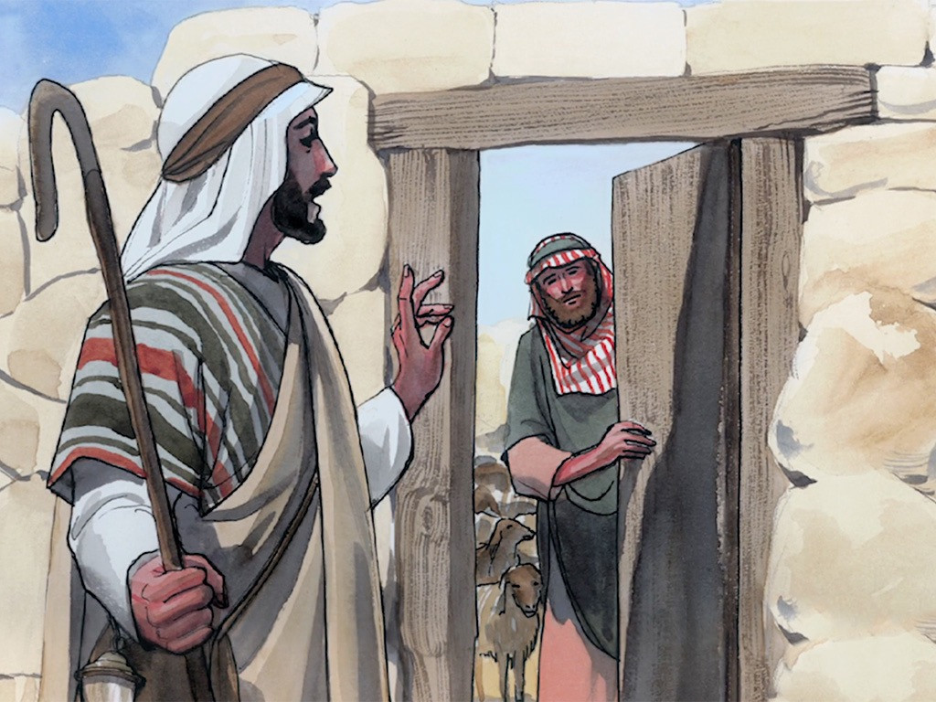
7
So Jesus said again, “I am telling you the truth: I am the gate for the sheep.

Slide 12
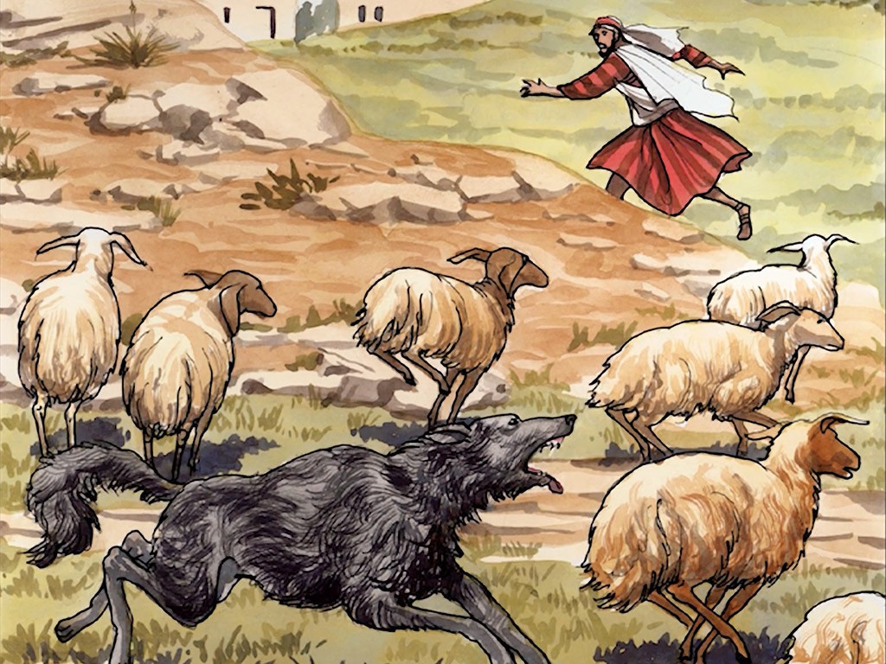
8
All others who came before me are thieves and robbers, but the sheep did not listen to them.

Slide 13
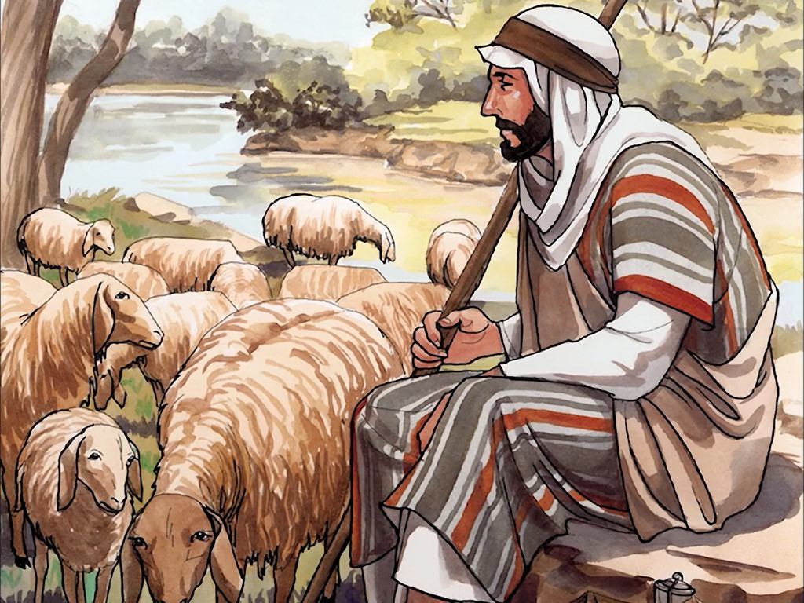
9
I am the gate. Those who come in by me will be saved; they will come in and go out and find pasture.

Slide 14
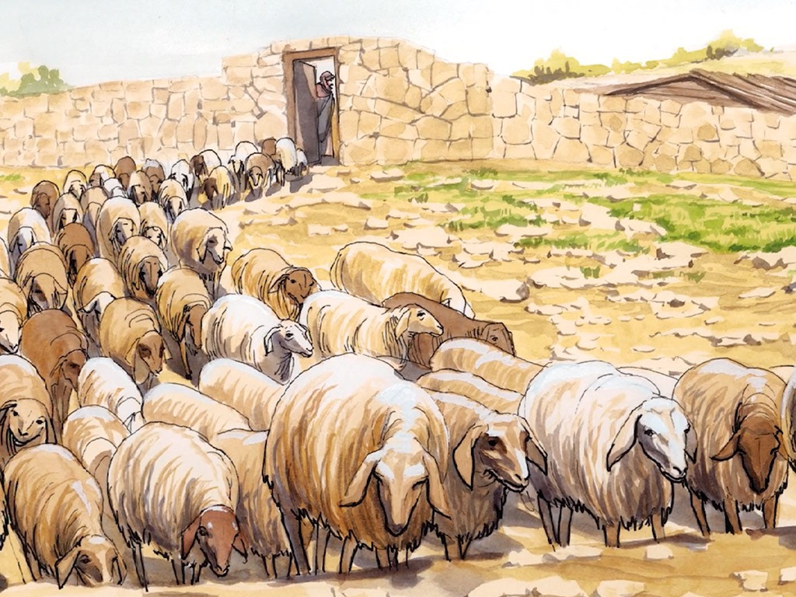
10
The thief comes only in order to steal, kill, and destroy. I have come in order that you might have life—life in all its fullness.

Slide 15
Leader: The Gospel of the Lord.
All: Praise to You,
Lord Jesus Christ.

Slide 16
GOSPEL MESSAGE

Slide 17
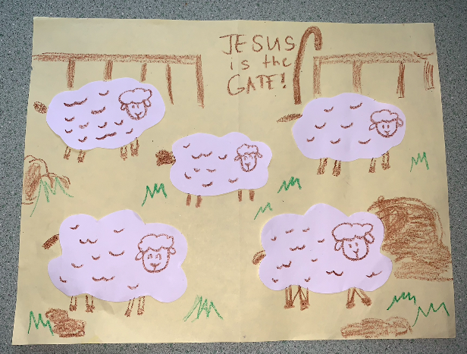
Activity:
Jesus is the Gate!
Colored Paper
Bond Paper
Scissors
Glue
Pen and Crayons

Slide 18
Instructions:
Cut out fluffy sheep outlines from the white paper.
Glue your sheep to the colored paper (a light shade of color will be better to use), leaving one a little separate from the others.
Draw a head and legs on all the sheep.
You can also add some grass and rock on the blank spaces.
Then start drawing a gate on the upper part, on the middle of the gate write the word “JESUS IS THE GATE”
Add a shepherd’s crook beside the word.

Slide 19
Closing Prayer
Dear God,
Lord thank you for guiding and protecting us from harmful things. May we always follow and obey You everytime we do things. Thank you God, for taking care of us, and thinking what is the best for us. Teach us, to be a good follower of You.
Amen.

Slide 20
LIVE THE WORD KIDS
Fourth Sunday of Easter | Cycle A

