Slide 1
LIVE THE WORD KIDS
Third Sunday of Easter | Cycle A

Slide 2
GOSPEL REFLECTION
Easter isn’t over, it has just begun! We continue to celebrate Christ’s resurrection with this story, as we see His unexpected encounter with disciples on the road to Emmaus. These bring the story to life and emphasize how we can find daily blessings in our lives, if our eyes are open for them.
That sometimes things in our lives don’t make sense to us. Even if we know God is at work, we have a difficult time understanding what He might be doing. In this lesson, we recognize that God’s big plans will come through, no matter what we can recognize immediately. Jesus revealed who He was to disciples, when they were ready and willing to comprehend. So we, too, can see His hand, if we are ready to look for it. Blessings are all around us if we expect them.

Slide 3
Leader: A reading from
the Holy Gospel
according to Luke.
All: Glory to You, Oh Lord.

Slide 4
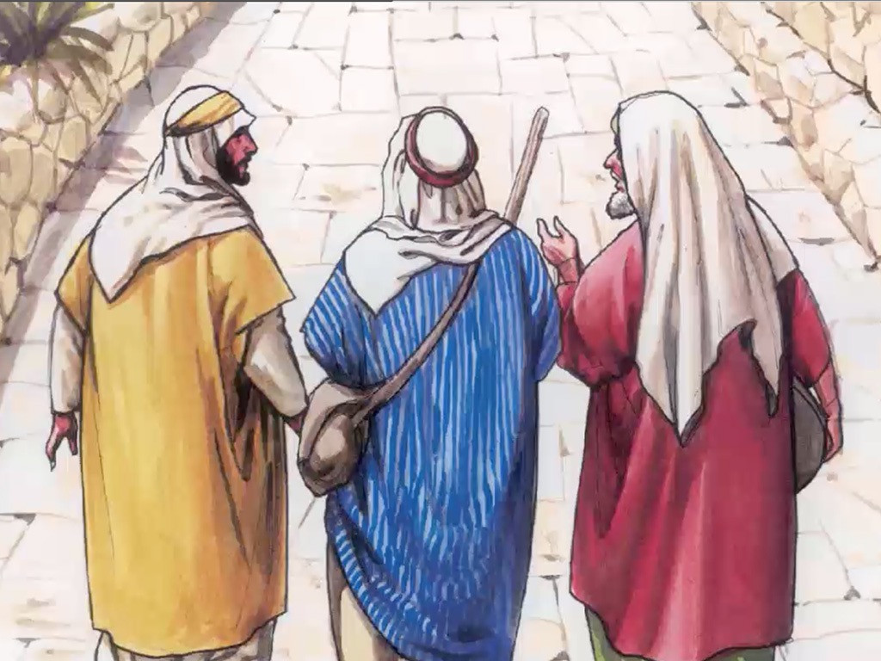
The Walk to Emmaus
Luke 24:13-35

Slide 5
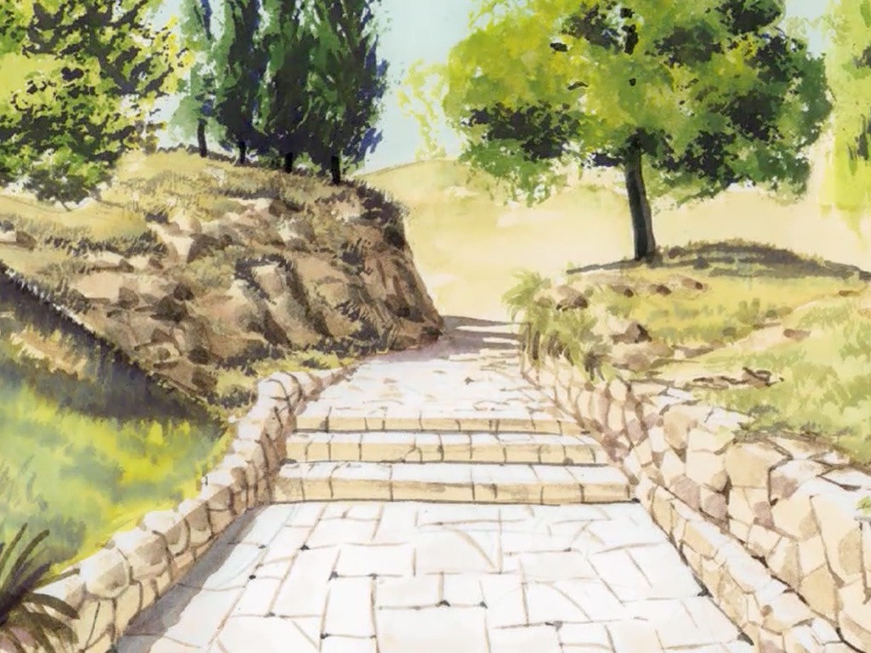
13
On that same day two of Jesus' followers were going to a village named Emmaus, about seven miles from Jerusalem,

Slide 6
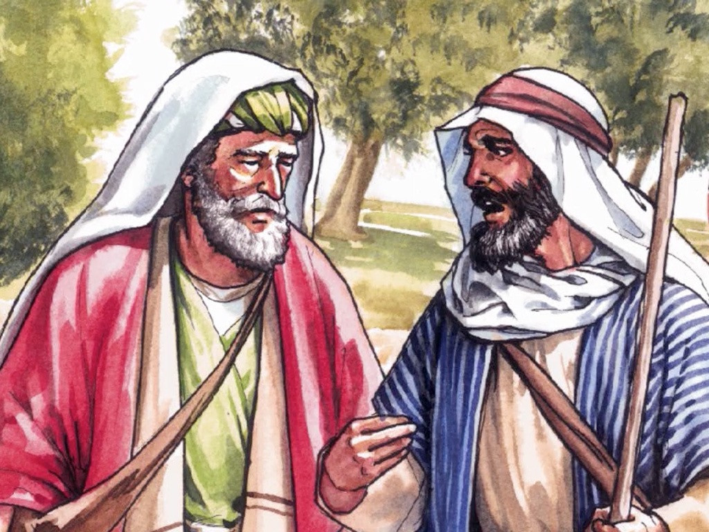
14
and they were talking to each other about all the things that had happened.

Slide 7
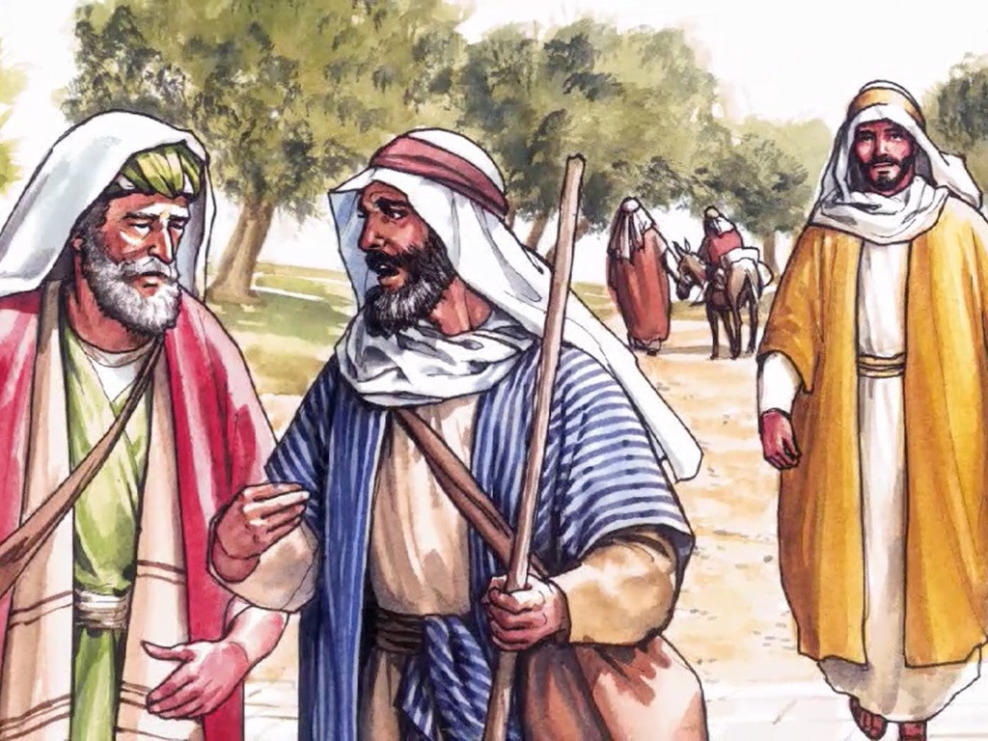
15
As they talked and discussed, Jesus himself drew near and walked along with them;

Slide 8
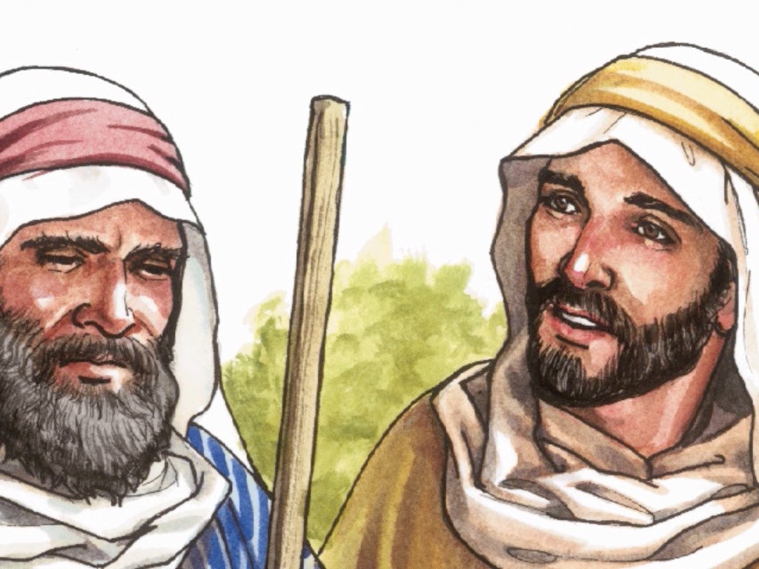
16
they saw him, but somehow did not recognize him.

Slide 9
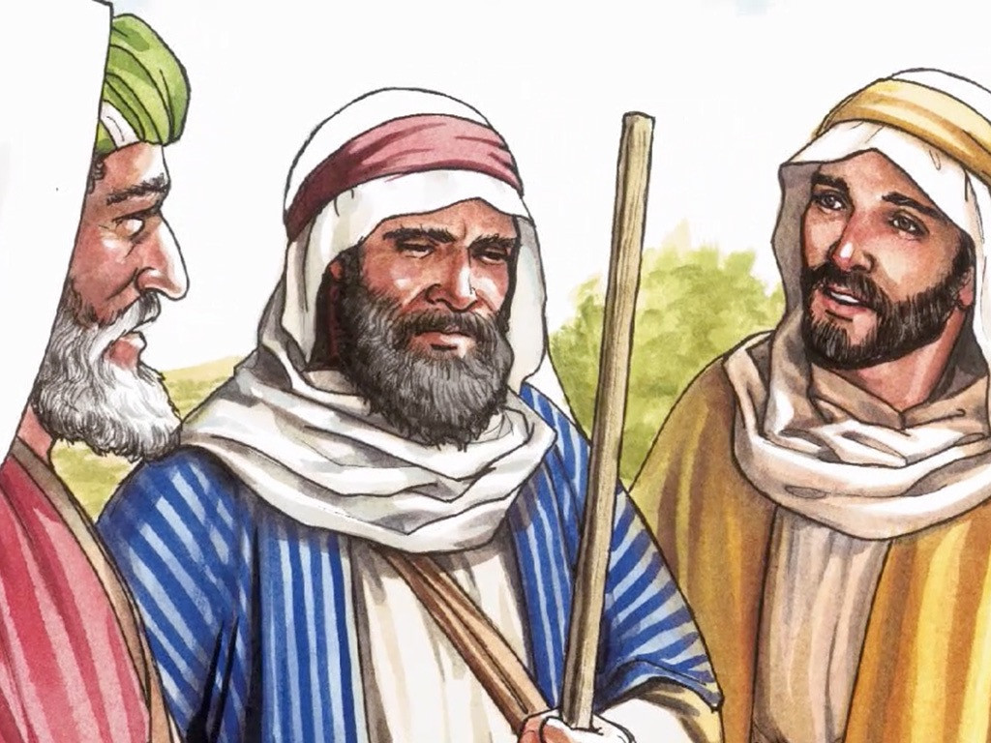
17
Jesus said to them, “What are you talking about to each other, as you walk along?”
They stood still, with sad faces.

Slide 10
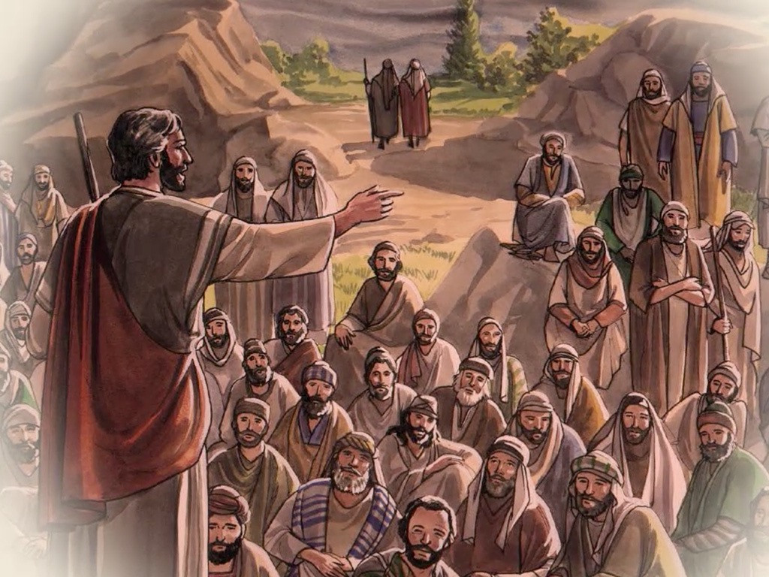
18
One of them, named Cleopas, asked him, “Are you the only visitor in Jerusalem who doesn't know the things that have been happening there these last few days?”

Slide 11
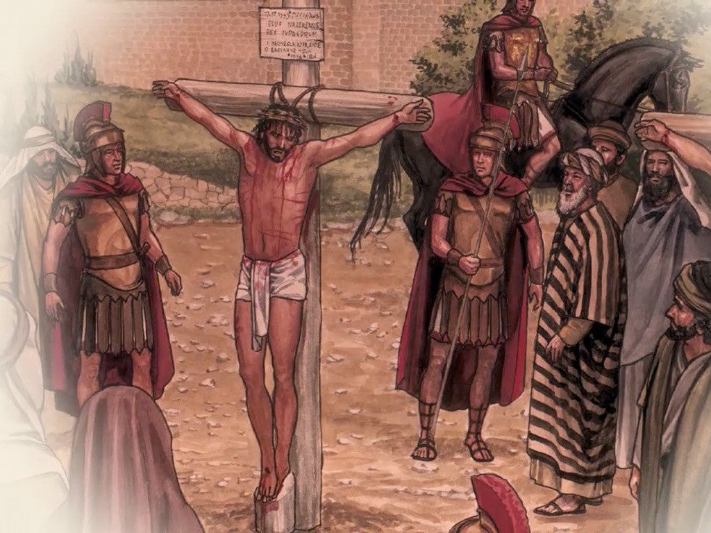
19
“What things?” he asked.
“The things that happened to Jesus of Nazareth,” they answered. “This man was a prophet and was considered by God and by all the people to be powerful in everything he said and did.

Slide 12
20
Our chief priests and rulers handed him over to be sentenced to death, and he was crucified.

Slide 13
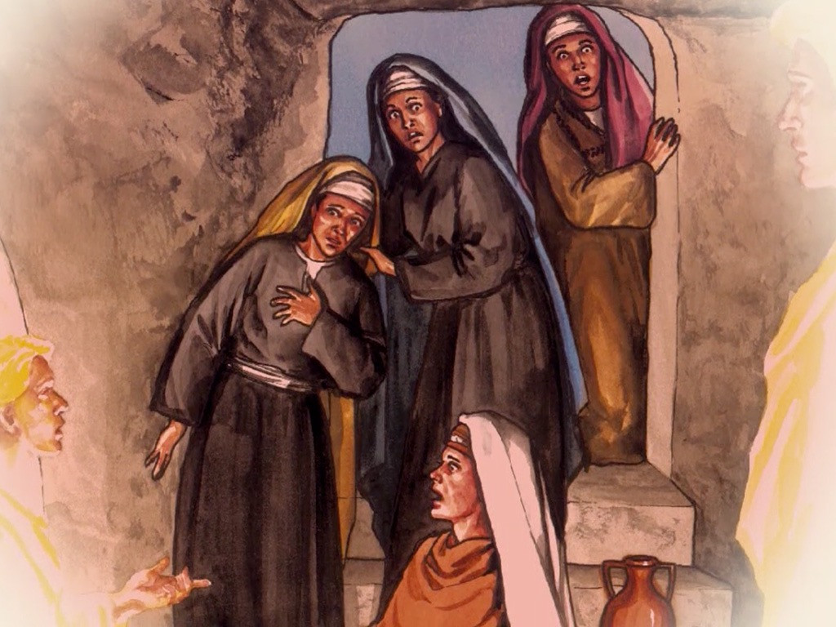
21
And we had hoped that he would be the one who was going to set Israel free! Besides all that, this is now the third day since it happened.

Slide 14
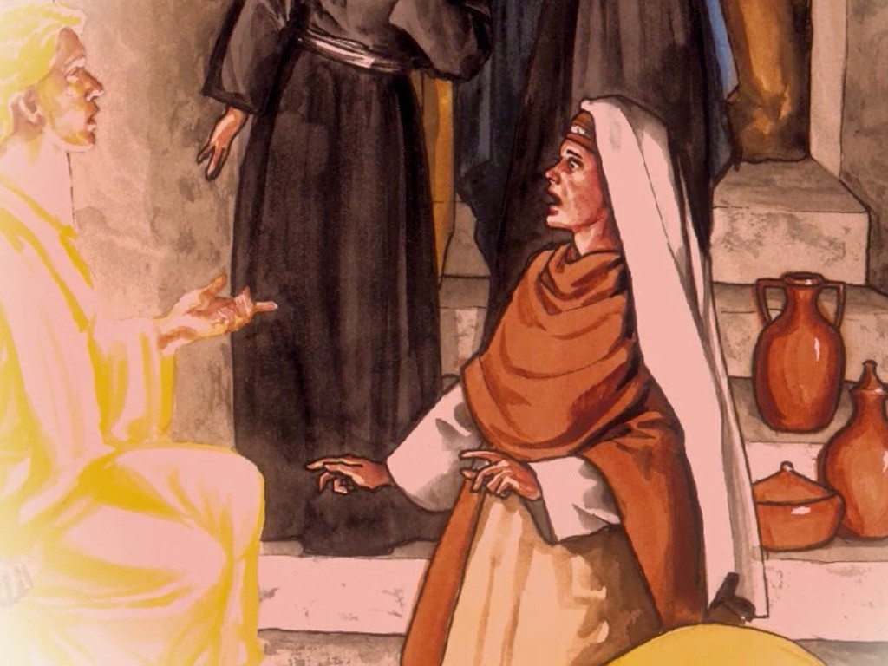
22
Some of the women of our group surprised us; they went at dawn to the tomb,

Slide 15
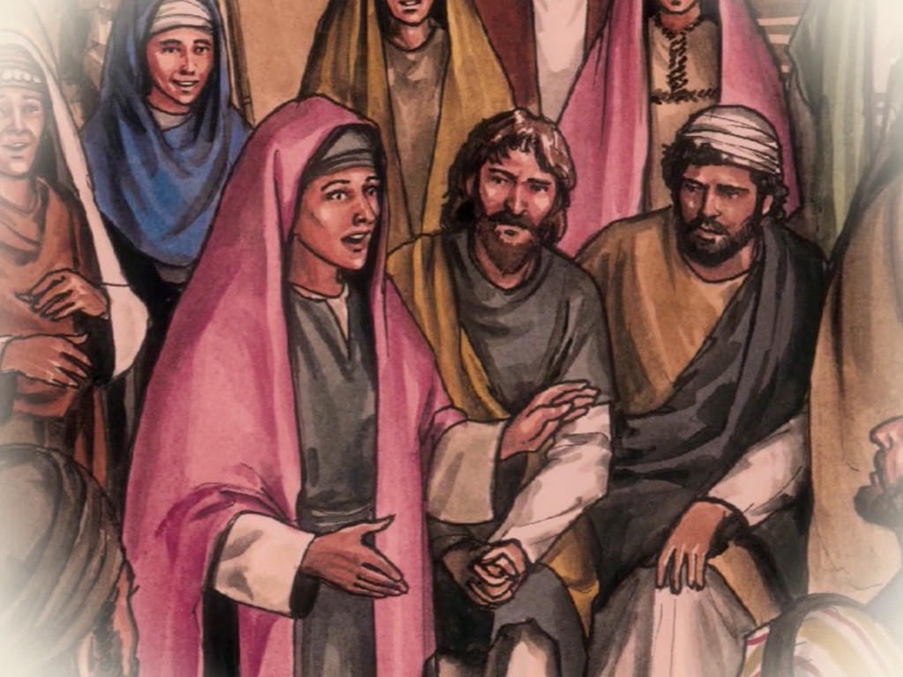
23
but could not find his body. They came back saying they had seen a vision of angels who told them that he is alive.

Slide 16
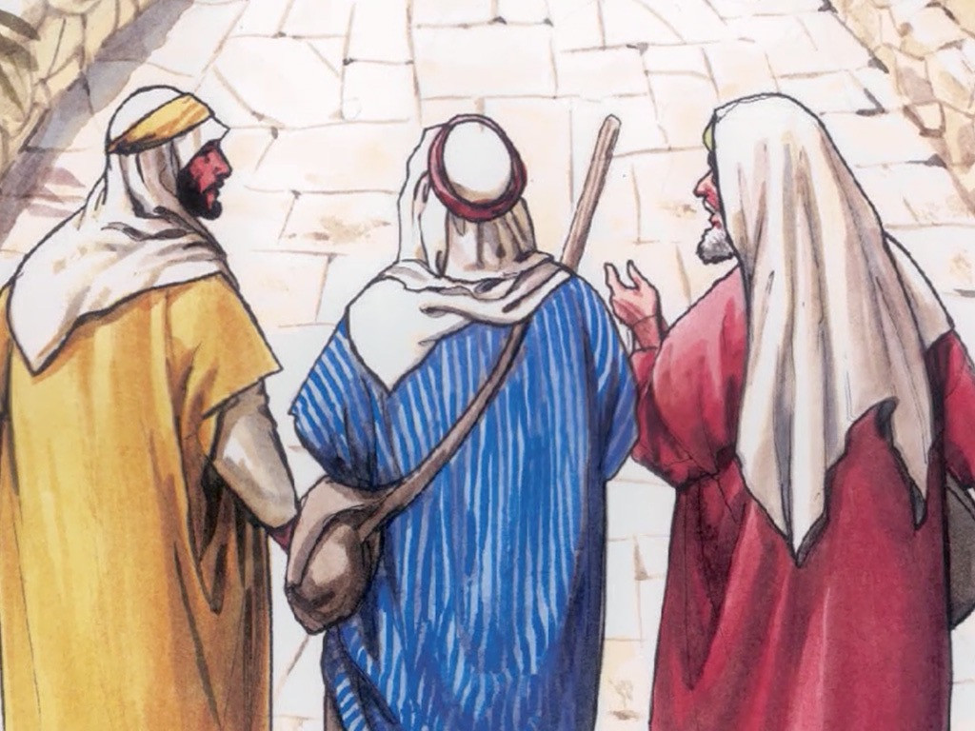
24
Some of our group went to the tomb and found it exactly as the women had said, but they did not see him.”

Slide 17
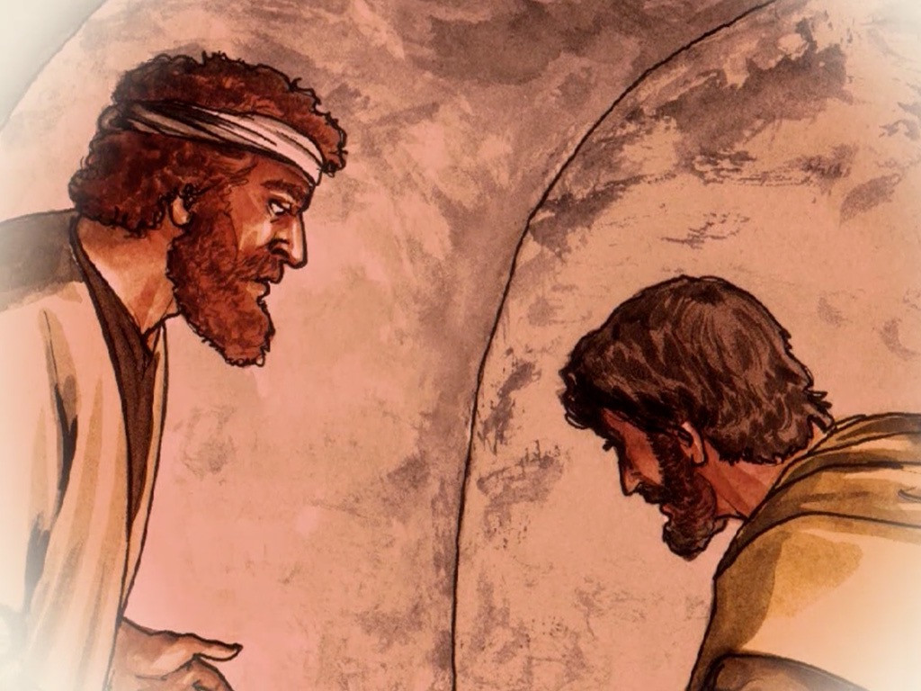
25
Then Jesus said to them, “How foolish you are, how slow you are to believe everything the prophets said!

Slide 18
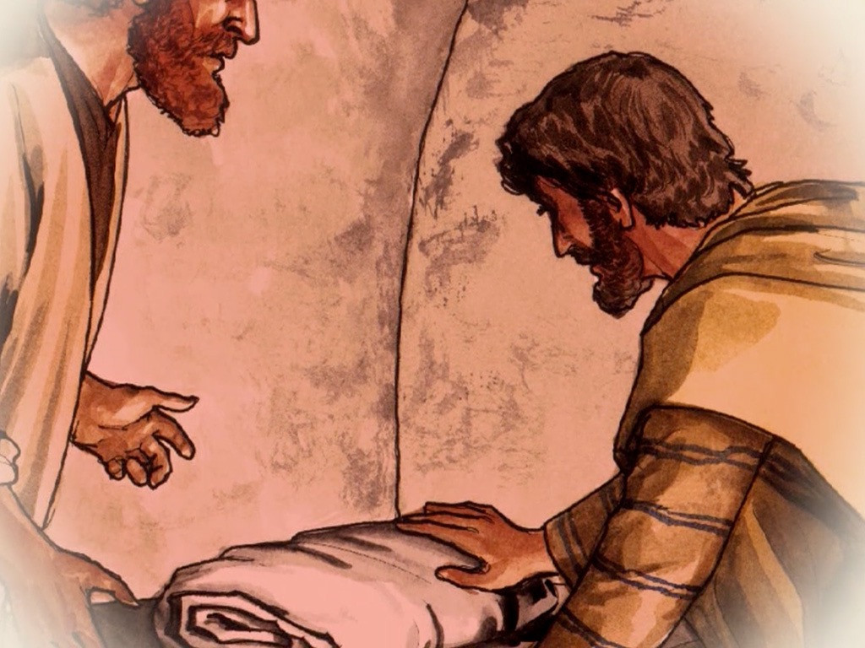
26
Was it not necessary for the Messiah to suffer these things and then to enter his glory?”

Slide 19
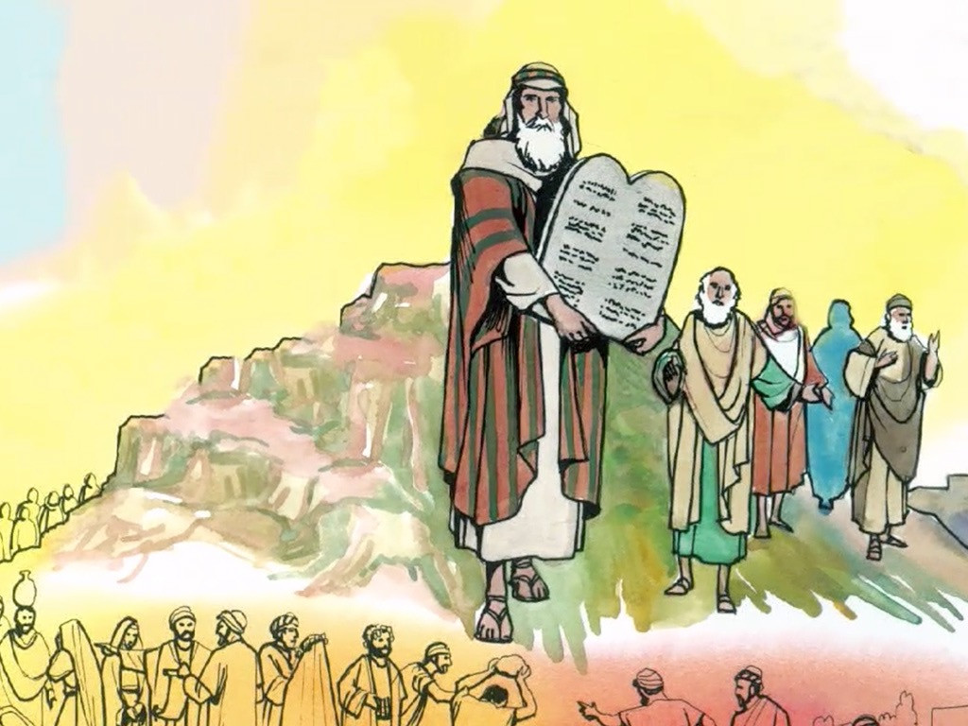
27
And Jesus explained to them what was said about himself in all the Scriptures, beginning with the books of Moses and the writings of all the prophets.

Slide 20
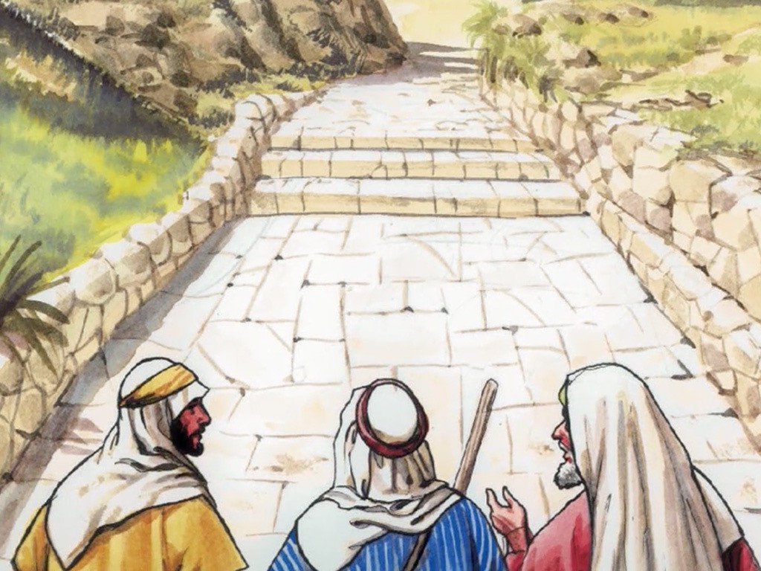
28
As they came near the village to which they were going, Jesus acted as if he were going farther;

Slide 21
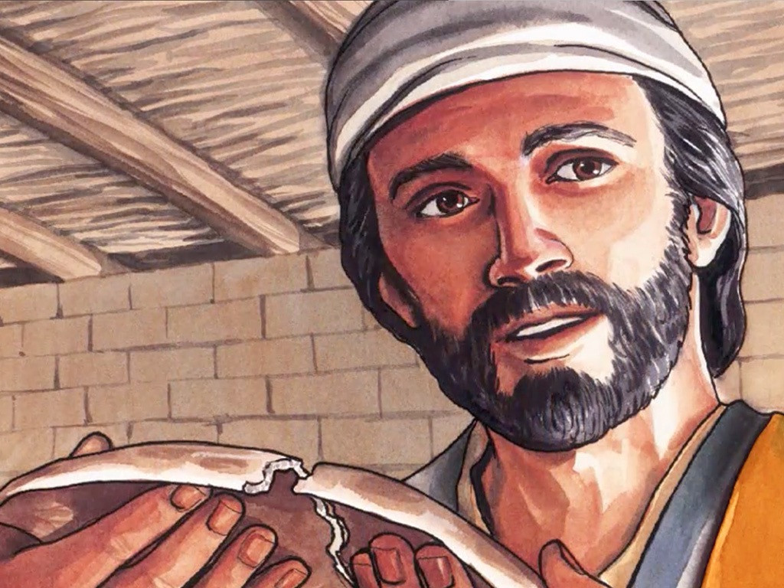
29
but they held him back, saying, “Stay with us; the day is almost over and it is getting dark.” So he went in to stay with them.

Slide 22
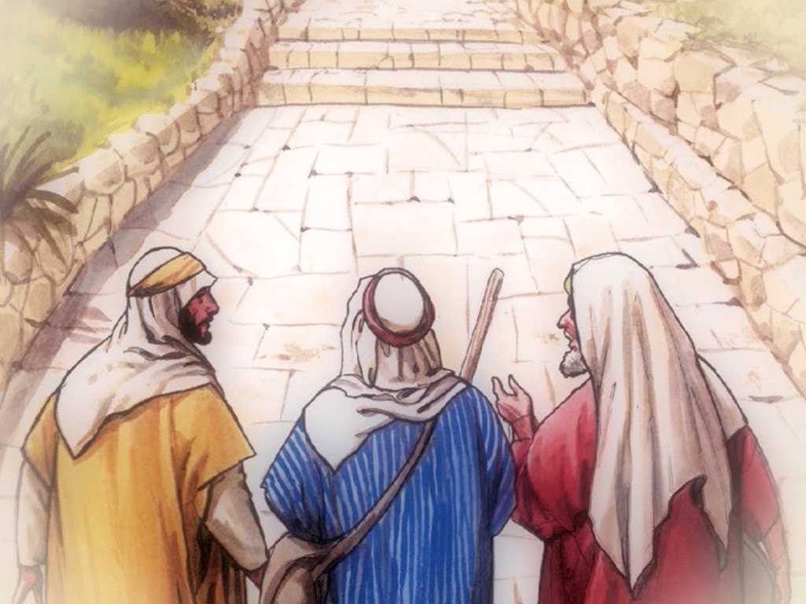
30
He sat down to eat with them, took the bread, and said the blessing; then he broke the bread and gave it to them

Slide 23
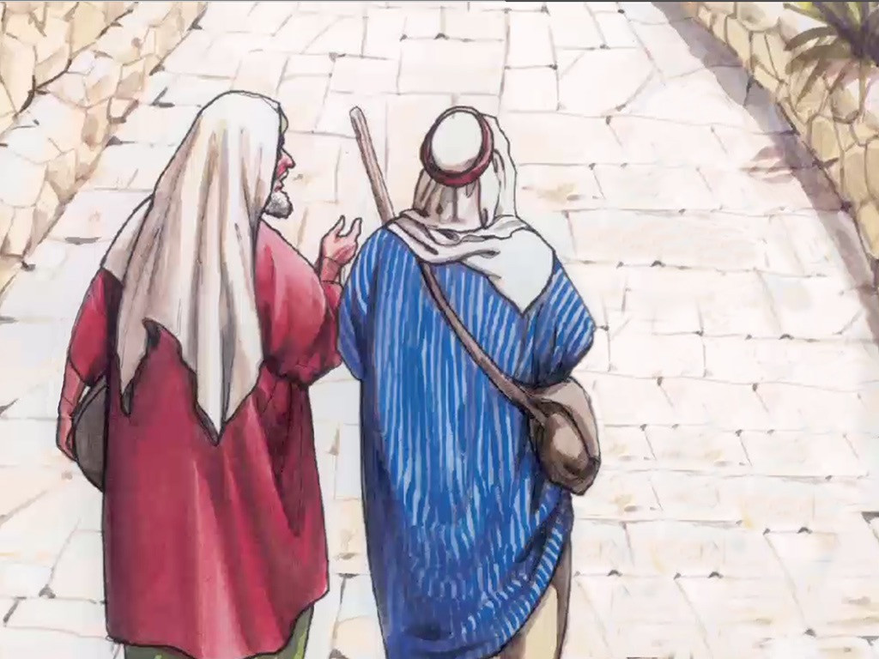
31
Then their eyes were opened and they recognized him, but he disappeared from their sight.

Slide 24
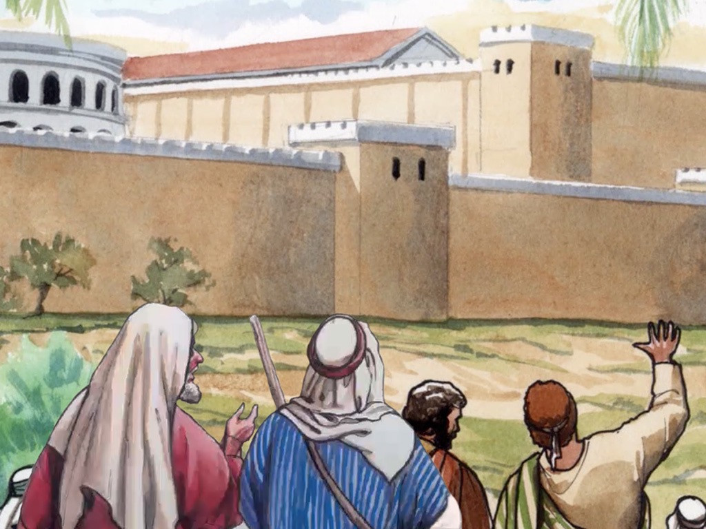
32
They said to each other, “Wasn't it like a fire burning in us when he talked to us on the road and explained the Scriptures to us?”

Slide 25
33
They got up at once and went back to Jerusalem, where they found the eleven disciples gathered together with the others

Slide 26
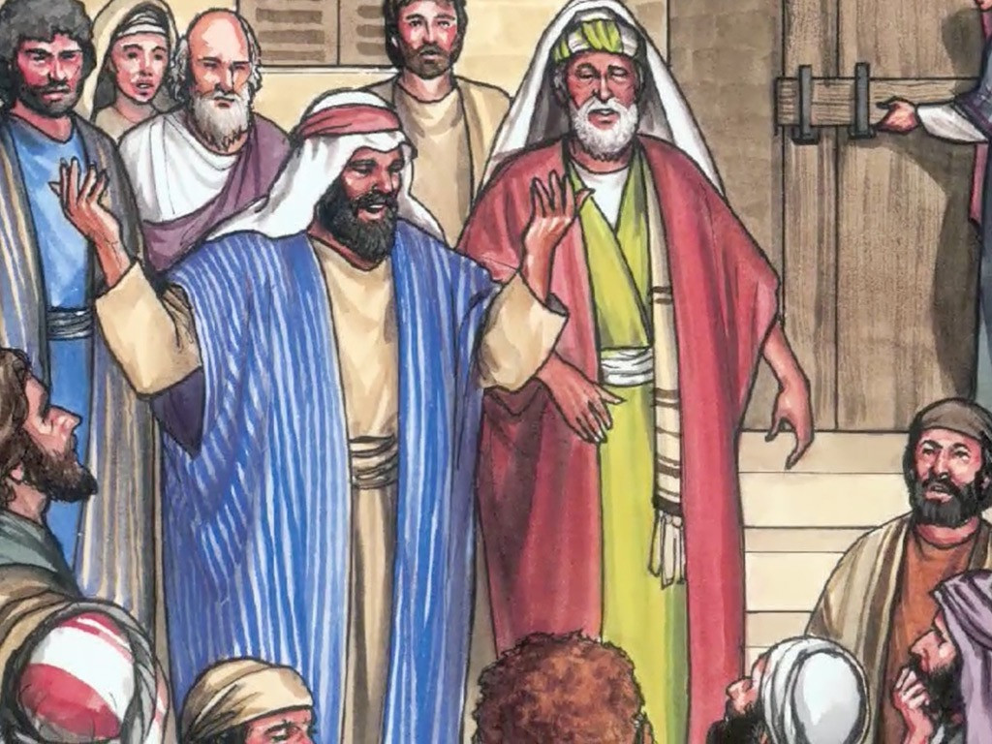
34
And saying, “The Lord is risen indeed! He has appeared to Simon!”

Slide 27
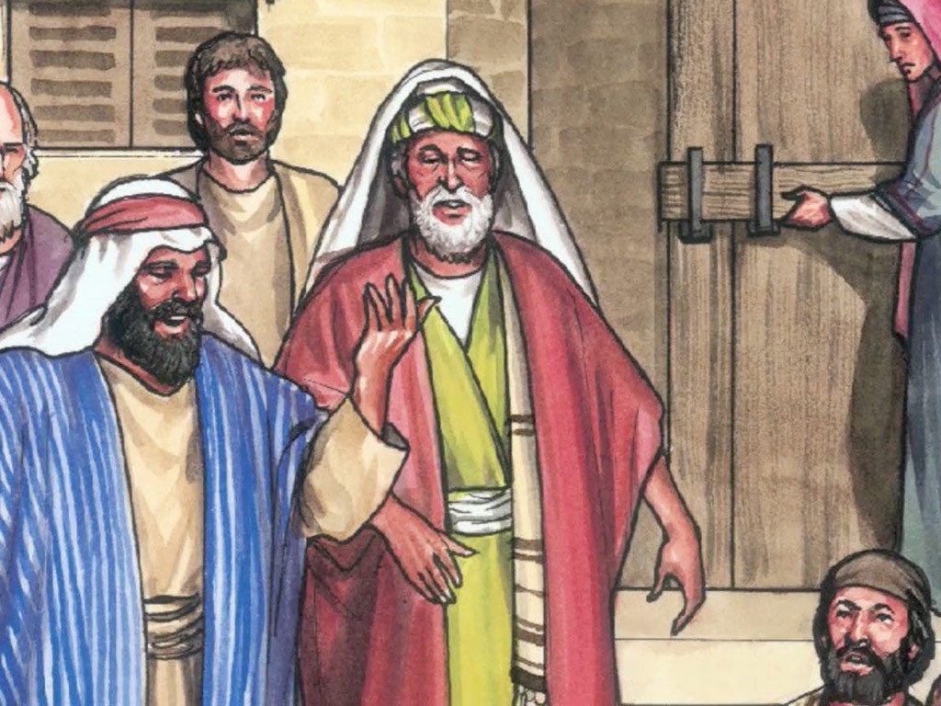
35
The two then explained to them what had happened on the road, and how they had recognized the Lord when he broke the bread.

Slide 28
Leader: The Gospel of the Lord.
All: Praise to You,
Lord Jesus Christ.

Slide 29
GOSPEL MESSAGE

Slide 30
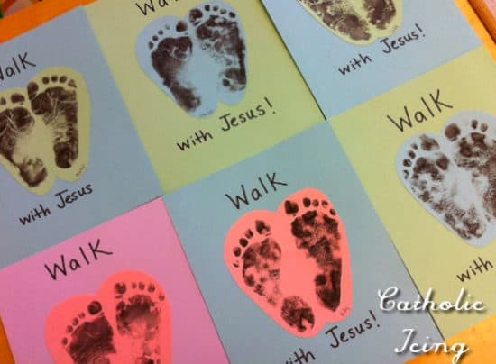
Activity:
Walk with Jesus
Colored Paper
Bond Paper
Scissors
Glue
Pen and Crayons

Slide 31
Instructions:
Draw and trace your foot in any colored paper.
Cut your traced outline of your foot.
Then paste in a different colored paper.
Write the word “Walk” at the upper part and “with Jesus” on the lower part of the foot.

Slide 32
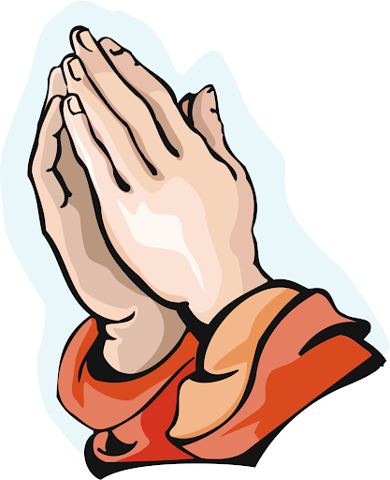
Closing Prayer
Dear God,
Lord thank you for taking care of us, and pouring out blessings even there are times that we fail to thank you and recognize you. Help us to recognize you in everything that we do. And may we always put our trust in you and be reminded that you are with us all along the way.
Amen.

Slide 33
LIVE THE WORD KIDS
Third Sunday of Easter | Cycle A

