Slide 1
LIVE THE WORD KIDS
Second Sunday of Easter | Cycle A

Slide 2
GOSPEL REFLECTION
On this second Sunday of Easter, Jesus continues to make his presence known to his disciples. He wanted them and us to know that He is always with us. The grave cannot keep us away from God’s love which comes to us in Jesus who rose from the dead. He appeared to the disciples, in their moments of fear, even though they had locked the door.
In today’s Gospel, Jesus greets his disciples with the gift of peace. His first words to his fearful disciples are “peace be with you!” This is an affirmation that where Jesus is truly present to us, there is peace. Even with his wounds, Jesus is not ashamed to offer us healing and peace. His peace helps to soothe our fears but it still requires faith.
Jesus also commissions his disciples to continue the work that he has begun. As Jesus was sent by God, so too does Jesus send his disciples. This continuity with Jesus' own mission is an essential element of the Church. Jesus grants the means to accomplish this mission when he gives his disciples the gift of the Holy Spirit. The Holy Spirit binds us together as a community of faith and strengthens us to bear witness to Jesus' Resurrection.

Slide 3
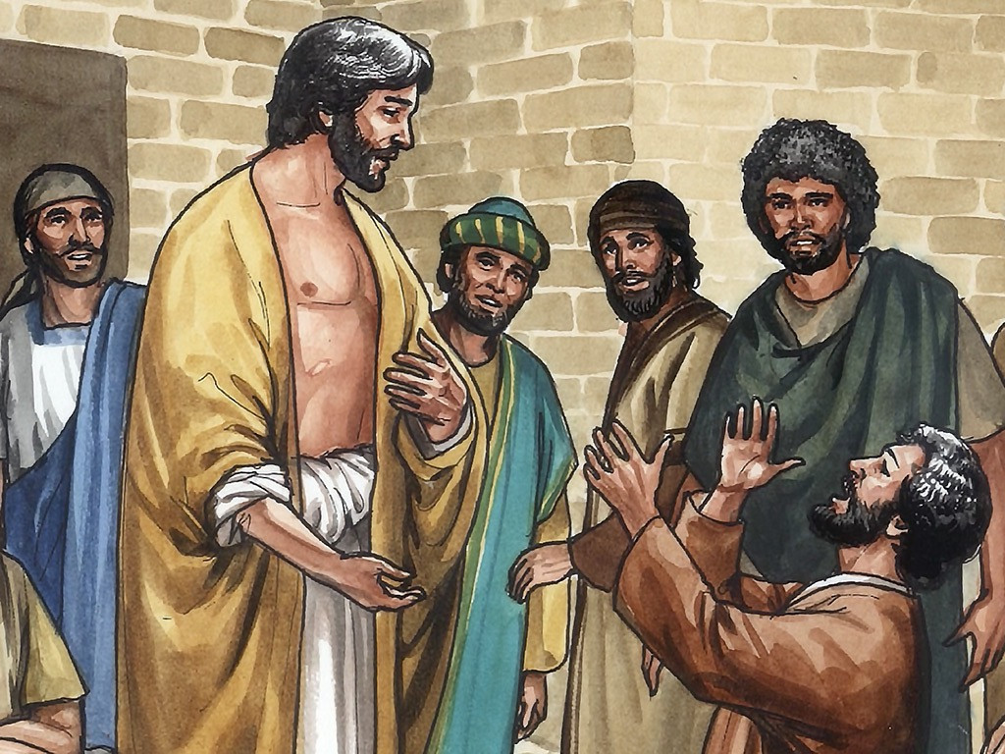
Jesus Appears to His Disciples
John 20: 19-31

Slide 4
Leader: A reading from
the Holy Gospel
according to John.
All: Glory to You, Oh Lord.

Slide 5
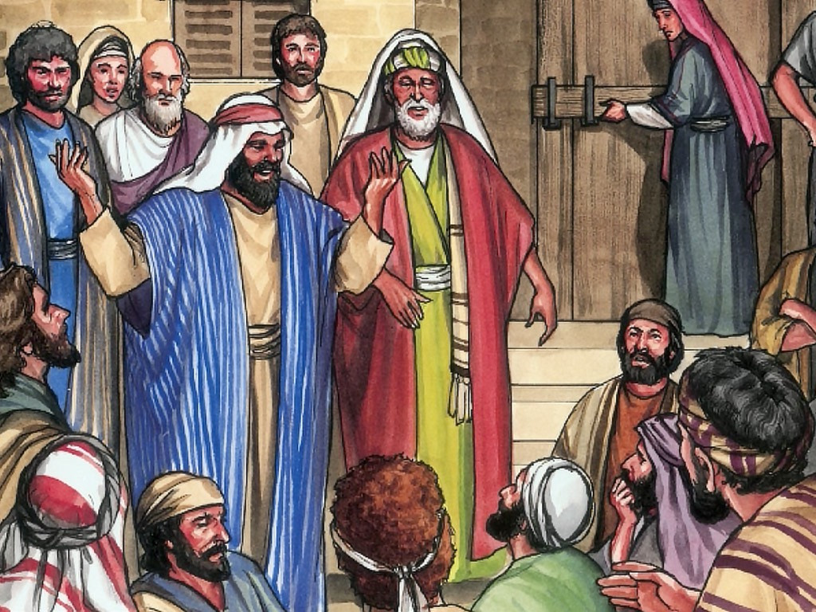
19
It was late that Sunday evening, and the disciples were gathered together behind locked doors, because they were afraid of the Jewish authorities. Then Jesus came and stood among them. “Peace be with you,” he said.

Slide 6
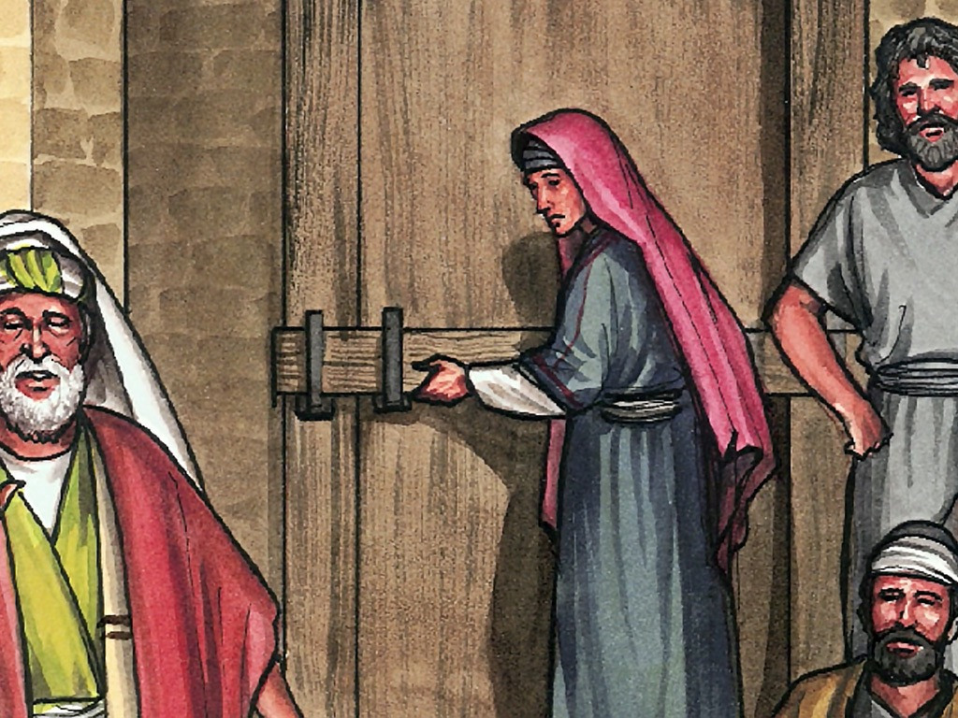
20
After saying this, he showed them his hands and his side. The disciples were filled with joy at seeing the Lord.

Slide 7
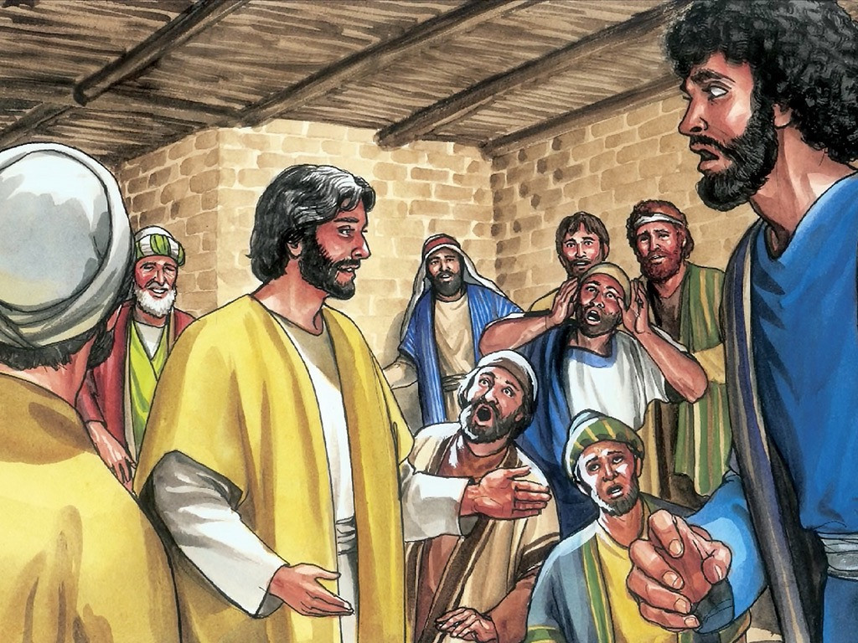
21
Jesus said to them again, “Peace be with you. As the Father sent me, so I send you.”

Slide 8
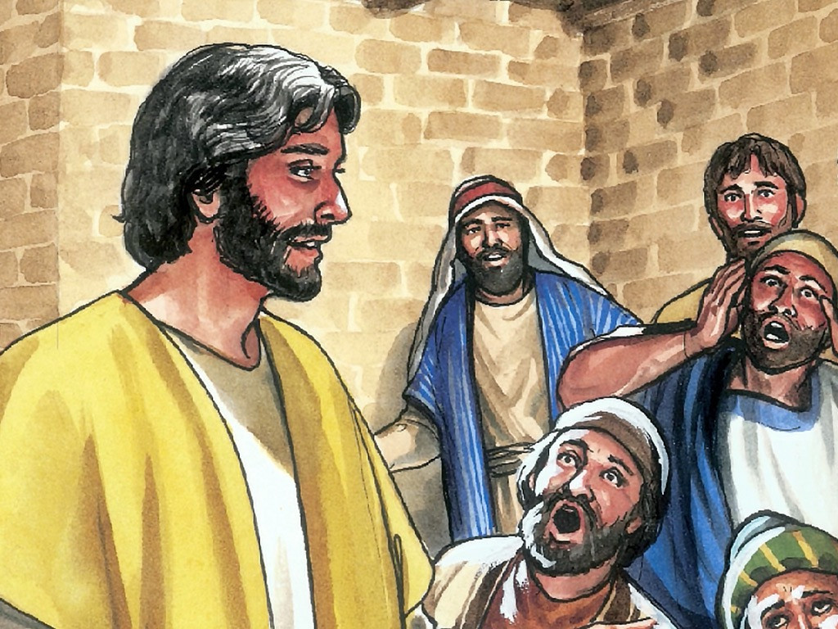
22
Then he breathed on them and said, “Receive the Holy Spirit.

Slide 9
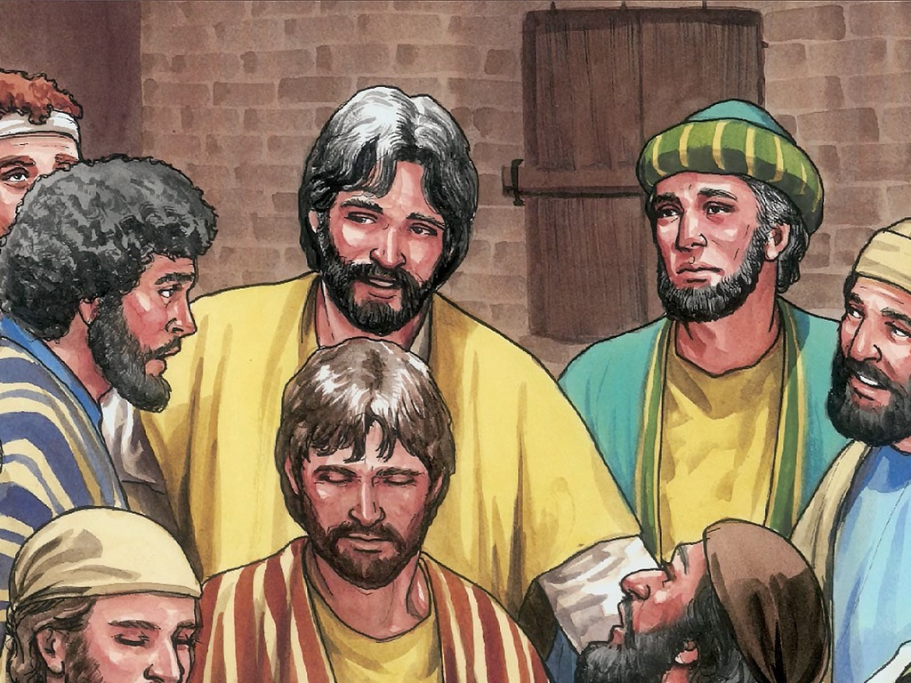
23
If you forgive people's sins, they are forgiven; if you do not forgive them, they are not forgiven.”

Slide 10
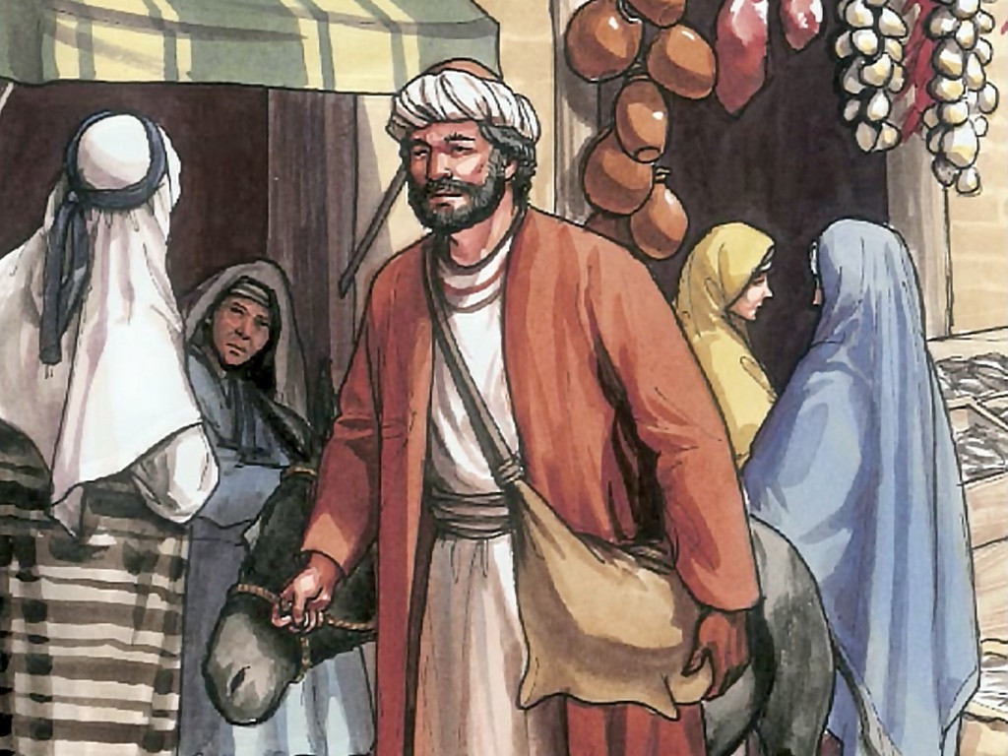
24
One of the twelve disciples, Thomas (called the Twin), was not with them when Jesus came.

Slide 11
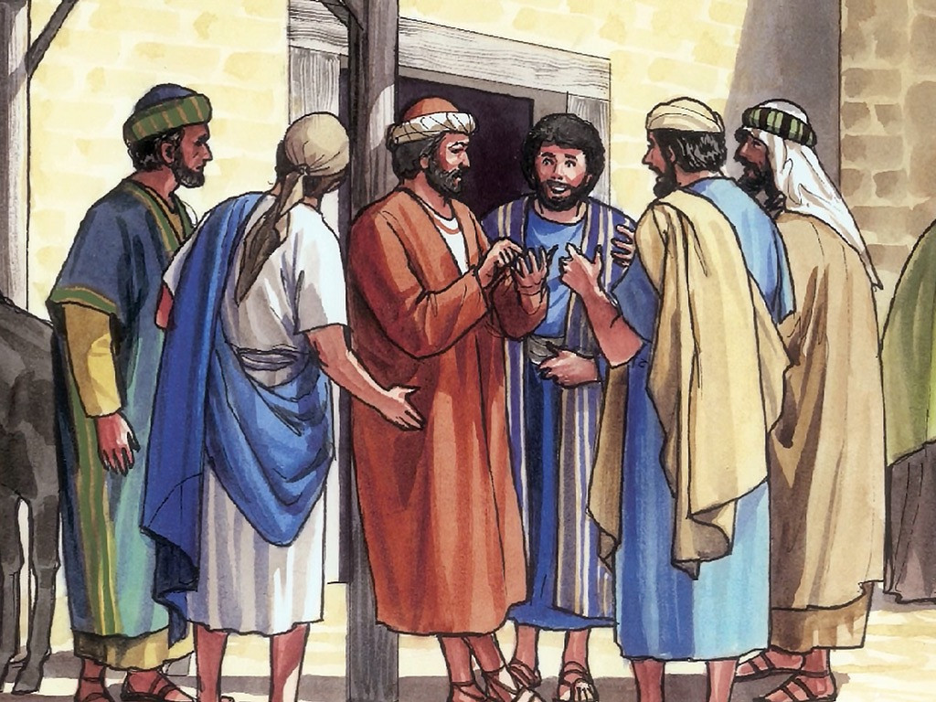
25
So the other disciples told him, “We have seen the Lord!”
Thomas said to them, “Unless I see the scars of the nails in his hands and put my finger on those scars and my hand in his side, I will not believe.”

Slide 12
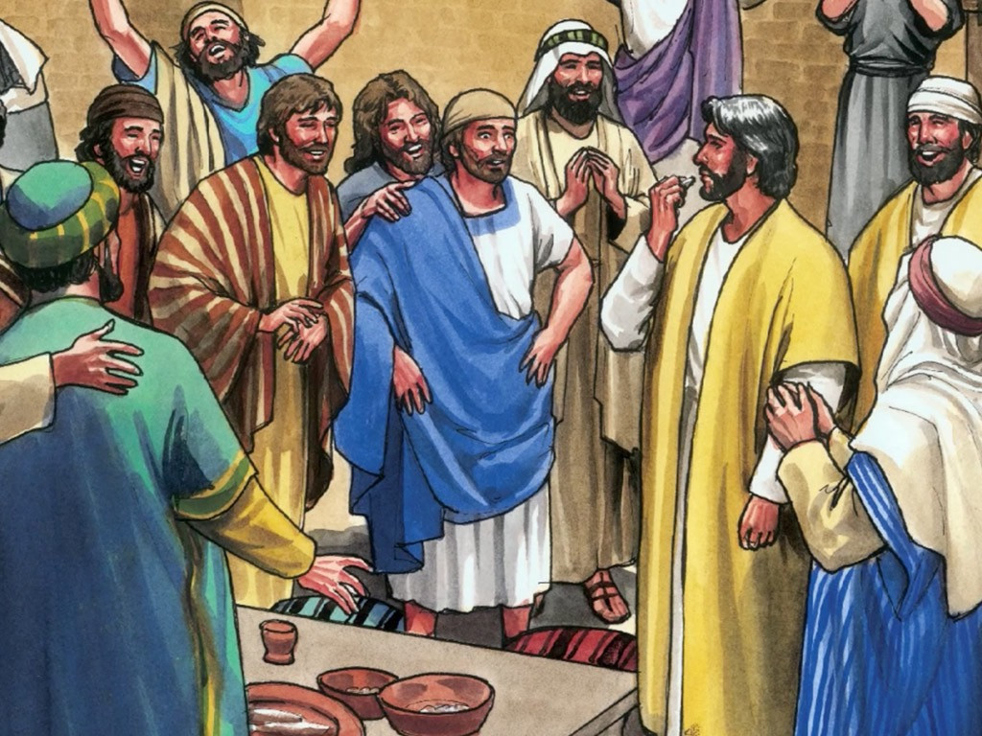
26
A week later the disciples were together again indoors, and Thomas was with them. The doors were locked, but Jesus came and stood among them and said, “Peace be with you.”

Slide 13
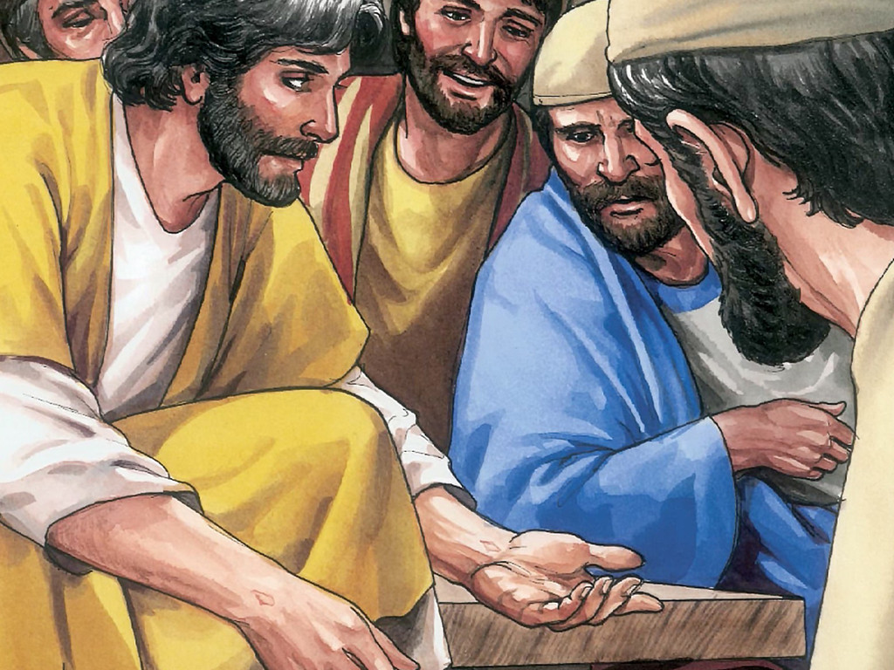
27
Then he said to Thomas, “Put your finger here, and look at my hands; then reach out your hand and put it in my side. Stop your doubting, and believe!”

Slide 14
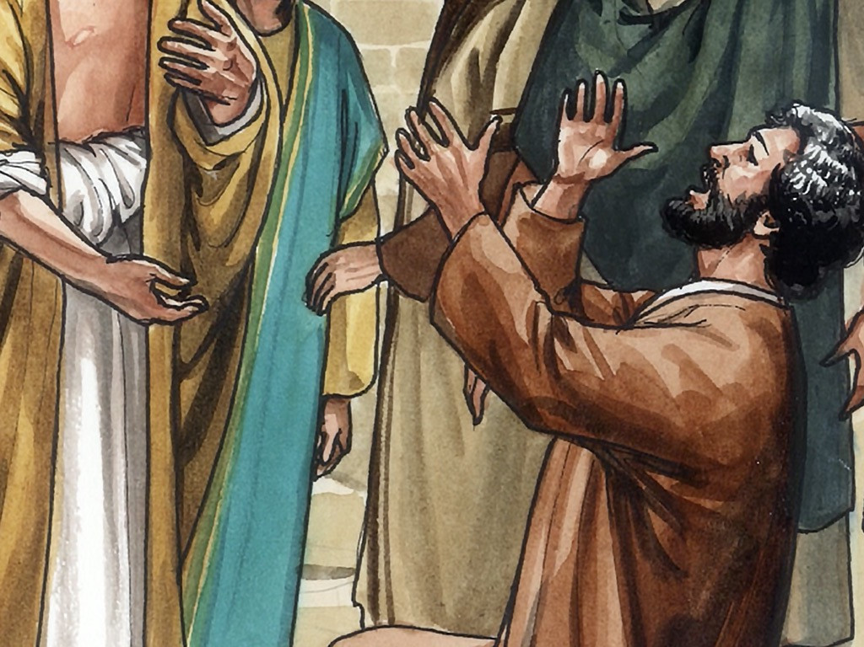
28
Thomas answered him, “My Lord and my God!”

Slide 15
29
Jesus said to him, “Do you believe because you see me? How happy are those who believe without seeing me!”

Slide 16
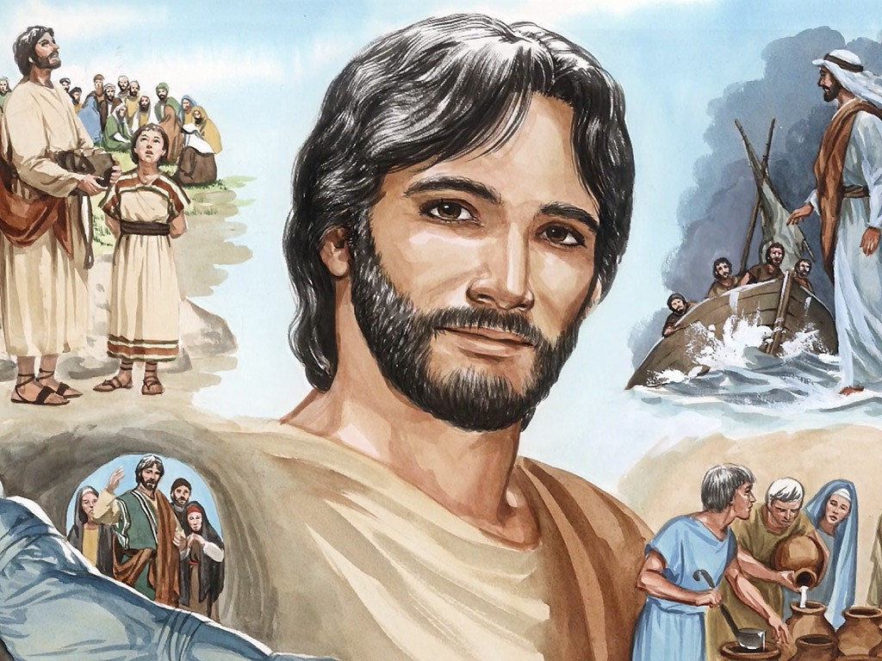
30
In his disciples' presence Jesus performed many other miracles which are not written down in this book.

Slide 17
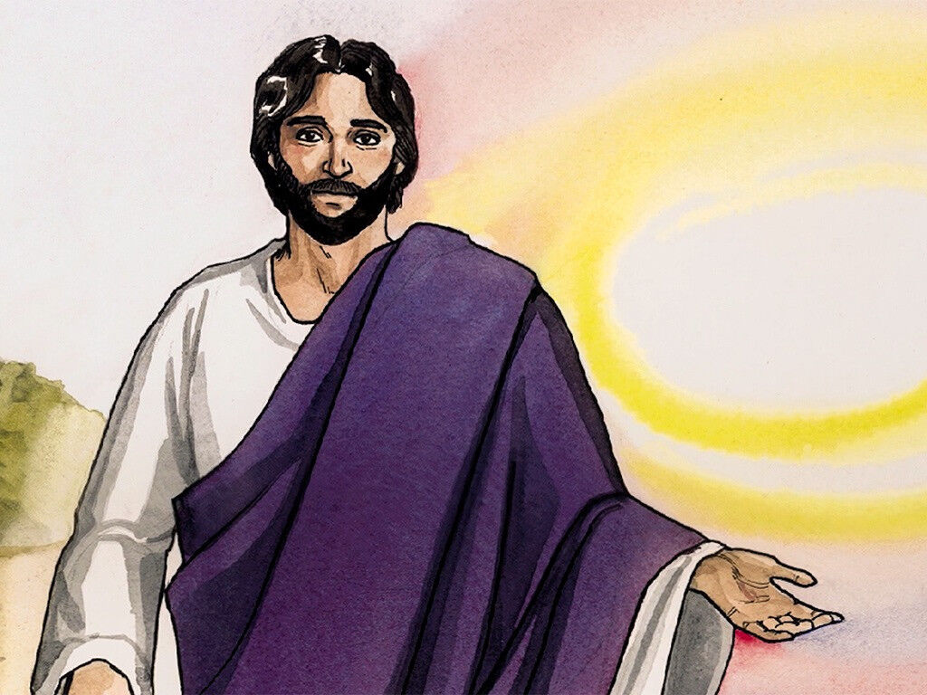
31
But these have been written in order that you may believe[a] that Jesus is the Messiah, the Son of God, and that through your faith in him you may have life.

Slide 18
Leader: The Gospel of the Lord.
All: Praise to You,
Lord Jesus Christ.

Slide 19
GOSPEL MESSAGE

Slide 20
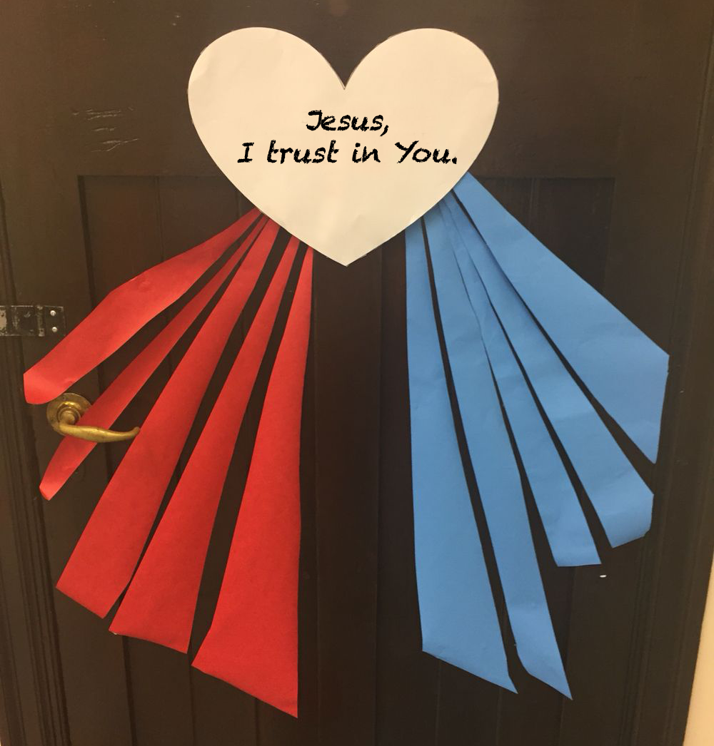
Activity:
Divine Mercy Heart
Blue and Red Colored Paper
Bond Paper
Scissors
Glue

Slide 21
Instructions:
Draw and cut a heart from the bond paper.
Fold the blue and red colored paper to form a diagonal lines.
After folding the colored paper, you may now cut it.
Make sure that the diagonal lines does not have the same length it must be from short to long size.
Glue the red diagonal lines colored paper to the lower left side of the heart while the blue color to the lower right of the heart.
After that, write down at the center of the heart the line “Jesus, I trust in You.”

Slide 22
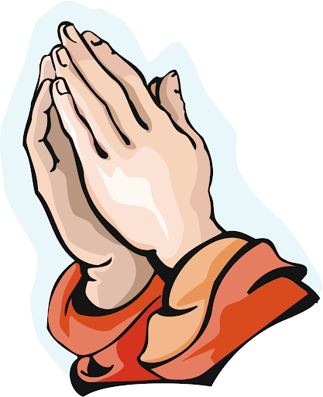
Closing Prayer
Dear God,
We give thanks for your life, death, and resurrection. Thank you for your love and for giving us the chance to have eternal life. Thank you for bringing peace in our heart. We pray that you will help us to remember your sacrifice and to follow you with our hearts always.
Amen.

Slide 23
LIVE THE WORD KIDS
Second Sunday of Easter | Cycle A

