Slide 1
LIVE THE WORD KIDS
Palm Sunday of the Lord’s Passion | Cycle A

Slide 2
GOSPEL REFLECTION
Palm Sunday celebrates the triumphal entry of Jesus into Jerusalem, just a few days before His betrayal and execution. On Palm Sunday, people celebrated Him and cheered, calling for salvation. Jesus brought salvation, of course, but not quite as they had anticipated.
It is on Palm Sunday that we enter Holy Week, and welcome Jesus into our lives, asking him to allow us a share in his suffering, death and Resurrection. This is also the time we remember and relive the events which brought about our redemption and salvation. The week when we cherish the memory of Jesus, who as described in the gospel of John, loved us to the extreme. We hear words from the prophet Isaiah that more closely resemble the messianic mission of Jesus than the storied memory of King David, whose glory is in the minds and hearts of the crowds shouting “hosanna.” Isaiah speaks of a servant who learns by suffering, who gives his back to those who beat him and his cheeks to those who pluck his beard. It is through these experiences that he has something to say to the weary—“a word that will rouse them.

Slide 3
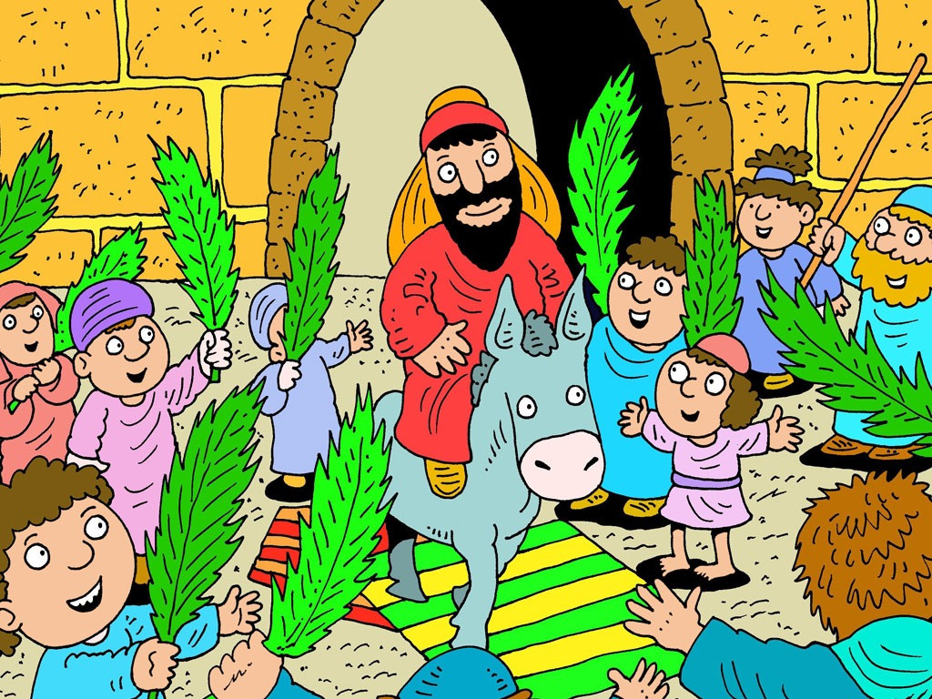
The Triumphant Entry into Jerusalem
Matthew 21:1-11

Slide 4
Leader: A reading from
the Holy Gospel
according to Matthew.
All: Glory to You, Oh Lord.

Slide 5
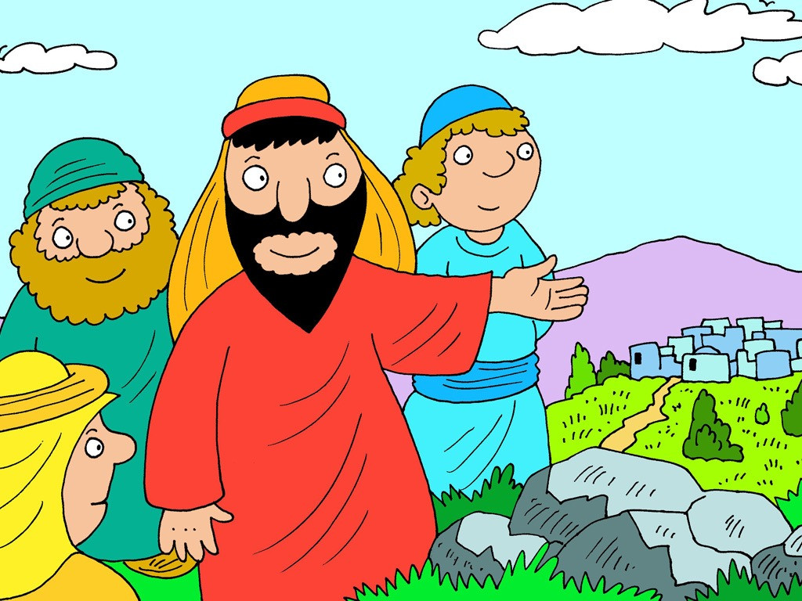
1
As Jesus and his disciples approached Jerusalem, they came to Bethphage at the Mount of Olives. There Jesus sent two of the disciples on ahead

Slide 6
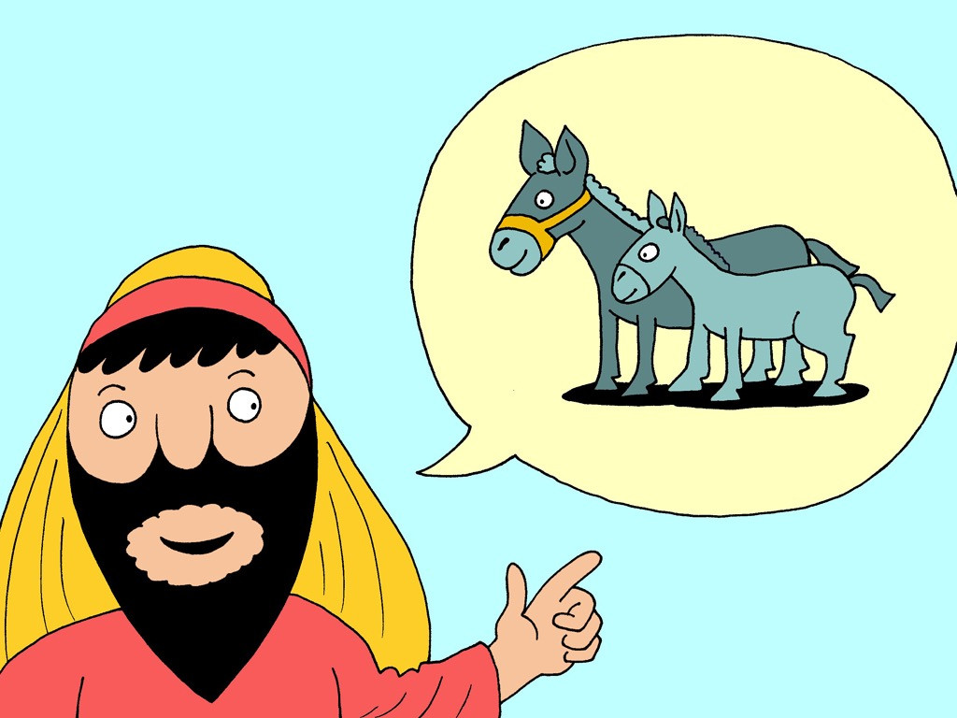
2
with these instructions: “Go to the village there ahead of you, and at once you will find a donkey tied up with her colt beside her. Untie them and bring them to me.

Slide 7
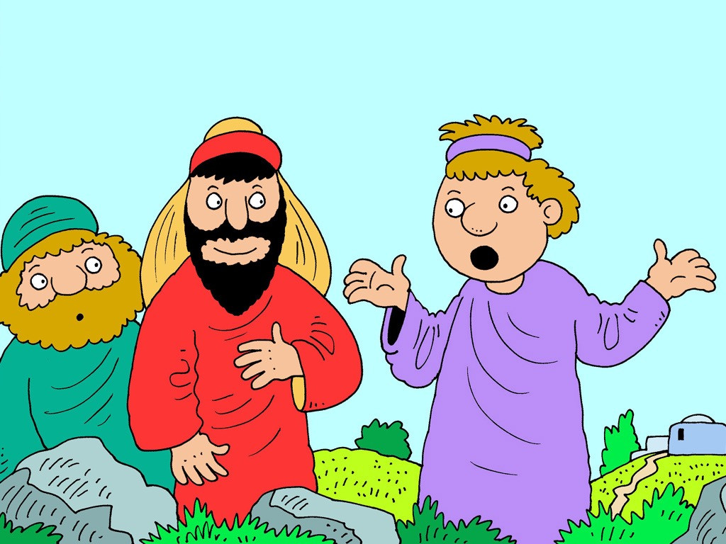
3
And if anyone says anything, tell him, ‘The Master [a] needs them’; and then he will let them go at once.”

Slide 8
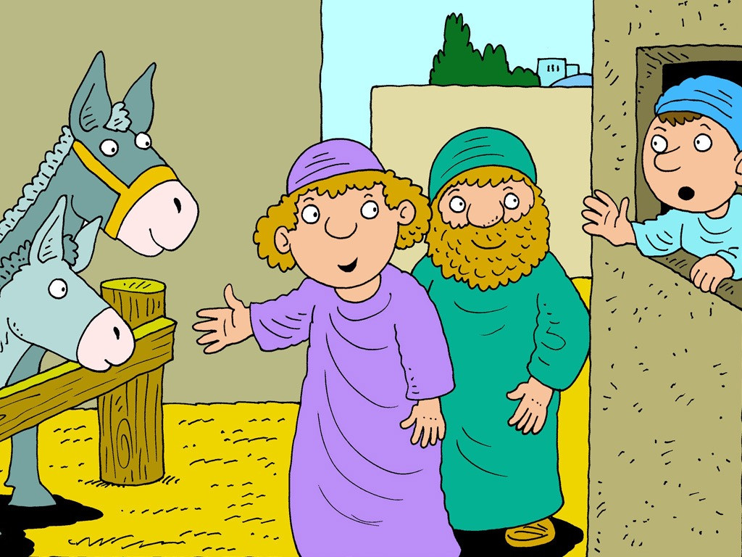
4
This happened in order to make come true what the prophet had said:

Slide 9
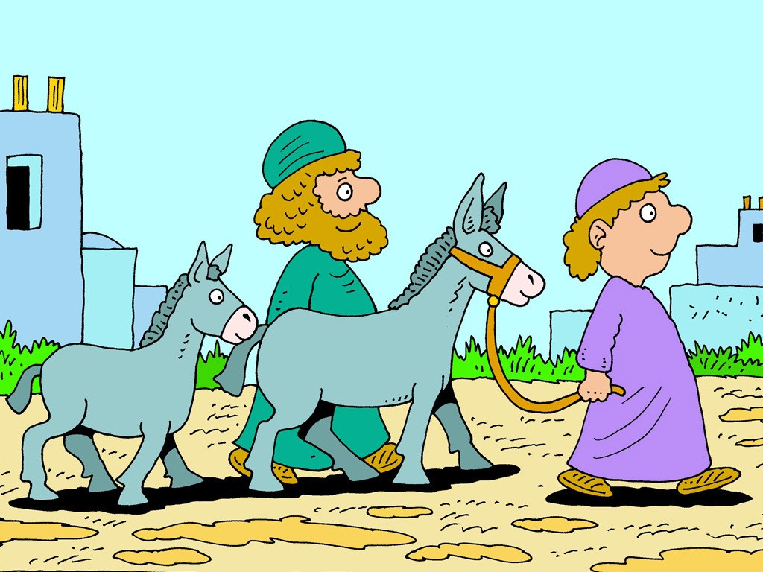
5
“Tell the city of Zion,
Look, your king is coming to you!
He is humble and rides on a donkey
and on a colt, the foal of a donkey.”

Slide 10
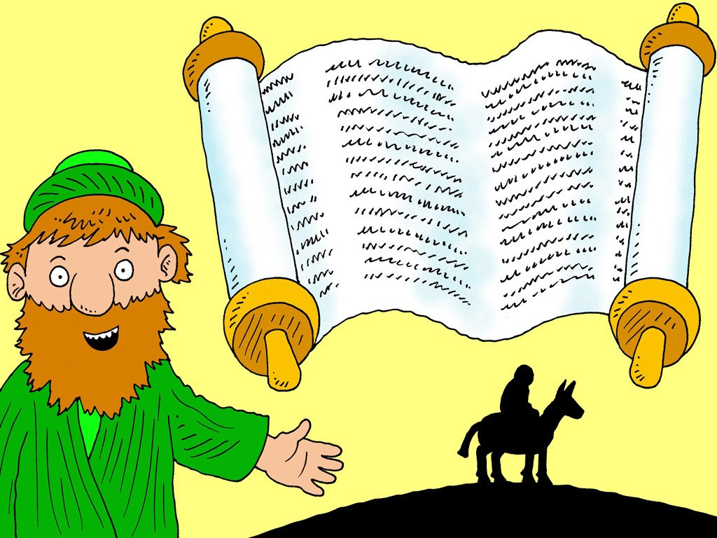
6
So the disciples went and did what Jesus had told them to do:

Slide 11
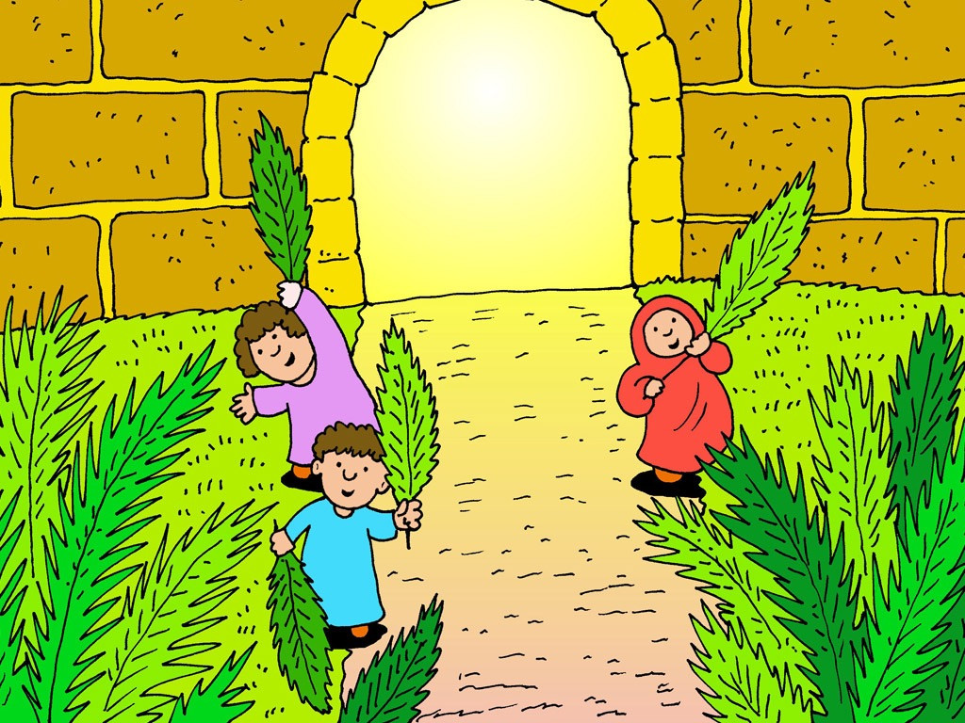
7
they brought the donkey and the colt, threw their cloaks over them, and Jesus got on.

Slide 12
8
A large crowd of people spread their cloaks on the road while others cut branches from the trees and spread them on the road.

Slide 13
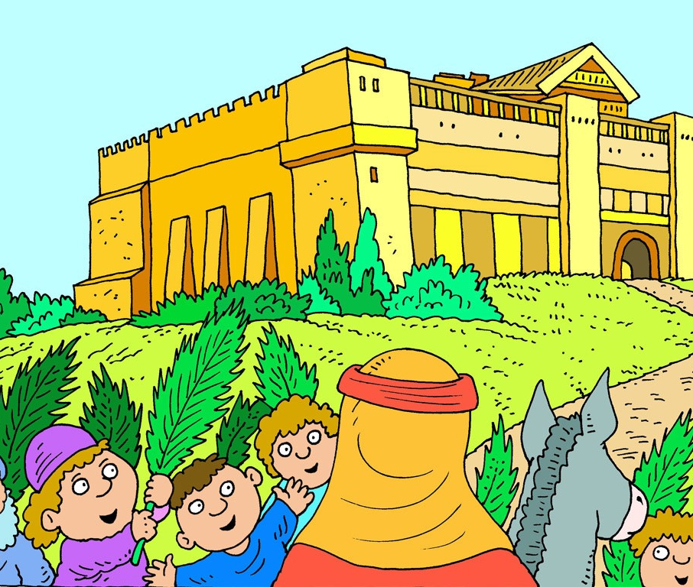
9
The crowds walking in front of Jesus and those walking behind began to shout, “Praise to David's Son! God bless him who comes in the name of the Lord! Praise be to God!”

Slide 14
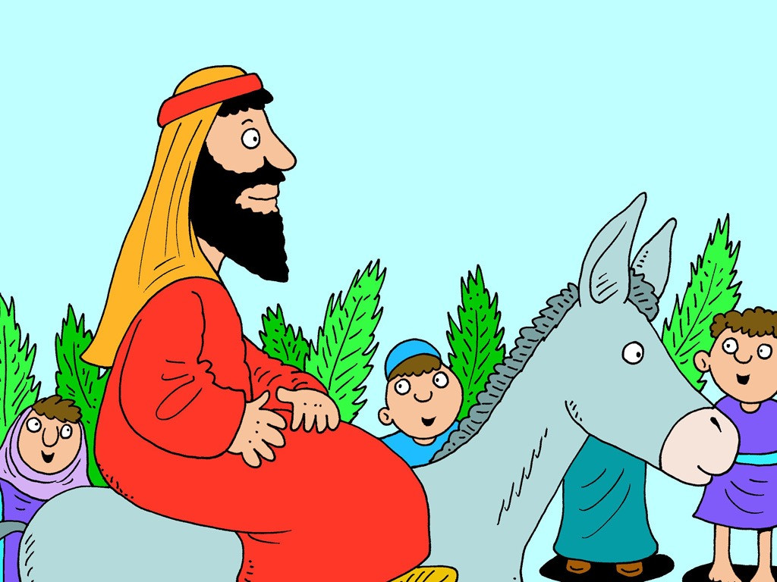
10
When Jesus entered Jerusalem, the whole city was thrown into an uproar. “Who is he?” the people asked.

Slide 15
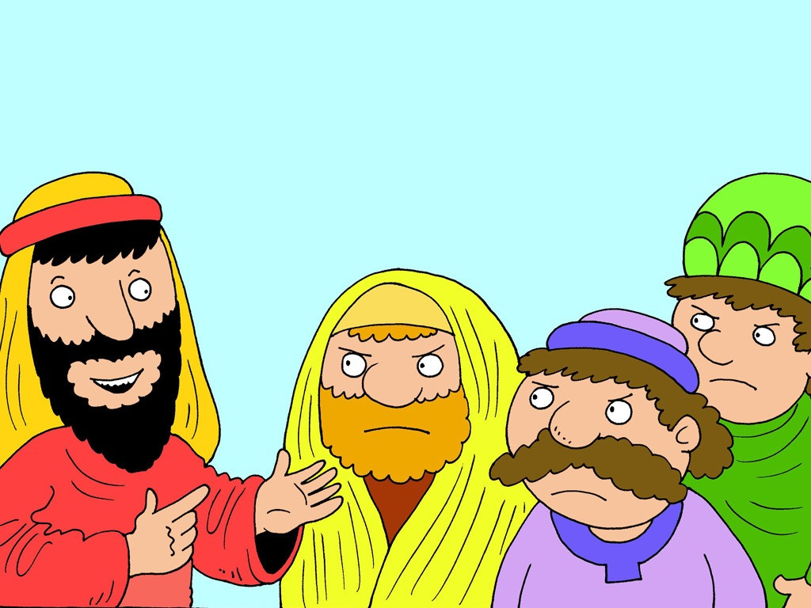
11
“This is the prophet Jesus, from Nazareth in Galilee,” the crowds answered.

Slide 16
Leader: The Gospel of the Lord.
All: Praise to You,
Lord Jesus Christ.

Slide 17
GOSPEL MESSAGE

Slide 18
Activity:
Palm Branch Craft
Green Colored Paper
Glue
Scissors
Popsicle Sticks

Slide 19
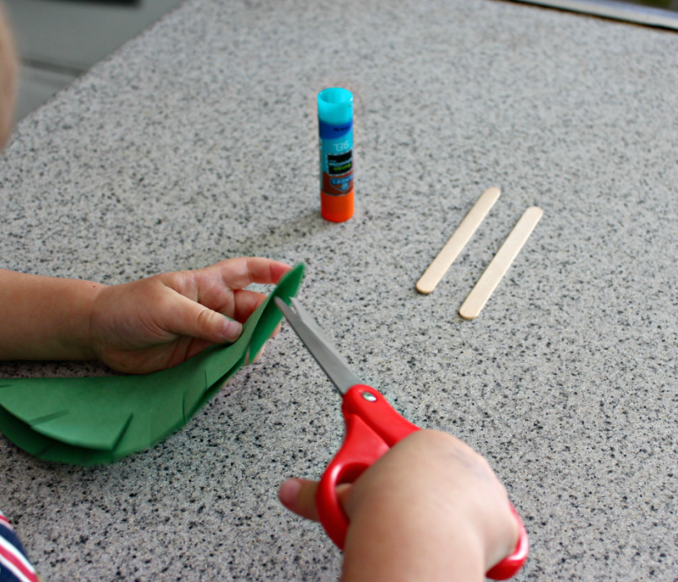
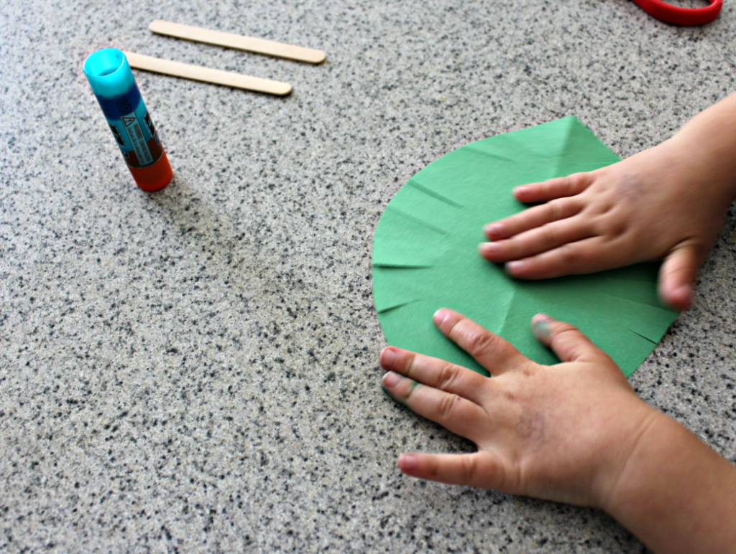
Instructions:
Cut palm branch shape from green colored paper. Easiest thing to do is fold paper in half before cutting to make sure it’s symmetrical.
Cut little slits around the perimeter of the leaf using scissors.
Use glue stick to put glue onto the craft stick and stick on your palm leaf.

Slide 20
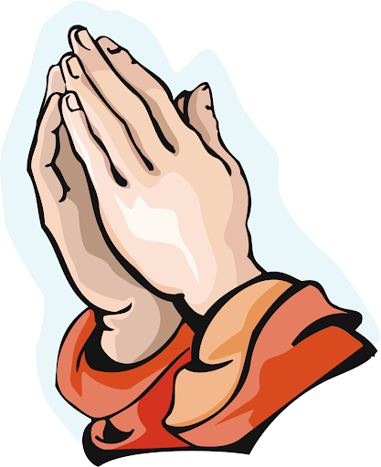
Closing Prayer
Dear God,
As we celebrate on this Palm Sunday help us to remember that day when all the adults and children waved palm branches and cheered as Jesus entered Jerusalem as King. We know Jesus rose from the dead and is alive. Help us to remember that he is our wonderful King and that we can praise him everyday!
In Jesus’ name – Amen.

Slide 21
LIVE THE WORD KIDS
Palm Sunday of the Lord’s Passion | Cycle A

