Slide 1
LIVE THE WORD KIDS
26th Sunday in Ordinary | Year C

Slide 2
GOSPEL REFLECTION
Having worked our way the past two weeks through several parables of Jesus, we now arrive at the story of the rich man and Lazarus. There is disagreement among the commentators whether or not this story is a parable. In all other parables, the players are anonymous; here one is named Lazarus. Whether or not it is a parable is unimportant for our study.
The story addresses two errors:
1) That of those who denied the survival of the soul after death and therefore, retribution in the next life
2) That of those who interpreted material prosperity in this life as a reward for moral uprightness, and adversity as punishment. This story shows that, immediately after death, the soul is judged by God for all its acts – the particular judgment – and is rewarded or punished. This story also teaches the innate dignity of every human person – independently of social, financial, cultural or religious position. Respect for this dignity implies that we must help those who are experiencing any material or spiritual need.

Slide 3
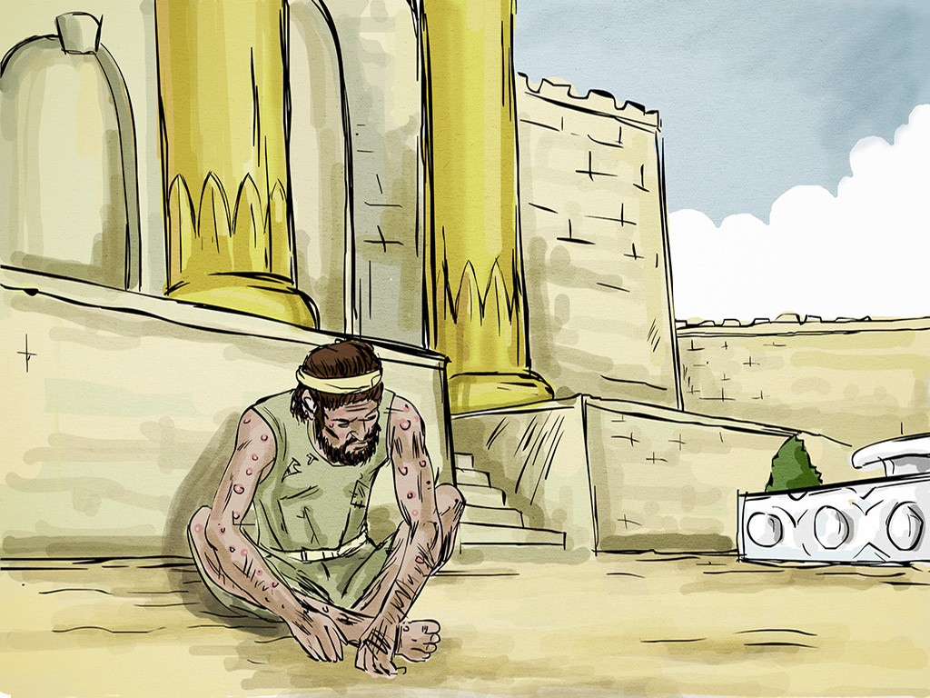
The Parable of the Rich Man and Lazarus
Luke 16:19-31

Slide 4
Leader: A reading from
the Holy Gospel
according to Luke.
All: Glory to You, Oh Lord.

Slide 5
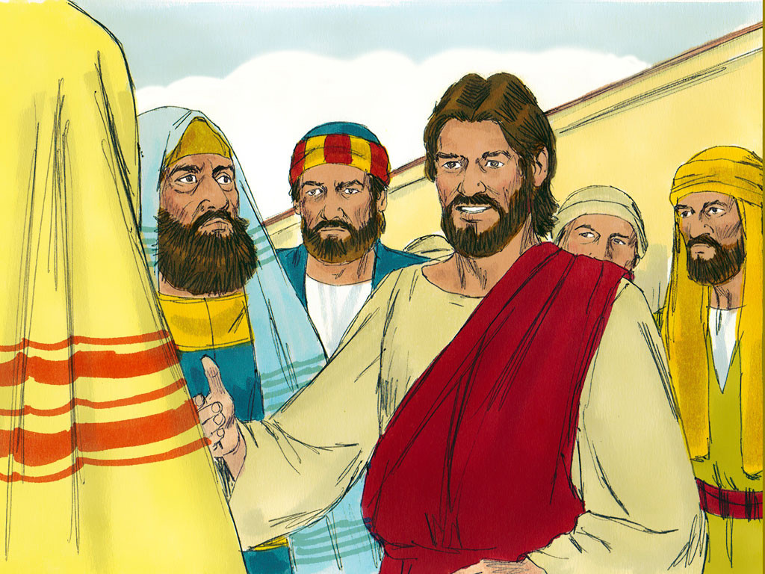
19
“There was once a rich man who dressed in the most expensive clothes and lived in great luxury every day.

Slide 6
20
There was also a poor man named Lazarus, covered with sores, who used to be brought to the rich man's door,

Slide 7
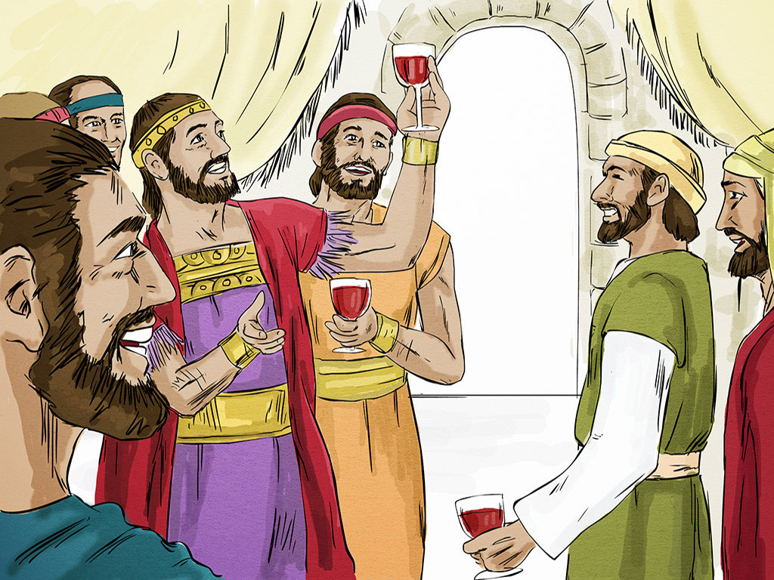
21
hoping to eat the bits of food that fell from the rich man's table. Even the dogs would come and lick his sores.

Slide 8
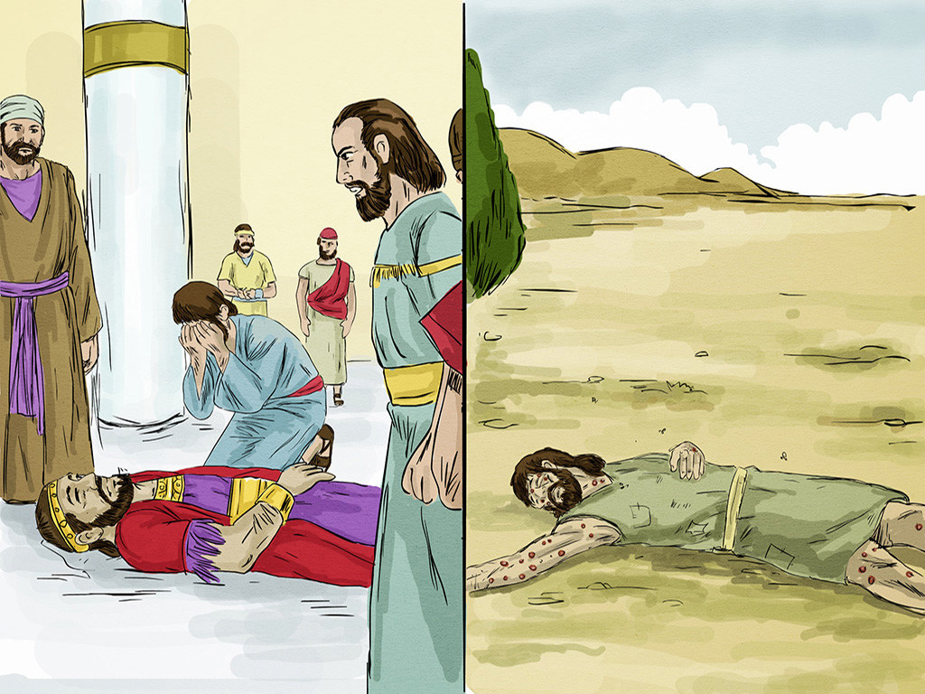
22
The poor man died and was carried by the angels to sit beside Abraham at the feast in heaven.

Slide 9
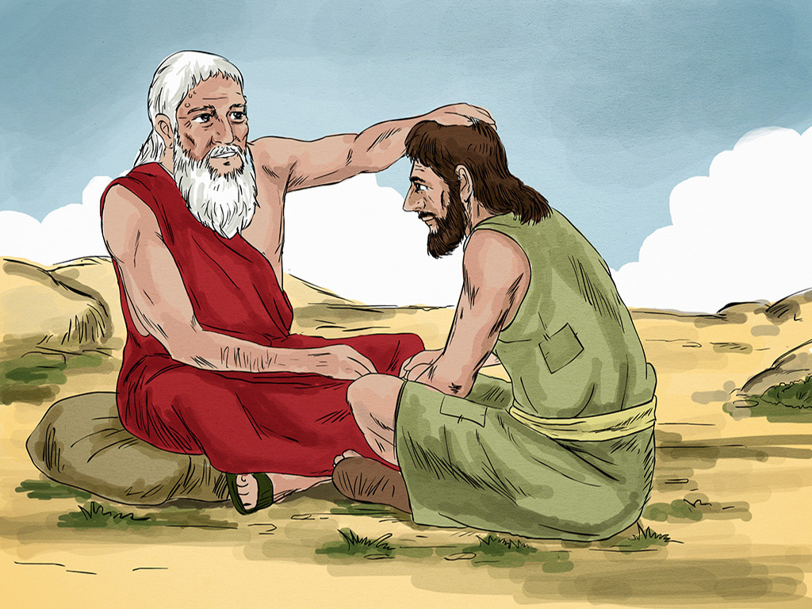
23
and in Hades,[a] where he was in great pain, he looked up and saw Abraham, far away, with Lazarus at his side.

Slide 10
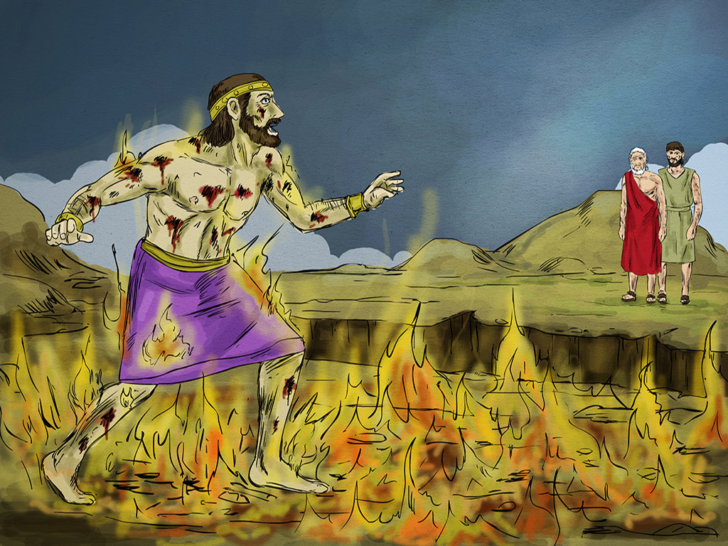
24
So he called out, ‘Father Abraham! Take pity on me, and send Lazarus to dip his finger in some water and cool off my tongue, because I am in great pain in this fire!’

Slide 11
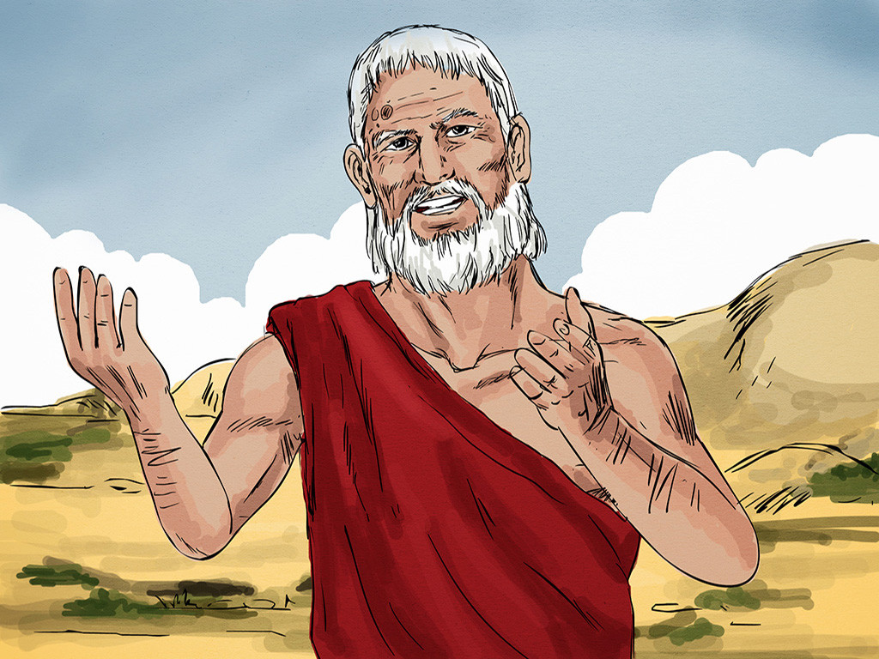
25
But Abraham said, ‘Remember, my son, that in your lifetime you were given all the good things, while Lazarus got all the bad things. But now he is enjoying himself here, while you are in pain.

Slide 12
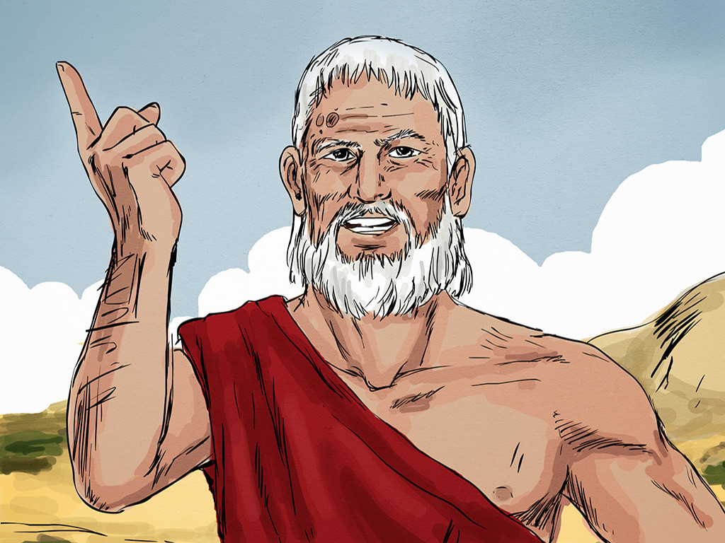
26
Besides all that, there is a deep pit lying between us, so that those who want to cross over from here to you cannot do so, nor can anyone cross over to us from where you are.’

Slide 13
27
The rich man said, ‘Then I beg you, father Abraham, send Lazarus to my father's house,

Slide 14
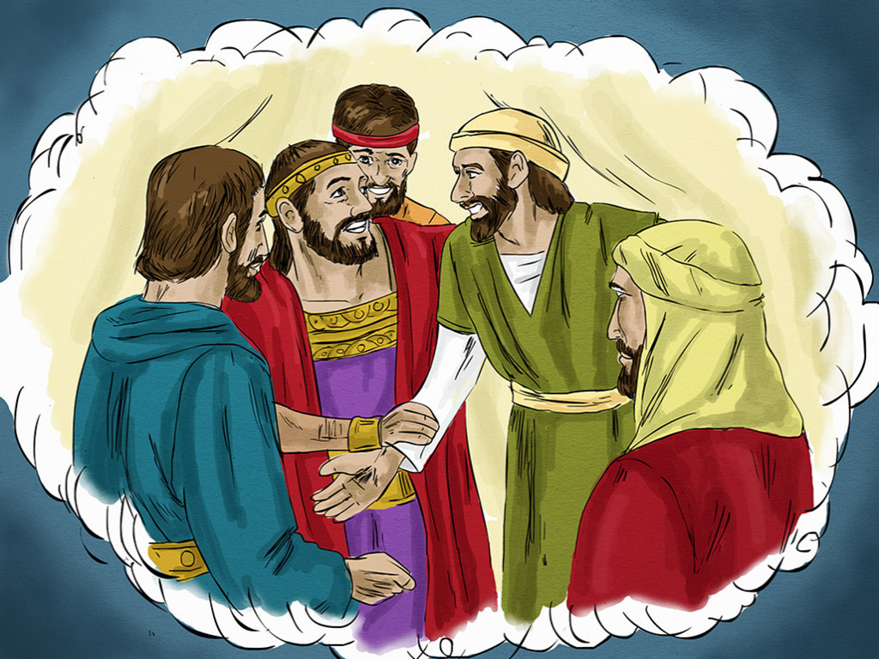
28
where I have five brothers. Let him go and warn them so that they, at least, will not come to this place of pain.’

Slide 15
29
Abraham said, ‘Your brothers have Moses and the prophets to warn them; your brothers should listen to what they say.’

Slide 16
30
The rich man answered, ‘That is not enough, father Abraham! But if someone were to rise from death and go to them, then they would turn from their sins.’

Slide 17
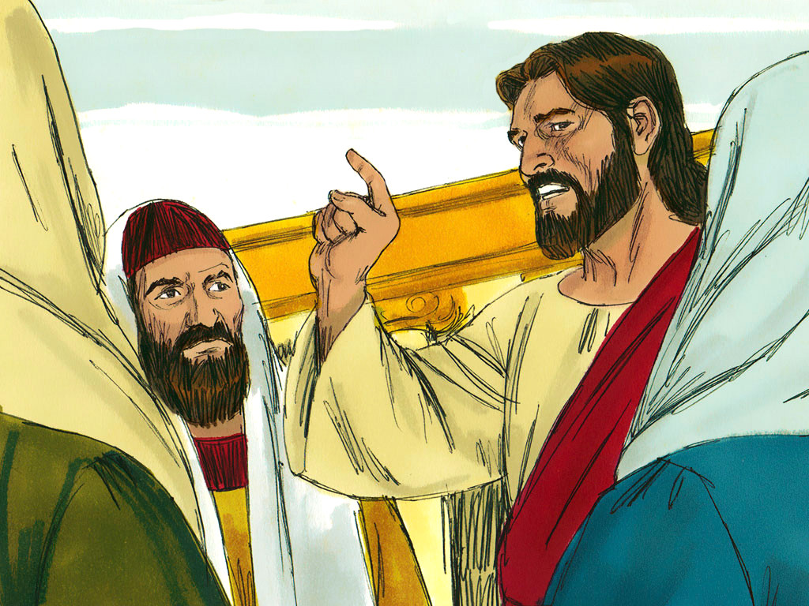
31
But Abraham said, ‘If they will not listen to Moses and the prophets, they will not be convinced even if someone were to rise from death.’

Slide 18
Leader: The Gospel of the Lord.
All: Praise to You,
Lord Jesus Christ.

Slide 19
GOSPEL MESSAGE

Slide 20
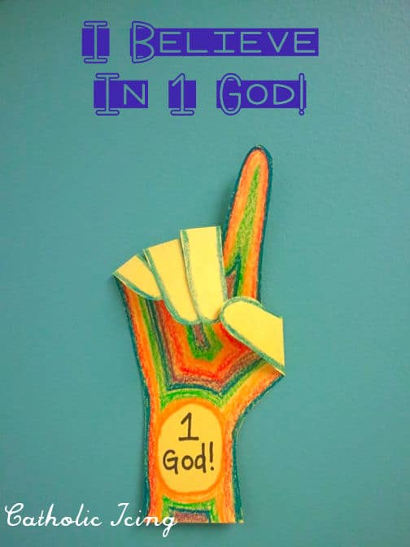
Activity: God is my #1
Paper
Pencil
Marker
Scissors

Slide 21
Instruction:
Trace your hand on the paper
Then write “1 God” on the arm part.
Finished coloring then cut it out and let them fold the fingers down.
God should be the most important part of our lives. When we let other things get in the way or distract us, we often wind up confused and disappointed. We should continue to pray and re-focus our hearts on the Lord and make Him our number one priority.

Slide 22
Closing Prayer
Dear God,
Thank You for the blessings that you always pour out to us. Thank you for always giving and providing the things we need. Lord, we pray that may we learn how to share it to others who are needed to. Help us to be an instrument of your love and blessings.
In Jesus' name we pray. Amen.
Amen.

Slide 23
LIVE THE WORD KIDS
26th Sunday in Ordinary | Year C

