Slide 1
LIVE THE WORD KIDS
25th Sunday in Ordinary | Year C

Slide 2
GOSPEL REFLECTION
God entrusts us with gifts like time, talents, and treasures. He wants us to use these things wisely and expects us to give them back to His control. God also wants to make sure nothing comes between us and Him. But some people worship money, in a way. They think about it all the time, or work constantly in order to get more money. Some people are not responsible with money and run out of it easily.
Did you know that God entrusts us with everything we have? That means He gives us all things, including money. Our possessions are not really ours to keep. It’s sort of like we are borrowing what we have from God. But He also promises to take care of us.
Also, consider that the gifts God gives us are not all monetary. He gives us talents, like being able to sing, or draw, or write, or dance, or make people laugh. He gives us time, which we can use to help one another or do things for Him. These items do not have a price tag. And when we use them for God, we can be assured that we will have joy and peace. Our joy is not in things, but in the Maker of things. If we are focused on loving temporary things or money, we will find ourselves disappointed. Let’s focus on the blessings of God!

Slide 3
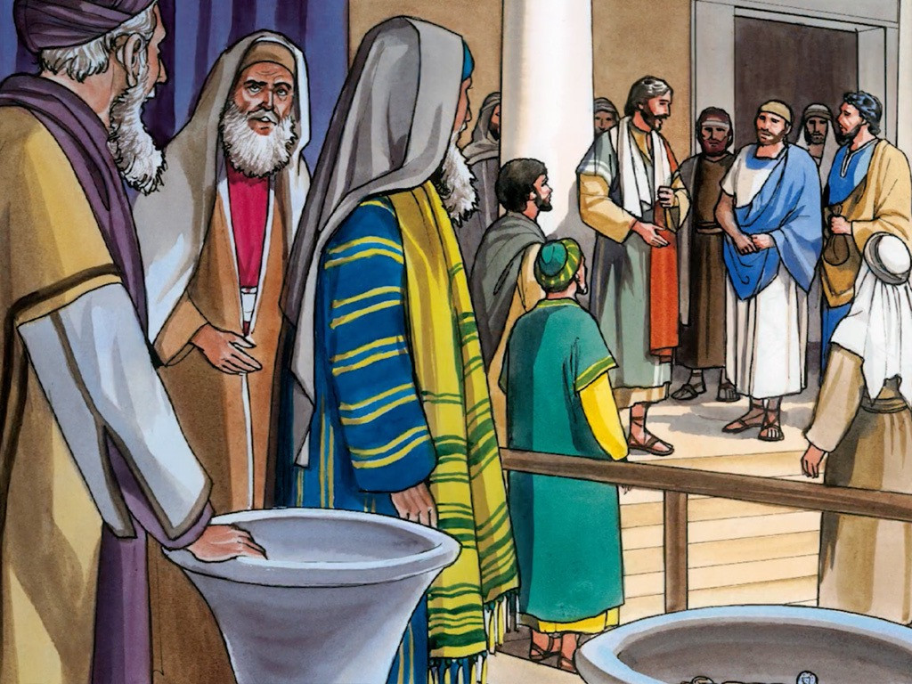
The Shrewd Manager
Luke 16:1-13

Slide 4
Leader: A reading from
the Holy Gospel
according to Luke.
All: Glory to You, Oh Lord.

Slide 5
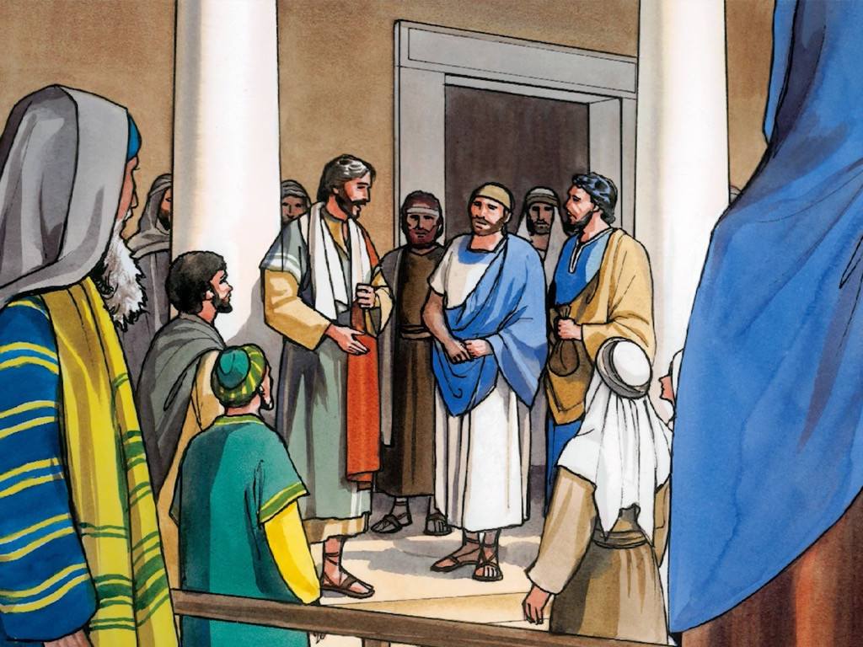
1
Jesus said to his disciples, “There was once a rich man who had a servant who managed his property. The rich man was told that the manager was wasting his master's money,

Slide 6
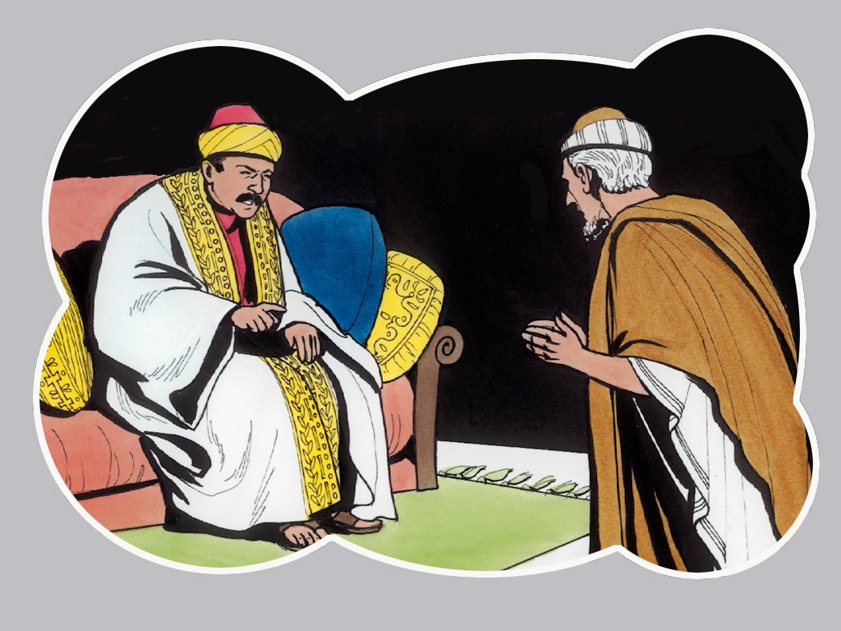
2
so he called him in and said, ‘What is this I hear about you? Turn in a complete account of your handling of my property, because you cannot be my manager any longer.’

Slide 7
3
The servant said to himself, ‘My master is going to dismiss me from my job. What shall I do? I am not strong enough to dig ditches, and I am ashamed to beg.

Slide 8
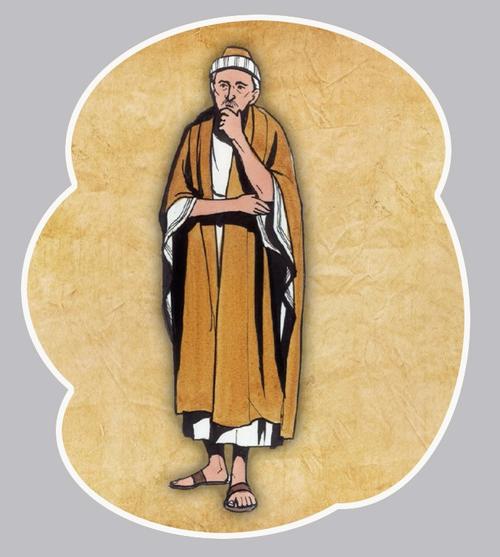
4
Now I know what I will do! Then when my job is gone, I shall have friends who will welcome me in their homes.’

Slide 9
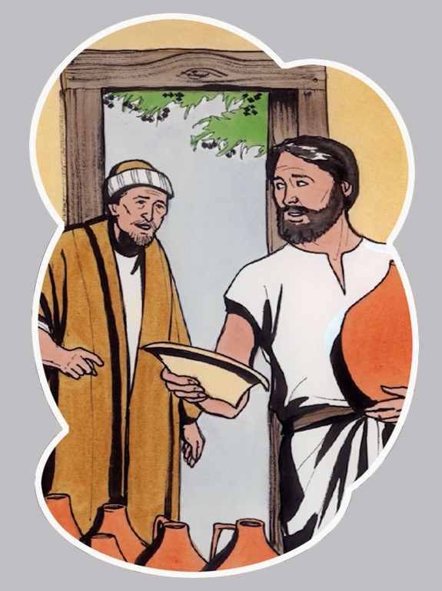
5
So he called in all the people who were in debt to his master. He asked the first one, ‘How much do you owe my master?’

Slide 10
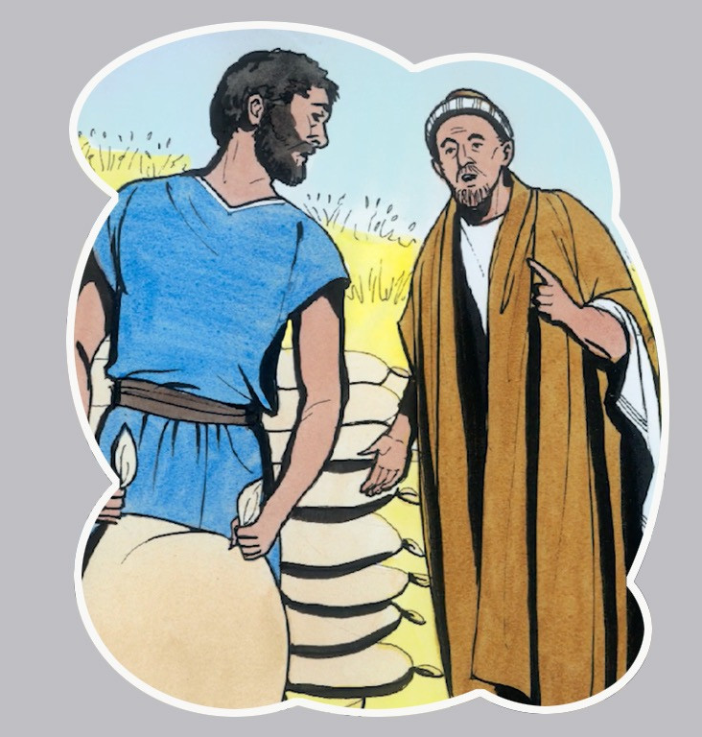
6
‘One hundred barrels of olive oil,’ he answered. ‘Here is your account,’ the manager told him; ‘sit down and write fifty.’

Slide 11
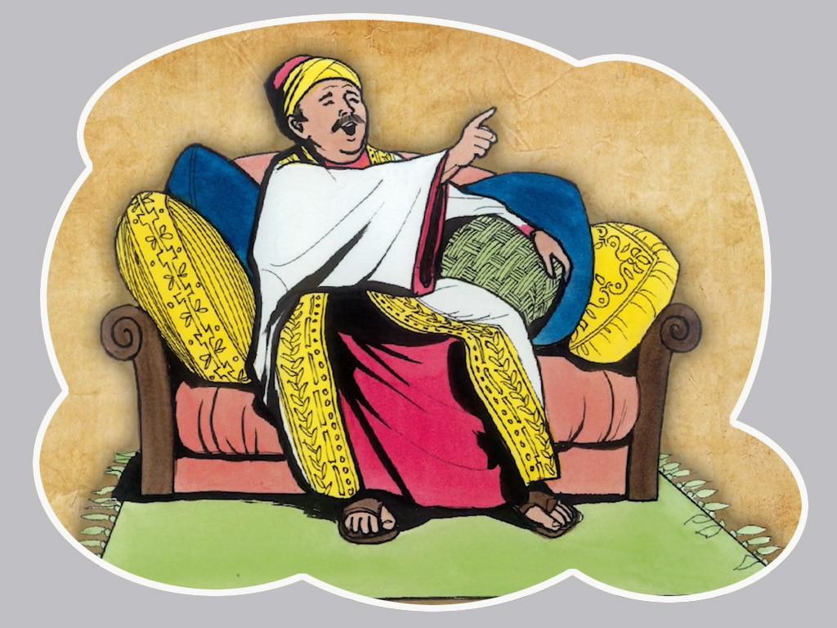
7
Then he asked another one, ‘And you—how much do you owe?’ ‘A thousand bushels of wheat,’ he answered. ‘Here is your account,’ the manager told him; ‘write eight hundred.’

Slide 12
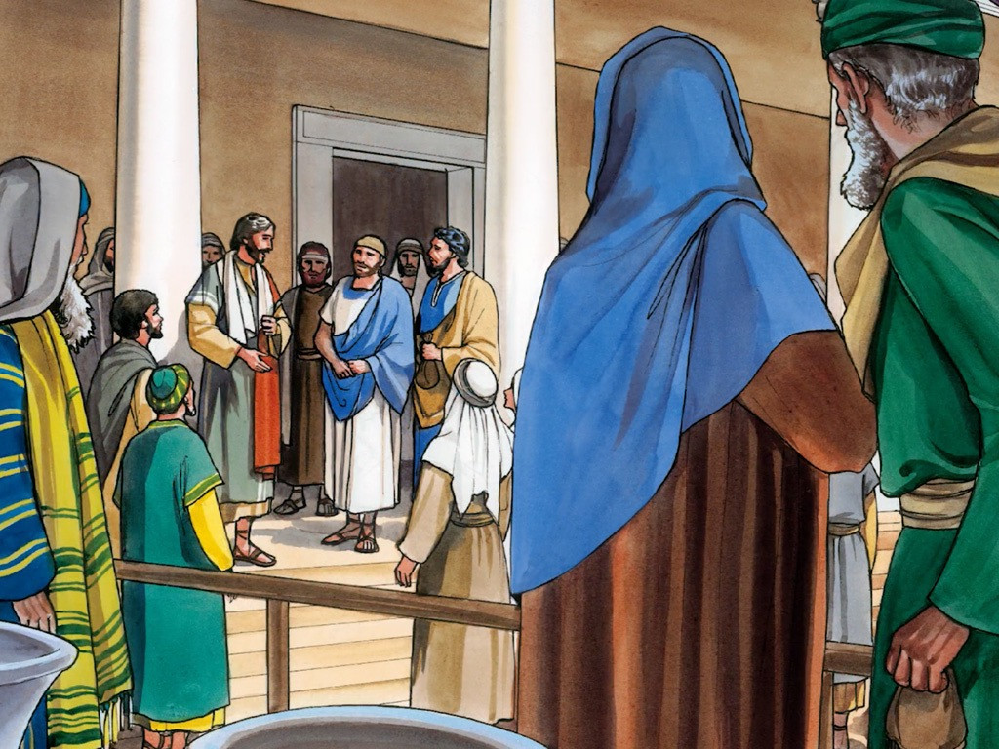
8
As a result the master of this dishonest manager praised him for doing such a shrewd thing; because the people of this world are much more shrewd in handling their affairs than the people who belong to the light.”

Slide 13
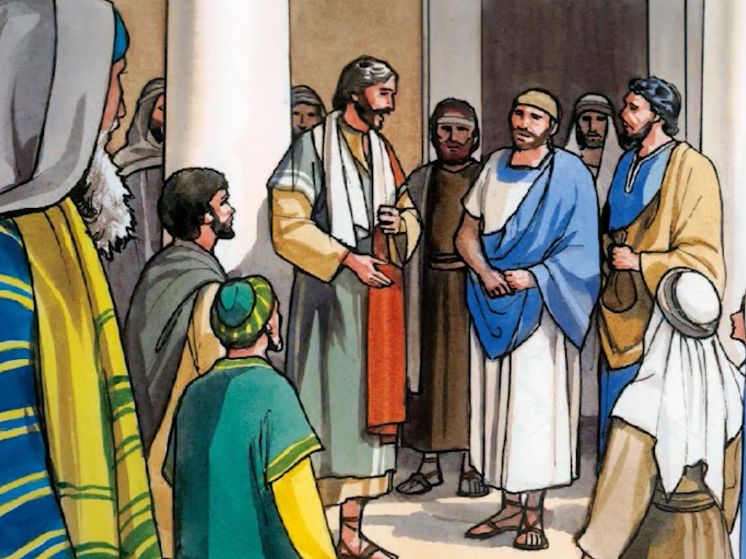
9
And Jesus went on to say, “And so I tell you: make friends for yourselves with worldly wealth, so that when it gives out, you will be welcomed in the eternal home.

Slide 14
10
Whoever is faithful in small matters will be faithful in large ones; whoever is dishonest in small matters will be dishonest in large ones.

Slide 15
11
If, then, you have not been faithful in handling worldly wealth, how can you be trusted with true wealth?

Slide 16
12
And if you have not been faithful with what belongs to someone else, who will give you what belongs to you?

Slide 17
13
“No servant can be the slave of two masters; such a slave will hate one and love the other or will be loyal to one and despise the other. You cannot serve both God and money.”

Slide 18
Leader: The Gospel of the Lord.
All: Praise to You,
Lord Jesus Christ.

Slide 19
GOSPEL MESSAGE

Slide 20
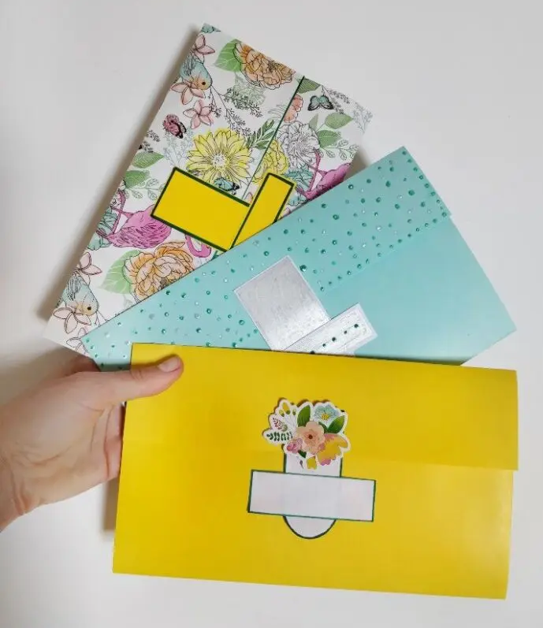
Activity: Paper Wallet
Colored Paper/ Bond Paper
Scissor
Markers
Coloring Material

Slide 21
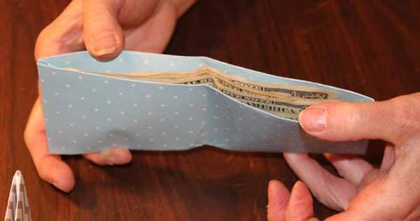
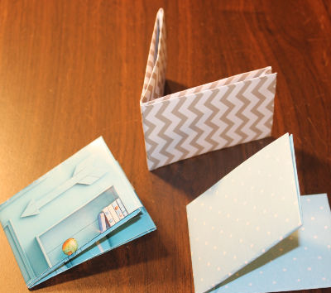
Instruction:
Fold the piece of paper in half long way (short sides together) and crease
Open up the paper and fold the bottom up to the middle crease. Then fold the top down to the middle crease.
Fold each side in about a half an inch.
Fold upper corners inward forming little triangles.
Fold lower corners outward forming little triangles.
Place a small piece of double-stick tape on half the folded sides
Fold in half inserting the small triangle inside each other
Fold in half and wallet is ready to use!

Slide 22
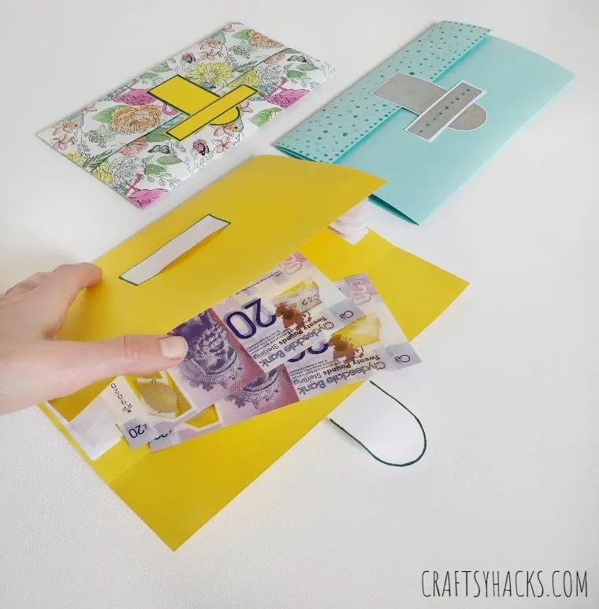
Instruction:
4. Fold in each of the corners. These edge of these folds should line up with the folds you made in the last step. Make sure you get all four corners.
5. Fold the left and the right sides of the paper in to the center crease. They should be symmetrical. You should now have two flaps, with folded corners. Once you are done with these folds, flip the paper over.
6.

Slide 23
Instruction:
Prepare Your Supplies. Collect all the supplies you will need beforehand. Choose your favorite colors and stickers for your wallet.
Fold the paper in half vertically. Start by laying the paper with the side you want facing outward down on the table. Make a good crease in the center, then unfold, back side facing out.
Fold the sides of the paper to the center. You will now fold the paper into fourths by folding each side into the center crease. Once you have done that, open the paper back up. You should have three creases, and the paper evenly divided into four parts.

Slide 24
Closing Prayer
Dear God,
Thank You for always trusting us in all things. Thank you for teaching us how to be honest and do things with a genuine heart. Lord, may we always serve you with our whole heart and always choose to do what is right.
In Jesus' name we pray. Amen.
Amen.

Slide 25
LIVE THE WORD KIDS
25th Sunday in Ordinary | Year C

