Slide 1
LIVE THE WORD KIDS
24th Sunday in Ordinary | Year C

Slide 2
GOSPEL REFLECTION
Our gospel reading today encompasses all of Chapter 15 of Luke’s gospel and consists of three parables in which Luke champions the theme that God’s mercy breaks through all human restrictions of how God should act toward sinners.
God’s mercy, indeed, is as foolish as a shepherd who abandons 99 sheep to save one, as a woman who turns her house upside down to recover a paltry sum.
Because the disciples have such a merciful God, they can embark trustingly and joyfully on Jesus’ way to this God. If the parable of the prodigal son sounds familiar, it is because you last heard it the 4th Sunday in Lent (Cycle C).

Slide 3
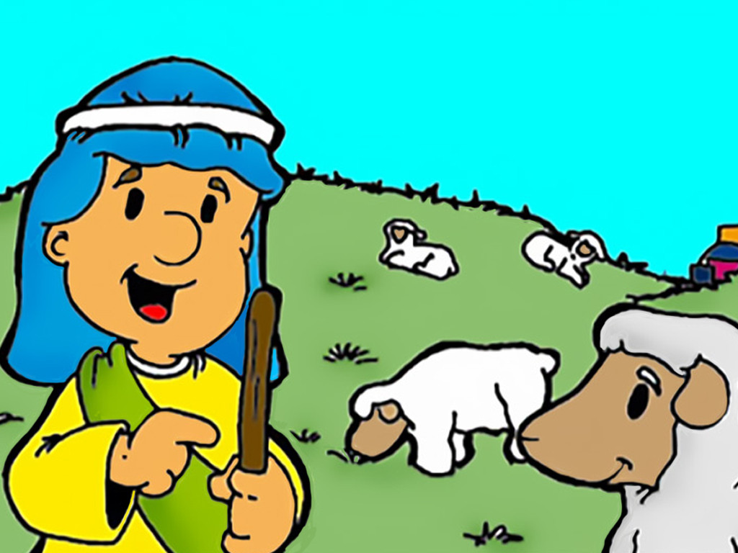
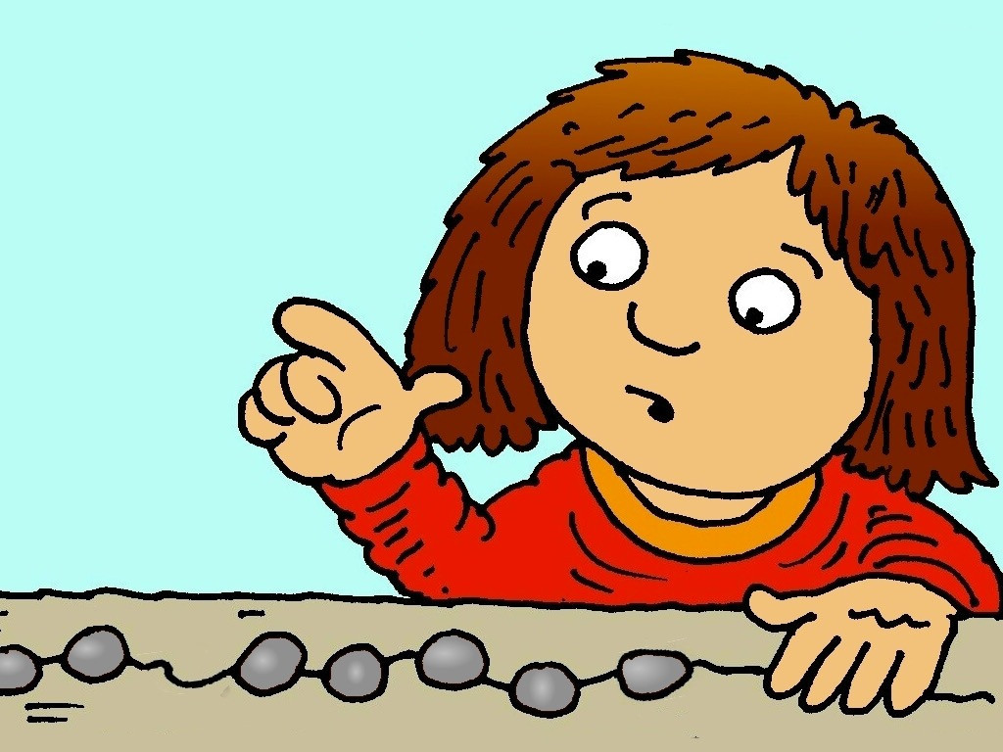
The Lost Coin and Sheep
Luke 15:1-10

Slide 4
Leader: A reading from
the Holy Gospel
according to Luke.
All: Glory to You, Oh Lord.

Slide 5
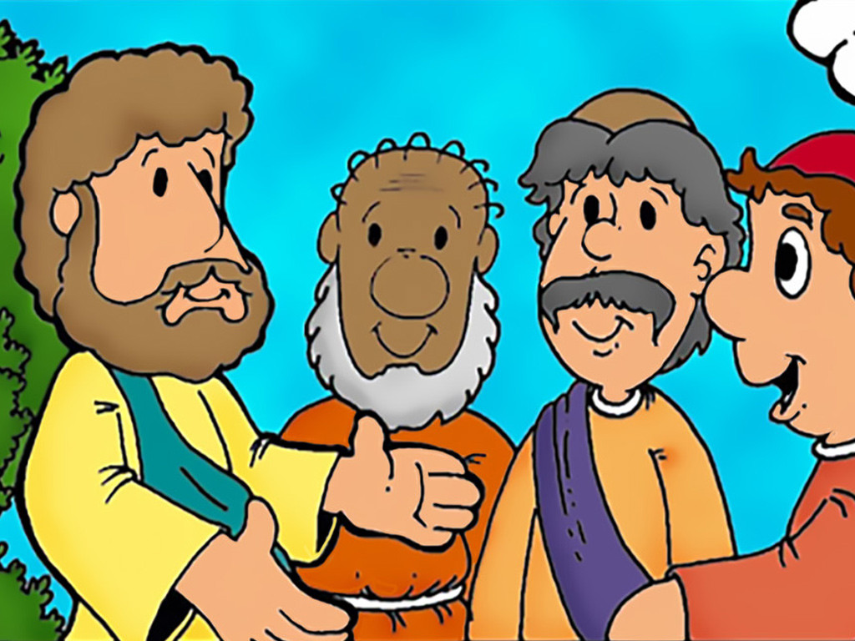
1
One day when many tax collectors and other outcasts came to listen to Jesus,

Slide 6
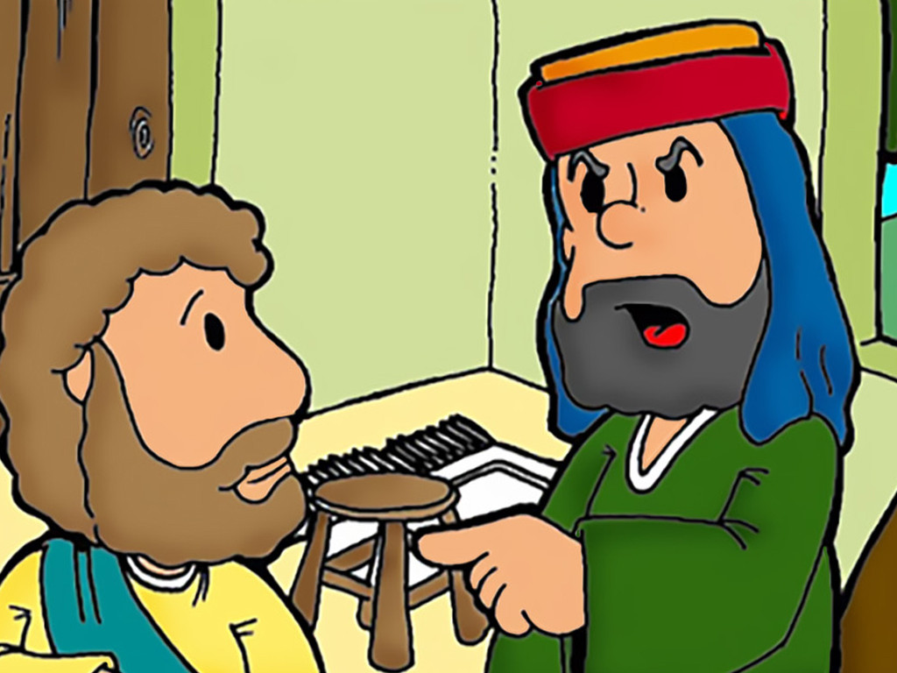
2-3
the Pharisees and the teachers of the Law started grumbling, “This man welcomes outcasts and even eats with them!”
So Jesus told them this parable:

Slide 7
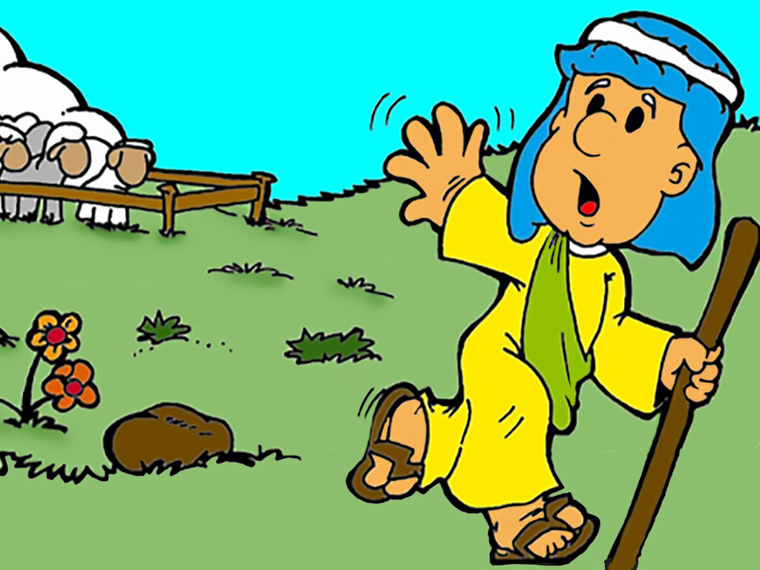
4
“Suppose one of you has a hundred sheep and loses one of them—what do you do? You leave the other ninety-nine sheep in the pasture and go looking for the one that got lost until you find it.

Slide 8
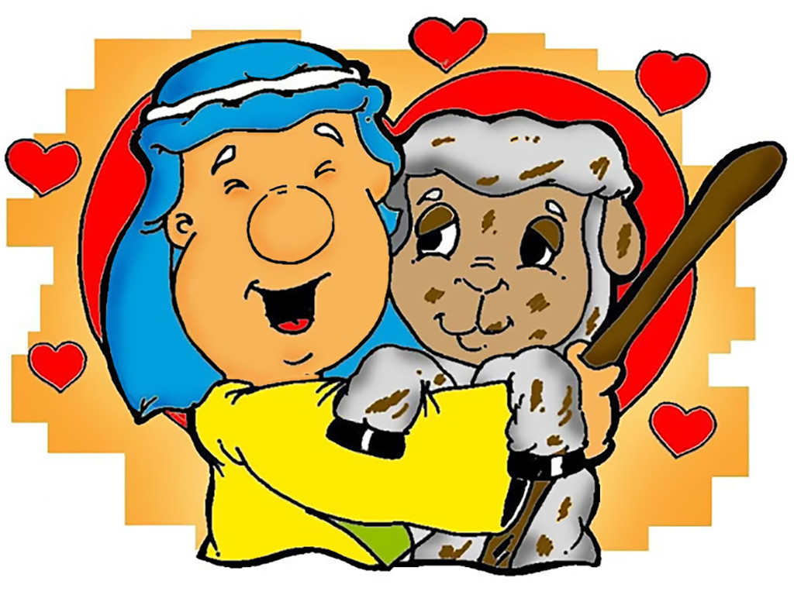
5
When you find it, you are so happy that you put it on your shoulders

Slide 9
6
and carry it back home. Then you call your friends and neighbors together and say to them, ‘I am so happy I found my lost sheep. Let us celebrate!’

Slide 10
7
In the same way, I tell you, there will be more joy in heaven over one sinner who repents than over ninety-nine respectable people who do not need to repent.

Slide 11
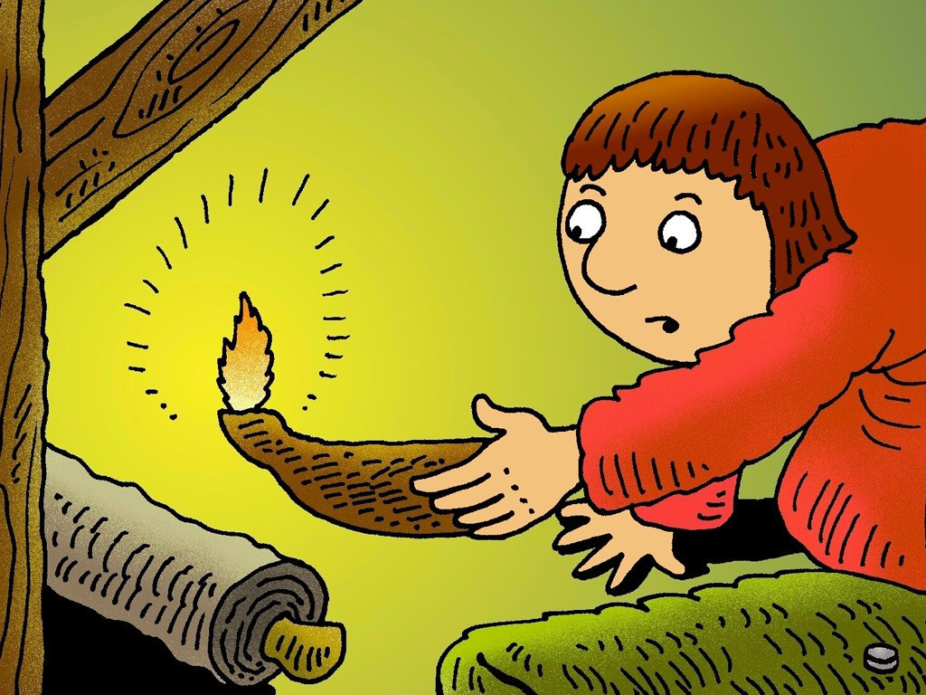
8
“Or suppose a woman who has ten silver coins loses one of them—what does she do? She lights a lamp, sweeps her house, and looks carefully everywhere until she finds it.

Slide 12
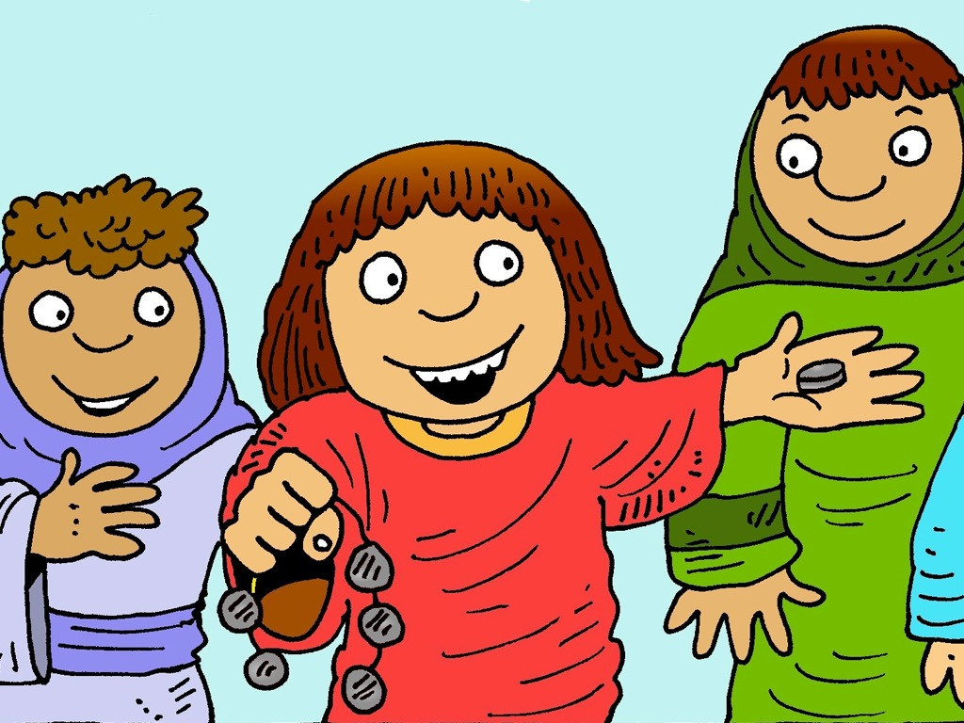
9
When she finds it, she calls her friends and neighbors together, and says to them, ‘I am so happy I found the coin I lost. Let us celebrate!’

Slide 13
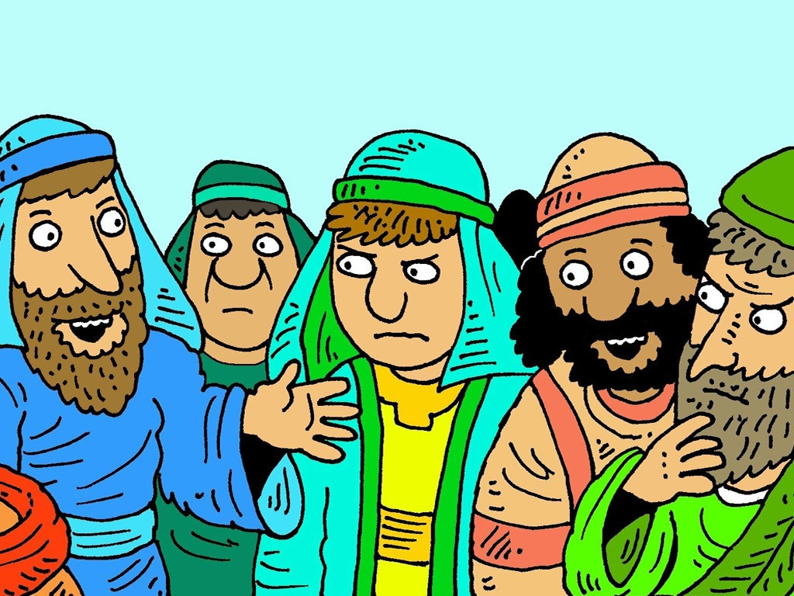
10
In the same way, I tell you, the angels of God rejoice over one sinner who repents.”

Slide 14
Leader: The Gospel of the Lord.
All: Praise to You,
Lord Jesus Christ.

Slide 15
GOSPEL MESSAGE

Slide 16
Activity: Sorry Card
Colored Paper/ Bond Paper
Scissor
Markers
Coloring Material

Slide 17
Instruction:
Cut the colored/ bond paper according to the size you need.
Fold it into the half. To form a card.
Make a design on the front of the card saying “Sorry” or “I’m Sorry”
You can now freely design your card.
Inside the card, write your letter saying your sorry and thank you to your parents.

Slide 18
Closing Prayer
Dear God,
Thank You for forgiving me for all the things I’ve done wrong and for always welcoming back despite of the sins I’ve made. Thank you for always loving and embracing us. Lord, teach us to be humble and be obedient children just like you.
In Jesus' name we pray. Amen.
Amen.

Slide 19
LIVE THE WORD KIDS
24th Sunday in Ordinary | Year C

